Slide 1
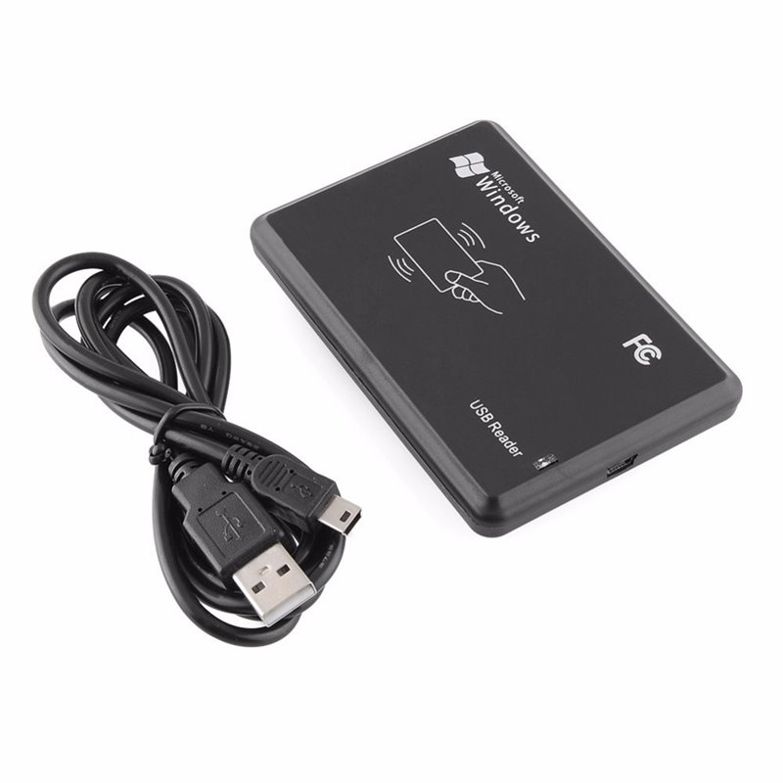
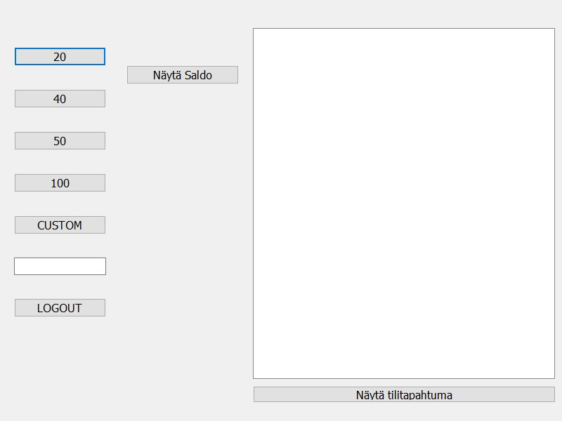
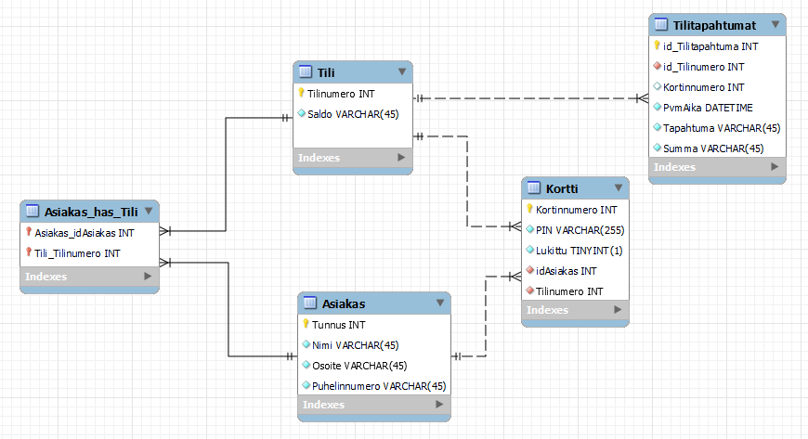
ATM
Venni Karhuikorpi, Juho Laurila, Topias Mäyrä, Lauri Laaksonen TVT21SPL+O
Information Technology, Product and Device Design
Introduction
The aims of this project were to make a database that is connected to an ATM. The ATM includes login and withdrawing money.
Objectives
The basic aims included making a database where the customer can have multiple accounts and cards, but each account can only have one customer linked to them and each card can only access one account. (See the figure 1 below.)
Making a user interface with QT Creator for logging in and handling the withdrawals and account transactions was mandatory in the ATM project. The user interface is connected to the database.
The user interface first asks for the card number and PIN, if those two match you will get into your account, then you can choose to withdraw money, view your recent transactions or logout. (See the figure 2→.)
FIGURE 1. The Database
Methods
We used a RFID card reader (Karin paska setti 5/5 en tiedä) for the logins.
We used Git Bash to host a localhost server to run the database online so the ATM can connect to the it.
Github was used for sharing the code.
The user interface was made with QT Creator
(See figure 3 for RFID reader.)
FIGURE 2. The User Interface
Results
The ATM system worked exactly like we wanted. The login in the database is encrypted and the ATM has options to withdraw 20€, 40€, 50€, 100€ or a custom amount like we wanted. You can also view your ten most recent transactions.
FIGURE 3. The RFID card reader
Conclusions
We didn’t have the time to include transfering money from an account to another. We still managed to do everything we wanted so overall we are very happy with how the project turned out.
References
1.All things QT: https://doc.qt.io/
Software Development Application Project
ECTS Credits: 6
Date of Publication: 2022, Spring
Instructors: Kari Jyrkkä, Teemu Leppänen, Pekka Alaluukas, Jukka Jauhiainen

