Slide 1
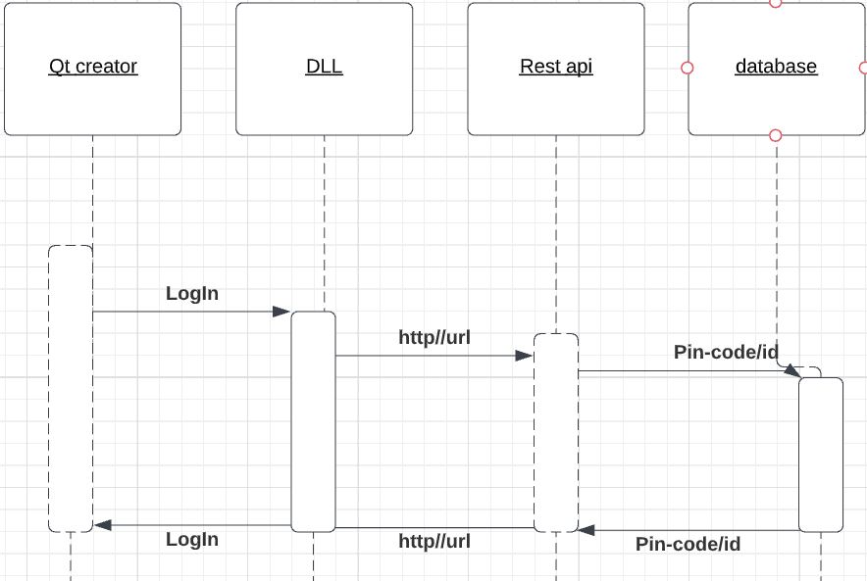
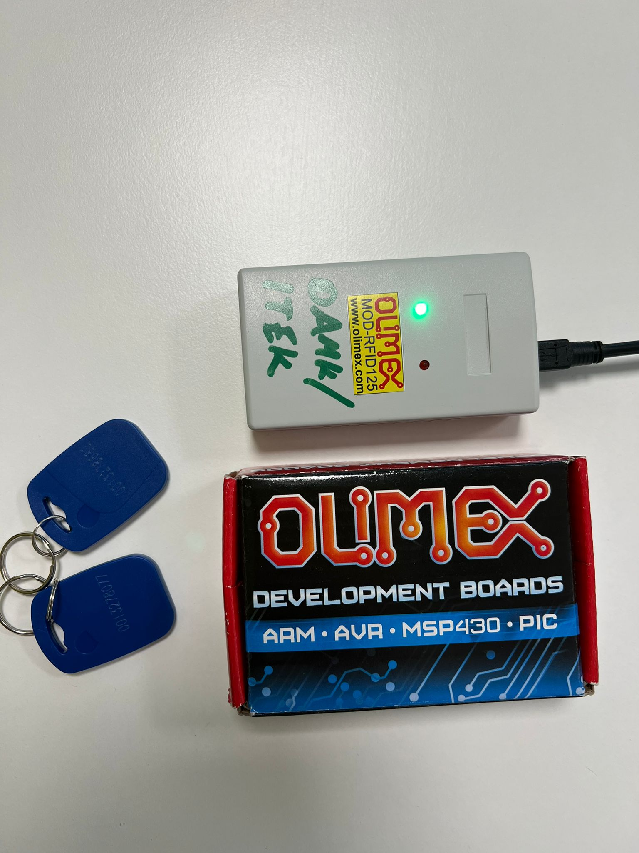
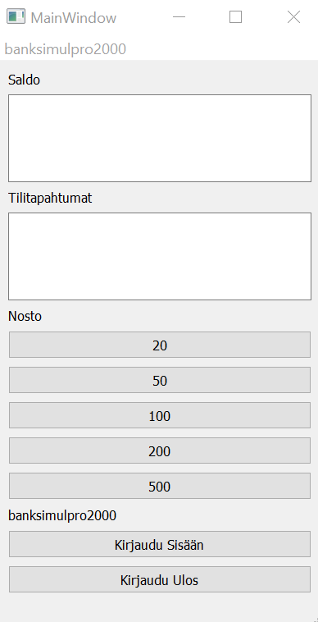
BankSimul
Meri Alikoski, Samuli Castrén, Inka Hirsilä, Juuso Jokelainen TVT21SPL
Information technology, Product and Device Design
Introduction
The idea of this project were to make an application that acts as an ATM. Card readers and cards were obtained from school (see Figure 1 below). In the ATM application the functions were cash withdrawing, viewing the balance and account transactions. The Customer can cash withdraw money from the account between 20 euros to 500 euros.
FIGURE 1. The card reader and the cards
Objectives
PIN and ID are checked from the database (SQL) and an information is sent to REST API which transfers the information to the user interface (DLL) and then the application shows the accuracy of the data. The RFID reader was installed to authenticate users ID and PIN code as correct.
The main goal was to allow communication from the application to the web server and vice versa as shown in the Figure 2 below.
FIGURE 2. The login diagram.
Methods
JavaScript and C ++ were used as programming languages ​​in the project. The programming application is Qt-Creator (as shown in Figure 3). CRUD operations are tested by using the Postman application. The Putty app was used to identify cards ID.
Results
The result is a working program that is easy to use from the customer perspective.
At the time of writing this poster
the user interfaces were not done
but the layout of the application
and the CRUD operations worked flawlessly.
The project taught how to make software independently and how to create layouts in Qt, but most importantly teamwork and patience.
The group is satisfied with the outcome.
Conclusions
As an option, a credit feature could have been added to the card, but there was no time to implement this.
Now the balance of the “account” can not go to minus.
FIGURE 3. The programming application
References
Git tutor: https://peatutor.com/express/
RFID reader instructions: https://www.qt.io/
Software Application Project
ECTC Credits: 15, Date of Publication: 2022 Spring
Instructor: Teemu Leppänen, Kari Jyrkkä

