Slide 1
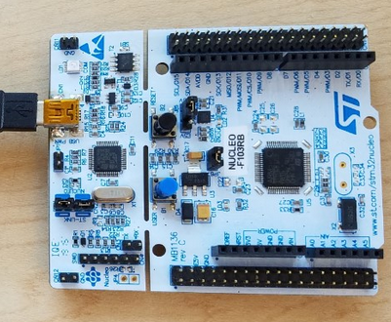
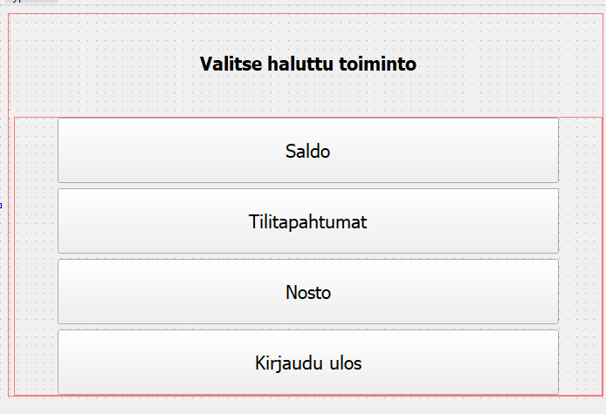
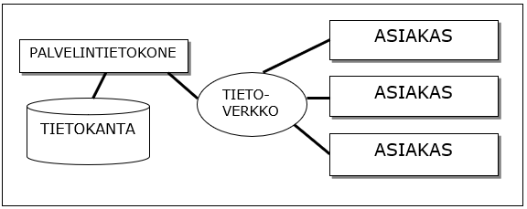
Bank Simulator
Matias Kauranen, Antti Kurkinen, Arttu Kääriäinen, Juhani Koski, TVT21SPL
Information Technology, Product and Device Design
Introduction
The focus of this project was to make a Bank Simulator, which could be used through a Qt widget based application, and to learn skills required to develop such programs.
Objectives
The basic aims included a debit account, protected by password and card-id. The user could ”withdraw” 20,40,50 or 100 euros and check account balance.
The device is controlled through a Qt widget application, which is connected to a database.
The secondary aims were to make a credit account, that the user could withdrawn any amount they wished and that the REST API included all the CRUD operations.
FIGURE 1. The System Diagram
Methods
The microcontroller used in the project was the STM32 Nucleo-64. Its purpose was to simulate a RFID reader. When the card-id and password were correct the user could access the ATM main menu. (See the figure 2 below.)
The user could then check account balance, history, withdraw cash or log out.
All the actions then will be updated to the database.
FIGURE 2. The Main Menu
Results
The application worked as planned. After the user withdraws cash, checks account balance or checks account history, it updates the database immediately.
All the secondary objectives were also achieved. Credit account and all the CRUD operations worked as intended.
FIGURE 3. STM32 Nucleo-64
Conclusions
Bank simulator was a great success. We learned a lot about programming, especially connecting frontend and backend to the database, and how these different software development applications work with each other.
Software Application Project
ECTS Credits: 15
Date of Publication: 2022, Spring
Instructor: Teemu Leppänen

