Slide 1
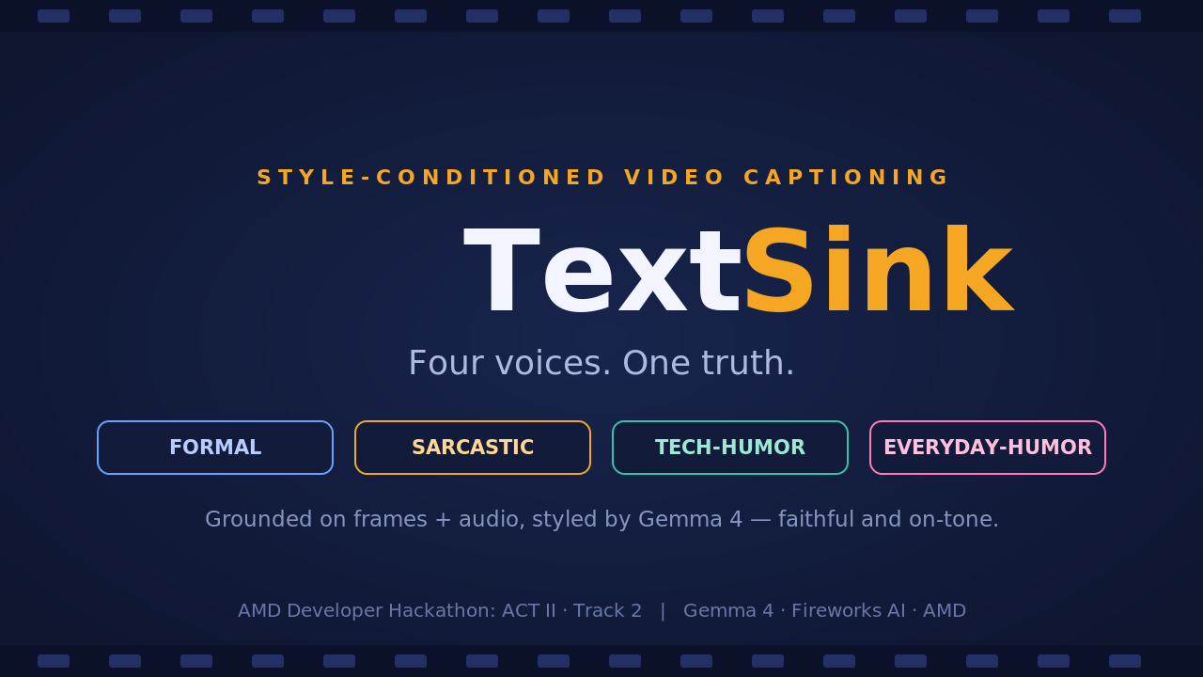
Notes:
TextSink: a containerized Track 2 agent. One clip in, four styled captions out. Built on Gemma via Fireworks on AMD. Theme: accurate where it counts, funny where it's allowed.

Slide 2
Two jobs. Most entries do one.
Track 2 scores every caption on accuracy AND tone — across four different styles.
Accurate but flat
Funny but wrong
Frame-only bots describe the scene correctly, then miss the joke — and miss everything that was spoken.
Prompt-only bots write a punchy line — that invents objects, people, or events never shown on screen.
TextSink is built to win both axes at once.
TextSink · AMD ACT II · Track 2
2
Notes:
The judge scores accuracy and tone. The two common failure modes are opposite: flat-but-correct, or funny-but-hallucinated. We target both.

Slide 3
One clip in. Four voices out.
A single 30s–2min clip becomes four captions — each faithful to the same facts.
FORMAL
SARCASTIC
Neutral, precise, broadcast register.
Dry and deadpan — never mean.
TECH-HUMOR
EVERYDAY-HUMOR
A joke a developer actually gets.
Relatable, warm, zero jargon.
TextSink · AMD ACT II · Track 2
3
Notes:
Same clip, four distinct voices. The four required styles: formal, sarcastic, humorous-tech, humorous-non-tech.

Slide 4
How it works
Separate the two things the judge scores — then optimize each.
Clip
>
Frames
+ Audio
>
Gemma 4:
scene facts (JSON)
>
4 tone
contracts
>
4 styled
captions
Grounding → accuracy
Tone contracts → tone
One model — Gemma 4 — does the grounding AND the four captions. ffmpeg + Whisper feed it; per-style contracts shape the voice.
TextSink · AMD ACT II · Track 2
4
Notes:
The pipeline: clip to frames+audio, Gemma extracts factual scene JSON, then four tone-contract prompts produce four captions locked to those facts. Gemma highlighted because it powers both grounding and captions.

Slide 5
Accuracy: ground before you write.
Sample frames every ~5s with ffmpeg (8–16 per clip).
Pull audio into a transcript with Whisper — catches spoken content frame-only bots miss.
Gemma extracts only what is visible or audible, as structured facts.
Every caption is locked to those facts. No invented objects, people, or brands.
scene facts (grounded)
{
"setting": "indoor room, daytime",
"subjects": ["a person","a laptop"],
"actions": ["types","smiles at
screen"],
"notable_audio": ["upbeat music"],
"mood": "focused"
}
TextSink · AMD ACT II · Track 2
5
Notes:
Accuracy is won in the grounding step. The caption model only ever sees these facts plus the transcript, so it can't hallucinate.

Slide 6
Tone: four contracts, four voices.
Same grounded scene. Four Gemma 4 captions — real, verified output.
SCENE official judge clip: an orange tabby kitten walks toward the camera through sunlit foliage
FORMAL
SARCASTIC
"An orange tabby kitten walks forward through the foliage toward the camera in a wooded area."
"A fierce predator emerges from the brush, clearly ready to conquer the entire forest one tiny, uncoordinated step at a time."
TECH-HUMOR
EVERYDAY-HUMOR
"The latest AI agent successfully navigating its first training environment. It’s small, but the feature set is looking promising."
"A tiny orange explorer makes a grand entrance, bravely navigating the treacherous jungle of backyard leaves."
TextSink · AMD ACT II · Track 2
6
Notes:
This is the differentiator. Each style has an explicit tone contract plus few-shot exemplars, so the four voices are distinct — not four reworded sentences. All four reference the same grounded action.

Slide 7
Gemma 4 — end to end.
One model, Gemma 4 (26B MoE), does BOTH the visual grounding and the four styled captions.
Served on-demand via Fireworks (H200), scale-to-zero — only bills while captioning.
MIT-licensed, single Docker container — clone, build, run.
Qwen 3.7 Plus + gpt-oss serverless fallback for zero-setup dev.
$5,500
addressable with one project:
$2,500 Track 2 + $3,000 Best Use of Gemma 4
TextSink · AMD ACT II · Track 2
7
Notes:
Keeping the caption model on Gemma is what qualifies for the $3k Gemma-in-captioning bonus, on top of the Track 2 prize. Same project, two pools.

Slide 8
Runs today — not a mockup.
Gemma 4 deployment verified: accurate grounding + 4 clean, on-tone captions.
Real ffmpeg frame sampling and audio extraction verified.
Full pipeline runs end-to-end and emits valid 4-style JSON; schema checks pass.
Ships a self-judge that scores accuracy + tone to tune prompts with data.
run it
docker run --rm \
-e FIREWORKS_API_KEY=$KEY \
-v $PWD/input:/input:ro \
-v $PWD/out:/output \
textsink
Four voices. One truth.
github.com/banksythequantLab/textsink
TextSink · AMD ACT II · Track 2
8
Notes:
Close on proof: it runs today, verified in a clean environment. Replace the repo URL with your public GitHub before submitting. End on the tagline.

