Slide 1
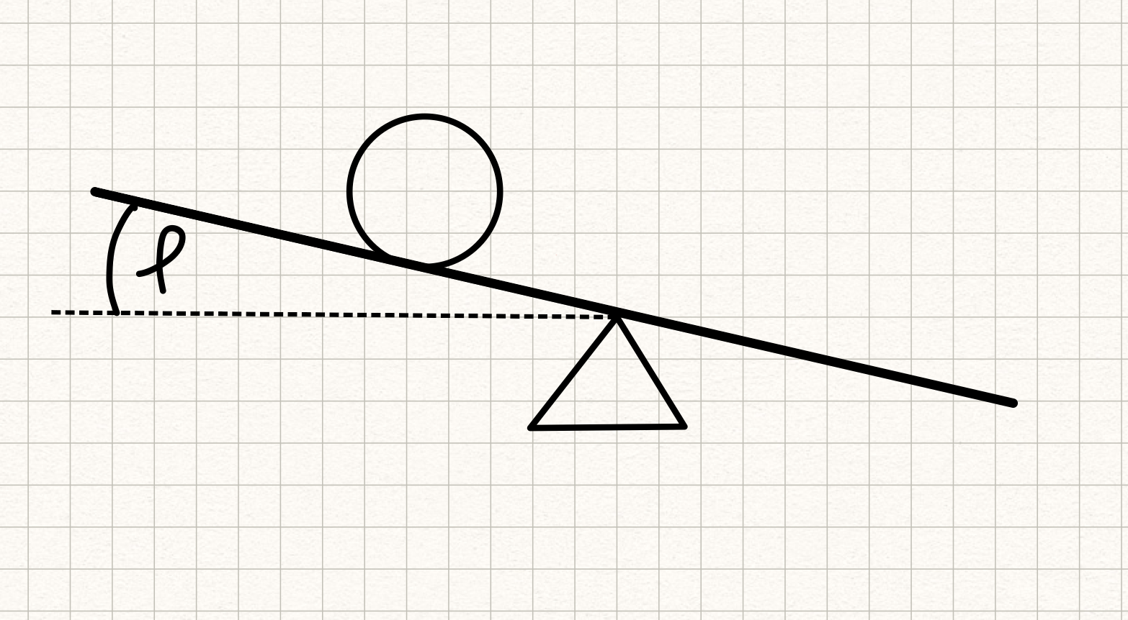






$$F_{r}$$
$$m$$
$$F_{t}$$
$$F_{h}$$
$$x$$
$$F_{g}$$

