Slide 1




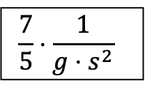



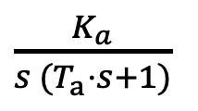
$$G_{s}$$
$$U$$
$\frac{K_{a}}{s^{ }(T_{a}⋅s+1)}$
$$α$$
i
$$φ$$
$$\frac{7}{5}⋅{\frac{1}{{g⋅s}^{2}}}^{ }$$
$$x$$
$$G_{s, Motor}$$
$$G_{s, Wippe}$$

Slide 2





$$G_{s}$$
$$G_{s, Antrieb}$$
$$U$$
$$α$$
i
$$φ$$
$$G_{s, Wippe}$$
$$x$$
$$G_{s, Motor}$$

