Slide 1




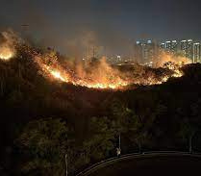
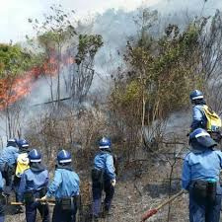


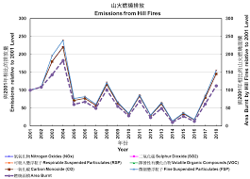

Automated
Wild Fire
Prediction
Project ID: 01
Students:
01 Alicia Yuen
30 Maya Yan
35 Valentina Banner
Gifted Education Fund
AIoT Coding, Engineering and Entrepreneurial Skills Education for Gifted Students
85 HILL FIRES WERE REPORTED DURING CHING MING FESTIVAL IN HONG KONG
Our project aims to improve the efficiency and effectiveness of forest fire prevention and response efforts by using data analysis and machine learning to predict and prevent wildfires. ​Our model looks at the factors of temperature, wind speed, rain size, and relative humidity to indicate the percentage chance of wildfires, as those are the four most determining factors.
BACKGROUND AND MOTIVIVATION
Over 10,000 fire incidents ​happen in Hong Kong every year due to negligence and environmental conditions. 600+ people have died from these incidents.
Wildfires release excessive amounts of carbon dioxide and other air pollutants into the atmosphere, contributing to Hong Kong's air pollution problem; it also damages the ecosystem, harms animals' habitats, contributes to deforestation, and exacerbate climate change.
The smoke caused by wildfires can travel miles, creating a risk to public health as inhaling large amounts of the pollutants such as carbon monoxide is not healthy. It can give people a greater risk of contracting lung-related diseases.
EXISTING SOLUTIONS
OUR SOLUTION
HILL FIRE IN FANLING WHERE IT BURNED THROUGH 250,000 SQUARE METRES OF HILLSIDE
In areas where fires commonly start, safeguards will be stationed. ​
Cameras with image recognition are also set up around areas with a high chance of fires.​
Data analysts go over climate data and manually find correlations to warn the public about fires; the Hong Kong Observatories' yellow and red fire warning system adapts this.
These solutions are only proactive, not preventative; they only send for help once the fires have started and already have affected the environment and people surrounding it.​
Users will input climate information, and the model will use the data to predict the probability of a wildfire happening of natural causes.​
Why is this an improvement to the previous solution? ​
It's automated. Unlike the solutions mentioned before, which rely heavily on manual labor, our solution is automated, making it more cost-effective and efficient.
It's preventative. Again, unlike the previous solutions, our software will warn people about fires before they have started instead of after. This prevents the environment from being harmed and fumes from being released into the air.
METHODOLOGY
We first collect climate information(temperature, humidity, rain levels, etc) with users' input or the Hong Kong Observatory Open Data API
The data then gets passed into our model and outputs the percentage chance that there will be a fire.
YouTube link:
https://youtu.be/9h0zErdJY9c
GitHub link:
https://github.com/realhuman101/AWP
EMMISIONS CAUSED BY HILLFIRES IN HONG KONG

