Slide 1
Countries responsible for Global Warming
Presented by
K.Bhargavi Latha
K.Ravi Teja
Sateesh.S

Slide 2
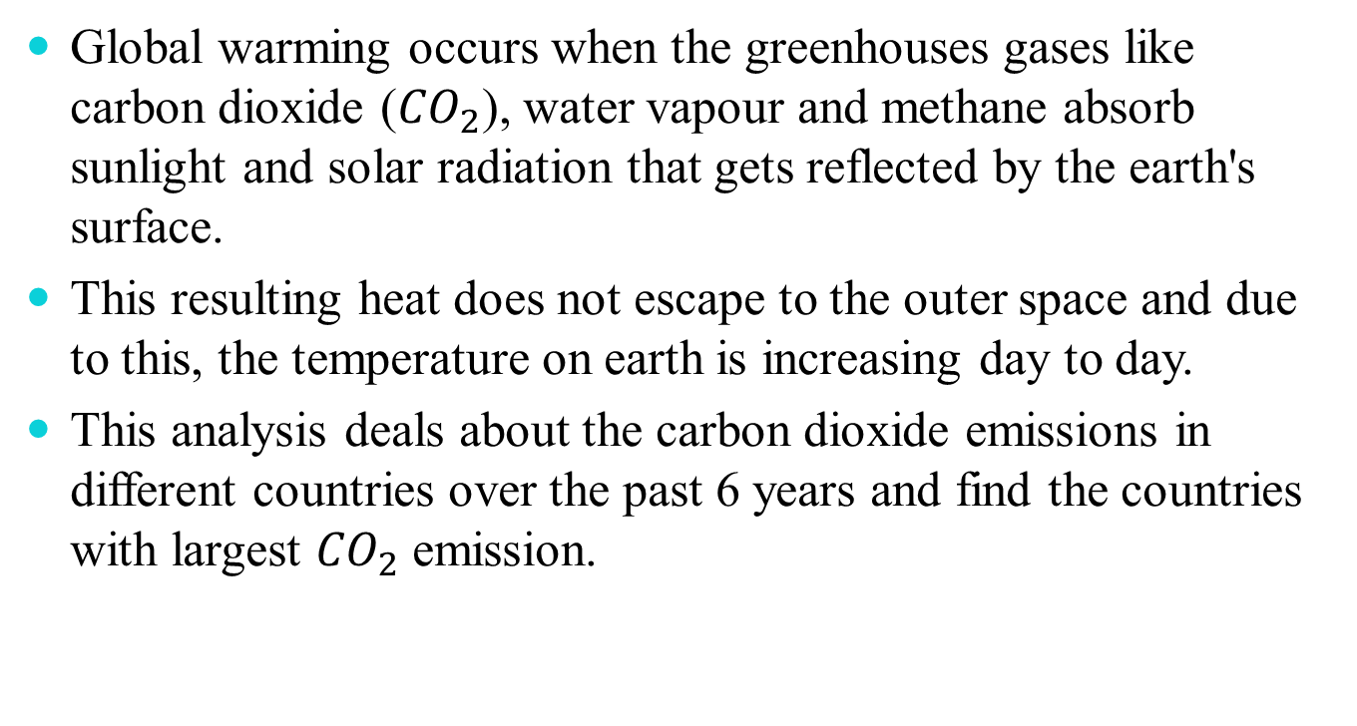
INTRODUCTION
Global warming occurs when the greenhouses gases like carbon dioxide (${CO}_{2}$), water vapour and methane absorb sunlight and solar radiation that gets reflected by the earth's surface.
This resulting heat does not escape to the outer space and due to this, the temperature on earth is increasing day to day.
This analysis deals about the carbon dioxide emissions in different countries over the past 6 years and find the countries with largest ${CO}_{2}$ emission.

Slide 3


${CO}_{2}$ EMISSIONS PER CAPITA
This is calculated by the contribution of the average citizen of each country by dividing the total emissions by its population. This gives us ${CO}_{2}$ emissions per capita.
In the visualization, the differences in per capita emissions of ${CO}_{2}$ across various countries is observed.

Slide 4
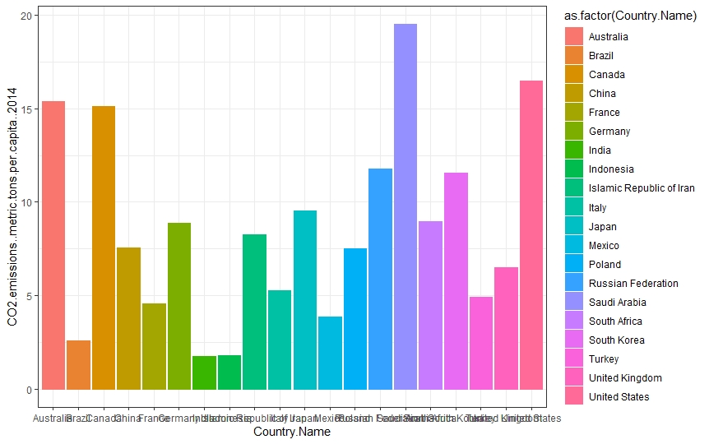

${CO}_{2}$ EMISSIONS PER CAPITA IN 2014

Slide 5
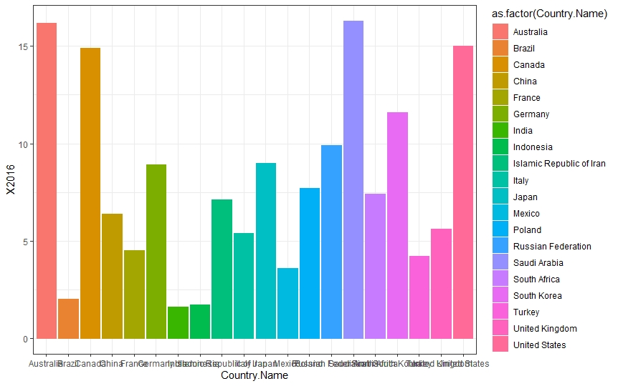

${CO}_{2}$ EMISSIONS PER CAPITA IN 2016

Slide 6
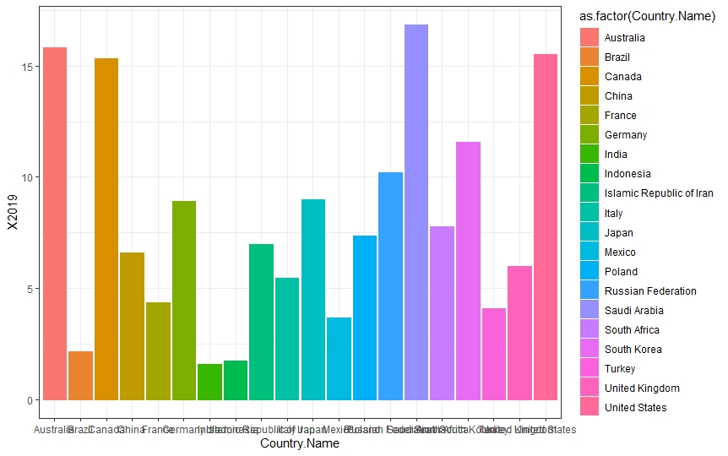

${CO}_{2}$ EMISSIONS PER CAPITA IN 2019

Slide 7
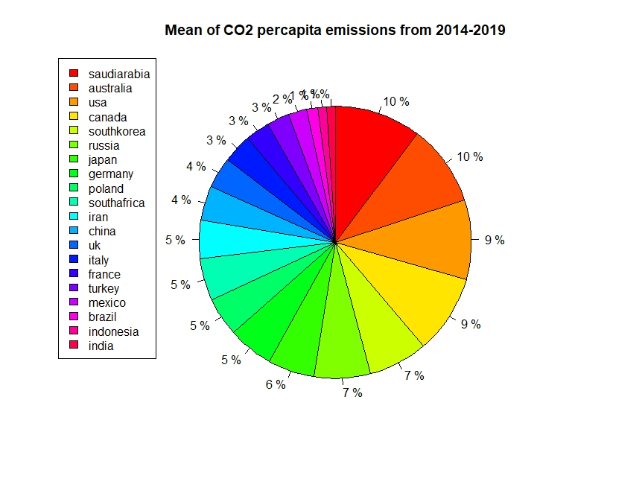

VARIOUS COUNTRIES ${CO}_{2}$ EMISSIONS PER CAPITA FROM 2014-2019

Slide 8

CONCLUSION
This analysis shows that Saudi Arabia and Australia are emitting highest amounts of ${CO}_{2}$ per capita.
From 2014-2019, the emissions per capita are decreasing gradually.

Slide 9
THANK YOU

