Slide 1

India City-wise Cost of Living Analysis
Presentation by:
B. Dharakeshwari (Batch - 536)

Slide 2
About me
B. Dharakeshwari
B.Tech — Computer Science Engineering
Interested in Data Science because I enjoy working with data, finding patterns and solving real-world problems. It also gives me the opportunity to combine my skills in Python, SQL, PowerBI, analytics and machine learning to make data-driven decisions.
Portfolio links
• LinkedIn: linkedin.com/in/dharakeshwaribanoth
• GitHub: github.com/Dharakeshwari-Banoth

Slide 3
Agenda
Project Overview
Tools & Technologies
Methodology
Dataset & Table Overview
Data Cleaning & Validation
Data Analysis & Insights
Hypothesis Testing
Challenges
Conclusion
Recommendations

Slide 4
Project Overview
Business problem
Problem statement
Project approach
Living costs differ across cities. Comparing rent, food-related indices and purchasing power can help people make more informed relocation and budgeting choices.
Clean and inspect the dataset, perform univariate and bivariate EDA, calculate summary statistics and communicate patterns through charts.
Analyze city-level cost-of-living indicators to compare cities and explore differences in living expenses, rent and purchasing power.
Primary audience
• Students, professionals and families comparing cities before relocation
• Analysts exploring relative city-level cost indicators
• Decision-makers planning preliminary budgets

Slide 5
Project Objectives
• Compare Cost of Living Index across Indian cities.
• Identify cities with high rent and restaurant price indices.
• Compare groceries and local purchasing power indicators.
• Explore relationships among indices using scatter plots and correlation analysis.
• Summarize distributions and descriptive statistics.
• Create clear visual outputs to support data-driven comparisons.

Slide 6
Tools & Technologies
Python
Pandas
Matplotlib
Core language for analysis and workflow
CSV loading, cleaning, filtering and summaries
Bar charts, scatter plots and histograms
Seaborn
Jupyter Notebook
CSV files
Correlation heatmap visualization
Interactive coding, execution and documentation
Storage format for processed datasets and outputs

Slide 7
Dataset & Table Overview
Fields | Description
City | City name
State / UT | Region associated with the city
Cost of Living Index | Relative everyday costs, excluding rent
Rent Index | Relative rental cost
Cost of Living Plus Rent Index | Combined living-cost and rent measure
Groceries Index | Relative grocery prices
Restaurant Price Index | Relative restaurant prices
Local Purchasing Power Index | Relative local purchasing power
Dataset description
• Source: Numbeo city-level indices.
• Unit of analysis: city.
• Focus: relative indices, not actual monthly expenses in rupees.

Slide 8
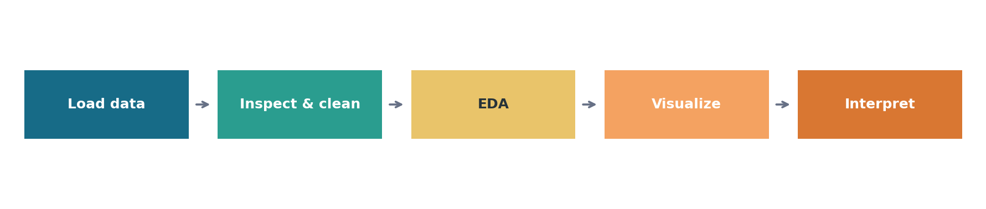
Methodology
Load the recovered CSV datasets into Pandas.
Inspect shape, column names, data types, missing values and duplicates.
Clean text spacing and convert index columns to numeric types.
Perform univariate and bivariate EDA, then save charts and summary outputs.
Perform Hypothesis Testing and give conclusion.

Slide 9
Data Cleaning & Validation
Duplicates
Text formatting
Data types
Exact duplicate rows were removed from the working copy.
Whitespace was stripped from column names and text values.
Index fields were converted to numeric; conversion failures become missing values and should be reviewed.
Validation checks
• Check dataset shape, column names and data types.
• Review missing values after numeric conversion; do not delete rows blindly.
• Check remaining duplicate rows and inspect descriptive statistics.
• Keep a copy of the original CSV to preserve raw data.

Slide 10
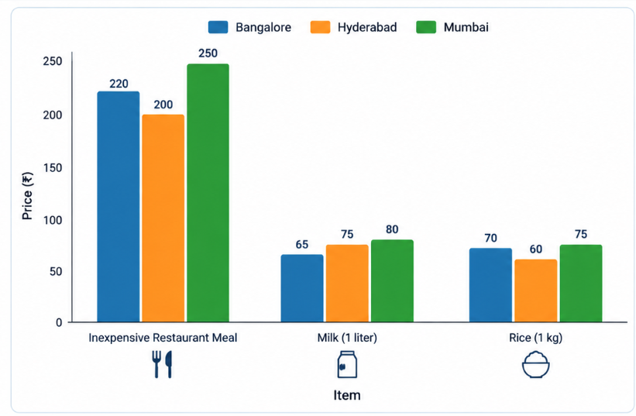
Univariate Analysis: City-wise Item Price Comparison
Interpretation
Restaurant meal: Mumbai has the highest price (₹250), followed by Bangalore (₹220) and Hyderabad (₹200).
Milk: Mumbai is highest at ₹80, while Bangalore is lowest at ₹65.
Rice: Mumbai is highest at ₹75, followed by Bangalore (₹70) and Hyderabad (₹60).

Slide 11
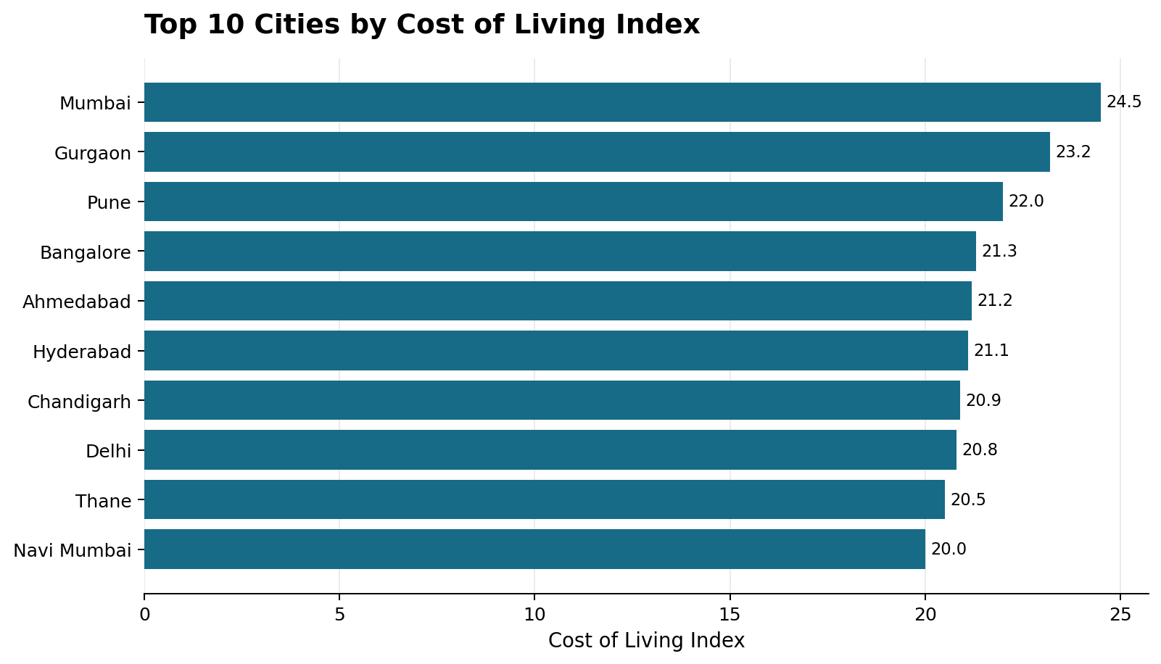
Univariate Analysis: Cost of Living
Interpretation
Mumbai has the highest Cost of Living Index at 24.5.
Gurgaon (23.2) and Pune (22.0) follow.
Coimbatore has a lower index of 17.1 in the reported data.
The chart highlights variations in living costs across cities.

Slide 12
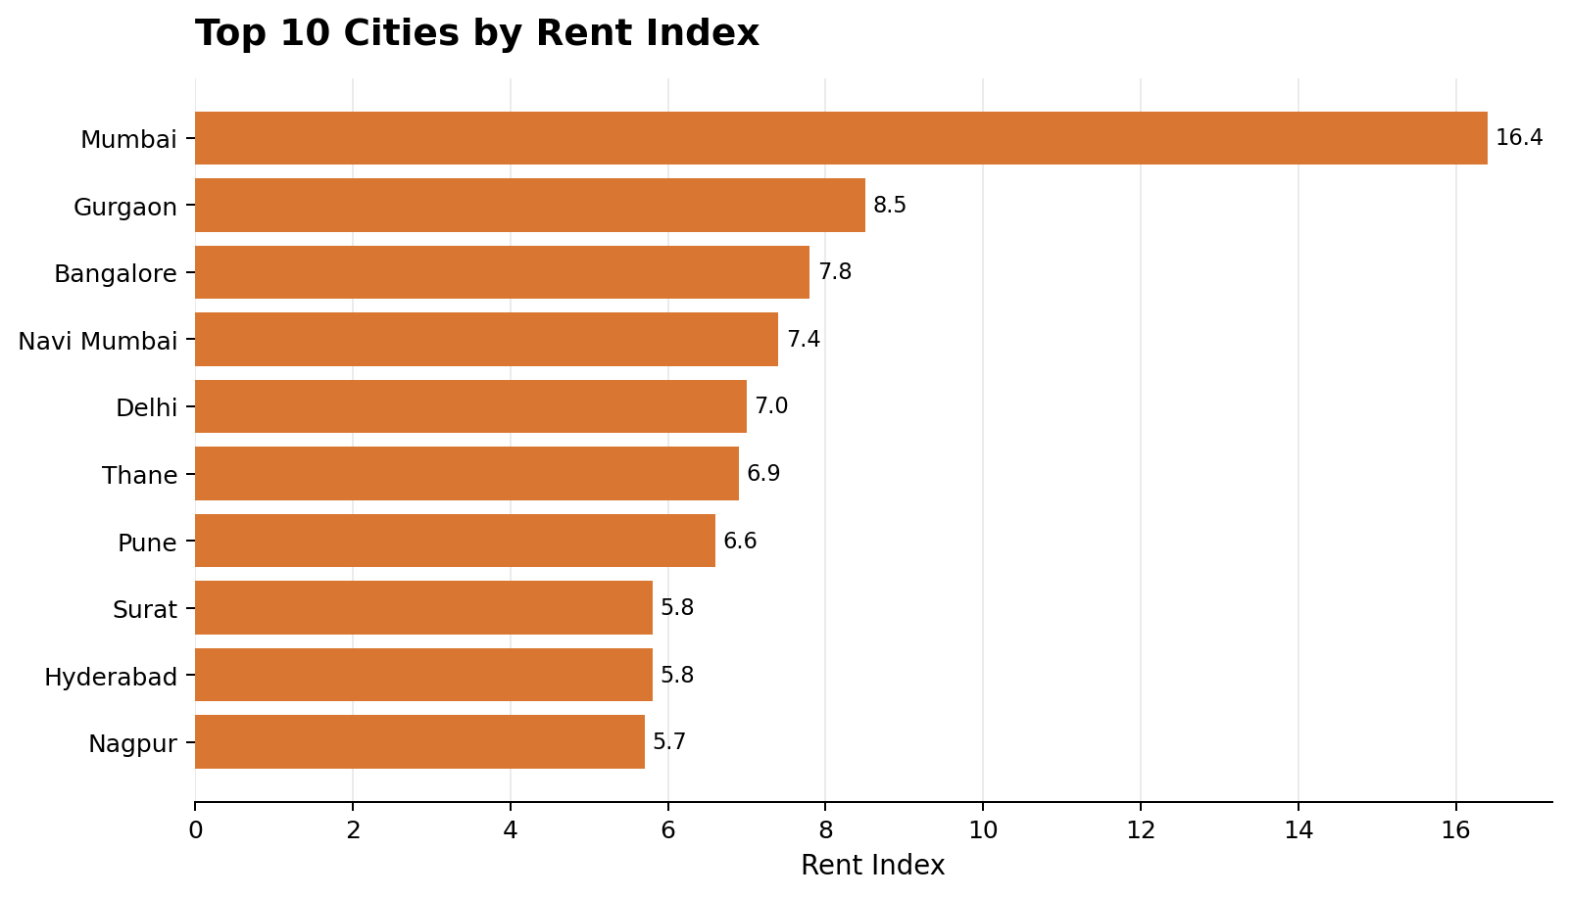
Univariate Analysis: Rent Index
Interpretation
Mumbai records the highest Rent Index at 16.4.
Gurgaon (8.5) and Bangalore (7.8) follow.
The difference highlights variations in rental costs.
Rent may contribute to differences in overall living costs.

Slide 13
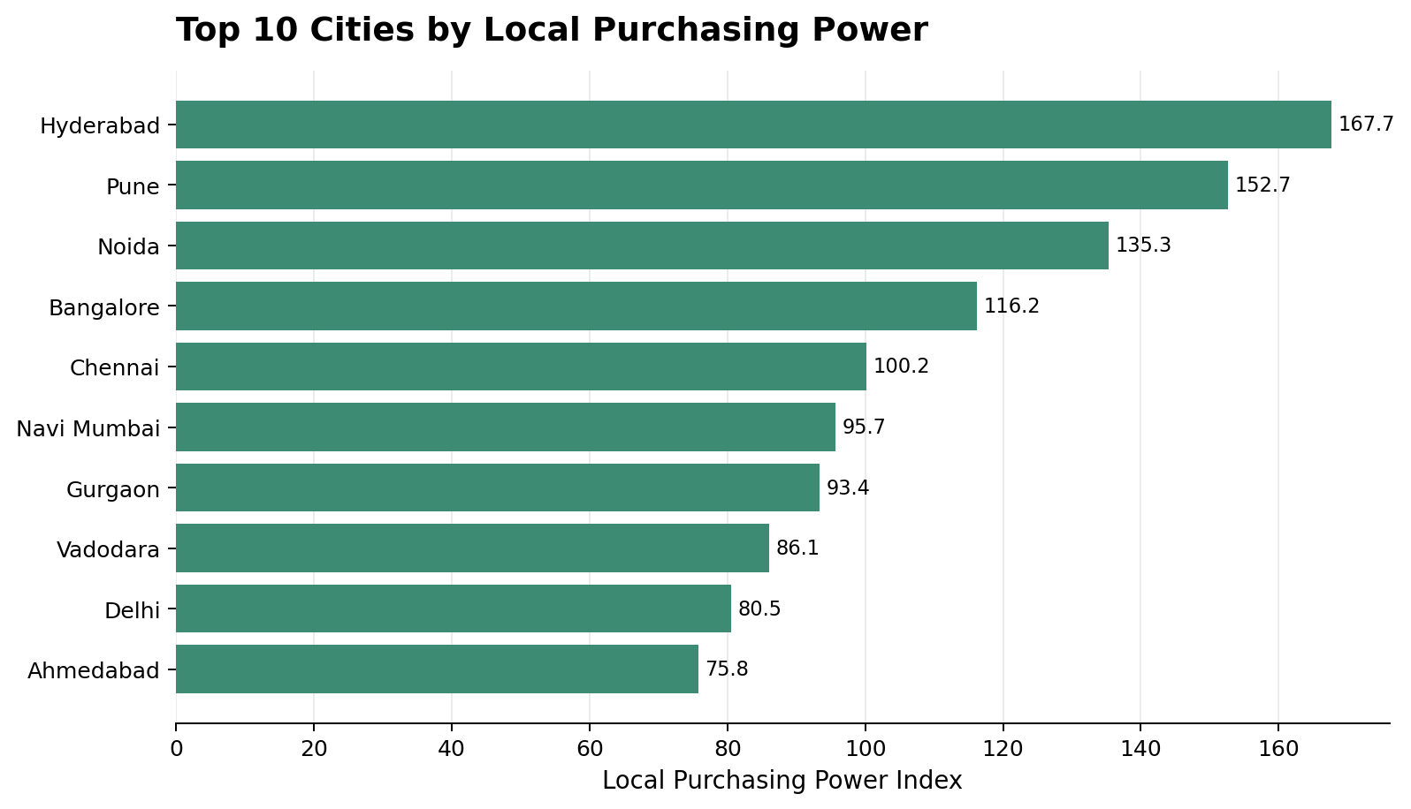
Univariate Analysis: Purchasing Power
Interpretation
Hyderabad has the highest reported index at 167.7.
Pune (152.7) and Noida (135.3) follow.
Higher index values indicate stronger relative purchasing power.
Purchasing power should be considered alongside living expenses.

Slide 14
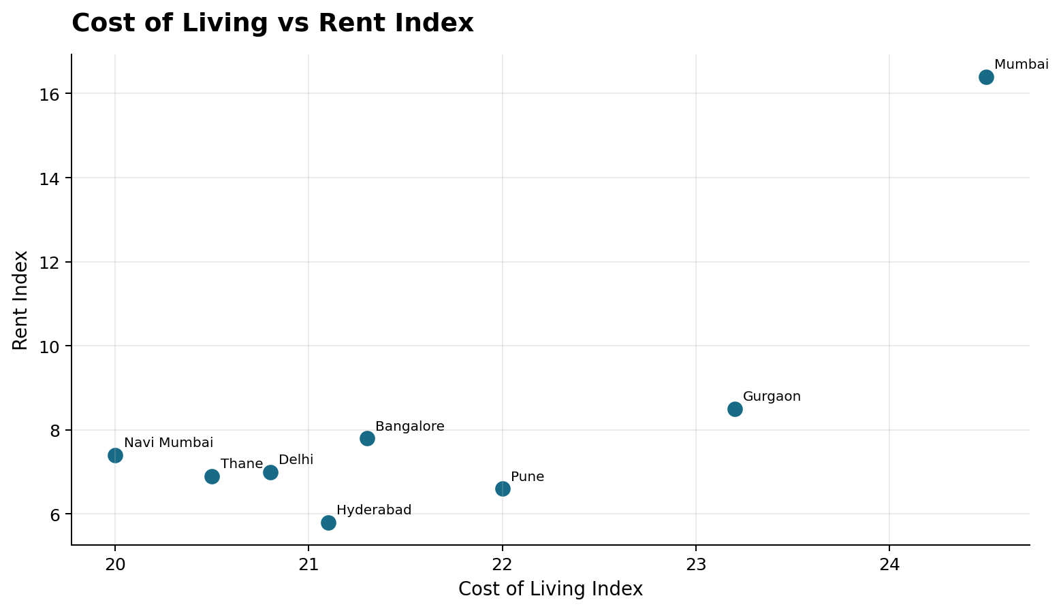
Bivariate Analysis: Cost of Living vs Rent
Interpretation
Pearson correlation coefficient: (r = 0.8099).
The result indicates a strong positive linear association.
Cities with higher rent indices tend to have higher cost-of-living indices.
The relationship is statistically significant (p < 0.001).
Correlation does not prove causation.

Slide 15
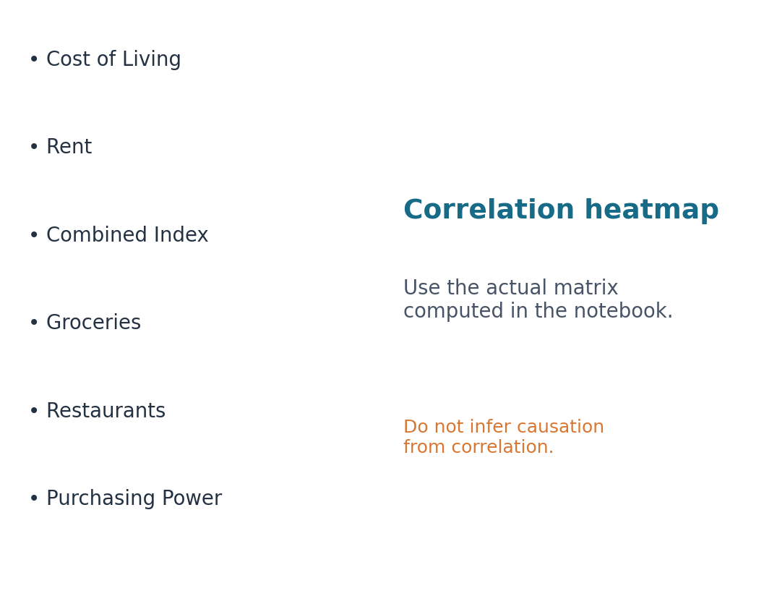
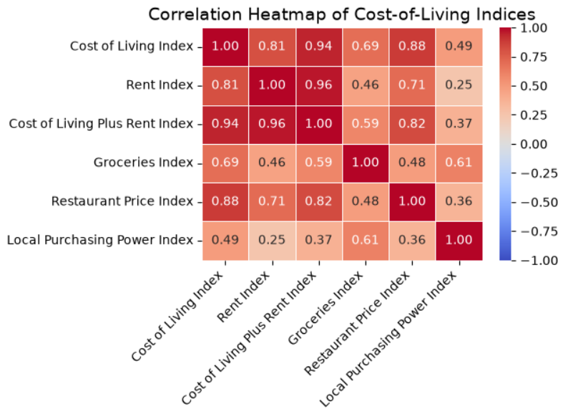
Multivariate Analysis: Correlation
Interpretation
Shows relationships among the numerical variables.
Values closer to +1 indicate strong positive correlations.
Values closer to −1 indicate strong negative correlations.
Values near 0 indicate weak linear relationships.
Use the displayed coefficients to identify the strongest relationships.

Slide 16
Hypothesis Testing: Python Workflow
  import pandas as pd
  from scipy.stats import pearsonr
  df = pd.read_csv(
  "data/processed/"
  "numbeo_india_city_indices.csv")
  cols = [
  "Cost of Living Index",
  "Rent Index"]
  data = df[cols].apply(
  pd.to_numeric, errors="coerce"
  ).dropna()
  r, p = pearsonr(
  data[cols[0]], data[cols[1]])
  print(len(data), round(r, 4), p)
Interpretation
• r = 0.8099 indicates a strong positive linear relationship.
• The p-value is below the 0.05 significance level.
• Reject H₀: the data provides evidence of a non-zero linear correlation.
Takeaway: Higher rent indices tend to accompany higher cost-of-living indices in this dataset.

Slide 17
Hypothesis Testing: Cost of Living vs Rent
H₀: No linear correlation between Cost of Living Index and Rent Index (ρ = 0)
H₁: A linear correlation exists between the two indices (ρ ≠ 0)
Decision: Reject H₀ because p < 0.05.
SAMPLE SIZE
28 cities
Valid values for both indices
CORRELATION (r)
0.8099
Strong positive linear association
P-VALUE
p < 0.001
Rounded output displayed 0.000000
SIGNIFICANCE
α = 0.05
P-value is below alpha

Slide 18
Cost of Living vs. Groceries Index
  from scipy.stats import pearsonr
  data = df[["Cost of Living Index", "Groceries Index"]].dropna()
  r, p = pearsonr(data["Cost of Living Index"], data["Groceries Index"])
  print("Correlation:", round(r, 4))
  print("P-value:", p)
  print("Reject H0" if p < 0.05 else "Fail to reject H0")
Interpretation
If p-value < 0.05, reject the null hypothesis. There is statistically significant evidence of a linear relationship between the two indices.
If p-value ≥ 0.05, fail to reject the null hypothesis. There is insufficient evidence of a linear relationship.
Takeaway: Higher rent indices tend to accompany higher cost-of-living indices in this dataset.

Slide 19
High-Rent vs. Low-Rent Cities
  from scipy.stats import ttest_ind
  data = df[["Cost of Living Index", "Rent Index"]].dropna()
  median = data["Rent Index"].median()
  high = data[data["Rent Index"] > median]["Cost of Living Index"]
  low = data[data["Rent Index"] <= median]["Cost of Living Index"]
  t, p = ttest_ind(high, low, equal_var=False)
  print("High-rent mean:", round(high.mean(), 2))
  print("Low-rent mean:", round(low.mean(), 2))
  print("P-value:", p)
  print("Reject H0" if p < 0.05 else "Fail to reject H0")
Interpretation
Null hypothesis (H₀): There is no significant difference in the mean Cost of Living Index between the high-rent and low-rent city groups.
Alternative hypothesis (H₁): There is a significant difference in the mean Cost of Living Index between the high-rent and low-rent city groups.
Takeaway: Higher rent indices tend to accompany higher cost-of-living indices in this dataset.

Slide 20
Conclusion
From city data to useful comparisons
  City-wise Cost of Living: The analysis highlights differences in the cost of living across Indian cities using Numbeo indices.
  Rent Impact: Pearson correlation analysis showed a strong positive relationship between rent and the Cost of Living Index ((r = 0.8099), (p < 0.001)) across 28 cities.
  Grocery and Restaurant Expenses: Comparisons of grocery and restaurant price indices reveal variations in everyday expenses between cities.
  Purchasing Power: The Local Purchasing Power Index provides additional insight into how cities differ in residents’ relative purchasing power.
  Data Visualization and Analysis: Data cleaning, descriptive statistics, correlation analysis, hypothesis testing, and charts helped identify patterns and communicate findings effectively.
  Practical Value: The analysis can support budgeting, relocation planning, and city selection. Results should be interpreted in the context of the dataset’s coverage and collection date.

Slide 21
Recommendations
  Compare rent and daily living costs before choosing a city for relocation.
  Consider local purchasing power alongside the Cost of Living Index.
  Update the analysis regularly to reflect changes in prices and living expenses.
  Include additional factors such as salaries, transportation costs, and utilities for a more comprehensive comparison.
  Use interactive dashboards to make city comparisons easier.
  Verify data quality and maintain regular backups of datasets, notebooks, and outputs.

Slide 22



Slide 23
THANK YOU

