Slide 1

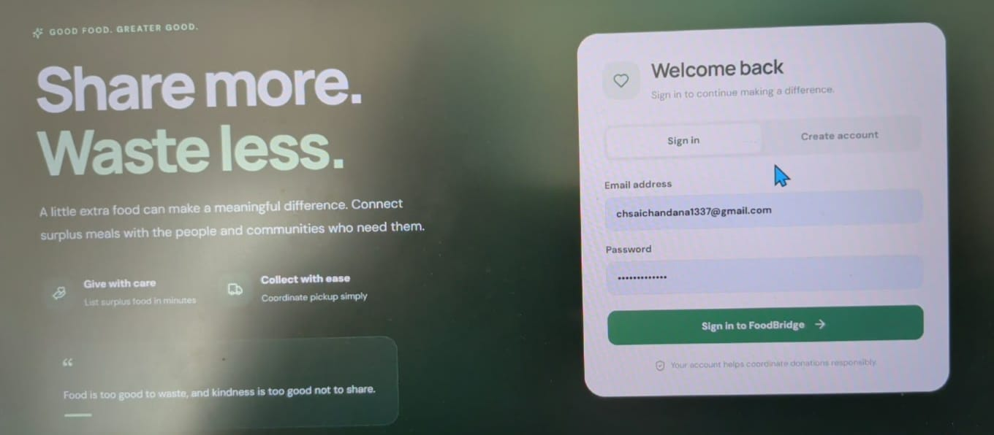
FOOD BRIDGE
PROBLEM STATEMENT : FOOD DONATION MARKET PLACE
TEAM NUMBER :05
TEAM MEMBERS:
1.T.SAI LOKESH-25MVCSMR0444
2. J.ANIL KUMAR-25MVCSMR0400
3.B.PRAVEEN -25MVCSMR0373
4.MD.MUSTAFA-25MVCSMR0420

Slide 2
HACKATHON PROJECT • MERN STACK
FoodBridge
Food should find people —
not landfills.
A real-time marketplace that connects surplus food from donors to NGOs before it expires.
↗
PROJECT SNAPSHOT
DONORS
NGOs
REAL-TIME
Problem domain: Food waste • Social impact • Web development
Team: [Add team member names]
React UI + Node/Express APIs + MongoDB
FOODBRIDGE • FOOD FORWARD
Notes:
Introduce FoodBridge as a real-time bridge between surplus food and organizations serving communities. Our goal is to make donations discoverable, safe to reserve, and easy to track.

Slide 3
The Challenge
02 / 07
Good food expires.
Need doesn’t.
19%
of food available to consumers was wasted in 2022
A coordination gap between surplus and hunger.
UNEP • Food Waste Index Report 2024
♥
HUNGER
↘
WASTE
◎
CLIMATE
NGOs need timely, reliable supply.
Edible surplus gets discarded.
Waste adds avoidable emissions.
Challenges: tight pickup windows • donor trust • double-booking • food safety
Source: unep.org/resources/publication/food-waste-index-report-2024
FOODBRIDGE • FOOD FORWARD
Notes:
Restaurants, hostels and caterers can have edible surplus while NGOs lack a fast, trusted way to discover it. UNEP estimated that 19% of food available to consumers was wasted in 2022, showing why better coordination matters.

Slide 4
Our Innovation
03 / 07
Two roles. One trusted flow.
↑
DONOR
LIVE FOOD LISTINGS
↓
NGO
Post surplus with quantity,
location & time.
Search • Filters • Status
Discover, reserve & collect.
STATUS LIFECYCLE
AVAILABLE
RESERVED
COLLECTED
✓
JWT + bcrypt
!
Expiry guard
↔
Atomic reserve
Secure sign-in & role access
Expired food cannot be claimed
Only one NGO can claim it
FOODBRIDGE • FOOD FORWARD
Notes:
FoodBridge is a two-sided marketplace: donors publish surplus and NGOs search for nearby, time-sensitive donations. Expiry checks, role-based access, and atomic reservation logic help prevent unsafe claims and double-booking.

Slide 5
How It Works
04 / 07
From donation post to confirmed pickup
01
02
03
04
Donor posts
Validate + save
Atomic reserve
Collect + persist
Name • quantity
Location • pickup/expiry
Required fields
MongoDB document
Available only
Expiry must be future
Status changes
Record survives refresh
USER JOURNEY
DONOR
Login → Add food → Track status
NGO
Login → Filter → Reserve → Collect
Safety rule: reserve only when status = Available AND expiryTime > now
FOODBRIDGE • FOOD FORWARD
Notes:
A donor submits food details, and the API validates and stores the record in MongoDB. An atomic conditional update reserves only an available, unexpired donation, then the NGO collects it and the status persists.

Slide 6
Technology & Algorithm
05 / 07
FULL-STACK TOOLKIT
React + Vite
Node.js
Express.js
MongoDB + Mongoose
JWT + bcrypt
bcrypt
Hash passwords
JWT + roles
Authorize requests
✓
✓
No plain-text credentials
Stateless access control
findOneAndUpdate
Atomic reservation
Regex + index
Fast discovery
✓
✓
Blocks race-condition double claims
status + pickupTime index
COMPLEXITY
Indexed lookup ≈ O(log n)
Search/filter ≈ O(n), capped at 200 results
Regex search fields: foodName • location • donor
FOODBRIDGE • FOOD FORWARD
Notes:
React and Vite power the interface, while Express APIs connect the application to MongoDB through Mongoose. bcrypt, JWT role middleware, and atomic findOneAndUpdate protect access and reservations; indexed listing queries and a 200-record cap keep searches manageable.

Slide 7
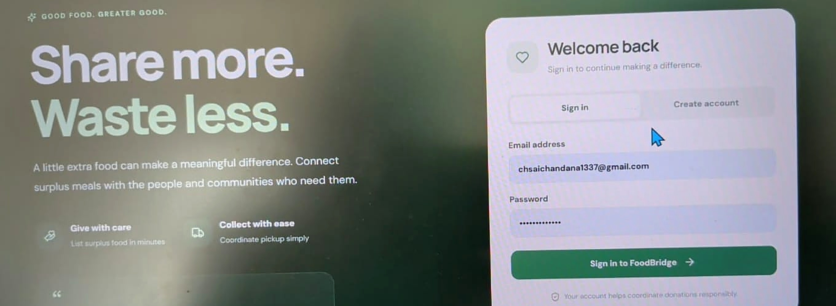
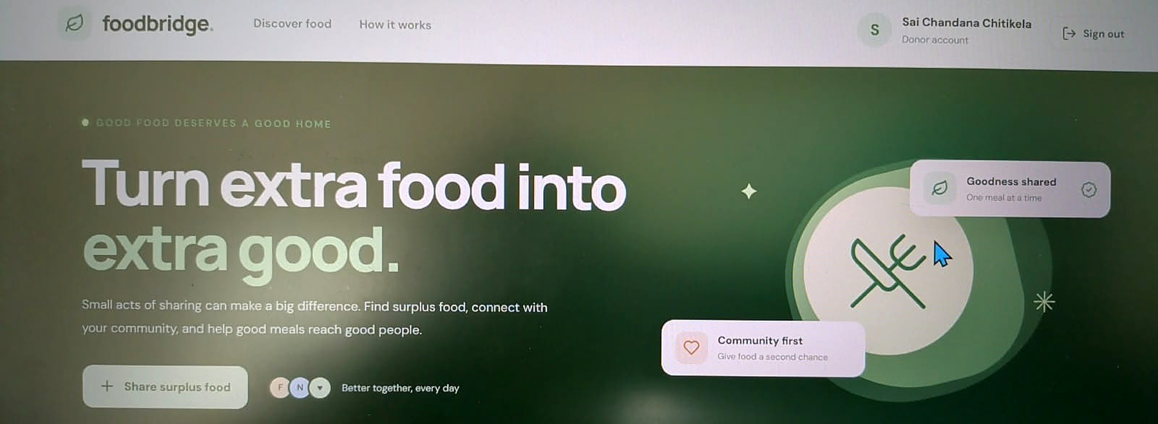
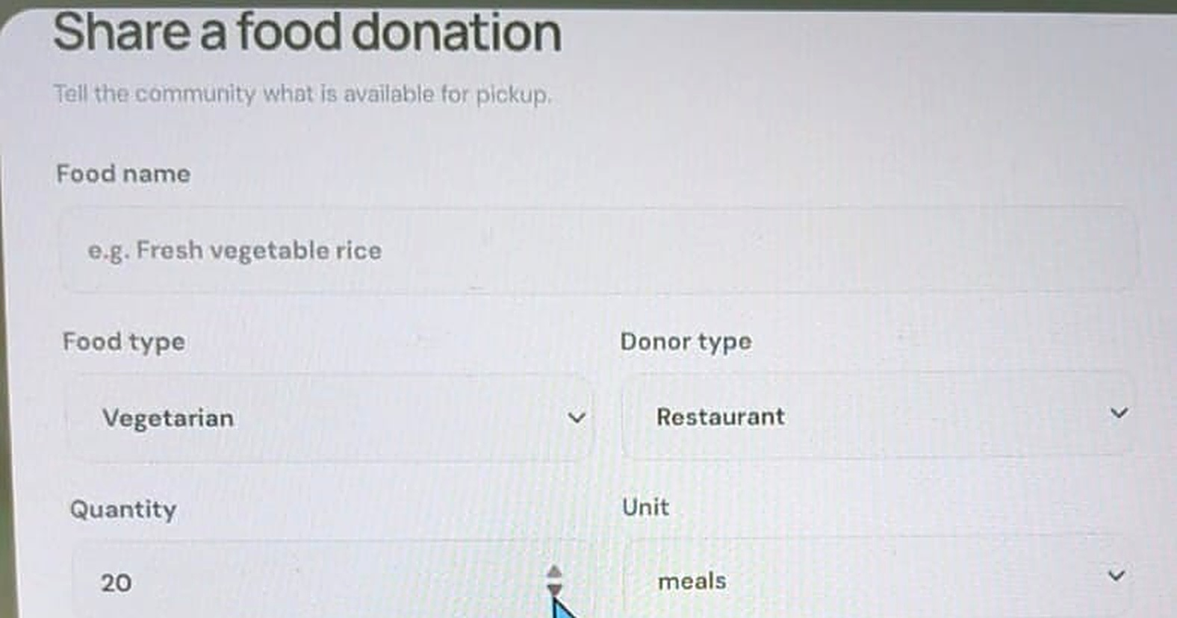
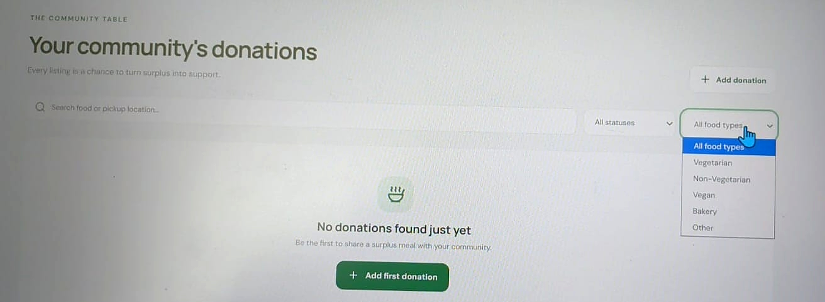
Demo & Impact
06 / 07
LIVE DEMO SCREENSHOTS
01 Login / Register
02 Donor Dashboard
03 Add Donation Form
04 NGO Filters
05 Status Change
DROP SCREENSHOT HERE
SAMPLE
Available
Reserved
Collected
6 / 6
Objectives achieved*
Less waste • Faster pickup • More meals reaching people
*As specified for the prototype: MERN • CRUD • REST • UI • auth/roles • clear results
FOODBRIDGE • FOOD FORWARD
Notes:
In the demo, show authentication, the donor dashboard, donation creation, NGO filters, and status updates. Walk one donation through Available, Reserved, and Collected, refresh to verify persistence, and connect the workflow to less waste and faster pickups.

Slide 8
FROM PROTOTYPE TO COMMUNITY IMPACT
Future Vision
Surplus food should feed people, not landfills.
⌖
CONNECT
✓
BUILD TRUST
↗
SCALE
Maps • SMS / WhatsApp alerts
NGO verification • meals-saved dashboard
Cloud • caching • rate limits • pagination
TODAY
Working full-stack prototype • CRUD • auth • roles
THANK YOU!
Questions & Answers
GITHUB REPOSITORY
[Add GitHub repository URL]
Let’s turn surplus into impact.
FOODBRIDGE • FOOD FORWARD
Notes:
Our current achievement is a full-stack prototype with CRUD, authentication, and role-based access. Next, we plan to add location-aware discovery, alerts, NGO verification, impact analytics, a mobile app, and production-ready scalability.

