Slide 1

HOLY MARY INSTITUTE OF TECHNOLOGY & SCIENCE (Approved by AICTE, New Delhi, Affiliated to JNTU, Hyderabad)
BOGARAM(V),KEESARA(M),MEDCHAL DISTRICT-501301
2021-2022
DEPARTMENT OF COMPUTER SCIENCE ENGINEERING
ACADEMIC RECORD MANEGEMENT AND ASSISTANT SYSTEM
By:
CH.BHARADWAJREDDY(18C91A0514)
B.VINOD KUMAR(18C91A0506)
D.KASIMBEE(18C91A0519)
Under the guidance of:
Mrs.EENAJA

Slide 2
ABSTRACT
Academic Record Management and Assistant System targets specifically to meet the requirements of the organization/institution engaged in importing training. The idea is to set up an effective training candidate base management, which incorporates various day to day activities e.g., Advertisement of the courses to get new candidates for training, complete management of student data, batch details, faculty information, course details and examination details. Besides all these comments and suggestions of candidates taking training there will be maintained. The system will be under the command of In charge of the company.

Slide 3
.
EXISTING SYSTEM:
The existing application has details of a User and Faculty through users, but it cannot retrieve details of the status accomplished successfully within limited amount of time. The majority of currently running application are web based, which requires heavy infrastructure and it is hard to work as per convenience. Currently working application require heavy maintenance cost and we can overcome with this issue.

Slide 4
DISADVANTAGES OF EXISTING SYSTEM
1.Authentication error will be occers
2. Less data integrity

Slide 5
PROPOSED SYSTEM:
In developed system users can view the profile of user, faculty and they can also view the dates of the exams published. Once the need for any courses arises then the user can register though the application. This is the way people can be benefited and especially when they are interested to learn a course.
This application focused more on user experience which is surveyed with many people. User does not need to go for login credential to look at the offered courses by the admin. Also overcome the issues authentication with faster and effectiveness.

Slide 6
ADVANTAGES OF PROPOSED SYSTEM
. Android project (easily Opertable).
. Esay access of data ( Retrieving of data).
. Admin can add students to any batch.
. Less space complexity and time complexity

Slide 7
SOFTWARE REQUIREMENTS :
Operating system : Windows XP
Coding Language : Android SDK
Editor : VS CODE
HARDWARE REQUIREMENTS :
System : Intel i 3Core.5th gen
Hard Disk : 20 GB.
Monitor : 15’’ LED
Input Devices : Keyboard, Mouse
Ram : 1 GB

Slide 8
SYSTEM DESIGN
Software design is the process by which an agent create a specification of a software
artifact, intended to accomplish goals, using a set of primitive components and subject
to constraints. Software design may refer to either "all the activity involved in
conceptualizing, framing, implementing, commissioning, and ultimately modifying
complex systems" or "the activity following requirements specification and
before programming, as in a stylized software engineering process.“ Software design
usually involves problem solving and planning a software solution .this includes both the Low level component design and high-level architecture design.

Slide 9
SYSTEM ANALYSIS
In this phase the requirements are gathered and analyzed. Users requirements are gathered in this
phase. This phase is the focus of the administrators and registered accounts. Meetings with users
and registered people are held to determine the requirements like: Who is going to use the
system? How will they use the system? What data should be input into the system? What data
should be output by the system? These are general questions that get answered during a
requirements gathering phase. After requirement gathering these requirements are analyzed for
their validity and the possibility of incorporating the requirements in the system to be development
is also studied

Slide 10
IMPLEMENTATION
Implementation is the most crucial stage in achieving a successful system and giving the user’s confidence
that the new system is workable and effective. Implementation of the modified application to replace an
existing one. This type of conversation is relatively easy to handle, provide there are no major changes in
the system.
Each program is tested individually at the time of development using the data and has verified that this
program linked together in the way specified in the programs specification. The computer system and its
environment are tested to the satisfaction of the user. The system that has been developed is accepted
and proved to be satisfactory for the user. And so the system is going to be implemented very soon. A
simple operating procedure is included so that the user can understand the different functions clearly and

Slide 11
SYSTEM TESTING
Software testing is a critical element of software quality and assurance and represents
ultimater review of specifications, design and coding. Testing is an exposure of the
system to trial input to see whether it produces correct output.

Slide 12
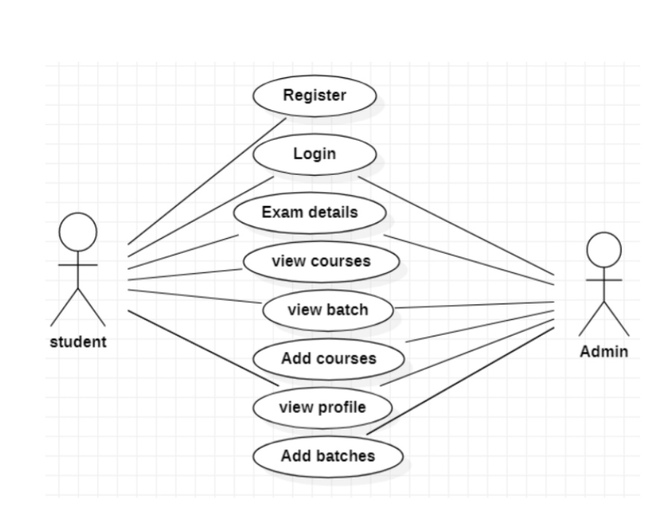
UML use case diagrams

Slide 13
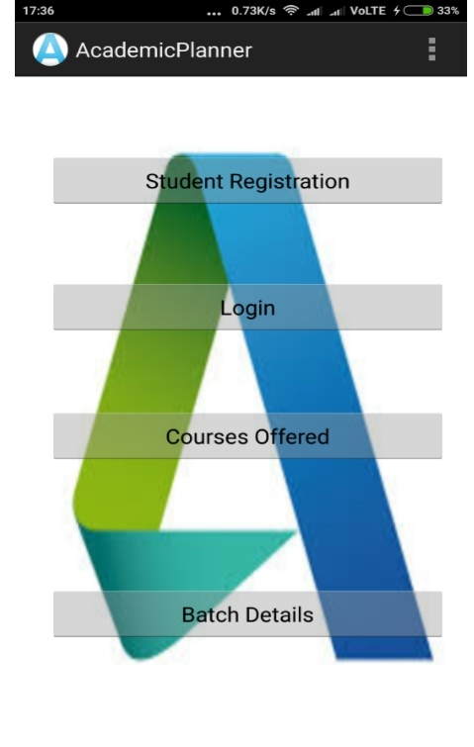
Final output of Application:-

Slide 14
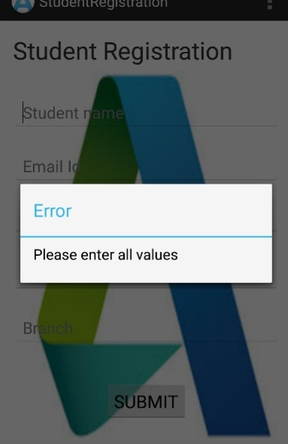
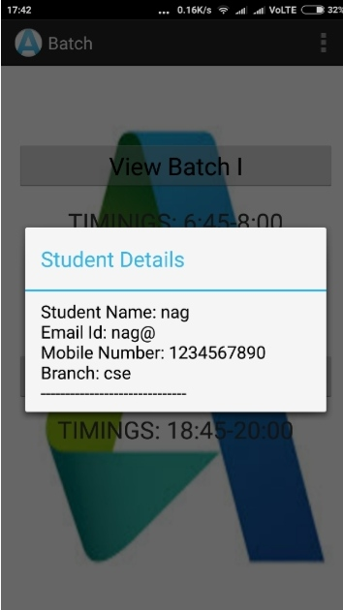
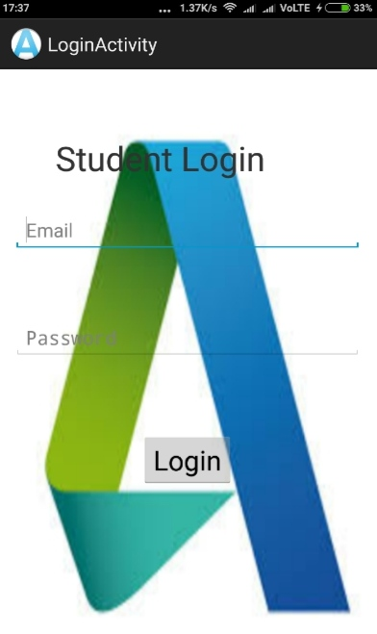

Slide 15
RESULTS:
Hence an Academic Record Management and Assistant System targets specifically to meet the requirements of the organization/institution engaged in importing training
This allows users to view their registered account and their performance at the tests conducted by the institution and to motivate themselves for better Performance in future

Slide 16
FUTUTRE SCOPE
One of the fastest growing industries now a day is mobile industry. There areh many
competitors in this area who are doing research and development on new platforms &
user experience. One such technology is Android from Google which is supported for
Google phones .the phones are DescribeDescribed as next generation Mobiles

Slide 17
CONCLUSION
At the end of this application it is a sophisticated approach for users to have a best selection and gives
better performance for Administrator so that he can easily add, update and view institution details and
students information. This initiative of academic record management and assistant system made more
easy to communicate with an institute. This is convenient to the students to view and register courses
easily. There is also a facility for the customer to check the status of registered courses and obtained marks

Slide 18


