Slide 1
Machine Learning and Data Mining for Data Science
By ASKS DATA SCIENCE GROUP
Key Ref: Gerstein Lab, “What is Cluster Analysis?”

Slide 2
Overview
Unsupervised Learning: Cluster Analysis
Machine Learning Workshop

Slide 3
Type of Unsupervised Learning question?
How is the data organized?
Which customers like the same kind of insurance plan?
Which common behaviors of the leaving customer?
What is the relationship between variables?
If a customer bought insurance A, will the customer buy insurance B?

Slide 4
Examples of Clustering Applications
Help marketers discover distinct groups in their customer bases, and then use this knowledge to develop targeted marketing programs
Identifying groups of motor insurance policy holders with a high average claim cost
Observed earth quake epicenters should be clustered along continent faults

Slide 5
Fundamentally different
Supervised learning
Unsupervised learning
Semi-supervised learning

Slide 6
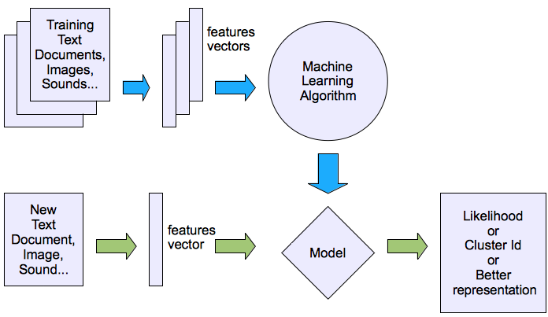
Machine learning structure
Unsupervised learning
Ref: Yi-Fan Chang, “An Overview of Machine Learning”

Slide 7
Things to consider
What is the input data?
How to measure the similarity between two points?
Do you have any idea of what the output should look like?
How should you evaluate the clustering results?

Slide 8
Remember?
What are the features?
How many dimensions?
What are the values?

Slide 9
Let’s practice
If we want to partition people in this room into groups for target marketing of your new car insurance, what do you want as… the feature space?
What are the features?
How many dimensions?
What are the values?

Slide 10
Type of data in clustering analysis
Interval-scaled variables
Binary variables
Nominal, ordinal, and ratio variables
Variables of mixed types

Slide 11
What clustering methods can we use?

Slide 12
Major Clustering Approaches (I)
Partitioning approach:
Construct various partitions and then evaluate them by some criterion, e.g., minimizing the sum of square errors
Typical methods: k-means, k-medoids, CLARANS
Hierarchical approach:
Create a hierarchical decomposition of the set of data (or objects) using some criterion
Typical methods: Diana, Agnes, BIRCH, ROCK, CAMELEON
Density-based approach:
Based on connectivity and density functions
Typical methods: DBSACN, OPTICS, DenClue

Slide 13
Major Clustering Approaches (II)
Grid-based approach:
based on a multiple-level granularity structure
Typical methods: STING, WaveCluster, CLIQUE
Model-based:
A model is hypothesized for each of the clusters and tries to find the best fit of that model to each other
Typical methods: EM, SOM, COBWEB
Frequent pattern-based:
Based on the analysis of frequent patterns
Typical methods: pCluster
User-guided or constraint-based:
Clustering by considering user-specified or application-specific constraints
Typical methods: COD (obstacles), constrained clustering

Slide 14
Key question… how to tell if two people are similar?

Slide 15
How to evaluate your results?

Slide 16
Quality: What Is Good Clustering?
A good clustering method will produce high quality clusters with
high intra-class similarity
low inter-class similarity
The quality of a clustering result depends on both the similarity measure used by the method and its implementation
The quality of a clustering method is also measured by its ability to discover some or all of the hidden patterns

Slide 17
Measure the Quality of Clustering
Dissimilarity/Similarity metric:
Similarity is expressed in terms of a distance function: d(i, j)
The definitions of distance functions are usually very different for interval-scaled, boolean, categorical, ordinal ratio, and vector variables.
Weights should be associated with different variables based on applications and data semantics.
It is hard to define “similar enough” or “good enough”
the answer is typically highly subjective.
There is a separate “quality” function that measures the “goodness” of a cluster.

Slide 18
Typical Alternatives to Calculate the Distance between Clusters
Single link: smallest distance between an element in one cluster and an element in the other, i.e., dis(K_{i}, K_{j}) = min(t_{ip}, t_{jq})
Complete link: largest distance between an element in one cluster and an element in the other, i.e., dis(K_{i}, K_{j}) = max(t_{ip}, t_{jq})
Average: avg distance between an element in one cluster and an element in the other, i.e., dis(K_{i}, K_{j}) = avg(t_{ip}, t_{jq})
Centroid: distance between the centroids of two clusters, i.e., dis(K_{i}, K_{j}) = dis(C_{i}, C_{j})
Medoid: distance between the medoids of two clusters, i.e., dis(K_{i}, K_{j}) = dis(M_{i}, M_{j})
Medoid: one chosen, centrally located object in the cluster

Slide 19
Centroid, Radius and Diameter of a Cluster (for numerical data sets)
Centroid: the “middle” of a cluster
Radius: square root of average distance from any point of the cluster to its centroid
Diameter: square root of average mean squared distance between all pairs of points in the cluster

Slide 20
Partitioning Algorithms: Basic Concept
Partitioning method: Construct a partition of a database D of n objects into a set of k clusters, s.t., min sum of squared distance
Given a k, find a partition of k clusters that optimizes the chosen partitioning criterion
Global optimal: exhaustively enumerate all partitions
Heuristic methods: k-means and k-medoids algorithms
k-means (MacQueen’67): Each cluster is represented by the center of the cluster
k-medoids or PAM (Partition around medoids) (Kaufman & Rousseeuw’87): Each cluster is represented by one of the objects in the cluster

Slide 21
The K-Means Clustering Method
Given k, the k-means algorithm is implemented in four steps:
Partition objects into k nonempty subsets
Compute seed points as the centroids of the clusters of the current partition (the centroid is the center, i.e., mean point, of the cluster)
Assign each object to the cluster with the nearest seed point
Go back to Step 2, stop when no more new assignment

Slide 22
The K-Means Clustering Method
Example
10
10
9
9
8
8
7
7
6
6
5
5
4
Assign each objects to most similar center
Update the cluster means
4
3
3
2
2
1
1
0
0
0
1
2
3
4
5
6
7
8
9
10
0
1
2
3
4
5
6
7
8
9
10
reassign
reassign
K=2
Arbitrarily choose K object as initial cluster center
Update the cluster means

Slide 23
Comments on the K-Means Method
Strength: Relatively efficient: O(tkn), where n is # objects, k is # clusters, and t is # iterations. Normally, k, t << n.
Comparing: PAM: O(k(n-k)² ), CLARA: O(ks² + k(n-k))
Comment: Often terminates at a local optimum. The global optimum may be found using techniques such as: deterministic annealing and genetic algorithms
Weakness
Applicable only when mean is defined, then what about categorical data?
Need to specify k, the number of clusters, in advance
Unable to handle noisy data and outliers
Not suitable to discover clusters with non-convex shapes

Slide 24
Variations of the K-Means Method
A few variants of the k-means which differ in
Selection of the initial k means
Dissimilarity calculations
Strategies to calculate cluster means
Handling categorical data: k-modes (Huang’98)
Replacing means of clusters with modes
Using new dissimilarity measures to deal with categorical objects
Using a frequency-based method to update modes of clusters
A mixture of categorical and numerical data: k-prototype method

Slide 25
What Is the Problem of the K-Means Method?
The k-means algorithm is sensitive to outliers !
Since an object with an extremely large value may substantially distort the distribution of the data.
K-Medoids: Instead of taking the mean value of the object in a cluster as a reference point, medoids can be used, which is the most centrally located object in a cluster.
10
10
9
9
8
8
7
7
6
6
5
5
4
4
3
3
2
2
1
1
0
0
1
2
3
4
5
6
7
8
9
10
0
0
1
2
3
4
5
6
7
8
9
10

Slide 26
Partitional Clustering
Output a single partition of the data into clusters
Good for large data sets
Determining the number of clusters is a major challenge

Slide 27
Hierarchical Clustering
Use distance matrix as clustering criteria. This method does not require the number of clusters k as an input, but needs a termination condition
Step 0
Step 1
Step 2
Step 3
Step 4
agglomerative
(AGNES)
a
a b
b
a b c d e
c
c d e
d
d e
e
divisive
(DIANA)
Step 4
Step 3
Step 2
Step 1
Step 0

Slide 28
Dendrogram: Shows How the Clusters are Merged
Decompose data objects into a several levels of nested partitioning (tree of clusters), called a dendrogram.
A clustering of the data objects is obtained by cutting the dendrogram at the desired level, then each connected component forms a cluster.

Slide 29
Different choices matter
Single-link
Distance between two clusters set equal to the minimum of distances between all instances
More versatile
Produces (sometimes too) elongated clusters
Complete-link
Distance between two clusters set equal to maximum of all distances between instances in the clusters
Tightly bound, compact clusters
Often more useful in practice

Slide 30
Example: Clusters Found
Single-Link
Complete-Link
1
2
1
2
2
2
2
2
1
1
1
1
* * * * * * * * *
2
2
1
1
2
2
1
1
2
2
2
2
1
1
2
2
2
2
2
1
2
1
1
1
1
* * * * * * * * *
2
2
1
1
2
2
1
1
2
2
2
2
1

Slide 31
Clustering High-Dimensional Data
Clustering high-dimensional data
Many applications: text documents, DNA micro-array data
Major challenges:
Many irrelevant dimensions may mask clusters
Distance measure becomes meaningless—due to equi-distance
Clusters may exist only in some subspaces

Slide 32
Clustering High-Dimensional Data
Methods
Feature transformation: only effective if most dimensions are relevant
PCA & SVD useful only when features are highly correlated/redundant
Feature selection: wrapper or filter approaches
useful to find a subspace where the data have nice clusters
Subspace-clustering: find clusters in all the possible subspaces
CLIQUE, ProClus, and frequent pattern-based clustering

Slide 33
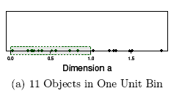
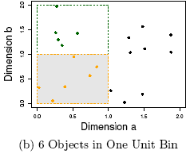
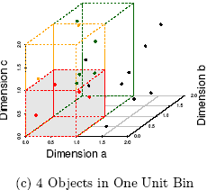
The Curse of Dimensionality (graphs adapted from Parsons et al. KDD Explorations 2004)
Data in only one dimension is relatively packed
Adding a dimension “stretch” the points across that dimension, making them further apart
Adding more dimensions will make the points further apart—high dimensional data is extremely sparse
Distance measure becomes meaningless—due to equi-distance

Slide 34
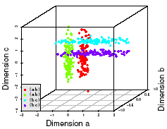
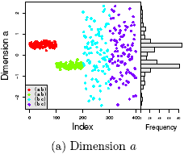
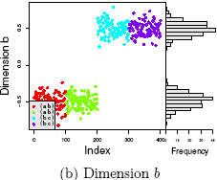
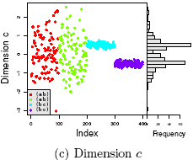
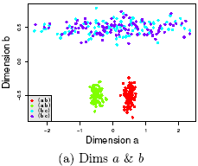
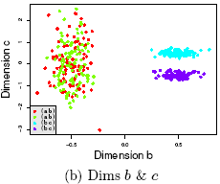
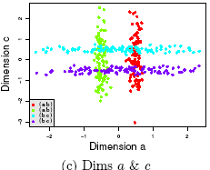
Why Subspace Clustering? (adapted from Parsons et al. SIGKDD Explorations 2004)
Clusters may exist only in some subspaces
Subspace-clustering: find clusters in all the subspaces

Slide 35
What Is Outlier Discovery?
What are outliers?
The set of objects are considerably dissimilar from the remainder of the data
Example: Sports: Michael Jordon, Wayne Gretzky, ...
Problem: Define and find outliers in large data sets
Applications:
Credit card fraud detection
Telecom fraud detection
Customer segmentation
Medical analysis

Slide 36
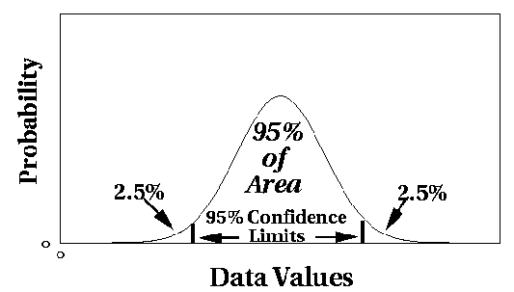
Outlier Discovery: Statistical Approaches
Assume a model underlying distribution that generates data set (e.g. normal distribution)
Use discordancy tests depending on
data distribution
distribution parameter (e.g., mean, variance)
number of expected outliers
Drawbacks
most tests are for single attribute
In many cases, data distribution may not be known

Slide 37
Outlier Discovery: Distance-Based Approach
Introduced to counter the main limitations imposed by statistical methods
We need multi-dimensional analysis without knowing data distribution
Distance-based outlier: A DB(p, D)-outlier is an object O in a dataset T such that at least a fraction p of the objects in T lies at a distance greater than D from O
Algorithms for mining distance-based outliers
Index-based algorithm
Nested-loop algorithm
Cell-based algorithm

Slide 38
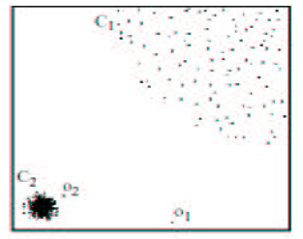
Density-Based Local Outlier Detection
Distance-based outlier detection is based on global distance distribution
It encounters difficulties to identify outliers if data is not uniformly distributed
Ex. C₁ contains 400 loosely distributed points, C₂ has 100 tightly condensed points, 2 outlier points o₁, o₂
Distance-based method cannot identify o₂ as an outlier
Need the concept of local outlier
Local outlier factor (LOF)
Assume outlier is not crisp
Each point has a LOF

Slide 39
Summary
Cluster analysis groups objects based on their similarity and has wide applications
Measure of similarity can be computed for various types of data
Clustering algorithms can be categorized into partitioning methods, hierarchical methods, density-based methods, grid-based methods, and model-based methods
Outlier detection and analysis are very useful for fraud detection, etc. and can be performed by statistical, distance-based or deviation-based approaches
There are still lots of research issues on cluster analysis

Slide 40
Recap Clustering Techniques
Clustering
Hierarchical
Partitional
Single Link
Complete Link
Square Error
Mixture Maximization
CobWeb
K-means
Expectation Maximization

Slide 41
Technique Characteristics
Agglomerative vs Divisive
Agglomerative: each instance is its own cluster and the algorithm merges clusters
Divisive: begins with all instances in one cluster and divides it up
Hard vs Fuzzy
Hard clustering assigns each instance to one cluster whereas in fuzzy clustering assigns degree of membership

Slide 42
More Characteristics
Monothetic vs Polythetic
Polythetic: all attributes are used simultaneously, e.g., to calculate distance (most algorithms)
Monothetic: attributes are considered one at a time
Incremental vs Non-Incremental
With large data sets it may be necessary to consider only part of the data at a time (data mining)
Incremental works instance by instance

Slide 43
Pattern Mining
Ref: Han et al, “Data Mining Concepts and Techniques”

Slide 44
What Is Frequent Pattern Analysis?
Frequent pattern: a pattern (a set of items, subsequences, substructures, etc.) that occurs frequently in a data set
First proposed by Agrawal, Imielinski, and Swami [AIS93] in the context of frequent itemsets and association rule mining
Motivation: Finding inherent regularities in data
What products were often purchased together?— Beer and diapers?!
What are the subsequent purchases after buying a PC?
What kinds of DNA are sensitive to this new drug?
Can we automatically classify web documents?
Applications
Basket data analysis, cross-marketing, catalog design, sale campaign analysis, Web log (click stream) analysis, and DNA sequence analysis.

Slide 45
Why Is Freq. Pattern Mining Important?
Freq. pattern: An intrinsic and important property of datasets
Foundation for many essential data mining tasks
Association, correlation, and causality analysis
Sequential, structural (e.g., sub-graph) patterns
Pattern analysis in spatiotemporal, multimedia, time-series, and stream data
Classification: discriminative, frequent pattern analysis
Cluster analysis: frequent pattern-based clustering
Data warehousing: iceberg cube and cube-gradient
Semantic data compression: fascicles
Broad applications

Slide 46
Basic Concepts: Frequent Patterns
Tid | Items bought
10 | Beer, Nuts, Diaper
20 | Beer, Coffee, Diaper
30 | Beer, Diaper, Eggs
40 | Nuts, Eggs, Milk
50 | Nuts, Coffee, Diaper, Eggs, Milk
itemset: A set of one or more items
k-itemset X = {x₁, …, x_{k}}
(absolute) support, or, support count of X: Frequency or occurrence of an itemset X
(relative) support, s, is the fraction of transactions that contains X (i.e., the probability that a transaction contains X)
An itemset X is frequent if X’s support is no less than a minsup threshold
Customer
buys both
Customer
buys diaper
Customer
buys beer

Slide 47
Basic Concepts: Association Rules
Find all the rules X → Y with minimum support and confidence
support, s, probability that a transaction contains X ∪ Y
confidence, c, conditional probability that a transaction having X also contains Y
Let minsup = 50%, minconf = 50%
Freq. Pat.: Beer:3, Nuts:3, Diaper:4, Eggs:3, {Beer, Diaper}:3
Tid
Items bought
10
Beer, Nuts, Diaper
20
Beer, Coffee, Diaper
30
Beer, Diaper, Eggs
40
Nuts, Eggs, Milk
50
Nuts, Coffee, Diaper, Eggs, Milk
Customer
buys both
Customer
buys diaper
Association rules: (many more!)
Beer → Diaper (60%, 100%)
Diaper → Beer (60%, 75%)
Customer
buys beer

Slide 48
Association Rules Outline
Goal: Provide an overview of basic Association Rule mining techniques
Association Rules Problem Overview
Large itemsets
Association Rules Algorithms
Apriori
Eclat

Slide 49
Example: Market Basket Data
Items frequently purchased together:
Bread ⇒PeanutButter
Uses:
Placement
Advertising
Sales
Coupons
Objective: increase sales and reduce costs

Slide 50
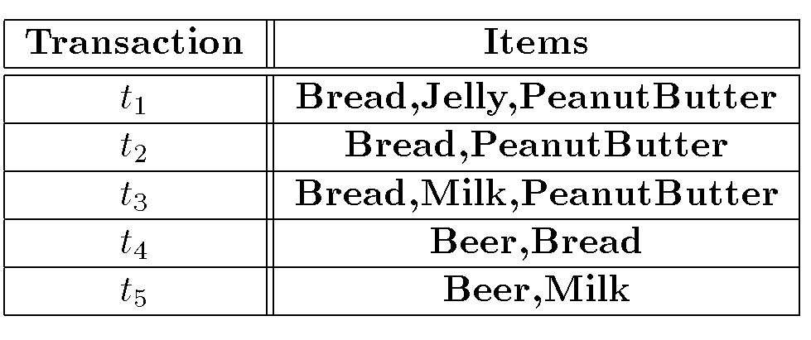
Association Rules Example
I = { Beer, Bread, Jelly, Milk, PeanutButter}
Support of {Bread,PeanutButter} is 60%

Slide 51
Association Rule Definitions
Association Rule (AR): implication X ⇒ Y where X,Y ⊆ I and X ∩ Y = ;
Support of AR (s) X ⇒ Y: Percentage of transactions that contain X ∪Y
Confidence of AR (α) X ⇒ Y: Ratio of number of transactions that contain X ∪ Y to the number that contain X

Slide 52
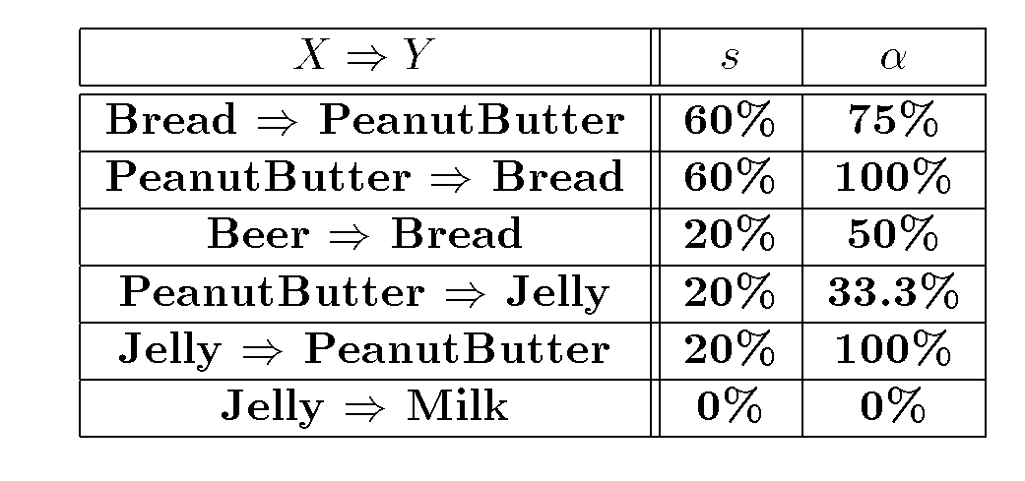
Association Rules Ex (cont’d)

Slide 53
Association Rule Problem
Given a set of items I={I₁,I₂,…,I_{m}} and a database of transactions D={t₁,t₂, …, t_{n}} where t_{i}={I_{i1},I_{i2}, …, I_{ik}} and I_{ij} ∈ I, the Association Rule Problem is to identify all association rules X ⇒ Y with a minimum support and confidence.
Link Analysis
NOTE: Support of X ⇒ Y is same as support of X ∪ Y.

Slide 54
Association Rule Techniques
Find Large Itemsets.
Generate rules from frequent itemsets.

Slide 55
Sequence Pattern Mining

Slide 56
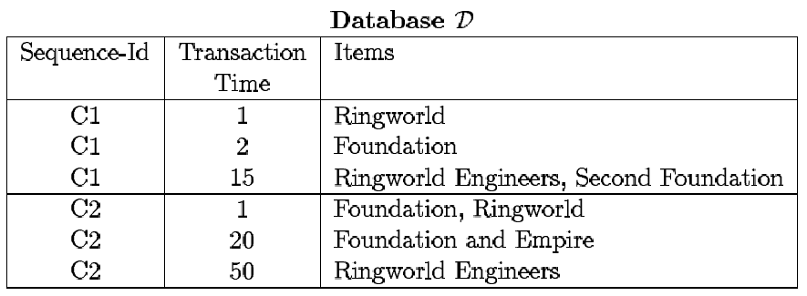
Input Database: example
45% of customers who bought Foundation will buy Foundation and Empire within the next month.

Slide 57
Workshop

Slide 58
Appendix
Ref: Gerstein Lab, “What is Cluster Analysis?”

Slide 59
Interval-valued variables
Standardized data
Calculate the mean absolute deviation:
where
Calculate the standardized measurement (z-score)
Using mean absolute deviation is more robust than using standard deviation

Slide 60
Similarity and Dissimilarity Between Objects
Distances are normally used to measure the similarity or dissimilarity between two data objects
Some popular ones include: Minkowski distance:
where i = (x_{i1}, x_{i2}, …, x_{ip}) and j = (x_{j1}, x_{j2}, …, x_{jp}) are two p-dimensional data objects, and q is a positive integer
If q = 1, d is Manhattan distance

Slide 61
Similarity and Dissimilarity Between Objects (Cont.)
If q = 2, d is Euclidean distance:
Properties
d(i,j) ≥ 0
d(i,i) = 0
d(i,j) = d(j,i)
d(i,j) ≤ d(i,k) + d(k,j)
Also, one can use weighted distance, parametric Pearson product moment correlation, or other disimilarity measures

Slide 62
Binary Variables
Object j
A contingency table for binary data
Distance measure for symmetric binary variables:
Distance measure for asymmetric binary variables:
Jaccard coefficient (similarity measure for asymmetric binary variables):
Object i

Slide 63
Dissimilarity between Binary Variables
Example
gender is a symmetric attribute
the remaining attributes are asymmetric binary
let the values Y and P be set to 1, and the value N be
set to 0

Slide 64
Nominal Variables
A generalization of the binary variable in that it can take more than 2 states, e.g., red, yellow, blue, green
Method 1: Simple matching
m: # of matches, p: total # of variables
Method 2: use a large number of binary variables
creating a new binary variable for each of the M nominal states

Slide 65
Ordinal Variables
An ordinal variable can be discrete or continuous
Order is important, e.g., rank
Can be treated like interval-scaled
replace x_{if} by their rank
map the range of each variable onto [0, 1] by replacing i-th object in the f-th variable by
compute the dissimilarity using methods for interval-scaled variables

Slide 66
Ratio-Scaled Variables
Ratio-scaled variable: a positive measurement on a nonlinear scale, approximately at exponential scale, such as Ae^{Bt} or Ae^{-Bt}
Methods:
treat them like interval-scaled variables—not a good choice! (why?—the scale can be distorted)
apply logarithmic transformation
y_{if} = log(x_{if})
treat them as continuous ordinal data treat their rank as interval-scaled

Slide 67
Variables of Mixed Types
A database may contain all the six types of variables
symmetric binary, asymmetric binary, nominal, ordinal, interval and ratio
One may use a weighted formula to combine their effects
f is binary or nominal:
d_{ij}^{(f)} = 0 if x_{if} = x_{jf} , or d_{ij}^{(f)} = 1 otherwise
f is interval-based: use the normalized distance
f is ordinal or ratio-scaled
compute ranks r_{if} and
and treat z_{if} as interval-scaled

Slide 68


Vector Objects
Vector objects: keywords in documents, gene features in micro-arrays, etc.
Broad applications: information retrieval, biologic taxonomy, etc.
Cosine measure
A variant: Tanimoto coefficient

