Slide 1
The Art of Data StoryTelling
By ASKS Data Science Group

Slide 2
Story can change your life…
Notes:
I mean… you can in the best case you can get promoted, in the worst case, you can get fired…

Slide 3
What is your story?
Notes:
Everyone has a story to tell.
Think of a few life-changing events that happened to you.
What are your best stories?
Let your students tell their stories.

Slide 4
Storytelling Process
Generate Contents
Storyboard
Locate Resources
Create
Share

Slide 5
Data Storytelling…
1st trick… Focus on the message you want to deliver.
But… we have
Gathered all sorts of data
What didn’t we have? We searched for more
We processed them and analyzed them too
And we make a lot of graphs… beautiful graphs…
Identify key insights you want to deliver
Don’t spend too much time on explaining the data nor the analysis

Slide 6
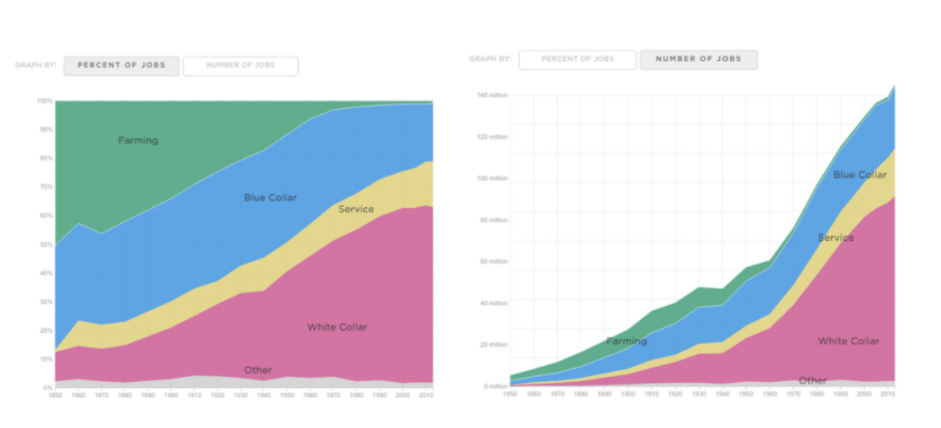
Present your data in a simple way…
Ref: https://www.import.io/post/8-fantastic-examples-of-data-storytelling/
Notes:
2nd trick… Combine what you can combine

Slide 7
About the audience…
2nd trick…Ask yourself who/where/when question.
Who is your audience?
Where is your audience?
When is your audience going to listen?

Slide 8
The who?

Slide 9
The where?

Slide 10
The when?

Slide 11
Once the key insight and the audience are set…
Identify the business value from the insight to that audience group.
The take home message?
The action you want from them?
Make the presentation specific for them
Notes:
departments in a manufacturing company about an upcoming new product should be tailored to the audience. Marketing wants to know the features that will help them sell the product. Finance wants to know the cost to make the product and whether customers will need credit options. Production wants to know the specifications so they can begin to integrate the product in the manufacturing process.
iPod in 2001. Steve Jobs knew users did not really care how many gigabytes they could store on their MP3 players. What they cared about was how many songs they could store. So Jobs told the audience that the iPod “puts a thousand songs in your pocket.”

Slide 12

Notes:
Evidence is important…

Slide 13
Use Deductive/Inductive Reasoning
Human make mistake… Data Scientist is human, therefore Data Scientist makes mistake.
Top-down leads to conclusion that is true
The blind men and the elephant…
Describe the data to support your logic

Slide 14
Is the conclusion… justified?

Slide 15
Beware of the Fallacies
If the patient is treated at the hospital, the claim should be sent automatically. The claim was not sent automatically, therefore the patient was not treated at the hospital.
Burden of Proof
A: This insurance policy will be a hit.
B: Can you prove it?
A: No one can disprove it.
Notes:
One or more of the premises can be shown to be false.➔ the claim can be sent many ways
The burden of proof lies with you not your audience

Slide 16
Do data visualization right, and win the day.

Slide 17
Take-home messages
Pick the key insights.
Don’t tell all data
Use data visualization in the story telling
Know the audience
Be concise and goal oriented.
Give evidence
Conclusion
Use logical reasoning to assist

