Slide 1
Data Visualization Information Visualization
By
ASKS Data Science Group

Slide 2
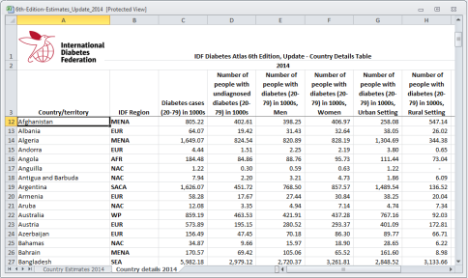
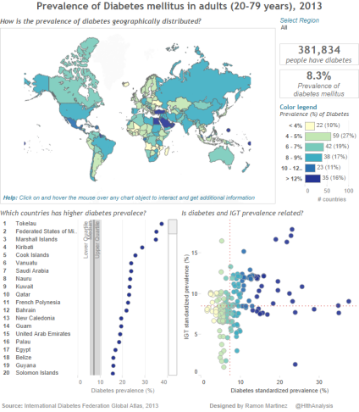
From Data
To Visualization
A meaningful data visualization is a result of a rigorous data analysis.
Ref: Ramon Martinez, “Visual Analytics”

Slide 3
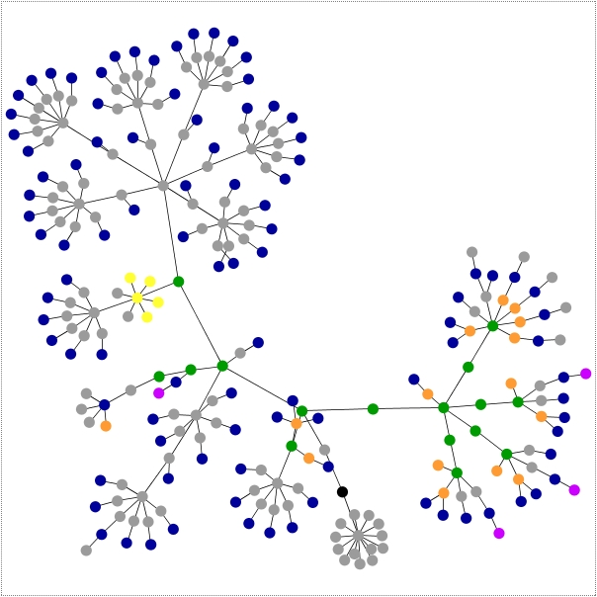
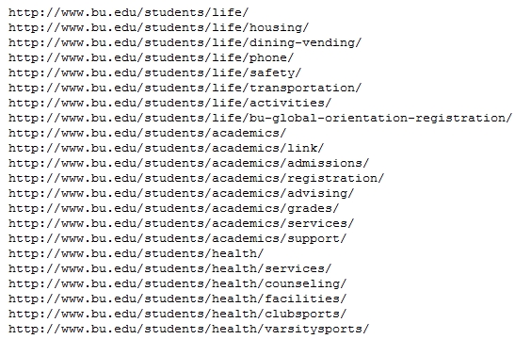
Information visualization
Visualization: converting raw data to a form that is viewable and understandable to humans.

Slide 4
Why data visualization?
Vision is by far our most powerful sense
There is an amazing connection between human visual sensors and the brain
Humans have an extraordinary visual capacity to detect patterns
To display data effectively we must understand a bit about Visual Perception
Ref: Ramon Martinez, “Visual Analytics”

Slide 5
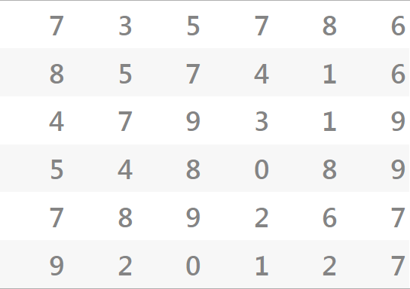
Visual perception
How many nines (9) are in this matrix?
Ref: Ramon Martinez, “Visual Analytics”

Slide 6
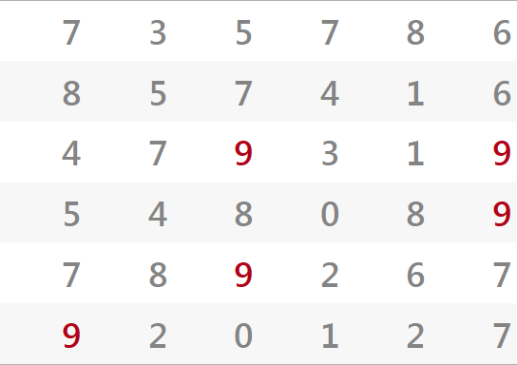
Visual perception
How many nines (9) are in this matrix?
Ref: Ramon Martinez, “Visual Analytics”

Slide 7
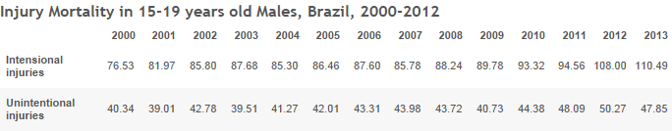
Visual perception
Can you see any pattern in this table?
Ref: Ramon Martinez, “Visual Analytics”

Slide 8
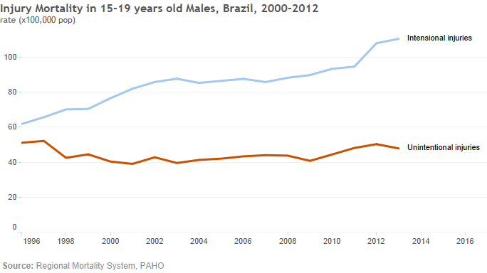
Visual perception
Can you see any pattern in this line graph?
Ref: Ramon Martinez, “Visual Analytics”

Slide 9
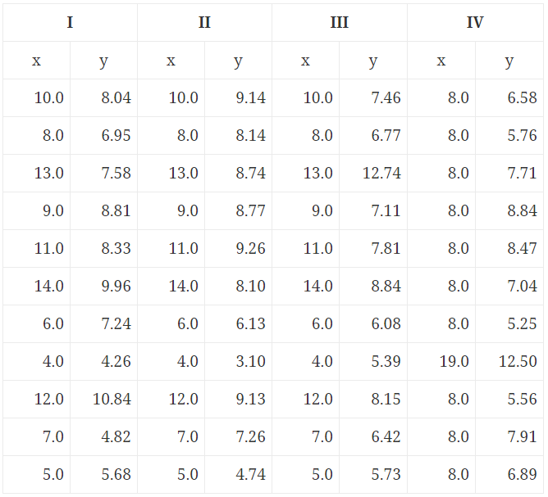
Statistics and Graphs
Anscombe’s Quartet
Four distinct datasets
Each with statistics properties that are essentially identical
Mean of x = 9.0
Mean of y = 7.5
Variance of x = 11
Variance of y = 4.13
Nearly identical correlation and regression line
Ref: Ramon Martinez, “Visual Analytics”
Notes:
In 1973, Francis J. Anscombe published a paper titled, Graphs in Statistical Analysis. The idea of using graphical methods had been established relatively recently by John Tukey, but there was evidently still a lot of skepticism. Anscombe first lists some notions that textbooks were “indoctrinating” people with, like the idea that “numerical calculations are exact, but graphs are rough.”
He then presents a table of numbers. It contains four distinct datasets (hence the name Anscombe’s Quartet), each with statistical properties that are essentially identical: the mean of the x values is 9.0, mean of y values is 7.5, they all have nearly identical variances, correlations, and regression lines (to at least two decimal places).

Slide 10
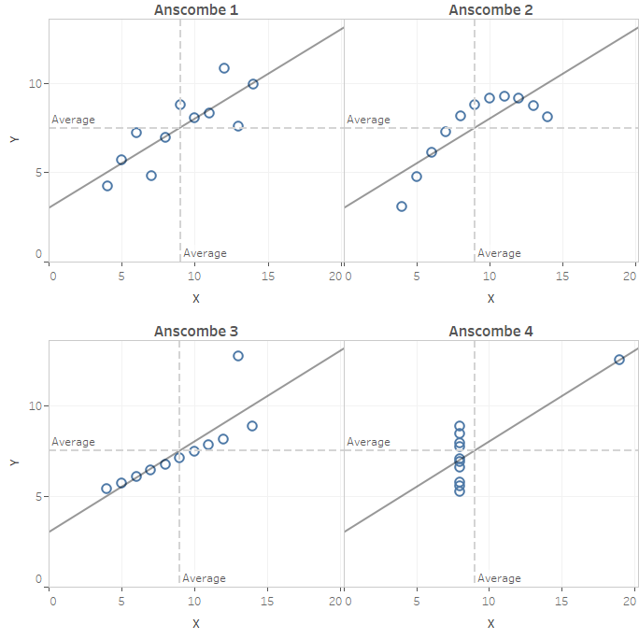
Statistics and Graphs
Anscombe’s Quartet
Four distinct datasets
Each with statistics properties that are essentially identical
But when plotted, they suddenly appear very different
Anscombe suggested the combined use of graphs and statistics methods in data analysis
Ref: Ramon Martinez, “Visual Analytics”

Slide 11
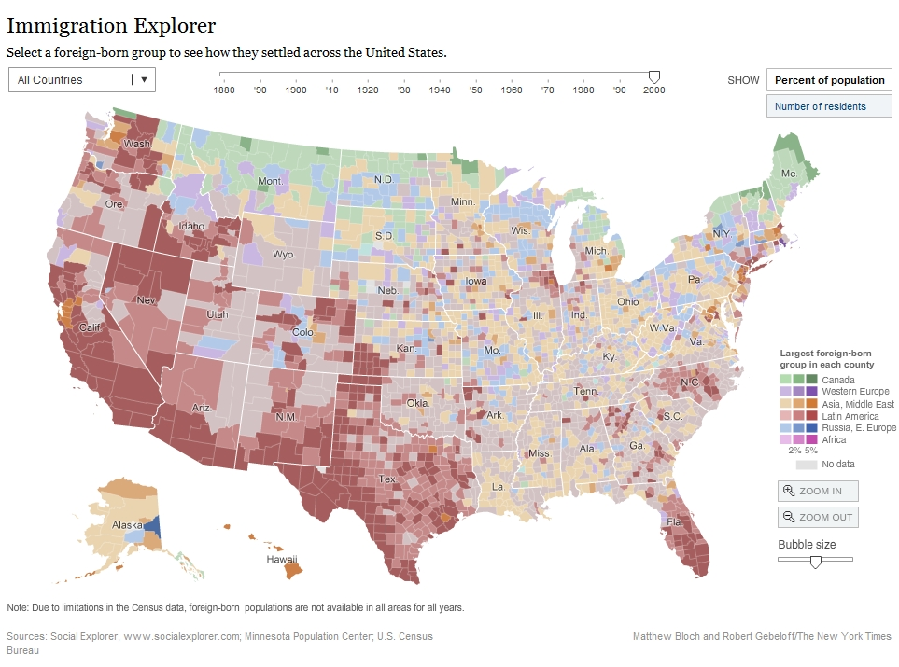
Examples: Spatial Data mapping
http://www.nytimes.com/interactive/2009/03/10/us/20090310-immigration-explorer.html
Notes:
11

Slide 12



Visual Analytics
Visual analytics is the science of analytical reasoning supported by interactive visual interfaces.
It encourages visual thinking by leveraging the powers of human perception
Visual Analytics methods allow people to combine:
+
human ﬂexibility, creativity, and background knowledge
IT capacities for data storage, processing, and visualization
=
to gain insight and make well-informed decisions in complex problems
Ref: Ramon Martinez, “Visual Analytics”
Notes:
Visual Analytics
Visual analytics is the science of analytical reasoning supported by interactive visual interfaces.
Visual Analytics methods allow people to combine human ﬂexibility, creativity, and background knowledge with today’s computers capacities for data storage and processing allowing them to gain insight and make well-informed decisions in complex problems.
the complex nature of any problem makes it indispensable to include human intelligence in the data analysis process.
human ﬂexibility, creativity, and background knowledge with the enormous storage and processing capacities of today’s computers to gain insight into complex problems.
Using advanced visual interfaces, humans may directly interact with the data analysis capabilities of today’s computer, allowing them to make well-informed decisions in complex situations.
Thomas, J., Cook, K.: Illuminating the Path: Research and Development Agenda for Visual Analytics. IEEE-Press (2005)

Slide 13
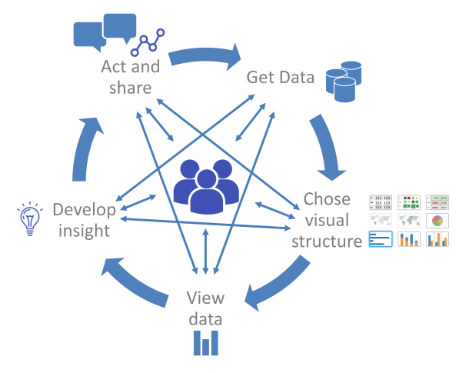
The Cycle of Visual Analytic
When people are exploring and analyzing data, they enter into an iterative and non-linear cycle of
data acquisition,
selection of visual structures
instantiate data views (graphs, visual forms)
analysis and synthesis, hypothesis building
sharing and re-examination
where at any point they may need to skip steps, back-up, seek additional data, or even start over.
Diagram adapted from the cycle of visual analytic diagram. Pat Hanrahan, Chris Stolte and Jock MacKinlay. Visual Analysis for Everyone. Whitepaper. Tableau Software, Inc., 2007 http://www.tableau.com/sites/default/files/whitepapers/visual-analysis-for-everyone.pdf
Ref: Ramon Martinez, “Visual Analytics”
Notes:
The creation and design of data visualization is an iterative and non-linear cycle of data acquisition, selection of visual structures and display of graphs (visual forms), analysis and synthesis, hypothesis building, sharing and re-examination

Slide 14
Data Analysis: Summary Stats vs. Data Exploration
Nathan Yau. Summary Statistics Tell You Little About the Big Picture. Flowing Data.
Available online: http://flowingdata.com/2017/07/07/small-summary-stats/
Notes:
Mean, median, and mode. These are the first things you learn about in your introductory statistics course. It’s often all you hear about when you see data in the news. People form policies for populations, based on the generalized numbers.
However, these summary statistics can only tell you so much about a dataset, which means you can only learn a limited amount about what the data represents — the people, places, and things.
If you’re the one who consumes the data, you should wonder what the means and medians actually represent. If you’re the one who analyzes the data, spend time with the most granular that time and resources allow for. Something more interesting will almost always come out of it.

Slide 15
What are the benefits of Data Visualization?
Show several different perspectives of the data.
Enable the interpretability on vast amounts of data
Identification of exceptions in the data.
Show visual patterns in the data.
Can explore trends within a database through visualization
Can navigate through data and visually orient themselves to the patterns in the data.

Slide 16
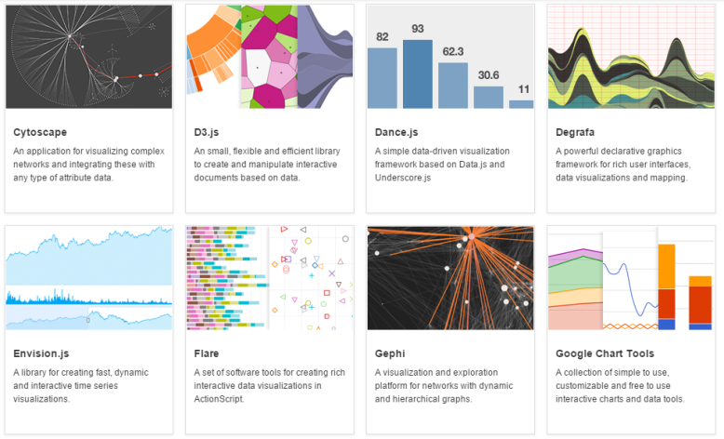
Data visualization tools
Ref: Ramon Martinez, “Visual Analytics”
There is a constellation of tools for visualizing data
DATAVISUALIZATION.CH selected tools: http://selection.datavisualization.ch/
Andy Kirk’s visualization resources: http://www.visualisingdata.com/resources/
Notes:
Selected Data Visualization Tools and Resources
DATAVISUALIZATION.CH selected tools: http://selection.datavisualization.ch/
Andy Kirk’s Visualization Resources: http://www.visualisingdata.com/resources/

Slide 17
Data visualization tools
Libraries
Libraries for adding charts and visualization capabilities to applications
Required programming or coding. Suitable for software developers
Use Programming Language directives to connect to data sources
Web-based tools
Visualization tools on the web
Easy to use, no programing required
Datasets should be upload. Suitable for small-medium datasets
Data Analytics and Visualization Platform
is an enterprise-class (complete) solution that provides the tools and methods for:
connect to most of the DBMS standards (SQL, Web services, local files, etc.)
to data exploration and visual analytics,
creation and design of data visualizations and dashboards, and
capability for team collaboration and content sharing, and dissemination
None or minimum programming required
Self-service approach, empower business users.
Ref: Ramon Martinez, “Visual Analytics”

Slide 18
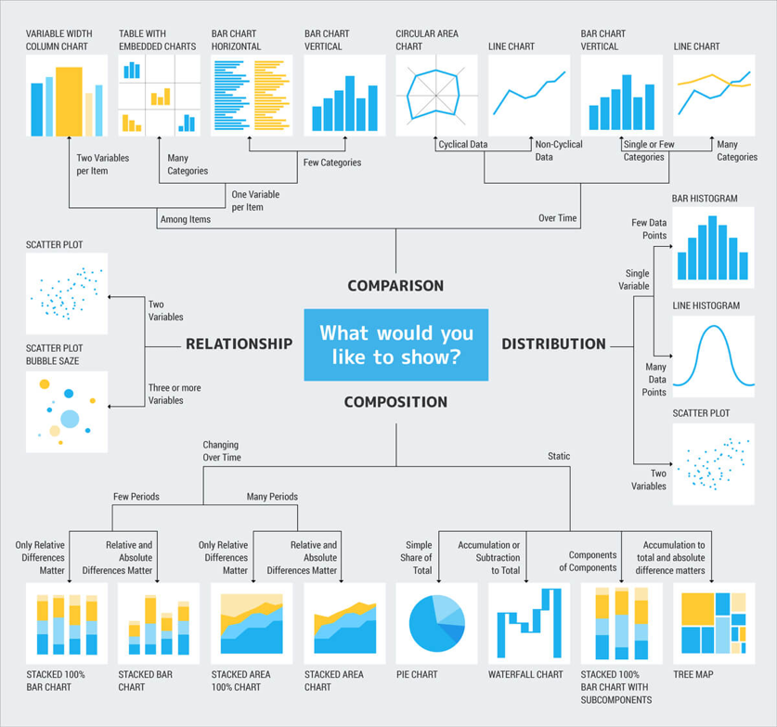
Ref: Crazy Egg,
crazyegg.com

Slide 19
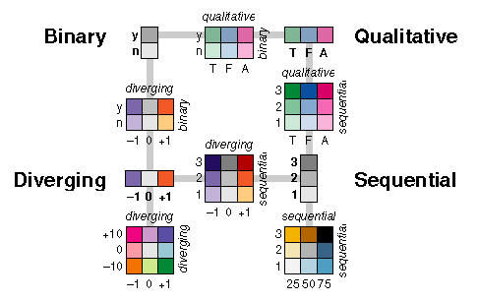
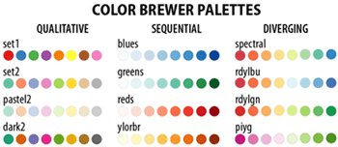
Rule of Thumb
Qualitative Do not use a perceived order color
Sequential Use a perceived order (The different in values should be uniform)
Diverging Two sequential palettes starting from a common color
Cynthia Brewer. Color Use Guidelines for mapping and Visualizations. Available online: http://www.personal.psu.edu/cab38/ColorSch/Schemes.html

Slide 20
Graph Design Principles
Show / emphasize the data
Maximize the data-ink ratio
Decluttering: erase non-data ink as much as possible.
Consider removing: Border, Grid lines, Background shading, Axis (if you plan on labeling the data points)
Erase redundant data ink
Use of color to add emphasis
Revise, iterate, edit and get feedback from others
Ref: Ramon Martinez, “Visual Analytics”

Slide 21
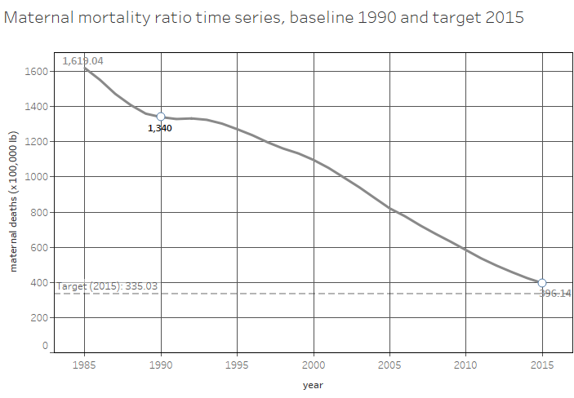
Line graph with lot of no-data ink
Ref: Ramon Martinez, “Visual Analytics”

Slide 22
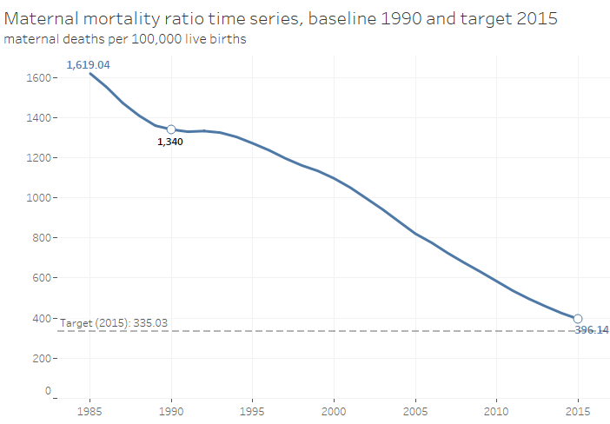
Enhancing data & removing no-data ink
Ref: Ramon Martinez, “Visual Analytics”

Slide 23
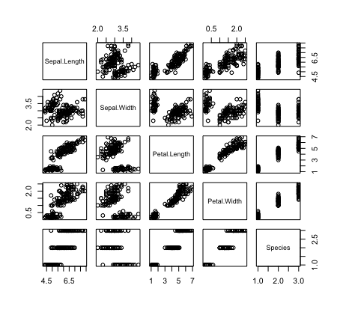
View the Correlation
What can you see?
Highly Correlated Features?
Many methods perform better if highly correlated attributes are removed.

Slide 24
Visualize High Dimensional Data
Can we visualize data with 100+ attributes?
Yes a few at a time.
We can also select only relevant features but we will look at it later
Can we look at all the features together?
Well… we are beings in 3D… so NO

Slide 25
Data Presentation
Univariate
Bivariate
Trivariate

Slide 26
Visualize High Dimensional Data
Can we visualize data with 100+ attributes?
Yes a few at a time.
We can also select only relevant features but we will look at it later
Can we look at all the features together?
Well… we are beings in 3D… so NO
What can we do?
Fear not Padawan… we have something called PCA and t-SNE

Slide 27
Data Mapping to Lower dimensions
Goal:
Given data in a high dimension space, project it into a (much) lower dimensional space while preserving as much information as possible.
Find the best planar projection of a 4D data
Find the best 10-D approximation of the 10⁴-D data.
To preserve information

Slide 28
PCA
Rotates multivariate dataset into a new configuration which is easier to interpret
Purposes
simplify data
look at relationships between variables
look at patterns of units

Slide 29
Applications
Examples:
How many unique “sub-sets” are in the sample?
How are they similar / different?
What are the underlying factors that influence the samples?
Which time / temporal trends are (anti)correlated?
Which measurements are needed to differentiate?
How to best present what is “interesting”?
Which “sub-set” does this new sample rightfully belong?
Uses:
Data Visualization
Data Reduction
Data Classification
Trend Analysis
Factor Analysis
Noise Reduction

Slide 30
Usages of PCA for Visualization

Slide 31
“Tracing Cattle Breeds with Principal Components Analysis Ancestry Informative SNPs”
Lewis et al
Goal: To trace the breed of unknown cattle samples.
Data: 30,000 Single Nucleotide Polymorphisms (SNPs) for 19 breeds (13 taurine, three zebu, and three hybrid breeds)
How?
Use PCA to select the subsets of SNPs that can perfectly reproduce population structure.
Create classification model based on the subsets to predict the cattle breed 100%

Slide 32
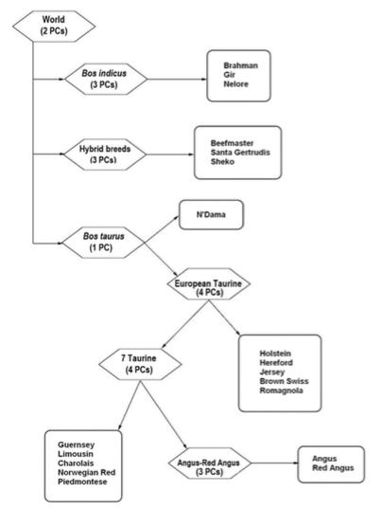

Slide 33
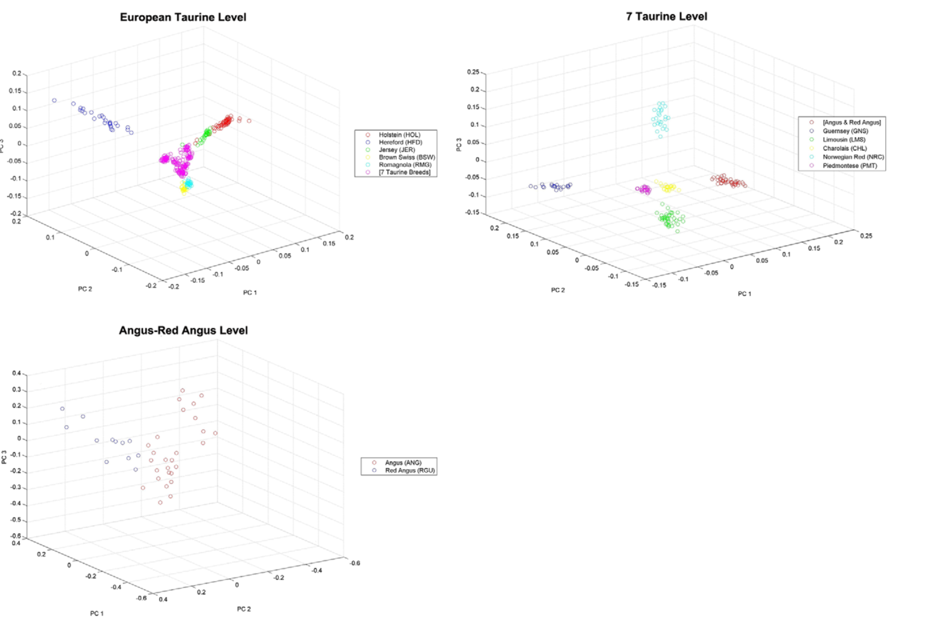

Slide 34
Limitations of PCA
PCA is not effective for some datasets.
For example, if the data is a set of strings
(1,0,0,0,…), (0,1,0,0…),…,(0,0,0,…,1) then the eigenvalues do not fall off as PCA requires.

Slide 35
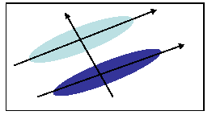
PCA and Discrimination
PCA may not find the best directions for discriminating between two classes.
Example: suppose the two classes have 2D Gaussian densities as ellipsoids.
1st eigenvector is best for representing the probabilities.
2nd eigenvector is best for discrimination.
Notes:
First eigenvector is best for representing the distribution on both data. Notice that first (and largest) eigenvector capture the largest variance of the data really well. But you won’t be able to distinct the two class using just one vector.

Slide 36
Data Visualization with Python

