Slide 1
Machine Learning for Data Science
By ASKS Data Science group
Ref: Majority of slides are from Jude Shavlik, Introduction to AI class

Slide 2
Overview
Machine Learning: Overview Task
Supervised Learning
Case Study

Slide 3
What is Machine Learning?

Slide 4
What type of questions can ML answer?
Supervised Learning
Is this of type X or Y?
A given claim is a fraudulent claim or not?
Is this of type A, B, C, or D?
A customer will want to buy the insurance plan A, B, C or D?
How Much / How Many?
How likely is this person to buy the insurance?
What will the second quarter of the insurance sale in the Northern region be?
What fraction of today’s flights will arrive on time?
How is the data organized?
Which customers like the same kind of insurance plan?
Which common behaviors of the leaving customer?
What is the relationship between variables?
If a customer bought insurance A, will the customer buy insurance B?
Unsupervised Learning

Slide 5
Real World

Slide 6
Practice
Will I buy your new insurance package?

Slide 7
Real World
Represent the problem using our own concepts
Feature Space

Slide 8
Practice
What are the features?
How many dimensions?
What are the values?

Slide 9
Real World
Represent the problem using our own concepts
Feature Space
Create a model to represent our data
Concepts/
Classes/
Decisions

Slide 10
Supervised Learning
Positive Examples
Negative Examples
Category of this example?
Notes:
Concept
Solid Red Circle in a (Regular?) Polygon
What about?
Figures on left side of page
Figures drawn before 5pm 2/2/89 <etc>

Slide 11
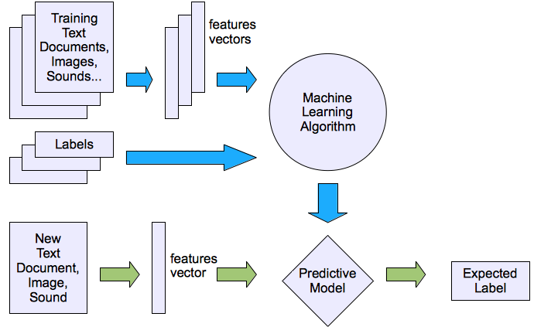
Machine learning structure
Supervised learning
Ref: Yi-Fan Chang, “An Overview of Machine Learning”

Slide 12
Learning with Data in Multiple Tables (Relational ML) – not covered in cs540
Previous Mammograms
Previous Blood Tests
Patients
Prev. Rx
Key challenge different amount of data for each patient

Slide 13
Where is the data? Where is the sample?
Getting Labeled Examples
Often ‘experts’ label
eg ‘books I like’ or ‘patients that should get drug X’
‘Time will tell’ concepts
wait a few weeks and see if the claim is frauden or not?
Use of Crowdsourcing
Need good representative examples, especially good ‘negative’ (counter) examples

Slide 14
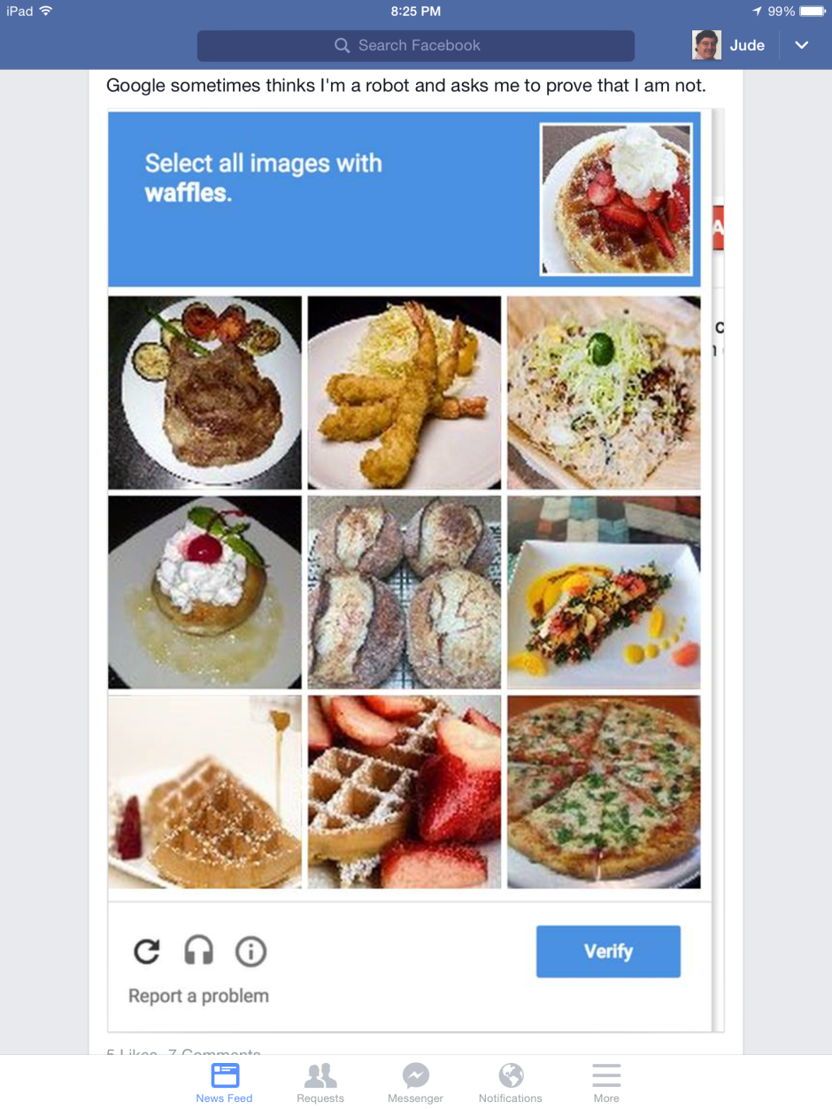
If it is Free, You are the Product
Google is using authentication (as a human) as a way to get labeled data for their ML algorithms!

Slide 15
IID and Other Assumptions
We are assuming examples are IID: independently identically distributed
We are ignoring temporal dependencies (covered in time-series learning)
We assume the ML algo has no say in which examples it gets (covered in active learning)
Data arrives in any order

Slide 16
Reminder: Concept Learning
Learning systems differ in how they represent concepts
Neural
Net
Backpropagation
ID3, C4.5, CART
Decision
Tree
Training
Examples
AQ, FOIL, Aleph
Φ ← X ∧ Y
Φ ← Z
Rules
.
.
.
Weighted Sum
SVMs
If 5x₁ + 9x₂ – 3x₃ > 12
Then +

Slide 17
Supervised Learning and Venn Diagrams
Venn Diagram
-
-
-
-
-
-
-
-
+
+
-
-
-
+
-
-
+
-
+
-
+
+
-
+
+
+
+
+
+
+
+
-
A
-
-
-
-
-
-
-
+
+
-
+
+
-
-
-
-
B
-
-
-
-
-
Feature Space
Concept = A or B (ie, a disjunctive concept)
Examples = labeled points in feature space
Concept = a label for regions of feat. space

Slide 18
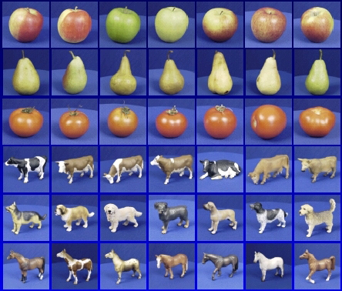

Generalization
Training set (labels known)
Test set (labels unknown)
How well does a learned model generalize from the data it was trained on to a new test set?
Ref: James Hays, “Machine Learning

Slide 19
Bias-variance tradeoff
Underfitting
Overfitting
Error
Test error
Training error
High Bias
Low Variance
Complexity
Low Bias
High Variance
Ref: James Hays, “Machine Learning

Slide 20
Bias-variance tradeoff
Few training examples
Test Error
Many training examples
High Bias
Low Variance
Complexity
Low Bias
High Variance
Ref: James Hays, “Machine Learning
Notes:
Note: these figures don’t work in pdf

Slide 21
Effect of Training Size
Fixed prediction model
Error
Testing
Generalization Error
Training
Number of Training Examples
Ref: James Hays, “Machine Learning

Slide 22
The perfect classification algorithm
Objective function: encodes the right loss for the problem
Parameterization: makes assumptions that fit the problem
Regularization: right level of regularization for amount of training data
Training algorithm: can find parameters that maximize objective on training set
Inference algorithm: can solve for objective function in evaluation
Ref: James Hays, “Machine Learning

Slide 23
Two ways to think about classifiers
What is the objective? What are the parameters? How are the parameters learned? How is the learning regularized? How is inference performed?
How is the data modeled? How is similarity defined? What is the shape of the boundary?
Ref: James Hays, “Machine Learning

Slide 24
Comparison
assuming x in {0 1}
Learning Objective
Training
Inference
Naïve Bayes
Logistic Regression
Gradient ascent
Linear SVM
Linear programming
Kernelized SVM
complicated to write
Quadratic programming
Nearest Neighbor
most similar features → same label
Record data
Ref: James Hays, “Machine Learning

Slide 25
What to remember about classifiers
No free lunch: machine learning algorithms are tools, not dogmas
Try simple classifiers first
Better to have smart features and simple classifiers than simple features and smart classifiers
Use increasingly powerful classifiers with more training data (bias-variance tradeoff)
Ref: James Hays, “Machine Learning

Slide 26
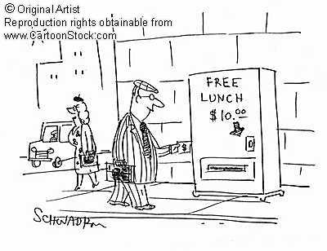
Remember…
No classifier is inherently better than any other: you need to make assumptions to generalize
Three kinds of error
Inherent: unavoidable
Bias: due to over-simplifications
Variance: due to inability to perfectly estimate parameters from limited data
Ref: James Hays, “Machine Learning
Notes:
You can only get generalization through assumptions.

Slide 27
Evaluation Methodologies
Ref: Jude Shavlik, Machine Learning Class

Slide 28
Learning from Examples: Standard Methodology for Evaluation
1) Start with a dataset of labeled examples
2) Randomly partition into N groups
3a) N times, combine N -1 groups into a train set
3b) Provide train set to learning system
3c) Measure accuracy on “left out” group (the test set)
Called N -fold cross validation (typically N =10)

Slide 29
Using Tuning Sets
Often, an ML system has to choose when to stop learning, select among alternative answers, etc.
One wants the model that produces the highest accuracy on future examples (“overfitting avoidance”)
It is a “cheat” to look at the test set while still learning
Better method
Set aside part of the training set
Measure performance on this “tuning” data to estimate future performance for a given set of parameters
Use best parameter settings, train with all training data (except test set) to estimate future performance on new examples

Slide 30
Experimental Methodology: A Pictorial Overview
collection of classified examples
training examples
testing examples
Statistical techniques such as 10-fold cross validation and t-tests are used to get meaningful results
train’ set
tune set
classifier
generate solutions
select best
LEARNER
expected accuracy on future examples

Slide 31
Parameter Setting
Notice that each train/test fold may get different parameter settings!
That’s fine (and proper)
I.e. , a “parameterless”* algorithm internally sets parameters for each data set it gets
* Usually, though, some parameters have to be externally fixed (e.g. knowledge of the data, range of parameter settings to try, etc)

Slide 32
Using Multiple Tuning Sets
Using a single tuning set can be unreliable predictor, plus some data “wasted” Hence, often the following is done:
1) For each possible set of parameters,
a) Divide training data into train’ and tune sets, using N-fold cross validation
b) Score this set of parameter value, average tune set accuracy
2) Use best set of parameter settings and all (train’ + tune) examples
3) Apply resulting model to test set

Slide 33
Choosing a Good N for CV (from Weiss & Kulikowski Textbook)
# of Examples
< 50
50 < ex’s < 100
> 100
Method
Instead, use Bootstrapping (B. Ephron) See “bagging” later in cs760
Leave-one-out (“Jack knife”)
N = size of data set
(leave out one example each time)
10-fold cross validation (CV), also useful for t-tests

Slide 34
What to Do for the FIELDED System?
Do not use any test sets
Instead only use tuning sets to determine good parameters
Test sets used to estimate future performance
You can report this estimate to your “customer,” then use all the data to retrain a “product” to give them

Slide 35
Doing Well by doing Poorly
You say: “Urrrgggg, my testset accuracy is only 0.1%” (on a two-category task)
I say: “Oh wow….That is great news!”
Why?
If you NEGATE your predictions, you’ll have 99.9% accuracy!

Slide 36
Doing Poorly by Doing Well
You say: “I have a great news….my testset accuracy is 98%” (on a two-category task)
I say: “That is bad news!”
Why might that be?
Because (let’s assume) the most common output value occurs 99% of the time!

Slide 37
Parameter Tuning (First Visit)
Algo: Collect K nearest neighbors, combine their outputs
What should K be?
It is problem (ie, testbed) dependent
Can use tuning sets to select good setting for K
Shouldn’t really
“connect the dots”
(Why?)
Tuning Set
Error Rate
2
3
4
5
K

Slide 38
Noise: Major Issue in ML
Worst Case of Noise
+, - at same point in feature space
Causes of Noise
Too few features (“hidden variables”) or too few possible values
Incorrectly reported/measured/judged feature values
Mis-classified instances

Slide 39
Noise - Major Issue in ML (cont.)
Overfitting
Producing an ‘awkward’ concept because of a few ‘noisy’ points
+ +
+
+ -
+
+ +
+
+ -
+
- -
- -
-
-
-
-
-
-
Bad performance on future ex’s?
Better performance?

Slide 40
How to reduce variance?
Choose a simpler classifier
Regularize the parameters
Get more training data
Ref: D. Hoiem
Notes:
The simpler classifier or regularization could increase bias and lead to more error.

Slide 41
Appendix: Various Classifiers
Ref: Taken from multiple machine learning classes (see source on slides)

Slide 42
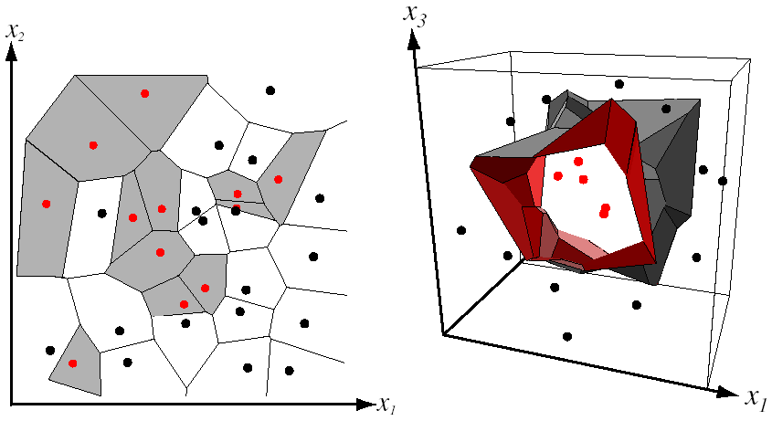
Nearest Neighbor Classifier
Assign label of nearest training data point to each test data point
from Duda et al.
Voronoi partitioning of feature space
for two-category 2D and 3D data
Source: D. Lowe

Slide 43
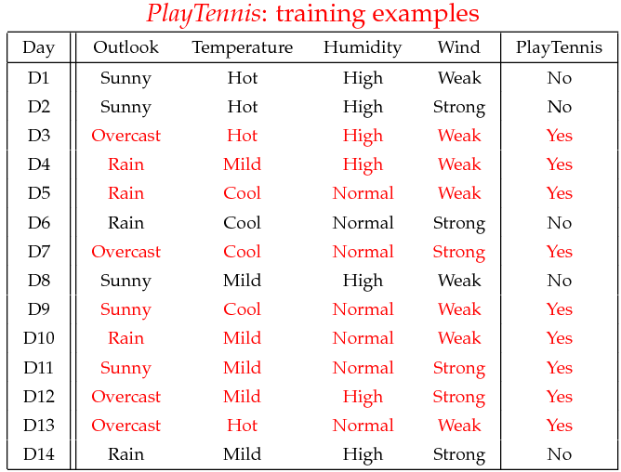
Example
Example: Play Tennis

Slide 44
Naïve Bayes (Probability Basics)
Prior, conditional and joint probability for random variables
Prior probability:
Conditional probability:
Joint probability:
Relationship:
Independence:
Bayesian Rule
Discriminative
Generative

Slide 45
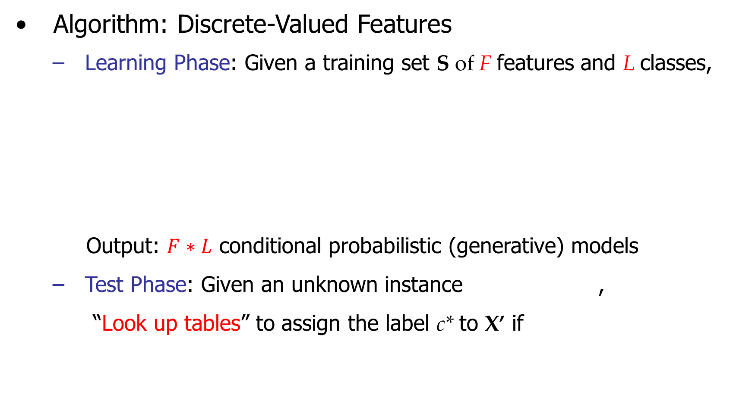
Naïve Bayes

Slide 46
Example
Learning Phase
Outlook | Play=Yes | Play=No
Sunny | 2/9 | 3/5
Overcast | 4/9 | 0/5
Rain | 3/9 | 2/5
Temperature | Play=Yes | Play=No
Hot | 2/9 | 2/5
Mild | 4/9 | 2/5
Cool | 3/9 | 1/5
Humidity | Play=Yes | Play=No
High | 3/9 | 4/5
Normal | 6/9 | 1/5
Wind | Play=Yes | Play=No
Strong | 3/9 | 3/5
Weak | 6/9 | 2/5
P(Play=Yes) = 9/14
P(Play=No) = 5/14

Slide 47
Example
Test Phase
Given a new instance, predict its label
x’=(Outlook=Sunny, Temperature=Cool, Humidity=High, Wind=Strong)
Look up tables achieved in the learning phrase
Decision making with the MAP rule
P(Outlook=Sunny|Play=Yes) = 2/9
P(Temperature=Cool|Play=Yes) = 3/9
P(Huminity=High|Play=Yes) = 3/9
P(Wind=Strong|Play=Yes) = 3/9
P(Play=Yes) = 9/14
P(Outlook=Sunny|Play=No) = 3/5
P(Temperature=Cool|Play==No) = 1/5
P(Huminity=High|Play=No) = 4/5
P(Wind=Strong|Play=No) = 3/5
P(Play=No) = 5/14
P(Yes|x’) ≈ [P(Sunny|Yes)P(Cool|Yes)P(High|Yes)P(Strong|Yes)]P(Play=Yes) = 0.0053
P(No|x’) ≈ [P(Sunny|No) P(Cool|No)P(High|No)P(Strong|No)]P(Play=No) = 0.0206
Given the fact P(Yes|x’) < P(No|x’), we label x’ to be “No”.

Slide 48
Classifiers: Logistic Regression
Maximize likelihood of label given data, assuming a log-linear model
x
x
x
x
x
x
male
o
x
x
o
o
Height
o
female
o
x2
x1
Pitch of voice
Ref: James Hays, “Machine Learning

Slide 49
Using Logistic Regression
Quick, simple classifier (try it first)
Outputs a probabilistic label confidence
Use L2 or L1 regularization
L1 does feature selection and is robust to irrelevant features but slower to train

Slide 50
Classifiers: Linear SVM
x
x
x
x
x
x
o
x
x
o
o
o
o
x2
x1
Find a linear function to separate the classes:
f(x) = sgn(w ⋅ x + b)
Ref: James Hays, “Machine Learning

Slide 51
Classifiers: Linear SVM
x
x
x
x
x
x
o
x
x
o
o
o
o
x2
x1
Find a linear function to separate the classes:
f(x) = sgn(w ⋅ x + b)
Ref: James Hays, “Machine Learning
Notes:
Maximizes a margin

Slide 52
Classifiers: Linear SVM
x
x
x
o
x
x
x
o
x
x
o
o
o
o
x2
x1
Find a linear function to separate the classes:
f(x) = sgn(w ⋅ x + b)
Ref: James Hays, “Machine Learning

Slide 53
Nonlinear SVMs
Datasets that are linearly separable work out great:
But what if the dataset is just too hard?
We can map it to a higher-dimensional space:
0
x
0
x
x²
0
x
Ref: James Hays, “Machine Learning

Slide 54
Nonlinear SVMs
General idea: the original input space can always be mapped to some higher-dimensional feature space where the training set is separable:
Φ: x → φ(x)
Ref: James Hays, “Machine Learning

Slide 55
Classifiers: Decision Trees
x
x
x
o
Protocol
x
x
x
o
x
o
x
TCP
ICMP
o
o
UDP
o
2 Yes/ 3 No
3 Yes/ 2 No
4 Yes/ 0 No
o
x2
Service
Flag
x1
ssh
telnet
SF- 3 Yes
SF- 0
No

Slide 56
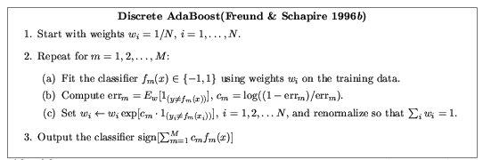
Ensemble Methods: Boosting
Ref: James Hays, “Machine Learning

Slide 57
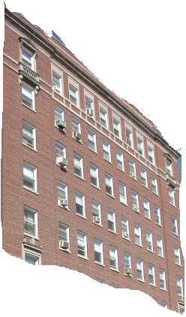
Boosted Decision Trees
High in
Image?
Gray?
Yes
No
Yes
No
Smooth?
Green?
High in
Image?
Many Long
Lines?
…
Yes
No
Yes
No
Yes
No
Yes
No
Blue?
Very High
Vanishing
Point?
Yes
No
Yes
No
Ground Vertical Sky
P(label | good segment, data)
Ref: James Hays, “Machine Learning

Slide 58
Case Study on Jupyter Notebook

