Slide 1


Jdon Framework 6.8
Domain-Driven Design Framework for Java

Slide 2

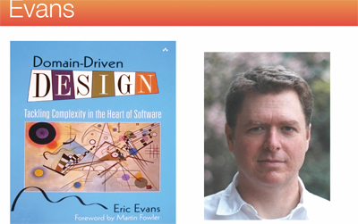
Evans DDD

Slide 3
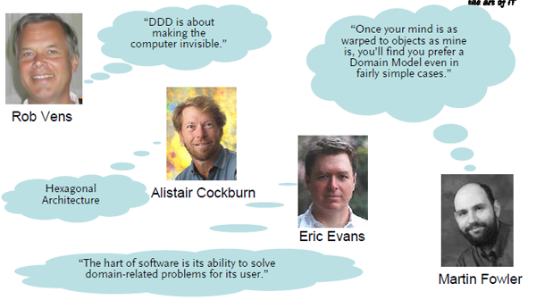
About DDD

Slide 4
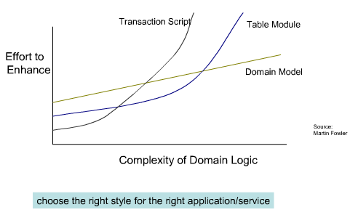
DDD Benefits

Slide 5
Jdon Framework (JF)
a light-weight framework for developing Domain-Driven Design applications.
Jdon introduces reactive event-driven into domain.
Help you develop a asynchronous concurrency and higher throughput application

Slide 6
Why Jdon
Differnce with Spring framework, Jdon framework is a event-driven framework.
Event vs. Request/Response
A command activates a Aggregate Root's method by disruptor's single thread, and it will react a event again, here both them are nonblocking and asynchronous.

Slide 7
Traditional scenarios
One request use a thread from Controller of MVC to Service to DAO(saving data to database) and the return response.
If in this long process there is a "synchronized" or a lock(even Optimistic lock), all other operations in this thread will be blocked.
That is a traditional performance bottleneck

Slide 8
Jdon Revolution
Jdon moves mutable state from database to memory, and uses Aggregate Root to guard it.
Singel write pricinple vs. synchronized /ACID/JTA/Optimistic lock
Only send a Command or Event to drive Aggregate Root to change its mutable state by its behaviours.

Slide 9
Jdon Revolution
if you worry about im-memory state will lost when power off, you can in the meantime send a domain event(another thread) to persiste the state or this event that lead up to that state
the domain event not blocks your state modification. you can have high throughput and lower latency.

Slide 10
What is Jdon?
Domain layer framework for DDD.
Domain container for running DDD application.

Slide 11
Popluar architecture
Frontend/Client
MVC(Angular.js) or Mobile application(IOS, Android)
Backend/Server
REST + Domain(micro-service + Aggregate)
Jdon is the Domain Container.

Slide 12
Three basic components
@Model : Aggregate Root Entity Model
@Service : Micro service or DDD service
@Component: Normal components.

Slide 13
AOP components
@Interceptor: AOP’s Interceptor
@Introduce: Advisor

Slide 14
@Model in-memory
@Model
public class MyModel {
private String userId;
private String name;
....
}
Only one instance of class MyModel will be loaded in-memory cache by Repository. Next all operations will focus this instance.

Slide 15
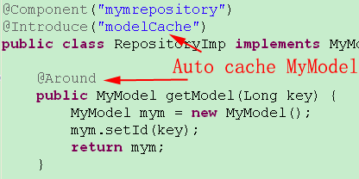
Loading Model from Repository
@Introduce(“modelCache”) must be annotated in repository class
@Around must be annotated on the loading method.
GitHub Source code

Slide 16
Communication Model
1. Prodcuer-Consumer
2. asynchronous concurrency nonblocking
@send : Producer method
@Consumer: Consumer class
@OnEvent: Consumer method.

Slide 17
Four Communications
1. @Component -----> @model
2. @model ------->@Component
3. @Compponent ------> @Component
4. @model------> @model

Slide 18
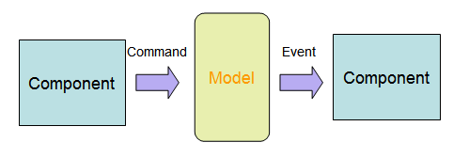
Command and Domain Events

Slide 19
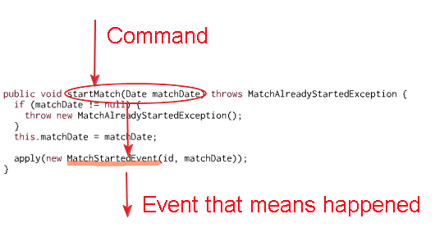
Command and Domain Events

Slide 20
Single Writer Principle
Disruptor
Queue
Domain Model
Aggregate root
@Model
Command
Single thread
Producer
@Component
@Service

Slide 21
Communications principle
Powered by disruptor from LMAX
Can handle 6 million orders per second on a single thread
recommended by Martin Fowler.

Slide 22
What is Domain Events
Events that happened in the domain.
captures the essence of business domains while staying decoupled from platform complexity or hard performance issues.
No Block concurrent, No Lock ,so fast. fit for multi-core.
Storage Ignorance ,Flexibility, Messaging Capabilities, Scalable.

Slide 23
One Command =>Many Events
Component architecture
async
Message
Persistence
@Consumer
GUI
MVC
Client
Domain Model
@Model
Command
async
Message
async
Message
Logging
@Consumer
Other Components
@Componet

Slide 24
One Command=>one Domain Event
Domain Model
Aggregate root
@Model
Producer
@Component
Command
Consumer
@Consumer
@Component
Domain Events
Command
Domain Model
Aggregate root
@Model

Slide 25
Domain Events is basic for CQRS
User interface
Commands
Query/
Reporting
Service
Commands
Domain
Events
Infrastructure
Event/Message BUS

Slide 26
How Domain Events work?
Disruptor
Or
Java
concurrent
Future
Domain Events
Consumer
@Consumer
@Component
Domain Model
Aggregate root
@Model

Slide 27
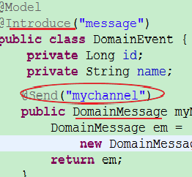
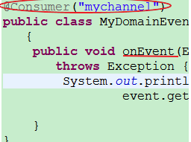
Event principle
@Send("mychannel") will push the DomainMessage into the Queue, And the consumer will fetch it from the Queue.
Queue
Mychannel
Powered by Ringbuffer

Slide 28
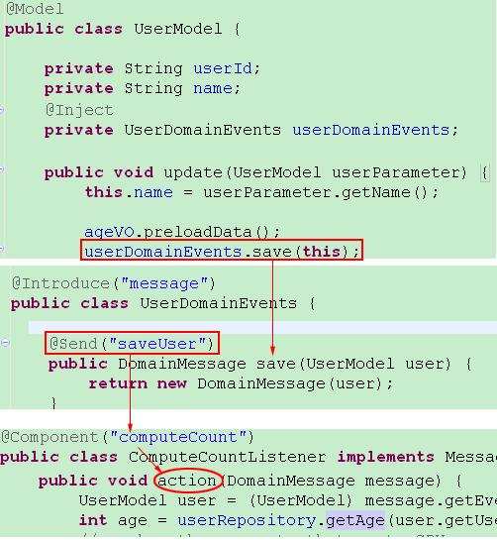
@Model =>@Component Example

Slide 29
Producer
@Model or @Service/@Component can be a Producer.
When a Component/Service sends messages to a Domain Model(aggregate root), that is a command,
When a domain model sends message to a Component, that is a event

Slide 30
Consumer
@Model cann’t be a Consumer
Only @Component can be a Consumer.
Two kinds of consumers:
@Consumer is for a class.
@OnEvent is for method of any @Component
If there are several consumers, action’s order is by the alphabetical of class name:AEventHandler => BEventHandler => CEvent…

Slide 31
Consumer return a result
If you want to return a result in consumer, you can set the result object into the DomainMessage of the event in DomainEventHandler :
void onEvent(EventDisruptor event, boolean endOfBatch) throws Exception {
//return the result “eventMessage=hello”
event.getDomainMessage().setEventResult("eventMessage=" + myModel.getId());
}

Slide 32
How to get the result?
If a consumer return a result, that is a asynchronous.
event.getDomainMessage(). getEventResult()
First times, maybe you can’t fetch it.
Second times You can get it.
You can call block method to fetch it a blocking way, this is :
event.getDomainMessage(). getBlockEventResult()

Slide 33
The benefits of @Consumer
Atomic;
separates a transaction into single event process, that is event stream.
Asynchronous
saving datas to DB or Lucene is high load, we can implement them with two EventHandlers by different latency.

Slide 34
Domain Events(DE) apply in JEE
Service
Tech.
Architecture
boundary
VO
Domain Events
Root Entity
Entity
boundary
Domain Events
Root Entity

Slide 35
Domain Events Pattern
Loose Coupling
business logic is separate from technology architecture. decouple "What" From "How"
Event-driven Architecture
asynchronous event-driven architectures
Asynchronous Lazy-load
like lazy evaluation of functional language .
True Scalability
Scale out on multi-core or multiple nodes using asynchronous message passing ( JMS).

Slide 36
Example 1: Concurrency pattern
No domain events codes： CPU killer:
public int getMessageCount(){
int messageCount = xxxx; // complex computing, high CPU usage, CPU killer
return messageCount;
}
Domain events can pre-load or pre-run the complex computing:
public int getMessageCount(DomainEvents domainEvents) {
if (messageCount == -1) {
if (messageCountAsyncResult == null) {
messageCountAsyncResult =
domainEvents.computeCount(account.getUserIdLong());
} else {
messageCount = (Integer)
messageCountAsyncResult.getEventResult();
}
}
return messageCount;
}

Slide 37
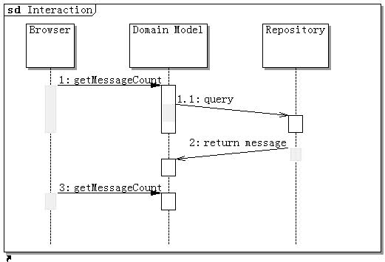
Example 2
Asynchronous Lazy load
1. invoking ‘getMessageCount’ will send a message to ‘computeCount’ of Repository by domainEvents.
2. again invoking ‘getMessageCount’ will return last step result.(such as by AJAX )
Download Sample Source

Slide 38
Lazy initialization/Lazy evaluation
On demand load or init a object from DB.
functions are not evaluated until their results are needed
no Hibernate LazyInitializationExceptions
no Open Session in View anti-pattern

Slide 39
Scale to distributed system
Distributed Cache
Persistence
Domain
Model
JMS
MQ
ZeroQ
RabbitMQ
Message
Send Email
Domain
Model
Message
Other Services
Distributed Cache

Slide 40
Events Challenge
Most programmers are good at a synchronous mode that be executed sequentially in a thread.
Events is a non-blocking concurrent programming mode, that maybe is harder to most people.
if domain business need be executed sequentially , so we can do it by domain events too.

Slide 41
Blocking problem
In a blocking system, wait thread is idle but continue to consume system resources.
This will very costs resource, for high transaction volume:
the number of idle threads =(arrival_rate * processing_time)
the result can be a very big number if the arrival_rate is high.
Blocking system is running under a very ineffective mode. No high throughout, no high CPU load.

Slide 42
Non-Blocking concurrent
Make a call which returns a result. don't need to use the result until at a much later stage of your process.
don't need to wait immediately after making the call, instead you can proceed to do other things until you reach the point where you need to use the result.
the call itself will return a "future" handle immediately. The caller can go off doing other things and later poll the "future" handle to see if the response if ready.

Slide 43
JdonFramework
Non-Blocking concurrent
Domain Model sends events to another thread(a consumer) by RingBuffer in Disruptor, so threads can communicates through events.
After consumer done, it will put the result in another RingBuffer that publisher can read or blocking read it, decided by business is or not executed sequentially.

Slide 44
Higher abstract of concurrent
Non-Blocking’s concurrent programming is complex.
How to develop a concurrent app. easily?
Like Actor Model
is like domain events, messages are sent asynchronously and non-blocking in a “fire-and-forget” manner. But LMAX team of the Disruptor thinks Actor model has bottleneck.
DCI Architecture
DCI is easy to be understood. It’s abstract level is high than domain events.

Slide 45
DCI
DCI: Data, Context, Interactions is a programming paradigm invented by Trygve Reenskaug.
keep our core model classes very thin.
logic/behaviour should be kept in roles.
Domain Events is a Interactions, Events Producer is the Role.

Slide 46
Model Injection
JdonFramework can inject Domain Events into domain model at runtime, this is maybe like Mixin.
Domain Events is Interactions of Roles, so Roles are then assigned(Injected) to data objects at runtime, only when required within given Context.

Slide 47
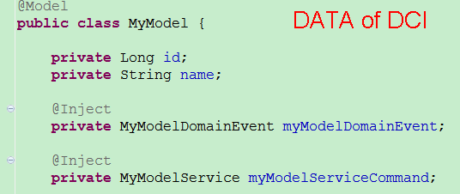
DCI ：Data
Domain Model is the DATA of DCI, no logic no behaviour.
Source: com.jdon.sample.test.domain.simplecase.MyModel

Slide 48
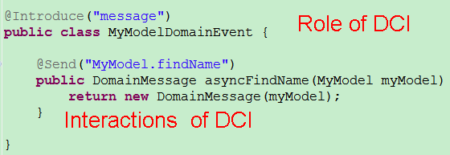
DCI : Role and Interactions
This is a Role of DCI，it includes the interactions of DCI. It is event producer
Source:com.jdon.sample.test.domain.simplecase.MyModelDomainEvent

Slide 49
DCI ： Context
In Context,The Role will be injected into the data.
//after fetching the myModel object, it has been injected events
MyModel myModel = repository.getModel(new Long(100));
// call myModel’s events
myModel .myModelDomainEvent.asyncFindName(this);

Slide 50
com.jdon.domain.dci.RoleAssigner
com.jdon.domain.dci.RoleAssigner is a Role assigner that can inject(Mixin) any interface into a data model.
When using RoleAssigner, it is not necessary that fetch a object of data model by a repository annotated with @Introduce("modelCache") and its get method with @Around

Slide 51
Different DCI styles
If we already hold on a model object, we can implements various functions by its domain events,such as modify/update a model.
Otherwise:
We create a context, and there we inject events or functions into a new model object by RoleAssigner,such as create or delete a model.

Slide 52
@Model
Context
RoleAssigner
client
inject
Create
Mixin
@Component
@Component
@Component
@Model
client
@Component
Modify
Event

Slide 53
concurrent programming is easy
Jdonframework makes an exploratory to promote non-blocking concurrent programming paradigm .
DCI and Domain Events are different abstract levels based concurrent programming .
DCI and UML colors analysis method can successfully docking, it is the highest level of abstraction of business-oriented.
Help most programmers quietly going to the way of non-blocking concurrent programming when they thinking in DDD.

Slide 54
DI and AOP
Dependency Injection(DI or IOC)
@Service or @Component can inject with each other by class construction(not supports setter injection).
@Service or @Component can be inected into @Model or by domain events.
Aspect-oriented programming(AOP)
with annotation @Introduce:
@Service or @Component can introduce each others as its interceptor. @Model can introduce any POJO or @Component as its interceptor.

Slide 55
@Model mechanism
Cache In-memeory
Inject proxy of c
C
A
@Model
Client
xx.getA(“a”)
interceptor
Inject proxy of B
Component
In Context
Container
Interceptor for B
with @Introduce
B that need
implements interface
and has @Introduce
Interceptor for A
with @Introduce

Slide 56
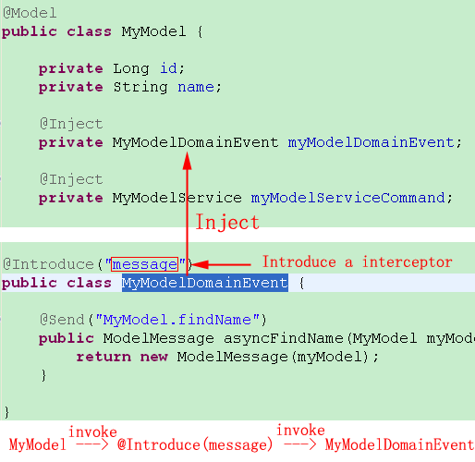
Inject a interceptor in @Model

Slide 57
Living space
@Model lives in cache that default is Guava Cache.
@Component/@Service lives in a context such as servletcontext.
All @Component can be injected into @Model.

Slide 58
@Component mechanism
Context container (ServletContext)
A
@Service
Client
xx.getA(“a”)
Inject proxy of B
Interceptor for B
with @Introduce
B that need
implements interface
@Component
Interceptor
(poincut=service)

Slide 59
@Service/@Component
@Service("testService")
public class TestServicePOJOImp implements TestService{
private final UserRepository userRepository;
public TestServicePOJOImp(UserRepository userRepository) {
this.userRepository = userRepository;
}
}
@Component()
public class UserRepository {
….
}
Difference between @Service and @Component is that the @Service class must have a interface then can be called by outside client beyond jdon.

Slide 60
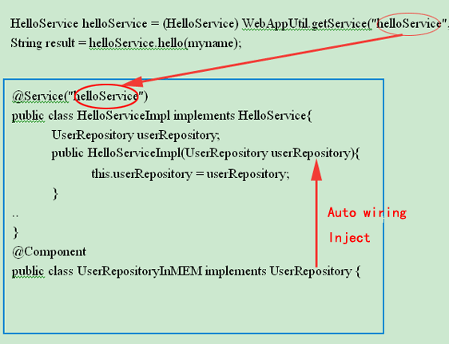
@Service
@Service expose to the client, has several kind instances: singleton , prototype or pool that have them annotations, default is prototype(spring default is singleton )。

Slide 61
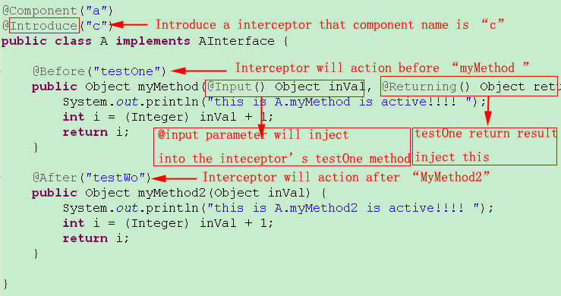
AOP: @Introduce mechanism

Slide 62
In-Memory Model
When a domain model object with @Model is fetch from repository, we need use @Introduce(“modelCache”) to mak the object live in memory.
There are two cache interceptors existed before and after domain layer.
Domain events need annotation @Introduce(“modelCache”) in the place that domain model objects are created or reconstructed from persistence or other systems.

Slide 63
JdonFramework Cache
Domain
Persistence
Presentation
DomainCacheInteceptor
@Introduce(“modelCache”)
CacheInterceptor
In aspect.xml

Slide 64
in memeory model
@Introduce(“modelCache”) must be annotated in
the reposotory that @Model objects are created or reconstructed This step is very important for domain events working

Slide 65
What happeded in memeory?
First times invoke “getModel” method of RepositoryImp, jdon will do two things:
One: put the return value(model) in cache. So next times can get it from cache.
Two: inject domain events into this model.
Next times, invoke the method again, we will get the model only one instance from cache.

Slide 66
Start jdonFramework in WEB
If all is annotation, no jdonframework.xml, no need this step
Configuration in Web.xml:
<context-param>
<param-name> modelmapping-config </param-name>
<param-value> jdonframework.xml </param-value>
</context-param>
<listener>
<listener-class>com.jdon.container.startup.ServletContainerListener</listener-class>
</listener>

Slide 67
How to use in application
AppUtil appUtil = new AppUtil();
// xxx is value of @Service(“xxx”) annotation on class.
XXXService xxxService = appUtil.getService(“xxx”);
xxxService.method();
If there is jdonframework.xml:
AppUtil appUtil = new AppUtil("com.jdon.jdonframework.xml");

Slide 68
Other features in JdonAccessory
Rapid development, template toolkit. JDBC template
Eliminate “Controller/Action” ,No controller code of MVC (only supports Struts 1.x)
Batch Query, auto pagination。

Slide 69
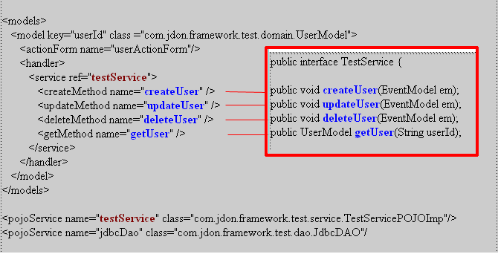
MVC Controller configuration in jdonframework.xml(struts1.x)

Slide 70
Jdonframework MVC(struts1.x)
ActionForm
Model
Controller
Jdonframework.xml
View
Service
View

Slide 71
Batch Query in jdon-jdbcTemp.jar
Cache supports.
Auto pagination.
In presentation layer:
extends com.jdon.strutsutil.ModelListAction
in persistence layer:
call getDatas of com.jdon.controller.model.PageIterator

Slide 72
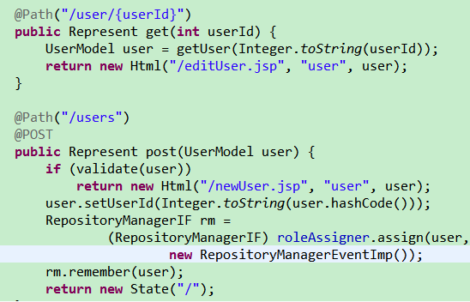
REST in JdonMVC

Slide 73
More details
JdonMVC REST for JdonFramework
Jivejdon (Medium-sized BBS / Forum software with JdonFramework)
http://sourceforge.net/projects/jdon/files/jivejdon/4.x/
Jdon on Github

