Slide 1


Jdon Framework 6.5
Domain-Driven Design Framework for Java
http://www.jdon.org/
10/2011

Slide 2

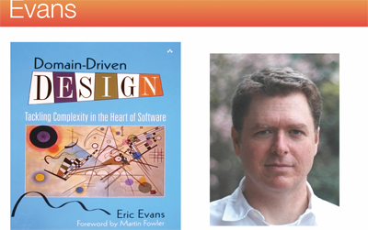
Evans DDD

Slide 3
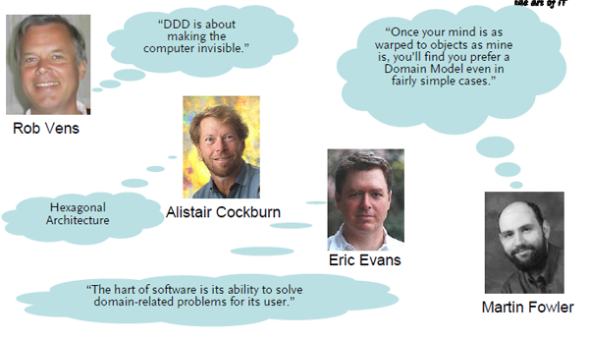
About DDD

Slide 4
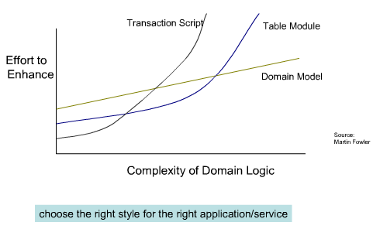
DDD Benefits

Slide 5
Jdon Framework (JF)
Domain model + In-memory + Events ;
DDD + DCI + Domain Events or Event Sourcing or CQRS
IOC or Dependency injection (DI) container
AOP interceptor;
a light-weight framework for developing Domain-Driven Design applications in the spirit of Evans。

Slide 6
Feature
Domain model is like DNA.
Domain models drive the technical components to finish the business logics,
Jdon framework make domain model easy to living in memory of a software system.
Jdon framework makes our software systems more scalable, and be better performance.

Slide 7
5 component models in JF
1. Entity Model with @Model;
2. Service with @ Service;
3. Component with @Component;
4. Prodcuer-Consumer mode with @send @Consumer;
5. Interceptor with @ Interceptor, need with @Introduce;
All in com.jdon.annotation.*

Slide 8
@Model in-memory
@Model
public class MyModel {
private String userId;
private String name;
....
}
A class with @Model will live in memory, default is Cache (Ehcache). Or Key-value store others.

Slide 9
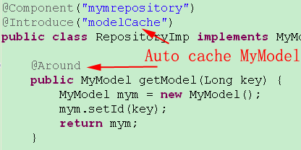
enable model in memeory
@Introduce(“modelCache”) must be annotated in
Repository that @Model objects are fetched or reconstructed This step is very important for domain events working
Source:com.jdon.sample.test.domain.onecase.repository.RepositoryImp

Slide 10
Event-driven or Event Sourcing
How does @Model drive @Component/@Service or Repository?
How does @Model communicate with each other?
That is Domain Events. Also is Event Sourcing.

Slide 11
Why Event Sourcing
captures the essence of business domains while staying decoupled from platform complexity or hard performance issues.
No Block concurrent, No Lock ,so fast. fit for multi-core.
Storage Ignorance ,Flexibility, Messaging Capabilities, Scalable.

Slide 12
Domain Model + Event
Component architecture
async
Message
Persistence
@Consumer
GUI
MVC
Client
Domain Model
@Model
async
Message
async
Message
Logging
@Consumer
Other Components
@Componet

Slide 13
It is CQRS
User interface
Commands
Query/
Reporting
Service
Commands
Domain
Events
Infrastructure
Event/Message BUS

Slide 14
Domain Events type
Producer-Consumer or Publisher-Subscriber patterns; Asynchronous; topic or queue (1:N or 1:1) ;
@Send(topicName) => @Consumer(topicName);
this mode is powered by disruptor that can handle 6 million orders per second on a single thread in LMAX recommended by Martin Fowler.
@Send(topicName) =>@Component(topicName);
This mode is powered by JDK FurtureTask.

Slide 15
How Domain Events work?
Disruptor
Or
Java
concurrent
Future
Domain Message
Pool.run
Consumer
@Consumer
@Component
Domain Model
@Model

Slide 16
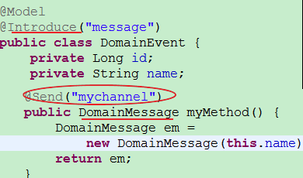
Domain Events: Step 1
(1) . annotate producer class with @Model and @Introduce("message")
(2) . annotate the method with @Send("mytopic") of the producer class
Source :com.jdon.sample.test.domain.onecase.DomainEvent

Slide 17
Domain Events: Step 1
@Introduce(“message”)："message" is the om.jdon.domain.message.MessageInterceptor configured in aspect.xml
It means introducing a MessageInterceptor for this class.
@ Send("mytopic"): "mytopic" is your topic name that equals to the "mytopic" in @Consumer("mytopic");
In this method, you must marshal your data into a DomainMessag that can be unmarshal in consumers.

Slide 18
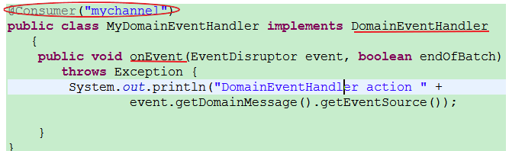
Domain Events: Step 2
(1) . annotate consumer class with@Consumer("mytopic");
(2). the consumer class need implement
com.jdon.domain.message.DomainEventHandler
Source:com.jdon.sample.test.domain.onecase.MyDomainEventHandler

Slide 19
Consumer
In topic model, action order is in alphabetical by the class name of @Consumer.
AEventHandler is before BEventHandler is before CEvent…
You can get the data by event.getDomainMessage() that producer set in its @Send method.

Slide 20
Consumer return the result
If you return the result, you can set the result into the DomainMessage of the event in DomainEventHandler :
void onEvent(EventDisruptor event, boolean endOfBatch) throws Exception {
//return the result “eventMessage=hello”
event.getDomainMessage().setEventResult("eventMessage=" + myModel.getId());
}

Slide 21
Domain Events Client
Client can be not only Servlet or Jsp or other WebFramework, but also can be a Java Application.
//init jdonframework
ContainerSetupScript css = new ContainerSetupScript();
css.prepare("com.jdon.jdonframework.xml", da);
AppUtil appUtill = new AppUtil("com.jdon.jdonframework.xml");
IServiceSample serviceSample = (IServiceSample) appUtil.getService("serviceSample");
//we got the result “eventMessage=hello”
String res = (String) serviceSample.eventPointEntry("hello");
Assert.assertEquals(res, "eventMessage=hello");
Source :com.jdon.SampleAppTest

Slide 22
The benefits of @Consumer
Martin fowler :LMAX Architecture, instead of transaction database or conversion.
Atomic;
Separate a transaction into single event process;
Save something to database and lucene file that have different latency; we can implement it with two EventHandler.

Slide 23
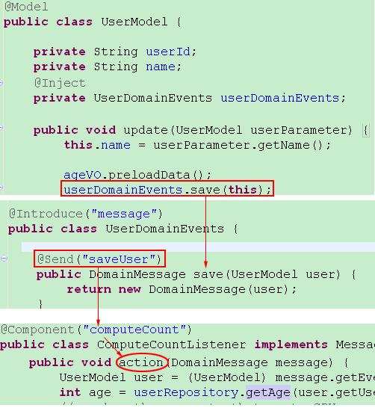
Domain Events: Queue
@Send(topic) ==> @Component(topic);
the consumer is a class with @Component(topic) that need implement com.jdon.domain.message.MessageListener
Before V6.4 .

Slide 24
Two kind of Consumers
@Consumer；1:N topic or 1:1 queue，mechanism is Disruptor that faster than Actor Model,
for lightweight small or atomic or stateless task.
@Componet；only 1:1 queue; it is singleton like other componentw registered in JF,
for weight stateful and no return task.

Slide 25
Domain Events(DE) apply in JEE
Service
Tech.
Architecture
boundary
VO
Domain Events
Root Entity
Entity
boundary
Domain Events
Root Entity

Slide 26
Domain Events Pattern
Loose Coupling
business logic is separate from technology architecture. decouple "What" From "How"
Event-driven Architecture
asynchronous event-driven architectures
Asynchronous Lazy-load
like lazy evaluation of functional language .
True Scalability
Scale out on multi-core or multiple nodes using asynchronous message passing ( JMS).

Slide 27
Example 1: Concurrency pattern
No domain events codes： CPU killer:
public int getMessageCount(){
int messageCount = xxxx; // complex computing, high CPU usage, CPU killer
return messageCount;
}
Domain events can pre-load or pre-run the complex computing:
public int getMessageCount(DomainEvents domainEvents) {
if (messageCount == -1) {
if (messageCountAsyncResult == null) {
messageCountAsyncResult =
domainEvents.computeCount(account.getUserIdLong());
} else {
messageCount = (Integer)
messageCountAsyncResult.getEventResult();
}
}
return messageCount;
}

Slide 28
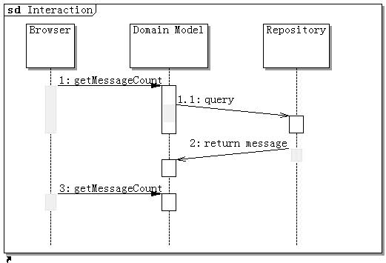
Example 2
Asynchronous Lazy load
1. invoking ‘getMessageCount’ will send a message to ‘computeCount’ of Repository by domainEvents.
2. again invoking ‘getMessageCount’ will return last step result.(such as by AJAX )
Download Sample Source

Slide 29
Lazy load Benefits
load any data on demand
functions are not evaluated until their results are needed
no Hibernate LazyInitializationExceptions
no Open Session in View anti-pattern

Slide 30
Asynchronous Processing
Asynchronous Processing is scalable architecture.
What is Asynchronous Processing ?
Make a call which returns a result. don't need to use the result until at a much later stage of your process. so, you don't need to wait immediately after making the call., instead you can proceed to do other things until you reach the point where you need to use the result.

Slide 31
Why Asynchronous Processing
the waiting thread is idle but consume system resources.
For high transaction volume:
the number of idle threads =(arrival_rate * processing_time)
the result can be a very big number if the arrival_rate is high.
The system is running under a very ineffective mode

Slide 32
DE @ AP
In polling mode, the call itself will return a "future" handle immediately. The caller can go off doing other things and later poll the "future" handle to see if the response if ready.
In this model, there is no extra thread being created so no extra thread co-ordination is needed.

Slide 33
Scale to distributed system
Distributed Cache
Persistence
Domain
Model
JMS
Message
Send Email
Domain
Model
Message
Other Services
Distributed Cache

Slide 34
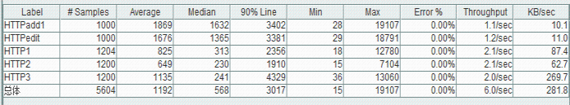
Performance test result
Performance test result for opensource jivejdon with Jdon Framework:
HTTPadd1 is add/insert function ,and HTTPedit is a edit/update function, HttP1.2.3 is a Read/Query function,
all these operations performance is almost equals to each other.
these operations only happened on the domain object in memory, database writing only occurs asynchronous in a consumer of domain events.

Slide 35
Events Problems
Programmer is good at sequence programming that running order in synchronous mode.
Events is a concurrent programming mode, but if business want a sequence running, that will need some new patterns for it.

Slide 36
Domain Events and Others
Never blocks ,Nothing blocks
concurrent, asynchronous message, Lazy load ,
Domain Events is like Actor Model
messages are sent asynchronously and non-blocking in a “fire-and-forget” manner. But LMAX team of the Disruptor say Actor model has bottleneck.
DCI Architecture
does the injection of the business logic methods into the @Model domain objects.

Slide 37
DCI
DCI: Data, Context, Interactions is a programming paradigm invented by Trygve Reenskaug.
keep our core model classes very thin.
logic/behaviour should be kept in roles.
Domain Events is a Interactions, Events Producer is the Role.

Slide 38
Model Injection
JdonFramework can inject Domain Events into domain model at runtime, this is maybe like Mixin.
Domain Events is Interactions of Roles, so Roles are then assigned(Injected) to data objects at runtime, only when required within given Context.

Slide 39
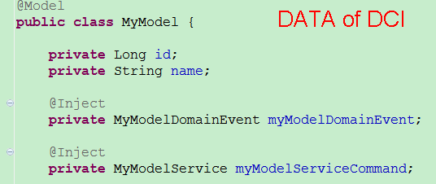
DCI ：Data
Domain Model is the DATA of DCI, no logic no behaviour.
Source: com.jdon.sample.test.domain.simplecase.MyModel

Slide 40
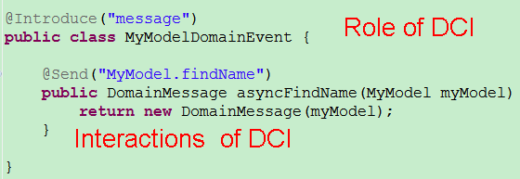
DCI : Role and Interactions
This is a Role of DCI，it includes the interactions of DCI. It is event producer
Source:com.jdon.sample.test.domain.simplecase.MyModelDomainEvent

Slide 41
DCI ： Context
In Context,The Role will be injected into the data.
//after fetching the myModel object, it has been injected events
MyModel myModel = repository.getModel(new Long(100));
// call myModel’s events
myModel .myModelDomainEvent.asyncFindName(this);
Full example download: SimpleJdonFrameworkTest.rar

Slide 42
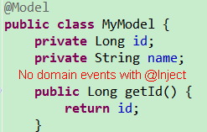
DCI(No Domain Events)
Inject domain events into the model, so it can directly publish events.If there is no domain events in domain model, we can publish events in Context.
Here is a data model of DCI

Slide 43
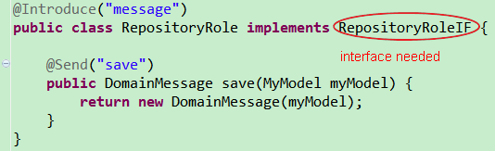
Role
Until the role implements a interface, our Mixin can work.

Slide 44
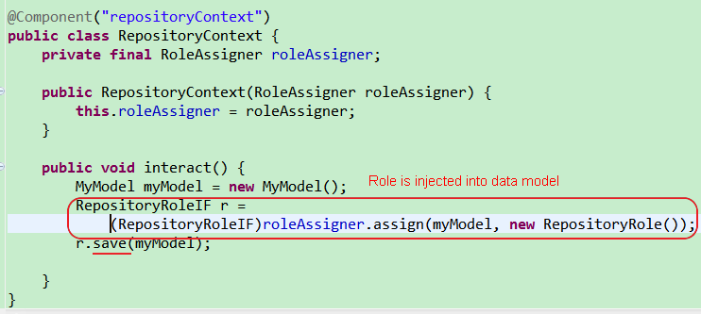
Context

Slide 45
com.jdon.domain.dci.RoleAssigner
com.jdon.domain.dci.RoleAssigner is a Role assigner that can inject(Mixin) any interface into a data model.
When using RoleAssigner, it is not necessary that fetch a object of data model by a repository annotated with @Introduce("modelCache") and its get method with @Around

Slide 46
Different DCI styles
If we already hold on a model object, we can implements various functions by its domain events,such as modify/update a model.
Otherwise:
We create a context, and there we inject events or functions into a new model object by RoleAssigner,such as create or delete a model.

Slide 47
@Model
Context
RoleAssigner
client
inject
Create
Mixin
@Component
@Component
@Component
@Model
client
@Component
Modify
Event

Slide 48
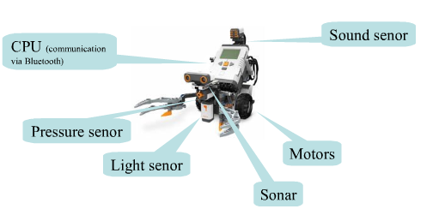
Example for DDD and DCI

Slide 49
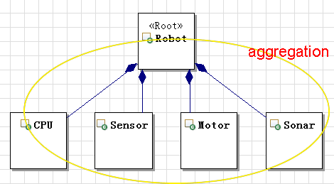
DDD Entity Model

Slide 50
roles-and-responsibilities
Knowing what; doing what;deciding what.
Robot know what? Do what?
Robot can feel or see or hear and detect.
Feeling and seeing and hearing is the responsibilities as a intelligent robot role.

Slide 51
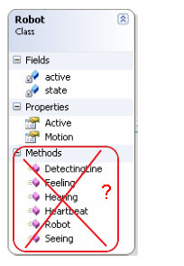
Where responsibilities will be?
All responsibilities are designed as methods of Robot Entity?
That will be a big model.
DCI says : No.

Slide 52
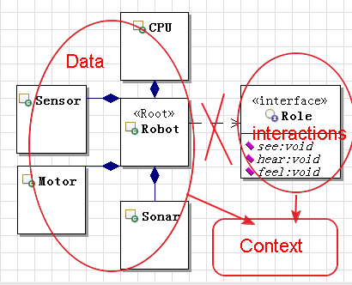
DCI
Responsibilities should be interactions of a Role
and will be injected into data model in context

Slide 53
Robot’s JdonFramework Impl.
Details in DDD DCI and Domain Events example
robot.zip
Robot example source download

Slide 54
JdonFramework: flexibility
Dependency Injection(DI or IOC)
@Service or @Component can inject with each other by class construction(not supports setter injection).
@Service or @Component can be inected into @Model or by domain events.
Aspect-oriented programming(AOP)
with annotation @Introduce:
@Service or @Component can introduce each others as its interceptor. @Model can introduce any POJO or @Component as its interceptor.

Slide 55
@Model mechanism
Cache In-memeory
Inject proxy of c
C
A
@Model
Client
xx.getA(“a”)
interceptor
Inject proxy of B
Component
In Context
Container
Interceptor for B
with @Introduce
B that need
implements interface
and has @Introduce
Interceptor for A
with @Introduce

Slide 56
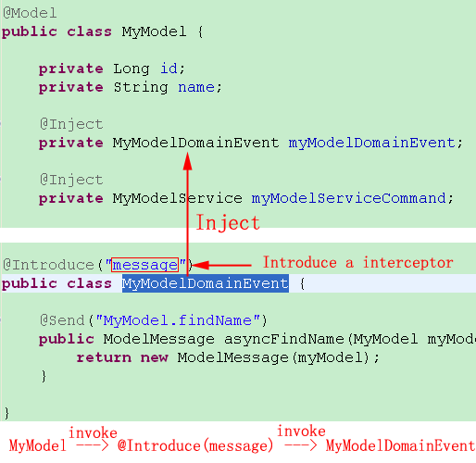
inject a interceptor in @Model

Slide 57
Living space
@Model lives in cache that default is ehcache.
@Component/@Service lives in a context such as servletcontext.
All @Component can be injected into @Model.

Slide 58
@Component mechanism
Context container (ServletContext)
A
@Service
Client
xx.getA(“a”)
Inject proxy of B
Interceptor for B
with @Introduce
B that need
implements interface
@Component
Interceptor
(poincut=service)

Slide 59
@Service/@Component
@Service("testService")
public class TestServicePOJOImp implements TestService{
private final UserRepository userRepository;
public TestServicePOJOImp(UserRepository userRepository) {
this.userRepository = userRepository;
}
}
@Component()
public class UserRepository {
….
}
Difference between @Service and @Component is that the @Service class must have a interface then can be called by outside client beyond jdon.

Slide 60
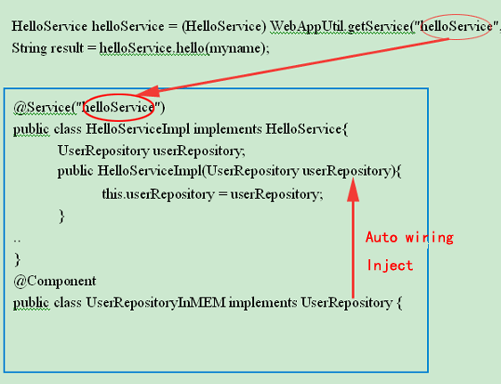
@Service
@Service expose to the client, has several kind instances: singleton , prototype or pool that have them annotations, default is prototype(spring default is singleton )。

Slide 61
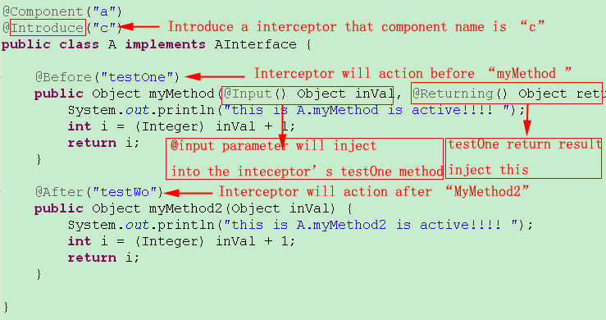
AOP: @Introduce mechanism

Slide 62
In-Memory Model
When a domain model object with @Model is fetch from repository, we need use @Introduce(“modelCache”) to mak the object live in memory.
There are two cache interceptors existed before and after domain layer.
Domain events need annotation @Introduce(“modelCache”) in the place that domain model objects are created or reconstructed from persistence or other systems.

Slide 63
JdonFramework Cache
Domain
Persistence
Presentation
DomainCacheInteceptor
@Introduce(“modelCache”)
CacheInterceptor
In aspect.xml

Slide 64
enable in memeory model
@Introduce(“modelCache”) must be annotated in
the reposotory that @Model objects are created or reconstructed This step is very important for domain events working

Slide 65
What time it is in memeory?
When we first time call the mehtod “getModel” of the interface of RepositoryImp, the framework will do two things:
1. put the return value(model) in cache. So next time can get it from cache.
2. inject domain events into this model.
Your cache need configure to live in memory without auto removing.
Next time, we call it again, we will get the model instance from cache.

Slide 66
Start jdonFramework in WEB
If all is annotation, no jdonframework.xml, no need this step
Configuration in Web.xml:
<context-param>
<param-name> modelmapping-config </param-name>
<param-value> jdonframework.xml </param-value>
</context-param>
<listener>
<listener-class>com.jdon.container.startup.ServletContainerListener</listener-class>
</listener>

Slide 67
How to use in application
AppUtil appUtil = new AppUtil();
// xxx is value of @Service(“xxx”) annotation on class.
XXXService xxxService = appUtil.getService(“xxx”);
xxxService.method();
If there is jdonframework.xml:
AppUtil appUtil = new AppUtil("com.jdon.jdonframework.xml");

Slide 68
Other features in JdonAccessory
Rapid development, template toolkit. JDBC template
Eliminate “Controller/Action” ,No controller code of MVC (only supports Struts 1.x)
Batch Query, auto pagination。

Slide 69
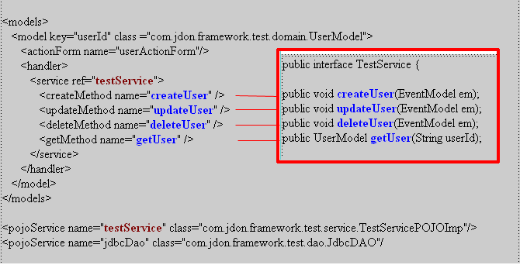
MVC Controller configuration in jdonframework.xml(struts1.x)

Slide 70
Jdonframework MVC(struts1.x)
ActionForm
Model
Controller
Jdonframework.xml
View
Service
View

Slide 71
Batch Query in jdon-jdbcTemp.jar
Cache supports.
Auto pagination.
In presentation layer:
extends com.jdon.strutsutil.ModelListAction
in persistence layer:
call getDatas of com.jdon.controller.model.PageIterator

Slide 72
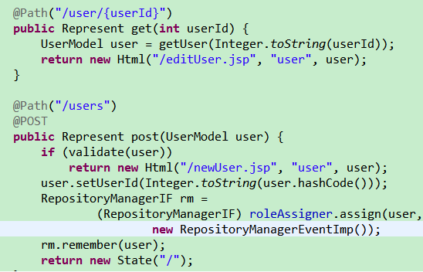
REST in JdonMVC

Slide 73
More details
REST + DCI + Domain events Example dowload SimpleJdonFrameworkTest.rar
JdonMVC REST for JdonFramework
Jivejdon (BBS or Forum software with JdonFramework)
http://code.google.com/p/jivejdon/
JdonFramework english: http://www.jdon.org
Jdon on Github

