Slide 1

JdonFramework
Domain-Driven Design Framework for Java
http://jdon.sf.net/

Slide 2
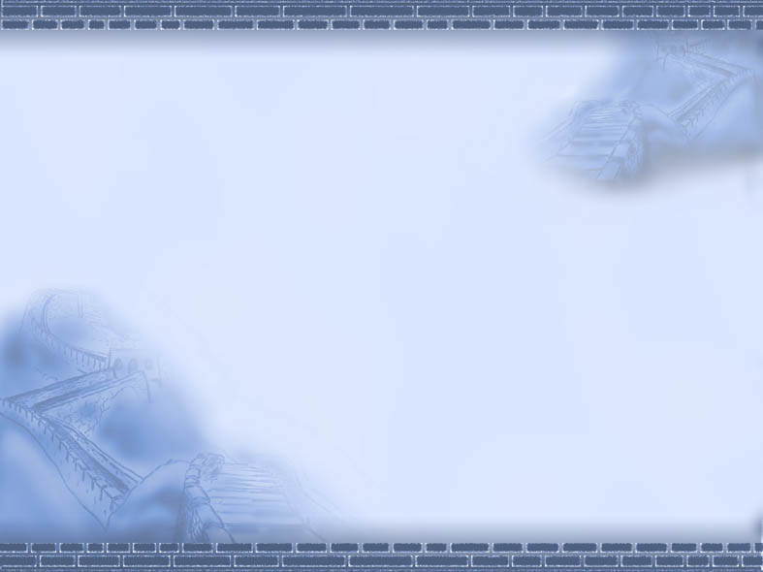
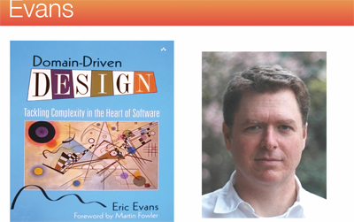
Evans DDD

Slide 3
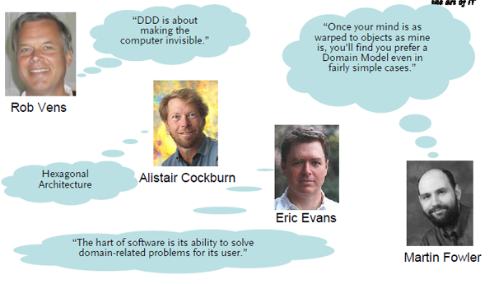
About DDD

Slide 4
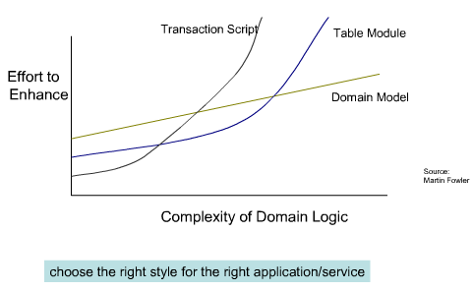
DDD Benefits

Slide 5
CQRS Architecture
Command Query Responsibility Segregation
User interface
Commands
Query/
Reporting
Service
Commands
Domain
Events
Infrastructure
Event/Message BUS

Slide 6
JdonFramework
A light-weight framework for developing Domain-Driven Design applications in the spirit of Evans。
Supports Domain Events
CQRS Style, Command Query Segregation
IOC or Dependency injection (DI) container
AOP
Licence: Apache 2.0

Slide 7
Two kinds of Components
Entity Model: annotation by @Model the class is a root one of a aggregation entity that defined in DDD
Service: annotation by @Component or @Service , this class is a component or Service 。

Slide 8
@Model command @Component
Component architecture
Domain Service
@Service
Persistence
@Component
Message
Message
Domain Model
@Model
Message
GUI
Message
Logging
@Component

Slide 9
@Model Code sample
@Model
public class UserModel {
private String userId;
private String name;
....
}

Slide 10
@Service/@Component
@Service("testService")
public class TestServicePOJOImp implements TestService{
private final UserRepository userRepository;
public TestServicePOJOImp(UserRepository userRepository) {
this.userRepository = userRepository;
}
}
@Component()
public class UserDAOJdbc implements UserRepository{
….
}

Slide 11
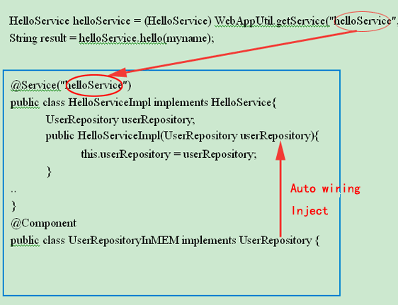
How to invoke @Service outside

Slide 12
Background
A class with @Model will live in memory, default is Cache (Ehcache). Or Key-value store
@Service expose to the client, has several kind instances: singleton , prototype or pool that have them annotations, default is prototype(spring default is singleton )。

Slide 13
Event-driven
How does @Model drive @Component/@Service or Repository?
How does @Model communicate with each other?
That is Domain Events.

Slide 14
It is CQRS
User interface
Commands
Query/
Reporting
Service
Commands
Domain
Events
Infrastructure
Event/Message BUS

Slide 15
Domain Events
Concurrency pattern
Asynchronous message, Lazy load , java concurrent.
@Model like Actor Model
@Model can only have impact on other @Model by sending messages to them, messages are sent asynchronously and non-blocking in a “fire-and-forget” manner.
DCI Architecture
does the injection of the business logic methods into the @Model domain objects.

Slide 16
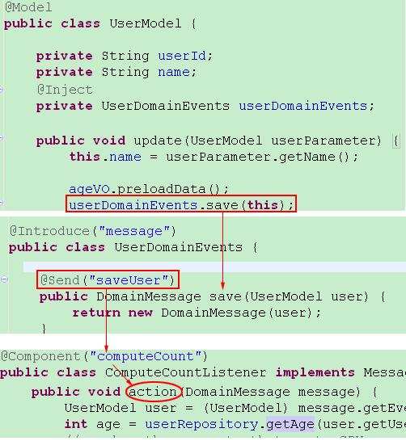
Domain Events implementation
Download Sample Source

Slide 17
How Domain Events work?
Java
concurrent
Future
Domain Message
Pool.run
Listerner
@Component
Domain Model
@Model
‘Future’ API in Java concurrent ,
Prefer Futures to Baked-In "Async APIs“

Slide 18
Domain Events Benefits
Loose Coupling
business logic is separate from technology architecture. decouple "What" From "How"
Event-driven Architecture
asynchronous event-driven architectures
Asynchronous Lazy-load
like lazy evaluation of functional language .
True Scalability
Scale out on multi-core or multiple nodes using asynchronous message passing ( JMS).

Slide 19
Domain Events(DE) in DDD
Service
Tech.
Architecture
boundary
VO
Domain Events
Root Entity
Entity
boundary
Domain Events
Root Entity

Slide 20
How to use DE?
Concurrency pattern
No domain events codes:
public int getMessageCount(){
int messageCount = xxxx; // complex computing, high CPU usage, CPU killer
return messageCount;
}
Domain events can pre-load or pre-run the complex computing:
public int getMessageCount(DomainEvents domainEvents) {
if (messageCount == -1) {
if (messageCountAsyncResult == null) {
messageCountAsyncResult =
domainEvents.computeCount(account.getUserIdLong());
} else {
messageCount = (Integer)
messageCountAsyncResult.getEventResult();
}
}
return messageCount;
}

Slide 21
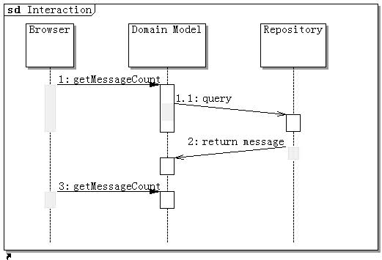
How to use DE?
Asynchronous Lazy load
1. invoking ‘getMessageCount’ will send a message to ‘computeCount’ of Repository by domainEvents.
2. again invoking ‘getMessageCount’ will return last step result.(such as by AJAX )
Download Sample Source

Slide 22
How to use DE?
Lazy load Benefits
load any data on demand
functions are not evaluated until their results are needed
no Hibernate LazyInitializationExceptions
no Open Session in View anti-pattern

Slide 23
Scale DE to JMS
@Component(“JMSListener ”)
public class JMSListener implements MessageListener{
…..
public void action(DomainMessage message) {
Connection connection = connectionFactory.createConnection();
Session session = connection.createSession(false,
Session.AUTO_ACKNOWLEDGE);
MessageProducer producer = session.createProducer(destination);
TextMessage message = session.createTextMessage(message.getSource);
producer.send(message);
}
…
}

Slide 24
Scale to distributed system
Distributed Cache
Persistence
Domain
Model
JMS
Message
Send Email
Domain
Model
Message
Other Services
Distributed Cache

Slide 25
DCI Architecture
DCI: Data Context and Interactions
Contexts are the new objects ?
JdonFramework say No, replace it with Domain Events.Domain model will send domain events to others components to realize a Context .
No need Context.class in code.no need new language.

Slide 26
flexibility
Dependency Injection(DI or IOC)
@Service or @Component can inject with each other by class construction(not supports setter injection).
@Service or @Component can be inected into @Model or by domain events.
Aspect-oriented programming(AOP)
with annotation @Introduce:
@Service or @Component can introduce each others as its interceptor. @Model can introduce any POJO or @Component as its interceptor.

Slide 27
DI and AOP of @Model
Cache container
Inject proxy of c
C
A
@Model
Client
xx.getA(“a”)
interceptor
Inject proxy of B
Component
In Context
Container
Interceptor for B
with @Introduce
B that need
implements interface
and has @Introduce
Interceptor for A
with @Introduce

Slide 28
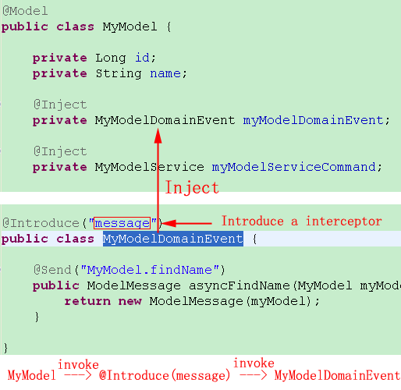
Code sample

Slide 29
DI and AOP of @Component
Context container (ServletContext)
A
@Service
Client
xx.getA(“a”)
Inject proxy of B
Interceptor for B
with @Introduce
B that need
implements interface
@Component
Interceptor
(poincut=service)

Slide 30
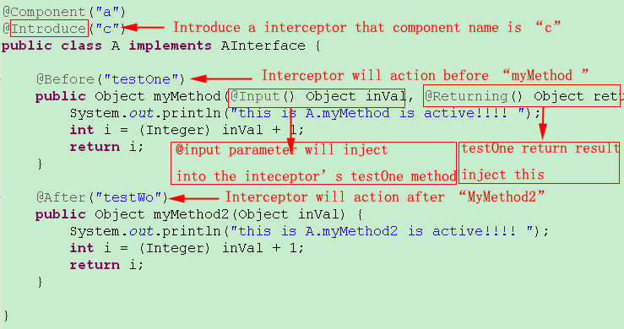
AOP: @Introduce sample

Slide 31
In-Memory Model
All objects of @Model live in memory.
Using AOP, Cache is be introduced into domain layer.
There are two cache interceptors existed before and after domain layer.
Domain events need annotation @Introduce(“modelCache”) in the place that domain model objects are created or reconstructed from persistence or other systems.

Slide 32
JdonFramework Cache
Domain
Persistence
Presentation
DomainCacheInteceptor
@Introduce(“modelCache”)
CacheInterceptor
In aspect.xml

Slide 33
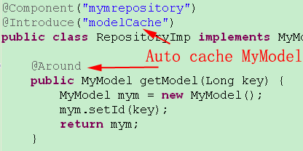
Annotation enable model Cache
@Introduce(“modelCache”) must be annotated in
the places that @Model objects are created or reconstructed
This step is very important for domain events working

Slide 34
JdonFramwork other features
Rapid development, template toolkit.
No MVC’s controller code, no controller’s business logic. (only suport Struts 1.x)
CQRS(Command Query Responsibility Segregation ), CUD of CRUD command’s flow is seprate from Query(R of CRUD)。
RESTful style, URL Mapping to Service and its method (need urlrewrite.xml)
Method URL path Service
POST/GET /SName/sMethod SName.sMethod

Slide 35
Pitfalls of Centralizing Controller
Control logic can get overly complex
Controllers can become dependent on information holders' contents.
Objects can become coupled indirectly through the actions of their controller.
The only interesting work is done in the controller.
---- < Object Design: Roles, Responsibilities, and Collaborations >

Slide 36
Eliminate “Controller/Action”
The Controller of MVC is Centralizing Controller.
JdonFramework replaces the controller class code with XM(jdonframework.xml ). No need any controllers in application.
Like MVVM, JdonFramrwork do some works as ViewModel. converts struts1.x actionform into model. vice versa.
Only for struts 1.x

Slide 37
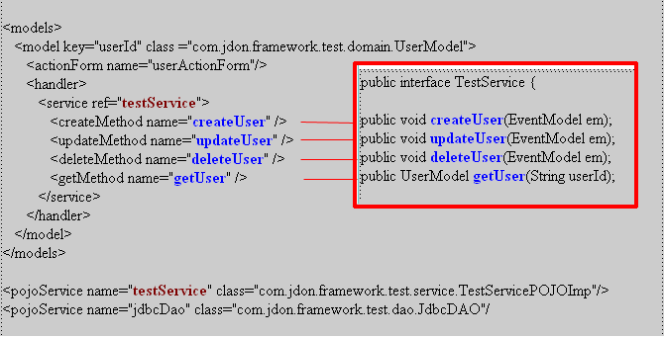
MVC Controller configuration jdonframework.xml(struts1.x)

Slide 38
Jdonframework MVC(struts1.x)
ActionForm
Model
Controller
Jdonframework.xml
View
Service
View

Slide 39
Struts1.x conf.
Display a domain model view for create or edit:
<action name="userActionForm" path="/userAction"
type="com.jdon.strutsutil.ModelViewAction“ scope="request" validate="false">
<forward name="create" path="/user.jsp" />
<forward name="edit" path="/user.jsp" />
</action>
Handle commands of Create Edit(Update) Delete (ModelHandler)
<action name="userActionForm" path="/userSaveAction"
type="com.jdon.strutsutil.ModelSaveAction“ scope="request" validate="true"
input="/user.jsp">
<forward name="success" path="/result.jsp" />
<forward name="failure" path="/result.jsp" />
</action>

Slide 40
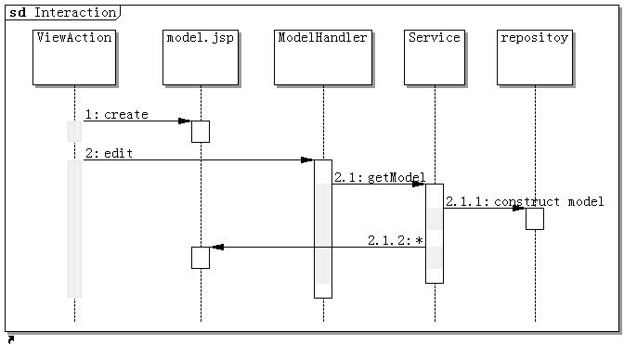
CQRS:READ/Query MVC Flow

Slide 41
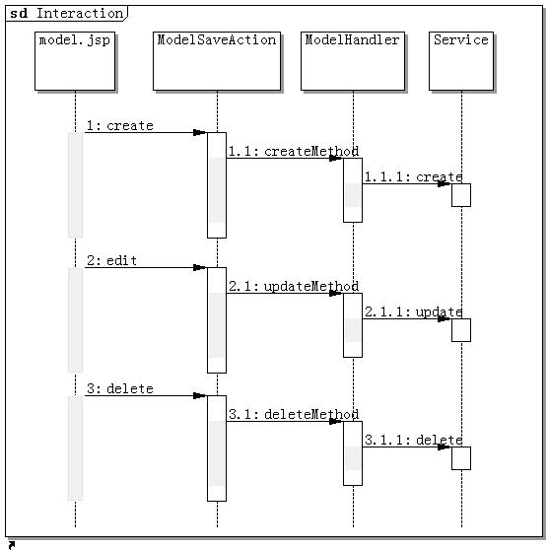
CQRS:Create/Update/Delete command MVC Flow

Slide 42
Batch Query
Cache supports.
Auto pagination.
In presentation layer:
extends com.jdon.strutsutil.ModelListAction
in persistence layer:
call getDatas of com.jdon.controller.model.PageIterator

Slide 43
More details
http://jdon.sf.net
Demo sample: http://www.jdon.com/testWeb
DDD Cargo samples Source Download
Jivejdon (Quora style with jdonframework)
https://sourceforge.net/projects/jdon/files/

