Slide 1
A Primer on Mixed Integer Linear Programming
Using Matlab, AMPL and CPLEX at Stanford University
Steven Waslander, May 2nd, 2005

Slide 2
Outline
Optimization Program Types
Linear Programming Methods
Integer Programming Methods
AMPL-CPLEX
Example 1 – Production of Goods
MATLAB-AMPL-CPLEX
Example 2 – Rover Task Assignment

Slide 3
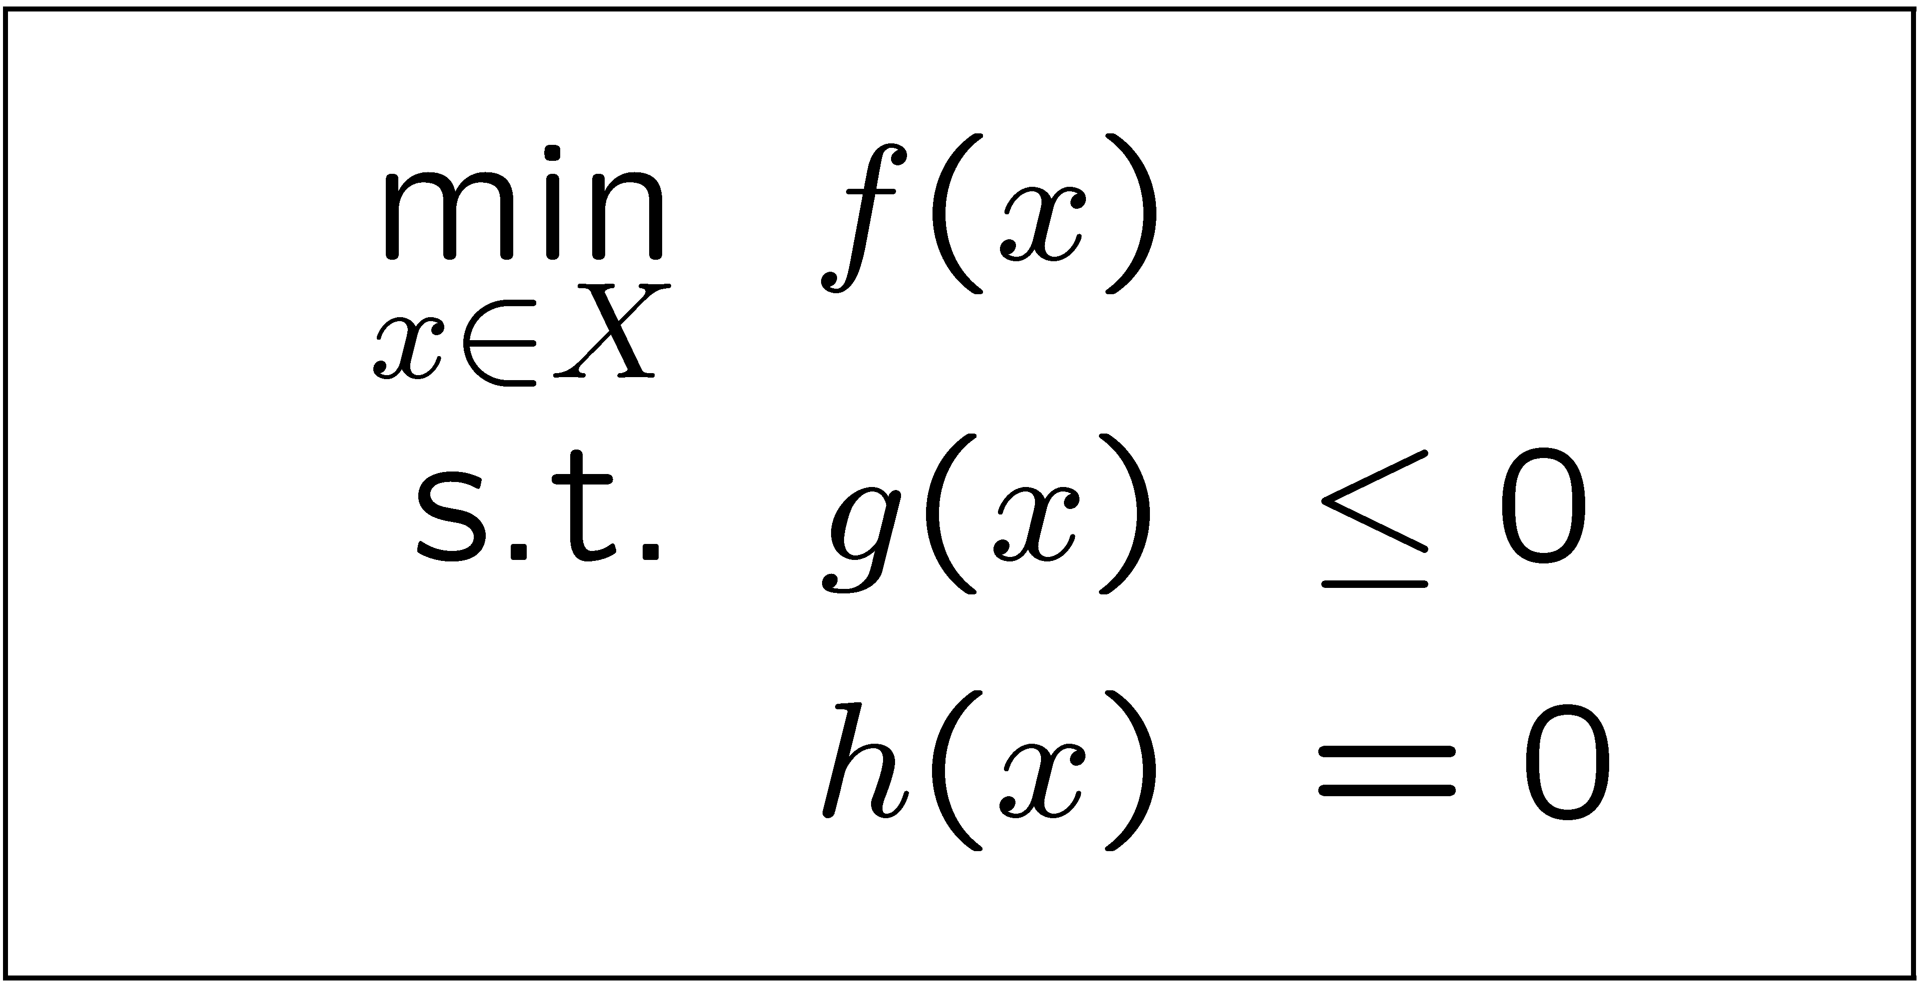
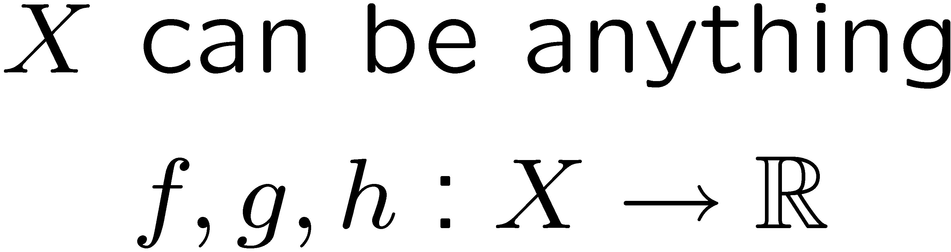
General Optimization Program
Standard form:
    where,
Too general to solve, must specify properties of X, f,g and h more precisely.

Slide 4
Complexity Analysis
(P) – Deterministic Polynomial time algorithm
(NP) – Non-deterministic Polynomial time algorithm,
  Feasibility can be determined in polynomial time
(NP-complete) – NP and at least as hard as any known NP problem
(NP-hard) – not provably NP and at least as hard as any NP problem,
  Optimization over an NP-complete feasibility problem

Slide 5
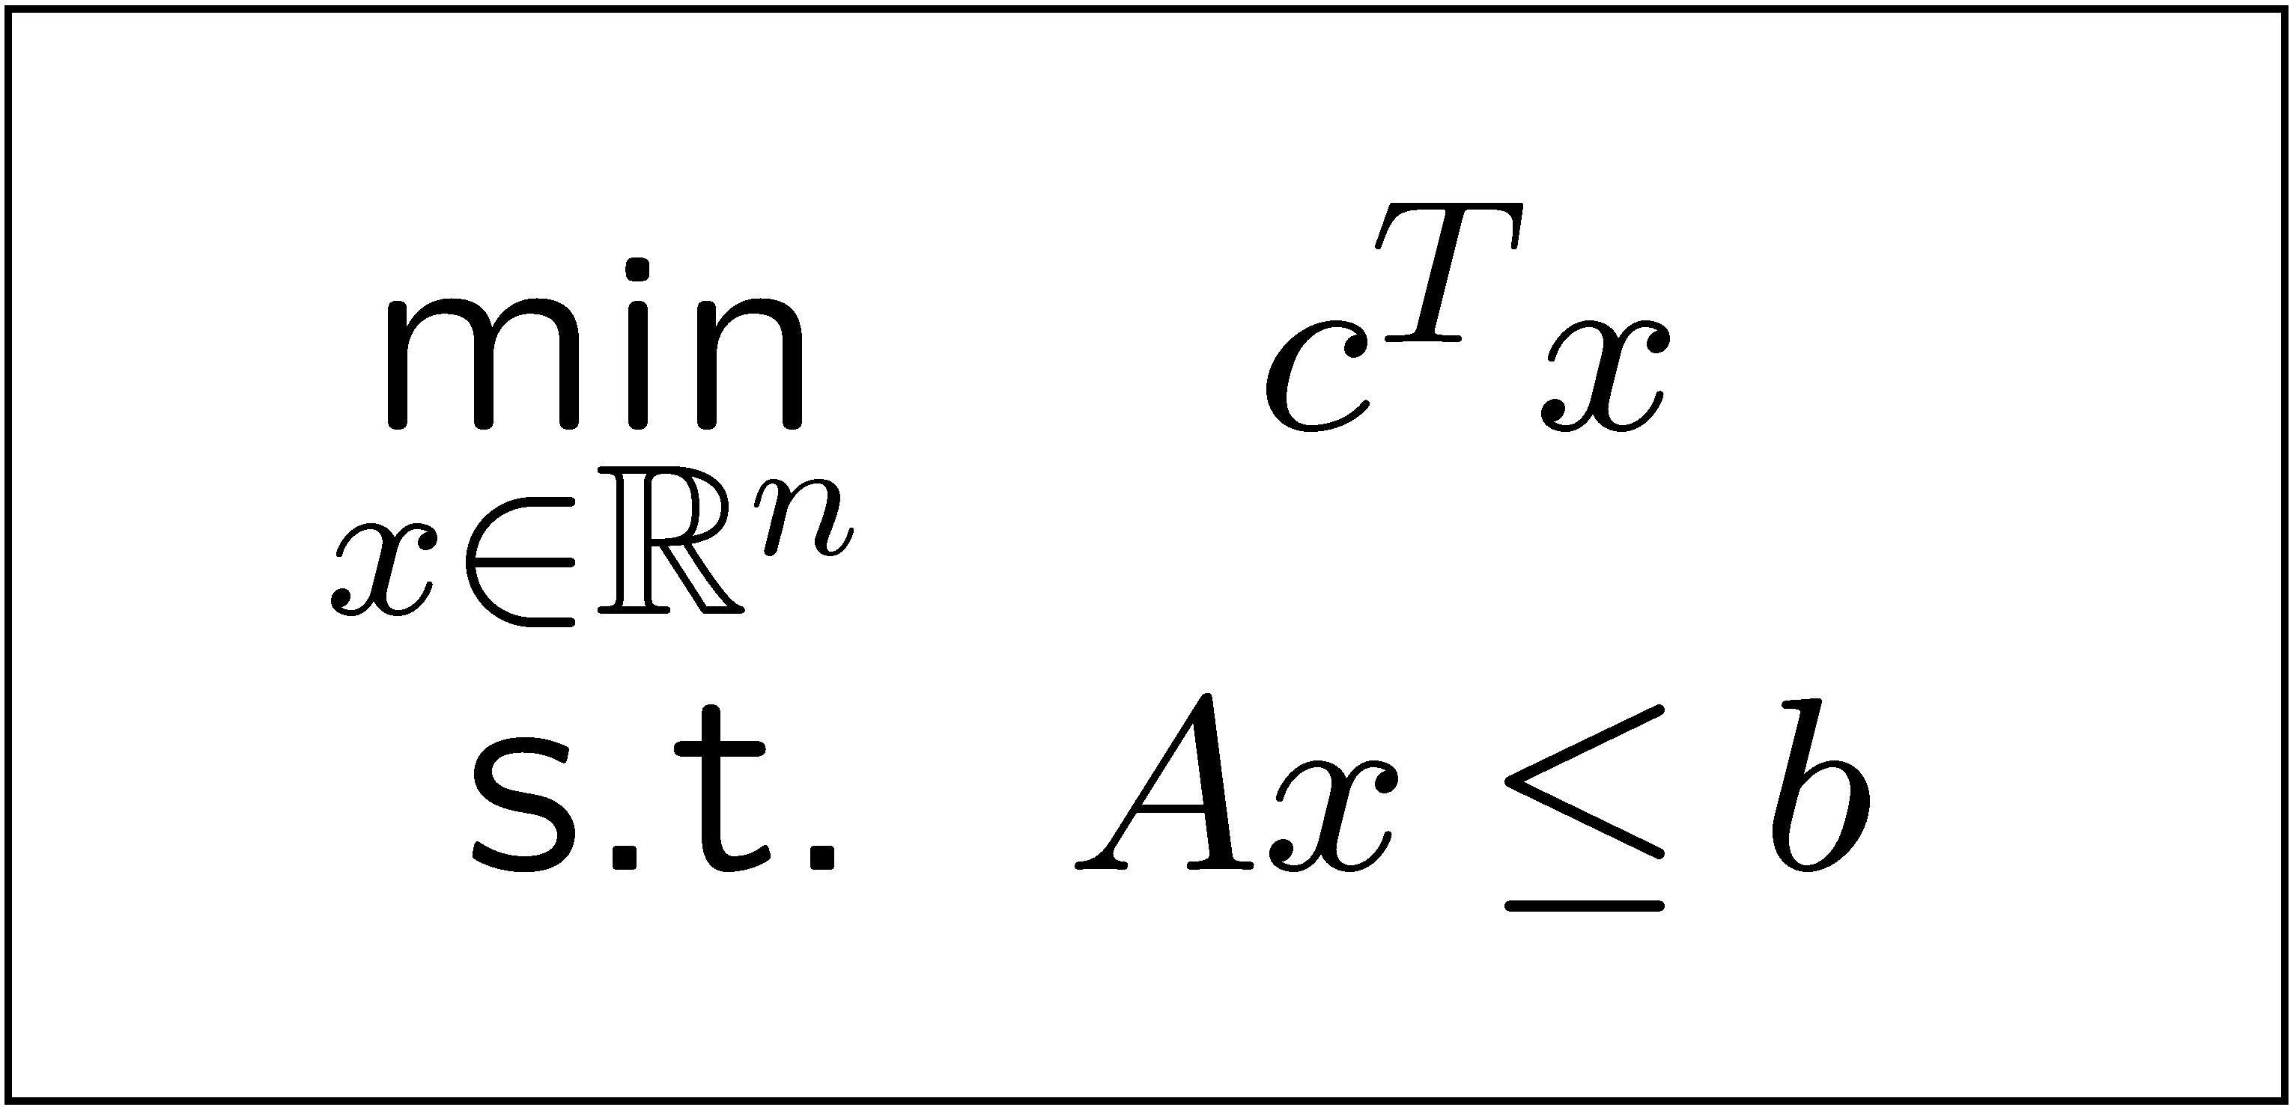
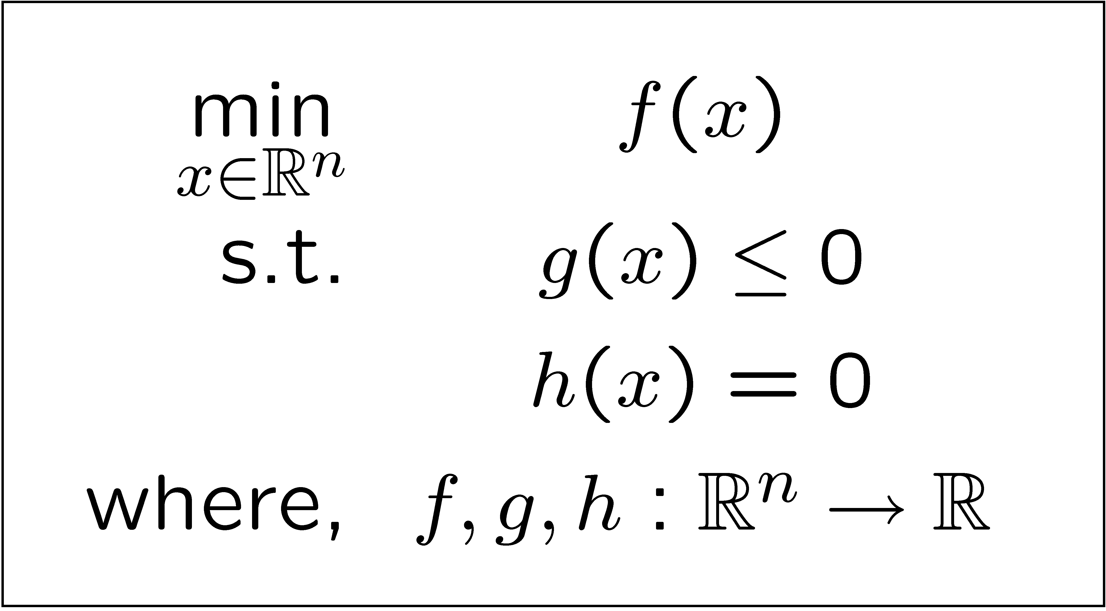
Optimization Problem Types – Real Variables
Linear Program (LP)
  (P) Easy, fast to solve, convex
Non-Linear Program (NLP)
  (P) Convex problems easy to solve
  Non-convex problems harder, not guaranteed to find global optimum

Slide 6
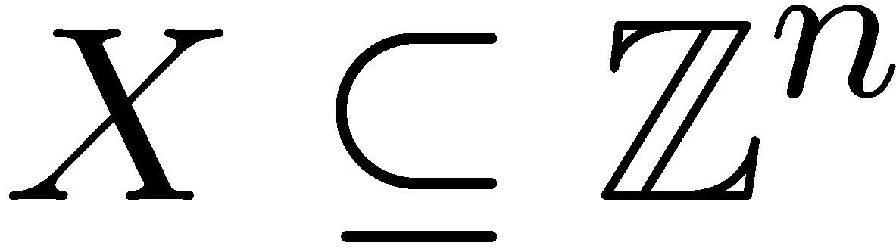
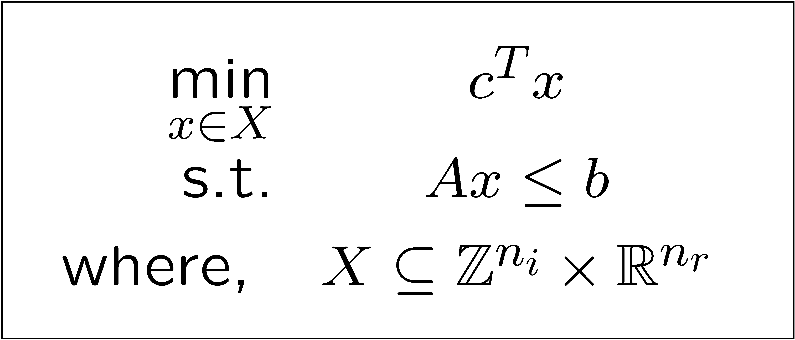
Optimization Problem Types –
Integer/Mixed Variables
Integer Programs (IP) :
  (NP-hard) computational complexity
Mixed Integer Linear Program (MILP)
  Our problem of interest, also generally (NP-hard)
  However, many problems can be solved surprisingly quickly!
MINLP, MILQP etc.
  New tools included in CPLEX 9.0!

Slide 7
Solution Methods for
Linear Programs
Simplex Method
  Optimum must be at the intersection of constraints (for problems satisfying Slater condition)
  Intersections are easy to find, change inequalities to equalities
x₂
c^{T}
x₁

Slide 8
Solution Method for
Linear Programs
Interior Point Methods
  Apply Barrier Function to each constraint and sum
  Primal-Dual Formulation
  Newton Step
Benefits
  Scales Better than Simplex
  Certificate of Optimality
x₂
-c^{T}
x₁

Slide 9
Solution Methods for
Integer Programs
Enumeration – Tree Search, Dynamic Programming etc.
  Guaranteed to find a feasible solution (only consider integers, can check feasibility (P) )
  But, exponential growth in computation time
x₁=0
x₁=1
x₁=2
X₂=0
X₂=1
X₂=2
X₂=0
X₂=1
X₂=2
X₂=0
X₂=1
X₂=2

Slide 10
Solution Methods for
Integer Programs
How about solving LP Relaxation followed by rounding?
Integer Solution
-c^{T}
x₂
LP Solution
x₁

Slide 11
Integer Programs
x₂
-c^{T}
x₁
LP solution provides lower bound on IP
But, rounding can be arbitrarily far away from integer solution

Slide 12
Combined approach to Integer Programming
Why not combine both approaches!
  Solve LP Relaxation to get fractional solutions
  Create two sub-branches by adding constraints
x₂
x₂
x₁≥2
-c^{T}
-c^{T}
x₁
x₁≤1
x₁

Slide 13
Solution Methods for
Integer Programs
Known as Branch and Bound
  Branch as above
  LP give lower bound, feasible solutions give upper bound
LP
J* = J₀
LP + x₁≤3
J* = J₁
x₁= 3.4, x₂= 2.3
LP + x₁≥4
J* = J₂
x₁= 3, x₂= 2.6
x₁= 3.7, x₂= 4
LP + x₁≤3 + x₂≤2
J* = J₃
LP + x₁≤3 + x₂≥3
J* = J₄
LP + x₁≤3 + x₂≥4
J* = J₅
LP + x₁≥4 + x₂≥4
J* = J₆

Slide 14
Branch and Bound Method for Integer Programs
Branch and Bound Algorithm
  1. Solve LP relaxation for lower bound on cost for current branch
    If solution exceeds upper bound, branch is terminated
    If solution is integer, replace upper bound on cost
  2. Create two branched problems by adding constraints to original problem
    Select integer variable with fractional LP solution
    Add integer constraints to the original LP
  3. Repeat until no branches remain, return optimal solution.

Slide 15
Integer Programs
Order matters
  All solutions cause branching to stop
  Each feasible solution is an upper bound on optimal cost, allowing elimination of nodes
x₂
Branch x₁
-c^{T}
x₁
Branch x₁ then x₂
Branch x₂

Slide 16
Additional Refinements –
Cutting Planes
Idea stems from adding additional constraints to LP to improve tightness of relaxation
Combine constraints to eliminate non-integer solutions
x₂
All feasible integer solutions remain feasible
Current LP solution is not feasible
x₁
Added Cut

Slide 17
Mixed Integer Linear Programs
No harder than IPs
  Linear variables are found exactly through LP solutions
Many improvements to this algorithm are included in CPLEX
  Cutting Planes (Gomery, Flow Covers, Rounding)
  Problem Reduction/Preprocessing
  Heuristics for node selection

Slide 18
Solving MILPs with
CPLEX-AMPL-MATLAB
CPLEX is the best MILP optimization engine out there.
AMPL is a standard programming interface for many optimization engines.
MATLAB can be used to generate AMPL files for CPLEX to solve.

Slide 19
Introduction to AMPL
Each optimization program has 2-3 files
  optprog.mod: the model file
    Defines a class of problems (variables, costs, constraints)
  optprog.dat: the data file
    Defines an instance of the class of problems
  optprog.run: optional script file
    Defines what variables should be saved/displayed, passes options to the solver and issues the solve command

Slide 20
Running AMPL-CPLEX on Stanford Machines
Get Samson
  Available at ess.stanford.edu
Log into epic.stanford.edu
  or any other Solaris machine
Copy your AMPL files to your afs directory
  SecureFX (from ess.stanford.edu) sftp to transfer.stanford.edu
Move into the directory that holds your AMPL files
  cd ./private/MILP

Slide 21
Running AMPL-CPLEX on Stanford Machines
Start AMPL by typing ampl at the prompt
Load the model file
  ampl: model optprog.mod; (note semi-colon)
Load the data file
  ampl: data optprog.dat;
Issue solve and display commands
  ampl: solve;
  ampl: display variable_of_interest;
OR, run the run file with all of the above in it
  ampl: quit;
  Epic26:~> ampl example.run

Slide 22
Example MILP Problem
Decision on when to produce a good and how much to produce in order to meet a demand forecast and minimize costs
Costs
  Fixed cost of production in any producing period
  Production cost proportional to amount of goods produced
  Cost of keeping inventory
Constraints
  Must meet fixed demand vector over T periods
  No initial stock
  Maximum number of goods, M, can be produced per period

Slide 23
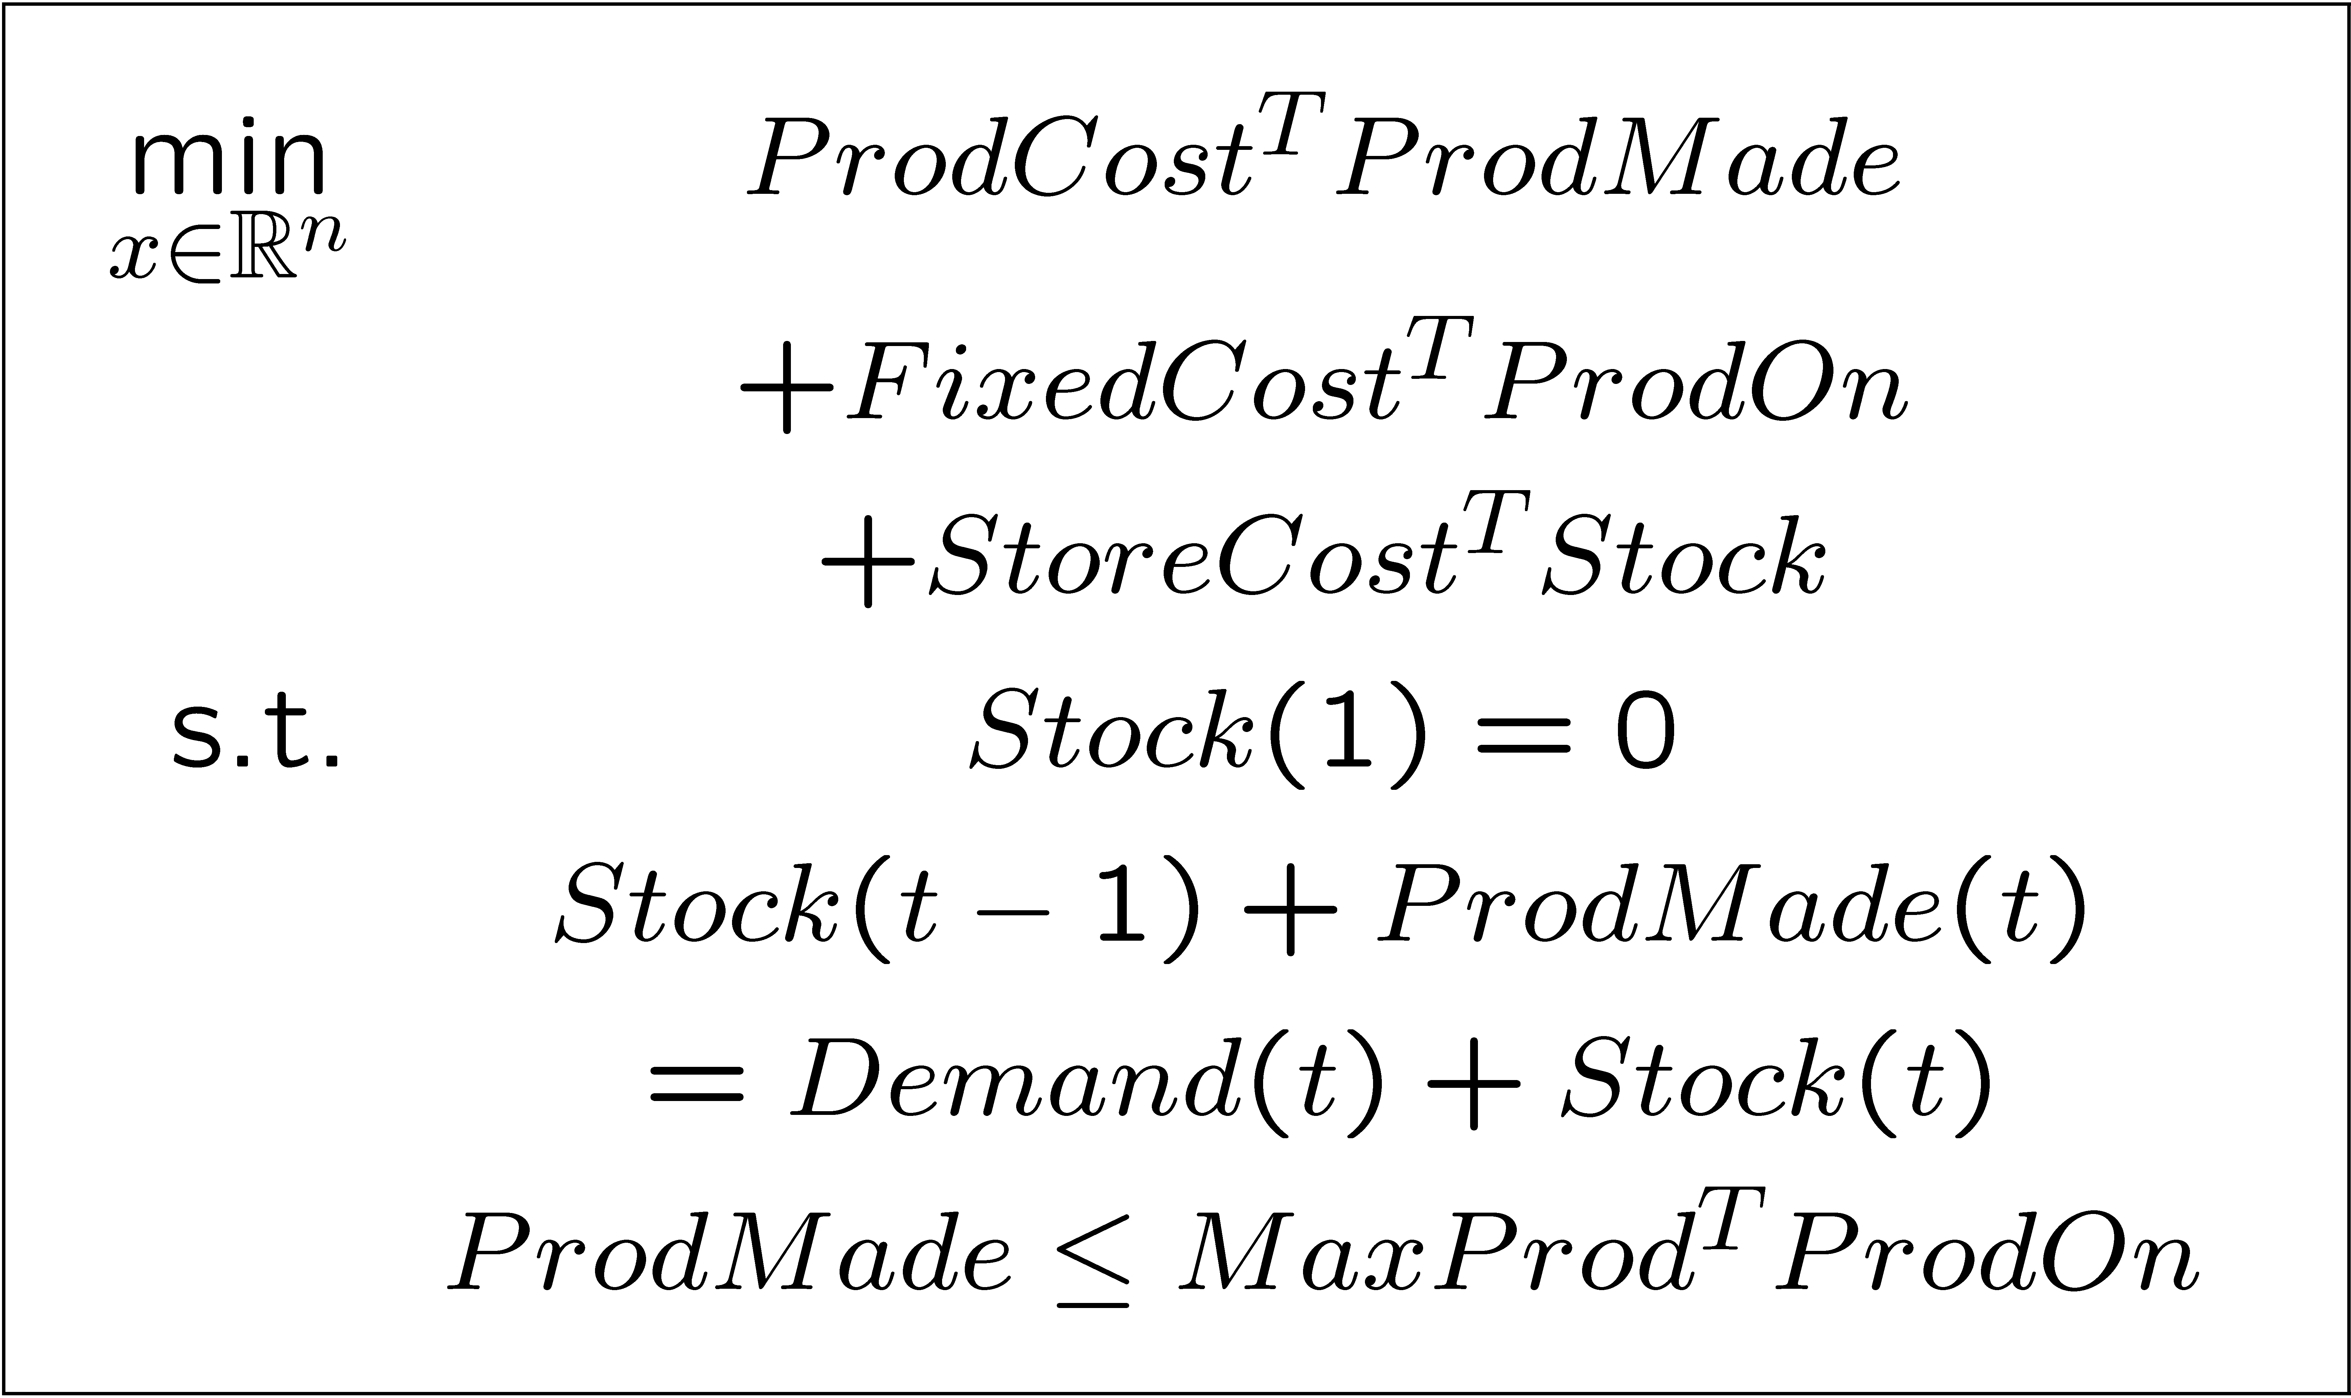
Example MILP Problem

Slide 24
AMPL:
Example Model File - Part 1
#------------------------------------------------
#example.mod
#------------------------------------------------
# PARAMETERS
param T > 0; # Number of periods
param M > 0; # Maximum production per period
param fixedcost {2..T+1} >= 0; # Fixed cost of production in period t
param prodcost {2..T+1} >= 0; # Production cost of production in period t
param storcost {2..T+1} >= 0; # Storage cost of production in period t
param demand {2..T+1} >= 0; # Demand in period t
# VARIABLES
var made {2..T+1} >= 0; # Units Produced in period t
var stock {1..T+1} >= 0; # Units Stored at end of t
var decide {2..T+1} binary; # Decision to produce in period t

Slide 25
AMPL:
Example Model File - Part 2
# COST FUNCTION
minimize total_cost:
sum {t in 2..T+1} (prodcost[t] * made[t] + fixedcost[t] * decide[t] +
storcost[t] * stock[t]);
# INITIAL CONDITION
subject to Init:
stock[1] = 0;
# DEMAND CONSTRAINT
subject to Demand {t in 2..T+1}:
stock[t-1] + made[t] = demand[t] + stock[t];
# MAX PRODUCTION CONSTRAINT
subject to MaxProd {t in 2..T+1}:
made[t] <= M * decide[t];

Slide 26
AMPL:
Example Data File
#------------------------------------------------
#example.dat
#------------------------------------------------
param T:= 6;
param demand := 2 6 3 7 4 4 5 6 6 3 7 8;
param prodcost := 2 3 3 4 4 3 5 4 6 4 7 5;
param storcost := 2 1 3 1 4 1 5 1 6 1 7 1;
param fixedcost := 2 12 3 15 4 30 5 23 6 19 7 45;
param M := 10;

Slide 27
AMPL:
Example Run File
#------------------------------------------------
#example.run
#------------------------------------------------
model example.mod;
data example.dat;
solve;
display made;

Slide 28
AMPL:
Example Results
epic26:~/private/example_MILP> ampl example.run
ILOG AMPL 8.100, licensed to "stanford-palo alto, ca".
AMPL Version 20021031 (SunOS 5.7)
ILOG CPLEX 8.100, licensed to "stanford-palo alto, ca", options: e m b q
CPLEX 8.1.0: optimal integer solution; objective 212
15 MIP simplex iterations
0 branch-and-bound nodes
made [*] :=
2 7
3 10
4 0
5 7
6 10
7 0
;

Slide 29
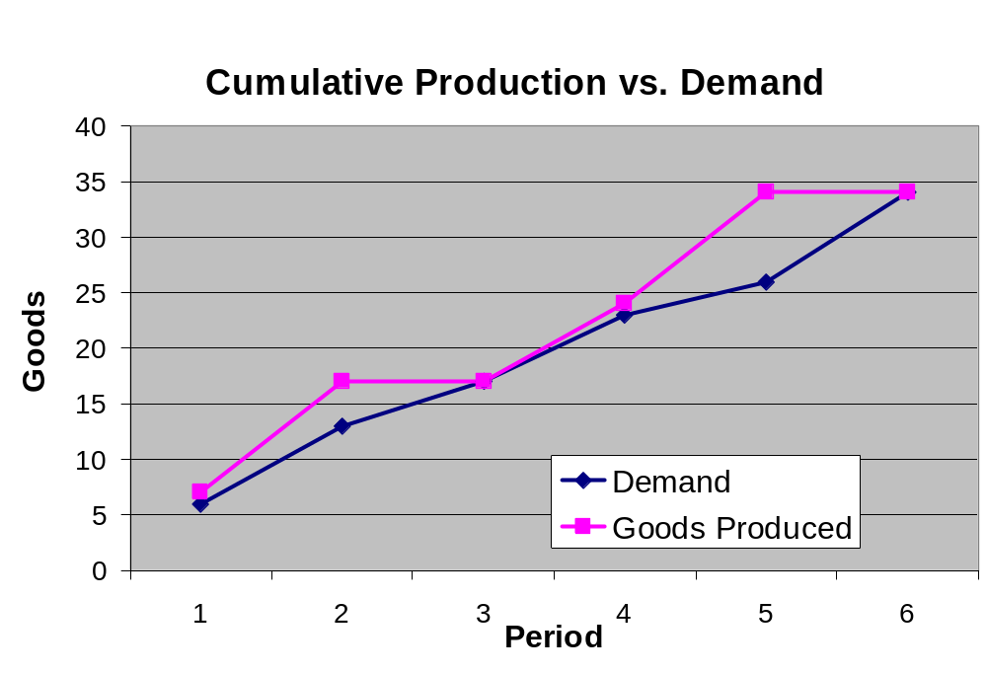
AMPL:
Example Results

Slide 30
Using MATLAB to Generate and Run AMPL files
Can auto-generate data file in Matlab
  fprintf(fid,['param ' param_name ' := %12.0f;\n'],p);
Use ! command to execute system command, and > to dump output to a file
  ! ampl example.run > CPLEXrun.txt
Add printf to run file to store variables for Matlab
  In .run: printf: variable > variable.dat;
  In Matlab: load variable.dat;

Slide 31
Further Example – Task Assignment
System Goal only: Minimum completion time
All tasks must be assigned
Timing Constraints between tasks (loitering allowed)
Obstacles must be avoided

Slide 32
Task Assignment Difficulties
NP-Hard problem
  Instead of assigning 6 tasks, must select from all possible permutations
  Even 2 aircraft, 6 tasks yields 4320 permutations
Timing Constraints
  Shortest path through tasks not necessarily optimal

Slide 33
Task Assignment:
Model File
#Objective function
minimize cost: ## <-- COST FUNCTION ##
#MissionTime;
minMaxTimeCostwt * MissionTime
+ (sum{j in BVARS} costStore[j]*z[j])
+ (sum{idxWP in WP, idxUAV in UAV} tLoiter[idxWP,idxUAV]);
#Constrain 1 visit per waypoint
subject to wpCons {idxWP in WP}:
(sum{p in BVARS} (permMat[idxWP,p]*z[p])) = 1;
#Constrain 1 permutation per vehicle
subject to permCons {idxUAV in UAV}:
sum{p in BVARS : firstSlot[idxUAV]<=ord(p) and ord(p)<=lastSlot[idxUAV]}
z[p] <= 1;
#Constrain "tLoiter{idxWP,idxUAV}" to be 0 if "idxWP" is not visited by "idxUAV"
subject to WPandUAV {idxUAV in UAV, idxWP in WP}:
tLoiter[idxWP,idxUAV] <= M * sum{p in BVARS: firstSlot[idxUAV]<=ord(p) and ord(p)<=lastSlot[idxUAV]} (permMat[idxWP,p]*z[p]);
#Constrain "minMaxTime" to be greater than largest mission time
subject to inequCons {idxUAV in UAV}:
MissionTime >= (sum{p in BVARS} (minMaxTimeCons[idxUAV,p]*z[p])) # flight time
+ (sum{idxWP in WP} tLoiter[idxWP,idxUAV]); # loiter time
#How long it will loiter at (or just before reaching) idxWP
subject to loiteringTime {idxWP in WP}:
tLoiterVec[idxWP] = sum{idxUAV in UAV} tLoiter[idxWP,idxUAV];
#Timing Constraints!!
subject to timing {t in TCONS}:
TOA[timeConstraintWpts[t,2]] >= TOA[timeConstraintWpts[t,1]] + Tdelay[t];
#Constrain "TimeOfArrival" of each waypoint
subject to timeOfArrival {idxWP in WP}:
TOA[idxWP] = sum{p in BVARS} timeStore[idxWP,p]*z[p] + tLoiterBefore[idxWP];
#Solve for "tLoiterBefore"
subject to sumOfLoiteringTime1 {p in BVARS, idxWP in WP}:
tLoiterBefore[idxWP] <= sum{idxPreWP in WP} (ord3D[idxWP,idxPreWP,p]*tLoiterVec[idxPreWP]) + M*(1-permMat[idxWP,p]*z[p]);
subject to sumOfLoiteringTime2 {p in BVARS, idxWP in WP}:
tLoiterBefore[idxWP] >= sum{idxPreWP in WP} (ord3D[idxWP,idxPreWP,p]*tLoiterVec[idxPreWP])
# given a waypoint idxWP and a permutation p, it equals 0 if idxWP is
# not visited, equals 1 if it is visited.
#Constrain loiterable waypoints
subject to constrainLoiter {idxWP in WP, idxUAV in UAV: loiteringCapability[idxWP,idxUAV]==0}:
tLoiter[idxWP,idxUAV] = 0;
# AMPL model file for UAV coordination given permutations
#
# timing constraints exist
# adjust TOE by loitering at waypoints
param Nvehs integer >=1; # number of vehicles, also number of permutations per vehicle constraints
param Nwps integer >=1; # number of waypoints, also number of waypoint constraints
param Nperms integer >=1; # number of total permutations, also number of binary variables
param M := 10000; # large number
param Tcons integer; # number of timing constraints
set WP ordered := 1..Nwps;
set UAV ordered := 1..Nvehs;
set BVARS ordered := 1..Nperms ;
set TCONS ordered := 1..Tcons;
#parameters for permMat*z = 1
param permMat{WP,BVARS} binary;
# parameters for minimizing max time
param minMaxTimeCons{UAV,BVARS};
# parameters for timing constraint
param timeConstraintWpts{TCONS,1..2} integer;
param timeStore{WP,BVARS};
param Tdelay{TCONS};
# parameters for calculating loitering time
param firstSlot{UAV} integer; # position in the BVARS where permutations for idxUAV begin
param lastSlot{UAV} integer; # position in the BVARS where permutations for idxUAV end
param ord3D{WP,WP,BVARS} binary; # ord3D{idxWP,idxPreWP,p}
# if idxPreWP is visited before idxWP or at the same time as idxWP in permutation p
param loiteringCapability{WP,UAV} binary; # =0 if it cannot wait at that WP.
# cost weightings
param costStore{BVARS}; #cost weighting on binary variables, i.e. cost for each permutation
param minMaxTimeCostwt; #cost weighting on variable that minimizes max time for individual missions
# decision variables
var MissionTime >=0;
var z{BVARS} binary;
var tLoiter{WP,UAV} >=0; #idxUAV loiters for "tLoiter[idxWP,idxUAV]" on its way to idxWP
# intermediate variables
var tLoiterVec{WP} >=0;
var TOA{WP} >=0;
var tLoiterBefore{WP} >=0; #the sum of loitering time before reaching idxWP

Slide 34
Rover Task Assignment:
Model File
Set definitions in AMPL
  Great for adding collections of constraints
# from Task_Assignment.mod
param Nvehs integer >=1;
param Nwps integer >=1;
set UAV ordered := 1..Nvehs;
set WP ordered := 1..Nwps;
var tLoiter{WP,UAV} >=0;
subject to loiteringTime {idxWP in WP}:
tLoiterVec[idxWP] = sum{idxUAV in UAV} tLoiter[idxWP,idxUAV];

Slide 35
Task Assignment: Results

Slide 36
Further Resources
AMPL textbook
  AMPL: A modeling language for mathematical programming, Robert Fourer, David M. Gay, Brian W. Kernighan
CPLEX user manuals
  On Stanford network at /usr/pubsw/doc/Sweet/ilog
MS&E 212 class website
  Further examples and references
Class Website
  This presentation
  Matlab libraries for AMPL

