Slide 1
One in four customers walked away.
Here is what it cost and how we win them back
Notes:
Open with the headline: one in four customers left. The next slides show the cost and the path to win them back.

Slide 2
Churn quietly drains $364M every month
$364M
26.02%
churn: 2,60,158 of 10,00,000 customers have left
Churned users paid standard rates, so core paying accounts are leaving.
of $1.40B monthly recurring revenue lost, about $4.37B a year.
Notes:
Anchor on the monthly loss, then the churn rate behind it.

Slide 3
From raw records to a decision tool
1
2
3
4
Python
Feature engineering
MS SQL Server
Power BI
Pandas, NumPy: clean, trim and standardize; check missing values and duplicates
Churn_Flag, Customer_Value, Tenure_Group, Age_Group
T-SQL queries slicing churn by contract, product, region, support
Two-page interactive dashboard with a what-if churn slider
Notes:
Four stages from raw data to a tool executives can use.

Slide 4
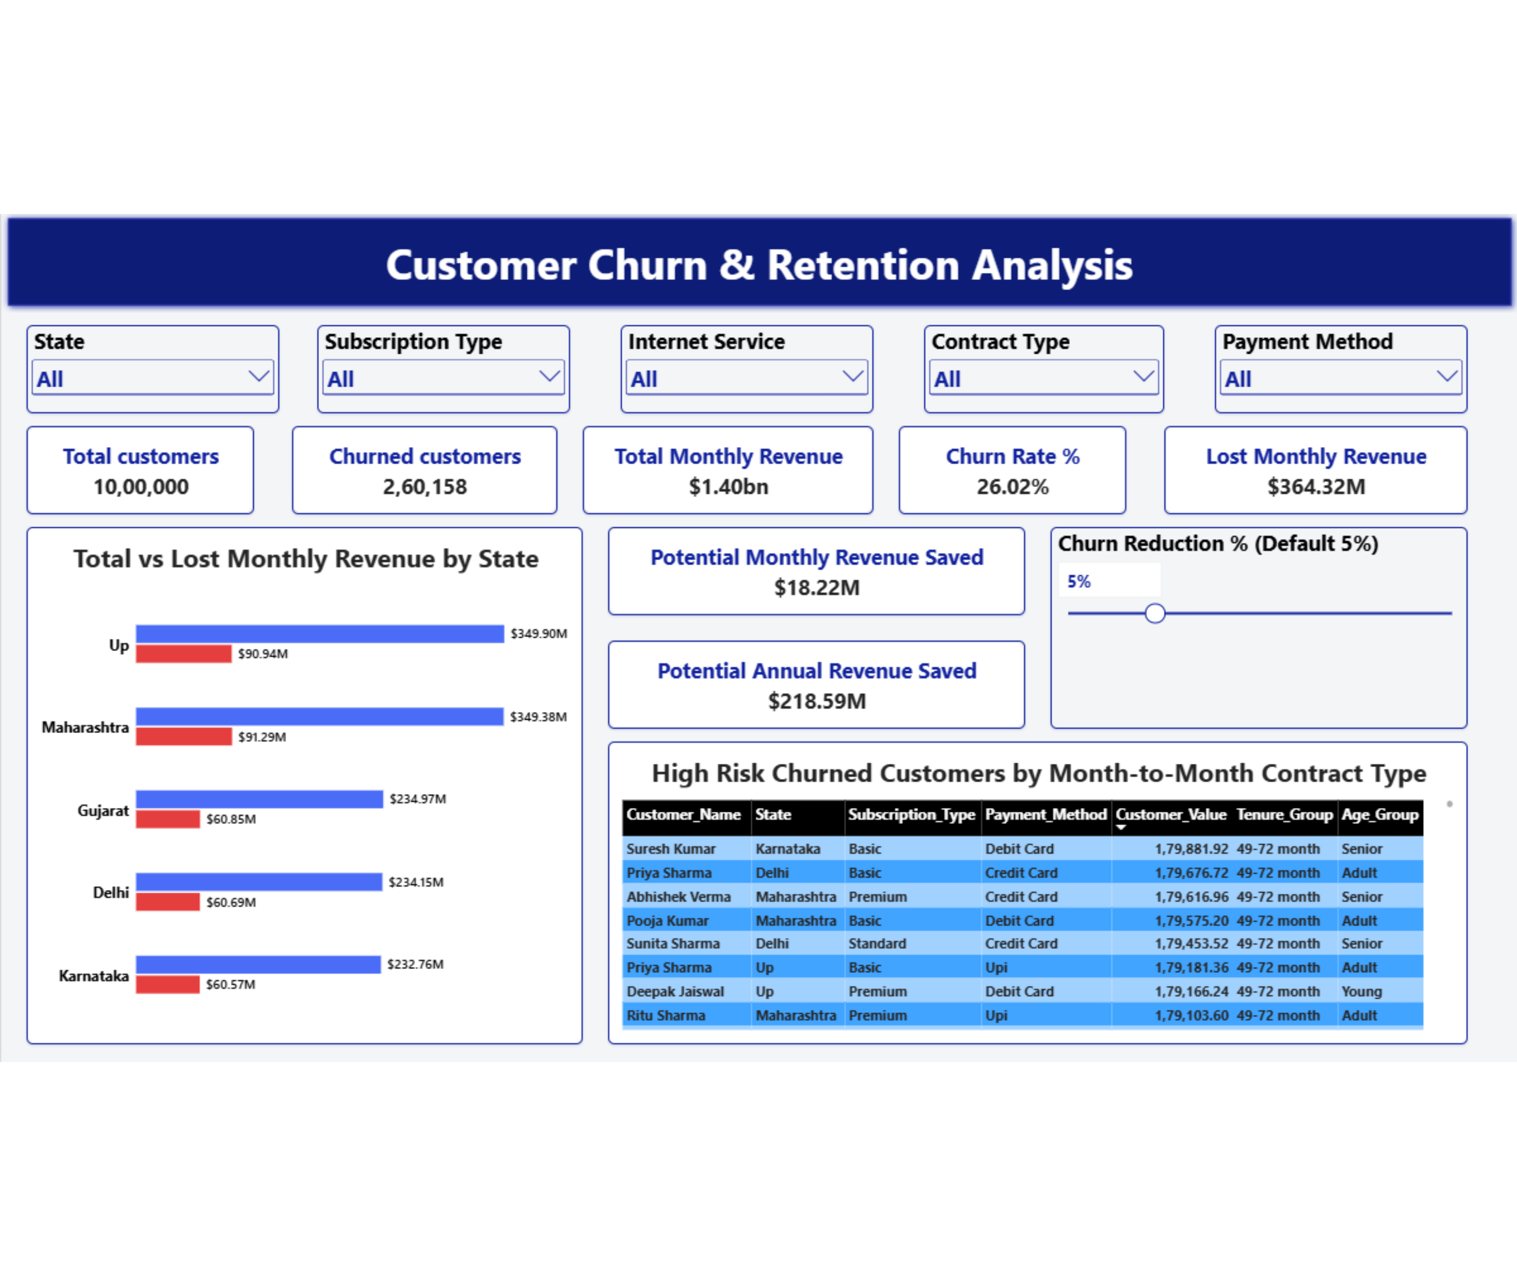
The executive dashboard puts the loss on one screen
KPI cards, state revenue comparison, high-risk accounts and a churn-reduction slider, filterable by state, plan, service, contract and payment.
Notes:
Walk through the dashboard's main panels.

Slide 5
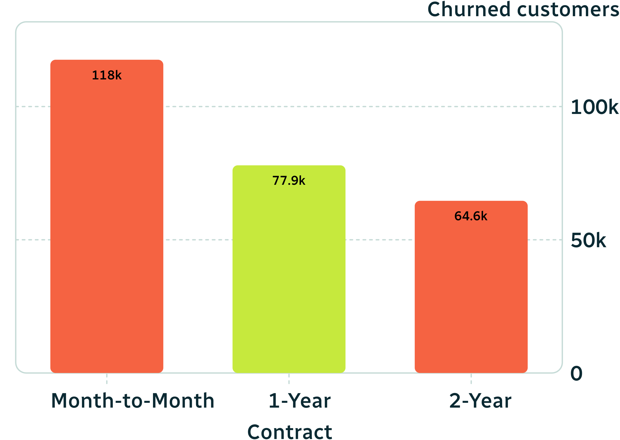
Month-to-month contracts drive 45% of churn
Month-to-Month: 1,17,582 churned (45.20%)
1-Year: 77,945 (29.96%)
2-Year: 64,631 (24.84%)
No lock-in means no cancellation friction.
Notes:
No lock-in, no friction.

Slide 6
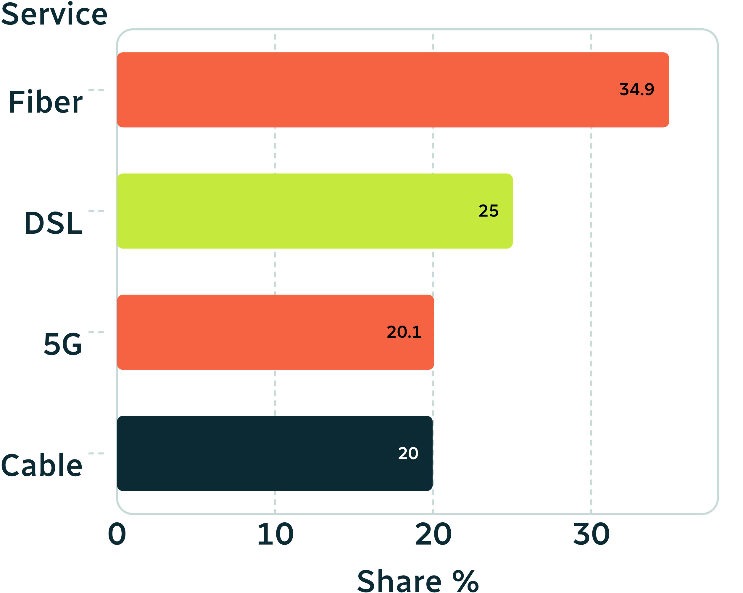
Fiber and Basic plans leak the most
Fiber is 34.93% of churn (90,885), ahead of DSL 25.04%, 5G 20.06%, Cable 19.97%.
Basic is 41.84% (1,08,851), against Standard 29.95% and Premium 28.21%.
Premium-priced fiber losing customers suggests line stability or competitor pricing.
Churn share by internet service, %
Notes:
Fiber leads; Basic leaks most.

Slide 7
Maharashtra and UP account for half the lost revenue
Maharashtra
UP
$91.29M
$90.94M
lost, 65,158 churned
lost, 64,852 churned
Together about half of the $364.32M monthly loss.
Notes:
Two states, half the loss.

Slide 8
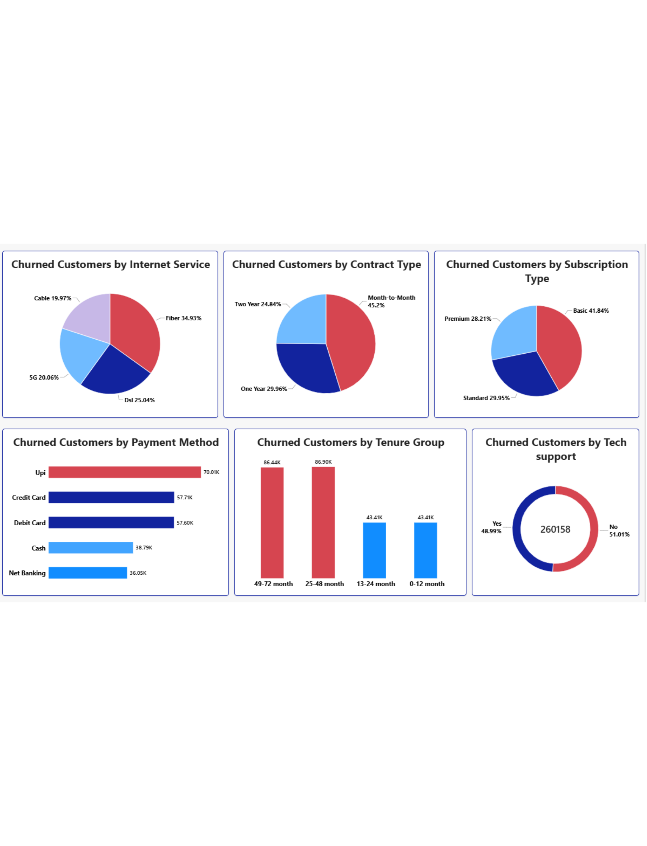
Our longest-standing customers are leaving
33.40% churn at 25–48 months (86,903 churned)
33.23% churn at 49–72 months (86,441 churned)
48.99% of churners contacted tech support, so contact is not retaining them
UPI has the most churn (70,005, 26.91%); adults 30–55 are 55.68% of churners
Notes:
Loyalty is not protecting us; support contact and payment habits add targeting clues.

Slide 9
Cutting churn just 5% saves $218.59M a year
$218.59M
recovered annually with a 5% churn reduction
$364.32M
$18.22M
baseline loss per month
recovered monthly; adjustable with the dashboard slider

Slide 10
Five moves to keep the customers we have
Offer 10% off or speed upgrades to move month-to-month customers to annual plans
Audit fiber line quality in Maharashtra and UP
Reward 2-year and 4-year milestones with loyalty perks
Add value features to the Basic tier
Let support agents offer billing credits and waivers on first contact

