Slide 1
GYM-BOT
By -
SAMARTH BANSAL
E22CSEU0139

Slide 2
GYM-BOT
GYM-BOT which help us in maintaining our gym schedule, guide us in training and much more , motivate user and advice our diet.

Slide 3
01
02
03
TABLE OF CONTENTS
PROBLEMS
SOLUTION
TOOLS

Slide 4
01
PROBLEMS

Slide 5
22.4%
90%
FACTS
18%
drop out because they cannot get up early in the morning
of People Quit After 3 Months of Hitting the Gym
of gym members actually go to the gym,
according to research

Slide 6
*BOOST YOUR MOOD *BUILD AGILITY *DECREASE YOUR FUTURE HEALTHCARE COSTS *DECREASE YOUR RISK OF METABOLIC SYNDROME *DELAY ONSET OF DEMENTIA *GIVE YOU MORE CONFIDENCE *HELP YOU SLEEP BETTER *IMPROVE CREATIVITY *IMPROVE FERTILITY *IMPROVE YOUR POSTURE *IMPROVE YOUR SKIN *INCREASE YOUR ENERGY *INCREASE YOUR FLEXIBILITY
BENEFITS OF FITNESS
BLAH BLAH !
*INCREASE YOUR RANGE OF MOTION
*LENGTHEN YOUR LIFE
*LOWER YOUR RISK OF INJURY
*MAKE YOUR DNA YOUNGER
*PROTECT YOUR HEART
*REDUCE BACK PAIN
*REDUCE CHRONIC PAIN
*REDUCE STRESS
*RELIEVE PMS SYMPTOMS
*SLOW COGNITIVE DECLINE
*STRENGTHEN YOUR BONES
*STRENGTHEN YOUR JOINTS

Slide 7
WHY THEY QUIT GYM
WHY?
WHY?

Slide 8
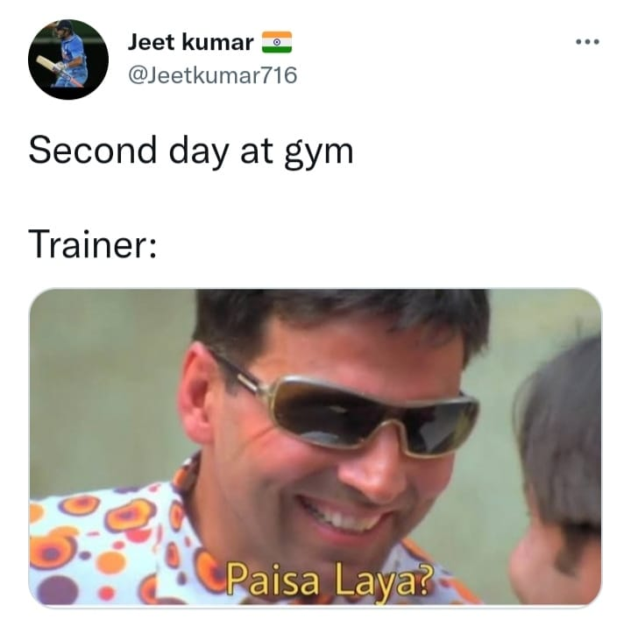
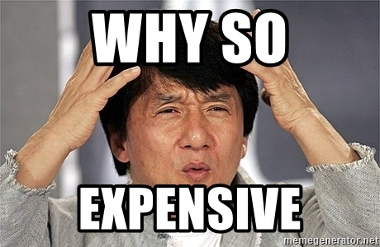
ANOTHER PROBLEM
1.
PEOPLE MUST HAVE A PROPER TRAINER
TO GET BEST 1-TO-1 GUIDANCE
TO ACHIEVE THEIR PERSONAL HEALTH/BODY GOAL
BUT
THEY ARE WAY TOO EXPENSIVE

Slide 9
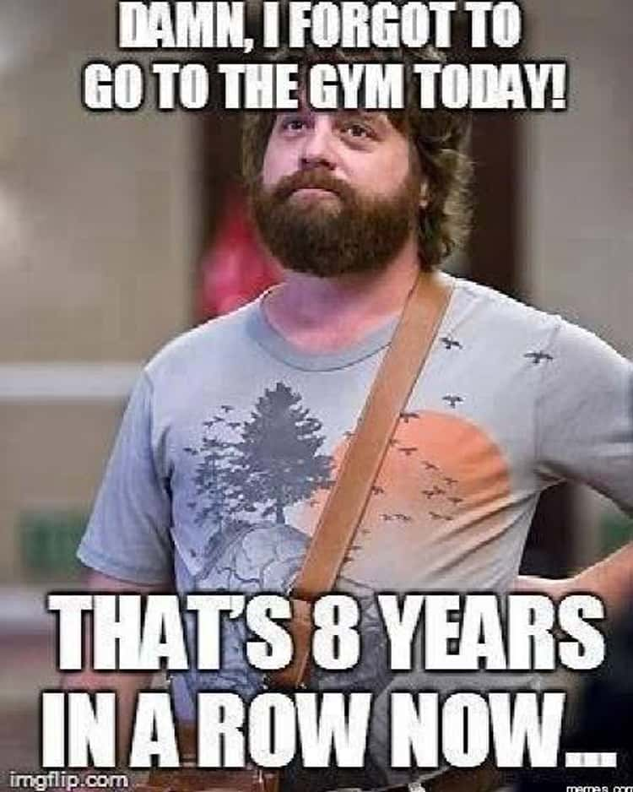

ANOTHER PROBLEM
2.
PEOPLE DON’T GET THE MOTIVATION
AND PATIANCE LATER RESULTING
IN QUITTING IT BY MAKING EXCUSES

Slide 10
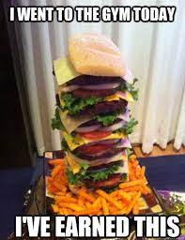
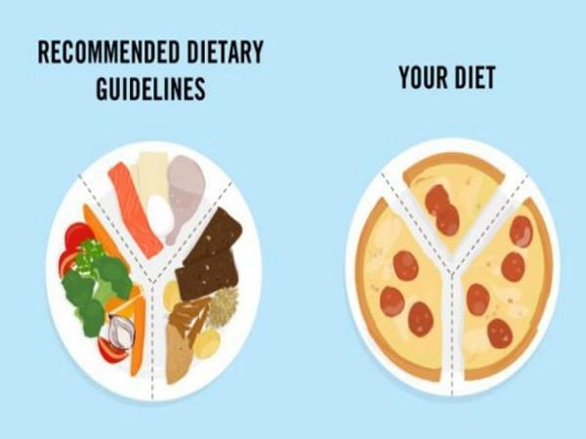
ANOTHER PROBLEM
3.
PEOPLE DON’T GET PROPER
DIET TIPS
WHICH RESULT IN IMPROPER GROWTH
OF BODY AND LATER DEMOTIVATION

Slide 11
02
SOLUTION

Slide 12
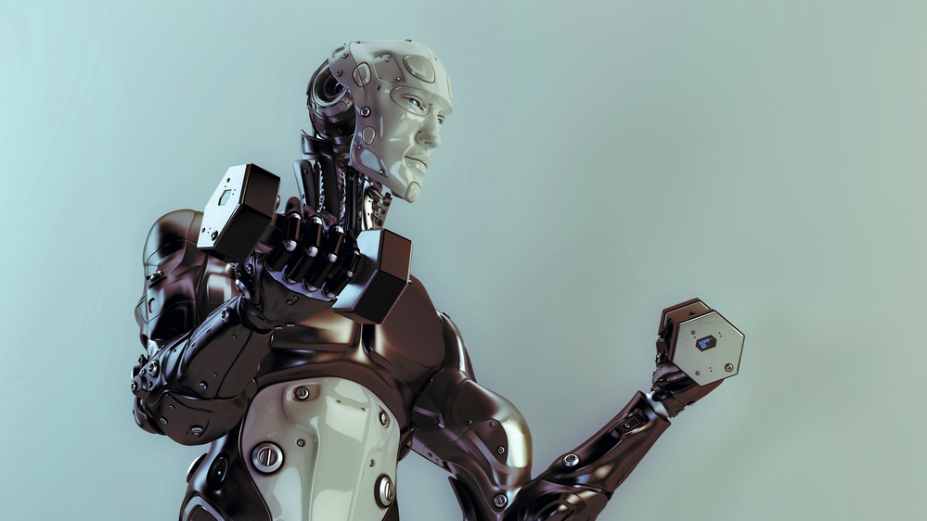
SOLUTION
GYM-BOT

Slide 13
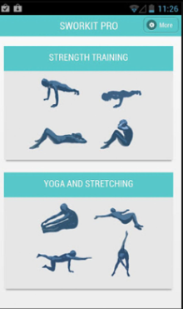
APPLICATION
YOUR TRAINER
YOUR MOTIVATOR
YOUR DIET ADVICER
YOUR PROGRESS RECORDER

Slide 14
PROBLEM VS SOLUTION
PROBLEM WITH TRAINER
SOLUTION WITH GYM-BOT
TOO COSTLY
NO GUARANTEES ABOUT A TRAINER'S REAL LEVEL OF KNOWLEDGE
RISKY IN COVID TIME
LOCATION & TIME MANAGEMENT ISSUES
PERSONALITY CLASHES
AVAILABLE FOR FREE
DICTATE / SHOW DETAILED GUIDANCE
WAKES YOU UP FOR GYM
GIVES YOU UNLIMITED MOTIVATION
ADVICE DIET TIPS
RECORDS YOUR DIALY PROGRESS &MORE

Slide 15
03
TOOLS USED

Slide 16
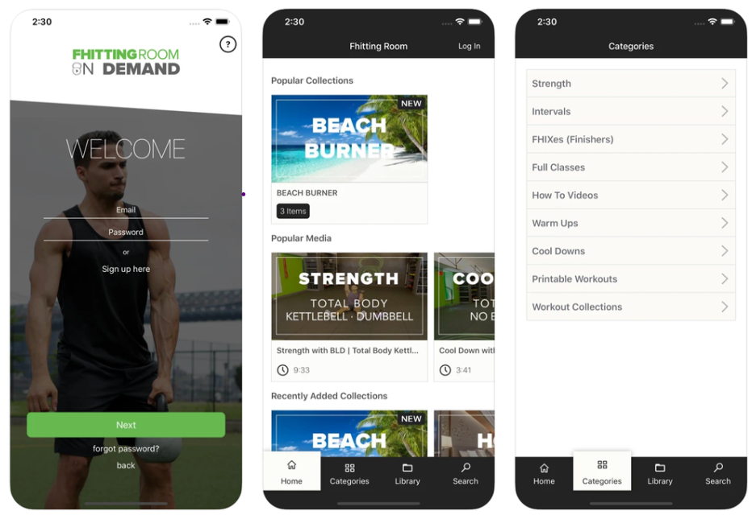
03
TOOLS USED
GYM-BOT
JUST REFERENCE!

Slide 17


TOOLS USED
ANDROID STUDIO
JAVA OOPS
Android Studio is the official Integrated Development Environment (IDE) for android application development.
Object-Oriented Programming is a methodology or paradigm to design a program using classes and objects.

Slide 18
OUTCOME,
Now people can train without an offline trainer. They will be helped with their motivation and diet factor. In Future ,by adding Artificial Intelligence and upgrading the UI ,we can be more user friendly.
“You need no one”

Slide 19
So,
GYM-BOT is your personal gym trainer which helps you to remind to go to the gym and guide you to your specific goal by dictating or by showing steps it to user, keeps you motivated and helps you in your diet .

Slide 20
THANKS!
Do you have any questions?

