Slide 1
GYM-BOT
By -
SAMARTH BANSAL

Slide 2
- ARNOLD SCHWARZENEGGER
"The resistance that you fight physically in the gym and the resistance that you fight in life can only build a strong character."

Slide 3
TABLE OF CONTENTS
01
03
02
04
OVERVIEW
CODE
UI
FUTURE
ADD-UPS

Slide 4
01
OVERVIEW

Slide 5

ABOUT BOT
GYM-BOT is your personal gym trainer that reminds you to workout, guides you towards your fitness goals, keeps you motivated, and helps with your diet.

Slide 6
PROBLEMS WHICH WE SOLVED
1
PERSONAL TRAINERS
ARE VERY
EXPENSIVE.
PEOPLE DON’T GET THE MOTIVATION
AND PATIANCE
PEOPLE CAN’T
MAINTAIN THEIR
SCHEDULE
2
3

Slide 7
02
UI

Slide 8
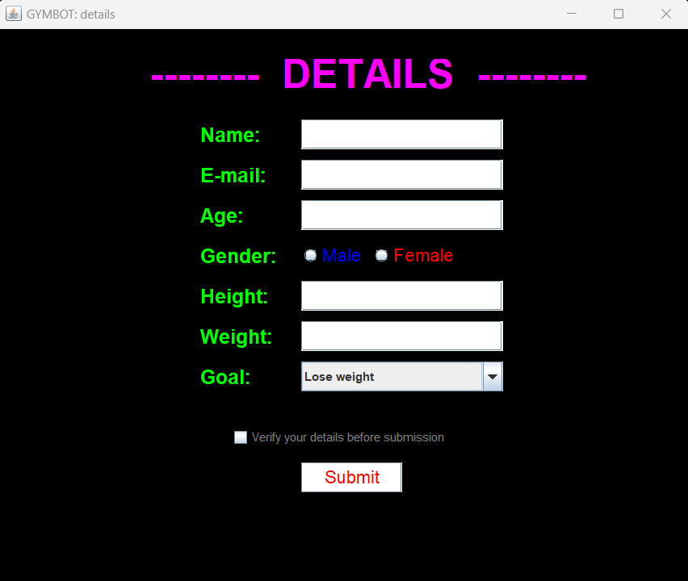
PAGE 1

Slide 9
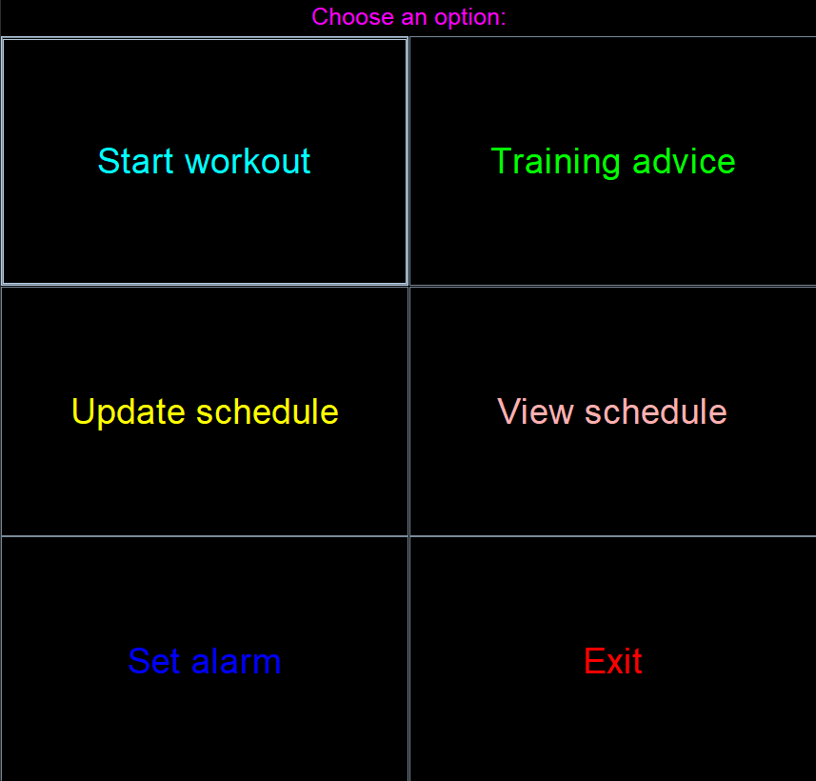
PAGE 2

Slide 10
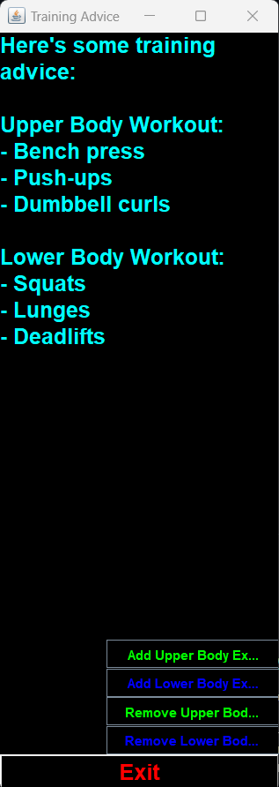
PAGE 3

Slide 11
USED JAVA SWING FOR USER INTERFACE

Slide 12
03
CODE

Slide 13
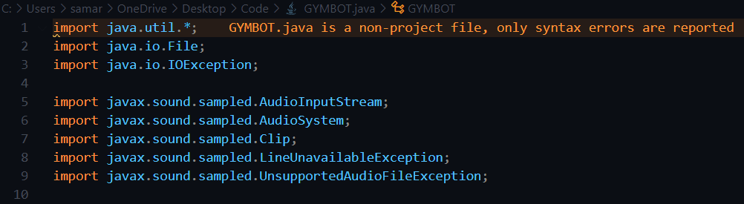
IMPORTED LIBRARY
used to load the contents of the java. util package in a Java program
tells the compiler where to look for the external classes you use in your code
checked exception that must be handled at compilation time
Provides interfaces and classes for capture, processing, and playback of sampled audio data.

Slide 14
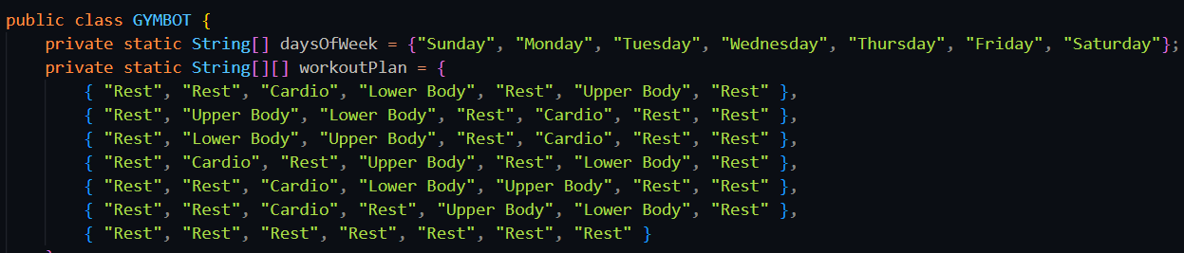
CODE WRITTEN
Introducing Array for having Days of Week and Workout Plan
Introducing Array for advising for Upper Body Exercise and Lower Body Exercise

Slide 15
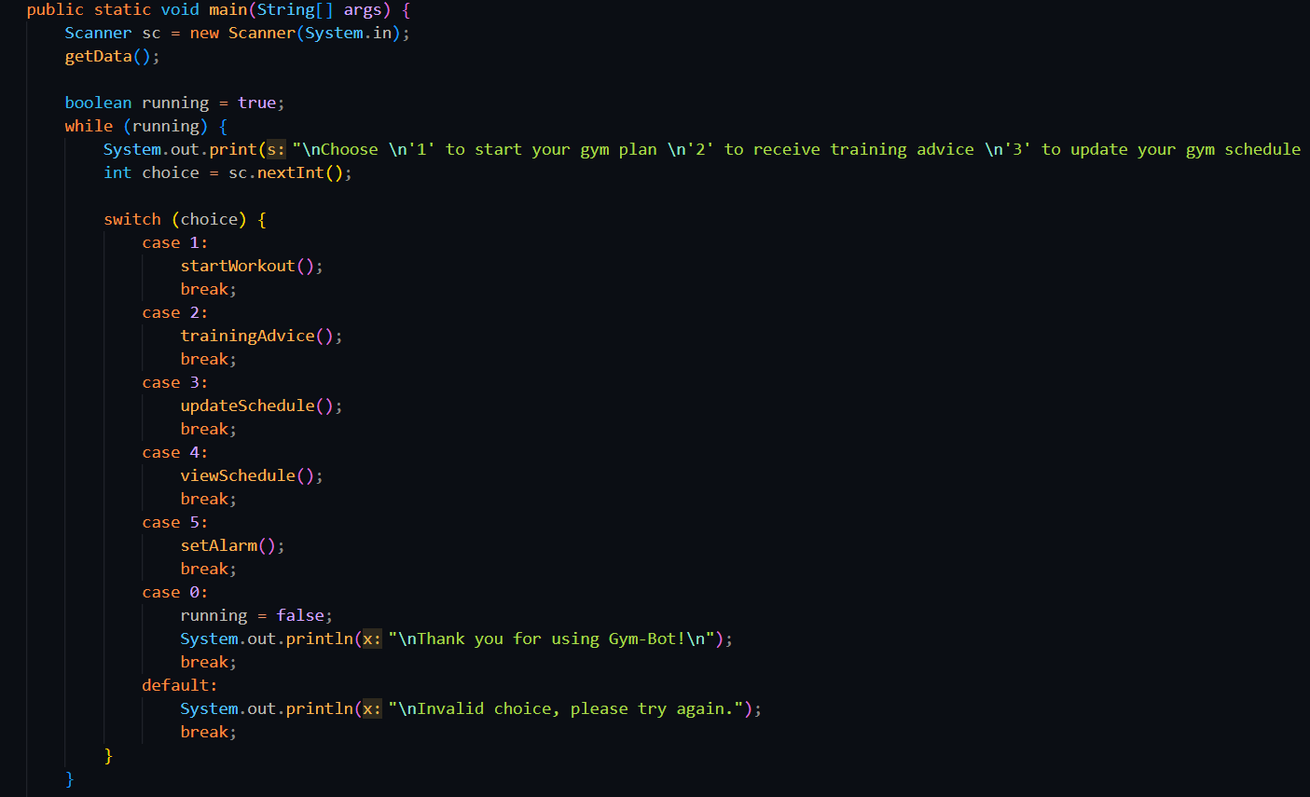
CODE WRITTEN
Making Menu for:
to start your gym plan
to receive training advice
to update your gym schedule
to view your gym schedule
to set Alarm
to exit

Slide 16
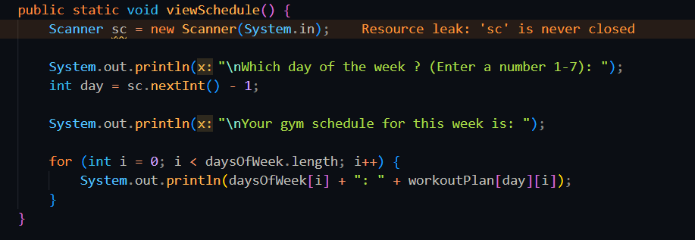
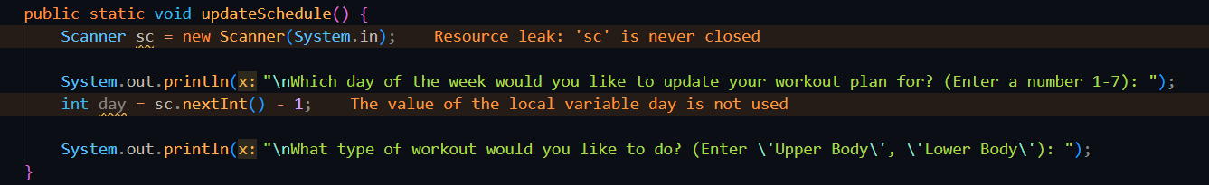
CODE WRITTEN
Code for
Seeing Schedule
Code for
Updating Schedule

Slide 17
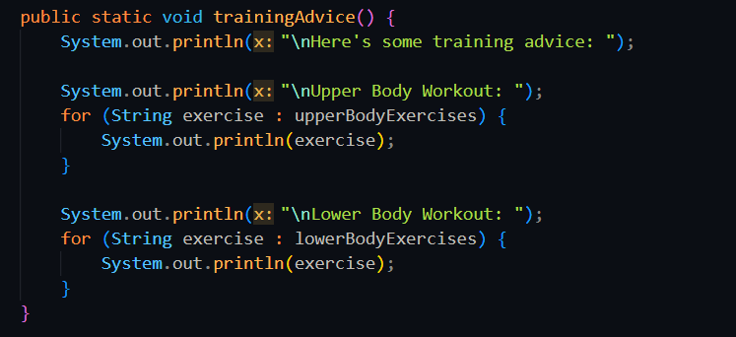
CODE WRITTEN
Code for
Training Advice

Slide 18
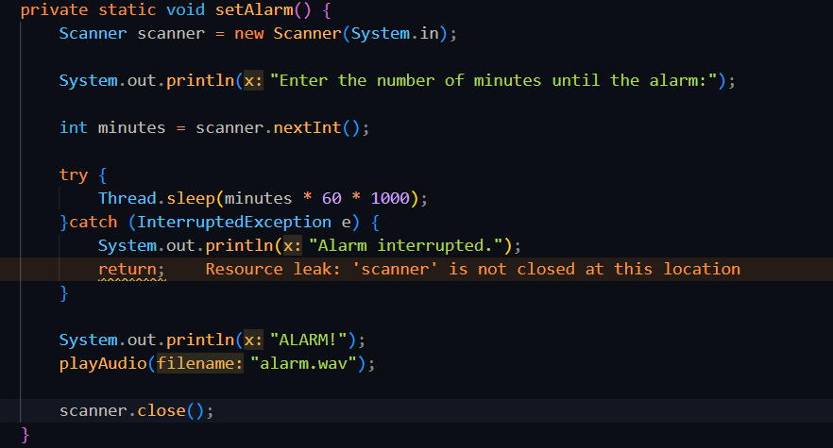
CODE WRITTEN
Code for
Setting Alarm

Slide 19
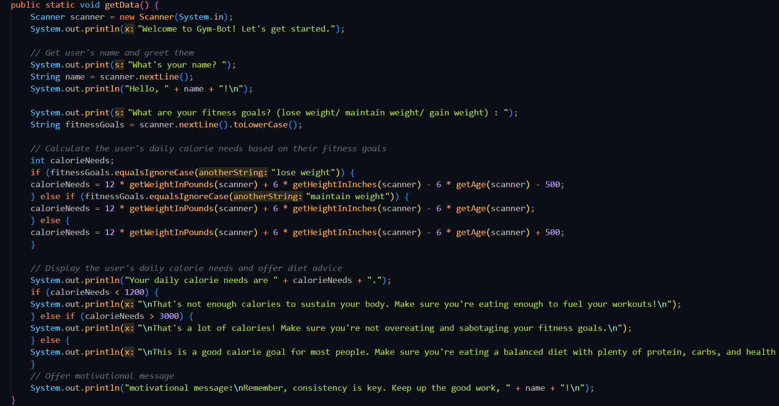
CODE WRITTEN
Code for
Getting Data about User for getting :
Name
Fitness Goal
Weight
Height
Age
And giving User :
Greetings
Calories Needed
His Situation
Advice on Diet
Motivation Message

Slide 20
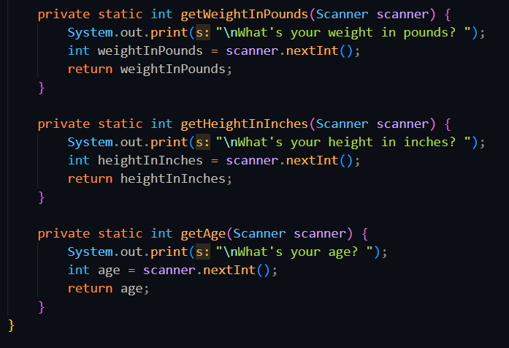
CODE WRITTEN
For Getting :
Weight
Height
Age
From User

Slide 21
USED JAVA OPPS FOR CODING
Object-Oriented Programming is a methodology or paradigm to design a program using classes and objects.
Platform Used For Coding Visual Studio Code

Slide 22
PROCESS
Step 1
Step 2
Step 3
Step 4
Step 5
Step 6
Making UI
for more Pages
Debug Program
Code for
Audio outputs
Code for
More Feature
Integrating
UI and Code
Run , Test, Code, Run…
Run , Test, Code, Run…

Slide 23
THANKS
Do you have any Question ?

