Slide 1
Network Coding: Theory and Practice
Apirath Limmanee
Jacobs University

Slide 2
Overview
Theory
  Max-Flow Min-Cut Theorem
  Multicast Problem
  Network Coding
Practice

Slide 3
Max-Flow Min-Cut Theorem
Definition
Graph
Min-Cut and Max-Flow

Slide 4
Definition
(From Wiki) The max-flow min-cut theorem is a statement in optimization theory about maximal flows in flow networks
The maximal amount of flow is equal to the capacity of a minimal cut.
In layman terms, the maximum flow in a network is dictated by its bottleneck.

Slide 5
Graph
Graph G(V,E): consists of a set and a set
  V consists of sources, sinks, and other nodes
  A member e(u,v) of E has a to send information from u to v
V of vertices
E of edges.
capacity c(u,v)
A
A
B
B
2
3
3
S
S
2
4
T
T
3
2
3
D
D
C
C

Slide 6
Min-Cuts and Max-Flows
Cuts: Partition of vertices into two sets
Size of a Cut = Total Capacity Crossing the Cut
Min-Cut: Minimum size of Cuts = 5
Max-Flows from S to T
Min-Cut = Max-Flow
3
A
A
B
2
B
3
3
3
3
3
2
3
2
S
S
1
2
2
4
T
2
3
4
T
3
3
2
2
2
3
3
D
D
C
C
2

Slide 7
Multicast Problem
Butterfly Networks: Each edge’s capacity is 1.
Max-Flow from A to D = 2
Max-Flow from A to E = 2
Multicast Max-Flow from A to D and E = 1.5
Max-Flow for each individual connection is not achieved.
A
B
C
F
G
D
E

Slide 8
Network Coding
Introduction
Linear Network Coding
Transfer Matrix
Network Coding Solution
Connection between an Algebraic Quantity and A Graph Theoretic Tool
Finding Network Coding Solution

Slide 9
Introduction
Ahlswede et al. (2000)
  With network coding, every sink obtains the maximum flow.
Li et al. (2003)
  Linear network coding is enough to achieve the maximum flow
b₁
A
b₂
B
C
b₁
b₂
F
b₁
b₁+b₂
b₂
b₁+b₂
G
b₁+b₂
D
E

Slide 10
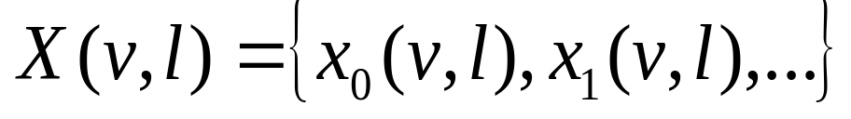
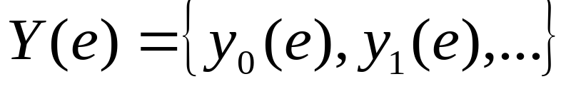
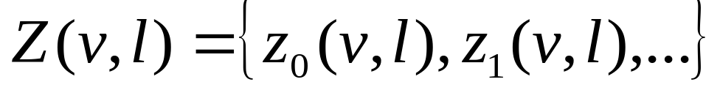
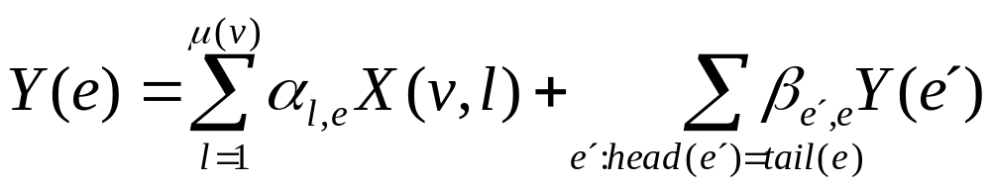
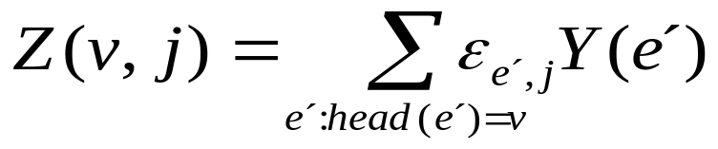
Linear Network Coding
Random Processes in a Linear Network
  Source Input:
  Info. Along Edges:
  Sink Output:
Relationship among them
Weighted Combination of processes generated at v
Weighted Combination of processes from adjacent edges of e
The index is a time index
Weighted Combination from all incoming edges
e comes out of v

Slide 11

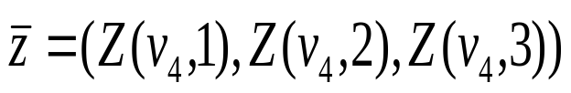
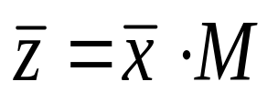


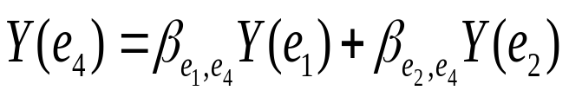
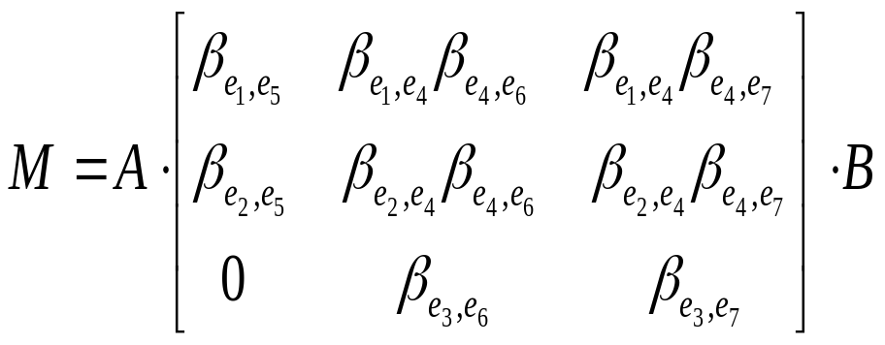


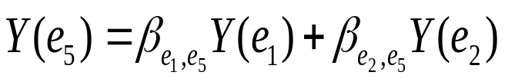


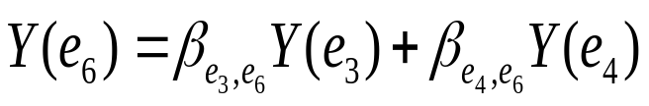
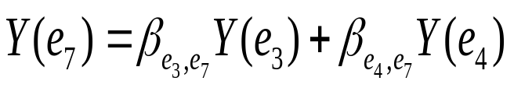
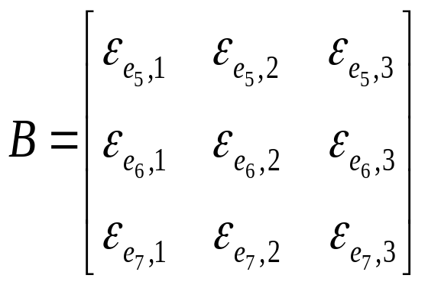
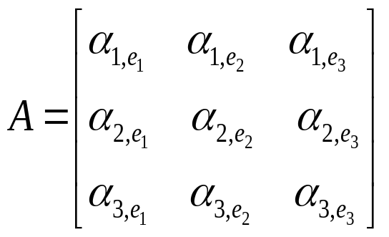
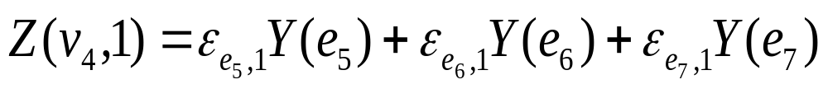
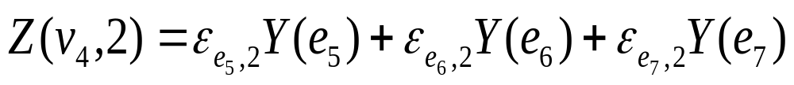
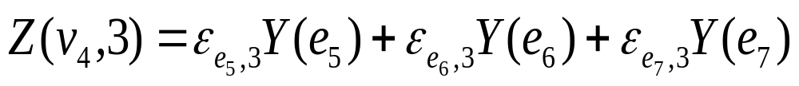
Transfer Matrix
e₁
v₂
e₅
e₂
v₁
e₄
e₆
v₄
e₃
e₇
v₃

Slide 12


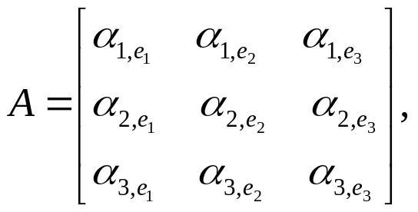
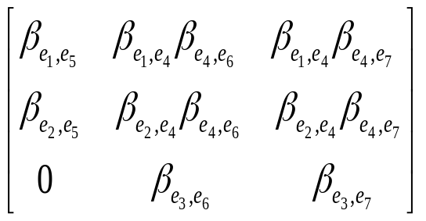
Network Coding Solution
We want
Choose to be an identity matrix.
Choose B to be the inverse of
NETWORK CODING SOLUTION EXISTS IF DETERMINANT OF M IS NON-ZERO

Slide 13







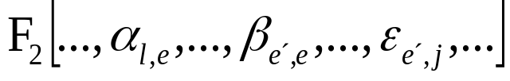
Connection between an Algebraic Quantity and A Graph Theoretic Tool
Koetter and Medard (2003): Let a linear network be given with source node , sink node , and a desired connection of rate . The following three statements are equivalent.
  1. The connection is possible.
  2. The Min-Cut Max-Flow bound is satisfied
  3. The determinant of the transfer matrix is non-zero over the Ring

Slide 14


Finding Network Coding Solution
Koetter and Medard (2003): Greedy Algorithm
Let a delay-free Communication Network G and a Solvable multicast problem be given with one source and N receivers. Let R be the rate at which the source generates information. There exists a solution to the network coding problem in a finite field with

Slide 15
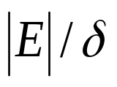

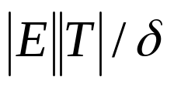

Random Network Coding
Jaggi, Sanders, et al. (2003): If the field size is at least , the encoding will be invertible at any given receiver with prob. at least , while if the field size is at least then the encoding will be invertible simultaneously at all receivers with prob. at least .

Slide 16
Practical Issues
Network Delay
Centralized Knowledge of Graph Topology
Packet Loss
Link Failures
Change in Topology or Capacity

Slide 17
Thank You

Slide 18
You Are Welcome.

