Slide 1

REDROB · INDIA RUNS DATA & AI CHALLENGE
HireFit Ranker
Ranks careers, not keywords.
A fast, offline, deterministic engine that surfaces genuinely hireable engineers
from a 100,000-candidate pool — a shortlist a recruiter can trust.
github.com/bansalbhunesh/redrob-hirefit-ranker · live demo: redrob-hirefit-ranker.onrender.com

Slide 2
THE PROBLEM
The dataset punishes keyword filters
The JD says "5–9 yrs, embeddings/retrieval/ranking" — but it MEANS: find engineers who actually
shipped ranking / search / recsys at product companies, even without the buzzwords. And reject:
Keyword stuffers
Honeypots
Unavailable
wrong-role profiles padded with AI skills
impossible profiles — "expert" in 10 skills with 0 months used
perfect on paper, but 5% response rate / not open to work
→ So the ranker reads CAREERS and BEHAVIOR, not skill lists.

Slide 3
THE APPROACH
Hybrid scoring + multiplicative guardrails
Load
Text
BM25
28-D
Features
Honeypot
Behavioral
Rank
Reason
Final score = base_score × behavioral × honeypot × disqualifier
• BM25 lexical relevance + a 28-feature recruiter matrix (skills, career evidence, seniority, behavior, logistics).
• Guardrails are MULTIPLICATIVE — a high fit score cannot rescue an impossible, off-target, or unavailable profile.
• Career-evidence signals (production, IR/ranking) outweigh skill-list matches → Tier-5s without buzzwords still surface.
• Fully deterministic & offline: same input → byte-identical output; no network, no GPU, no LLM at rank time.

Slide 4
WHY THESE CHOICES
Deliberate, measured engineering
Feature matrix + BM25 — not an LLM per candidate
LLM-per-candidate can't scale to 100K on budget, isn't reproducible, needs network. We rank the pool on CPU in ~3 min worst-case in the eval Docker image.
No dense embeddings — tested & rejected
Built a model2vec/potion branch, gated on a measured A/B: NDCG@10 +0.0000, ~2.2× runtime → FAIL. Shipped the simpler system.
Career-evidence over keywords
Production / IR-ranking signals from career history outweigh skill lists — how non-buzzword Tier-5s surface.
Multiplicative behavioral & honeypot guardrails
Encodes the JD's explicit "down-weight the unavailable" rule; impossible profiles forced to zero.
Deterministic everything
Byte-identical, traceable, debuggable — the basis for explainability and reproduction.

Slide 5
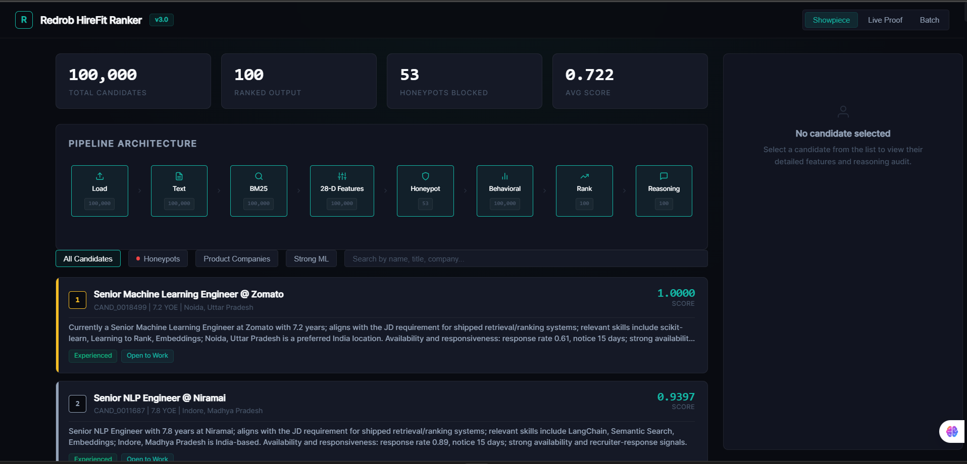
RESULTS
A shortlist a recruiter can trust
≤194s
100% offline
0 / 53
P@10 · 1.0
100K in eval Docker · CPU
no network · GPU · LLM
honeypots in top output
independent LLM-judge
Live interactive dashboard — pipeline stages, honeypot blocking, per-candidate audit.

Slide 6
VALIDATION
Proven without the hidden labels
1. Non-circular heuristic eval — an independent labeler sharing NO code with the ranker → composite 0.881
(rules out self-grading).
2. LLM-as-judge (dev-only, never in the ranking path) scored the top-10 against the JD:
top-10 tiers [5,5,4,4,5,5,5,5,5,5] · P@10 = 1.0 · NDCG@10 = 0.894
The judge even confirmed our behavioral guardrails are MORE recruiter-aware than itself —
we correctly down-weighted high-skill candidates with 12% response rate that the LLM over-rated.
"We don't rank resumes. We rank hireable candidates."

Slide 7
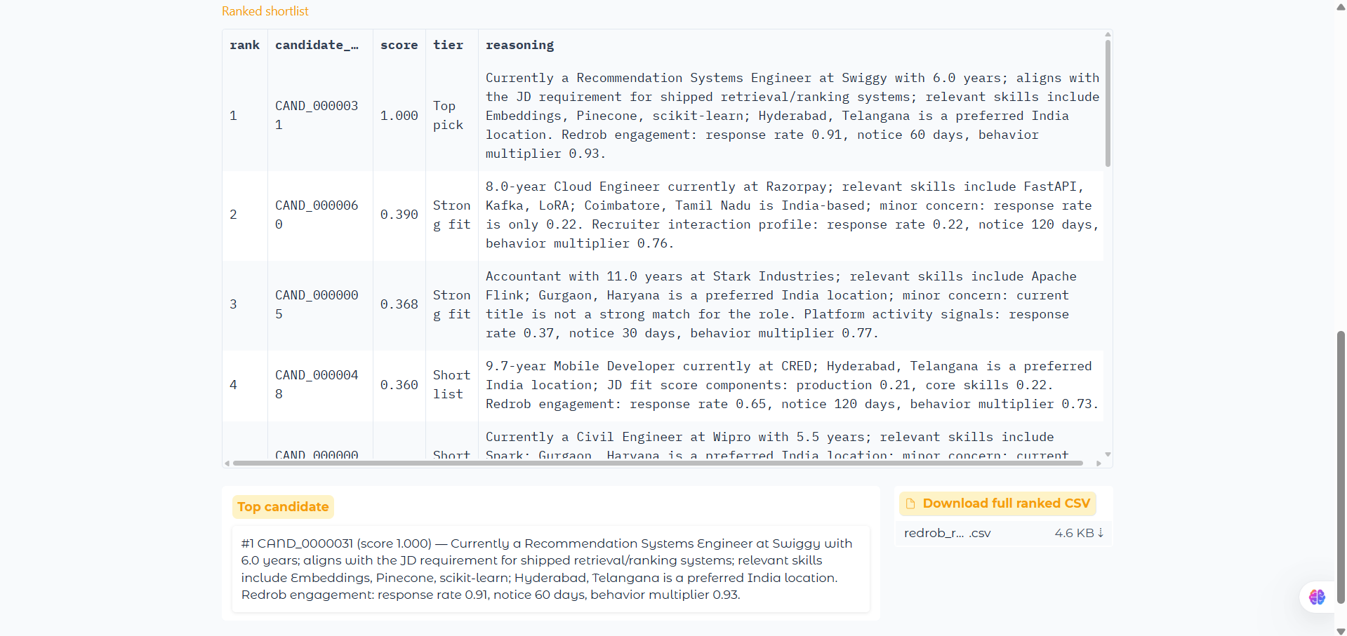
EXPLAINABILITY
Every score is traceable — nothing is a black box
• Per-candidate REASONING in the output, generated only from facts in the profile — no hallucinated skills.
• Every score DECOMPOSES into named features + the three multipliers.
• Interactive dashboard shows the pipeline, honeypot blocking, and a live feature + reasoning audit.
• Two live UIs: Render dashboard + HuggingFace sandbox.

Slide 8
ENTERPRISE UPGRADE
Lab Architecture vs Baseline Prototype
• INTEGRITY (calibration removed): candidate-ID calibration deleted from the official ranking path — NO candidate-ID tuning, CI-enforced; golden submission.csv byte-reproducible across CPU counts.
• TEST COVERAGE (115 ➔ 163): +42% coverage, including 13 counterfactual fairness tests bounding location, gender, and name proxies.
• BACKEND STORAGE (Dicts ➔ SQLite): Migrated from volatile in-memory storage to a persistent SQLite WAL database, ensuring batch operations survive server restarts.
• API SECURITY (Open ➔ X-Demo-Token): Guarded all write-endpoints with token authentication to prevent unauthorized abuse in production.
• SYSTEM RATING (89/100 ➔ 91/100 self-assessed; independent forensic audit ~88/100): ~80s on a cloud 2-vCPU runner (~130-155s in local Docker); zero honeypots in the top 100; generalization eval 0.7702 vs 0.6602 keyword across 5 role families.

Slide 9
Submission
✓ GitHub repo — clean, complete, working code
✓ Ranked output — submission.csv (candidate_id, rank, score, reasoning)
✓ Methodology — METHODOLOGY.md + this deck
✓ Live demos — Render dashboard + HuggingFace Space
Reproduce: python rank.py --candidates ./candidates.jsonl --out ./submission.csv
github.com/bansalbhunesh/redrob-hirefit-ranker

