Slide 1


Harsh Bansal

Slide 2
Tourism activity creates demand.
Tourism industry value chain meets & s preads demand across industries & boo sts more economic activities.
Tourism induces more consumption.

Slide 3

People who are interested in opening a restaurant, lodging, transport services, or any other similar businesses which fall within the tourism industry.
This also recommends travelers' tourist venues to be visited in a given state of a country.

Slide 4




The Wikipedia
page https://en.wikipedia.org/wiki/List_of_district s_in_India scraped to obtain all the districts of India.
Geopy API used to obtain latitude and longitude of
the respective districts.
Removed any missing values present in the dataset
The dataset consists of a single Dataframe with 9
columns.
The final dataset contains 719 rows which includes 36 states.

Slide 5
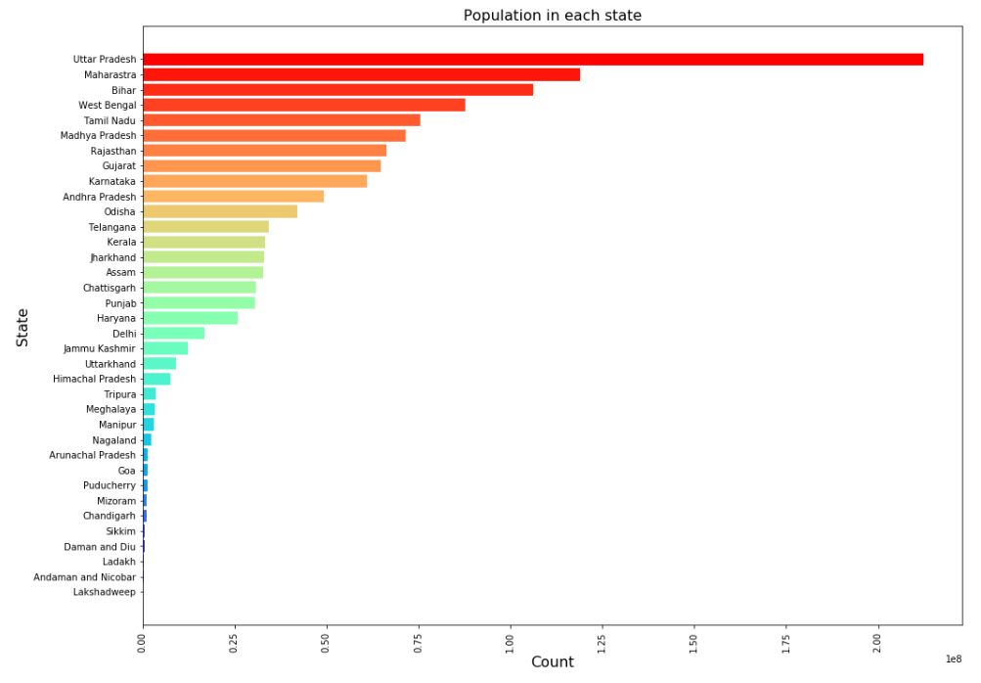







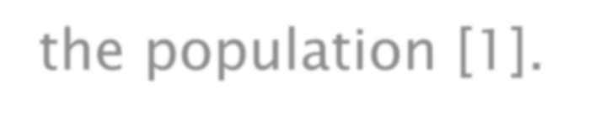
There are speciﬁc factors within the characteristics of the population which makes the tourism industry lead to an improvement of the socio-economic
conditions of the population [1].

Slide 6
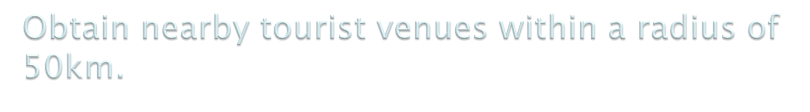
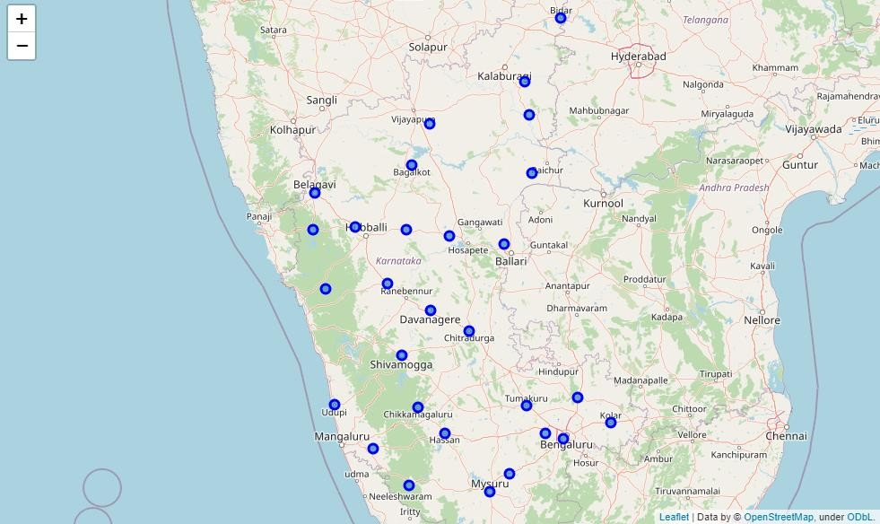

Slide 7
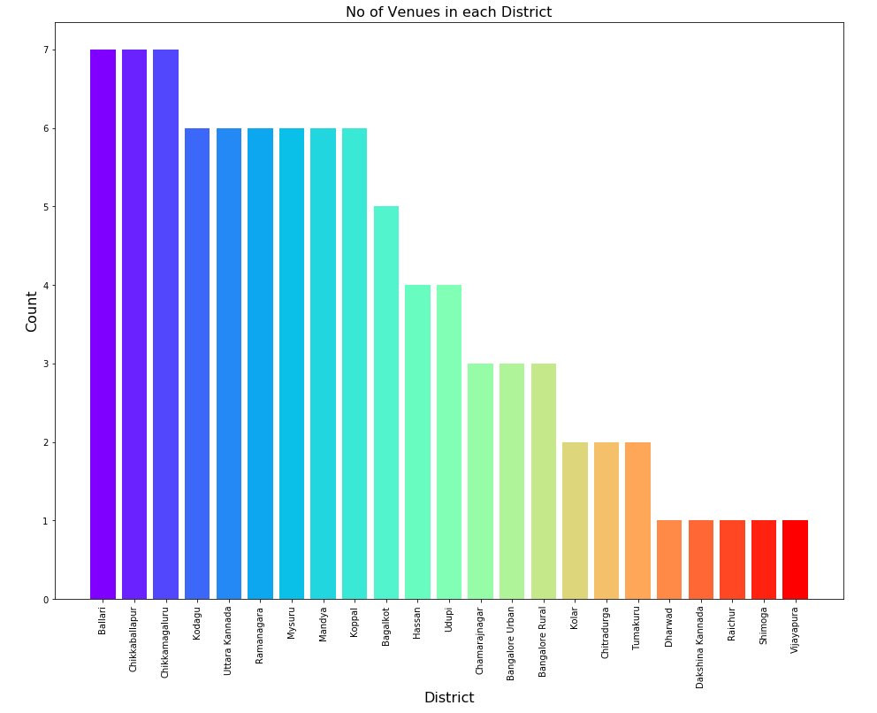

Count of number of venues in each District

Slide 8
Perform one-hot encoding to obtain famous tourist spots in each district.
Use the venues obtained to find the best business that could be established in the locality.
Use K-means algorithm to cluster the business categories obtained.

Slide 9
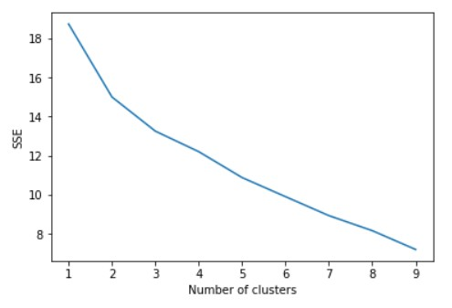
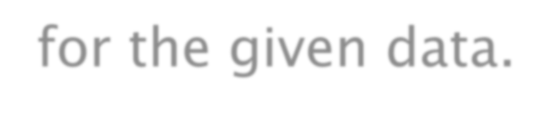
Elbow method used to find optimum value of k
for the given data.

Slide 10
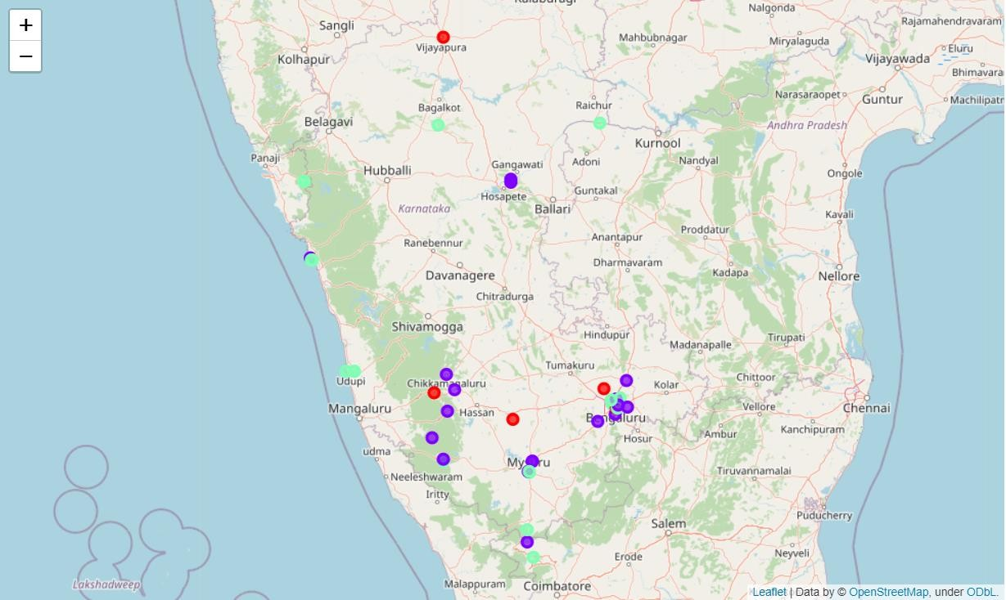
The colors purple, green, and red represents cluster 0, 1, and 2 respectively.

Slide 11
The results show that the most common business in cluster one at the respective venues are Indian Restaurants.
So Indian Restaurants are popular in these tourist venues and opening up a similar one can attract many tourists.
Whereas in cluster two the most sought business is the Hotel,
Seafood Restaurants, and Cafeterias.
The green clusters at the seaside clearly indicate that opening a seafood restaurant would help a person make the best use of the opportunity.
Finally, in cluster three Fast Food/Vegetarian Restaurants have been given a top priority.

Slide 12


Used K-means clustering algorithm to cluster the tourist spots based on exploring the frequency of the businesses that are present which could help indicate a business opportunity that could be established in the locality.
Future possible research could make use of other significant factors which includes the foot traffic,, accessibility, and average business rates. These above-mentioned factors could help the system make the analysis more accurate.

Slide 13
[1] Rivero, Marcelino & Cárdenas-García, Pablo. (2014). Population characteristics and the impact of tourism on economic development. Tourism Geographies. 16. 10.1080/14616688.2014.889207.

