Slide 1
Ind Study W4

Slide 2
Content
Hardware Requirements
CPU vs GPU
Virtualized DNN
Memory Requirements
HDF5 File
Introduction
Create HDFS file
Read HDF5 file

Slide 3
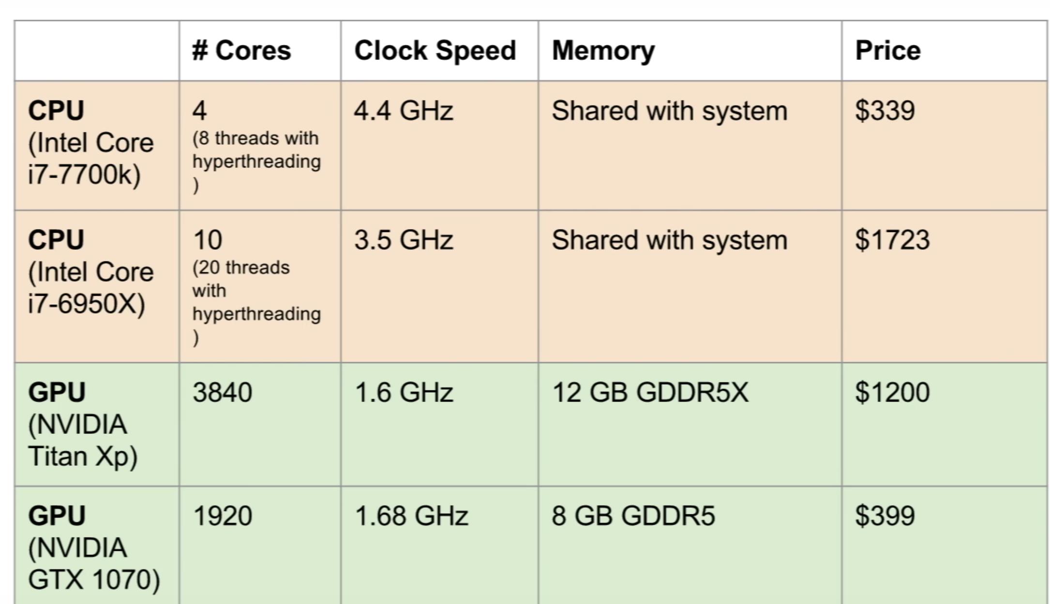
CPU vs GPU
CPU: Fewer cores, but each core is much faster and much more capable; great at sequential tasks
GPU: Originally developed for computer graphics; More core but each core is much slower and dumber; great at parallel tasks

Slide 4
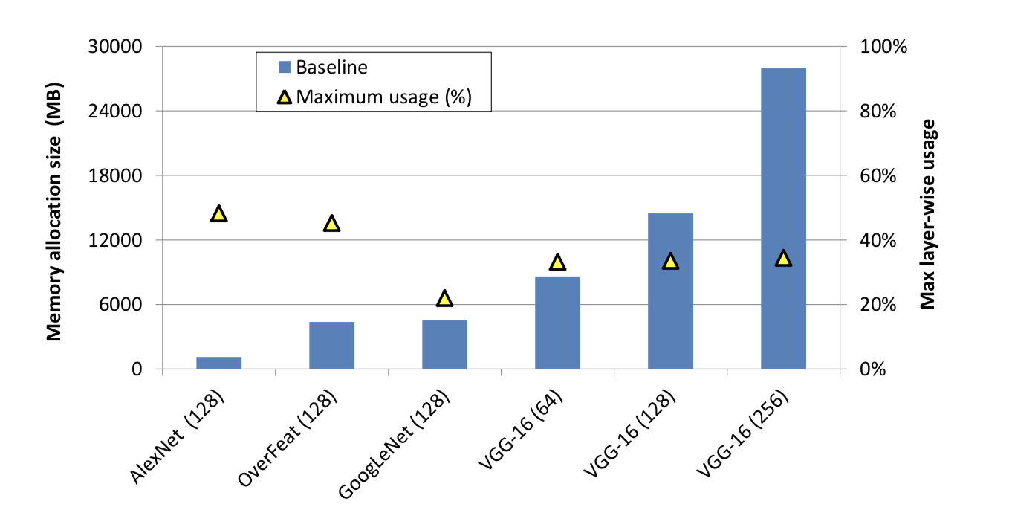
Virtualized Deep Neural Network
Enables VGG-16 with batch size 256 (requiring 28 GB of memory) to be trained on a single NVIDIA Titan X GPU card containing 12 GB of memory with 18% performance loss
Single GPU can accommodate a batch size of 64 for VGG-16

Slide 5
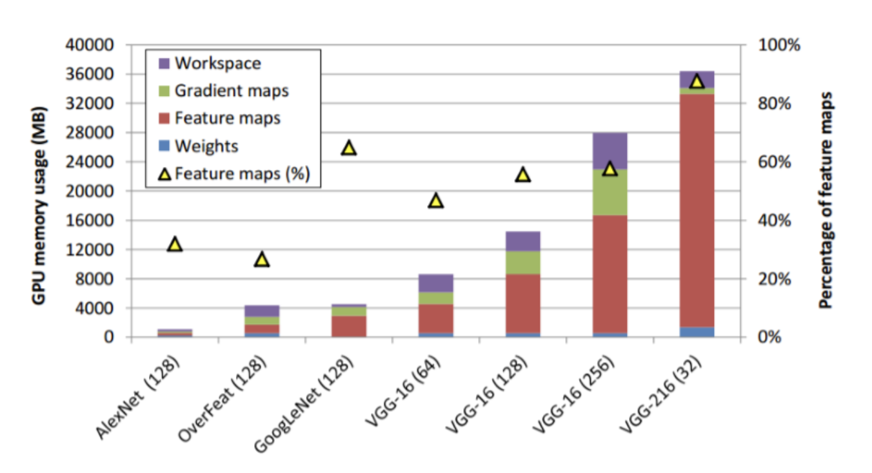
Memory requirements: CNN Model
Model | Layers | Memory | Batch SIze
AlexNet | 5 CV+2FC | 1.1 GB
VGG-16 | 16 CV+ 3 FC | 28 GB | 256

Slide 6
Who occupies the memory
We can divide the the data in GPU memory into 4 categories
Model Parameters (Weights)
Feature Map: intermediate results generated in forward process (most memory consuming>50%)
Gradient Maps: intermediate results generated in backward process
Workspace: buffer used for temporary variables/matrices

Slide 7
How to use Transfer Learning
Classifier: Use as is for classifying new data
Standalone Feature extractor: Use to pre process image for feature extraction
Integrated Feature extractor: integrate into a new model, but freeze layers of pre-trained model during training
Weight-Initialization: Use pre-trained model like a weight-initialization for new model

Slide 8
HDF5 Files: Introduction
Designed to store and organize large amount of data
Not efficient to load images from disk every time

Slide 9
Data Transformations
Randomly located crop of 224*224 pixels from a 256*256 pixel image
Flip the image horizontally

Slide 11
References
Memory efficient deep neural network: https://arxiv.org/pdf/1602.08124.pdf
Deep Learning GPU Solutions: https://www.exxactcorp.com/Exxact-VWS-1542881-DPN-E1542881
How to train very large deep model on one GPU: https://medium.com/syncedreview/how-to-train-a-very-large-and-deep-model-on-one-gpu-7b7edfe2d072
Resnet-50-from-scratch-using-the imagenet-dataset: https://blog.exxactcorp.com/deep-learning-with-tensorflow-training-resnet-50-from-scratch-using-the-imagenet-dataset/
Transfer learning: https://machinelearningmastery.com/how-to-use-transfer-learning-when-developing-convolutional-neural-network-models/
HDF5 File: http://machinelearninguru.com/deep_learning/data_preparation/hdf5/hdf5.html
Image enhancement in python: https://code.tutsplus.com/articles/image-enhancement-in-python--cms-29289
Image Processing by Interpolation and Extrapolation: http://netpbm.sourceforge.net/doc/extendedopacity.html
Manipulating images with Pillow: https://machinelearningmastery.com/how-to-load-and-manipulate-images-for-deep-learning-in-python-with-pil-pillow/

