Slide 1
ANZ INSIGHTFUL ANALYSES and visualizations
Presented by: Mohit Bansal

Slide 2
OVERALL INSIGHTS
Total time period as shown from the data: 3 months data (August 1, 2018 - 12 am to October 31, 2018 – 12 am)
Total customers during the three month period: 100 (with multiple transactions)
Total transaction amount: AUD 2263284.2
Total debited amount: AUD 586707.35
Total credited amount: AUD 1676576.85
Total authorized amount: AUD 309866.35
Total posted amount: AUD 1953417.85

Slide 3
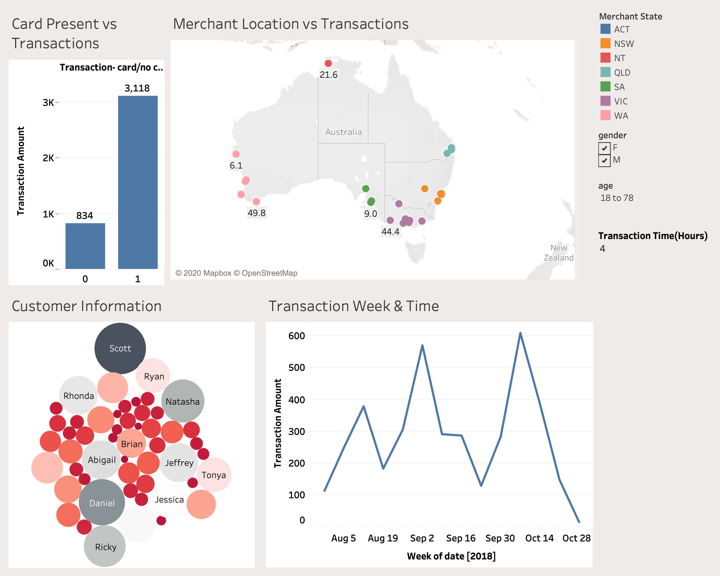
ANZ AUTHORIZED TRANSACTIONS

Slide 4
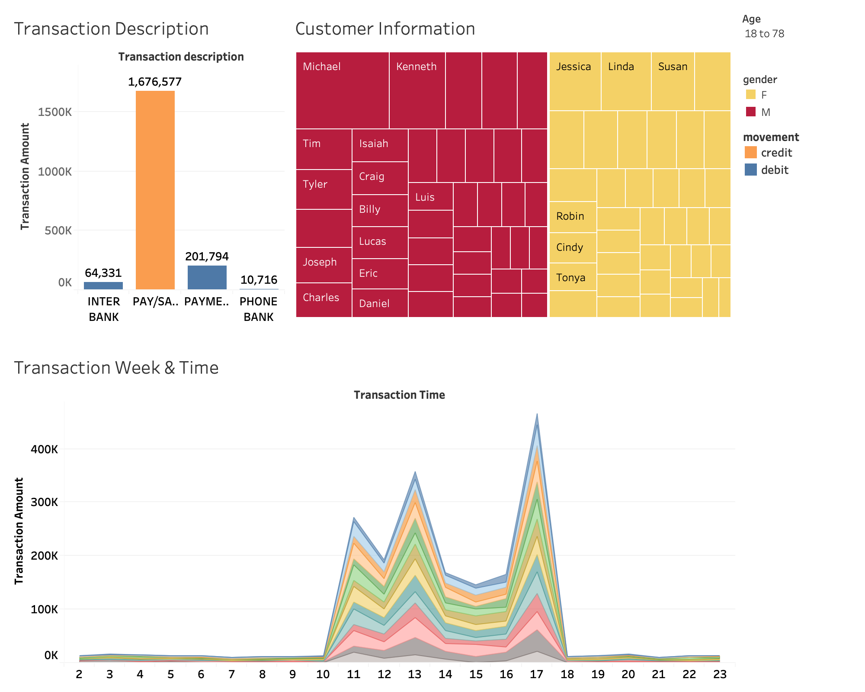
Posted transactions

