Slide 1
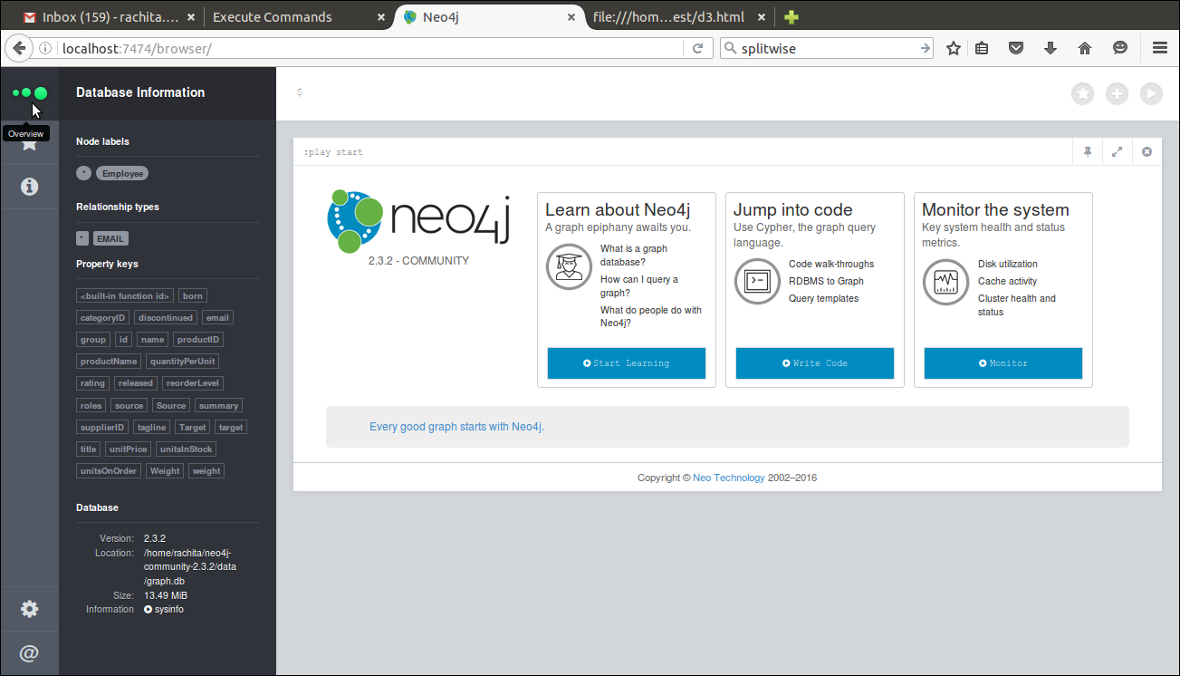
Start Neo4j and load the graph data in the form of nodes and relationships (can be done using python packages or Java spring)

Slide 2
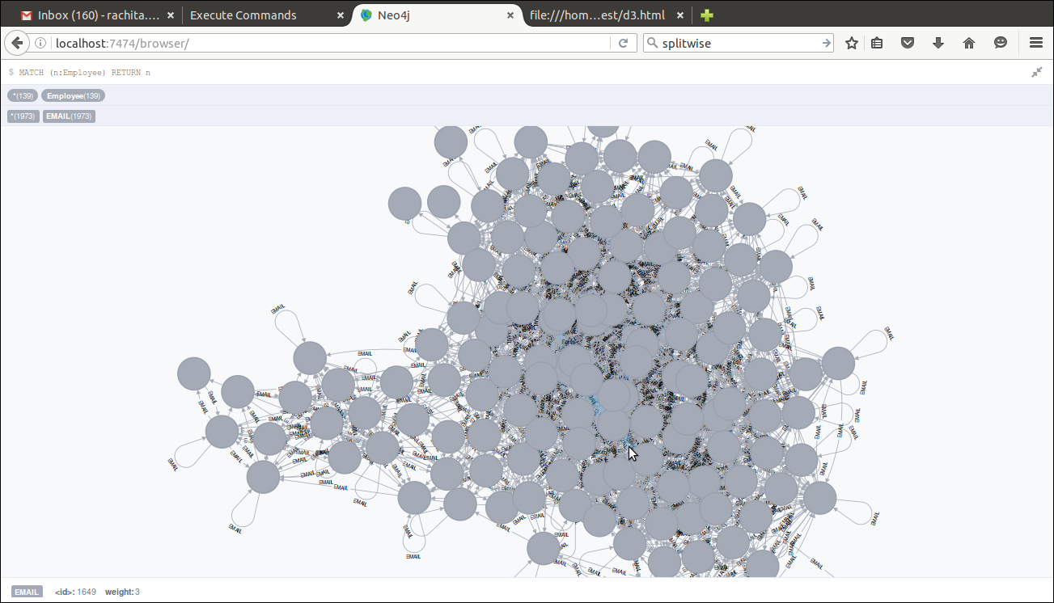
Query the nodes, neo4j gives you data in form of visualization and rows as well

Slide 3
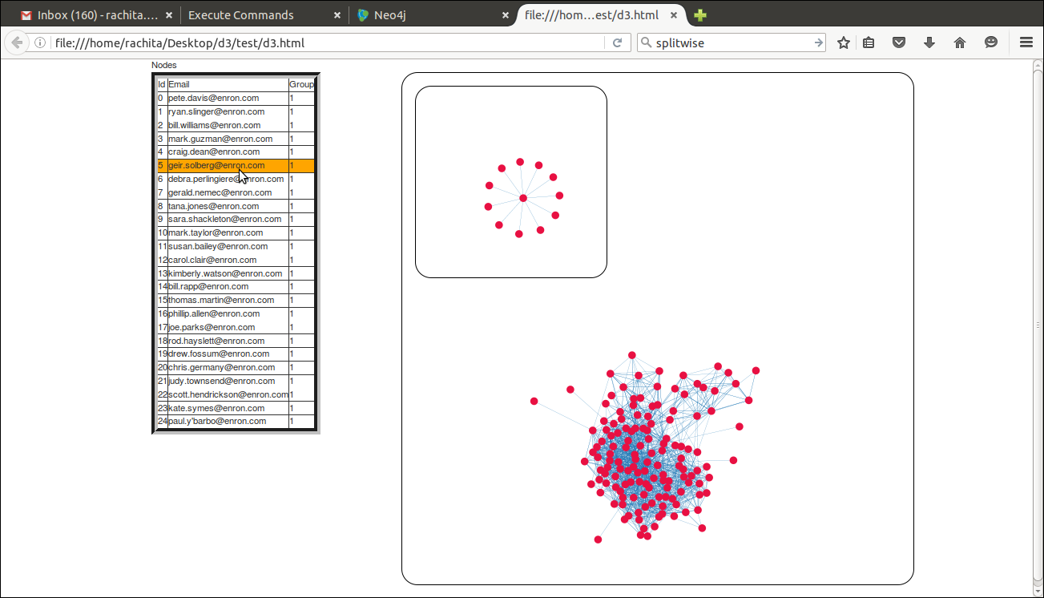
D3 can be used on top of neo4j to visualize the graph. Click on the email to get the connections in the smaller graph as shown..

Slide 4
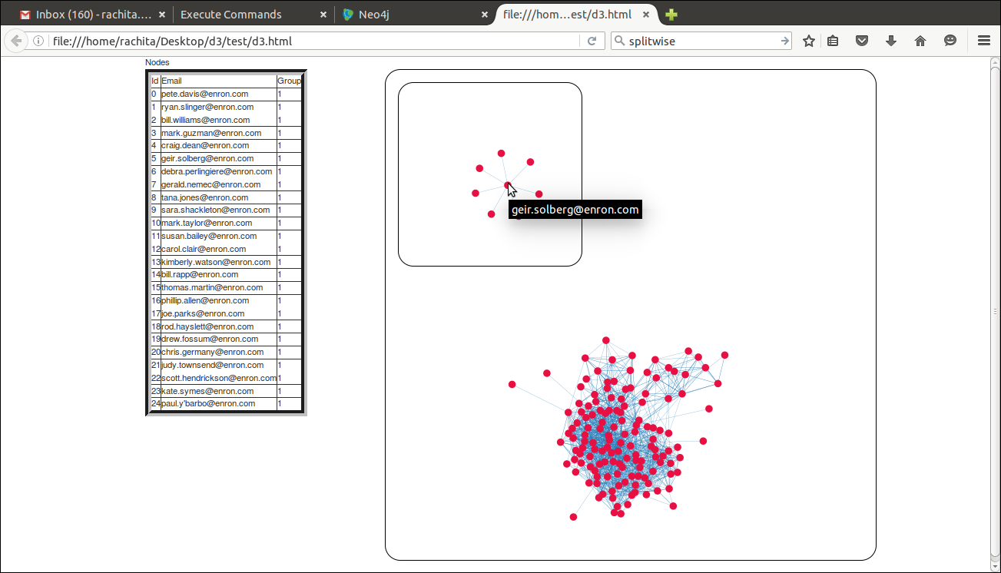
Small application which sends a POST request to query enron data from neo4j and gets back a json response which is used by D3.js

Slide 5
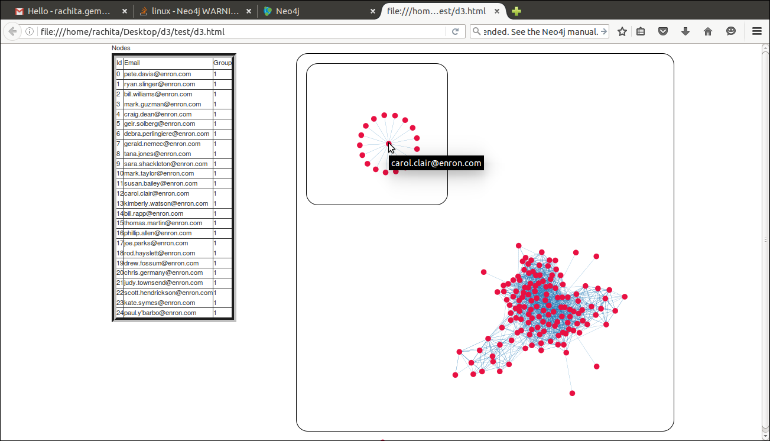
On click of email address, client sends a POST request to neo4j which generates a json response fetching the connections and then d3 displays that person's graph in the mini graph section.

