Slide 1

Customer Shopping Behavior Analytics Pipeline
End-to-End Data Analytics Project using Python, PostgreSQL, SQL, and Power BI
RAW DATA
PYTHON CLEANING
POSTGRESQL
SQL ANALYSIS
POWER BI DASHBOARD

Slide 2
EXECUTIVE SUMMARY
A Complete Analytics Workflow — From CSV to Dashboard
This project analyzes customer shopping behavior to uncover revenue trends, segment performance, and product insights — delivered through an interactive Power BI dashboard connected to PostgreSQL.
3.9K
$59.76
3.75
Customers Analyzed
Avg. Purchase Amount
Avg. Review Rating

Slide 3


BUSINESS PROBLEM
Business Problem & Objective
The business needed to understand customer shopping behavior and identify revenue trends, high-value segments, and product performance patterns. Six key questions drove the analysis:
Revenue & Categories
Customer Demographics
Subscription Impact
Which product categories generate the highest revenue?
Which age groups contribute the most revenue?
Do subscribers spend more than non-subscribers?
Product & Review Performance
Strategic Focus
Which customer segments should the business prioritize?
Which products are top performers and what is the overall review rating pattern?
Outcome: Raw customer data was converted into decision-ready insights.

Slide 4
ARCHITECTURE
Solution Architecture
End-to-End Pipeline Flow
End-to-end analytics architecture from raw data ingestion to interactive BI reporting.
01
02
03
CSV Dataset
Python + Pandas
SQLAlchemy → PostgreSQL
Raw customer transaction data ingestion
Data cleaning & feature engineering
Structured database loading via URL.create
04
05
DBeaver SQL Analysis
Power BI Dashboard
CTEs, window functions, ranking queries
Interactive BI reporting & business insights

Slide 5
DATA ENGINEERING
Backend Data Preparation
Python and Pandas transformed the raw CSV into a clean, analysis-ready dataset.
Column Standardization
Data Cleaning Steps
Lowercase snake_case naming
Duplicate column validation
Unnecessary field removal
Loaded raw CSV into Pandas DataFrame
Standardized column names to snake_case
Category-wise median imputation for missing ratings
Created age_group using qcut
Mapped frequency text labels to numeric days
Validated and removed redundant columns
Example Transformations
Customer ID → customer_id
Purchase Amount (USD) → purchase_amount_usd
Review Rating → review_rating
Frequency of Purchases → frequency_of_purchases

Slide 6



FEATURE ENGINEERING
Feature Engineering for Business Analysis
Three engineered fields made the dataset SQL-ready and BI-compatible.
review_rating
age_group
purchase_frequency_days
Missing values filled using category-wise median — preserving product-category behavior patterns.
Customers bucketed into: Young Adult, Adult, Middle-aged, Senior for demographic segmentation.
Text labels mapped to numeric days: Weekly=7, Fortnightly=14, Monthly=30, Quarterly=90, Annually=365.

Slide 7
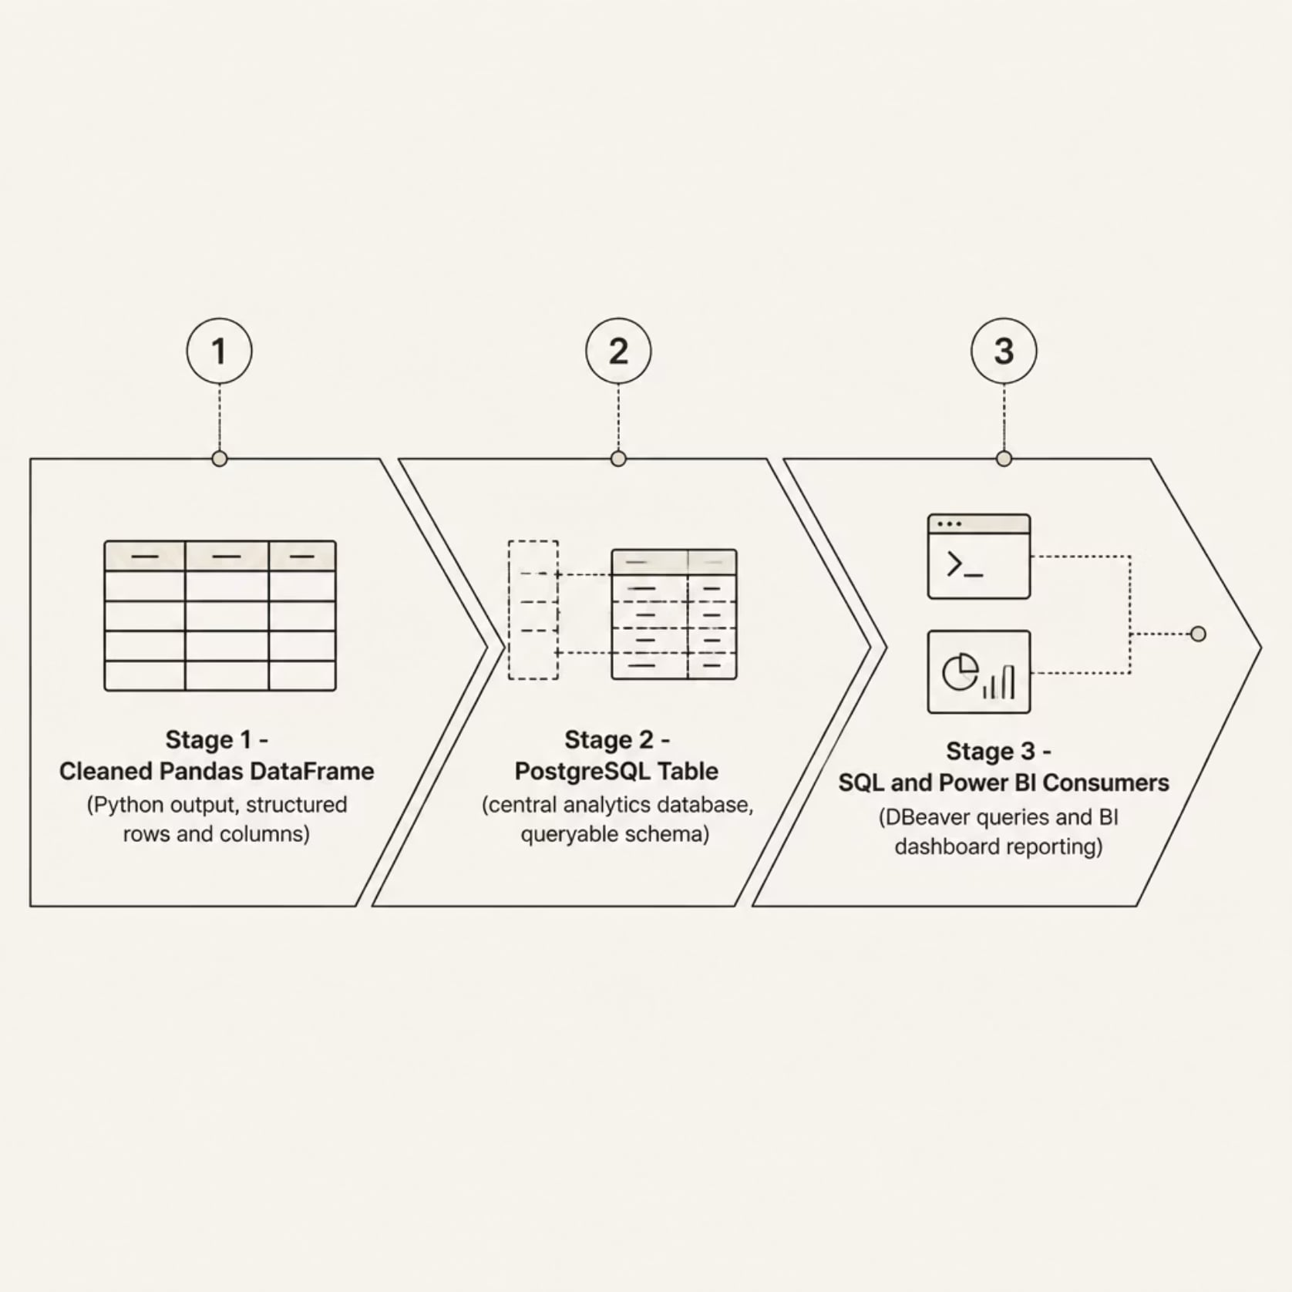
DATABASE LAYER
PostgreSQL as the Analytics Database Layer
Database Loading Approach
The cleaned Pandas DataFrame was loaded into a local PostgreSQL database using SQLAlchemy.
SQLAlchemy engine with URL.create for secure connections
Cleaned DataFrame pushed directly into PostgreSQL
PostgreSQL became the central analytics layer for SQL and Power BI
This converted a flat CSV into a structured database table suitable for querying, reporting, and BI integration.

Slide 8
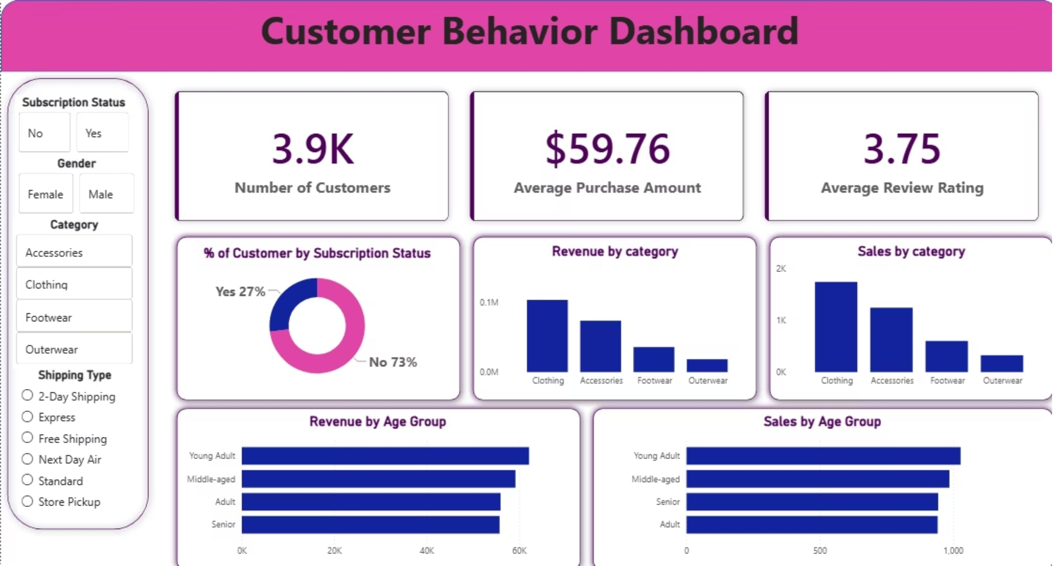

SQL ANALYTICS
Advanced SQL Analysis Layer
SQL Techniques Used
Business Questions Answered
Total revenue by gender
Discount customers spending above average
Top 5 products by average review rating
Subscriber vs. non-subscriber revenue comparison
Standard vs. Express shipping purchase behavior
SQL analysis in DBeaver used to validate metrics and generate business insights.
Aggregations & GROUP BY analysis
CTEs for modular query design
Window functions & ranking
Revenue & customer segmentation queries

Slide 9
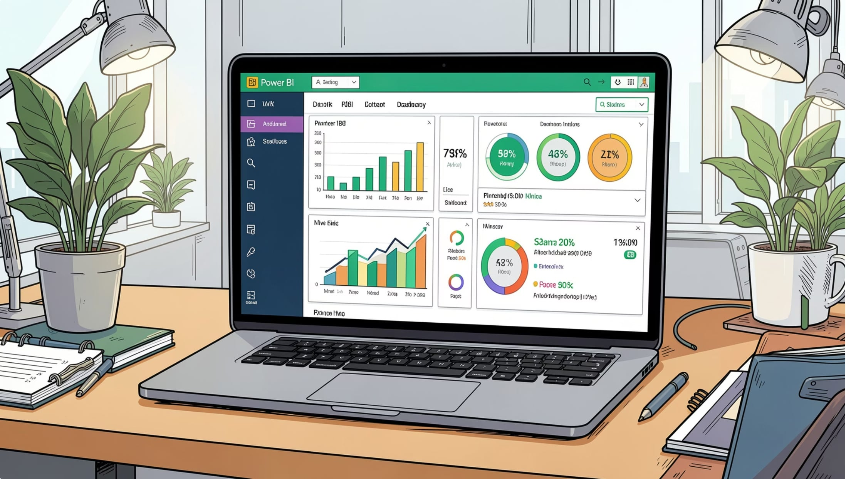
BUSINESS INTELLIGENCE
Interactive Power BI Dashboard
Power BI Desktop connected directly to PostgreSQL, building an interactive dashboard for stakeholder analysis.
Dashboard Components
KPI Cards: Total Customers, Avg. Purchase Amount, Avg. Review Rating
Visuals: Donut chart, category revenue charts, age group breakdowns
Slicers: Subscription Status, Gender, Category, Shipping Type
3.9K
$59.76
3.75
Total Customers
Avg. Purchase
Avg. Rating

Slide 10
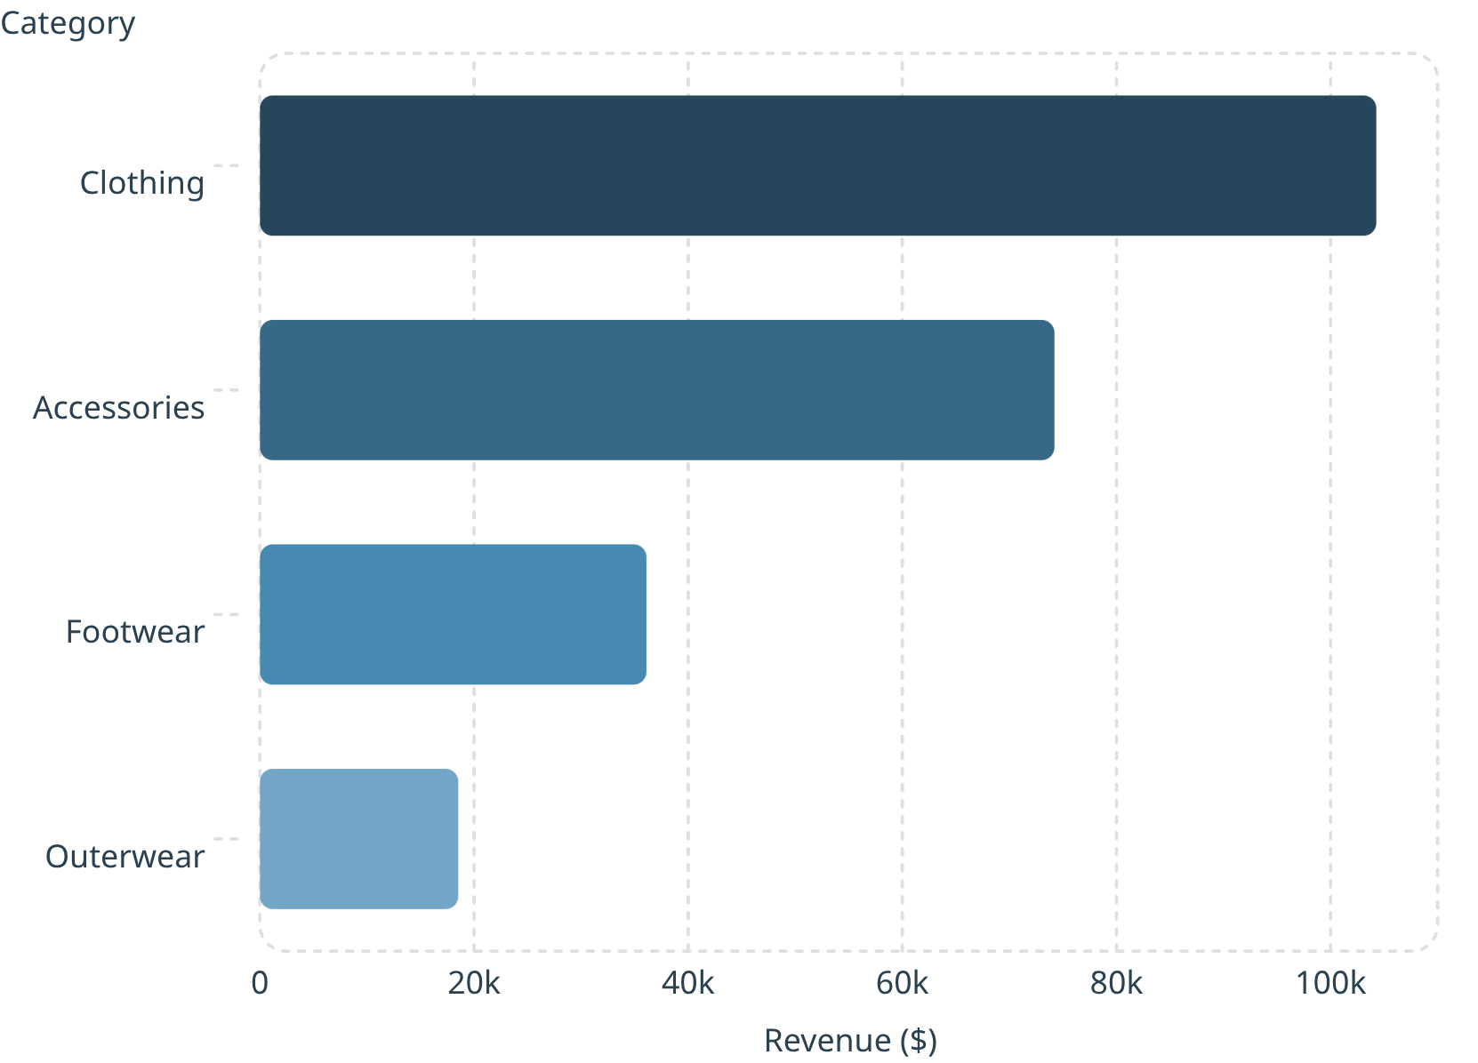

KEY INSIGHTS
Key Business Insights
Category Revenue Highlights
Clothing: $104,264 — 1,737 sales, dominant category
Accessories: $74,200 — 1,240 sales
Footwear: $36,093 — 599 sales
Outerwear: $18,524 — 324 sales
Clothing leads both revenue and volume — prioritize for marketing and inventory planning.
Subscription Gap
Top Revenue Segment
Strongest Season
73% non-subscribers vs. 27% subscribers — strong conversion opportunity.
Young Adults: $62,143 — highest-value demographic for targeted campaigns.
Fall: $60,018 — ideal for seasonal campaign planning.

