Slide 1
Implementation of
Asynchronous FIFO
Summer Internship Project
Bansari Mistry
EC081
Electronics and Communication Department,
Faculty of Technology,
Dharmsinh Desai University

Slide 2
INDEX
Introduction
Block Diagram
Write-Read Operations
Full & Empty Flag Condition
RTL View
Metastability & Clock Domain Crossing
Simulation Results
Delay Analysis
Application
Conclusion

Slide 3
KEYWORDS
Clock Domain Crossing (CDC) – Safe transfer of data between asynchronous clocks
Read/Write Pointers – Core mechanism to track data locations for reading and writing.
Full/Empty Flags – Essential for preventing overflow and underflow conditions.

Slide 4
INTRODUCTION
A First-In-First-Out (FIFO) is a sequential storage mechanism in which the earliest data written into the buffer is the first to be retrieved.
Principle of Operation: Data elements are inserted at the write interface and removed from the read interface in the exact order of arrival, thereby preserving temporal sequence.
Significance: Ensures orderly data transfer without loss, duplication, or reordering, which is critical in high-speed digital systems.
TYPES OF FIFO:
1.SYNCHRONOUS FIFO
2.ASYNCHRONOUS FIFO

Slide 5

ASYNCHRONOUS FIFO
Asynchronous FIFO is used to transfer data between two independent clock domains.
Unlike synchronous FIFO, the write clock (WCLK) and read clock (RCLK) are unrelated in frequency and phase.
Uses pointer synchronization and Gray code encoding to avoid metastability when passing control signals across clocks.
Provides status flags (Full & Empty) for safe operation.
Essential in SoC designs, communication interfaces, and multi-clock systems where data integrity must be maintained.

Slide 6
KEY MODULES
Dual Port Ram
Write Module
Read Module
Synchronizer
Binary to Gray Converter & Gray to Binary Converter

Slide 7
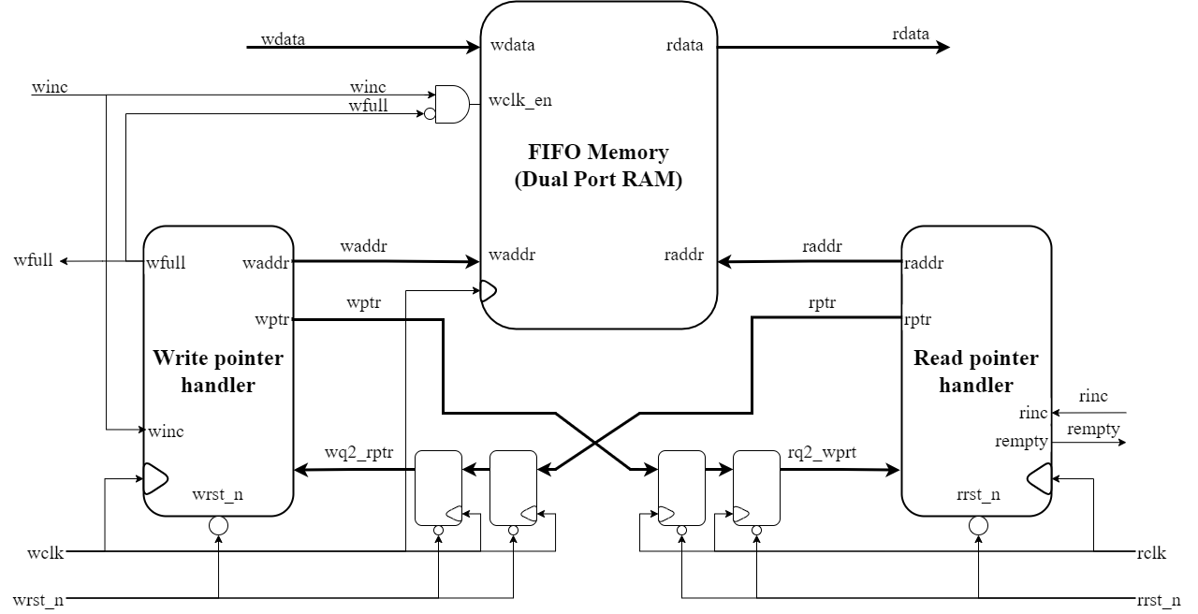
BLOCK DIAGRAM

Slide 8
1D
0111
0111
1C
0110
0110
1B
0101
0101
1A
0100
0100
D
0011
0011
C
0010
0010
B
0001
0001
A
0000
1000
0000

Slide 9
WRITE OPERATION
The write mechanism operates entirely within the write clock (WCLK) domain, independent of the read domain.
When the Write Enable (WEN) is active at the write clock edge, the write pointer increments and the input data is stored into the FIFO memory.
To ensure data integrity, the write pointer is compared with the synchronized read pointer, preventing overwriting of unread data

Slide 10
READ OPERATION
The read mechanism operates entirely within the read clock (RCLK) domain, independent of the write domain.
When the Read Enable (REN) is active at the read clock edge, the read pointer increments and the corresponding data word is retrieved from the FIFO memory.
To ensure data integrity, the read pointer is compared with the synchronized write pointer, preventing access to invalid or unwritten locations.

Slide 11
READ OPERATION
The Empty flag is asserted when the read and synchronized write pointers are equal, indicating no unread data is available.
This mechanism enables reliable data extraction across asynchronous clock domains, safeguarding against underflow and data corruption.

Slide 12
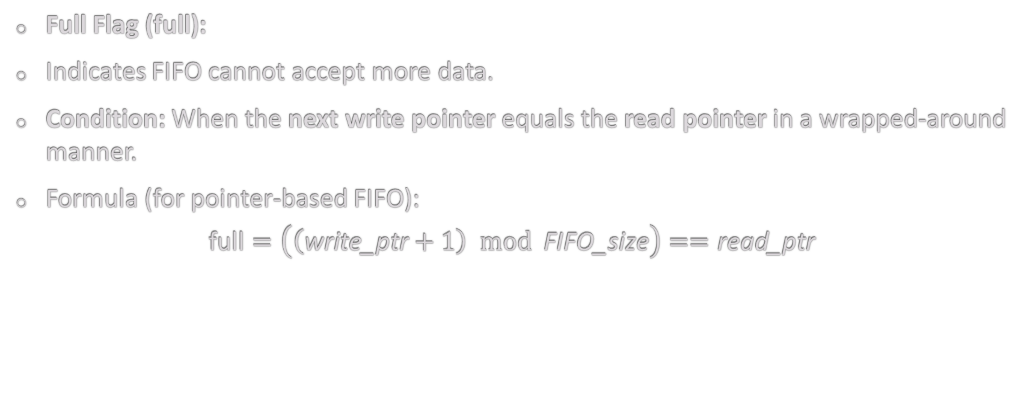
FULL FLAG GENERATION
Full Flag (full):
Indicates FIFO cannot accept more data.
Condition: When the next write pointer equals the read pointer in a wrapped-around manner.
Formula (for pointer-based FIFO):
$$\text{full}=\left(\left(\text{write}\text{_}\text{ptr}+1\right) mod \text{FIFO}\text{_}\text{size}\right)==\text{read}\text{_}\text{ptr}$$

Slide 13
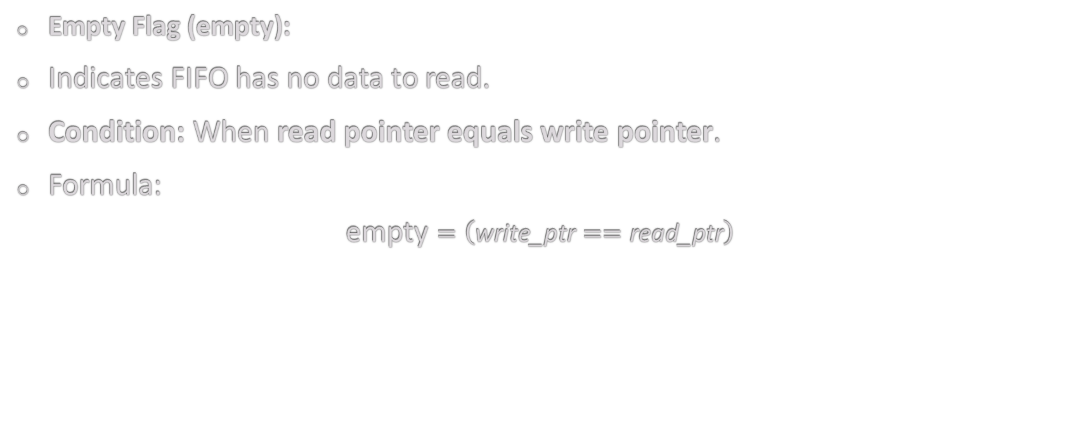
EMPTY FLAG GENERATION
Empty Flag (empty):
Indicates FIFO has no data to read.
Condition: When read pointer equals write pointer.
Formula:
$$\text{empty}=\left(\text{write}\text{_}\text{ptr}==\text{read}\text{_}\text{ptr}\right)$$

Slide 14
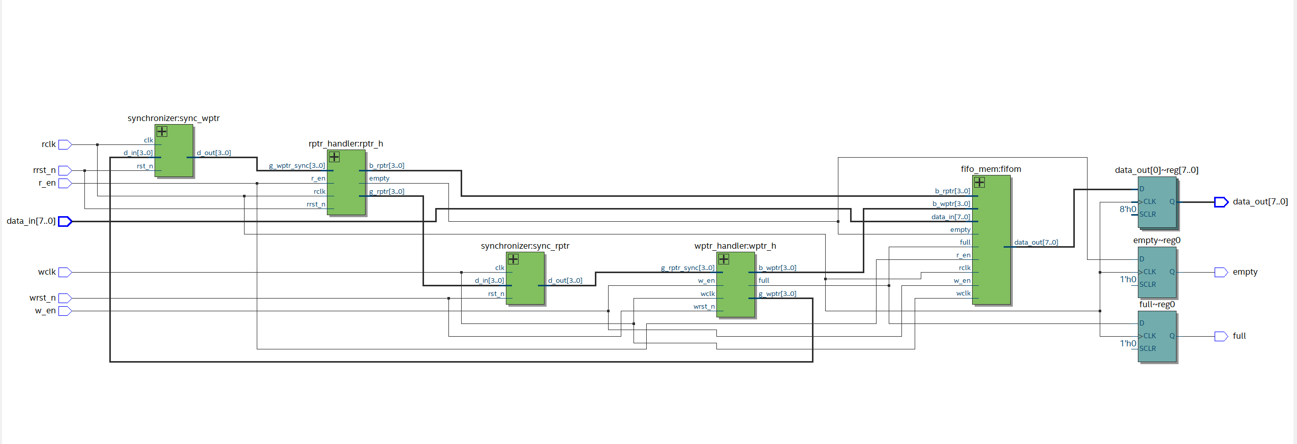
RTL VIEW

Slide 15
METASTABILITY & CLOCK DOMAIN CROSSING
Clock Domain Crossing (CDC): Occurs when signals pass between two asynchronous clock domains, such as write and read clocks in an async FIFO.
Metastability: A temporary, unpredictable state of a flip-flop that arises when an input changes close to the clock edge, potentially causing incorrect data propagation.
Impact in FIFO: Unsynchronized pointer or control signals can lead to data corruption, underflow, or overflow.
Mitigation Techniques:
1.Synchronizer Flip-Flops: Multi-stage flip-flops to stabilize signals across domains.
2.Gray Code Pointers: Minimizes transitions to a single bit, reducing metastability risk.
Significance: Ensures reliable and deterministic operation of asynchronous FIFO across independent clock domains.

Slide 16
SIMULATION RESULTS

Slide 17
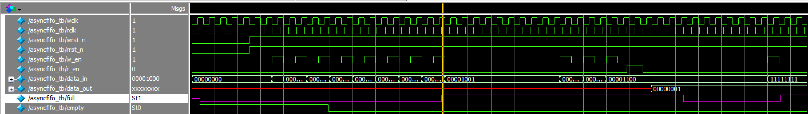
i.Full Flag is Set

Slide 18
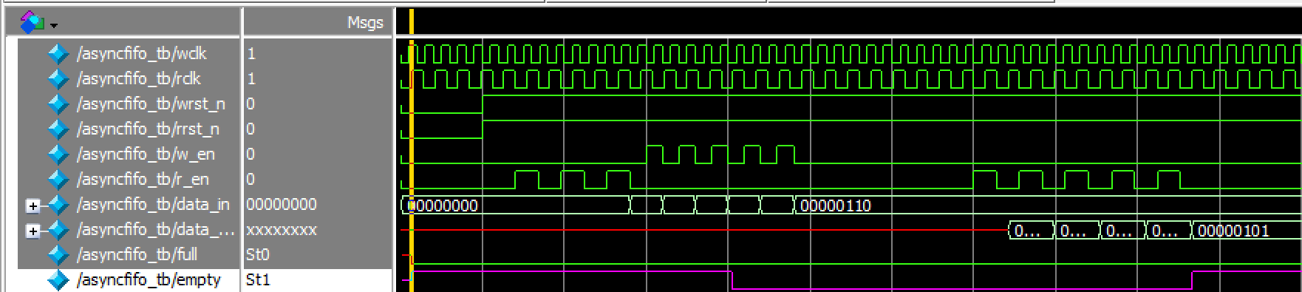
ii.Empty Flag is Set

Slide 19
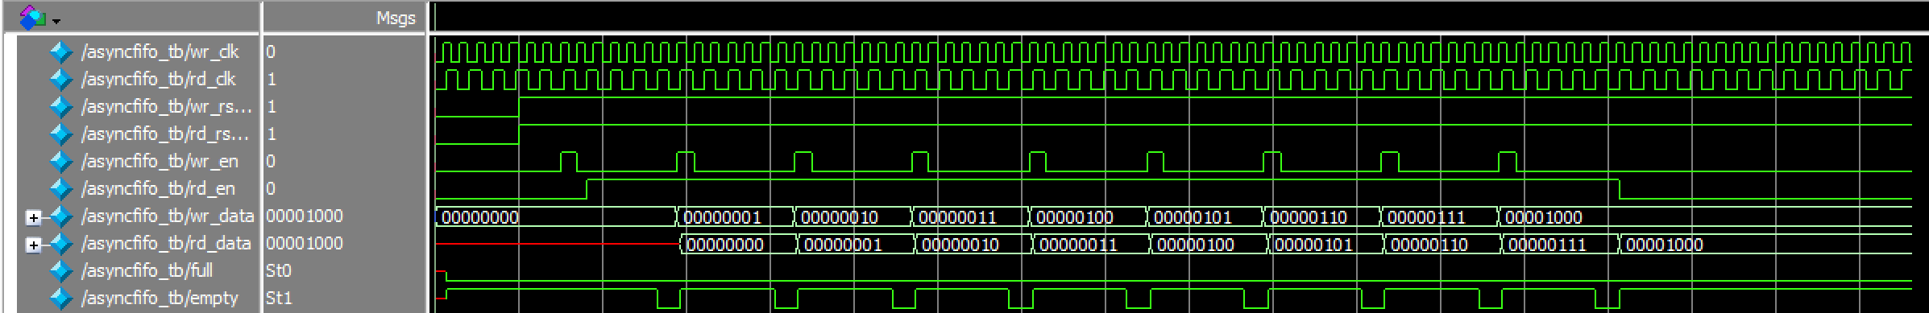
iii.Simultaneous Write/Read Condition

Slide 20
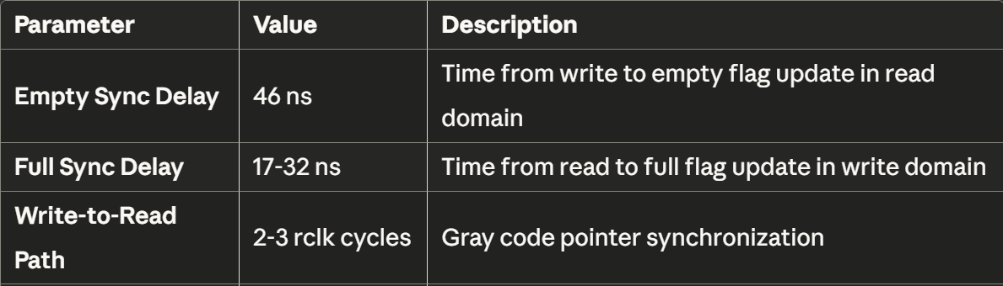
DELAY ANALYSIS

Slide 21
APPLICATIONS
Clock Domain Crossing (CDC):Safely transfers data between subsystems operating on different clocks.
High-Speed Data Transfer:Used in communication interfaces (UART, SPI, Ethernet, PCIe) to handle mismatched clock frequencies.
Multirate Systems:Audio, video, and DSP pipelines where producer and consumer work at different rates.
SoC / FPGA Integration:Connects IP cores with independent clock domains.
Networking & Telecom:Buffers packet/data streams between transmitter and receiver.
Processor–Peripheral Interfaces:Bridges between CPU clock and slower/faster peripherals.

Slide 22
CONCLUSION
Asynchronous FIFO provides a reliable mechanism for data transfer across independent clock domains.
It effectively addresses metastability concerns, ensuring robust and error-free communication.
The use of Full and Empty flags enables efficient flow control and prevents data loss or overflow.
Its versatility makes it an essential component in SoC integration, high-speed interfaces, and multirate system design.
Overall, asynchronous FIFO serves as a critical building block in modern digital systems, balancing performance, scalability, and reliability.

Slide 23
REFERENCE
C. E. Cummings, "Simulation and synthesis techniques for asynchronous FIFO design," 2002
P. R. Rao and M. Nanda, “Implementation and Verification of Asyn-chronous FIFO under Boundary Condition,” IJERT, vol. 6, no. 13, 2018.
E. Xie and J. Zhou, “Analysis and Comparison of Asynchronous FIFOand Synchronous FIFO,” Proc. IEEE EEBDA Conf., pp. 260–264, 2023.

Slide 24
THANK YOU

