Slide 1

INVENTORY MANAGEMENT SYSTEM
Lok Jagruti Kendra University
(LJKU)
Developed By:
1. | Lakshmi Renju | 21018501210054
2. | Bansil Pabari | 21018501210037
IMCA ICA-D SEM-6
Group No: - 6
Under the Guidance of:
Prof. Rita Gokani
Submitted To:
L.J. INSTITUTE OF COMPUTER APPLICATION

Slide 2
TABLE OF CONTENTS

Slide 3
1. INTRODUCTION
This document outlines the functionalities and benefits of an Inventory Management System (IMS). An IMS acts as a centralized hub for managing your stock, offering real-time information on item quantities and locations. This eliminates the need for manual tracking and scattered data, providing a clear picture of your inventory levels. By implementing an IMS, businesses can expect improved cost control through minimized storage expenses and optimized stock levels.

Slide 4
1.1. EXISTING SYSTEM
Traditional Methods: Inventory management traditionally relied on manual methods such as spreadsheets, physical counts, and manual bill generation.
Prone to Errors: Manual methods are prone to errors due to human oversight or miscalculations.
Time-consuming: Manual inventory management processes are time-consuming, requiring significant manual effort.
Cumbersome with Growth: As businesses grow and inventory complexity increases, manual methods become increasingly cumbersome to manage.
Need for Efficiency: The limitations of traditional methods highlight the need for a more efficient and automated solution.
Role of IMS: Inventory Management Systems (IMS) address these limitations by providing an efficient and automated solution to manage inventory effectively.

Slide 5
1.2. NEED FOR THE NEW SYSTEM
Complexities of Electronic Items: Managing electronic items presents unique challenges that our current inventory system's manual processes struggle to handle effectively.
Lack of Real-time Data: The current system lacks real-time data, leading to delays in order fulfillment and stockouts.
Impact on Customer Satisfaction: These shortcomings compromise customer satisfaction and hinder our competitiveness in the market.
Need for Streamlined Operations: Upgrading to a modern electronic-specific inventory management system is essential to streamline operations and improve efficiency.
Cost Reduction: Implementing a new system will help reduce costs associated with inefficiencies in inventory management processes.
Competitive Advantage: Staying ahead in this fast-paced industry requires leveraging technology to optimize inventory management processes and maintain a competitive edge.

Slide 6
1.3. OBJECTIVE OF THE NEW SYSTEM
Invoice Generation: Facilitate seamless invoice generation, including automation of creation and sending invoices to customers upon order completion.
Stock Management: Enhance stock management capabilities with real-time tracking, monitoring stock movements, and automated alerts for low stock levels.
Order History: Maintain comprehensive order history records for easy access, order details viewing, order status tracking, and historical data analysis.
Search Functionality: Incorporate efficient search functionality for quick retrieval of products, orders, invoices, or other relevant information.
Product Management: Improve product management with tools for adding, updating, and categorizing products efficiently, including managing product attributes, pricing, and specifications.
Brand Management: Implement brand management functionality, categorizing products by brand, managing brand information, and facilitating brand-specific reporting and analysis.
Category Management: Enhance category management capabilities, organizing products into logical categories, managing category hierarchies, and facilitating category-based reporting and analysis.
Payment Modes: Provide information on payment modes, including advance payment, full payment, and outstanding payments.
Downloadable PDF Invoices: Allow customers to easily download PDF invoices directly.

Slide 7
1.4. PROBLEM DEFINITION
Manual processes: Inefficient and error-prone manual tracking of stock levels, order placement, and stock locations.
Inaccurate data: Outdated or unreliable data leads to poor decision-making regarding inventory management.
Stockouts and excess inventory: Inability to predict demand accurately can result in stockouts leading to lost sales and customer dissatisfaction, or excess inventory incurring storage costs and reducing cash flow.
Limited visibility: Lack of a centralized system makes it difficult to track inventory across multiple locations and manage stock flow effectively.

Slide 8
1.5. CORE COMPONENTS
MANAGE CATEGORY: This IMS portal is mainly use for mobile store. Which has functionalities of add, update, delete categories likes mobile phones and laptops and product with stock management.
MANAGE PRODUCT: This IMS portal is mainly use for mobile store. Which has functionalities of add, update, delete products with stock management.
MANAGE INVOICE: Invoicing and billing application for different business purposes helps mainly the service providers and freelancers to manage and track their payment status. This IMS is mainly use for mobile store which has functionalities of generating invoice.
GENERATE REPORT: Admin will be able to generate yearly, quarterly, monthly collection report as per the need.

Slide 9
1.6. PROJECT PROFILE
Project Title | INVENTORY MANAGEMENT SYSTEM
Duration | 3 Months
Project Internal Guide | Prof. Rita Gokani
Front End | CSS, HTML, Bootstrap
Backend | MySQL, PHP
Operating System | Window 11

Slide 10
1.7. ASSUMPTIONS AND CONSTRAINTS
Assumptions:
Data Accuracy: The system relies on accurate and up-to-date product information, including item descriptions, unique identifiers (SKUs), and quantities.
Data Integrity: Inventory data needs to be entered and maintained consistently. This ensures the system operates on reliable information and minimizes errors.
User Access Controls: Clearly defined user roles and permissions are crucial for data security. This ensures only authorized personnel can access and modify inventory data.
System Integration: An effective IMS integrates seamlessly with other relevant business applications such as accounting and sales software. This promotes data flow and eliminates the need for manual data entry across various systems.
Constraints:
Data Accuracy: An IMS is only as good as the data it receives. Inaccurate or inconsistent data entry can lead to misleading inventory levels and hinder the system's effectiveness.
System Limitations: While IMS offer automation, complex business rules or specific needs might require customization beyond the system's base functionalities.
Integration Challenges: Integrating an IMS with existing enterprise software (ERP, accounting) can be complex and require additional resources.
Implementation Costs: The initial investment in acquiring and implementing an IMS can be significant, especially for larger businesses.
User Adoption: Successful utilization requires proper training for staff to effectively navigate the system and leverage its features.

Slide 11
1.8. ADVANTAGES AND LIMITATIONS OF THE PROPOSED SYSTEM
Advantages:
All operations are accurate and user friendly. A modern approach to work in less time.
Facilitate to maintain Stock and records.
We get Proper Details on Inventory.
Easy to maintain Product.
Lead Time Awareness for acquiring new stock.
Limitations:
Stock must be always updated.
Technology Constraints works with specific type of hardware-based
System cannot be customized.
Always need a person to update the system and generate an invoice.

Slide 12
2. REQUIREMENT DETERMINATION & ANALYSIS
2.1. REQUIREMENT DETERMINATION
⮚ Hardware Requirement:
● Intel(R) Core (TM) i5-6040U CPU@ 2.3GHz
● 4GB Ram
● Hard Disk 1GB(HDD)
⮚ Software Requirement:
● Operating System: Windows 11
● Database: MySQL Xampp
● Development Tool: Visual Studio Code

Slide 13
2.2. TARGETED USERS:
1) Admin
• The administrator who oversees operating this system and can make changes in system.

Slide 14
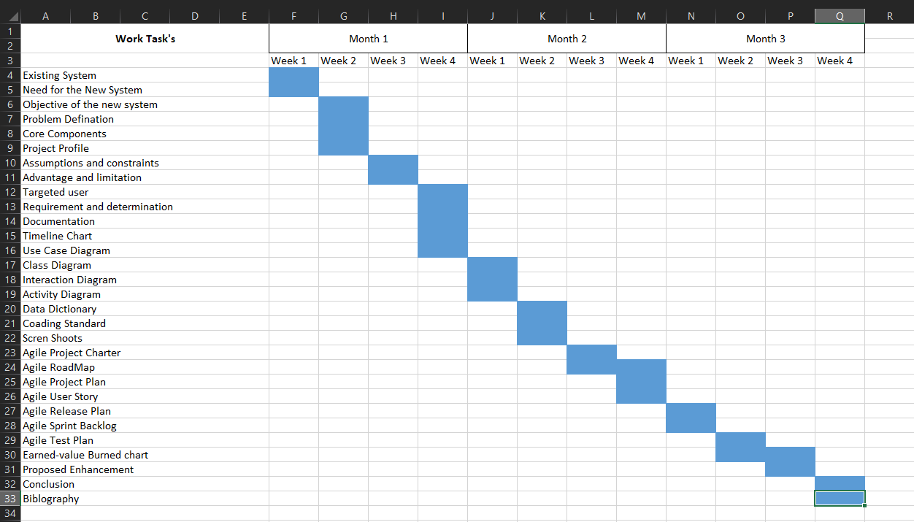
2.3. Proposed Timeline Chart:

Slide 15
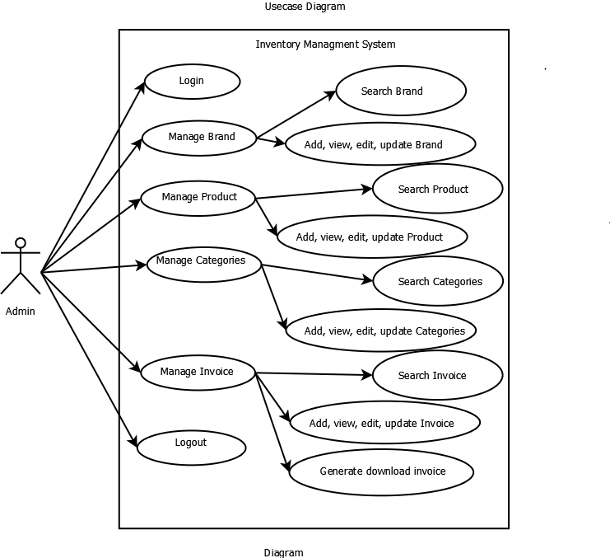
3. System Design:
3.1. Use Case Diagram:

Slide 16
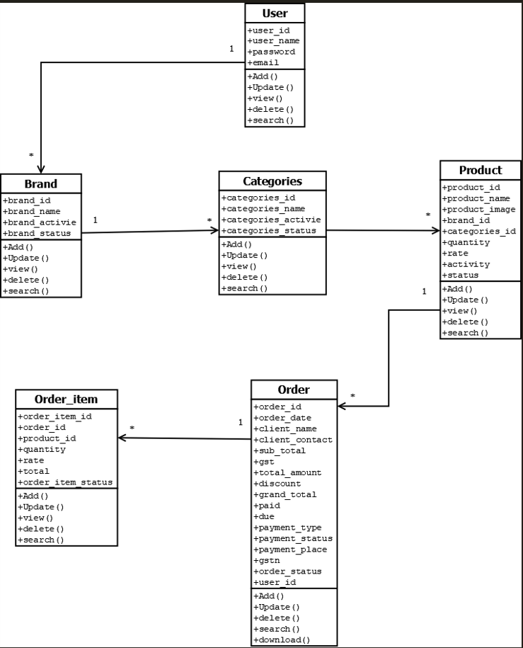
3.2. Class Diagram:

Slide 17
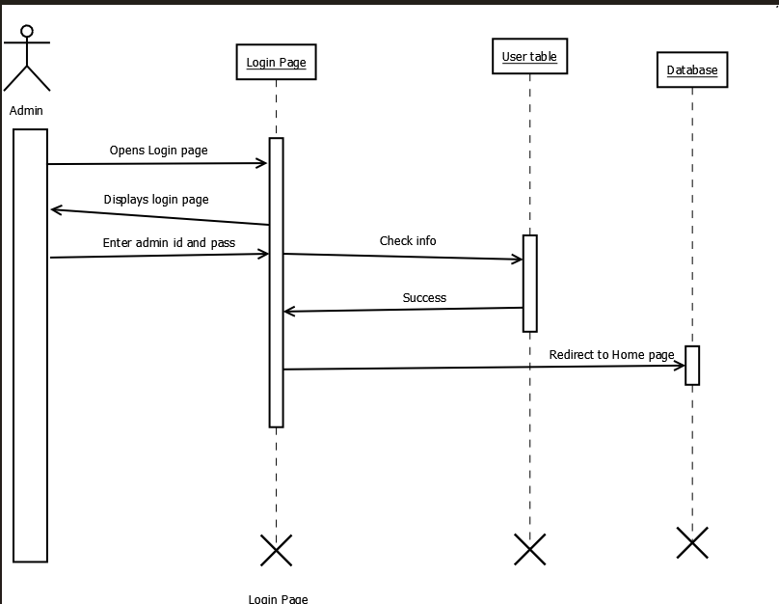
3.3. Interaction Diagram
Interaction Diagram for Login System:

Slide 18
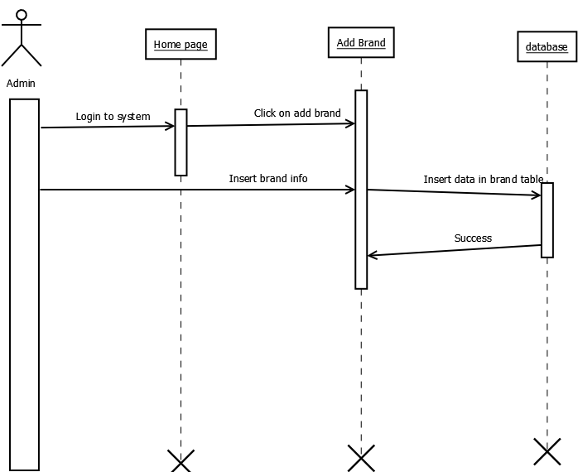
Interaction Diagram for Add Brand:

Slide 19
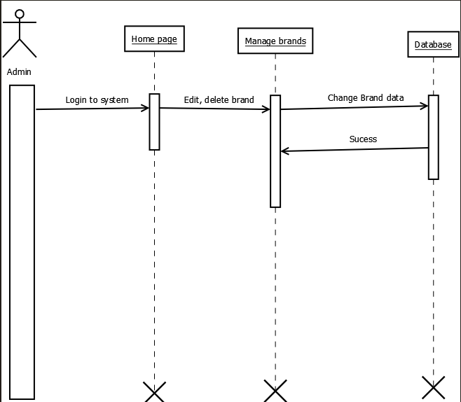
Interaction Diagram for Manage Brand:

Slide 20
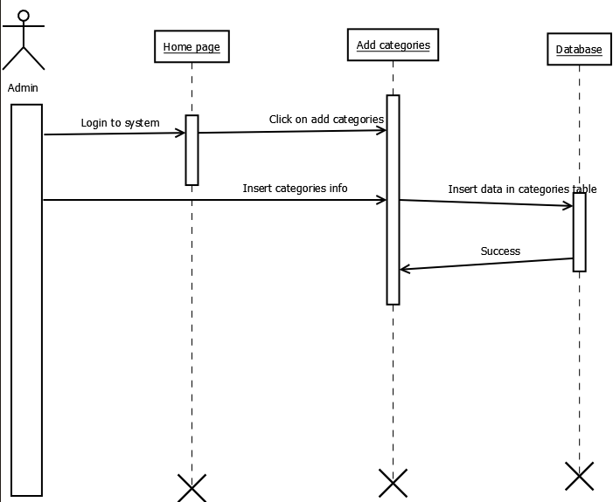
Interaction Diagram for Add Categories:

Slide 21
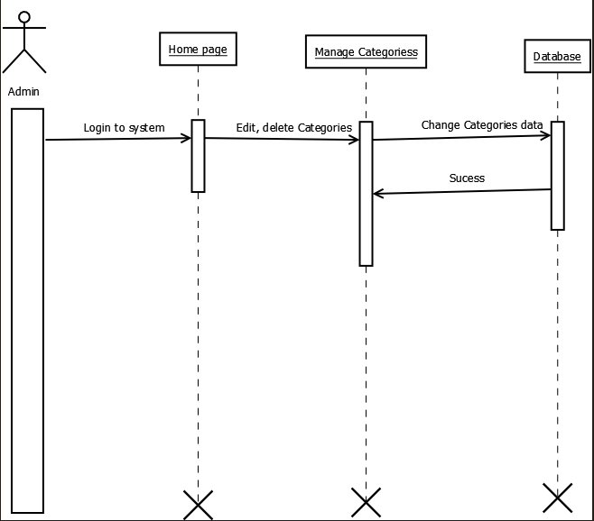
Interaction Diagram for Manage Categories:

Slide 22
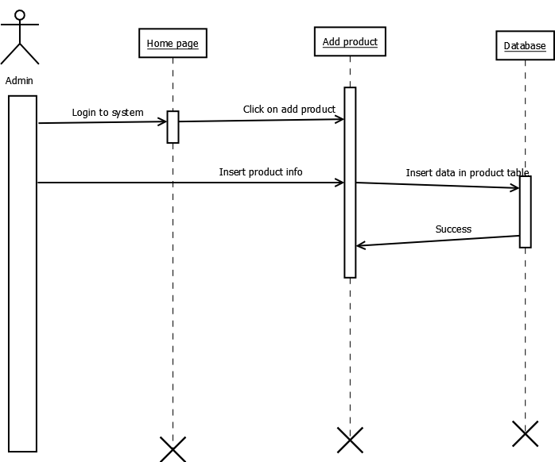
Interaction Diagram for Add Product:

Slide 23
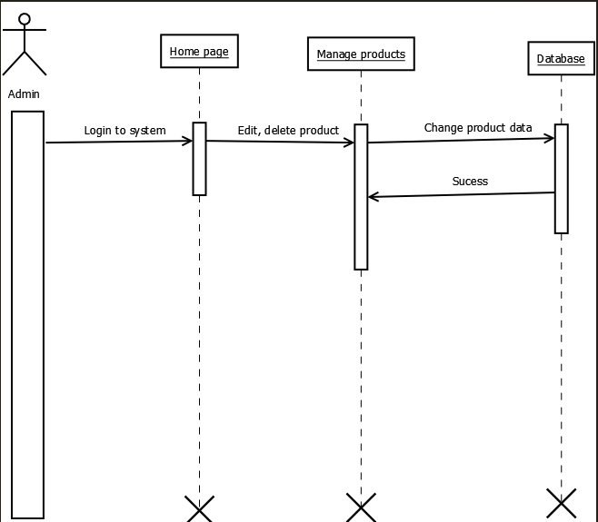
Interaction Diagram for Manage Product:

Slide 24

Interaction Diagram for Add Invoice:

Slide 25
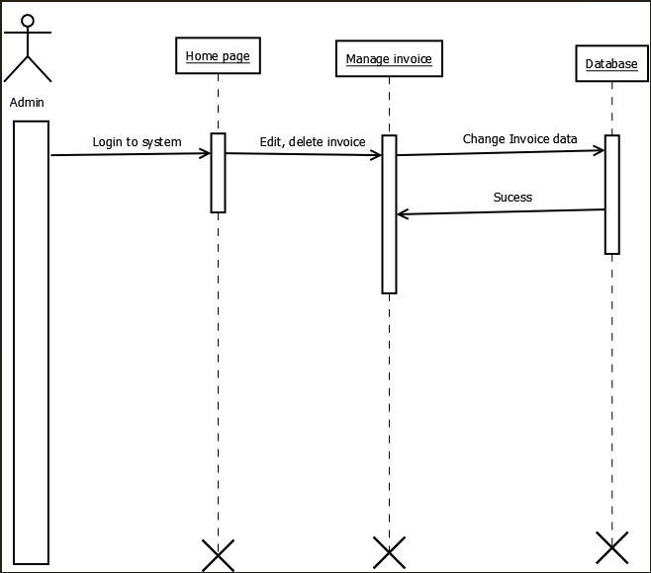
Interaction Diagram for Manage Invoice:

Slide 26
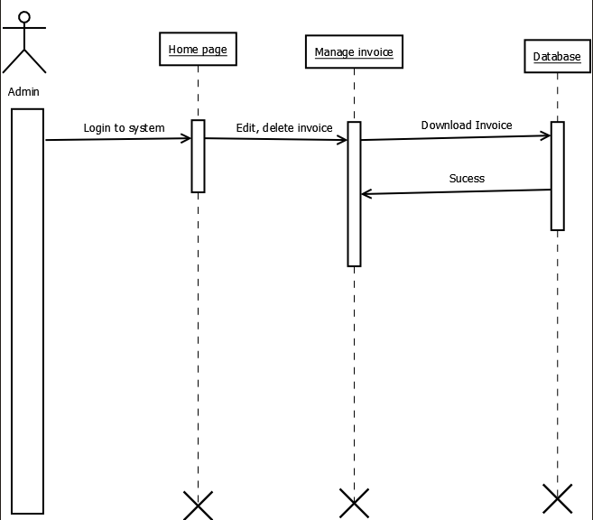
Interaction Diagram for Download Invoice:

Slide 27
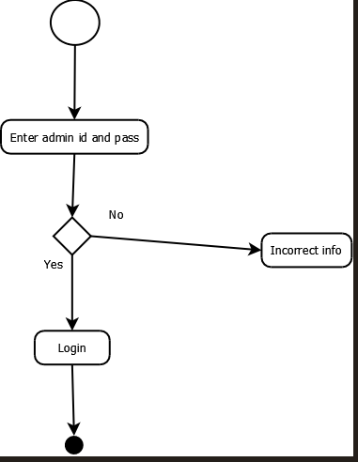
3.4. Activity Diagram
Activity Diagram for Login

Slide 28
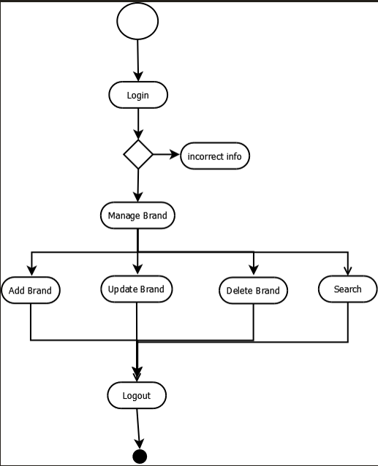
Activity Diagram for Manage Brand:

Slide 29
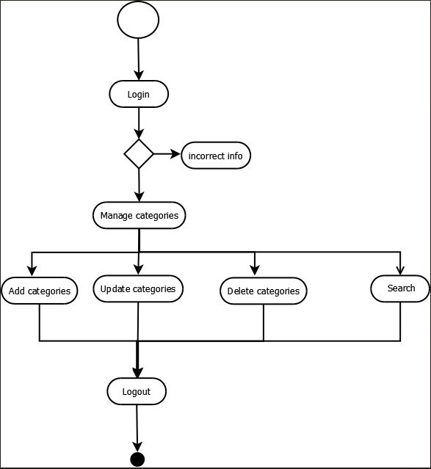
Activity Diagram for Manage Categories:

Slide 30
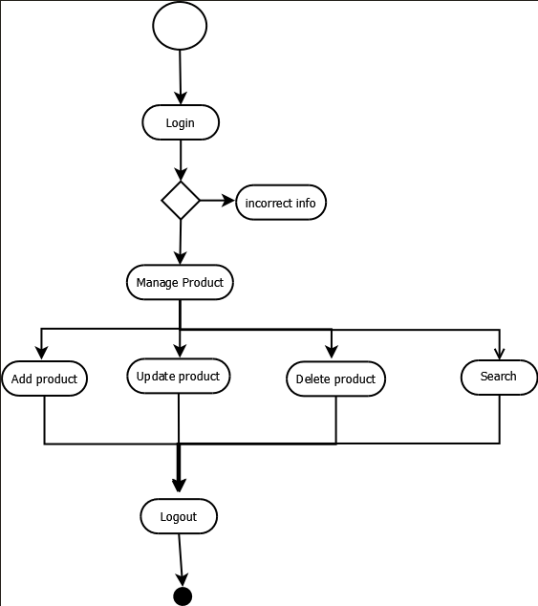
Activity Diagram for Manage Product:

Slide 31
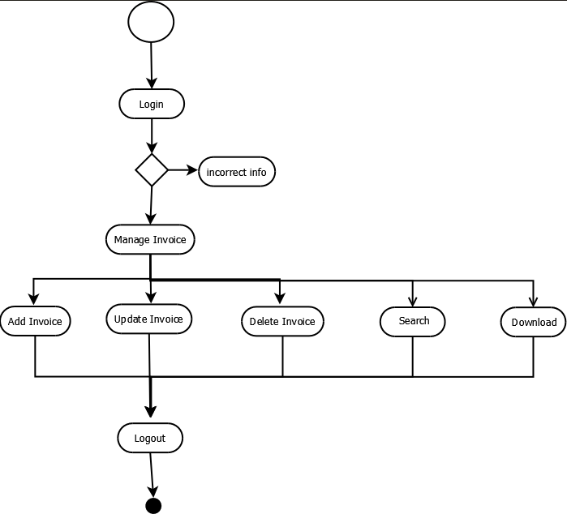
Activity Diagram for Manage Invoice:

Slide 32
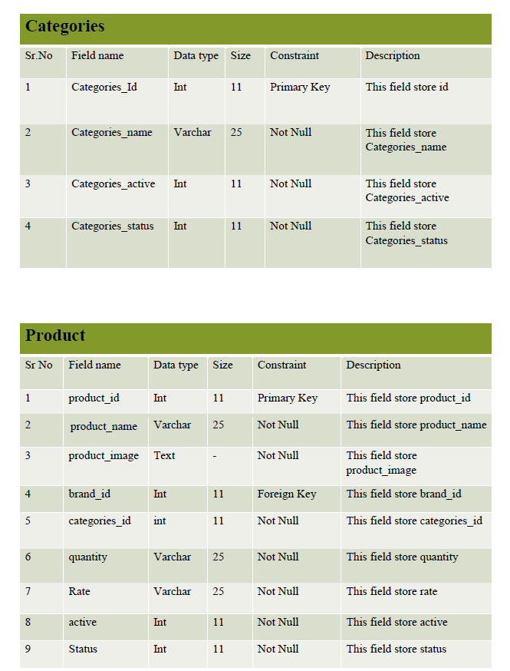
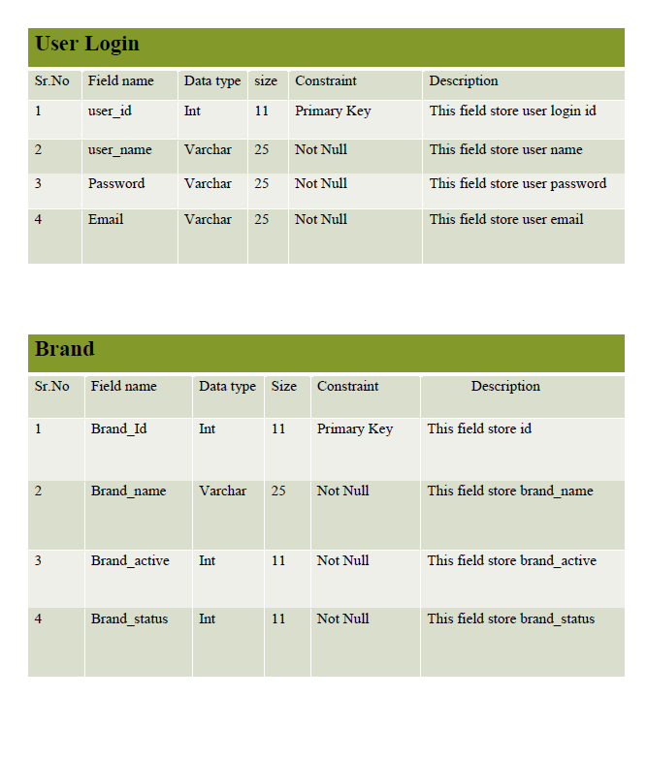
3.5. Data Dictionary:

Slide 33
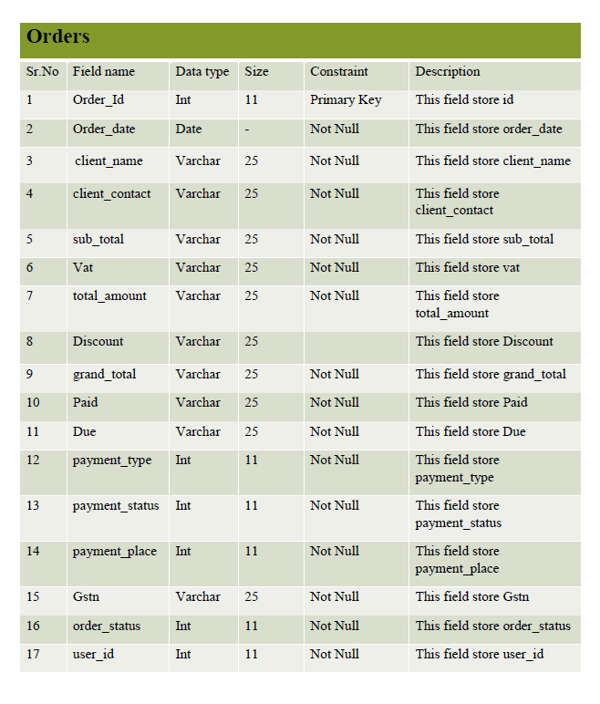
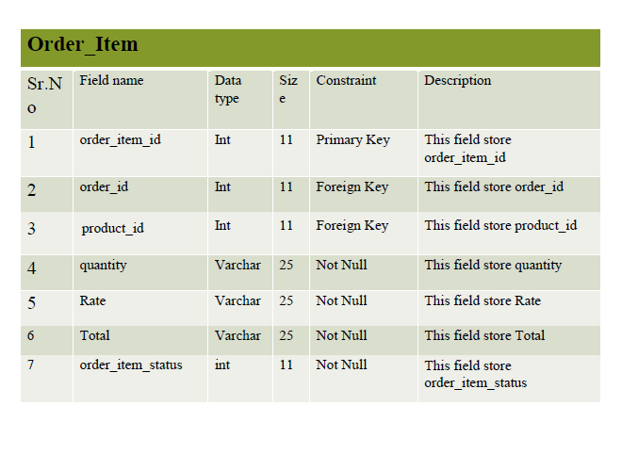

Slide 34
4. Development:
4.1. Coding standards:
1. Follow naming conventions in variable name and methods name.
2. Give minimum two spaces between operator and operand.
3. Give proper indentation.

Slide 35
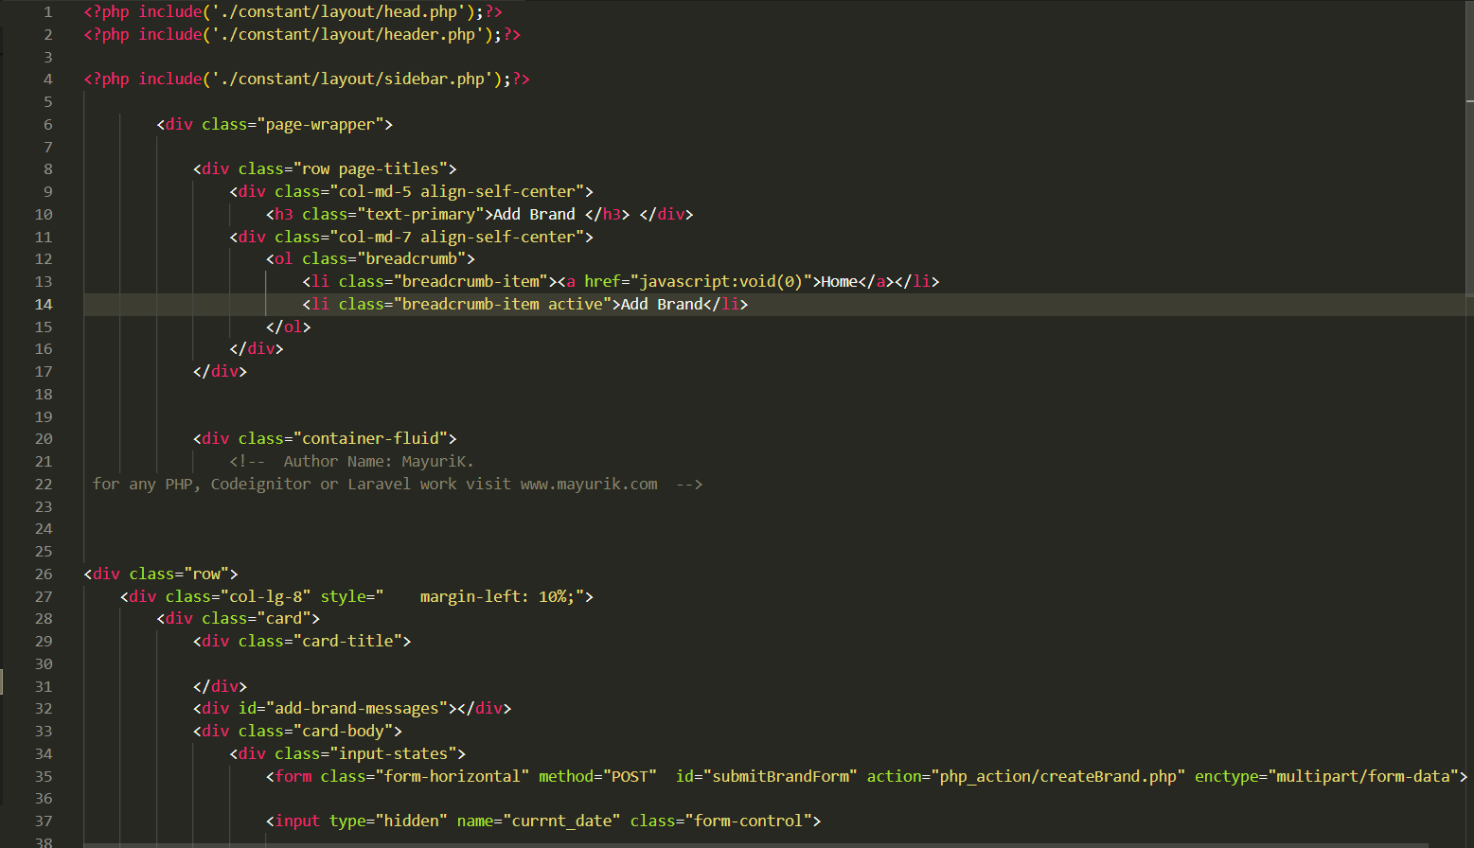
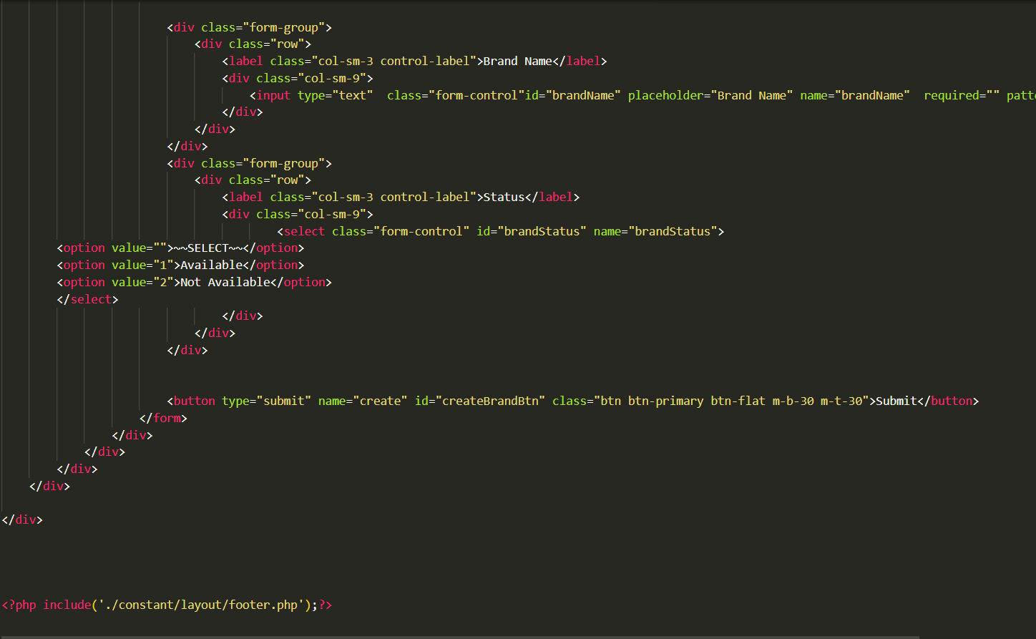
(1) addBrand.php

Slide 36
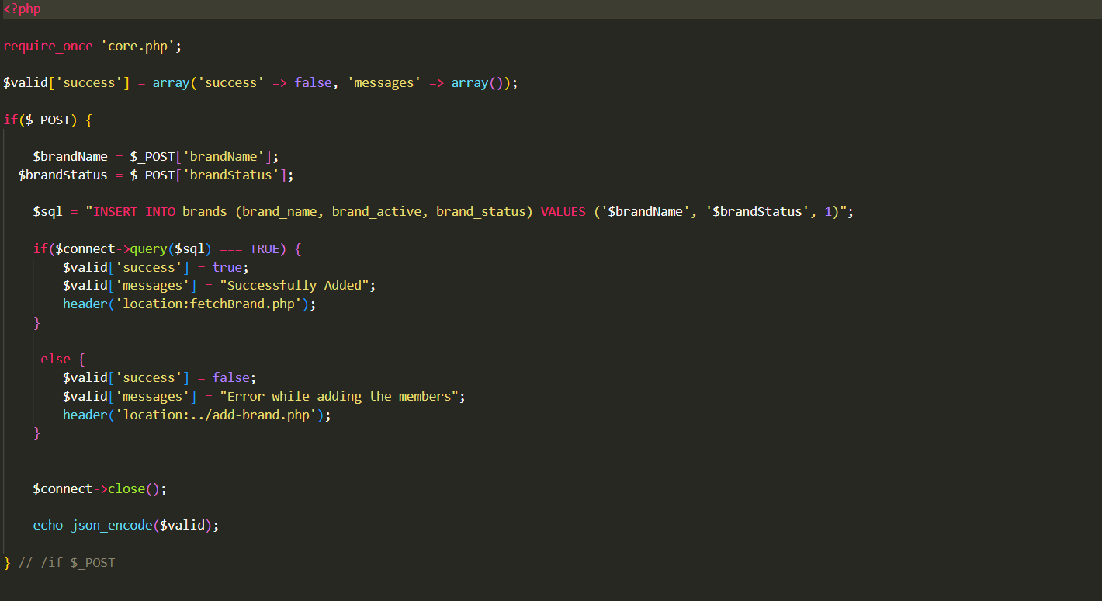
(2) createbrand.php

Slide 37
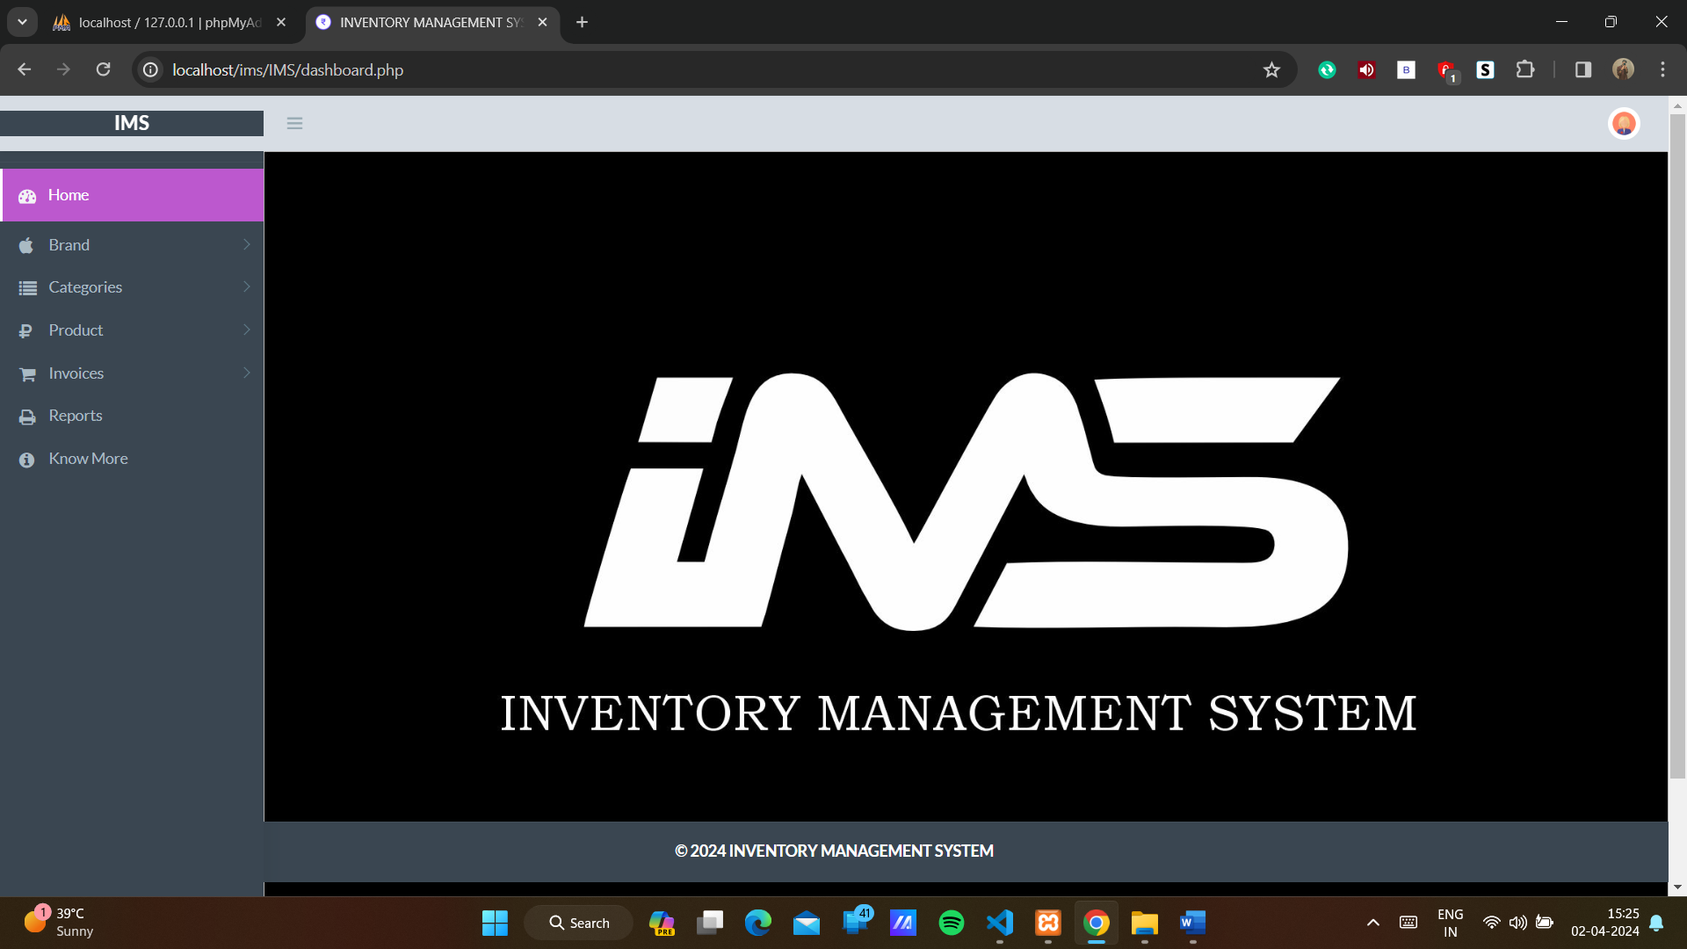
4.2. Screen shots:

Slide 38
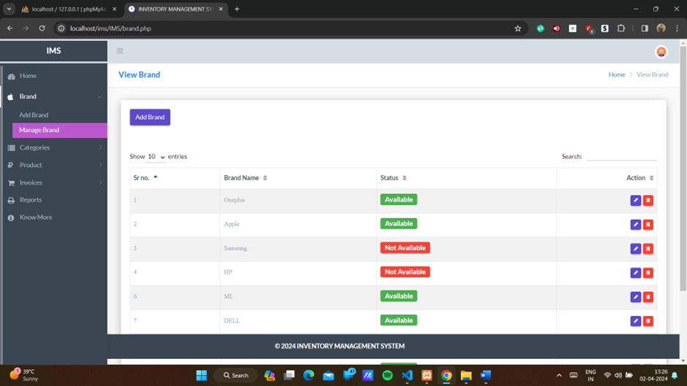

Slide 39
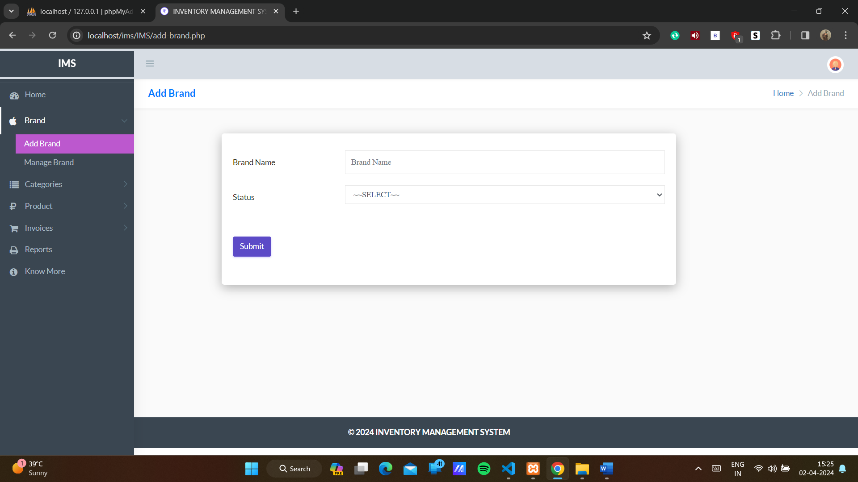

Slide 40
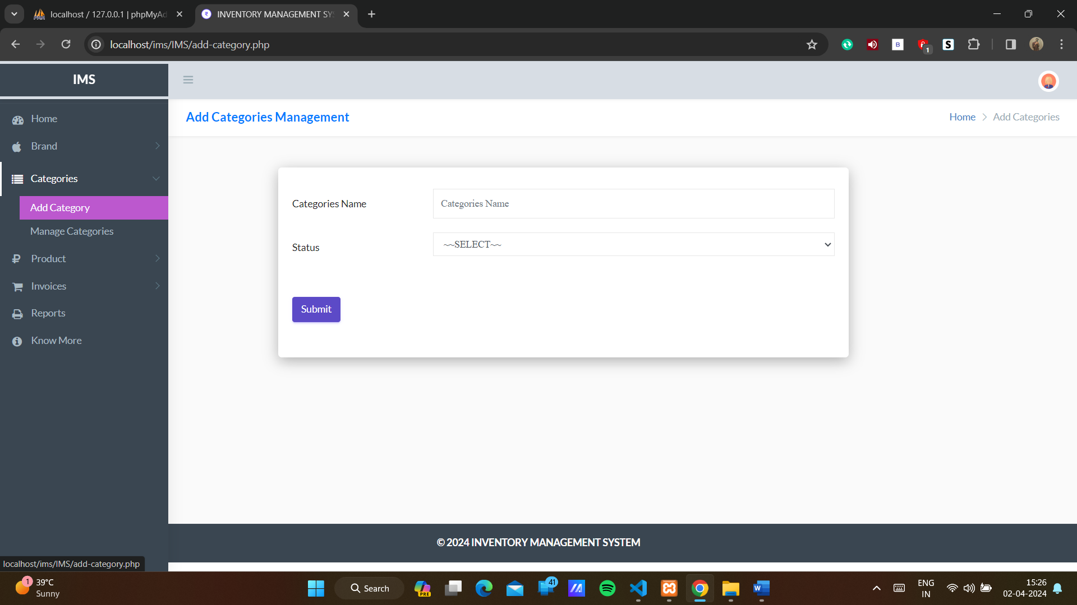

Slide 41
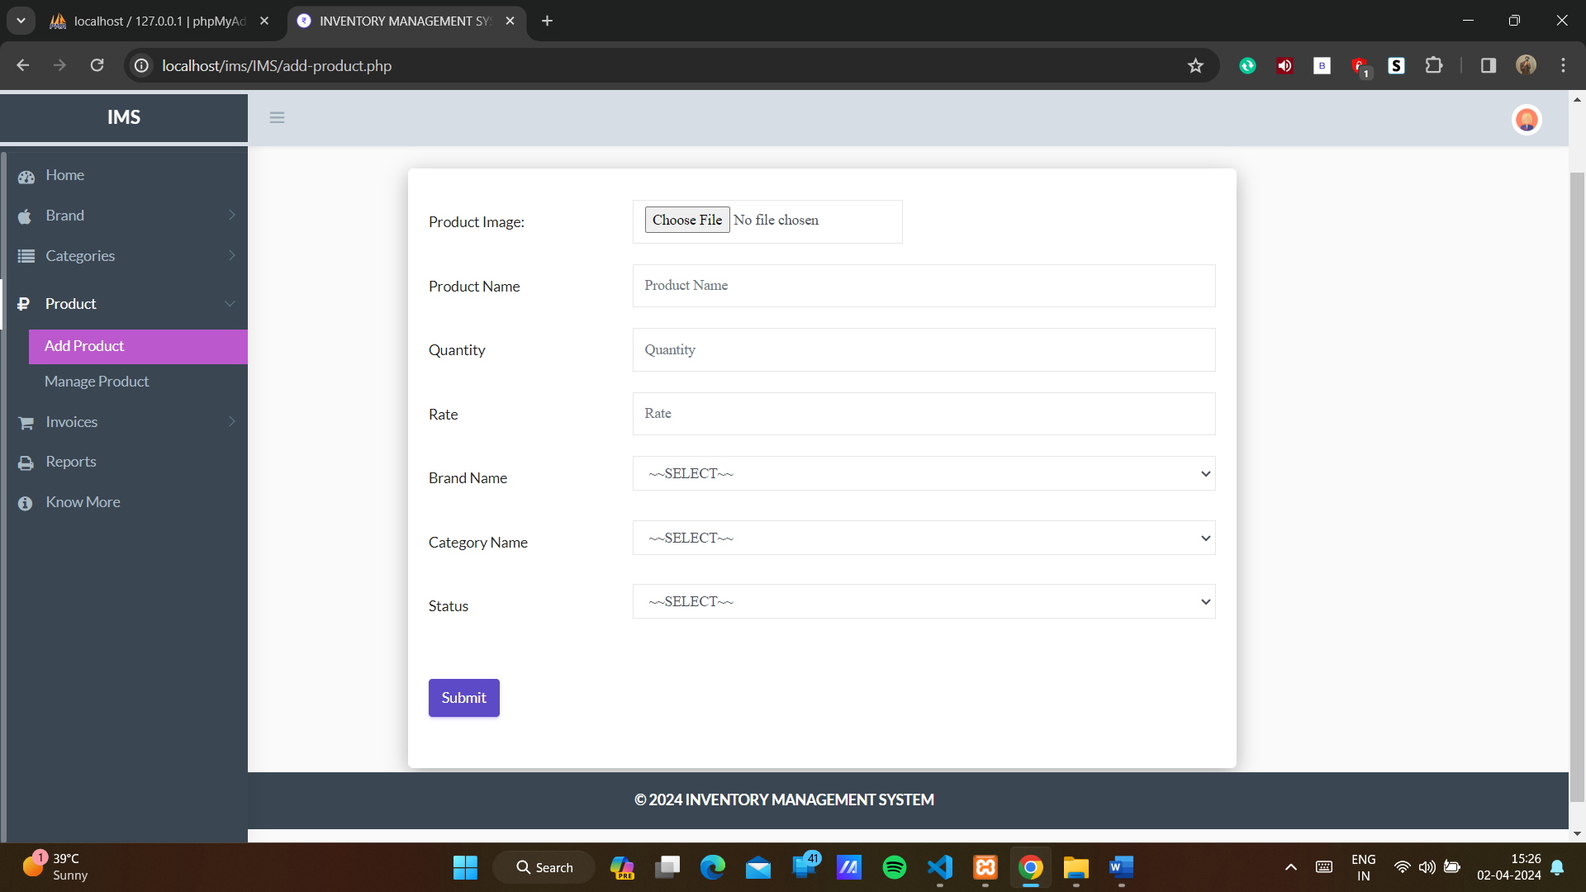

Slide 42
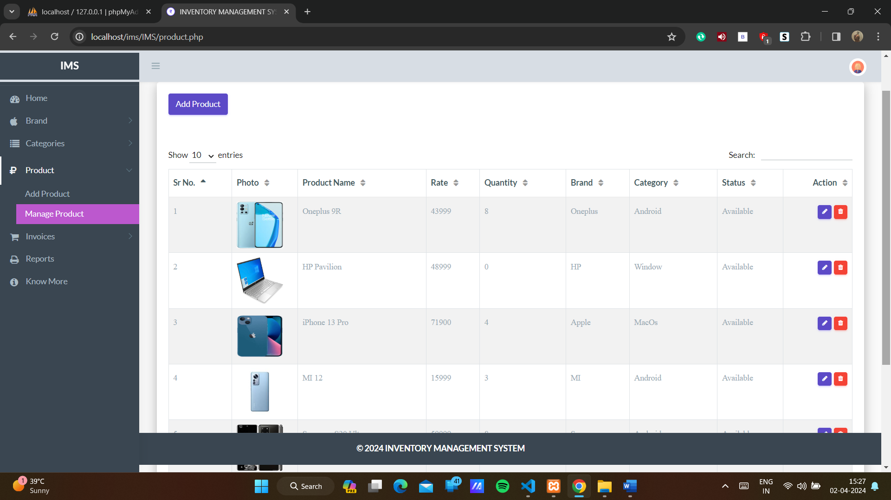

Slide 43
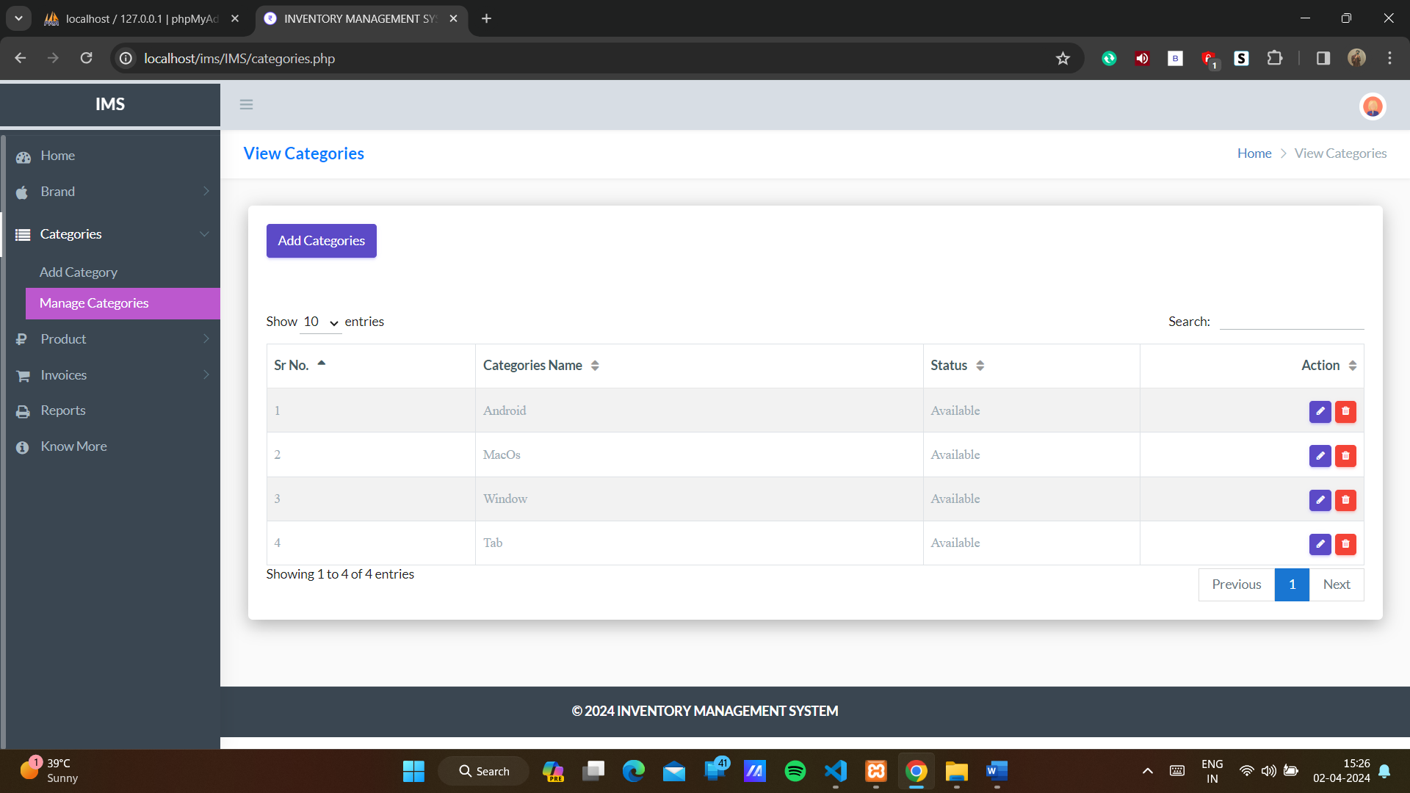

Slide 44
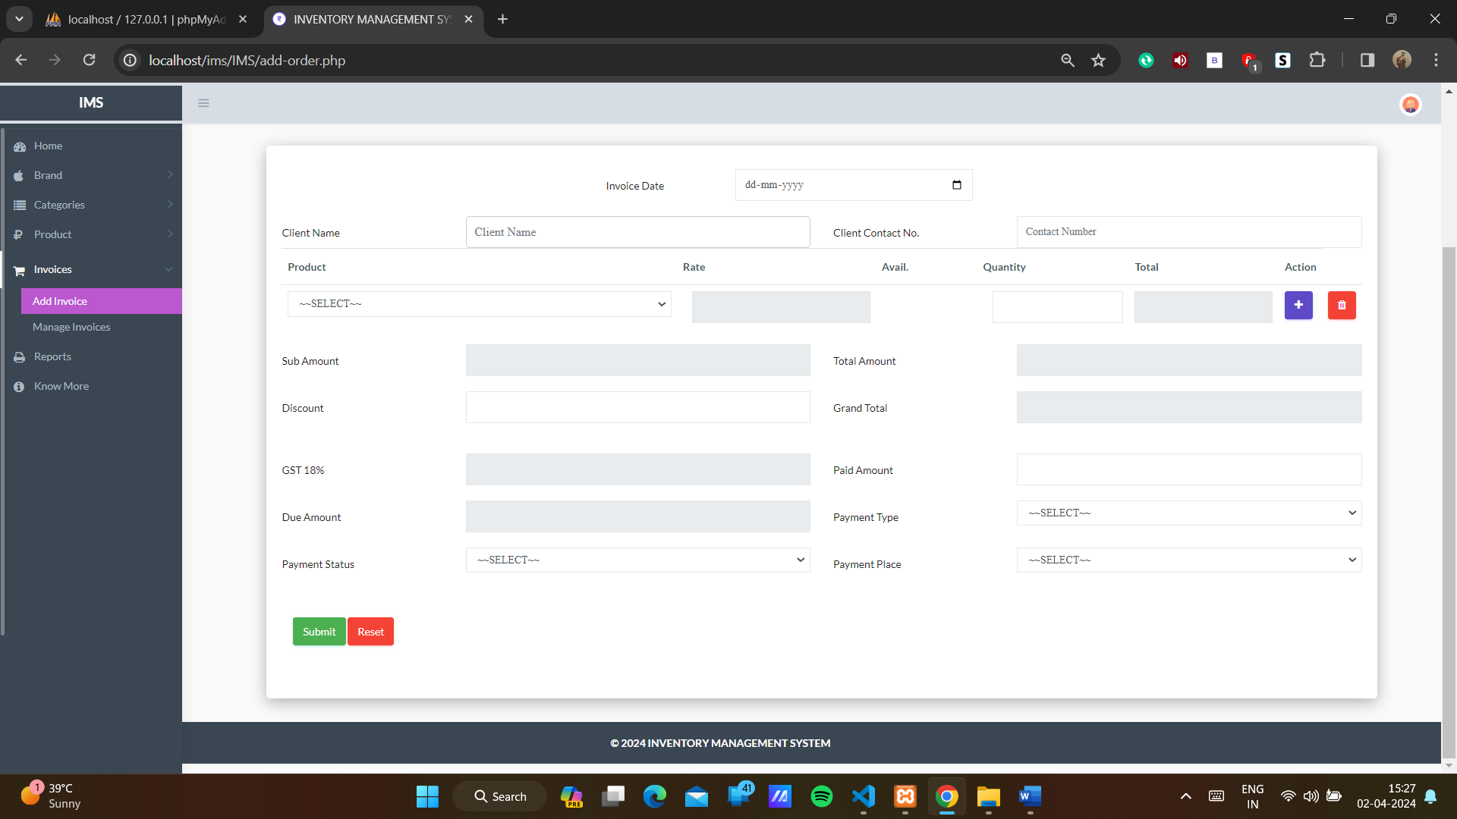

Slide 45
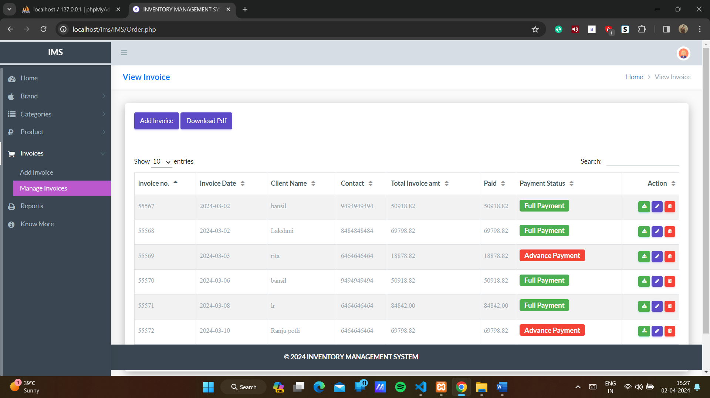

Slide 46
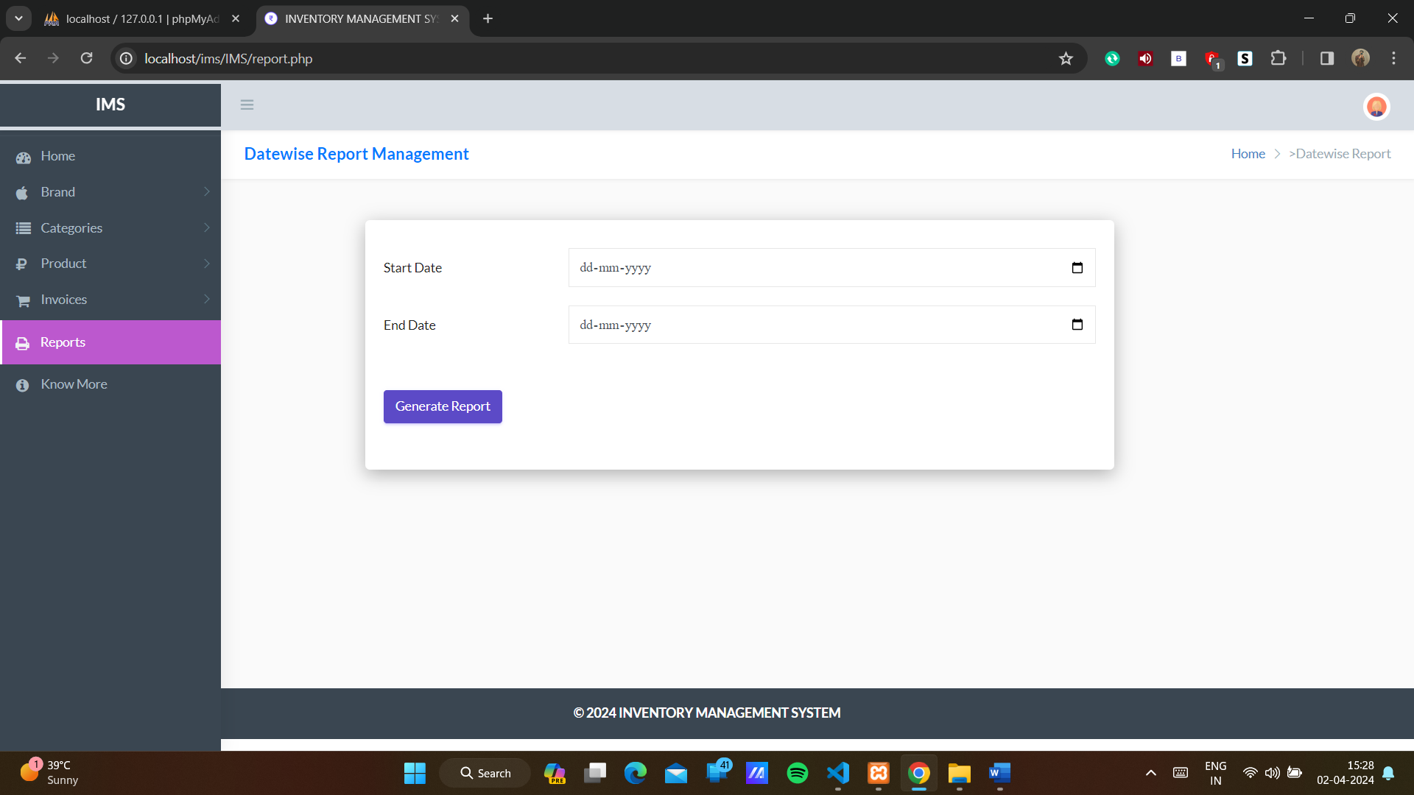

Slide 47
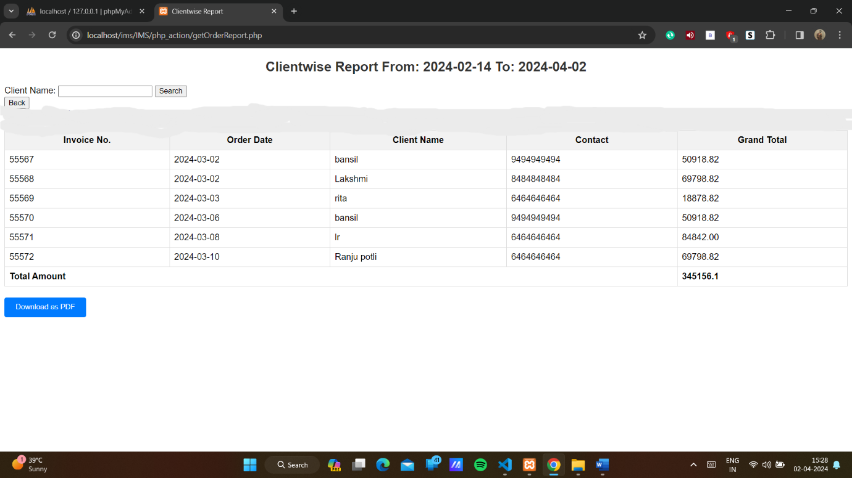

Slide 48
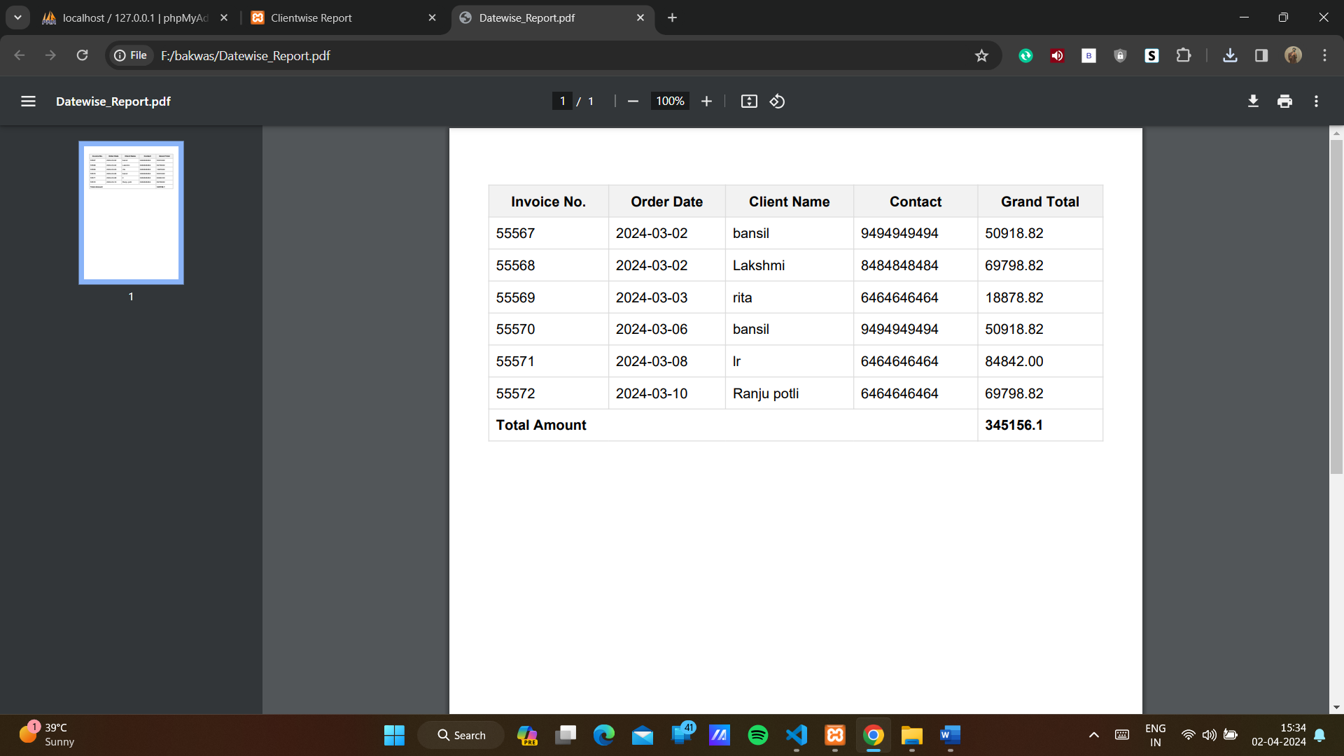

Slide 49
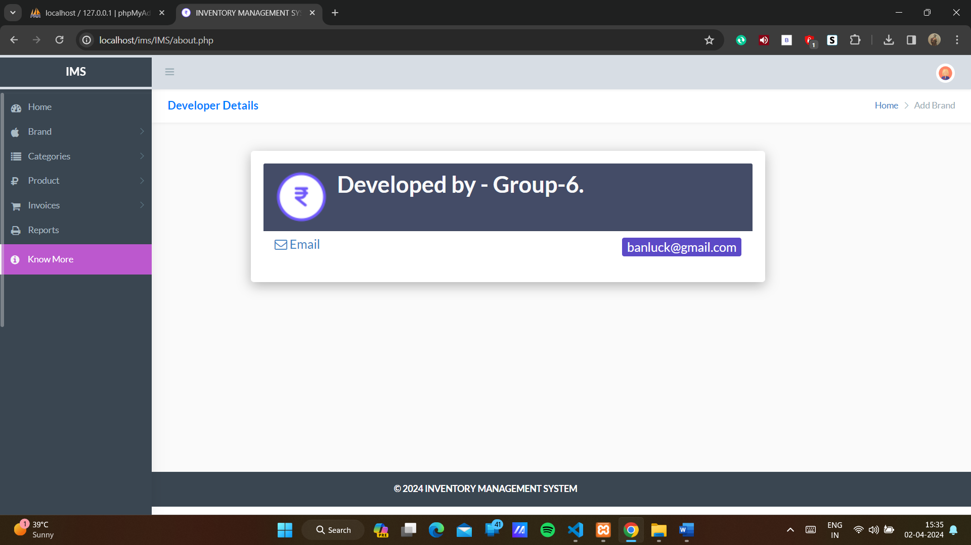

Slide 50
5. Agile Documentation:
5.1 Agile Project Charter
Project Details
Mission | The aim of creating an inventory management system is to effectively track, manage, and control inventory levels, ensuring accurate stock information, streamlined operations, and optimized supply chain processes to meet customer demand efficiently.
Vision | The vision for an inventory management system is to become the industry standard solution, revolutionizing inventory control with cutting costs empowering businesses to achieve their fullest potential in supply chain management and customer satisfaction.
Scope | Admin can deal in a wide range of courses. They can analyse customer buying patterns and preferences and maintain the stock early, can give discounts. Business can be easily scaled.
Date | 05/04/2024
General Project Information
Project Name | Inventory Management System
Project Champion | Bansil Pabari, Lakshmi Renju
Project Sponsor | LJ Institute of Computer Application
Project Manager | Prof Rita Gokani
Stakeholders | Admin
Expected Start Date | 09/01/2024
Expected Completion Date | 05/04/2024

Slide 51
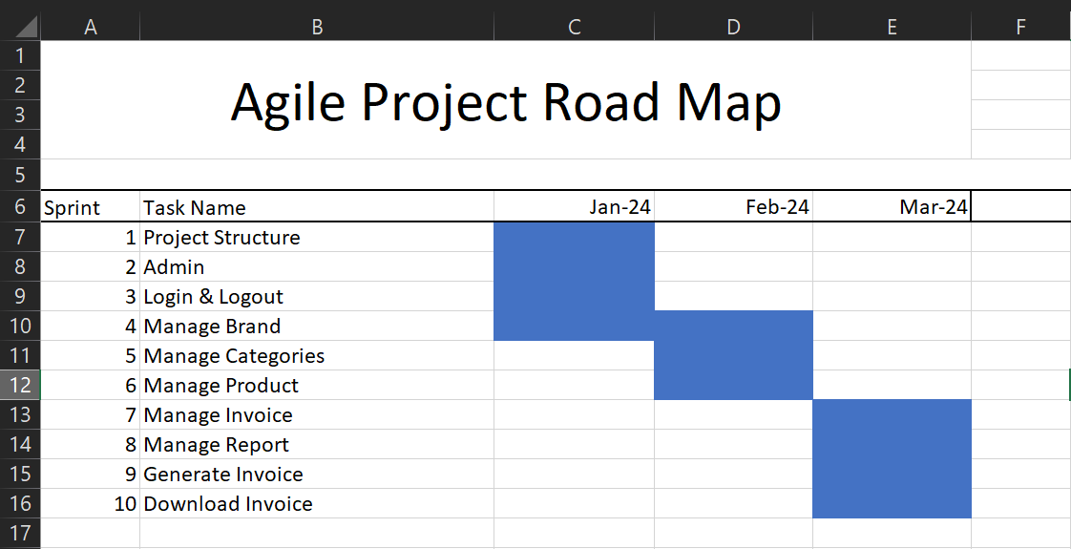
5.2 Agile Roadmap / Schedule:

Slide 52
5.3 Agile Project Plan:
Task Name | Duration | Start | Finish | Status
Sprint#1 : Project Structure | 6d | 09/01/2024 | 14/01/2024 | Completed
UI Designing | 4d | 15/01/2024 | 18/01/2024 | Completed
Database Management | 4d | 19/01/2024 | 22/01/2024 | Completed
Sprint#2 : Admin | 6d | 23/01/2024 | 28/01/2024 | Completed
Admin UI Designing | 2d | 29/01/2024 | 30/01/2024 | Completed
Sprint#3 : Login and Logout | 1d | 31/01/2024 | 31/01/2024 | Completed
Admin Login | 1d | 01/02/2024 | 01/02/2024 | Completed
Validation | 2d | 02/02/2024 | 03/02/2024 | Completed
Sprint#4 : Manage Brand | 2d | 04/02/2024 | 05/02/2024 | Completed
Add, Update, View, Delete, Search | 5d | 06/02/2024 | 10/02/2024 | Completed
UI Designing | 3d | 11/02/2024 | 13/02/2024 | Completed
Sprint#5 : Manage Categories | 2d | 14/02/2024 | 15/02/2024 | Completed
Add, Update, View, Delete, Search | 5d | 16/02/2024 | 20/02/2024 | Completed
UI Designing | 3d | 21/02/2024 | 23/02/2024 | Completed
Sprint#6 : Manage Product | 2d | 24/02/2024 | 25/02/2024 | Completed
Add, Update, View, Delete, Search | 5d | 26/02/2024 | 01/03/2024 | Completed
UI Designing | 3d | 02/03/2024 | 04/03/2024 | Completed
Sprint#7 : Manage Invoice | 2d | 05/03/2024 | 06/03/2024 | Completed
Add, Update, View, Delete, Search | 5d | 07/03/2024 | 11/03/2024 | Completed
UI Designing | 3d | 12/03/2024 | 14/03/2024 | Completed
Sprint#8 : Manage report | 2d | 15/03/2024 | 16/03/2024 | Completed
Search | 2d | 17/03/2024 | 18/03/2024 | Completed
UI Designing | 3d | 19/03/2024 | 21/03/2024 | Completed
Sprint#9 : Generate Invoice | 3d | 22/03/2024 | 24/03/2024 | Completed
Search | 3d | 25/03/2024 | 27/03/2024 | Completed
Sprint#10 : Download Invoice | 5d | 28/03/2024 | 01/04/2024 | Completed
Download as pdf | 4d | 02/04/2024 | 05/04/2024 | Completed

Slide 53
5.4 Agile User Story:
User Story ID | As a (type of user) | I want to (perform some task) | So that I can (achieve some goal)
1 | Admin | Manage Brand | Add, Update, Delete, Search and View the Brand
2 | Admin | Manage Categories | Add, Update, Delete, Search and View the Categories
3 | Admin | Manage Product | Add, Update, Delete, Search and View the Product
4 | Admin | Manage Invoice | Add, Update, Delete, Search and View the Invoice
5 | Admin | Generate Invoice | View Invoice
6 | Admin | Download Invoice | Download the invoice as pdf
7 | Admin | Generate Report | View report of sales from particular date or month
8 | Admin | Download Report | Download report of sales from particular date or month

Slide 54
5.5 Agile Release Plan:
Task Name | Duration | Start | Finish | Release Date
Sprint#1 : Project Structure | 6d | 09/01/2024 | 14/01/2024 | 14/01/2024
UI Designing | 4d | 15/01/2024 | 18/01/2024 | 18/01/2024
Database Management | 4d | 19/01/2024 | 22/01/2024 | 22/01/2024
Sprint#2 : Admin | 6d | 23/01/2024 | 28/01/2024 | 28/01/2024
Admin UI Designing | 2d | 29/01/2024 | 30/01/2024 | 30/01/2024
Sprint#3 : Login and Logout | 1d | 31/01/2024 | 31/01/2024 | 31/01/2024
Admin Login | 1d | 01/02/2024 | 01/02/2024 | 01/02/2024
Validation | 2d | 02/02/2024 | 03/02/2024 | 03/02/2024
Sprint#4 : Manage Brand | 2d | 04/02/2024 | 05/02/2024 | 05/02/2024
Add, Update, View, Delete, Search | 5d | 06/02/2024 | 10/02/2024 | 10/02/2024
UI Designing | 3d | 11/02/2024 | 13/02/2024 | 13/02/2024
Sprint#5 : Manage Categories | 2d | 14/02/2024 | 15/02/2024 | 15/02/2024
Add, Update, View, Delete, Search | 5d | 16/02/2024 | 20/02/2024 | 20/02/2024
UI Designing | 3d | 21/02/2024 | 23/02/2024 | 23/02/2024
Sprint#6 : Manage Product | 2d | 24/02/2024 | 25/02/2024 | 25/02/2024
Add, Update, View, Delete, Search | 5d | 26/02/2024 | 01/03/2024 | 01/03/2024
UI Designing | 3d | 02/03/2024 | 04/03/2024 | 04/03/2024
Sprint#7 : Manage Invoice | 2d | 05/03/2024 | 06/03/2024 | 06/03/2024
Add, Update, View, Delete, Search | 5d | 07/03/2024 | 11/03/2024 | 11/03/2024
UI Designing | 3d | 12/03/2024 | 14/03/2024 | 14/03/2024
Sprint#8 : Manage report | 2d | 15/03/2024 | 16/03/2024 | 16/03/2024
Search | 2d | 17/03/2024 | 18/03/2024 | 18/03/2024
UI Designing | 3d | 19/03/2024 | 21/03/2024 | 21/03/2024
Sprint#9 : Generate Invoice | 3d | 22/03/2024 | 24/03/2024 | 24/03/2024
Search | 3d | 25/03/2024 | 27/03/2024 | 27/03/2024
Sprint#10 : Download Invoice | 5d | 28/03/2024 | 01/04/2024 | 01/04/2024
Download as pdf | 4d | 02/04/2024 | 05/04/2024 | 05/04/2024

Slide 55
5.6 Agile Sprint Backlog:
Sprint#6 : Manage Product | Yes | Yes | High | Completed | 2
Add, Update, View, Delete, Search | Yes | Yes | High | Completed | 1
UI Designing | Yes | Yes | High | Completed | 2
Sprint#7 : Manage Invoice | Yes | Yes | High | Completed | 2
Add, Update, View, Delete, Search | Yes | Yes | High | Completed | 2
UI Designing | Yes | Yes | Medium | Completed | 2
Sprint#8 : Manage report | Yes | Yes | High | Completed | 2
Search | Yes | Yes | High | Completed | 2
UI Designing | Yes | Yes | Medium | Completed | 3
Sprint#9 : Generate Invoice | Yes | Yes | High | Completed | 2
Search | Yes | Yes | High | Completed | 2
Sprint#10 : Download Invoice | Yes | Yes | High | Completed | 2
Download as pdf | Yes | Yes | High | Completed | 2
Task Name | Story | Sprint Ready | Priority | Status | Story Point
Sprint#1 : Project Structure | Yes | Yes | High | Completed | 2
UI Designing | Yes | Yes | High | Completed | 2
Database Management | Yes | Yes | High | Completed | 1
Sprint#2 : Admin | Yes | Yes | High | Completed | 2
Admin UI Designing | Yes | Yes | High | Completed | 2
Sprint#3 : Login and Logout | Yes | Yes | High | Completed | 1
Admin Login | Yes | Yes | High | Completed | 1
Validation | Yes | Yes | High | Completed | 1
Sprint#4 : Manage Brand | Yes | Yes | Medium | Completed | 3
Add, Update, View, Delete, Search | Yes | Yes | High | Completed | 2
UI Designing | Yes | Yes | Medium | Completed | 3
Sprint#5 : Manage Categories | Yes | Yes | Medium | Completed | 3
Add, Update, View, Delete, Search | Yes | Yes | High | Completed | 2
UI Designing | Yes | Yes | High | Completed | 2

Slide 56
5.7 Agile Test Plan:
Test Case ID : 101 | Test Case Name : Admin Login
Designed by : Lakshmi Renju | Design Date :- 28/01/2024
Module Name : Users | Sub Module Name : Login
Executed by : Lakshmi Renju | Execution Date : 01/02/2023
Brief Description : Admin Login (with Data : “user name: admin & password: rootadmin”) | Test Priority (Low/Medium/High) : High
Pre-Conditions: Admin username and password should be correct | Correct Username & Password.
Dependencies : None
Test Step | Test Data | Expected Result | Actual Result | Status (Pass/Fail) | Remarks
1 | UserName: admin Password: rootadmin | Successfully login & redirect to Home Page. | Login Successful. | Pass | None
2 | UserName: adminn Password: rootadminn | Show “Invalid Credentials.” | Login Not Successful | Fail | Need to Show Error Message.

Slide 57
 | Test Case ID : 102 | Test Case Name : Add Invoice
 | Designed by : Bansil Pabari | Design Date :05/03/2024
 | Module Name : Orders | Sub Module Name : Orde
 | Executed by : Bansil Pabari | Execution Date : 11/03/2024
 | Brief Description: Admin can Add the Invoice. | Test Priority (Low/Medium/High) : High
 | Pre-conditions : Admin must be Logged in.
 | Dependencies : None
Test | Test Step | Action | Expected Result | Actual Result | Status (Pass/Fail)
1 | Click on Add Invoice | Open Add Invoice Page | Show form for Entering details | Show form for Entering details | Pass
2 | Fill course Details. | Taking Valid details | Validation of input data | Validation of input data | Pass
3 | Submit data | Click on Submit button | Add Invoice and show it in invoice page | Add Invoice and show it in invoice page | Pass

Slide 58
Test | Test Step | Action | Expected Result | Actual Result | Status (Pass/Fail)
1 | Click on Invoice | Open Invoice Page | Show Invoice | Show Invoice | Pass
2 | Click on download Invoice | Taking Valid detail from database And download | Validation of all data | Validation of all data | Pass
 | Test Case ID : 103 | Test Case Name : Download Invoice
 | Designed by : Lakshmi Renju | Design Date :28/03/2024
 | Module Name : Orders | Sub Module Name : Orde
 | Executed by : Bansil Pabari | Execution Date : 05/04/2024
 | Brief Description: Admin can Download the Invoice. | Test Priority (Low/Medium/High) : High
 | Pre-conditions : Admin must be Logged in.
 | Dependencies : None

Slide 59
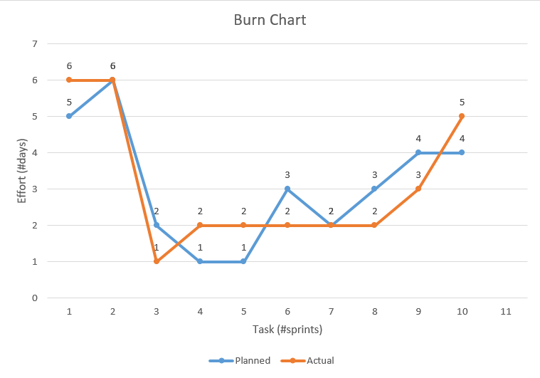
5.8 Earned-Value Burned Chart:

Slide 60
6. Proposed Enhancement:
We will try to implement SMS functionality in our system when the stock is less and need to buy.
Try to implement online so the other branch also gets info.
Try to connect with automated product scanner machine so no need to type all information.
Make a flexible website so all shop owner can set by own product and no need for a person to write all entry.

Slide 61
7. Conclusion:
As we wrap up this project, we have learned a lot about how inventory systems work and why they are so important for businesses. Our main goal was to create a system that is easy to use, grows with the business, and helps save time and money.
We focused on using simple tools like Php to build it.

Slide 62
8. Bibliography:
✵ www.google.com
✵ www.geeksforgeeks.org
✵ www.tutorialspoint.com
✵ www.w3school.com

