Slide 1
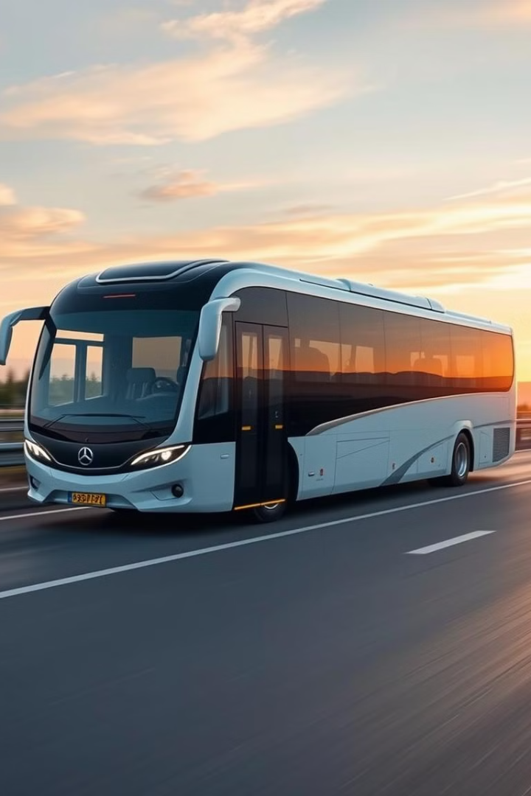


blueBus: Online Bus Ticket Booking
Welcome to the presentation of blueBus, a revolutionary online platform designed to simplify and enhance the bus ticket booking experience. This presentation will outline the project's objectives, system architecture, feasibility study, and expected outcomes.
Done by :
Ansh Gadoya [ 14 ]
Bansil Pabari [ 19 ]

Slide 2

Introduction to blueBus
Online Bus Ticket Booking
User-Friendly Interface
blueBus is an online bus ticket booking website designed to provide a seamless and convenient way for users to book tickets for their journeys.
Our website is user-friendly and intuitive, making it easy for users to navigate and find the information they need to make their bookings.

Slide 3
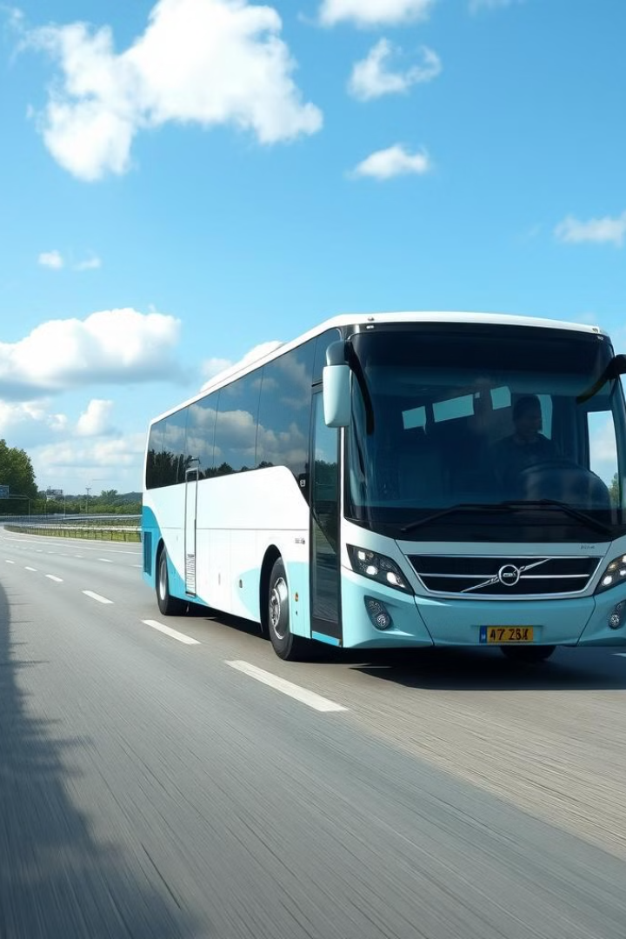
Objectives of the Project
1
Simplified Booking Process
2
Comprehensive Bus Network Coverage
To streamline the bus ticket booking process, making it user-friendly and efficient for customers.
To provide a wide range of bus routes and operators, connecting diverse destinations across the country.
3
Real-Time Availability and Pricing
4
Secure Payment Options
To offer real-time information on seat availability and pricing, ensuring transparent and accurate details for customers.
To implement secure payment gateways, providing a safe and reliable platform for financial transactions.

Slide 4

Current Bus Ticket Booking System
Traditional Booking Methods
Modern Online Booking
The current system relies on offline methods, such as physical ticket counters and phone reservations. These methods are often time-consuming, inconvenient, and prone to errors.
The blueBus system offers a user-friendly online platform for booking tickets. This system eliminates the need for physical visits or phone calls, allowing users to book tickets conveniently from any device.

Slide 5

Methodology
1
Planning
Initial planning involves defining project goals, user requirements, and key features. It's the foundation for the project's direction.
2
Iteration and Development
The project is divided into short iterations, or sprints. Each sprint focuses on delivering specific functionalities, allowing for flexibility and continuous improvement.
3
Testing and Feedback
Regular testing and feedback loops are essential for identifying and addressing any issues early in the development cycle.
4
Deployment and Maintenance
Once the development process is complete, blueBus is deployed to production. Ongoing maintenance ensures the website remains functional and up-to-date.

Slide 6
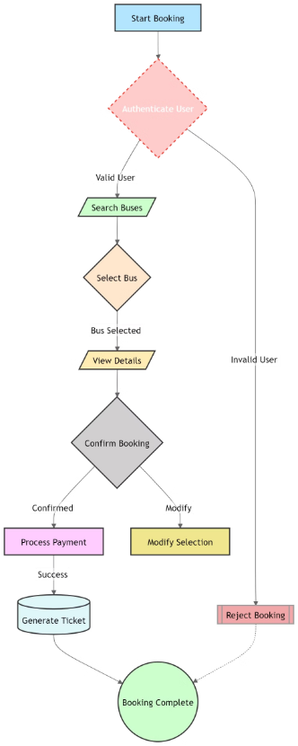

System Architecture and Block Diagram

Slide 7
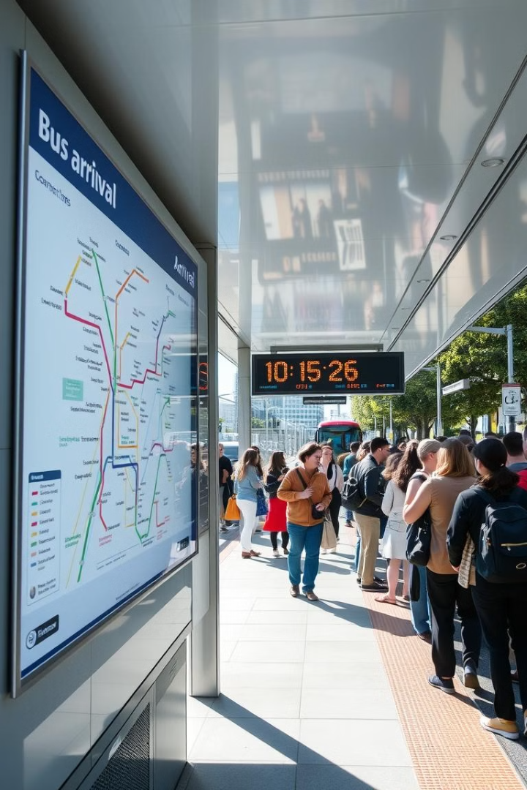
Feasibility Study
Market Demand
Technology Viability
The demand for online bus ticket booking services is steadily increasing, indicating a strong potential market for blueBus.
The chosen technologies, including Python, Django, and MySQL, are readily available and well-suited for building a robust and scalable online platform.
Financial Feasibility
Competitive Landscape
The projected costs for development and ongoing operations are reasonable and can be offset by potential revenue streams.
While there are existing bus ticket booking services, blueBus offers unique features and competitive advantages, such as a user-friendly interface, comprehensive route coverage, and real-time information.

Slide 8






Expected Outcomes
Improved Customer Experience
1
Streamlined booking process, real-time information, and secure transactions.
2
Increased Revenue
Enhanced user satisfaction, higher booking volume, and potential for new revenue streams.
3
Enhanced Efficiency
Automation of ticket booking, reduced manual effort, and improved operational efficiency.
4
Stronger Market Position
Competitive advantage, wider customer base, and stronger brand recognition.
Positive Impact on the Bus Industry
5
Modernization, improved customer satisfaction, and enhanced safety and security.

Slide 9






Advantages of blueBus
Flexible Scheduling
Competitive Pricing
Reliable Bus Operators
Excellent Customer Support
Choose from a wide variety of departure times and routes, catering to your travel needs.
Enjoy competitive fares and special offers, making travel more affordable.
Partnering with reputable bus operators, ensuring a comfortable and safe journey.
Dedicated customer service team available to assist with any inquiries or concerns.

Slide 10
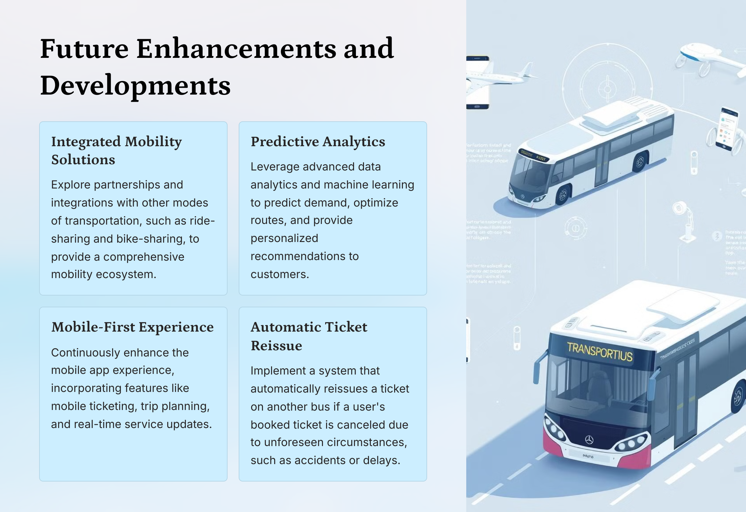

Slide 11

Conclusion
This presentation has explored the development and potential of blueBus, a revolutionary online platform designed to streamline the bus ticket booking process. Through its user-friendly interface, advanced features, and commitment to providing real-time information, blueBus aims to revolutionize the bus travel experience. The project promises to enhance efficiency, improve customer satisfaction, and solidify blueBus's position as the leading online bus ticket booking platform.

Slide 12
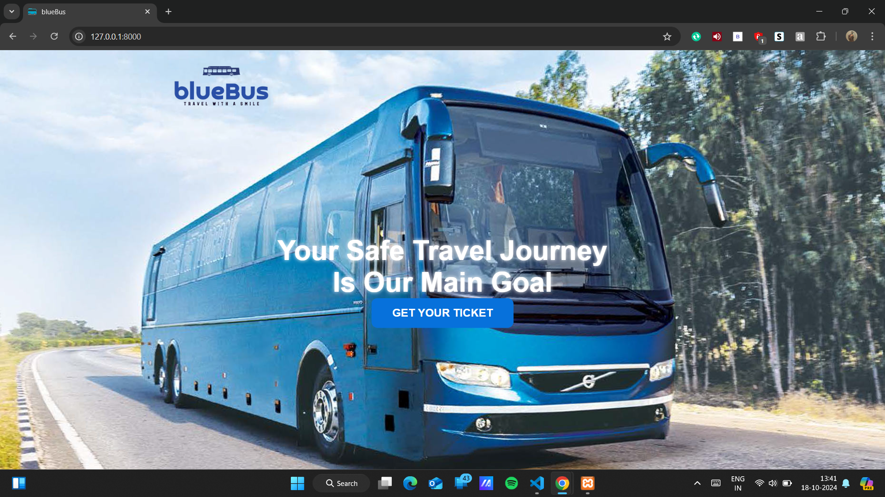

Slide 13
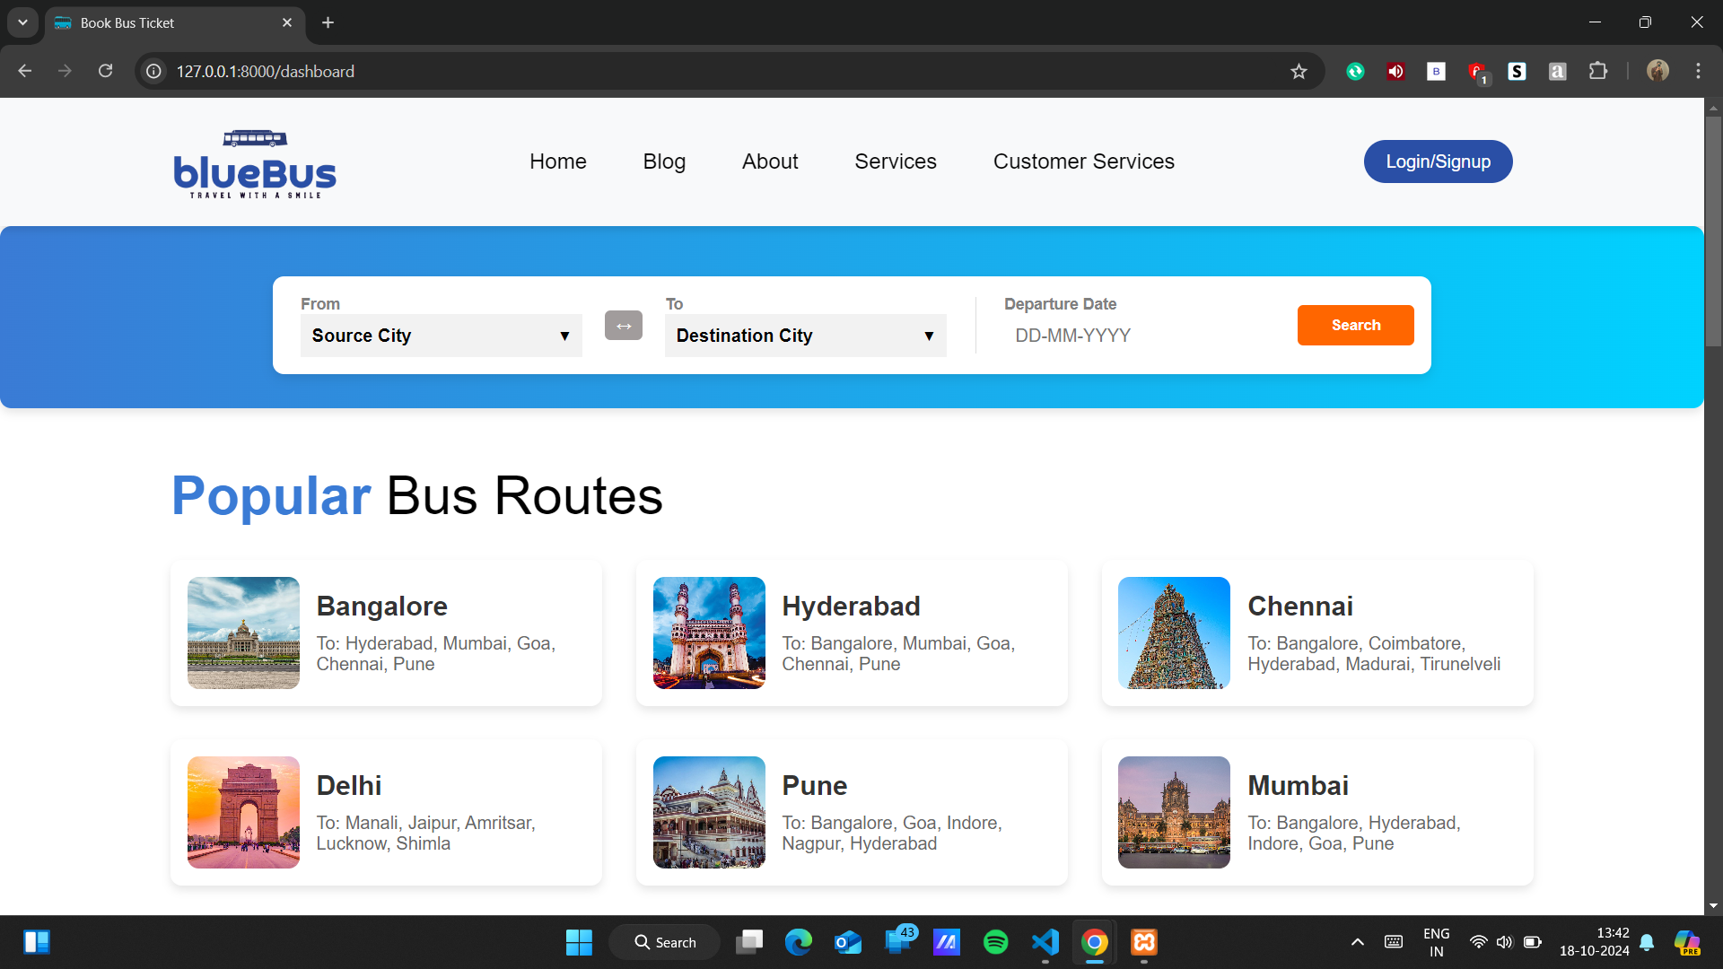

Slide 14
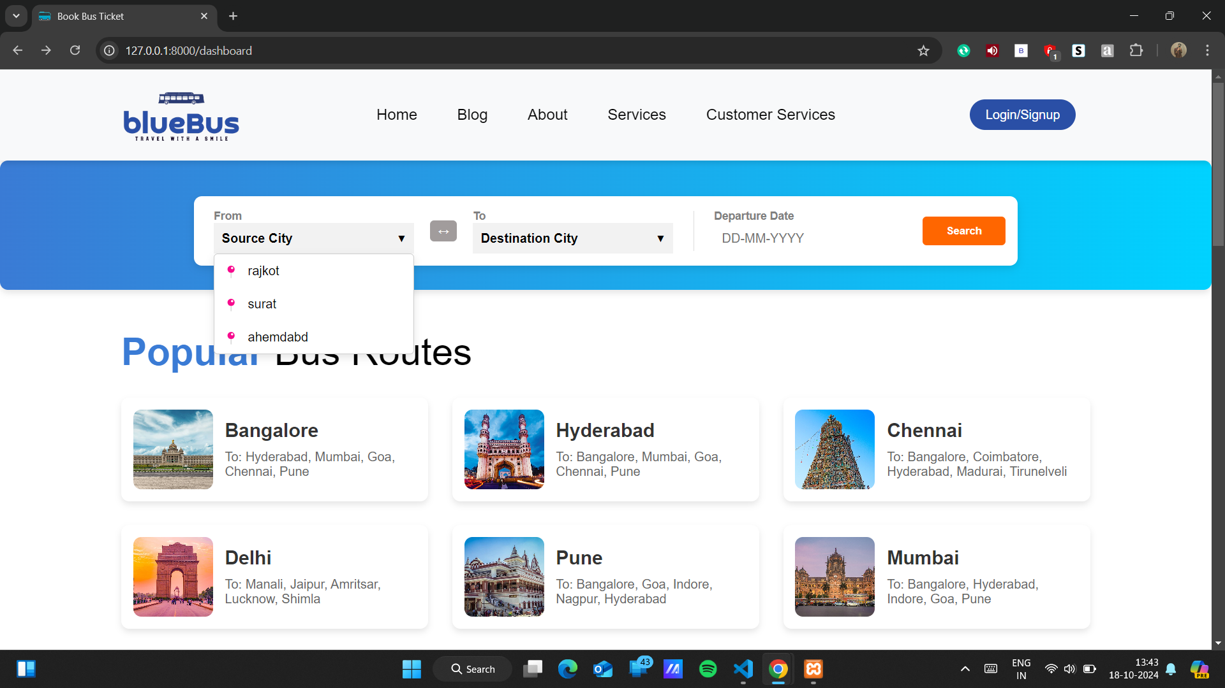

Slide 15
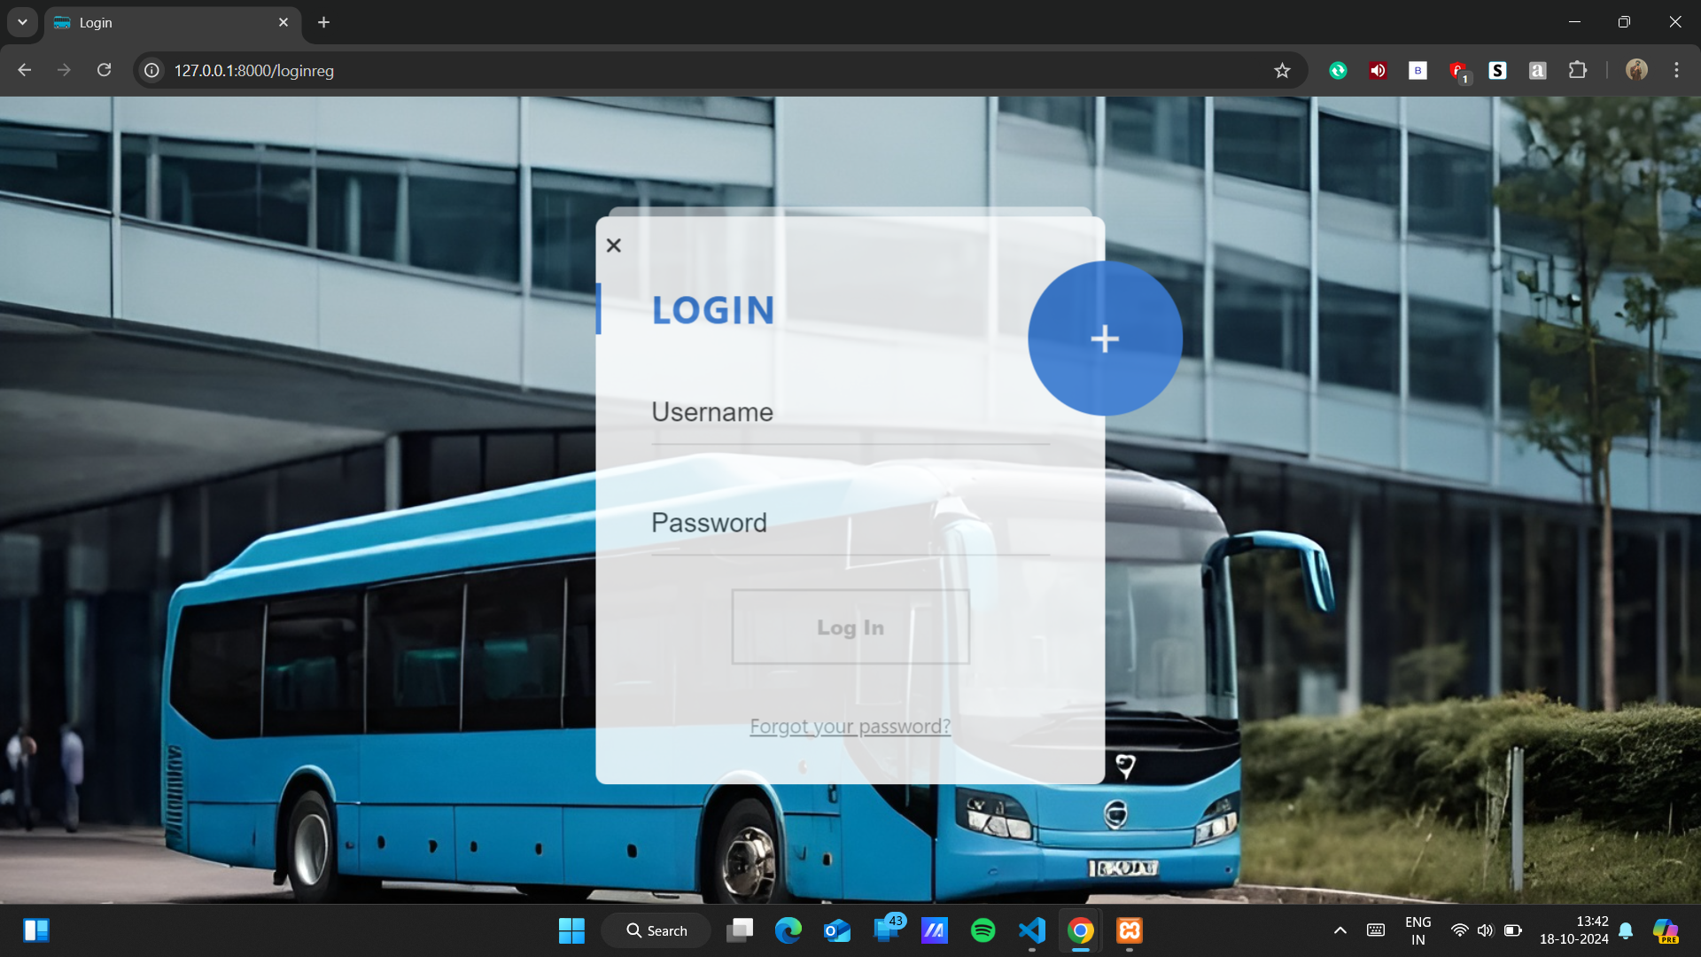

Slide 16
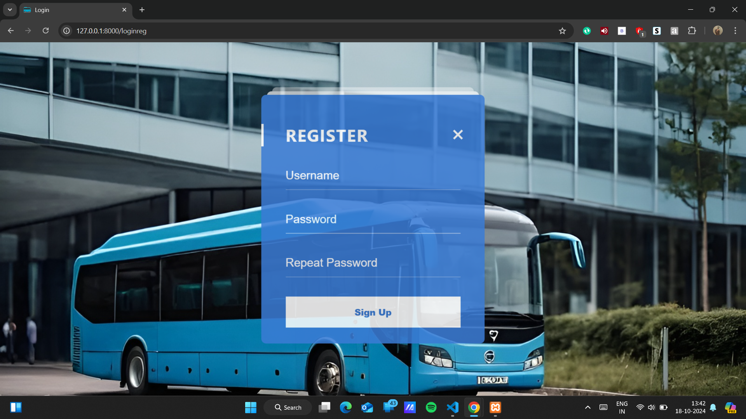

Slide 17
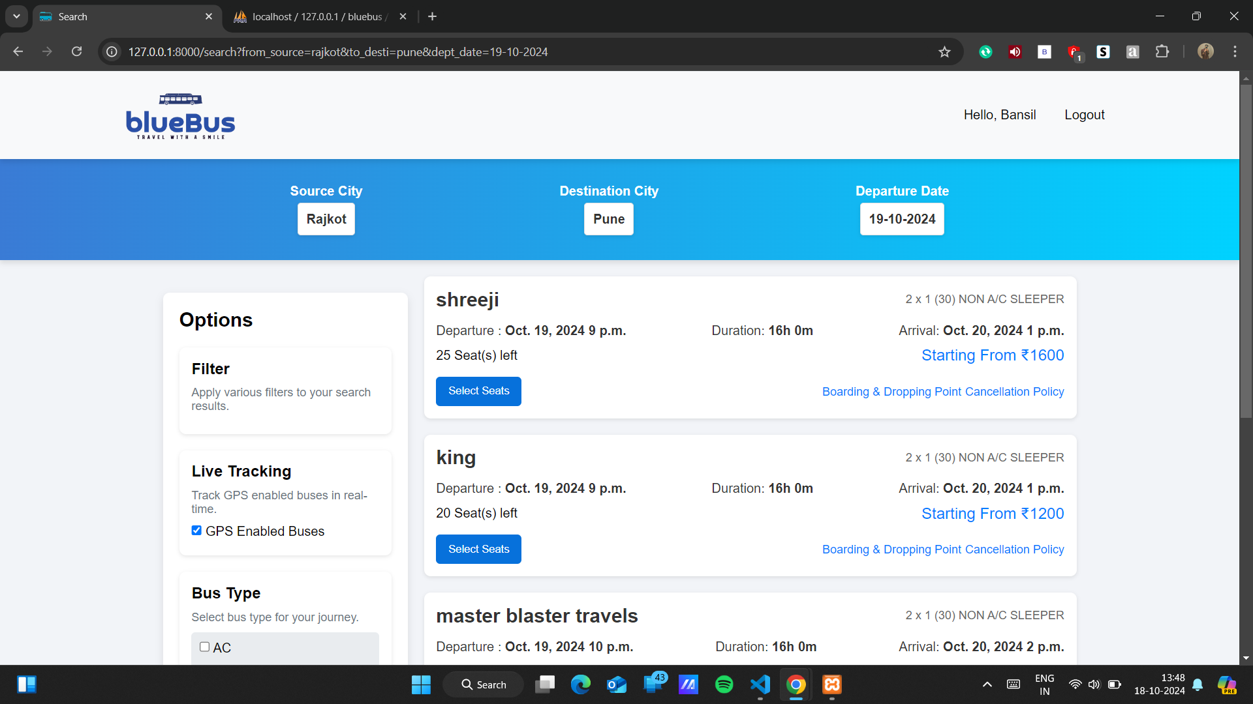

Slide 18
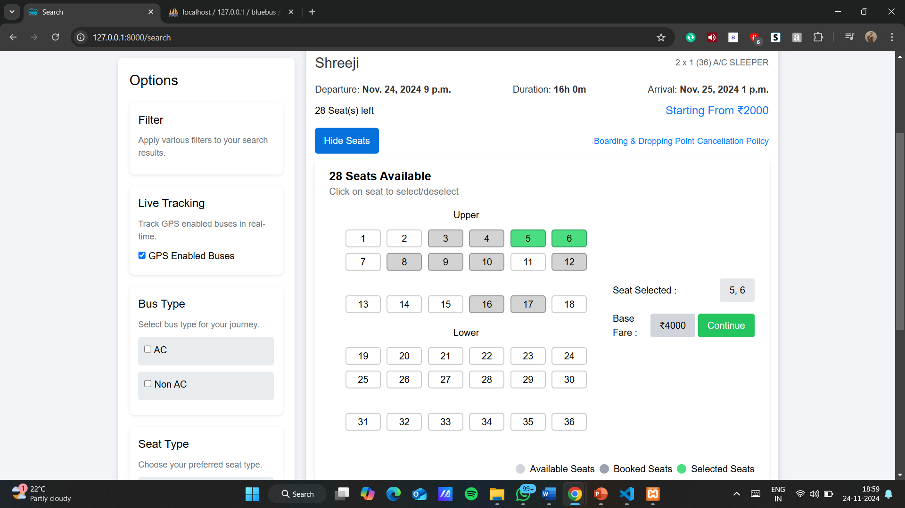

Slide 19
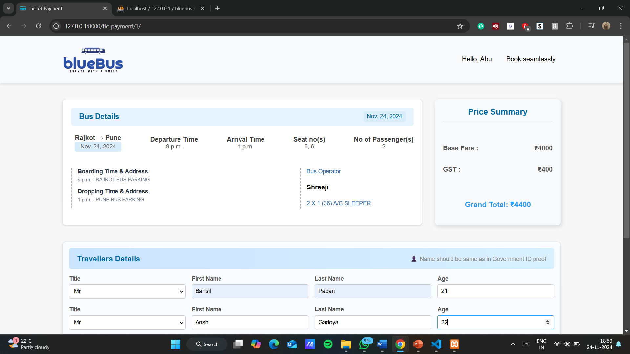

Slide 20
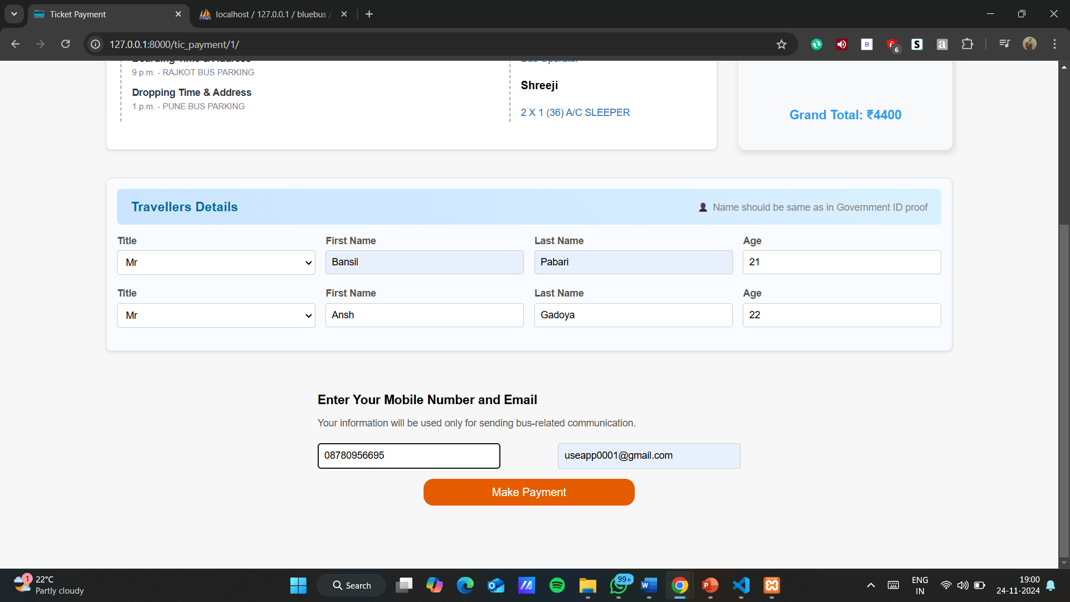

Slide 21
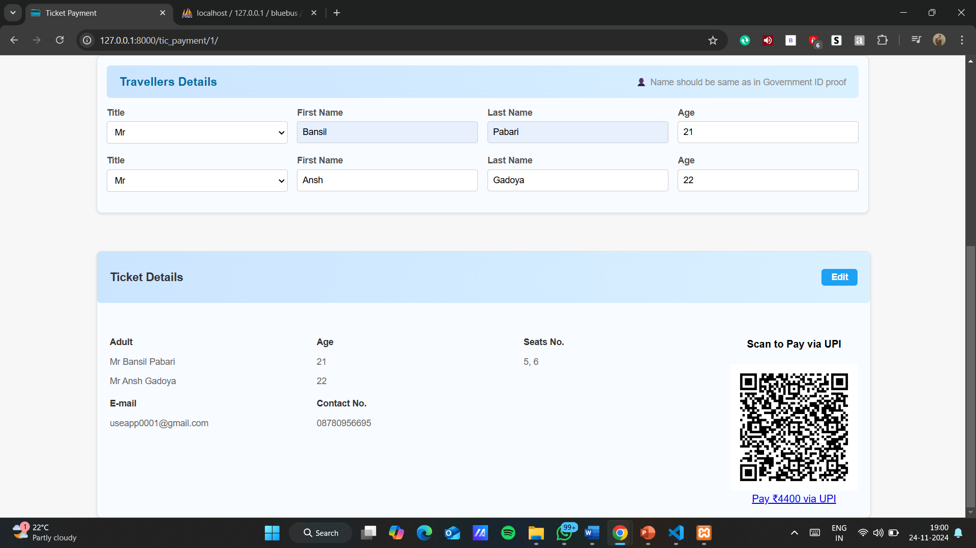

Slide 22
