Slide 1
G1
G2
G3
G4
G5
GERMIFS studies
BVSLR
Traditional GWAS
CardiogramPlusC4D
58 loci

Slide 3
miRNA
expression
Age
Training
Cognitive Ability

Slide 4
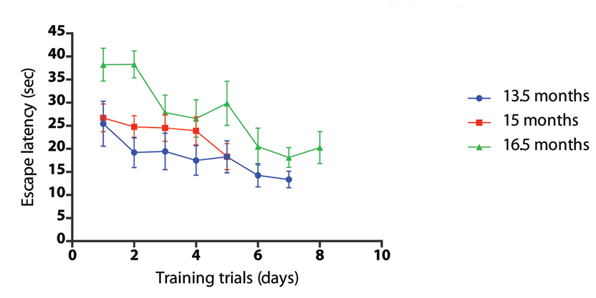

Slide 5
