Slide 1




Identification of disease-associated gen-regulatory networks
Teilprojekt 3
Johannes Söding Jeanette Erdmann
09 May 2016

Slide 2
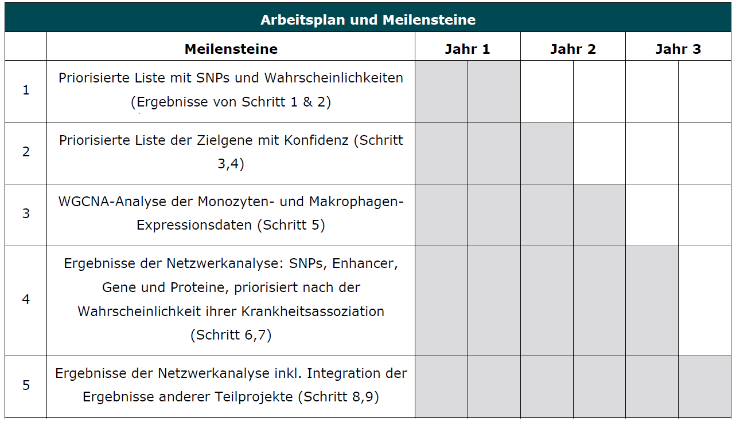
We started with our work 18 months late, 11 months ago
︎

Slide 3
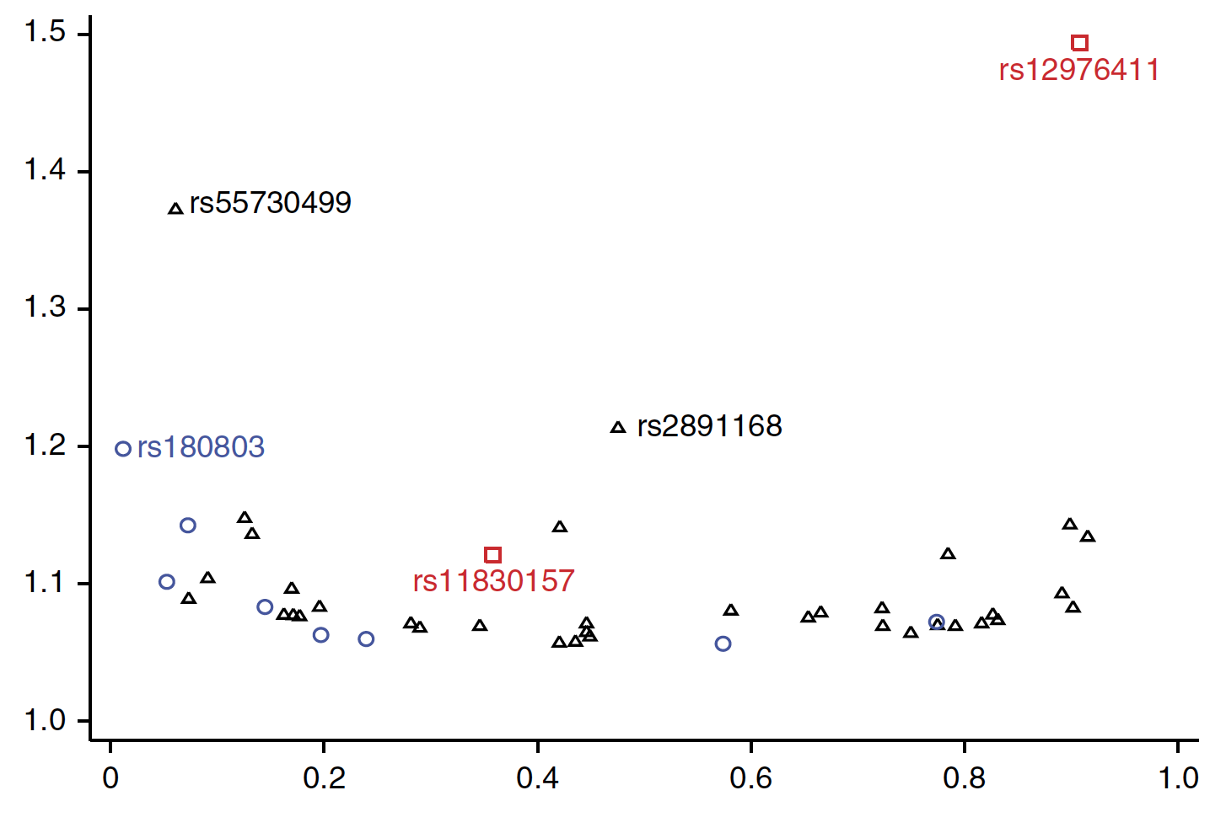
GWAS have discovered many new loci... but fewer new mechamisms than hoped for
CAD GWAS identified ~54 statistically significant risk loci in unbiased way! ⁽¹⁾
Odds Ratio (OR)
Effect Allele Frequency
But: we need new mechanisms!
~30% of loci linked to LDL/HDL metabolism or high blood pressure
PCKS7 found in GWAS is targeted by 2 phase-III drugs
Most others cannot be linked to plausible genes or mechanisms
E.g. strongest CVD locus (9p21.3) with OR 1.5(!) still mysterious⁽²⁾
Why?
⁽¹⁾ CARDIoGRAMplusC4D Consortium, Nature Genetics (2015),
⁽²⁾ Hannou et al., Trends in Endocrin. & Metabolism (2015); Swerdlow et al., Curr. Cardiol. Rep. (2015)

Slide 4
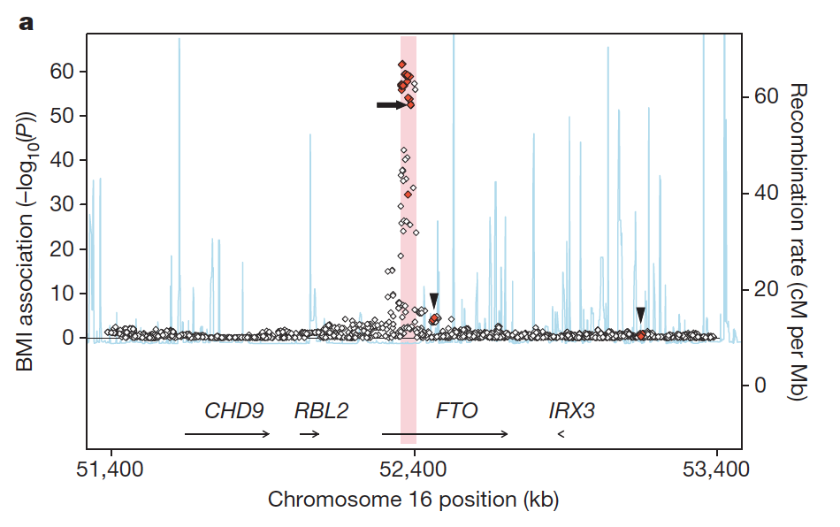
Many regulatory GWAS SNPs may not target the nearest gene
Example: FTO / IRX3 regulation at 500 Mbp, Smemo et al, Nature 2014
Examples in Sheffield et al., Genome Res. 2013
Maurano et al, Science 2012: „79% represent [enhancer-gene] pairings with distant promoters versus those of the nearest gene.“
Anderssen et al., Nature 2014: „60% of the inferred TSS-associated enhancers were not linked with the nearest TSS, and 64% of enhancers have at least one correlated TSS within 500 kilobases.

Slide 5
GTEx identifies target genes of GWAS risk SNPs by intersecting with eQTLs
Genotypes
disease states
genes
0 1 0 0 1 1 0 2 0 0 1 1 0 0 1
0 0 0 1 0 0 0 0 0 0 1 1 0 0 0
0 1 0 0 1 1 0 1 0 1 0 1 0 0 0
0 1 0 1 1 1 0 2 1 1 0 0 0 1 0
0 2 0 0 1 1 0 0 1 1 0 1 0 1 0
0
0
1
1
0
GWAS
patients
risk SNPs
intersection
tissues
Gene expressions
genes
eQTLs
0.13 0.23 0.02 0.29 3.28 2.60
0.16 0.27 0.00 0.67 2.39 2.40
0.11 0.18 0.09 0.83 2.27 3.74
0.22 0.30 0.04 0.26 2.56 3.28
0.17 0.19 0.12 0.64 2.08 2.86
0.13 0.23 0.02 0.29 3.28 2.60
0.16 0.27 0.00 0.67 2.39 2.40
0.11 0.18 0.09 0.83 2.27 3.74
0.22 0.30 0.04 0.26 2.56 3.28
0.17 0.19 0.12 0.64 2.08 2.86
0 1 0 0 1 0 0 1 0 1 0 1 0 0 0
0 1 0 1 1 1 0 2 1 1 0 0 0 1 0
0 2 0 0 1 1 0 0 1 1 0 1 0 1 0
0 1 0 0 1 1 0 1 0 0 1 1 0 0 1
0 0 0 1 0 0 0 0 0 0 1 1 0 0 0
0.13 0.23 0.02 0.29 3.28 2.60
0.16 0.27 0.00 0.67 2.39 2.40
0.11 0.18 0.09 0.83 2.27 3.74
0.22 0.30 0.04 0.26 2.56 3.28
0.17 0.19 0.12 0.64 2.08 2.86
0.13 0.23 0.02 0.29 3.28 …
0.16 0.27 0.00 0.67 2.39 … 0.18 0.09 0.83 2.27 3.74 …
0.22 0.30 0.04 0.26 2.56 …
0.17 0.19 0.12 0.64 2.08 …
GTEx
patients
tissues
genes

Slide 6
Bayesian joint GWAS-eQTL analysis aggregates signal from all SNPs
Genotypes
disease states
genes
Use Bayesian variable selection logistic regression! (Saikat)
0 1 0 0 1 1 0 2 0 0 1 1 0 0 1
0 0 0 1 0 0 0 0 0 0 1 1 0 0 0
0 1 0 0 1 1 0 1 0 1 0 1 0 0 0
0 1 0 1 1 1 0 2 1 1 0 0 0 1 0
0 2 0 0 1 1 0 0 1 1 0 1 0 1 0
0
0
1
1
0
GWAS
patients
learn
risk
explanatory SNPs
predict risk
predicted disease risk
Gene expressions
genes
0.13 0.23 0.02 0.29 3.28 2.60
0.16 0.27 0.00 0.67 2.39 2.40
0.11 0.18 0.09 0.83 2.27 3.74
0.22 0.30 0.04 0.26 2.56 3.28
0.17 0.19 0.12 0.64 2.08 2.86
0.13 0.23 0.02 0.29 3.28 2.60
0.16 0.27 0.00 0.67 2.39 2.40
0.11 0.18 0.09 0.83 2.27 3.74
0.22 0.30 0.04 0.26 2.56 3.28
0.17 0.19 0.12 0.64 2.08 2.86
0 1 0 0 1 0 0 1 0 1 0 1 0 0 0
0 1 0 1 1 1 0 2 1 1 0 0 0 1 0
0 2 0 0 1 1 0 0 1 1 0 1 0 1 0
0 1 0 0 1 1 0 1 0 0 1 1 0 0 1
0 0 0 1 0 0 0 0 0 0 1 1 0 0 0
0.13 0.23 0.02 0.29 3.28 2.60
0.16 0.27 0.00 0.67 2.39 2.40
0.11 0.18 0.09 0.83 2.27 3.74
0.22 0.30 0.04 0.26 2.56 3.28
0.17 0.19 0.12 0.64 2.08 2.86
0.33
0.12
0.83
0.53
0.38
0.13 0.23 0.02 0.29 3.28 …
0.16 0.27 0.00 0.67 2.39 … 0.18 0.09 0.83 2.27 3.74 …
0.22 0.30 0.04 0.26 2.56 …
0.17 0.19 0.12 0.64 2.08 …
GTEx
patients
genes

Slide 7
Graphical model for Bayesian approach
w
y_{n}
Gene expressions
ϕ_{n}
Disease states
GWAS
x_{n}
X,ɸ
GTEx genotypes
N

Slide 8
Bayesian joint GWAS-eQTL analysis links gene-tissue pairs to disease risk
Predicted genetic risk
expression of gene g in tissue t

Slide 9
Subnetwork analysis using non-negative matrix factorization
Find subnetworks whose non-negative additive contributions can best explain expression across > 9 tissues and over 700 GTEx patients
Contributions to gene expression can only be ≥ 0!
Gene expressions
subnetworks
genes
0.13 0.23 0.02 0.29 3.28 2.60
0.16 0.27 0.00 0.67 2.39 2.40
0.11 0.18 0.09 0.83 2.27 3.74
0.22 0.30 0.04 0.26 2.56 3.28
0.17 0.19 0.12 0.64 2.08 2.86
genes
0.13 0.23 0.02 0.29 3.28 2.60
0.16 0.27 0.00 0.67 2.39 2.40
0.11 0.18 0.09 0.83 2.27 3.74
0.22 0.30 0.04 0.26 2.56 3.28
0.17 0.19 0.12 0.64 2.08 2.86
0.13 0.23 0.02 0.29 3.28 2.60
0.16 0.27 0.00 0.67 2.39 2.40
0.11 0.18 0.09 0.83 2.27 3.74
0.22 0.30 0.04 0.26 2.56 3.28
0.17 0.19 0.12 0.64 2.08 2.86
0.13 0.23 0.02 0.29 3.28 …
0.16 0.27 0.00 0.67 2.39 … 0.18 0.09 0.83 2.27 3.74 …
0.22 0.30 0.04 0.26 2.56 …
0.17 0.19 0.12 0.64 2.08 …
=
×
patients
patients
subnetworks
tissues
Expression of all genes in each tissue for each patient
Expression of all subnetworks in each tissue for each patient
Subnetworks: which genes contribute to each subnetwork

Slide 10
Bayesian joint GWAS-eQTL analysis aggregates signal from all SNPs
Genotypes
Disease states
genes
0 1 0 0 1 1 0 2 0 0 1 1 0 0 1
0 0 0 1 0 0 0 0 0 0 1 1 0 0 0
0 1 0 0 1 1 0 1 0 1 0 1 0 0 0
0 1 0 1 1 1 0 2 1 1 0 0 0 1 0
0 2 0 0 1 1 0 0 1 1 0 1 0 1 0
0
0
1
1
0
GWAS
patients
learn
risk
explanatory SNPs
predict risk
Predicted disease risk
Gene expressions
Gene expressions
subnetworks
genes
0.13 0.23 0.02 0.29 3.28 2.60
0.16 0.27 0.00 0.67 2.39 2.40
0.11 0.18 0.09 0.83 2.27 3.74
0.22 0.30 0.04 0.26 2.56 3.28
0.17 0.19 0.12 0.64 2.08 2.86
0.13 0.23 0.02 0.29 3.28 2.60
0.16 0.27 0.00 0.67 2.39 2.40
0.11 0.18 0.09 0.83 2.27 3.74
0.22 0.30 0.04 0.26 2.56 3.28
0.17 0.19 0.12 0.64 2.08 2.86
0 1 0 0 1 0 0 1 0 1 0 1 0 0 0
0 1 0 1 1 1 0 2 1 1 0 0 0 1 0
0 2 0 0 1 1 0 0 1 1 0 1 0 1 0
0 1 0 0 1 1 0 1 0 0 1 1 0 0 1
0 0 0 1 0 0 0 0 0 0 1 1 0 0 0
0.13 0.23 0.02 0.29 3.28 2.60
0.16 0.27 0.00 0.67 2.39 2.40
0.11 0.18 0.09 0.83 2.27 3.74
0.22 0.30 0.04 0.26 2.56 3.28
0.17 0.19 0.12 0.64 2.08 2.86
0.33
0.12
0.83
0.53
0.38
0.13 0.23 0.02 0.29 3.28 …
0.16 0.27 0.00 0.67 2.39 … 0.18 0.09 0.83 2.27 3.74 …
0.22 0.30 0.04 0.26 2.56 …
0.17 0.19 0.12 0.64 2.08 …
GTEx
patients
patients
genes

Slide 11
Bayesian joint GWAS-eQTL analysis links gene subnetworks to disease risk
Predicted genetic risk
expression of subnetwork s in tissue t

Slide 12
Bayesian variable selection logistic regression for
risk prediction, fine mapping of GWAS SNPs, and prediction of disease-associated regulatory gene subnetworks

Slide 13
Methods for association testing
Standard GWAS
Univariate methods
Individual test statistics (e.g. Wald test, Cochran-Armitage trend test)
Correction for multiple testing
Incorporating interactions
Multivariate methods
Penalized regression methods (LASSO)
Factorial methods (DAPC-based FS)

Slide 14
Univariate logistic regression
Analysis of each SNP is done independently
Phenotype of patient n
logistic function
Effect of SNP i
# minor alleles of SNP i in patient n
1
0
Likelihood

Slide 15
Classical hypothesis tests
Is data compatible with null hypothesis?
value is calculated from hypothesis tests, e.g. Wald test
p-value calculated for distribution with 1 df
Is > threshold ?
Null-hypothesis (no effect)
Likelihood
effect strength

Slide 16
Univariate methods
Strengths
Weaknesses
Straightforward
Computationally fast
Conservative
Easy to interpret
Multivariate system, univariate framework
Effect size of individual SNPs may be too small
Marginal effects of individual SNPs ≠ combined effects

Slide 17
Multivariate regression
Joint analysis of SNPs takes account of linkage structure
Independent SNPs
For all SNPs
1
0
But, number of SNPs >> samples
Overfitting
How to introduce sparsity?

Slide 18
LASSO penalized regression
How LASSO produces sparsity in multivariate regression?
Another way of seeing how the lasso produces sparsity is to view it from a Bayesian perspective, where the lasso penalty produces a double exponential prior
Multicollinearity
Variability in penalty parameter

Slide 19
Bayesian logistic regression
… looks at both null hypothesis and alternate hypothesis
prior probability for non-causal
prior probability for causal
Likelihood
effect strength

Slide 20
Prior on effect size
prior probability for causality
expected effect size
Dependence of parameters on external information ξ_{if} :
effect strength
Hyperparameters β_{f}, γ_{f} can be learnt from the data!

Slide 21
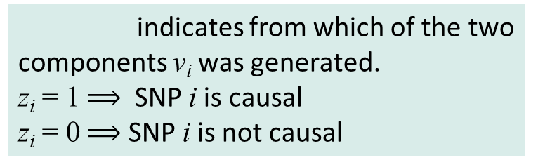
Prior on effect size
indicates from which of the two components v_{i} was generated.
z_{i} = 1 SNP i is causal
z_{i} = 0 SNP i is not causal
effect strength

Slide 22
How to learn hyperparameters?
Avoid point estimates of v_{i} because they can only be estimated very unreliably
⇒ integrate out v = (v₀ ,v₁,…,v_{i} ,…)
Maximize the marginal likelihood:
Integral over v usually by MCMC sampling. Very inefficient.
We found analytical approximation (iterative Laplace approx.) ⇒ can efficiently optimize marginal likelihood
Bayesian approach allows us to learn hyperparameters even though we have no reliable point estimates for any of the v_{i}’s

Slide 23
How to use the hyperparameters?
Fine mapping causal variants
[Posterior probability for a SNP to be causative]
Risk prediction of patients
Risk prediction methodology is not well-developed, limited by heritability.
We benchmark our method against existing finemapping methods.

Slide 24
Simulation method
Randomly select 100 loci (each with 120-200 SNPs)
Randomly pick 50 loci to be causal
In each causal loci, pick 2 SNPs as causal
Generate phenotype
With NO environmental variance (heritability = 1)
With environmental variance (heritability = 0.3)

Slide 25

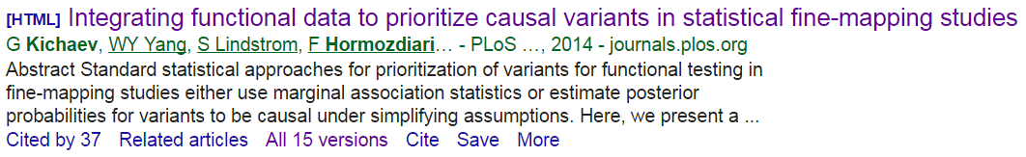
Finemapping causal variants
Requires significant coverage of genotyped / imputed SNPs at the causal loci.
Most existing statistical methods use point estimates.
PAINTOR is the best method till date.
Uses annotation from ENCODE, DHS, etc.
Assumes distribution of z-score would be same as distribution of LD (and tries to find the best overlap region)

Slide 26
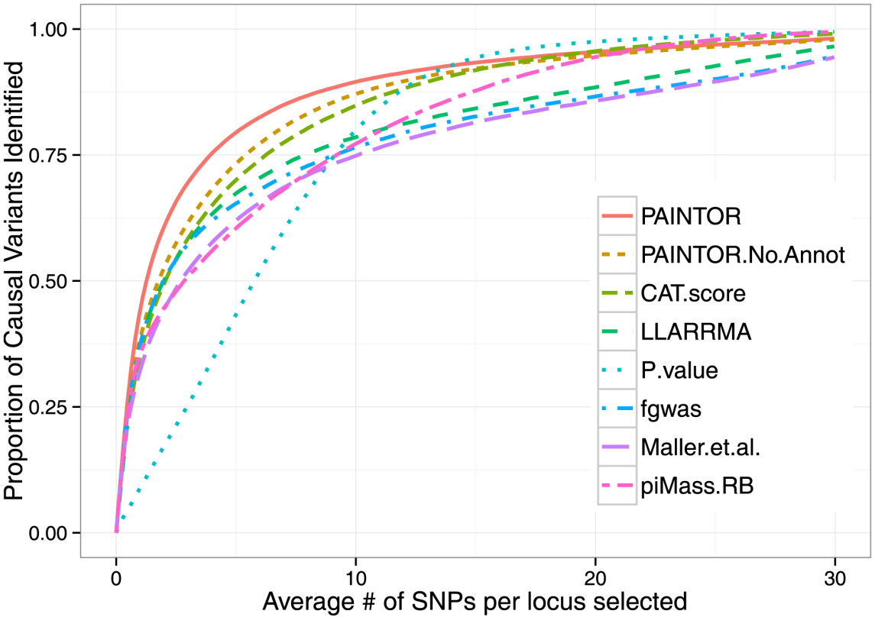
PAINTOR outperforms other methods

Slide 27
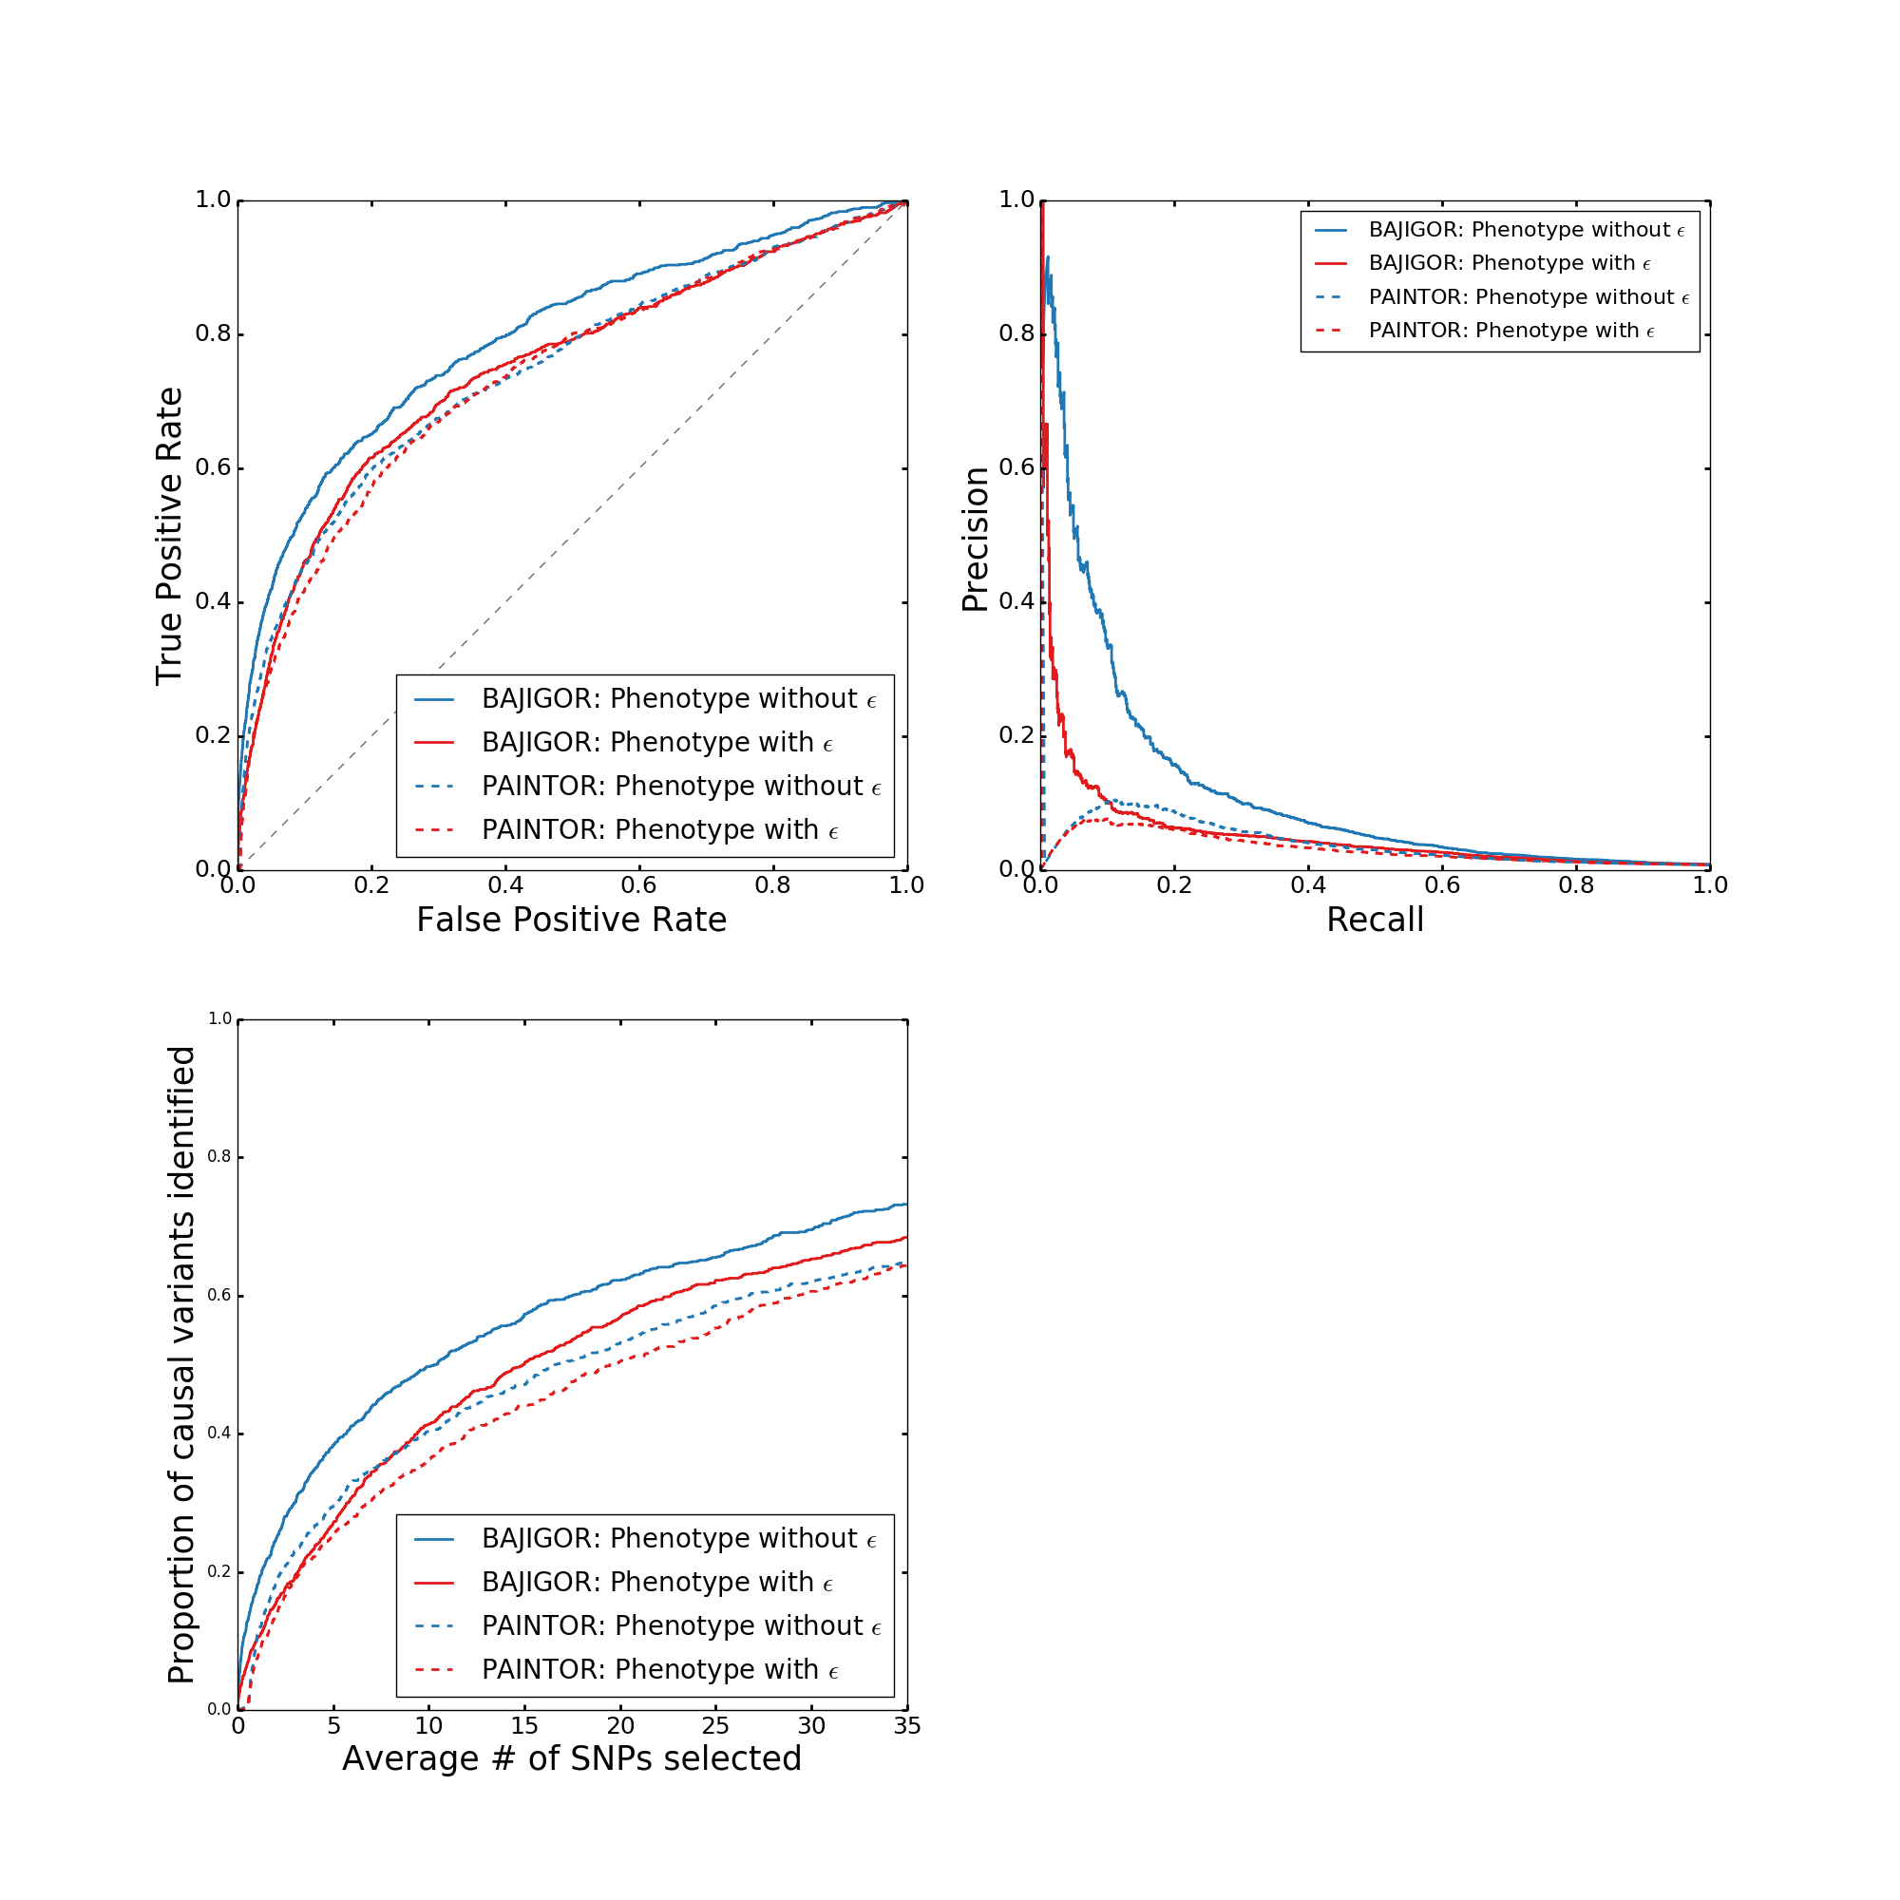
Results

Slide 28
Risk prediction cross-validation
Select loci and generate phenotype (discussed earlier)
Randomly pick 20 samples for cross-validation
Learn from remaining 2400 samples
Predict on the 20 samples
Repeat N times
Repeat whole simulation S times

Slide 29
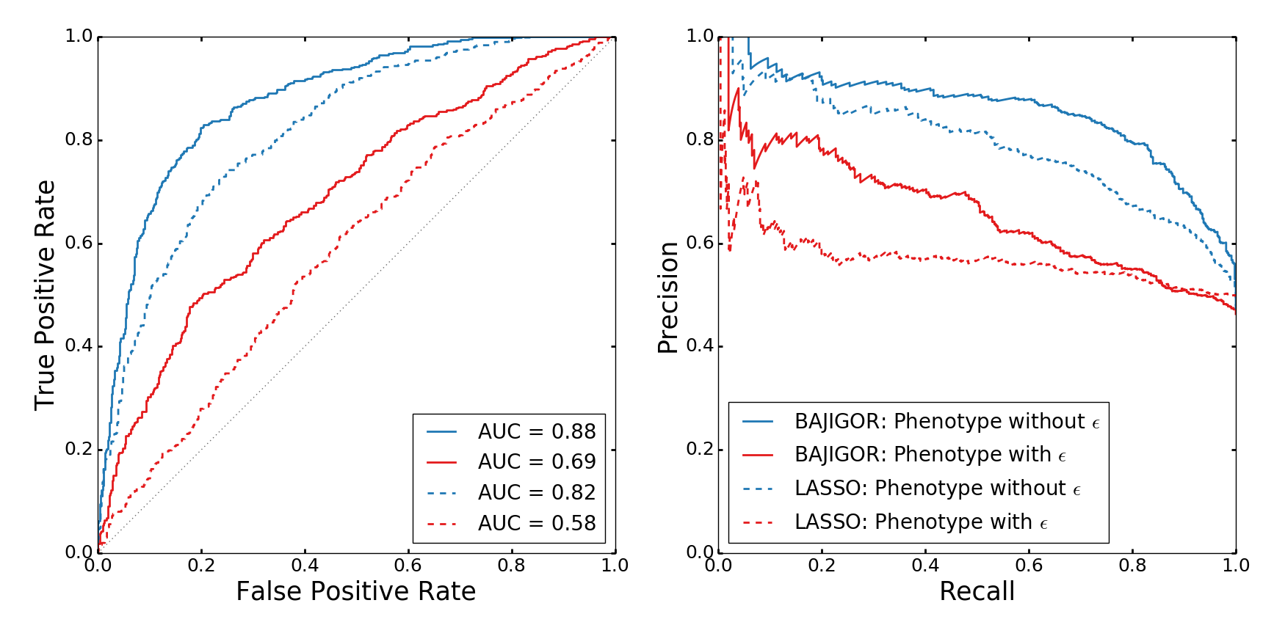
Results

Slide 30
Identification of target genes for regulatory SNPs

Slide 31
Goal: predict target genes for regulatory SNPs
Step 1: Create a map of Enhancer-Gene Interactions
Enhancer
Core Promoter
Gene
Step 2: Predict likely targets for GWAS SNPS
Enhancer
Core Promoter
Gene
Predict most likely target genes of GWAS SNPs
i.e., genes implicated in causation of disease

Slide 32
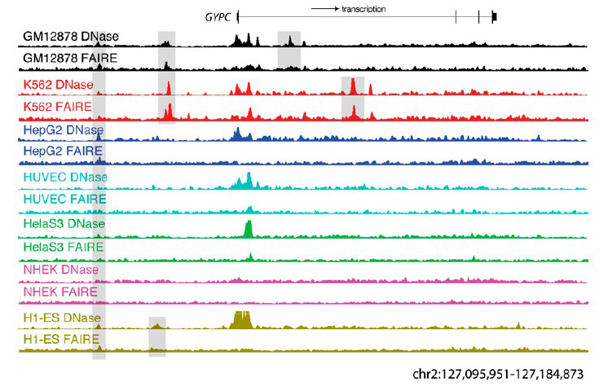
Chromatin accessibility is highly regulated
Song, L. et al. Genome Res. 21, 1757–1767 (2011).

Slide 33
Correlation Approach
Pearson
correlation
112 cell types
Chromatin Accessibility
Gene Expression

Slide 34
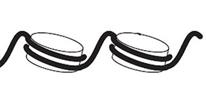
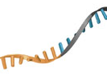
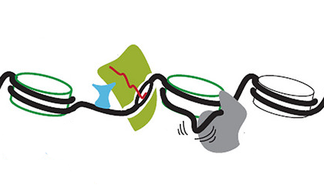
The Genome-wide data
Chromatin Accessibility: DNase hypersensitive sites (DHS)
Gene Expression
DHS profiles in 112 Cell types
112 DHS values for each of ~ 500k genotyped SNPs
~20 000 protein coding genes
>10 000 non-coding RNAs

Slide 35
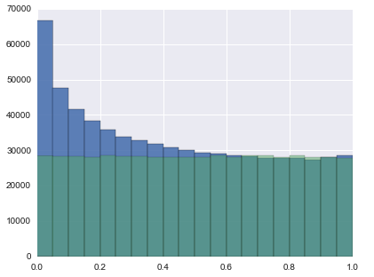
Compute P-values to correct for systematic differences between DNA accessibility etc.
chrom. A
corr?
corr?
corr?
chrom. A
corr?
corr?
corr?
chrom. B
corr?
enh
enh
gene
enh
enh
correlation coeff.
TP + FP (true + false pos.)
FP
(false pos.)
TP
FP
-1.0
corr. coeff.
1.0
TP
FP
0.0
corr. p-value
1.0

Slide 36
False discovery rate (FDR) estimation
cut-off
TP
FP
corr. p-value

Slide 37
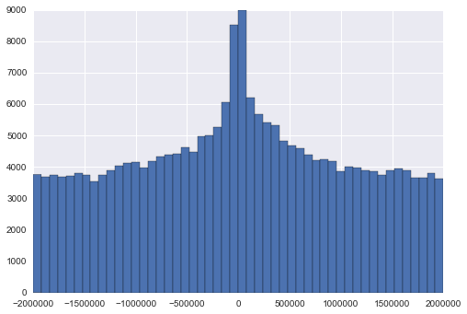
Genomic distance is very informative!
corr. p-value ≤ 0.015
TP
FP
-2 Mbp
0 Mbp
+2 Mbp
Distance from gene start

Slide 38
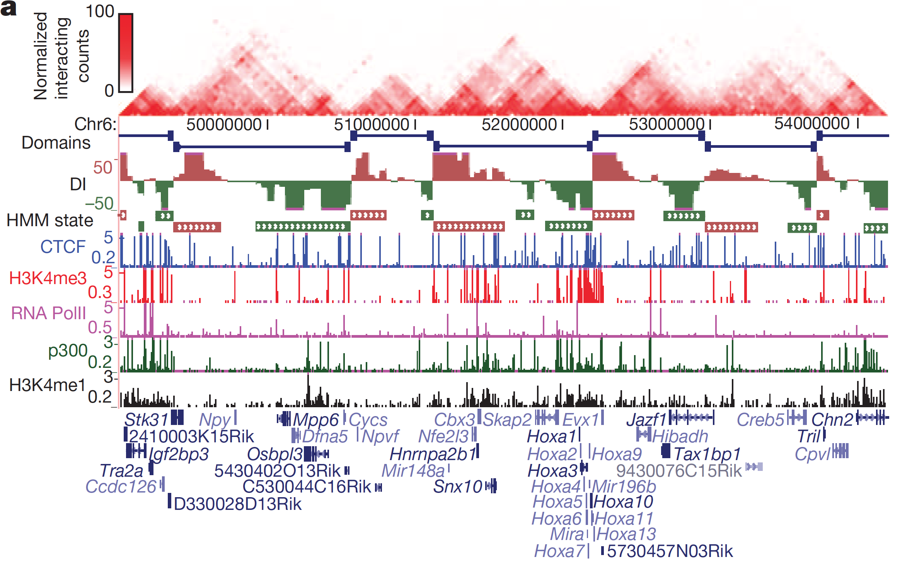
HiC measures DNA-DNA contacts genome-wide (resolution ~50kbp, only very few cell types available)
Topological domains
Dixon. et al. Nature (2012).

Slide 39
How to integrate information from correlation, distance, HiC etc.?
Bayesian approach
Enhancer e and
gene g coupled?
expr-DHS correlation p-value
distance e to g
Bayes factor
Prior prob’s

Slide 40
Estimating the Bayes factor for correlation
tp density
tp-density(pval_{e,g})
BF =
fp-density(pval_{e,g})
fp density
corr. pval_{e,g}

Slide 41
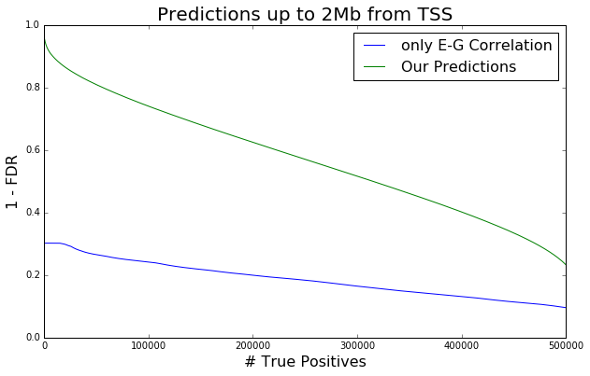
We predict 100,000 SNP-gene interactions with false discovery rate < 25%
# true SNP-gene interactions

Slide 42
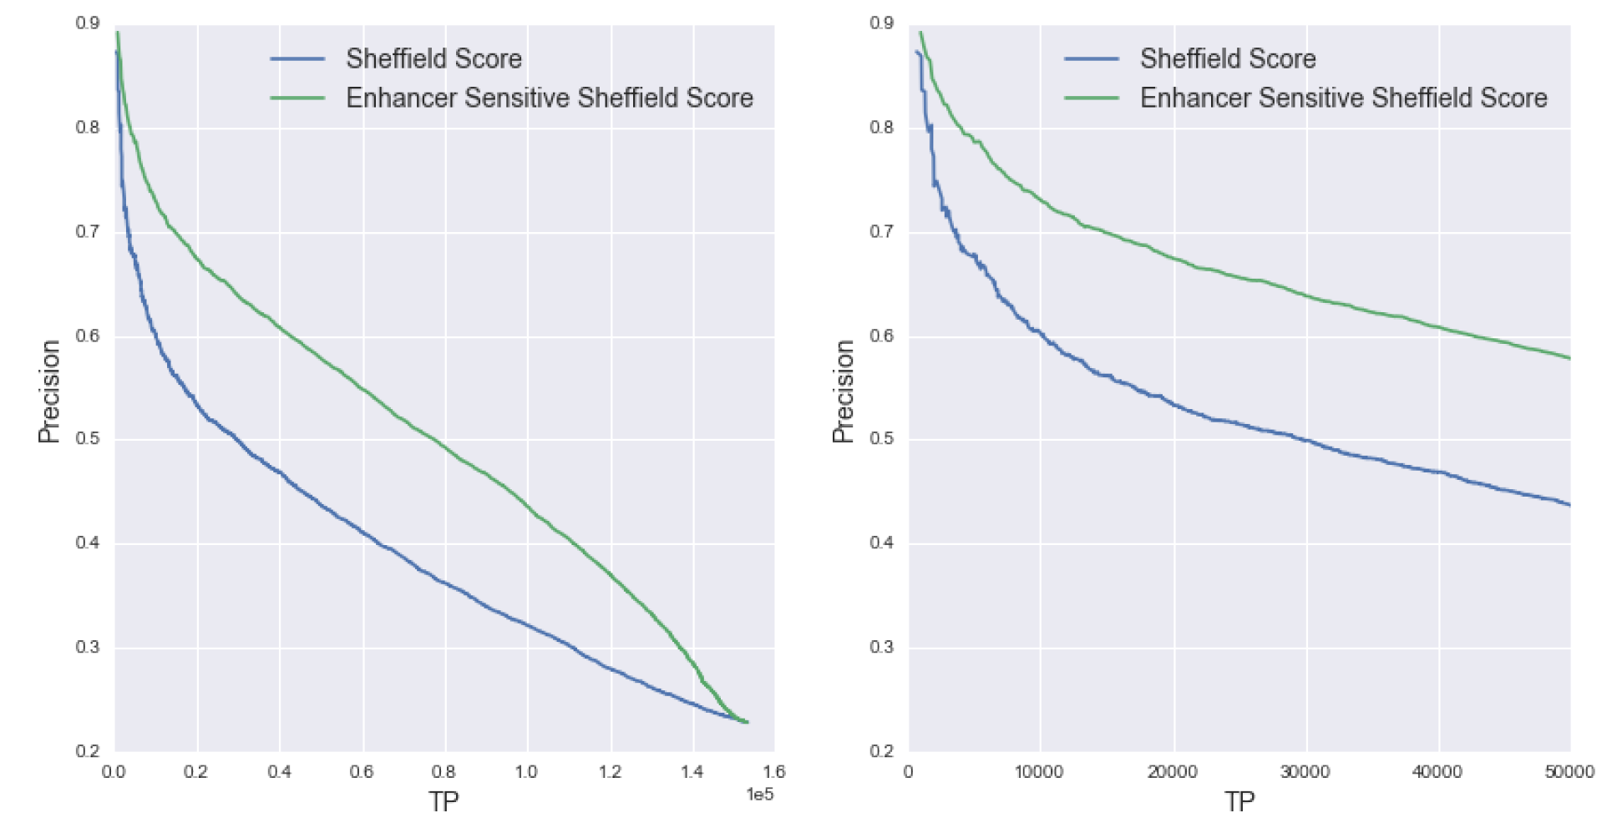
Results from October 2014
Precision vs. true positive links for Chr. 1, up to 100 kbp from TSS
Score by Sheffield et al. 2013
Our DHS correlation score
1-FDR

Slide 43
Ressource: List of target genes for all genotyped human SNPs
Excerpt for all CAD risk SNPs and SNPs in LD > 0.9
Position | SNP ID | Target gene | Distance (bp) | Probability
chr10 44747059 | rs535176 | RP11-20J15.2 | 10202 | 0.82
chr6 134214525 | rs12190287 | TCF21 | 4249 | 0.81
chr14 100133250 | rs17562391 | CYP46A1 | -17391 | 0.79
chr14 100115608 | rs4905878 | HHIPL1 | 4161 | 0.78
chr12 111884608 | rs3184504 | SH2B3 | 40856 | 0.78
chr10 44760033 | rs634963 | RP11-20J15.2 | -2772 | 0.76
chr1 109817838 | rs660240 | PSRC1 | 7952 | 0.73
… | … | … | … | …
see geme catalog, piublication by Chrisitan Gieger
High probability for interaction with risk SNP makes target gene likely to be causally implicated in the disease!

Slide 44
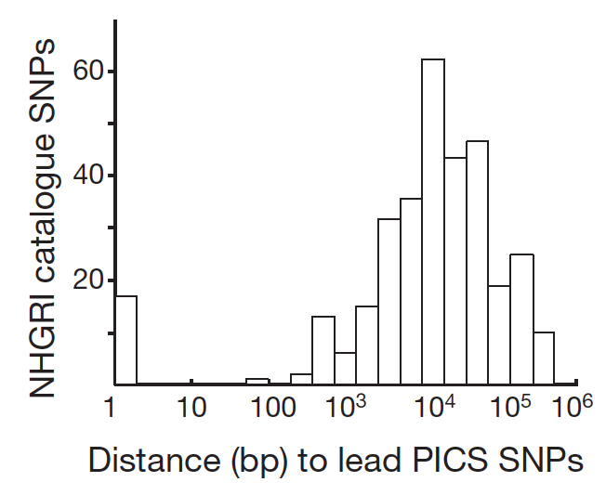
„Index SNPs reported in the GWAS catalogue have on average only a 5% chance of representing a causal SNP“
Farh et al., Genetic and epigenetic fine mapping of causal autoimmune disease variants, Nature (2015)
„... index SNPs reported in the GWAS catalogue have on average only a 5% chance of representing a causal SNP. Rather, GWAS catalogue index SNPs are typically some distance from the [most likely causal] PICS lead SNP (median 14 kb), and many are not in tight LD.“
Main difficulty in GWAS and eQTL approaches: linkage makes it challenging to resolve causal SNPs
DHS-based approach has high resolution independent of linkage
We make target gene predictions for entire genome, not only genotyped SNPs
We have chance to identify new genes whose dysregulation is associated with disease risk

Slide 45

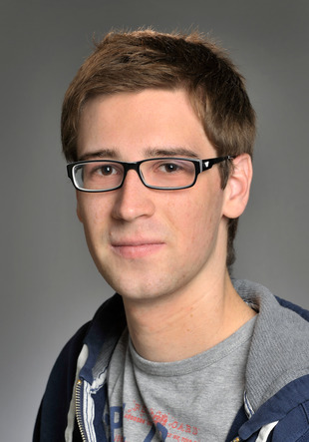

Many thanks to:
Christian Roth
Saikat Banerjee
Hiwi / bachelor student on e:AtheroSysMed since 10/2013
Postdoc on e:AtheroSysMed since 06/2015

Slide 46
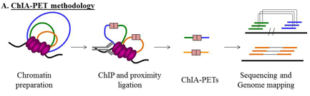
Schritt 3: Vorhersage von Zielgenen für regulatorische SNPs.
Validierung und Enhancement mit Hilfe von ChIA-PET-Daten in einzelnen Zellen (z.B. Li et al., Cell 2012)

Slide 47
High-throughput combinatorial measure-ment of enhancer-promoter interactions
Collaboration with Patrick Cramer and Ania Sawicka, MPI BPC
Library of ~10 000
human promoters
×
Library of ~20 000 human enhancers
Measure activity for every promoter-enhancer pair by NGS
unique
tag
unique
tag
5’ priming
∼10kbp intron
3’ priming
GFP
Promoter from library
Enhancer from library
2×50 bp paired-end sequenced
Constructs on plasmids
poly(A)-site

Slide 48
Delayed project start due to lab move to Goettingen
Project financing started April 2014
Postdoc Saikat Banerjee started in June 2015 (delayed by 18 months)
Worked on eAtheroSysMed with Hiwi student Christian Roth

