Slide 1
UML
ajou
Image Text photographer Index date
Create() Delete() Update() Next() Previous()
us
Image text
Create() Delete() Update()
Interview
Image Text Index date
Create() Delete() Update() Next() Previous()
epilogue
Image Text Title author Index Date
Create() Delete() Update() Next() Previous()

Slide 2
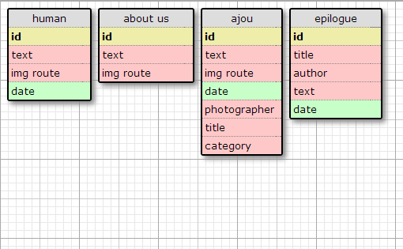
DATABASE MODELING

