Slide 1
Product Backlog
A list of all desired work on the project
  Usually a combination of
    story-based work (“let user search and replace”)
    task-based work (“improve exception handling”)
List is prioritized by the Product Owner
  Typically a Product Manager, Marketing, Internal Customer, etc.

Slide 2
Product Backlog
Requirements for a system, expressed as a prioritized list of Backlog Items
Is managed and owned by a Product Owner
Spreadsheet (typically)
Usually is created during the Sprint Planning Meeting
Can be changed and re-prioritized before each PM

Slide 3
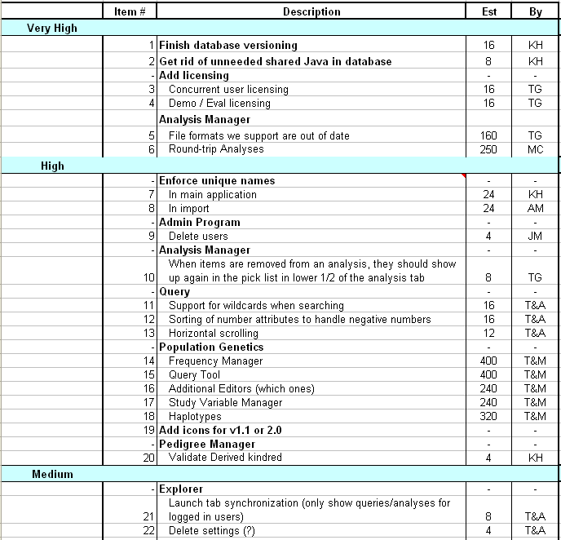
Sample Product Backlog

Slide 4
From Sprint Goal to Sprint Backlog
Scrum team takes the Sprint Goal and decides what tasks are necessary
Team self-organizes around how they’ll meet the Sprint Goal
  Manager doesn’t assign tasks to individuals
Managers don’t make decisions for the team
Sprint Backlog is created

Slide 5
Sprint Backlog during the Sprint
Changes
  Team adds new tasks whenever they need to in order to meet the Sprint Goal
  Team can remove unnecessary tasks
  But: Sprint Backlog can only be updated by the team
Estimates are updated whenever there’s new information

Slide 6
Sprint Backlog
A subset of Product Backlog Items, which define the work for a Sprint
Is created ONLY by Team members
Each Item has it’s own status
Should be updated every day

Slide 7
Sprint Backlog
No more than 300 tasks in the list
If a task requires more than 16 hours, it should be broken down
Team can add or subtract items from the list. Product Owner is not allowed to do it

Slide 8
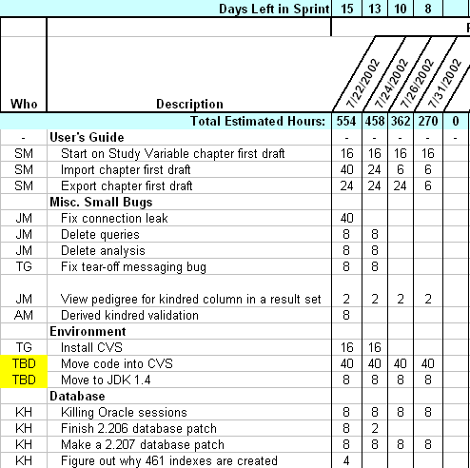
Sample Sprint Backlog

Slide 9
Sprint Burn down Chart
Depicts the total Sprint Backlog hours remaining per day
Shows the estimated amount of time to release
Ideally should burn down to zero to the end of the Sprint
Actually is not a straight line
Can bump UP

Slide 10
Information Radiator
"Two characteristics are key to a good information radiator. The first is that the information changes over time. This makes it worth a person's while to look at the display... The other characteristic is that it takes very little energy to view the display."

Slide 11
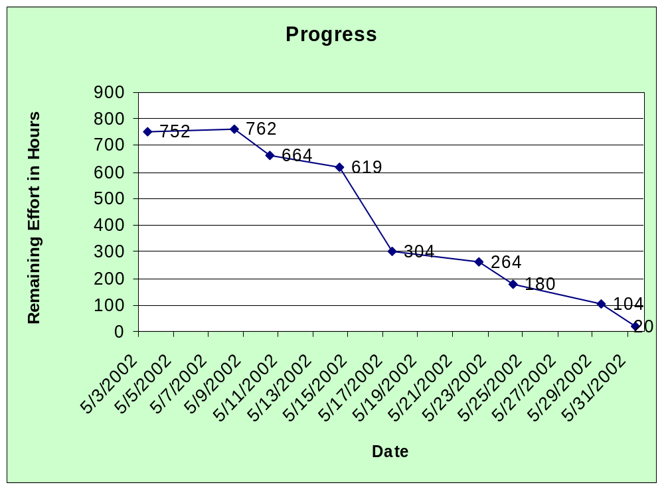
Sprint Burndown Chart

Slide 12
Release Burndown Chart
Will the release be done on right time?
X-axis: sprints
Y-axis: amount of hours remaining
The estimated work remaining can also burn up

Slide 13
Product Burndown Chart
Is a “big picture” view of project’s progress (all the releases)

Slide 14
Scalability of Scrum
A typical Scrum team is 6-10 people
Jeff Sutherland - up to over 800 people
"Scrum of Scrums" or what called "Meta-Scrum“
Frequency of meetings is based on the degree of coupling between packets

Slide 15
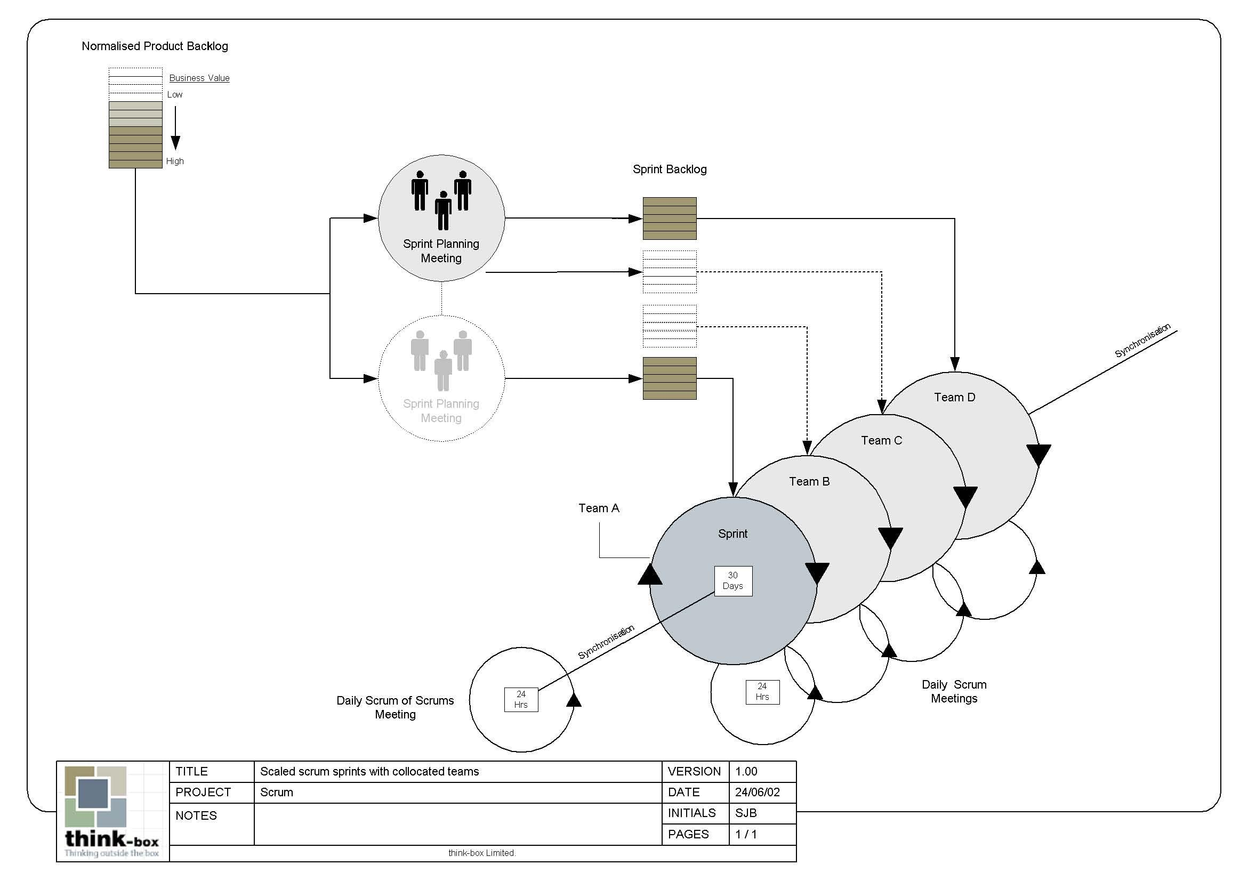
Scalability of Scrum

Slide 16
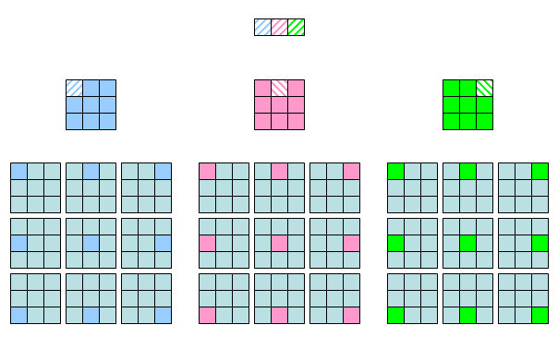
Scalability of Scrum

Slide 17
Pros/Cons
Advantages
  Completely developed and tested features in short iterations
  Simplicity of the process
  Clearly defined rules
  Increasing productivity
  Self-organizing
  each team member carries a lot of responsibility
  Improved communication
  Combination with Extreme Programming
Drawbacks
  “Undisciplined hacking” (no written documentation)
  Violation of responsibility
  Current mainly carried by the inventors

Slide 18
Thank You !!!

