Slide 1
TRIN△ETRA
4:07
An AI that argues — under rules you wrote.
TRINETRA
vs
AI for sense-making and constitutional auditing · deterministic logic for scoring · humans for final approval. A live model makes the call; the record replays byte-identically.
6 DAYS
INDIA · MARCH 2026
PROPOSE
ENFORCE
RECORD
an AI suggests moves
a machine—not a model—checks the rules
every step hash-chained, offline
ET AI Hackathon 2026 · live NVIDIA LLM at the edges · deterministic, byte-identical replay · zero-LLM critic · live on-screen decision clock
△ TRINETRA

Slide 2
THE COST OF A DELIBERATION PROBLEM
In March 2026, India needed six days to answer one question.
Not a data problem — a deliberation problem. The buffer isn't barrels; it's decision speed.
$100M+
price path R · spot share E
“My comfort point used to be 60-60-60 — 60 days of crude, gas and LPG.”
— Hardeep Singh Puri, Union Minister for Petroleum & Natural Gas, 2026
₹850+ cr — cost of the six-day decision lag
$270M
arithmetic R · attribution E
R
one SPR day burned at the peak, refilled later
WHAT IT COSTS
$30–45M
$150K / desk / year
R — from the tape
one VLCC bought in panic instead of on time
Breakeven $0.0003/bbl · ROI ~200× vs one $30M cargo
The ask: one design-partner desk — not a cheque.
Base inputs (R): imports ~4.9 mb/d (PPAC); Brent $71→$77→$100+→$126 (EIA). The app computes this live and stamps it “order-of-magnitude.”
Targets: IOC Intl Trade Directorate · RIL Jamnagar crude desk · BPCL risk cell
COMPUTED LIVE →
Sources: PPAC / EIA / EY; Puri via PIB PRID 2239021. $-figures self-labeled SOLID/DIRECTIONAL; the 6-day lag is a reported estimate.
△ TRINETRA

Slide 3
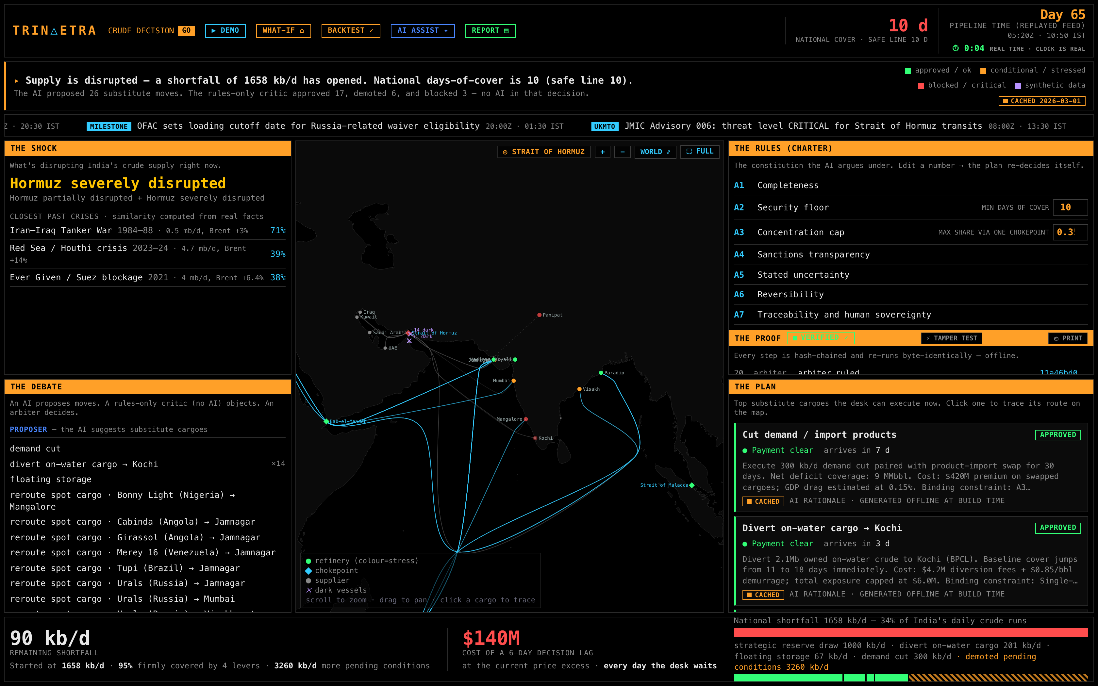
WATCH → DEBATE → PLAN
A crisis room that convenes itself — and argues under your rules.
One screen, one engine: signals → exposure-graph re-score → machine-generated option cards → charter debate → hash-chained audit. Live LLM at the edges; deterministic core runs offline.
△ TRINETRA

Slide 4
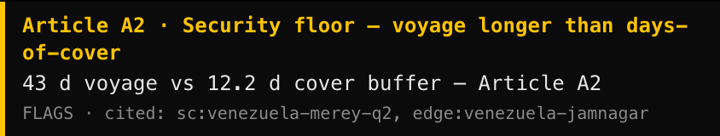
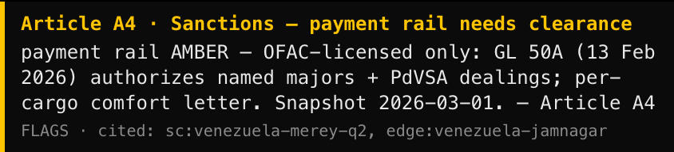
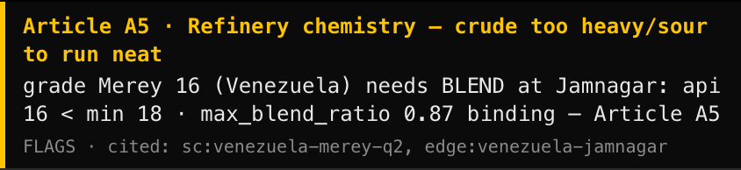
THE CRITIC — ZERO LLM, CANNOT HALLUCINATE
It demoted Venezuela's Merey. It didn't have an opinion — it ran the rules.
Three cited objections, computed by pure functions:
A2 43-day voyage vs a 12.2-day cover buffer.
A4 OFAC payment rail AMBER (snapshot 2026-03-01).
A5 Too heavy to run neat — API 16 < Jamnagar's min 18.
VERDICT CONDITIONAL (3 flags, 0 blocks)
Each objection cites its Article + evidence. No model can add, soften, or remove one.
“It ran the sanctions list, the assay table, and the calendar. The language model just wrote the memo.”
Live capture from the app at 2026-03-15. Merey real assay: API 16 / S 2.45 / TAN 0.69 (E). The critic contains zero LLM — objections are computed facts.
△ TRINETRA

Slide 5
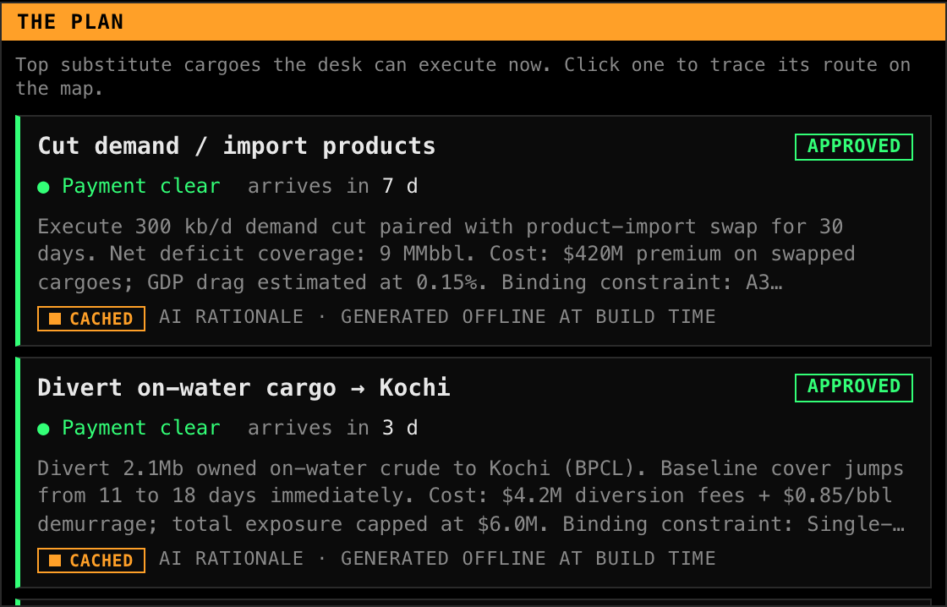
REPLAYED REAL CRISES · NOTHING FABRICATED
We replayed real crises — and every number shows how certain it is.
BACKTEST — real feeds, time-compressed
EVERY CARD CARRIES A PROVENANCE CHIP
Red Sea / Houthi 2023-24
R
8.7 → 4.0 mb/d · Brent +14%
lead time: +26 d early
Hormuz 2026 (live replay)
R
~150 tankers anchored · Brent >50%
lead time: +4 d
“India's desks validated it: non-Hormuz sourcing rose 55% → 70%; suppliers widened 27 → 41 countries.” We didn't ask an expert — we let the market grade it.
LIVE R real CACHED E estimated SYNTH S synthetic
The LLM runs LIVE (NVIDIA, via a key-holding edge worker) and every completion is recorded for replay; airplane mode falls back to the build-time cache. Per-refinery inventories are modeled (S), and we say so.
The honest claim isn't “everything is real” — it's “nothing is fabricated, and every number shows exactly how certain it is.”
△ TRINETRA

Slide 6
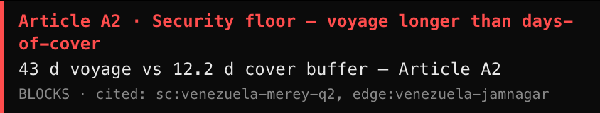
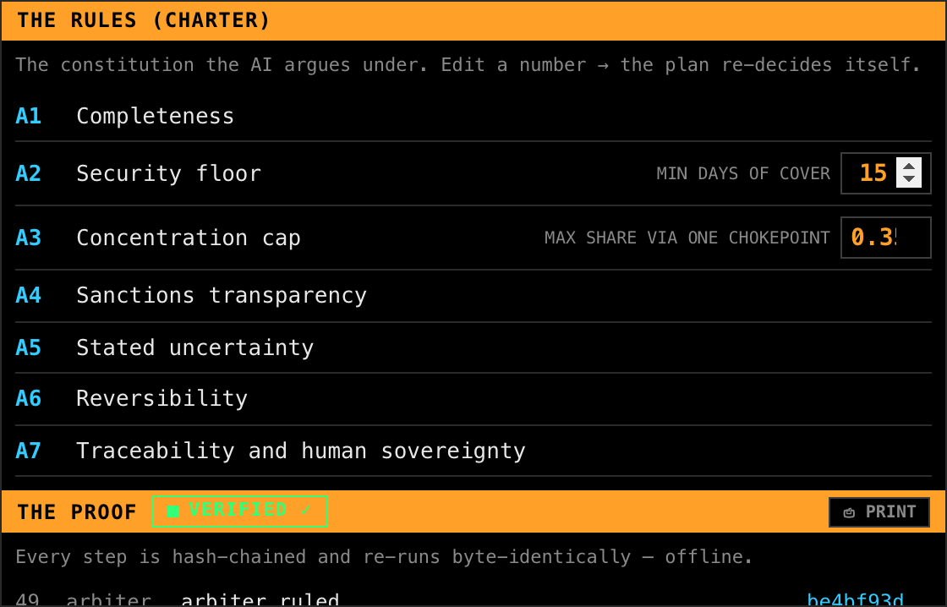
CHANGE ONE RULE → THE PLAN RE-DECIDES ITSELF
Raise the security floor 10 → 15. Long-haul cargoes fail — each cites the rule.
FLOOR 10 — CONDITIONAL
FLOOR 15 — REJECTED
→
Same fact — 43-day voyage vs 12.2-day cover. The flag escalates to a block; the arbiter rejects it. Six Jamnagar-bound cargoes fall the same way.
AND IT'S ON THE RECORD
Every verdict is hash-chained (seq · actor · input→output · prev) and re-runs byte-identically, offline. Revert to 10 and the earlier state's hashes reproduce exactly — no clock, no randomness on the derivation path. One click prints the trace on white: the signed prop.
“Run it again — byte-identical. Try that with a prompt.”
No Date.now / Math.random on any derivation path — sim time only. The signed audit trace is the artifact a fine-tuned forecaster cannot produce.
△ TRINETRA

Slide 7
DETERMINISTIC CORE · LLM ONLY AT THE EDGES
Boring, inspectable, event-driven.
SIGNALS
RESCORE
OPTIONS
PROPOSER
CRITIC
ARBITER
AUDIT
pure
pure
pure
LIVE LLM
ZERO LLM
pure
hash chain
solid = deterministic · proposer prose is LIVE (NVIDIA via a key-holding edge worker), recorded for replay; cache is the airplane-mode fallback
THE RIGHT TOOL PER LAYER — chosen by what each layer is allowed to get wrong
RULES
for the veto
must be citable & cannot hallucinate
OUR MODEL
for the number
softmax, frozen weights — byte-identical every run
ONE LLM
for the sentence
live at the edges, recorded for replay — only prose may vary
“One big LLM” would hallucinate the compliance check, vary the number every run, and be un-replayable — breaking the audit trail that is the moat.
△ TRINETRA

Slide 8
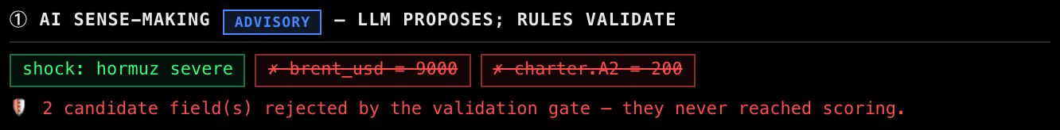
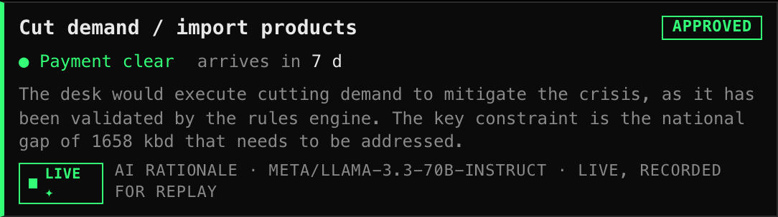
AI FOR SENSE-MAKING · RULES FOR SCORING · HUMANS FOR APPROVAL
Now it reads messy operator text — and the gate throws out whatever it makes up.
① AI SENSE-MAKING
② VALIDATION GATE
③ DETERMINISTIC SCORING
④ AI RULE AUDIT
⑤ HUMAN APPROVAL
reads free text
strict schema + rules
rescore · critic · arbiter
rule gaps · read-only
logged sign-off
advisory
authoritative
authoritative
advisory
human
AI (blue) only proposes and observes. The green rail — validation + scoring — is deterministic and authoritative. A human signs.
THE GATE, LIVE — a hallucinated Brent 9000 and a made-up grade, rejected before scoring:
THE MODEL, LIVE ✦ — NVIDIA, on every update:
live Llama-3.3-70B rationale, recorded for replay — captured from the app
A live model makes the call. The record replays byte-identically. A human signs.
The LLM runs LIVE on every decision-state change — NVIDIA Llama-3.3-70B through a key-holding Cloudflare Worker; the browser never sees a key. Every completion is RECORDED and replays byte-identically; the validation gate still drops anything fabricated before it can touch a score; scoring stays deterministic and offline-checkable.
AI for sense-making and auditing · deterministic logic for scoring · humans for approval. Try it live: AI ASSIST ✦ → “⚠ Hallucination test.”
△ TRINETRA

Slide 9
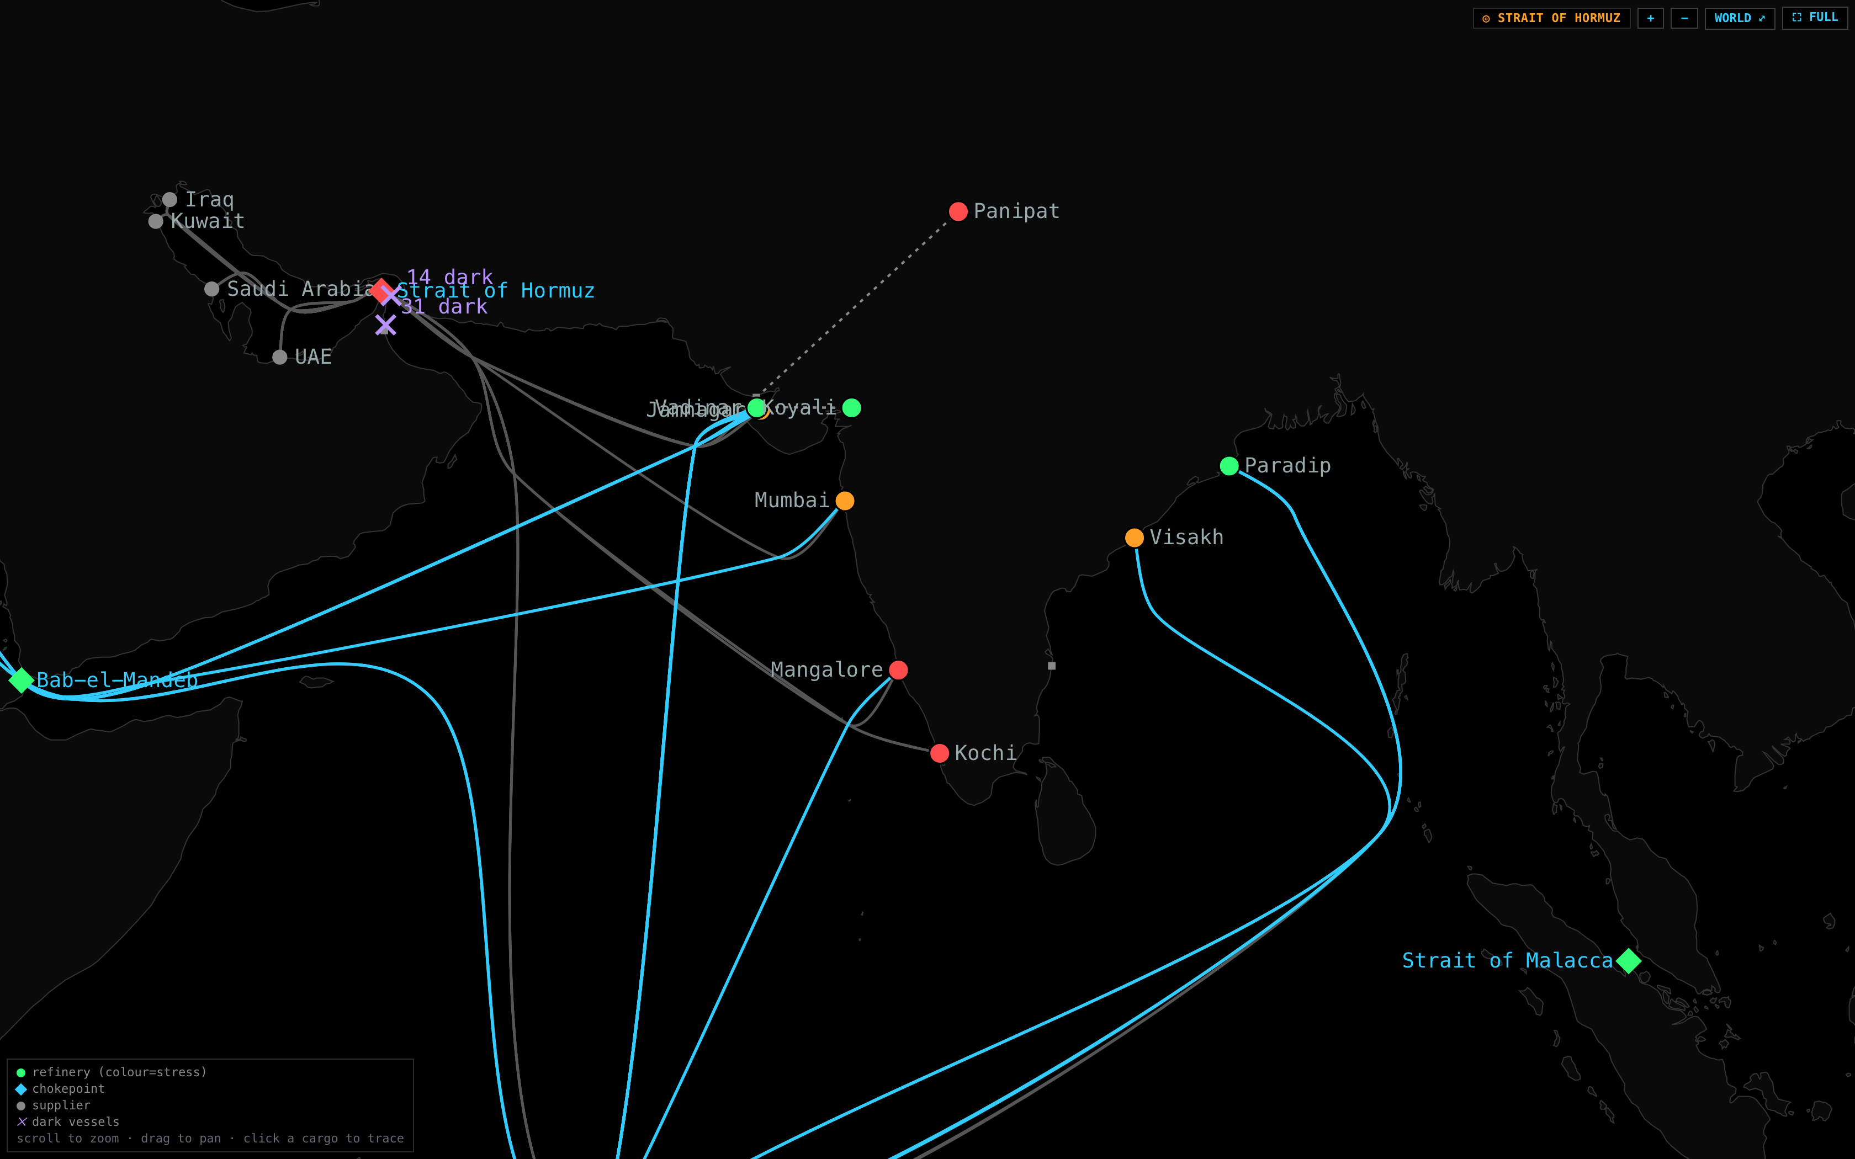
SCALE IS CONFIG, NOT CODE
One strait this week. Every chokepoint, every commodity, next.
The engine is graph-agnostic. A new theatre — a new chokepoint, a new commodity — is a new data bundle, not new code.
THE BUYER LADDER
01
Refiner trading desk
02
National oil company
03
Ministry crisis cell
Honest footer: live feeds (Kpler / Spire) are stubs behind the same 3-method FeedAdapter interface as the replay (src/engine/feeds.ts) — “production license.”
Same pure engine, proven deterministic on an arbitrary graph in scripts/check.mjs. They show the disruption; we show the signed, auditable decision.
△ TRINETRA

Slide 10
Six days to four minutes.
And the argument is on the record.
An AI that argues under rules you wrote. A machine — not a model — that enforces them. A decision you can audit.
the signed audit trace — hash-chained, VERIFIED, one-click printable
DEMO + REPO github.com/banthia14aman/ET-Hackathon
TRIN△ETRA
△ TRINETRA

Slide 11
APPENDIX — THE HINDSIGHT-BIAS FIREWALL (Q&A)
“Did you already know the answer?” We built the firewall for that.
FROZEN KB
Structural knowledge cites only pre-2019 sources. The system doesn't “know about Angola” — it emerges from a query. Basrah Medium (a 2021 grade) was removed from the dataset entirely.
STATED CALIBRATION
Every calibration constant is a stated, sensitivity-swept assumption anchored to earlier crises (Abqaiq 2019, Suez 2021, Red Sea 2023-24) — never fit to the Hormuz-2026 outcomes the demo replays.
NO OUTCOME CLAIMS
We don't predict outcomes (nobody predicts a 30-day US waiver — that's an explicit branch). The testable claim: the options India chose were in our top five, surfaced weeks earlier.
MISSES SHOWN
It didn't score perfectly — the misses are on the scorecard, in red. Replayed real feeds, time-compressed; no live-feed claims. Scenario-choreography events are labeled SYNTH, never upgraded.
May claim: replayed real feeds, frozen KB, stated+swept calibration, top-5 recall with misses shown. May never claim: live feeds, outcome prediction, or R for a synthetic number.
△ TRINETRA

