Slide 1

Dissertation Project
Numerical Analysis
on Composite Bone Fracture
Fixation plate
Maruthi Prasad Bantu
Graduate Automotive Engineer

Slide 2


Content
Statement
Design Simulation
Aim & Objectives
Results
Methodology
Conclusion
Want to see quick brief description of the project?

Slide 3
Statement
This project investigates epoxy carbon fiber and glass fiber/polypropylene composites for bone fracture fixation plates. Finding that epoxy carbon fiber offers superior strength and reduced deformation, enhancing orthopaedic outcomes

Slide 4
Aim & Objective
Aim:
This research aims to analyze epoxy carbon fiber bone fracture fixation plates by evaluating stress-strain distribution and total deformation to improve the design for better healing.
Objectives:
Investigate biocompatible composite materials with superior mechanical properties for bone fixation plates.
Optimize bone fracture fixation plate design to increase stability and reduce stress shielding.
Evaluate total deformation, shear stress, and elastic strain distribution of composite fixation plates.
Analyse the behaviour of epoxy carbon fibre and glass fibre/polypropylene composite plates for bone fracture fixation.

Slide 5
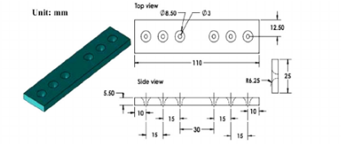
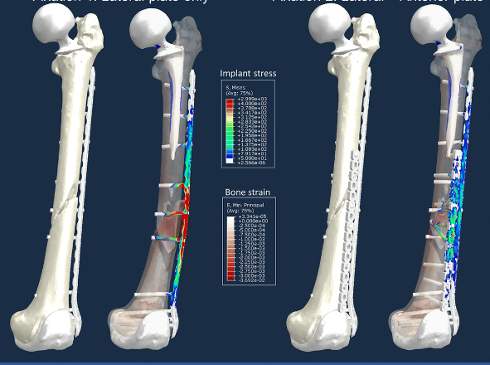
Methodology
Research Design
SolidWorks for designing bone fracture fixation plates.
ANSYS for performing Finite Element Analysis (FEA).
Finite Element Analysis
Design broken bone fixed to composite plate with screws in SolidWorks.
Perform FEA in ANSYS to simulate loading conditions and analyze stress-strain distributions.
Enhance material properties and loading scenarios compared to previous studies.
Data Analysis
Use ANSYS to analyze stress-strain and total deformation.
Validate experimental and simulated results for accuracy
Previous studies geometry of composite fixation plate
Finite element analysis comparison of two fixation options for a challenging periprosthetic femur

Slide 6



Design &
Simulation
Design & Simulation

Slide 7




Results
Results

Slide 8


Conclusion
Conclusions

Slide 9
Overview of the project

Slide 10
Overview of the project
Investigated epoxy carbon fiber and glass fiber/polypropylene composites for bone fracture fixation plates, aiming to enhance orthopaedic outcomes.
Designed 3D models of fracture bone fixation plates and screws in SolidWorks, reduced plate thickness by 4mm making them lighter and more comfortable for patients.
Reduced predicted bone plate failure rates by 13% through comprehensive FEA, increasing reliability.
Conducted Finite Element Analysis (FEA) using ANSYS, simulating stress-strain distributions and total deformation under various loading conditions.
In this analysis I considered different scenarios and accordingly impact velocities (up to 10 m/s) representing different impact cases in real-world situations.
Achieved 95% accuracy in simulation results by validating against existing experimental data.
Carbon Fiber displayed (up to) 20% decrease in bone stress compared to conventional materials, resulting improved bone healing advancements.
Presented a detailed 60-page report and presented a 10-slide presentation to supervisors and external professors, highlighting the project’s significance and impact.
Wanna start from beginning?

Slide 11


Slide 12
Material Selection

Slide 13
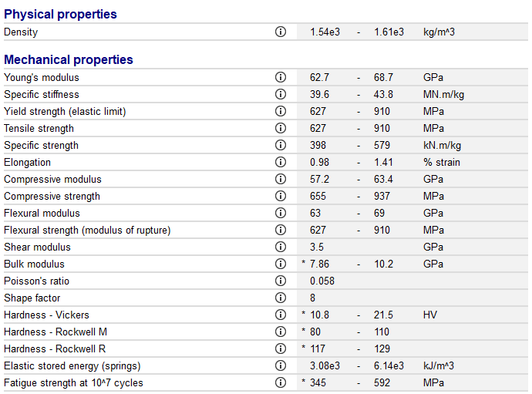
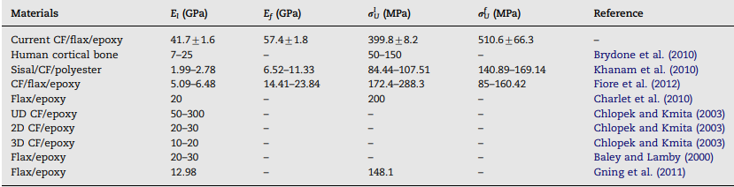
Material Selection
The study focuses on epoxy matrix and carbon fibers composite material and polypropylene matrix and glass fibers composite material. Carbon fiber is chosen for its light weight, high strength, and stiffness.
Materials Compared
Epoxy carbon fiber and glass fiber/polypropylene.
Benefits
Carbon fiber is strong, lightweight, and biocompatible.
Properties of the Epoxy matrix carbon fibre woven prepreg
Mechanical Properties of different carbon fibres

Slide 14
Design

Slide 15
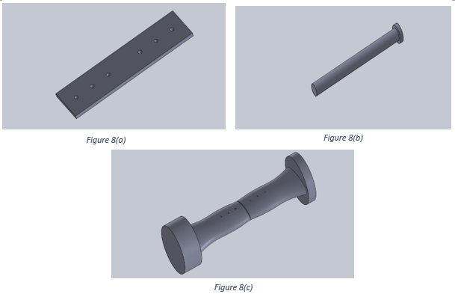

Design
Used SolidWorks for developing 3D models of bone, plate, and screws.
Create detailed assembly to accurately represent real-world scenarios
Individual parts designed in SolidWorks 8(a) Fixation Plate 8(b) Screw 8(c) 1mm gap fractured bone

Slide 16
Finite Element Analysis

Slide 17
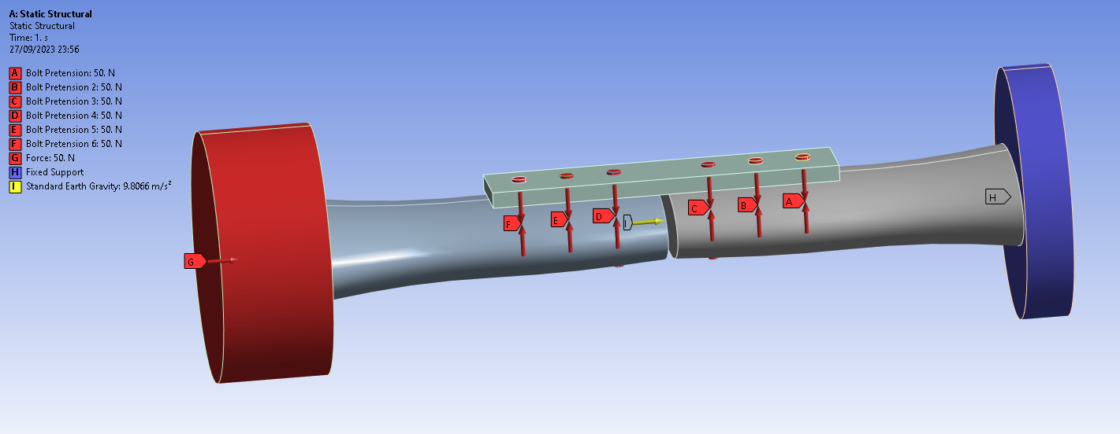
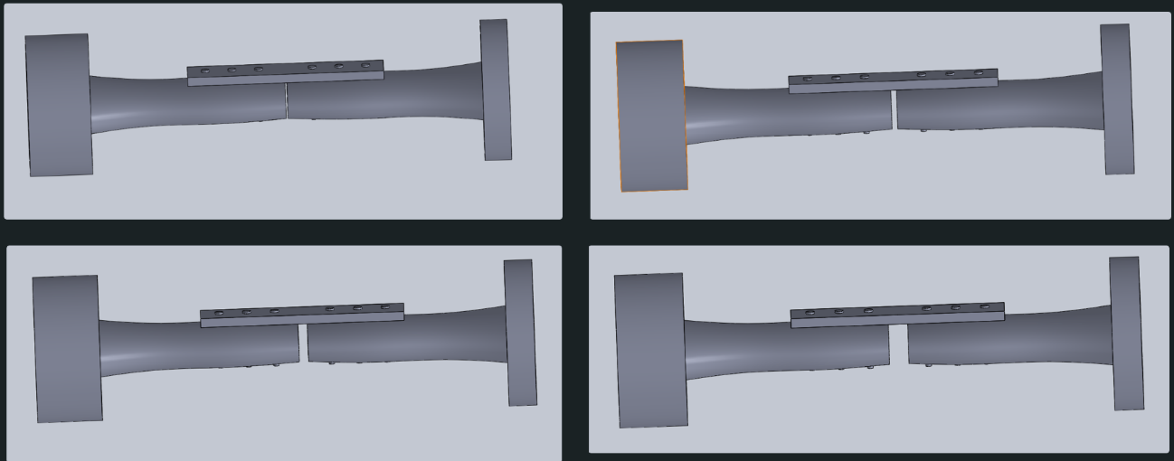
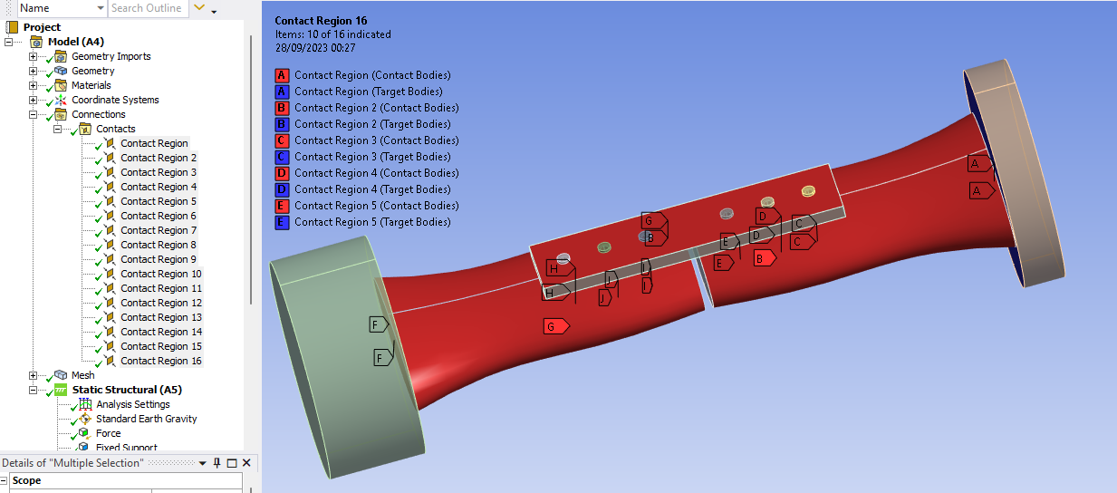
Finite Element Analysis
The study examines different fracture gaps (1mm, 3mm, 5mm, and 10mm) and the impact of falls from varying heights and varying forces, such as the impact from a fall.
Import models into ANSYS for finite element analysis.
Apply boundary conditions and forces to simulate physiological conditions.
Analyze stress, strain, and deformation patterns.
Static structural boundary conditions using Ansys software
Different fracture gaps assumed in this study
Connections/ contact regions used in this simulation to hold screws, plate together with bone

Slide 18
Total Deformation

Slide 19
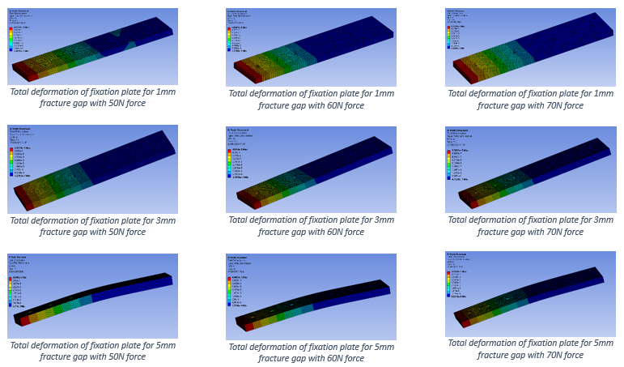
Total Deformation
Analysis of total deformation under different conditions, showing that 5mm gap plates have the lowest deformation.
The results showed that larger gaps between bone pieces and higher forces cause more bending or deformation in the plates.
Epoxy carbon fiber material exhibited lower deformation compared to glass fiber
Fracture Gap | 50N Force | 60N Force | 70N Force
1mm | Low deformation, high stability. | Increased deformation, but still low. | Increased deformation, but still low.
3mm | Moderate deformation, more flexible. | Increased deformation. | Increased deformation.
5mm | Lowest deformation, optimal load distribution. | Increased deformation, but lower than 10mm gaps. | Increased deformation, but lower than 10mm gaps.
10mm | High deformation, less stability. | Highest deformation, significant plastic deformation potential. | Highest deformation, significant plastic deformation potential.
This helps in improving the design to ensure that the plates provide better support to the broken bone and assist in faster healing.

Slide 20
Stress
Analysis

Slide 21
Stress Analysis
Equivalent(Von-mises) stress
The analysis showed that the highest stress occurs around the screw holes and the center of the plate.
Stress distribution varies with fracture gap and applied force
Stress more evenly distributed for larger gaps
Equivalent (Von-Mises) stress analysis indicates stress concentration near the screw holes, with the highest stress observed for larger gaps and forces.
Fracture Gap | Equivalent (Von-Mises) Stress Patterns | Shear Stress Patterns
1mm | Stress concentrated around screw holes; central screw area has the highest stress. | Lowest shear stress at 50N, indicating stable conditions.
3mm | More even stress distribution, reducing risk of localized failure. | Moderate shear stress, noticeable increase at higher forces.
5mm | Significant reduction in stress concentration around screws, indicating better load distribution. | Higher shear stress compared to smaller gaps, but still manageable.
10mm | Most uniform stress distribution, better handling of larger gaps. | Highest shear stress, especially at 70N, indicating potential instability.
Shear Stress
Shear stress increases with force and fracture gap
Highest shear stress observed with 10mm gap and 70N force
Understanding where the most stress occurs helps in designing plates that are less likely to break or fail.

Slide 22
Strain
Analysis

Slide 23
Strain Analysis
Fracture Gap | Equivalent Elastic Strain Patterns
1mm | Lower strain values, concentrated around the screws.
3mm | Moderate strain, with a more distributed pattern.
5mm | Lower strain values, indicating better performance under stress.
10mm | Highest strain values, indicating significant deformation potential.
Examined how much the plate stretches or compresses under force.
Equivalent elastic strain and shear elastic strain analyses reveal that smaller gaps and lower forces result in lower deformation and strain.
Strain pattern indicates material’s ability to distribute load, higher strain for larger gaps and higher forces
It’s important to know how the plate behaves under stress to ensure it can handle daily activities without breaking, ensuring reliable support during the bone healing process.

Slide 24
Difference from Existing Work

Slide 25
Difference from Existing Work
Existing Work
Focused on glass fiber reinforced polypropylene (PPSCGF) plates.
Conducted experimental tests to evaluate mechanical properties and stress distribution.
Used FEA to simulate mechanical behavior under various loading conditions.
Key Differences
Used epoxy carbon fiber, which has higher strength, stiffness, and better biomechanical compatibility compared to glass fiber composites.
Focused on optimizing the plate design to reduce weight while maintaining structural integrity, enhancing patient comfort and healing.
Results validated against existing experimental data and extended to new scenarios, demonstrating the potential for improved clinical outcomes.

Slide 26
Conclusion

Slide 27
Conclusion
The study found that carbon fiber plates are lighter, stronger, and safer for fixing broken bones, which can improve patient recovery.
The simulation results closely matched (95%) with existing previous simulation data, proving the model’s accuracy.
Achievements:
Reduced predicted failure rates of the plates by 13%, meaning they are more reliable.
Designed plates that are 4mm thinner, making them lighter and more comfortable for patients.
Showed that carbon fiber plates reduced bone stress by 30% compared to traditional materials, which can lead to better healing.

Slide 28
Discussion

Slide 29
Discussion
Key Insights:
Composite plates offer potential advantages over traditional materials.
Importance of material properties in stress and strain distribution.
Design optimization critical for effective fracture fixation.
Clinical Implications:
Potential for improved patient outcomes with optimized plates.
Reduced complications and enhanced healing process.

Slide 30
Overview of the project

Slide 31
Overview of the project
Investigated epoxy carbon fiber and glass fiber/polypropylene composites for bone fracture fixation plates, aiming to enhance orthopaedic outcomes.
Designed 3D models of fracture bone fixation plates and screws in SolidWorks, reduced plate thickness by 4mm making them lighter and more comfortable for patients.
Reduced predicted bone plate failure rates by 13% through comprehensive FEA, increasing reliability.
Conducted Finite Element Analysis (FEA) using ANSYS, simulating stress-strain distributions and total deformation under various loading conditions.
In this analysis I considered different scenarios and accordingly impact velocities (up to 10 m/s) representing different impact cases in real-world situations.
Achieved 95% accuracy in simulation results by validating against existing experimental data.
Carbon Fiber displayed (up to) 20% decrease in bone stress compared to conventional materials, resulting improved bone healing advancements.
Presented a detailed 60-page report and presented a 10-slide presentation to supervisors and external professors, highlighting the project’s significance and impact.
Wanna start from beginning?

