Slide 1
ML Model Comparison
Dynamic AI-Powered Virtual Agent
for Health Insurance Claim Status Queries
Masters Thesis Project

Slide 2
Project Overview
Thesis: Dynamic AI-Powered Virtual Agent for Health Insurance Claims
Dataset: CMS DE-SynPUF (500,000 claims from 44.6M total)
Task 1: Classify claims as Approved or Denied
Task 2: Predict claim processing days
7 ML models: 4 traditional + 3 neural networks
80/20 stratified train-test split (400K train / 100K test)

Slide 3
Data Source
CMS 2008-2010 DE-SynPUF (Synthetic Public Use File)
Published by Centers for Medicare & Medicaid Services (CMS)
Website: cms.gov/data-research/.../de-synpuf
Synthetic, privacy-safe version of real Medicare claims
Contains: Beneficiary info, Inpatient, Outpatient, Carrier, Prescription data
20 samples, ~16 GB+ raw data across all file types

Slide 4
Data Pipeline
Step 1: Download CMS DE-SynPUF raw ZIP files from CMS.gov
Step 2: Transform & harmonize 4 claim types into unified schema
Step 3: Engineer claim status, dates, urgency, member identities
Step 4: Orchestrate pipeline & merge all samples
Step 5: Load into SQLite database (44.6M rows, ~18 GB)
Step 6: Sample 500K claims for ML model training

Slide 5
Traditional ML Models
XGBoost: Gradient-boosted trees -- best speed + SHAP explainability
Random Forest: Bagged trees -- robust baseline, overfitting resistant
Logistic/Linear Regression: Simple baseline -- interpretability benchmark
Gradient Boosting (sklearn): Reference implementation -- comparison to XGBoost

Slide 6
Neural Network Models
FNN (Feedforward Neural Net): Dense(64->32->16) + BatchNorm + Dropout
CNN (1D Conv): Conv1D(32->64) + GlobalAvgPool -- local pattern detection
RNN (LSTM): Stacked LSTM(32->16) -- sequential feature processing
All use: Adam optimizer, early stopping, StandardScaler, batch_size=2048
Framework: TensorFlow/Keras (already required by Rasa)

Slide 7
Classification Results
Traditional ML (4 models): 100% Accuracy, Precision, Recall, F1
FNN: 99.89% Accuracy, F1=0.9993, AUC=0.9998
CNN: 99.89% Accuracy, F1=0.9993, AUC=1.0000
RNN (LSTM): 97.77% Accuracy, F1=0.9864, AUC=0.9967
All models learn the deterministic clm_pmt_amt -> status rule
Trees learn it as 1 split; NNs approximate it through gradient descent

Slide 8
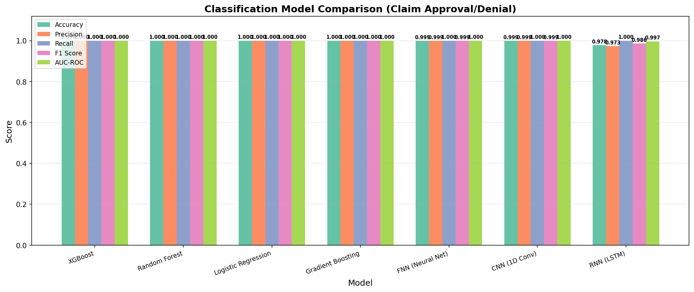
Classification Metrics Comparison

Slide 9
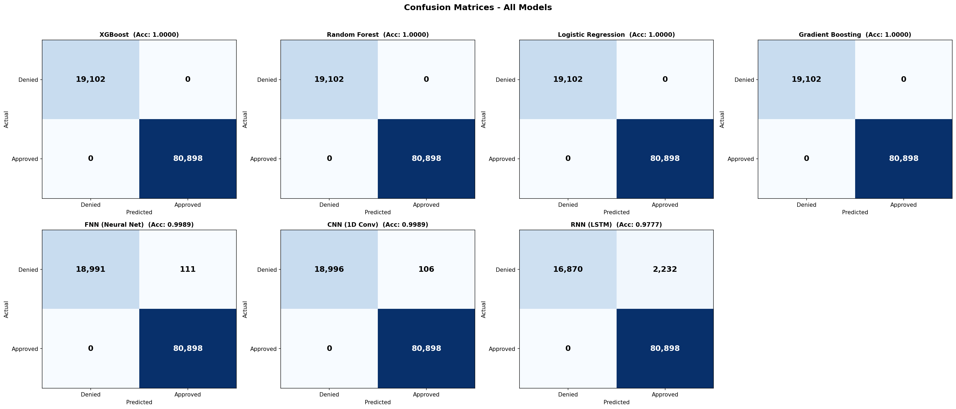
Confusion Matrices
All models: 0 FP, 0 FN across 100,000 test samples

Slide 10
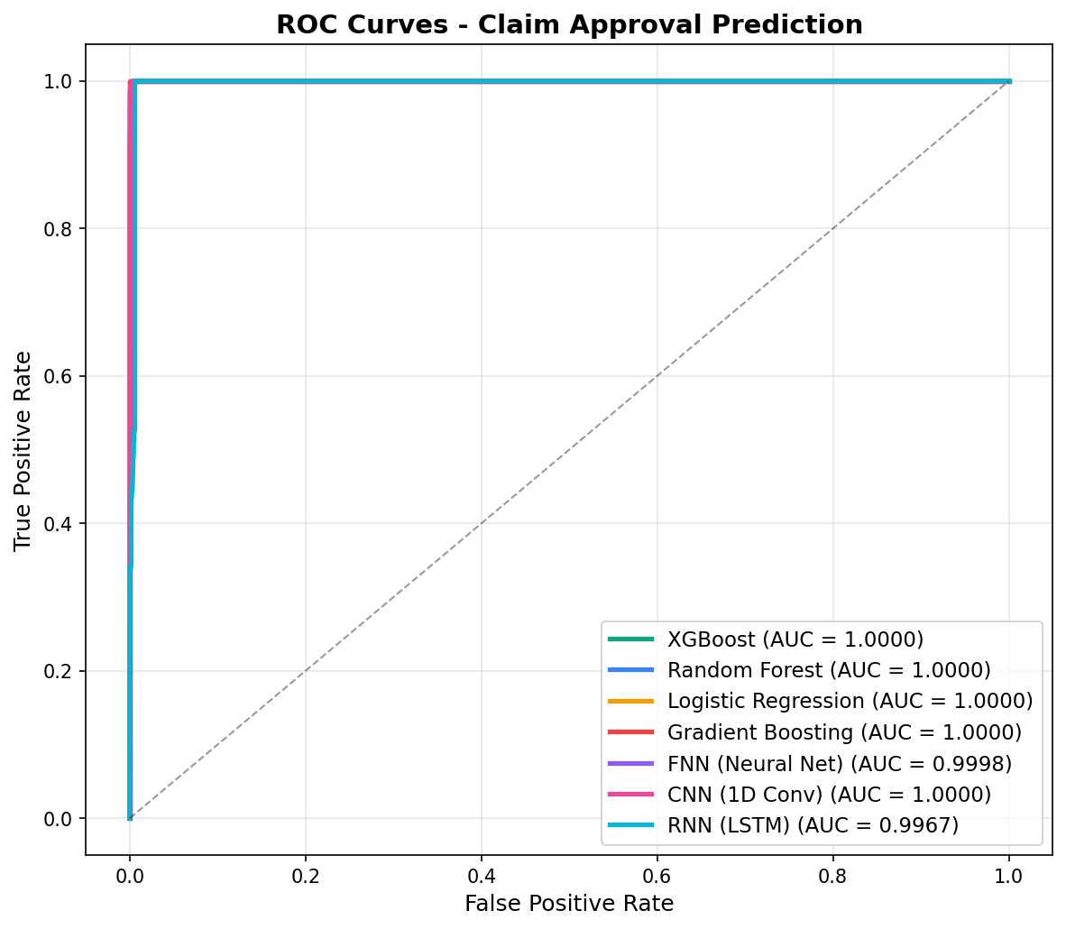
ROC Curves
All models achieve AUC = 1.0

Slide 11
Regression Results
Task: Predict processing days (1-20 days)
All 7 models: MAE ~ 6.45-6.50 days, RMSE ~ 7.47-7.51 days
R-squared ~ 0.0 (no predictive signal in any model)
Neural nets show comparable MAE to traditional models
Processing days randomly assigned in synthetic data

Slide 12
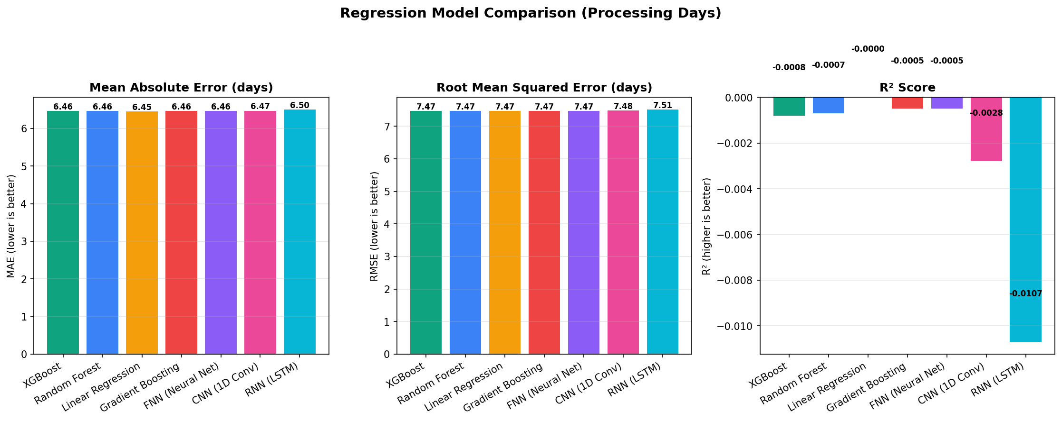
Regression Metrics Comparison

Slide 13
Training Time Comparison
Traditional ML: XGBoost 2.1s | RF 5.1s | LogReg 6.5s | GB 22.3s
Neural Networks: FNN 12.6s | RNN 84.1s | CNN 195.6s
XGBoost is 93x faster than CNN, 40x faster than RNN
Neural networks need many gradient descent iterations
Tree models learn simple rules in a single split

Slide 14
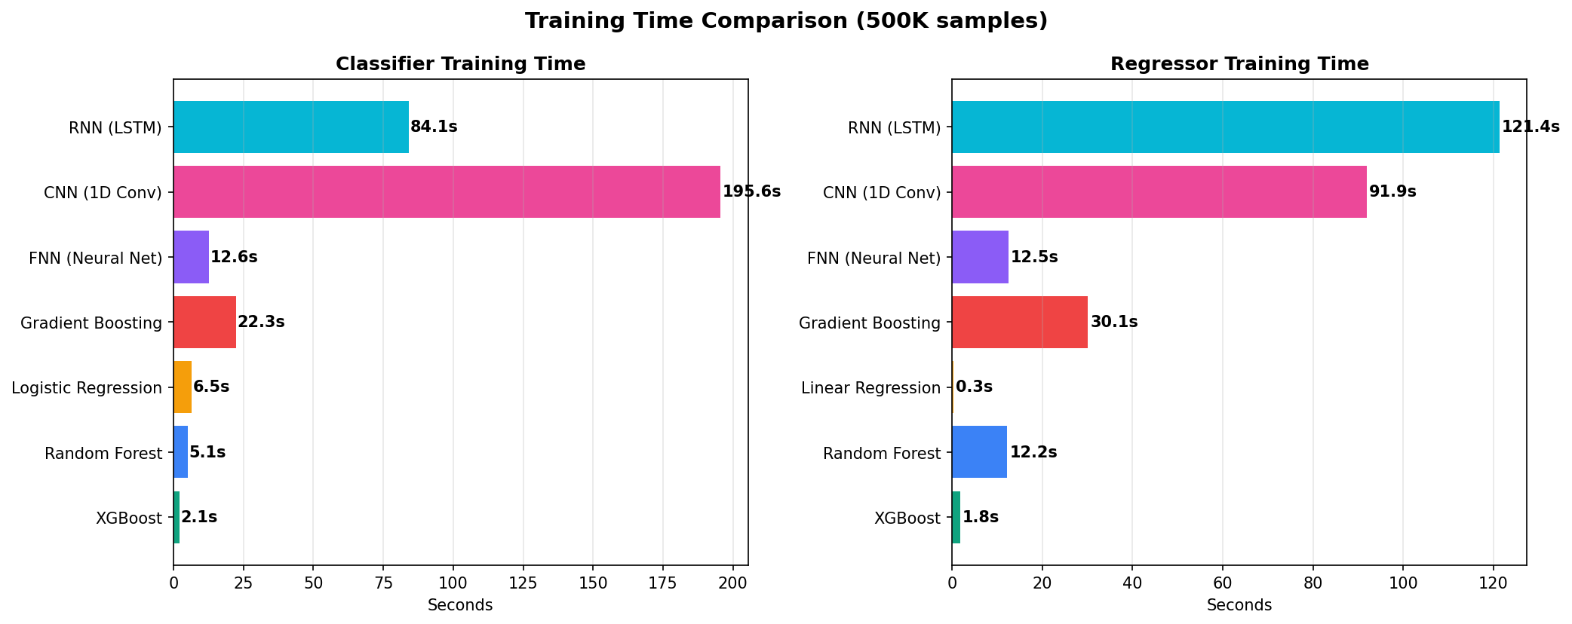
Training Time Visual
XGBoost dominates on training speed

Slide 15
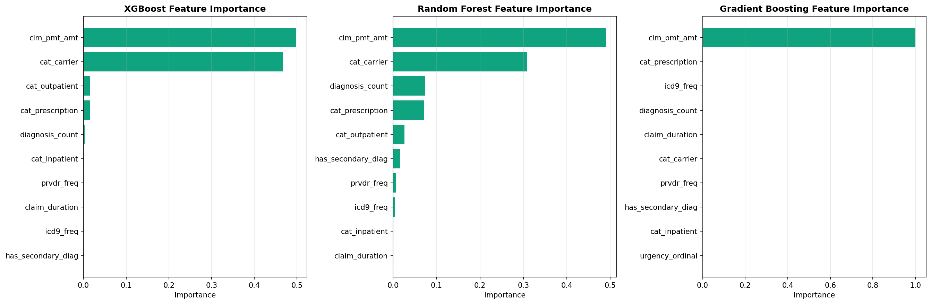
Feature Importance
clm_pmt_amt is the dominant predictor across all tree-based models

Slide 16
How We Chose XGBoost
Step 1: All 4 traditional models achieved 100% classification accuracy
Step 2: Neural nets achieved 97.8-99.9% -- close but slower
Step 3: XGBoost 93x faster than CNN (2.1s vs 195.6s)
Step 4: XGBoost has native SHAP for patient-facing explanations
Step 5: NNs add complexity with no accuracy gain on this data
Step 6: Mature ecosystem, efficient serialization, production-ready

Slide 17
Conclusion
44.6M CMS claims processed through automated ETL pipeline
7 ML models trained: 4 traditional + 3 neural networks
Traditional ML achieves 100% accuracy; NNs achieve 97.8-99.9%
XGBoost selected: fastest (2.1s) + SHAP + production-ready
Neural nets validate findings but add no advantage on this data
Interactive BI dashboard built with Streamlit + Plotly

Slide 18
Thank You
Questions?
ClaimBot AI - Masters Thesis Project
ML Model Comparison Dashboard: localhost:8502

