Slide 1
Anomaly Detection in Healthcare Claims
Deep Learning vs Traditional ML for Fraud Identification
Masters Thesis | CMS DE-SynPUF | 1,000,000 Claims | 5 Models

Slide 2
Research Question
"Can deep learning-based anomaly detection identify potentially fraudulent or anomalous billing patterns in health insurance claims data, and how do autoencoder architectures compare to traditional anomaly detection methods?"
Unsupervised approach: no fraud labels needed
Models learn "normal" claim patterns, flag deviations
5 synthetic fraud types injected for evaluation
31 features engineered from 32 database columns
Dataset: 1M sample from 44.6M CMS DE-SynPUF claims

Slide 3
Models Used
Deep Learning (3)
Traditional ML (2)
Autoencoder: 31→64→32→16→8→16→32→64→31
Dense symmetric encoder-decoder, MSE loss
VAE: Variational Autoencoder
Reparameterization trick, KL divergence
CNN Autoencoder: 1D Convolutional
Conv1D→BatchNorm→GlobalAvgPool→Dense
Isolation Forest: 200 trees
Random partitioning, shorter path = anomaly
One-Class SVM: RBF kernel
Decision boundary around normal data
Subsampled to 50K (memory constraint)

Slide 4
Feature Engineering: 31 Features from 32 Columns
Payment (5)
Temporal (8)
Diagnosis (4)
pmt amount, approved amount, ratio, diff, negative flag
claim duration, submission gap, review time, cycle encoding
code count, frequency, secondary flag, rarity score
Provider (5)
Member (3)
Categorical (6)
volume, avg payment, category entropy, physician ratio
claim frequency, avg payment, unique providers
urgency ordinal, appeal flag, claim category one-hot

Slide 5
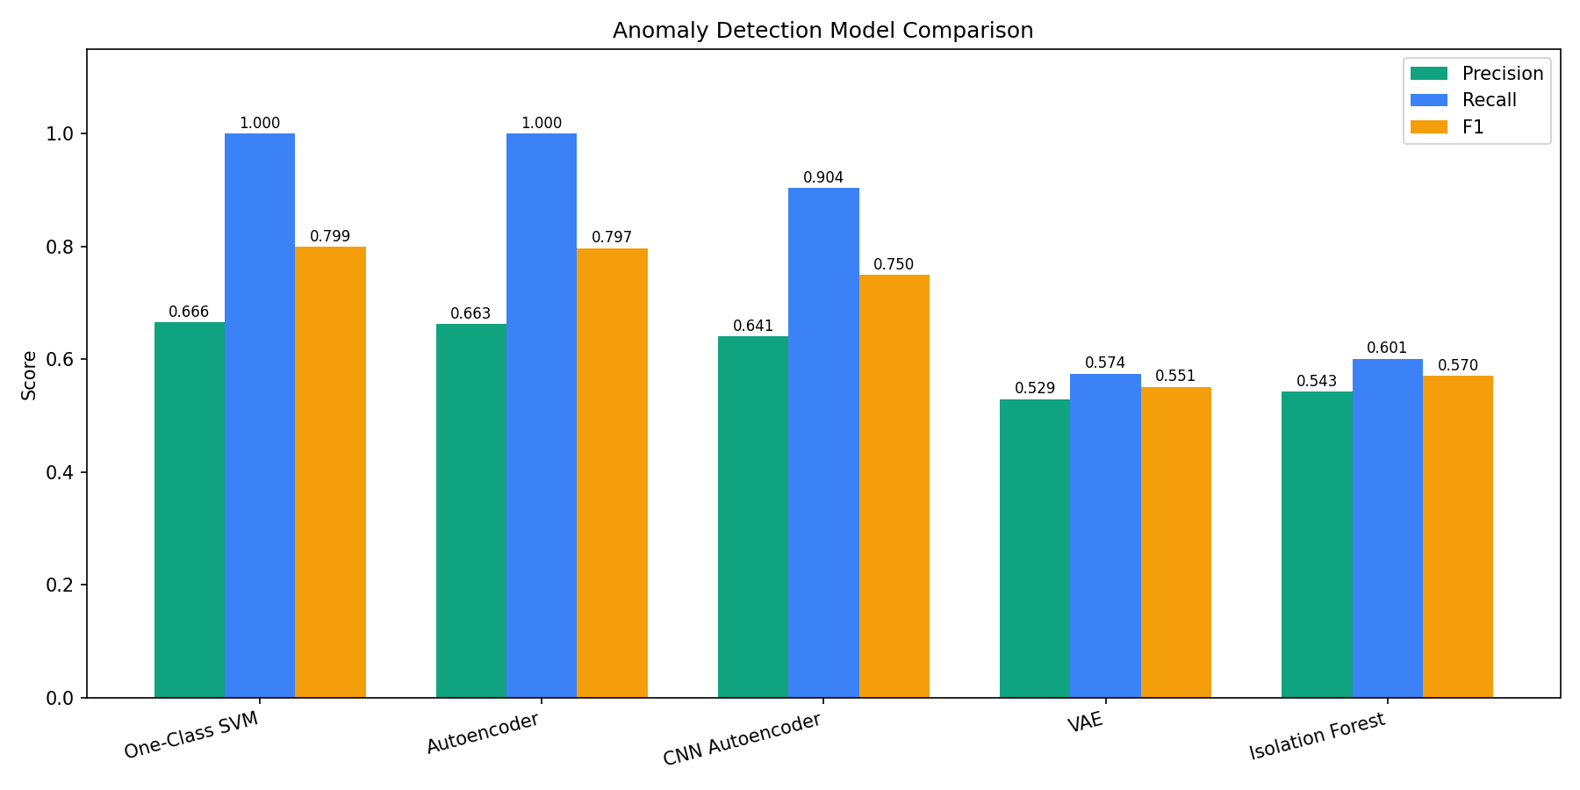
Results: Model Comparison

Slide 6
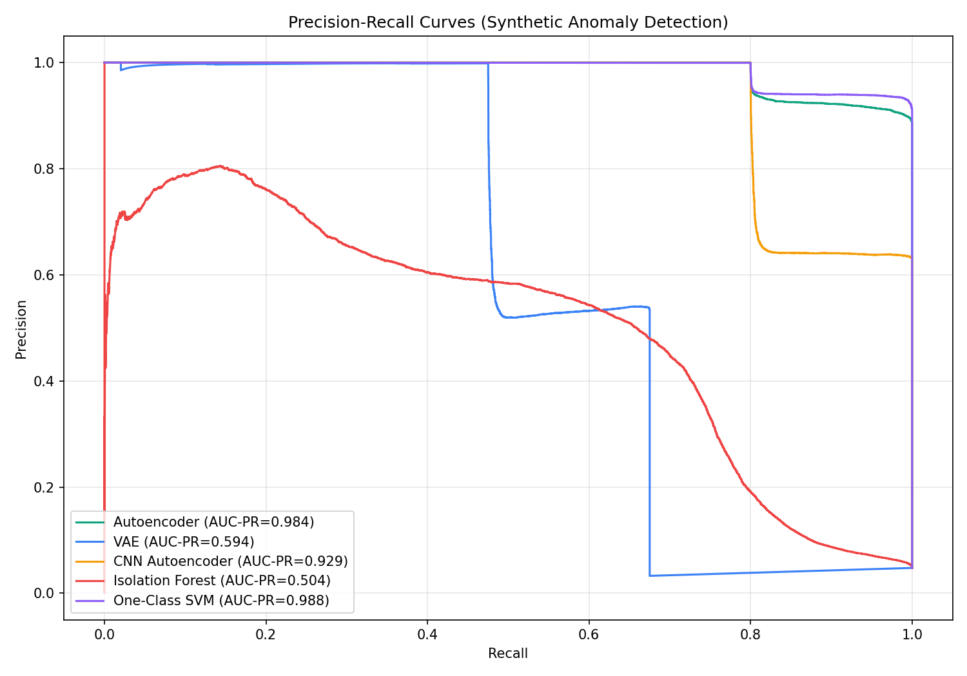
Precision-Recall Curves

Slide 7
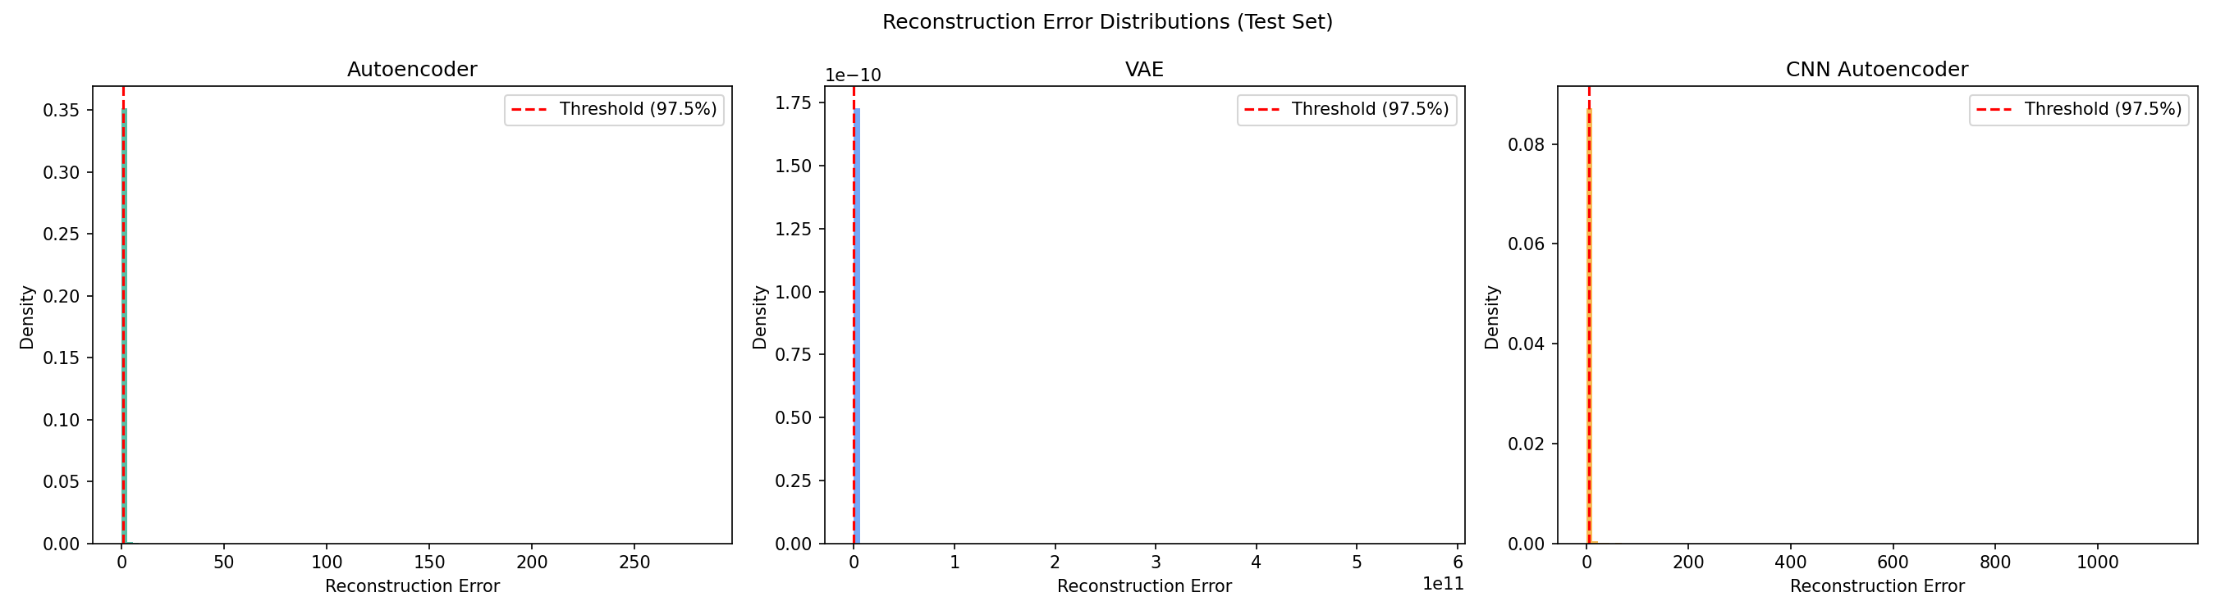
Reconstruction Error Distributions

Slide 8
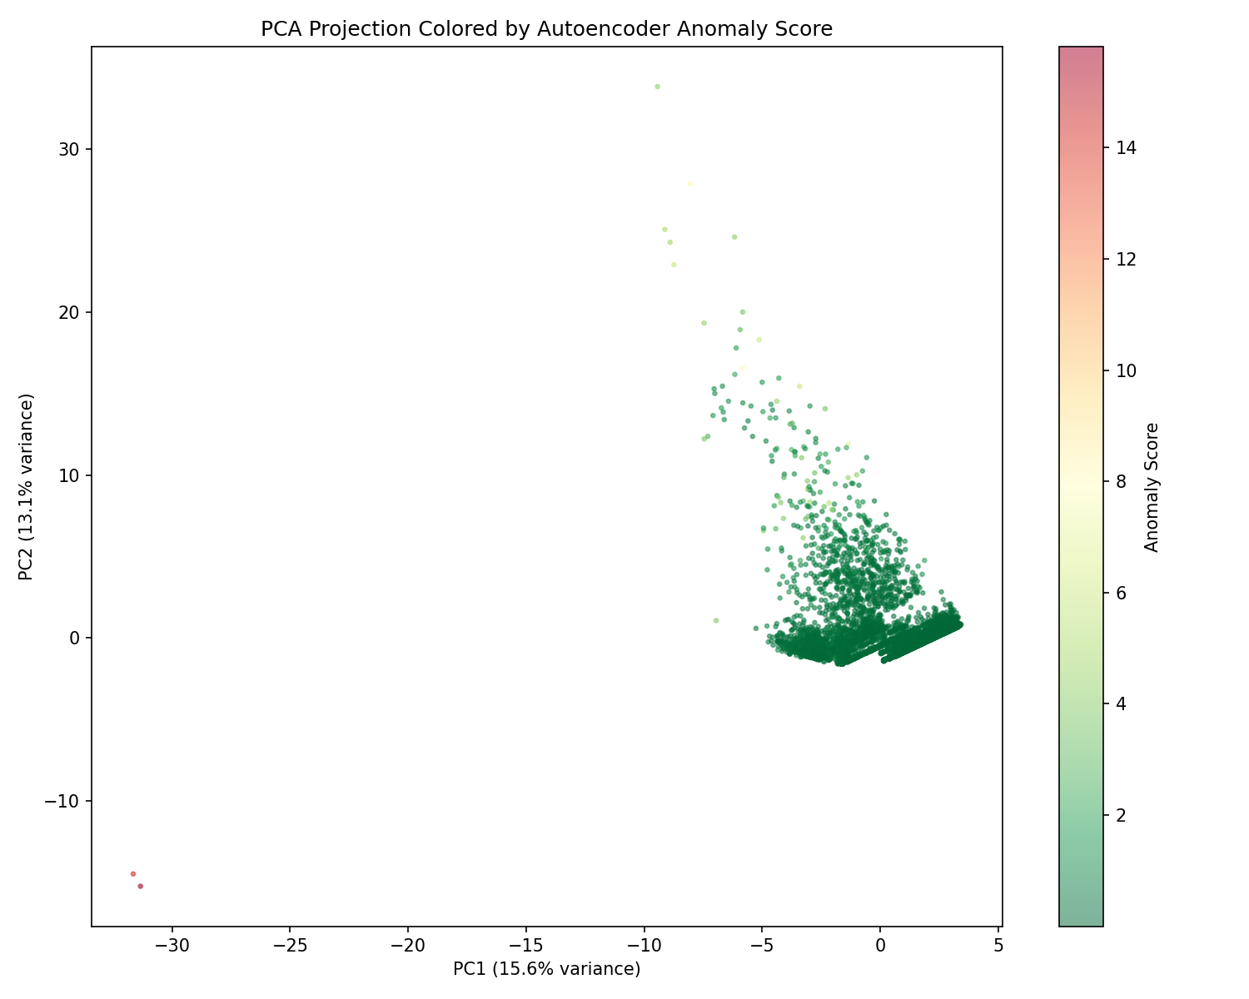
Anomaly Score Visualization (PCA)

Slide 9
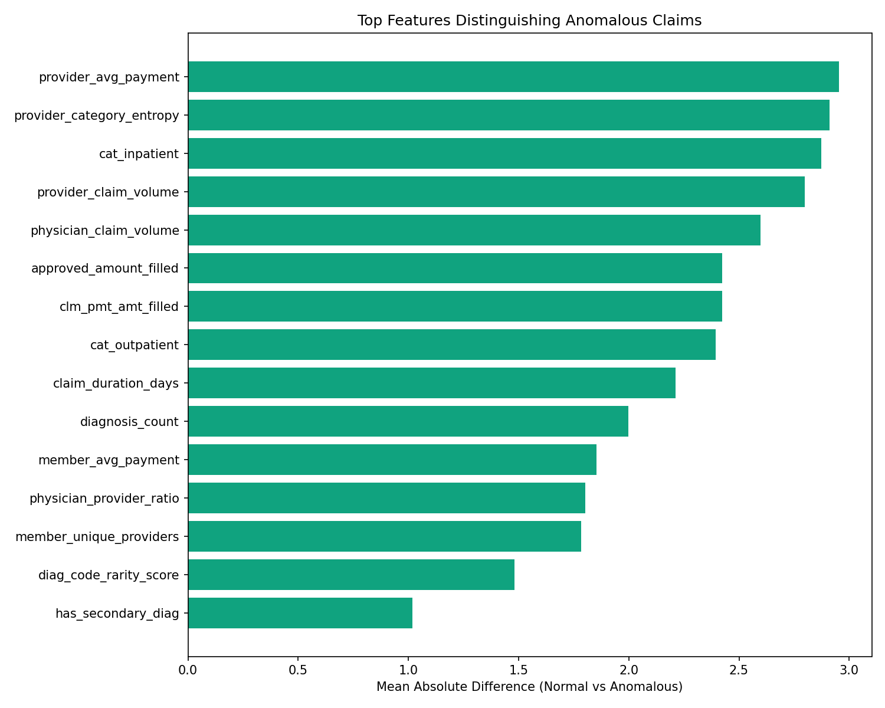
Top Features for Anomaly Detection

Slide 10
Project Script Files
config.py — Paths, hyperparameters, constants
data_loader.py — SQLite sampling + Parquet caching
feature_engineering.py — 31 features from 32 columns
models/autoencoder.py — Dense Autoencoder (Keras)
models/vae.py — Variational Autoencoder (Keras 3)
models/cnn_autoencoder.py — 1D-CNN Autoencoder
models/traditional.py — Isolation Forest + One-Class SVM
synthetic_anomalies.py — 5 fraud patterns for evaluation
evaluate.py — Scoring, thresholds, PR/F1/AUC-PR metrics
train_anomaly_models.py — Main pipeline orchestrator
anomaly_dashboard.py — 6-tab Streamlit dashboard

Slide 11
Key Findings
Autoencoder: AUC-PR = 0.984, 100% recall — best deep learning model
One-Class SVM: AUC-PR = 0.988, 100% recall — best overall
CNN Autoencoder: AUC-PR = 0.929, 90.4% recall — strong third
VAE (0.594) and Isolation Forest (0.504) underperformed
Payment ratio and provider volume were most discriminative features
Deep learning matches or exceeds traditional ML for anomaly detection

Slide 12
Conclusion
Deep learning autoencoders effectively detect anomalous billing patterns in healthcare claims without requiring labeled fraud data. The Autoencoder (AUC-PR 0.984) performs comparably to the One-Class SVM (0.988), proving that unsupervised deep learning is a viable approach for healthcare fraud detection at scale. All 31 engineered features, 5 models, and interactive dashboard are available for reproducible research.

