Slide 1
DATA ANALYTICS CAPSTONE PROJECT
Bluestock Mutual Fund Analytics & Investor Insights Platform
Anurag Singh
Python | Pandas | NumPy | SciPy | PostgreSQL | Power BI | Matplotlib | Jupyter
June 2025 | Mutual Fund Analytics Domain
Notes:
Title slide introducing the Bluestock Mutual Fund Analytics project by Anurag Singh.

Slide 2
Problem Statement & Project Objectives
BUSINESS PROBLEM
PROJECT OBJECTIVES
- 40+ mutual fund schemes make comparison complex
- Raw returns mislead: 23% return fund had -52.57% drawdown
- Risk-adjusted metrics unavailable to retail investors
- SIP gaps of 36-93 days indicate potential churn
- No unified platform for industry, fund, and investor data
- Geographic and demographic insights are siloed
1. Industry Analysis - AUM growth, SIP, fund houses
2. Performance Analytics - CAGR, Sharpe, Sortino, Alpha, Beta
3. Risk Analytics - VaR, CVaR, Rolling Sharpe, Drawdown
4. Investor Analytics - Demographics, geography, behavior
5. Advanced Analytics - HHI, SIP continuity, cohorts
6. Dashboard Development - 4-page interactive Power BI
Goal: Build a scalable analytics platform that transforms mutual fund data into actionable insights for investors, fund managers, and wealth advisors.
Notes:
Core problem: 40+ schemes create information overload. Fund 119599 had 23% return but -52.57% drawdown. Six objectives cover full analytics spectrum.

Slide 3
Data Sources & Project Architecture
DATASETS
ARCHITECTURE PIPELINE
1. NAV History - Daily NAV for 40 schemes (2022-2026)
2. Fund Master - Scheme metadata and expense ratios
3. Benchmark Data - Nifty 50 daily closing values
4. Investor Transactions - 5,000 investors, 33,000 records
5. SIP Dataset - Monthly inflows across 12 categories
6. Industry Dataset - Quarterly AUM by fund house
Raw Data (CSV/SQL)
EDA & Visualization
Advanced Analytics
ETL & Cleaning
Performance Analytics
Power BI Dashboard
KEY OUTPUT FILES
sharpe_values.csv | sortino_values.csv | alpha_beta.csv | max_drawdown.csv | fund_scorecard.csv | sip_continuity.csv
Python
Pandas
NumPy
SciPy
PostgreSQL
Power BI
Matplotlib
Jupyter
Notes:
Six datasets processed via ETL pipeline. Python and Pandas for transformation, PostgreSQL for storage, Power BI for visualization.

Slide 4
Industry Analysis Highlights
Rs 62.74L Cr
Rs 31,000 Cr
26.12 Cr
40
17.17%
9.35 Cr
Total AUM
Monthly SIP
Total Folios
Schemes
YoY Growth
Active SIPs
AUM GROWTH TREND (2022-2025)
TOP FUND HOUSES BY AUM
- AUM grew from Rs 82L Cr (2022) to peak Rs 150L Cr (mid-2024)
- Correction to Rs 120L Cr by early 2025 due to volatility
- Strong bull run 2023-2024 driven by domestic liquidity
- SIP inflows: Rs 0.13M Cr (2022) to Rs 0.35M Cr (2025)
- SIP growth persisted even during corrections
1. SBI Mutual Fund - Rs 13 Lakh Crore
2. ICICI Prudential MF - Rs 11 Lakh Crore
3. HDFC Mutual Fund - Rs 10 Lakh Crore
4. Nippon India MF - Rs 8 Lakh Crore
5. Kotak Mahindra MF - Rs 6 Lakh Crore
6. Aditya Birla Sun Life - Rs 5.5 Lakh Crore
7. UTI Mutual Fund - Rs 4.5 Lakh Crore
Top 3 control ~50% of total AUM
Liquid category dominates with Rs 4,51,275 Cr (48.4% of inflows). Sectoral/Thematic at Rs 1,03,829 Cr.
Notes:
Industry AUM reached 62.74 lakh crore with 26.12 crore folios. SIP inflows grew from 0.13M to 0.35M crore. Top 3 fund houses control 50% of AUM.

Slide 5
Investor Analytics Highlights
Rs 4 Billion
Rs 107.44K
5,000
33,000
Total Investment
Avg Transaction
Total Investors
Total Transactions
GEOGRAPHIC ANALYSIS
AGE-GROUP BEHAVIOR
TRANSACTION PATTERNS
- Top: Punjab, Tamil Nadu, MP
- Also: Rajasthan, Gujarat, WB, Telangana
- Each contributes ~Rs 0.3 Billion
- Uniform = broad penetration
- 18-25: Rs 50K average (lowest)
- 26-35: Rs 100K average
- 36-45: Rs 100K average
- 46-55: Rs 100K average
- 56+: Rs 100K average
- SIP: 58.49% (Rs 2 Bn)
- Lumpsum: 35.34% (Rs 1 Bn)
- Redemption: 6.17% only
- Spike: Early 2025
- Likely ELSS tax-saving
KEY INSIGHTS:
- 18-25 cohort invests 50% less - opportunity for micro-SIP products
- SIP dominance at 58.49% validates systematic investing as primary channel
- Low 6.17% redemption rate indicates strong investor stickiness
- Monthly volume: 40-100 daily, spike in early 2025
Notes:
5,000 investors generated 33,000 transactions worth Rs 4 billion. SIP dominates at 58.49%. 18-25 cohort invests 50% less - micro-SIP opportunity.

Slide 6
Performance Analytics - Risk-Adjusted Metrics
14.09%
0.54
0.16
100.00
Avg 3Y Return
Avg Sharpe
Avg Alpha
Top Score
TOP 10 FUND SCORECARD
Rank
AMFI Code
Score
3Y Ret%
Sharpe
Alpha
Max DD%
Std Dev%
1
120505
100.00
18.08
1.18
0.30
-18.19
19.29
2
119598
99.55
23.39
0.95
0.30
-28.71
25.14
3
149324
92.42
20.08
0.95
0.29
-31.17
24.84
4
100033
90.69
16.58
1.09
0.26
-16.22
18.94
5
120843
90.39
15.65
1.31
0.28
-12.97
15.89
6
119094
84.98
15.18
1.00
0.25
-20.96
19.41
7
148567
83.18
14.81
1.45
0.27
-11.27
14.19
8
149323
82.28
17.16
1.13
0.25
-17.25
17.75
9
148569
75.90
13.58
1.23
0.29
-16.40
17.67
10
118634
75.15
20.15
0.45
0.21
-23.34
25.24
Fund 120505 scores 100/100 - best RISK-ADJUSTED balance. Fund 119599 has 23.14% return but ranks 13th due to -52.57% drawdown.
Notes:
Composite scorecard ranks 40 funds. Fund 120505 wins at 100 - best risk-adjusted. Fund 119599 had highest return 23% but worst drawdown -52.57%.

Slide 7
Advanced Analytics - Quantitative Deep Dive
ROLLING 90-DAY SHARPE RATIO
SIP CONTINUITY ANALYSIS
- Fund 120505: Started at 5.8, stabilized at 2-3
- Fund 120843: Most volatile, range -1 to 6.2
- Fund 149324: Dropped to -2.5 in late 2023
- Even top funds have negative Sharpe periods
- Static metrics mask temporal variation
- INV000028: 93.6 gap days - highest churn risk
- INV000004: 85.4 days - nearly quarterly gaps
- INV000072: 83.0 days - severe disengagement
- 36-50 day cohort: best recovery probability
- Auto-debit reduces churn significantly
SECTOR CONCENTRATION (HHI)
TAIL RISK: MAX DRAWDOWN
- Fund 119092: HHI 0.205 (Highly Concentrated)
- Fund 101207: HHI 0.200 (Highly Concentrated)
- Fund 120505 (Rank 1): HHI 0.160 (Moderate)
- High HHI + Low Sharpe = poor outcome
- Optimal zone: HHI 0.12-0.16
- Worst: Fund 119599 at -52.57%
- Fund 119095: -51.68% (May 2026)
- Fund 101207: -35.45%
- Best equity: Fund 120843 at -12.97%
- Safest: Fund 101208 at -0.16% (debt)
Critical: Extreme HHI > 0.18 correlates with poor risk-adjusted returns. Fund 119092 has highest HHI (0.205) but Sharpe of only 0.03.
Notes:
Four advanced techniques: Rolling Sharpe shows temporal variation. SIP continuity identifies churn risk. HHI measures concentration. Max DD reveals tail risk.

Slide 8
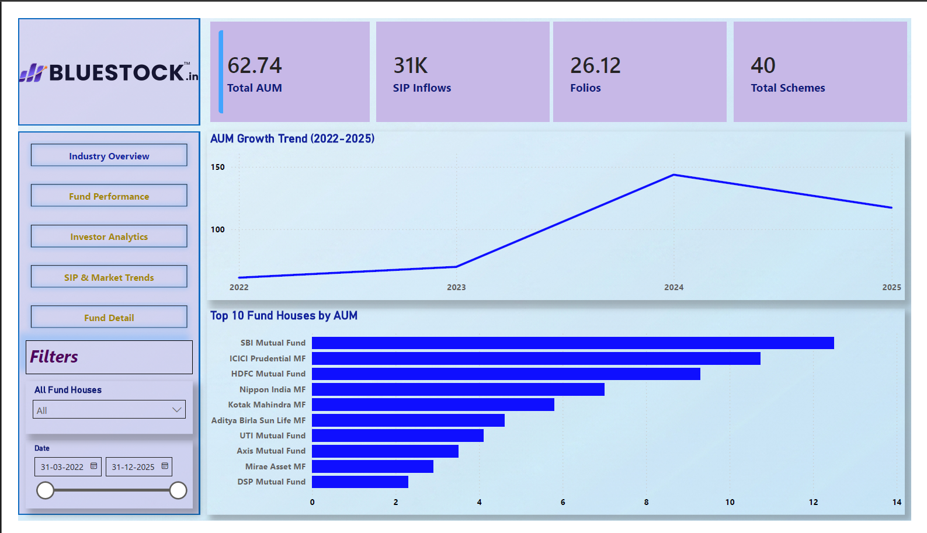
Power BI Dashboard - Industry Overview
DASHBOARD FEATURES
KPI Cards:
- Total AUM: Rs 62.74L Cr
- SIP Inflows: Rs 31K Cr
- Folios: 26.12 Cr
- Schemes: 40
Visualizations:
- AUM Growth Trend
- Top 10 Fund Houses
Filters:
- Fund House selector
- Date: 03/2022 - 12/2025
Navigation:
- Fund Performance
- Investor Analytics
- SIP & Market Trends
[INSERT: Industry Overview Dashboard Screenshot]
Notes:
Page 1: Industry Overview dashboard. Four KPI cards, AUM growth trend chart, top 10 fund houses bar chart. Replace placeholder with actual screenshot.

Slide 9
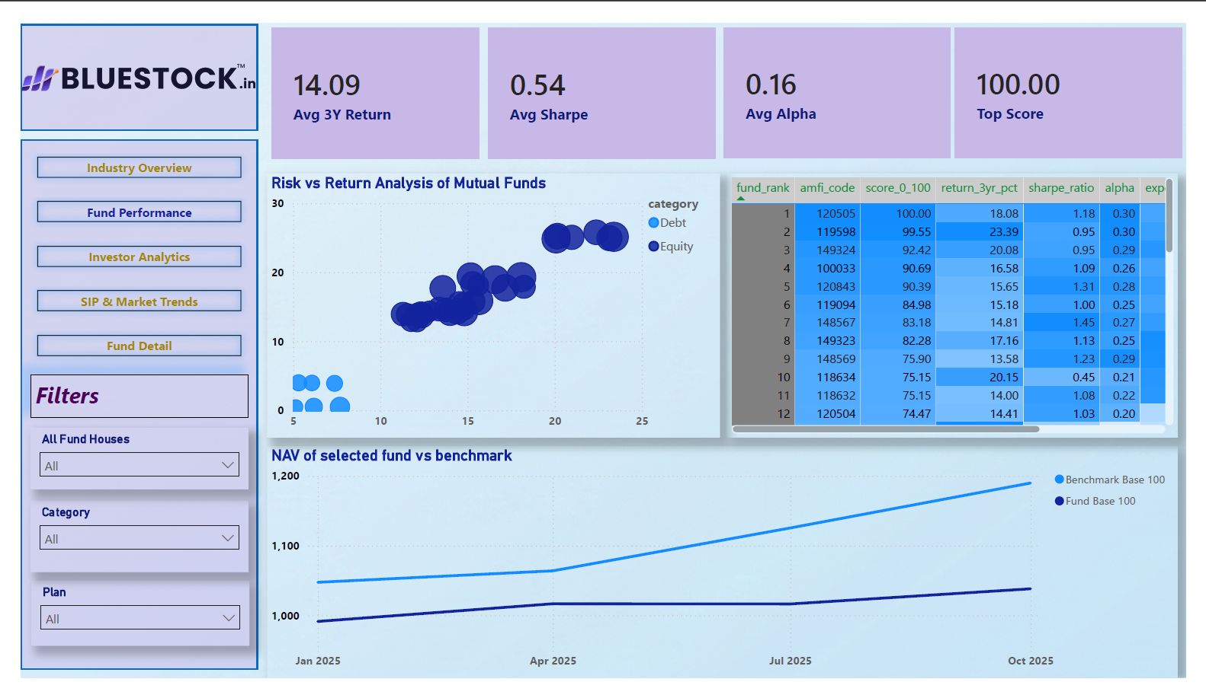
Power BI Dashboard - Fund Performance
DASHBOARD FEATURES
KPI Cards:
- Avg 3Y Return: 14.09%
- Avg Sharpe: 0.54
- Avg Alpha: 0.16
- Top Score: 100.00
Visualizations:
- Risk vs Return scatter
- Equity vs Debt
- Fund Scorecard table
- NAV vs Benchmark
Key Feature:
- Composite scoring 0-100
- Multi-metric ranking
Filters:
- Fund House, Category, Plan
[INSERT: Fund Performance Dashboard Screenshot]
Notes:
Page 2: Fund Performance dashboard. Risk vs Return scatter plot, fund scorecard table, NAV vs Benchmark chart. Replace placeholder with actual screenshot.

Slide 10
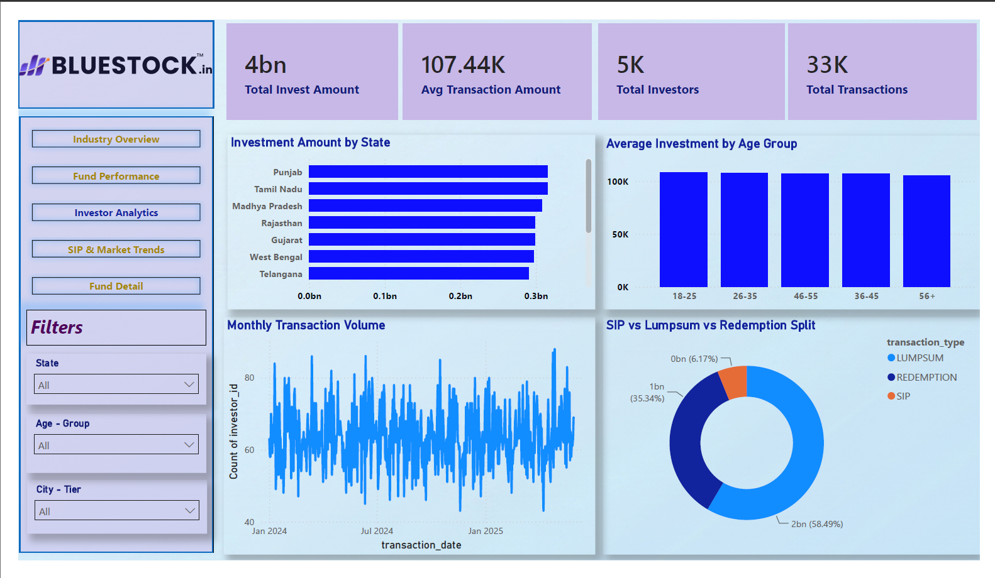
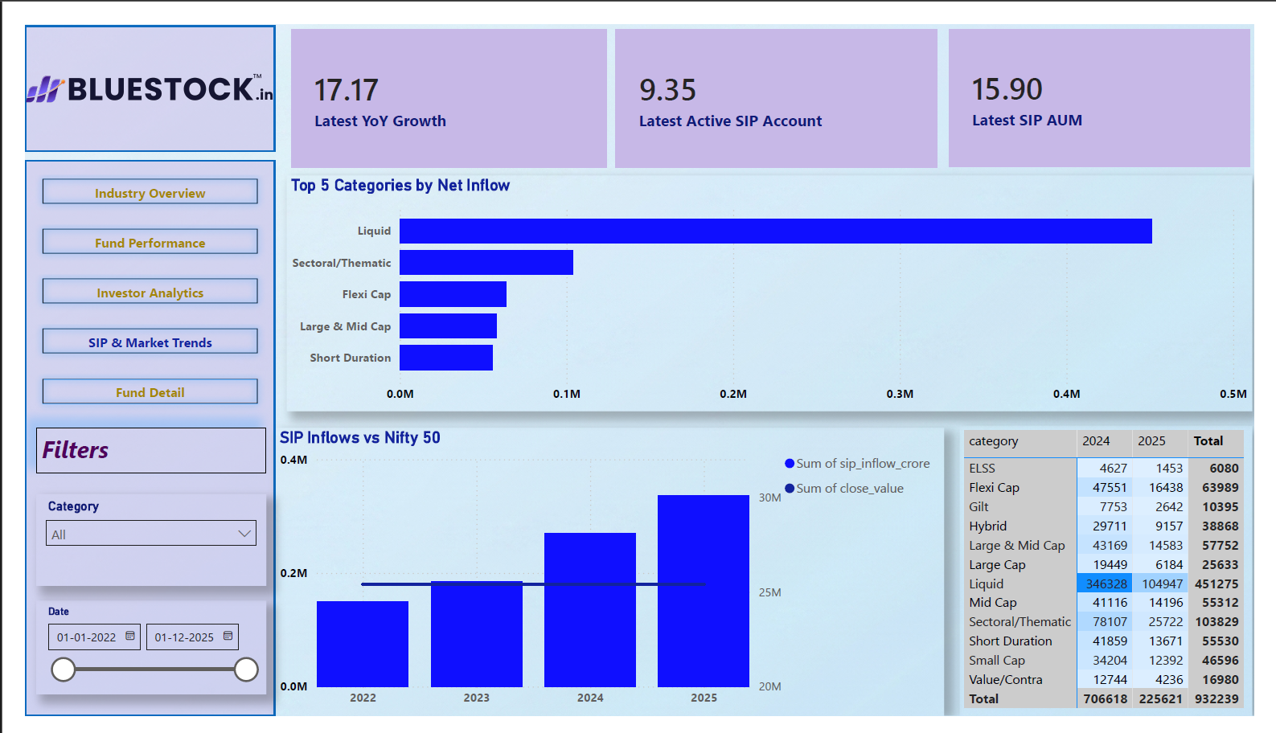
Power BI Dashboard - Investor & SIP Trends
PAGE 3: INVESTOR ANALYTICS
PAGE 4: SIP & MARKET TRENDS
[INSERT: Investor Analytics Screenshot]
[INSERT: SIP & Market Trends Screenshot]
Notes:
Page 3: Investor analytics - Rs 4 billion, 5000 investors, 33000 transactions, 58.49% SIP. Page 4: SIP trends - 17.17% YoY, 9.35 Cr accounts, Liquid dominance.

Slide 11
Key Findings & Business Recommendations
TOP 12 FINDINGS
RECOMMENDATIONS
1. Fund 120505 = Score 100/100 (best risk-adjusted)
2. Fund 119599: 23% return but -52.57% DD = Rank 13
3. SIP = 58.49% of all flows (dominant channel)
4. Liquid = 48.4% of total inflows
5. Top 3 fund houses control ~50% of AUM
6. Rolling Sharpe reveals temporal instability
7. 20+ investors At Risk (gap > 60 days)
8. High HHI correlates with poor Sharpe
9. 18-25 cohort invests 50% less
10. 17.17% YoY growth = structural shift
11. Fund 120843: Sharpe 1.31, DD -12.97%
12. Near-zero daily Beta across all funds
FOR RETAIL INVESTORS:
- Use Sharpe > 1.0 and Max DD < -20%
- Maintain SIP via auto-debit
- Diversify across 2-3 categories
FOR FUND MANAGERS:
- Monitor rolling Sharpe
- Target moderate HHI (0.12-0.16)
FOR AMCs:
- Build ML churn prediction
- Launch micro-SIP (Rs 100-500)
- Re-engage 40-75 gap-day investors
FOR WEALTH ADVISORS:
- Use 0-100 scorecard for clients
- Expand into Tier 2/3 cities
- Use drawdown for expectations
Notes:
12 key findings with actionable recommendations for 4 stakeholder groups. Most critical: raw returns are dangerously misleading without risk metrics.

Slide 12
Thank You!
Bluestock Mutual Fund Analytics & Investor Insights Platform
40 Funds Analyzed
6 Risk Metrics
5,000 Investors
4-Page Dashboard
100/100 Top Score
CONTACT
Anurag Singh
Data Analytics | Mutual Fund Analytics | Business Intelligence
Python | SQL | Power BI | Advanced Analytics | Dashboard Development
Notes:
Project summary: 40 funds, 6 metrics, 5000 investors, 4-page dashboard, top fund score 100. Thank you for your time.

