Slide 1



Generic Outlier Detection in Multi-Armed Bandit
Yikun Ban¹
Yikunb2@illinois.edu
Jingrui He¹
Jingrui@illinois.edu
¹ University of Illinois at Urbana-Champaign

Slide 2
Roadmap
Problem Definition
Proposed Algorithm
Experiments
Conclusion

Slide 3
Multi-Armed Bandit (MAB)
MAB is a well-known tool for online decision making.
Works on MAB date back to (Tompsom, 1933);
Various problems have been studied (e.g., best arm, top-K arms)；
Broad applications (e.g., online recommendation, crowdsourcing).
In this paper, we study outlier detection in MAB.
Outlier
Arm 4
. . .
Arm 1
Arm 2
Arm 3
. . .
Arm n

Slide 4


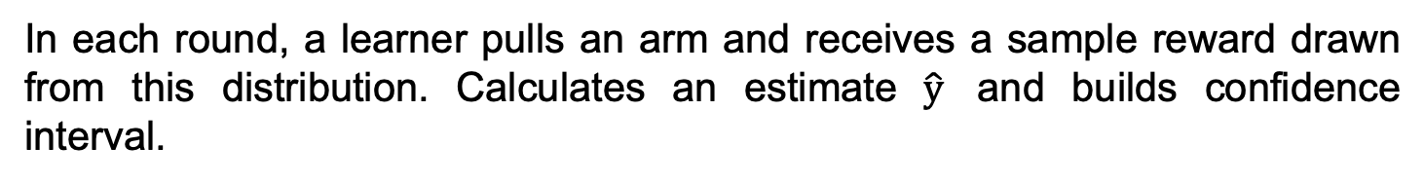





Multi-Armed Bandit (MAB)
Given $n$arms, each arm is associated with a probability distribution with an expected reward $y$ (unknown).
In each round, a learner pulls an arm and receives a sample reward drawn from this distribution. Calculates an estimate $\hat{y}$ and builds confidence interval.
1.0
$$y_{4}$$
Expected Reward
$${\hat{y}}_{i}$$
estimate
$$y_{n}$$
0.5
$$y_{3}$$
$$y_{1}$$
$$y_{2}$$
0.0
. . .
Arm 1
Arm 2
Arm 3
Arm 4
. . .
Arm n
Notes:
In MAB setting, Given n arms, each arm is associated with a probability distribution with an expected reward, which is unknown.
In each round, a learner pulls an arm and receives a sample reward drawn from this distribution, so that we can calculate an estimate for its expected reward and build its confidence interval.

Slide 5
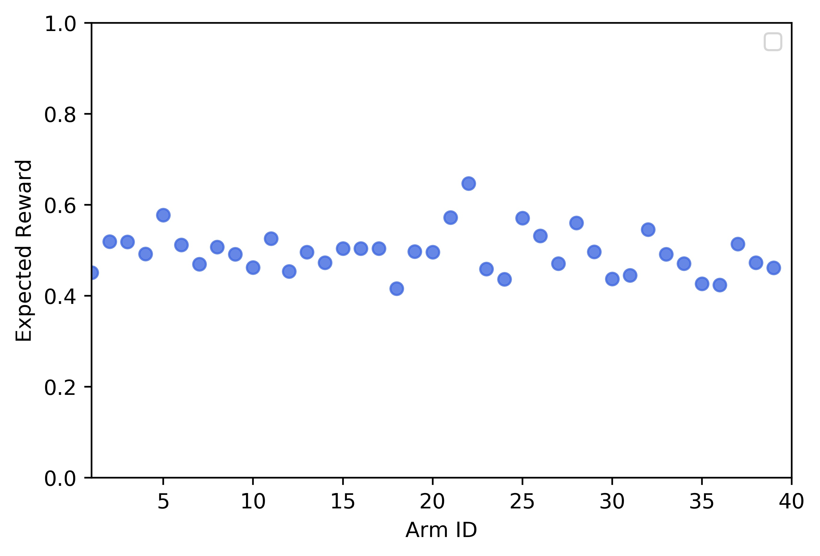
Outlier Arm
Outlier arms: Their expected rewards are far away from most of the other arms.
Outlier
Best Arm
Outlier
Outlier
Outlier
Arm ID
Notes:
The outlier are these arms whose expected rewards are far away from most of the other arms.
For example, in the left figure, the outlier arm represented by the red point deviates significantly from the normal arms denoted by the blue points.
Note that outlier arm is different from best arm detection, because the best arm is the arm with the highest reward while is not necessary being an outlier.
Furthermore, the expected reward of an outlier arm can be below the normal arms and even in the middle of normal arms. Outlier arm detection has various applications such as in medical test and online recommendation.

Slide 6
Real-world Applications
Medical tests (Zhuang, 2017).
Arm: Disease;
Reward: Biomarker’s presence for certain disease;
Goal: Find the disease with exceptional presence of biomarker.
Online recommendation (Li, 2010).
Arm: Article;
Reward: Click-through rate;
Goal: Find the articles with much higher popularity.
Notes:
Consider the medical test.
medical researchers are testing the effectiveness of a biomarker X in distinguishing several different diseases.
Each disease can be modeled as an arm and the leaner needs to observe presence of the biomarker with respect to certain disease.
So that our goal is to find the disease having an exceptional presence of the biomarker .
Second, In the online recommendation, the learner needs to recommend an article to a user.
Each article can be modeled as an arm [24].
And the click- through rate is the expected reward of an arm.
Our goal it to find the article with exceptional higher expected reward.
Which enables us to analyze the article with high popularity and recommend similar articles to certain users.

Slide 7
Limitations of Existing Work
Existing outlier arm definition, K-sigma rule (Zhuang, 2017) :
Mean of expected rewards of all arms + K times standard deviation.
Outlier
Outlier
Outlier
Limitations:
(1) Choose a proper K;
(2) Detect arms whose expected rewards are not high but far away.
Notes:
The outlier arm detection problem was first studied by [39]. It classifies the arms whose expected rewards are above a threshold as the outliers. The threshold is defined by a general statistical rule, the mean of expected rewards of all arms plus k times standard deviation, called the k-sigma rule. Unfortunately, there are two major drawbacks of using the k-sigma rule to identify outlier arms. In this paper, we refer to the distribution of expected rewards of all arms as global distribution, which is the unknown prior knowledge.
First, the value of K is difficult to determine, because we do not the known then expected rewards of all arms.
For example, in this two figure, even though we use the same k, we cannot formulate outlier arm in a correct way.
Second, it cannot detect the outlier arms whose expected reward is not high while being far away from most of the other arms.
For example, in the figure, the red point obviously is an outlier but it is near to the mean.

Slide 8






Problem Definition
We use two constraints to formulate an outlier arm.
$$\left(1\right) ε:$$
Define the shortest distance allowed between an outlier arm and normal arms.
$$\left(2\right) ρ:$$
Define the minimum proportion of normal arms (blue points).
$$ε$$
Problem definition: Design a pulling algorithm, such that the returned set of arms satisfy the criteria of ( , )-outlier arm with probability at least 1− .
$$ε$$
$$ρ$$
$$δ$$
Notes:
Formally, we use two constraints to formulate an outlier arm. First, we use epsilon to define the shortest distance allowed between an outlier arm and normal arms. Second, we use rho to define the minimum proportion of normal arms, like the blue points in the figure.
So, our objective is to design a pulling algorithm, such that the returned set of arms satisfies the criteria of outlier arms with probability at least one minus delta .

Slide 9
Roadmap
Problem Definition
Proposed Algorithm
Experiments
Conclusion

Slide 10











Proposed Algorithm: GOLD
Propose algorithm, GOLD:
Consider two arms as neighbors if their confidence intervals overlap,
i.e.,
, where is a constant transformed by
$$b$$
$$ε.$$
Create an edge between two neighbor arms.
1.0
$$y_{ }$$
$${\hat{y}}_{j}$$
estimate
0.5
$${\hat{y}}_{i}$$
estimate
$$y_{j}$$
Expected Reward
$$y_{i}$$
edge
0.0
Arm
Arm
$$i$$
$$j$$
Notes:
Therefore, we propose an algorithm, gold, to solve this problem.
We consider two arms as neighbors if their confidence intervals overlap, where Beta is the upper confidence bound.
In other words, the neighbor arms need to satisfy this criterion, where b is a constant transformed by epsilon.
To observe the relation among arms, each arm can be thought as a node and we create an edge between two neighbor arms.

Slide 11

Proposed Algorithm: GOLD
Initialization: A complete graph formed by arms.
$$n$$
Community: A connected component of the graph.
Community 1
Arm 1
Arm 2
Arm 3
Arm 4
Arm 5 (Outlier)
Notes:
Because the confidence interval of each arm is extremely large in the beginning, a complete graph is formed by n arms. Also, we define a connected component of the graph a community.

Slide 12




Proposed Algorithm: GOLD
Pulling process: Pull each arm in a Round-Robin way. At each round, the learner pulls an arm to obtain the reward. Then, updates its estimate and confidence interval.
1.0
$$y_{ }$$
$${\hat{y}}_{j}$$
estimate
$$y_{j}$$
0.5
Expected Reward
$${\hat{y}}_{i}$$
estimate
$$y_{i}$$
0.0
edge
Arm
Arm
$$i$$
$$j$$
Notes:
In the pulling process, at each round, the learner pulls an arm to obtain the reward. Then, updates its estimate and confidence interval.

Slide 13
Proposed Algorithm: GOLD
Pulling process: Pull each arm in a Round-Robin way. At each round, the learner pulls an arm to obtain the reward. Then, updates its estimate and confidence interval.
Remove edge if the two arms are not neighbors.
1.0
$${\hat{y}}_{j}$$
estimate
$$y_{ }$$
0.5
Expected Reward
$${\hat{y}}_{i}$$
estimate
0.0
edge
Arm
Arm
$$i$$
$$j$$
Notes:
As more pulls on each arm, we have more confidence to its estimate.
The confidence interval of each arm will become smaller and smaller.
Then We remove the edge if the connected two arms are not neighbors anymore.

Slide 14
Proposed Algorithm: GOLD
Pulling process: Pull each arm in a Round-Robin way. At each round, the learner pulls an arm to obtain the reward. Then, updates its estimate and confidence interval.
Remove edge if the two arms are not neighbors.
Arm 1
Arm 2
Arm 3
Arm 4
Arm 5
Outlier
Notes:
During the process, more and more edges are removed.

Slide 15
Proposed Algorithm: GOLD
Pulling process: Pull each arm in a Round-Robin way. At each round, the learner pulls an arm to obtain the reward. Then, updates its estimate and confidence interval.
Remove edge if the two arms are not neighbors.
Form new communities.
Community 1
Community 2
Arm 1
Arm 2
Arm 3
Arm 4
Arm 5
Outlier
Notes:
Form new communities.

Slide 16


Proposed Algorithm: GOLD
Termination status of an arm: Its community’s size is smaller than n × (1− ).
$$ρ$$
Termination status of the algorithm: The number of arms that have already achieved the termination status is larger than n × (1 − ).
$$ρ$$
Community 1
Community 2
Arm 1
Arm 2
Arm 3
Arm 4
Arm 5
Outlier
Notes:
Because the outlier arm is far away from normal arms. The edges among outlier arm and normal arms tend to be removed first.
Based on this observation, we define the following two termination status.
First, The termination status of an arm is when its community’s size is smaller than n times one minus rho.
Second, The termination status of the algorithm is when the number of arms that have achieved the termination status is larger than n times one minus rho.

Slide 17
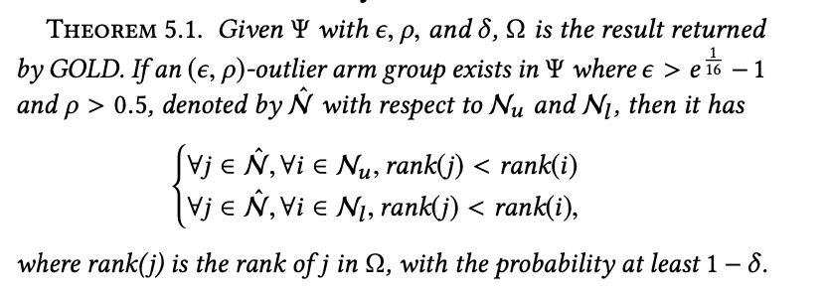

Theoretical Analysis
Number of outlier arms is unknown.
Arm deviates most should have the priority to be investigated first.
Therefore, instead of detecting a set of outlier arms, we propose to rank all the arms:
Outlier arms are ranked higher than the normal arms.
(1) Correctness: The returned result is correct with probability at least 1- .
$$δ$$
Notes:
However, given a set of arms, the specific number of outlier arms is usually unknown. Moreover, even given a set of outliers, the arm deviates most should have the priority to be inspected when the ground truth is not provided in practice. Therefore, instead of identifying a set of arms as outliers, we propose to rank order all the arms such that the outlier arms are ranked higher than the normal arms.
The algorithm has a few good properties. First, the return set of arms are true outlier arms with probability at least one minus delta.
Second, the total number of pulls needed to terminate for this algorithm is upper bounded by this item.

Slide 18
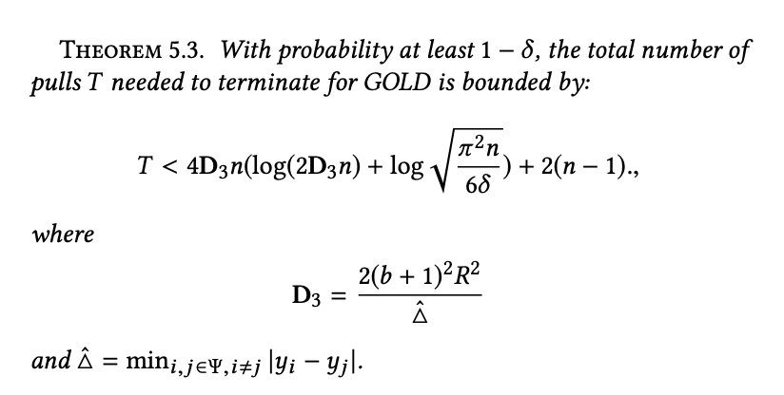



Theoretical Analysis
Required number of pulls for GOLD is proportional to
$$O\left(n\log{n}\right).$$
(2) Upper bound: The total number of pulls needed to terminate with probability 1- .
$$δ$$
$$\sim O(n\log{n })$$
Notes:
Second, we provide the upper bound of number of pulls needed by GOLD, to show that the proposed algorithm is efficient.

Slide 19
Roadmap
Problem Definition
Proposed Algorithm
Experiments
Conclusion

Slide 20
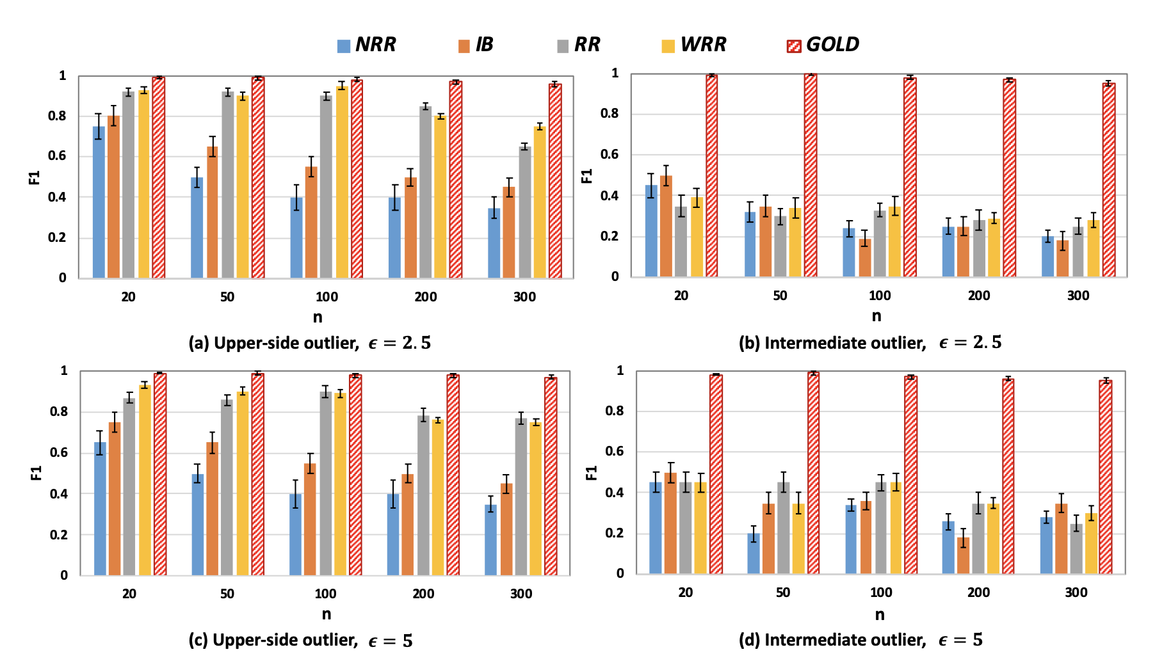



Experiments-Synthetic
$$n=20, 50, 100, 200, 400$$
Upper-side outlier: Above the normal arms.
$$ε=2.5, 5$$
Intermediate outlier: In the middle of normal arms.
$$ρ=0.9$$
Better
Notes:
We evaluate the proposed algorithm both on synthetic and real-world datasets.
Frist, we inject two types of outlier arms.
The first type is the upper side outlier, which means the expected reward of outlier arm is much higher than normal arms.
The second type is the intermediate outlier whose expected reward is in the middle of normal arms.
In summary, GOLD outperforms all the baselines.
The most competitive baselines are RR and WRR.
They have good performance on detecting upper while still worse than gold.
However, they are not able to detect intermediate
Because they simply use the k-sigma role, as the analysis before.
Because GOLD terminates once it finds the outlier arms, saving the unnecessary pulls

Slide 21
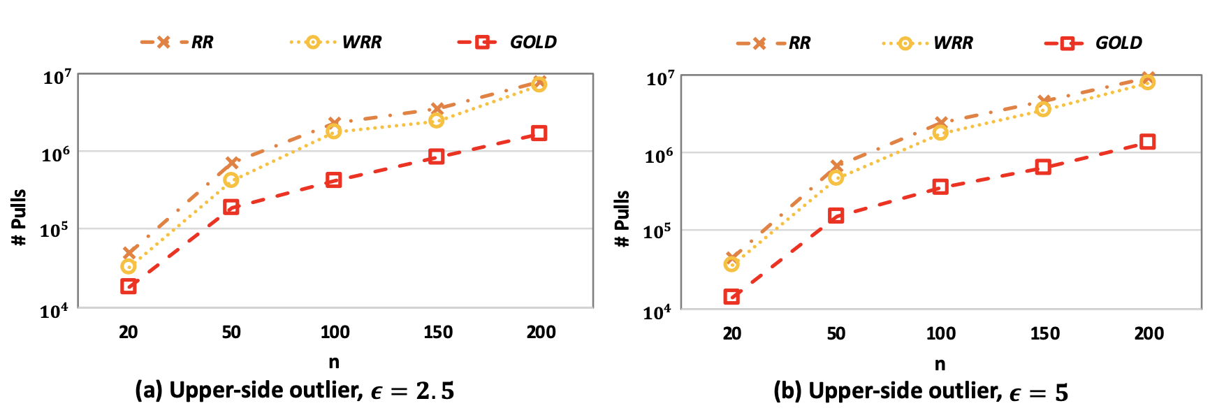
Experiments-Synthetic
$$n=20, 50, 100, 200, 400$$
Upper-side outlier: Above the normal arms.
$$ε=2.5, 5$$
Intermediate outlier: In the middle of normal arms.
$$ρ=0.9$$
Better
Notes:
We evaluate the proposed algorithm on both synthetic and real-world datasets.
Frist, we inject two types of outlier arms.
The first type is the upper side outlier, which means the expected reward of outlier arm is much higher than normal arms.
The second type is the intermediate outlier whose expected reward is in the middle of normal arms.
In summary, GOLD outperforms all the baselines.
The most competitive baselines are RR and WRR.
They have good performance on detecting upper while still worse than gold.
However, they are not able to detect intermediate
Because they simply use the k-sigma role, as the analysis before.
Because GOLD terminates once it finds the outlier arms, saving the unnecessary pulls

Slide 22
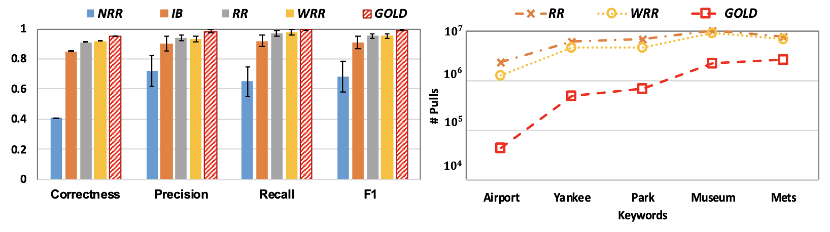

Experiments-Twitter
47 regions can be thought of as the arms with a Bernoulli distribution.
Reward is 1 if the selected region contains the keyword.
$$n=47, ε=2.5, ρ=0.9.$$
Better
Better
Achieves 98% accuracy while saving 89% cost on average.
Notes:
In this application, each region corresponds to an arm. A region has an unknown probability of generating a tweet containing the keyword
In this application, each region corresponds to an arm. A region has an unknown probability of generating a tweet containing the keyword, which can be regarded as a Bernoulli distribution.

Slide 23
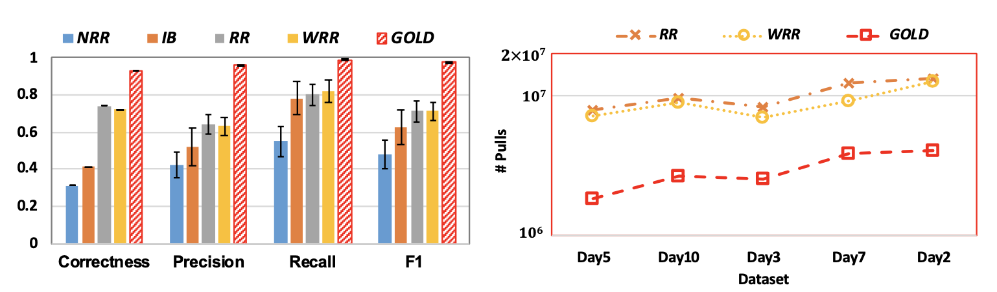

Experiments-Yahoo!
An article can be regarded as an arm and recommended to a user
$$ε=2.5, ρ=0.9.$$
Better
Better
Achieves 97% accuracy while saving 78% cost on average.
Notes:
This is an online recommendation dataset.
Our goal is to detect outlier articles.
This is a large-scale clickstream data set provided by Yahoo Webscope program.

Slide 24
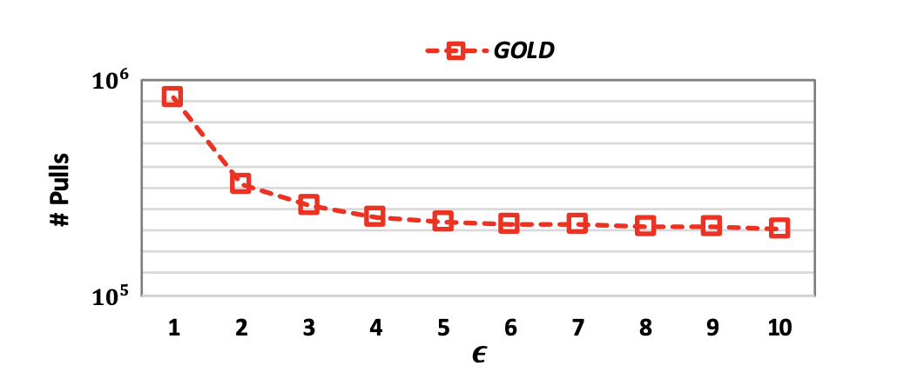
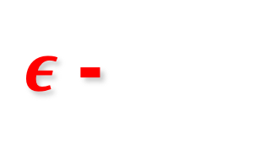


$ε$ -
Effect
Effect of on the number of pulls required by GOLD
$$ε$$
Consistent with our upper bound analysis, the number of pulls required by GOLD decreases as increases.
$$ε$$
Notes:
This figure shows the number of pulls required by GOLD with varying ε value. Here, we use the synthetic data set (Upper-side outlier, n = 100). Consistent with our analysis in Theorem 5.3, the number of pulls required by GOLD decreases as ε increases.

Slide 25
Roadmap
Problem Definition
Proposed Algorithm
Experiments
Conclusion

Slide 26
Conclusion
(1) Introduced a new outlier detection problem in MAB:
Formulate outlier arms more accurately with a broader coverage;
Comprehensive parameters.
(2) Proposed an algorithm, GOLD:
Theoretical guarantee of correctness (effectiveness);
Upper bound of termination (efficiency).
(3) Evaluated GOLD on both synthetic and real-world data sets:
Achieve 98% accuracy on average;
Save 83% exploration cost on average.

Slide 27
Thank You!
Generic Outlier Detection in Multi-Armed Bandit
Yikun Ban (www.banyikun.com), Jingrui He (www.hejingrui.org)
University of Illinois at Urbana-Champaign

Slide 28
Reference
Honglei Zhuang, Chi Wang, and Yifan Wang. 2017. Identifying outlier arms in multi-armed bandit. In Advances in Neural Information Processing Systems (NIPS). 5204–5213.
Lihong Li, Wei Chu, John Langford, and Robert E Schapire. 2010. A contextual- bandit approach to personalized news article recommendation. In Proceedings of the 19th international conference on World wide web. ACM, 661–670.
William R Thompson. 1933. On the likelihood that one unknown probability exceeds another in view of the evidence of two samples. Biometrika 25, 3/4 (1933), 285–294.

