Slide 1
What makes an Android App popular?
Presented by Xu Han, Data Science ScM
Oct 20, 2019
Github repo
Notes:
https://github.com/bao1981105/Google-Apps-Download-Prediction

Slide 2
Introduction
People nowadays spend more time with their phones. While this is a great opportunity for the market, it also becomes a challenge for developers to develop a popular app. The data was downloaded from Kaggle.
In this project, the goal is to predict the number of installs from features of the app itself such as category, size, current version, rating, paid or free etc.
Target variable: number of installs. ‘<10k’, ‘<500k’, ‘<5 million’, ‘> 5 million’.
This is a classification problem.
Notes:
https://www.kaggle.com/lava18/google-play-store-apps

Slide 3
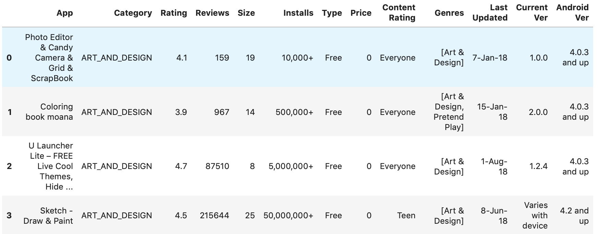
Preprocessing: Original df

Slide 4
Preprocessing: Data Cleaning
Original df shape: (10841, 13); df_preprocessed shape: (9676, 68)
Drop duplicates, adjust columns that has datatype ‘Object’, use ordinal encoder to preprocess target variable and reduce the number of groups to four
Use Regular Expression to extract number from string and convert it back to int/float64.

Slide 5
Preprocessing: Missing values
Run MCAR test on df_preprocessed (test result p = 0)
Train test split
Iterative impute missing values for continuous features in test dataset
Use minmax scaler, standard scaler on continuous features, onehot encoder, ordinal encoder on categorical features in test dataset
For categorical features, make a new column for missing values
Check percentage of missing data and drop two columns that has 91% data missing

Slide 6
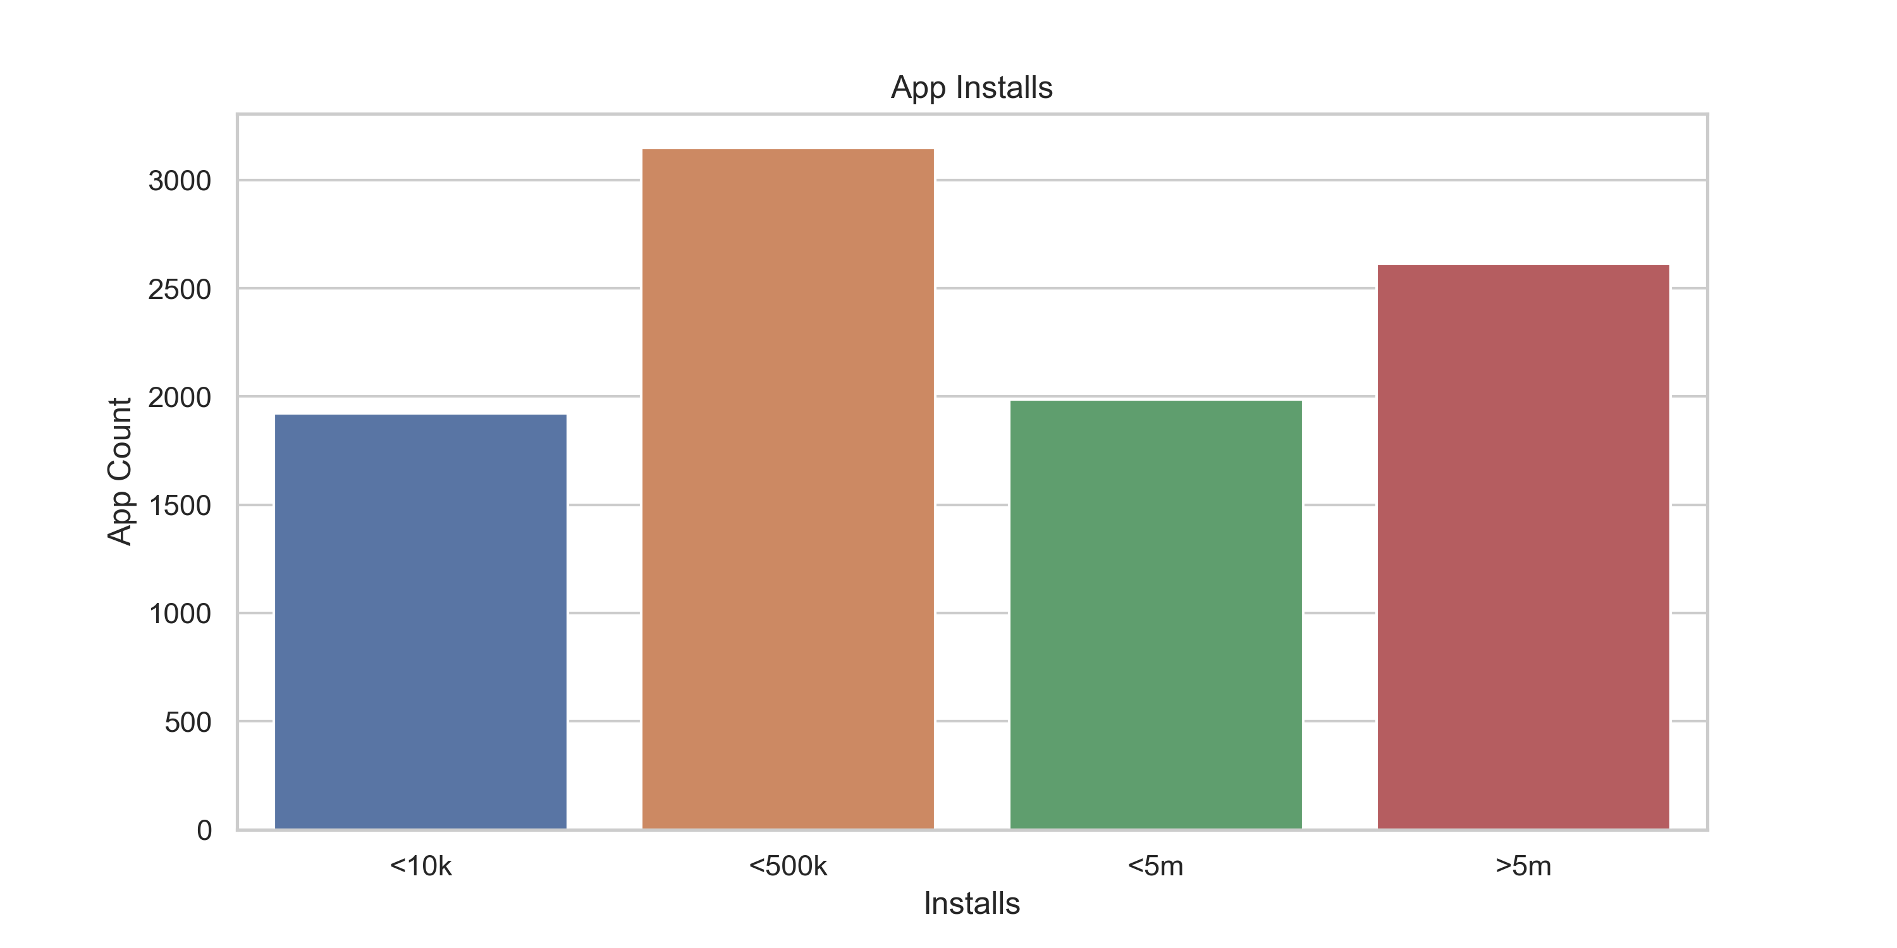
EDA: Data Balance

Slide 7
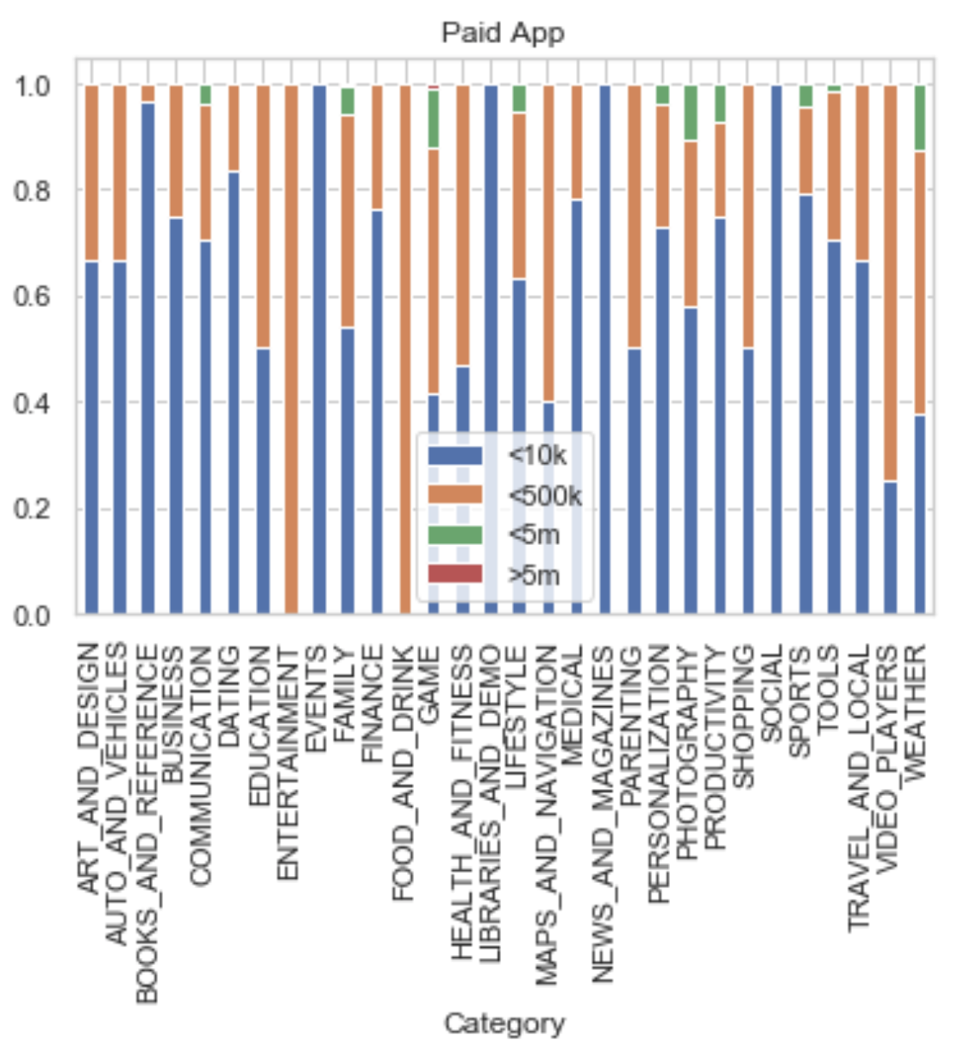
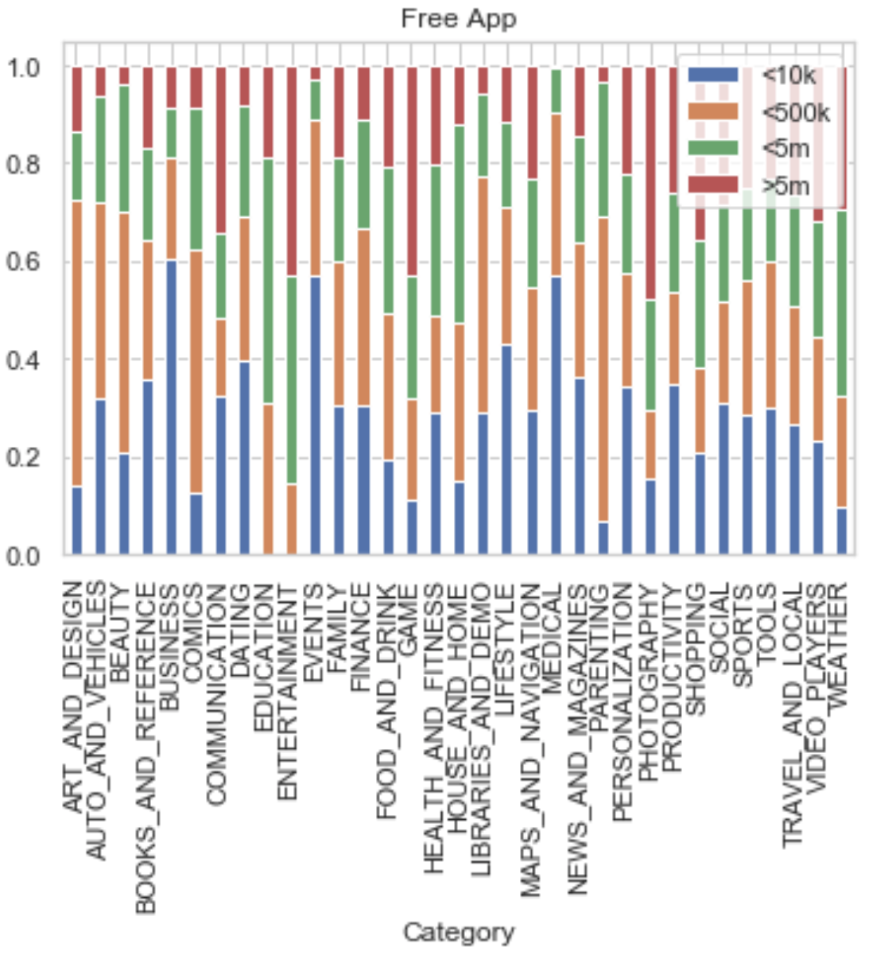
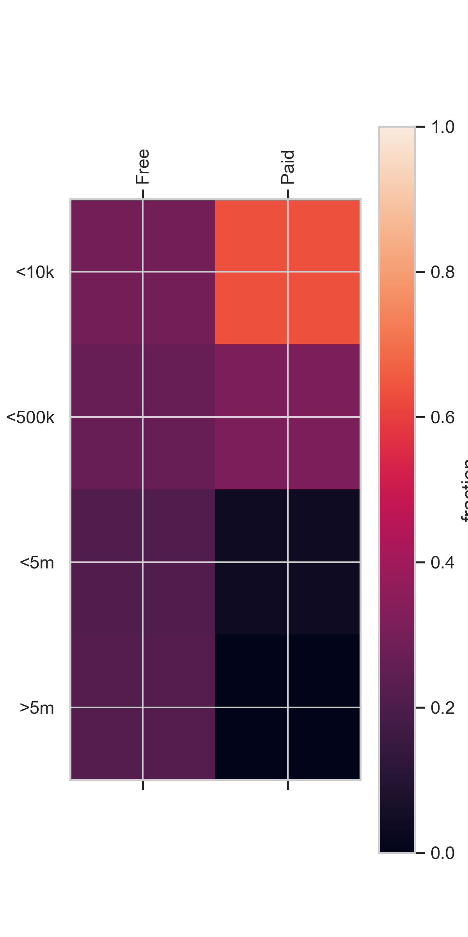
EDA: Free & entertainment apps have more downloads

Slide 8
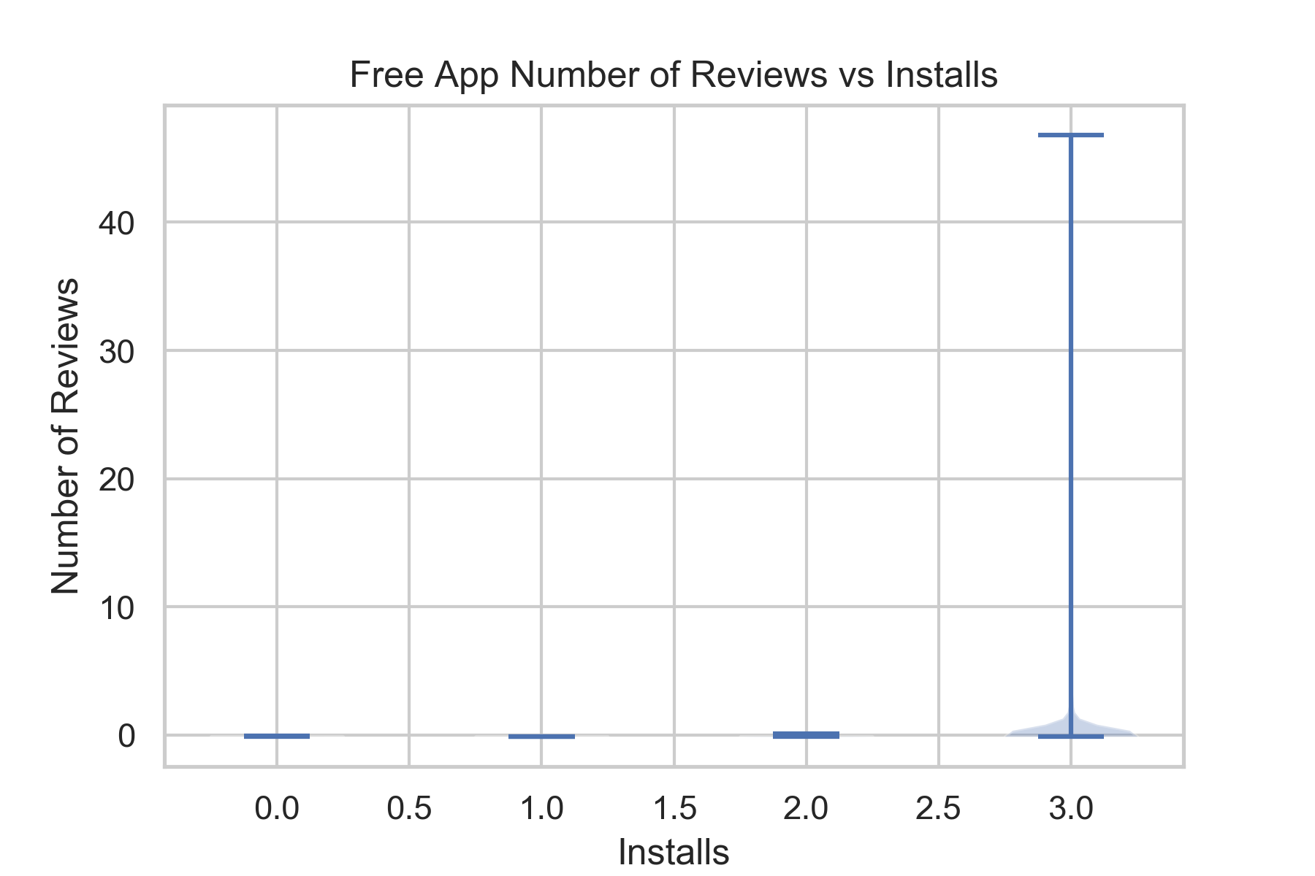
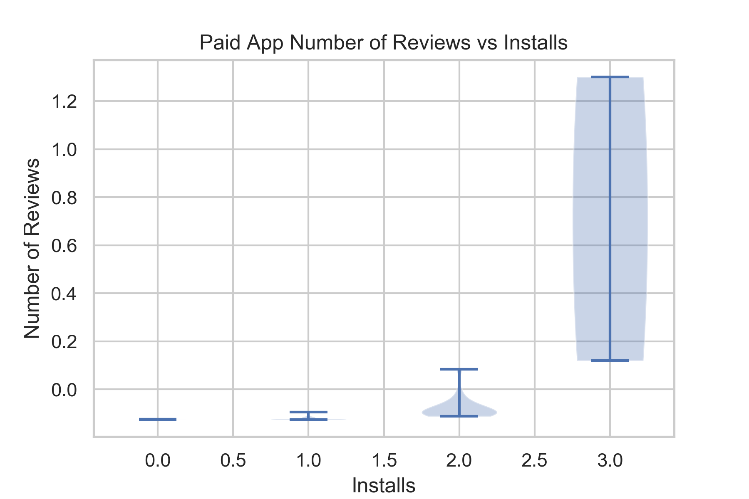
EDA: People care about popular paid app?

