Slide 1


Eklipse.GG
Churn Analysis
By Bao Hoang

Slide 2
Overview
During this analysis, it is clearly that the dataset in imbalanced, indicates that most of the users are content with Eklipse, and tend not to quit premium subscription, and possibly the impacts of some features are underestimate.
Users using Eklipse in Chrome android, desktop have a tendency to cancel the most.
The more the user apply Eklipse for normal clips, active daily, and streaming more frequently would be the loyal customer.

Slide 3
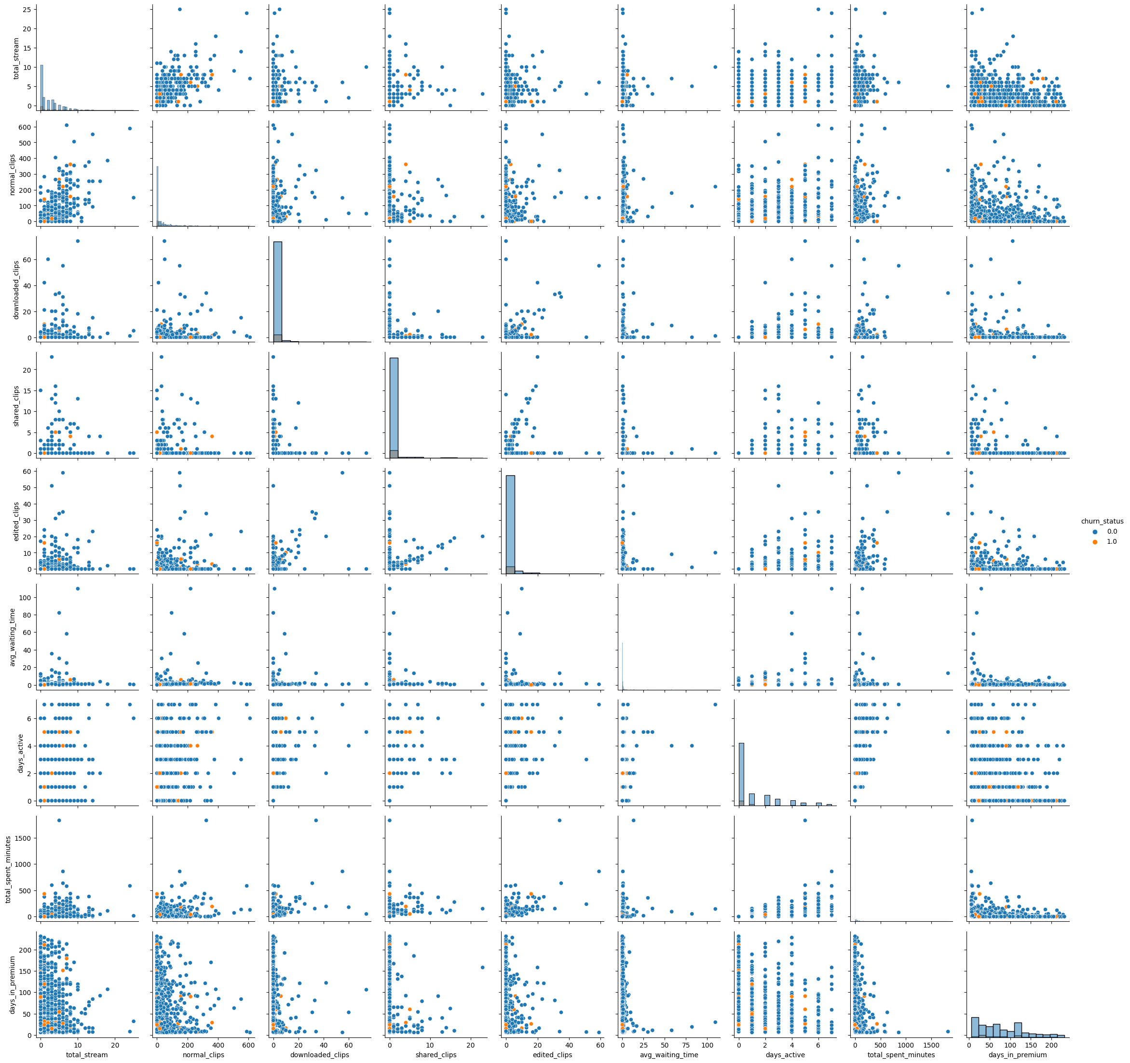
Overall dataset
Most of the dataset are distributed positive skewed due to the nature of the components.
Some elements might not affect much on our customer’s behavior such as using Chorme on Apple devices, edited clips or downloaded clips.
Interestingly, the duration of staying in premium accounts is not the reason they might cancel or not.
We might focus on significant elements such as using Chrome on Android devices, using Desktop, App via Android.

Slide 4
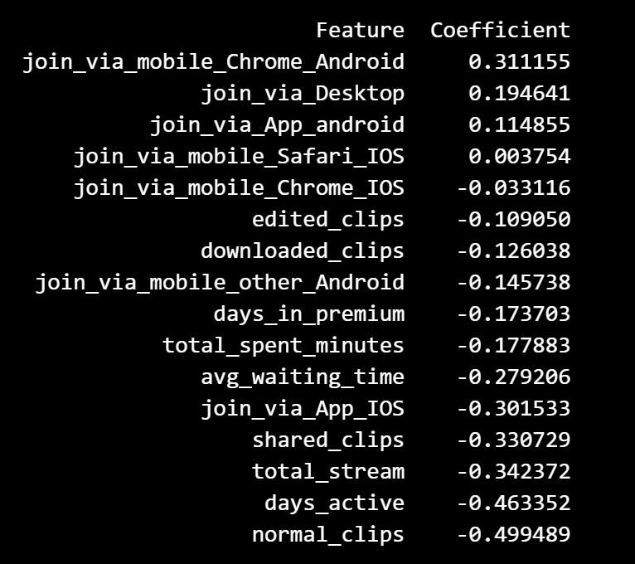
Churn prediction model
By the nature of the dataset, it necessary to use Logistic regression model for forecasting.
Here is the result of the model that was conducted
Those with negative coefficient contribute to the increase in duration of premium accounts, the lower they are, the more meaningful to our users.
Those with positive coefficient would be the main reasons for premium termination.
It is shown that there are some issues with user via Chrome on Android device, Desktop and App Android.

Slide 5
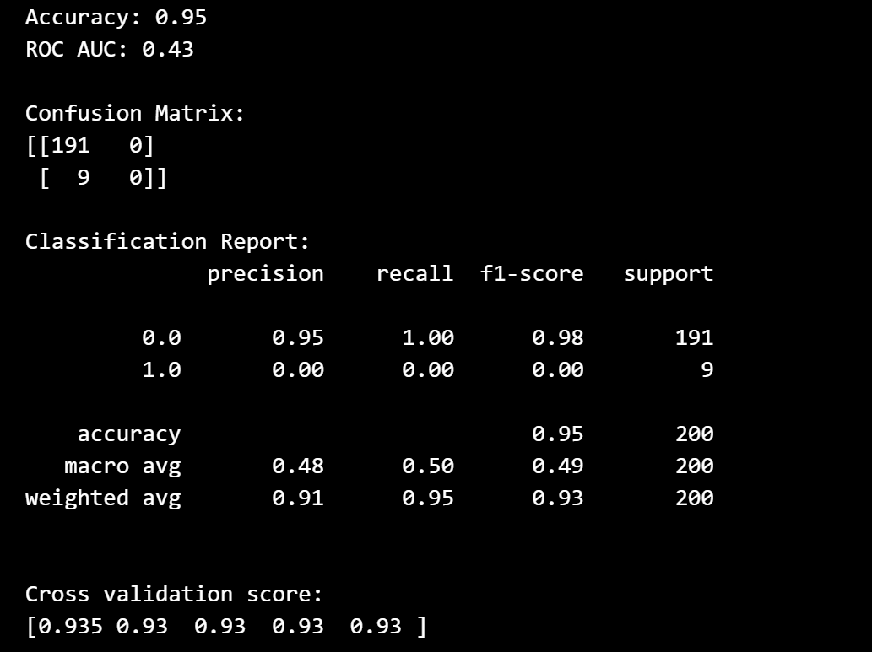
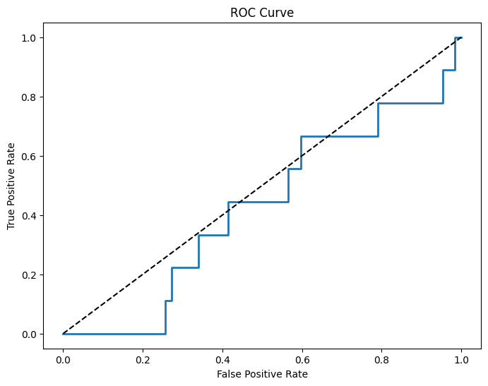
Model Valuation
In summary, this classification report suggests that the model performs very well for not churn but fails to correctly predict any instances of churn. The class imbalance issue is evident
In addition, the ROC AUC score is 43%, it's possible that the model is making predictions that are not much better than random guessing for your specific dataset.
In the image, it’s clearly shown that the model fails to predict the true positive classes or false positive classes.

Slide 6
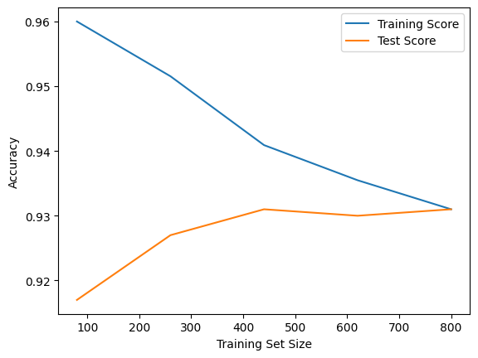
Testing Overfitting
For deeper understanding of the model whether the data is suitable for churn prediction, we should estimate if the model is overfitting or underfitting.
As clearly shown in the image the more the training set size expand, the more accuracy of training score and test score meet, the less overfitting the model is.

Slide 7
Summary
Eklipse should focus on performance of apps via Chrome, on desktop and Android.
Normal clips greatly helps to attract customer, while the main business of the company is on short clips (highlight moment). The premium features might not influence positively to the customers (need to improve)
Increase the frequency of using apps and streaming is important. (Adding special effects, more interactive features between streamers and
The dataset is not suitable for churn prediction model, and it is essential to address this issue.

Slide 8
How To Improve
Here is some suggestion that might aid to enhance the quality of the model:
With the imbalance of the data, choosing the appropriate evaluation metrics. Most of the data is positive skewed distributed, it could not track the tendency of the users.
We could add the variance in time of total_stream, variance of edited clips, downloaded clips and total spending time, variance in number of views the streamers acquire.
Adding further investigation, for example, measuring the satisfaction level of the customers, the influence of social media, social network

