Slide 1
Log-Based CDC
Presenter: Bao Nguyen
May 2023

Slide 2
Agenda
Context 1: Only CDC
Context 2: CDC + Transform
Reference model: Only CDC
Reference model: CDC + Transform
Architecture for both Context 1 and Context 2
Git: https://github.com/bao2902/logbasedcdc
Concepts: Docker
Concepts: Apache Kafka
Concepts: Debezium
Debezium CDC Insert Message Example
Debezium CDC Update Message Example
Debezium CDC Delete Message Example
Concepts: KSQL
Pros and Cons: Apache Kafka
Pros and Cons: Debezium

Slide 3
Context 1: Only CDC
Description:
- We have a Users table (fields: user_id, first_name, last_name) in a source PostgreSQL database.
- We have a Wages table (fields: user_id, wage) in a soure PostgreSQL database.
- We have a Users table (fields: user_id, first_name, last_name) in a sink PostgreSQL database.
- We have a Wages table (fields: user_id, wage) in a sink PostgreSQL database.
- We want to synchronize the Change Data Capture (CDC) to the tables Users and Wages in a sink PostgreSQL database when the tables Users and Wages are inserted, updated, or deleted in the source PostgreSQL database.
- We expect this synchonization happenning in near-real-time.

Slide 4
Context 2: CDC + Transform
Description:
- We have a Users table (fields: user_id, first_name, last_name) in a source PostgreSQL database.
- We have a Wages table (fields: user_id, wage) in a soure PostgreSQL database.
- We have a User_Wages table (fields: user_id, full_name, wage) in a sink PostgreSQL database.
- We want to synchronize the Change Data Capture (CDC) to the table User_Wages in a sink PostgreSQL database when the tables Users and Wages are inserted, updated, or deleted in the source PostgreSQL database.
- This synchonization includes the data tranforming as following:
+ User_Wages.user_id = Users.user_id
+ User_Wages.full_name = Users.first_name + ' ' + Users.last_name
+ User_Wages.wage = Wages.wage
- We expect this synchonization happenning in near-real-time.

Slide 5
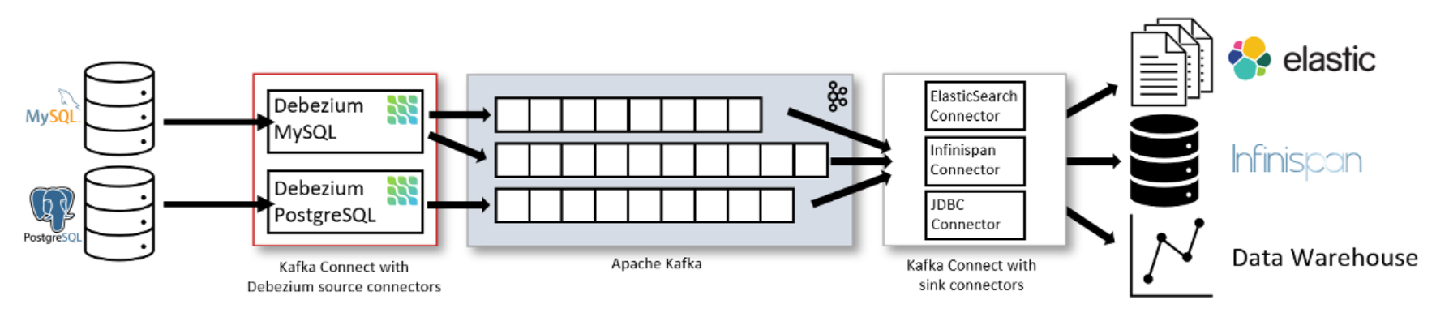
Reference model: Only CDC
Reference: https://blog.palark.com/debezium-cdc-for-apache-kafka/

Slide 6
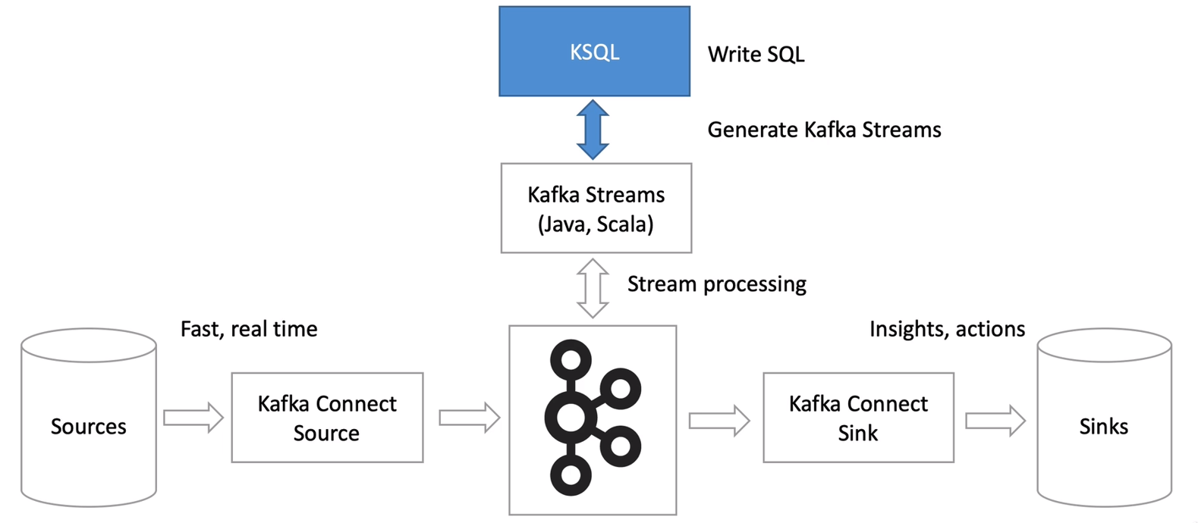
Reference model: CDC + Transform
Reference: https://www.udemy.com/course/kafka-ksql/

Slide 7
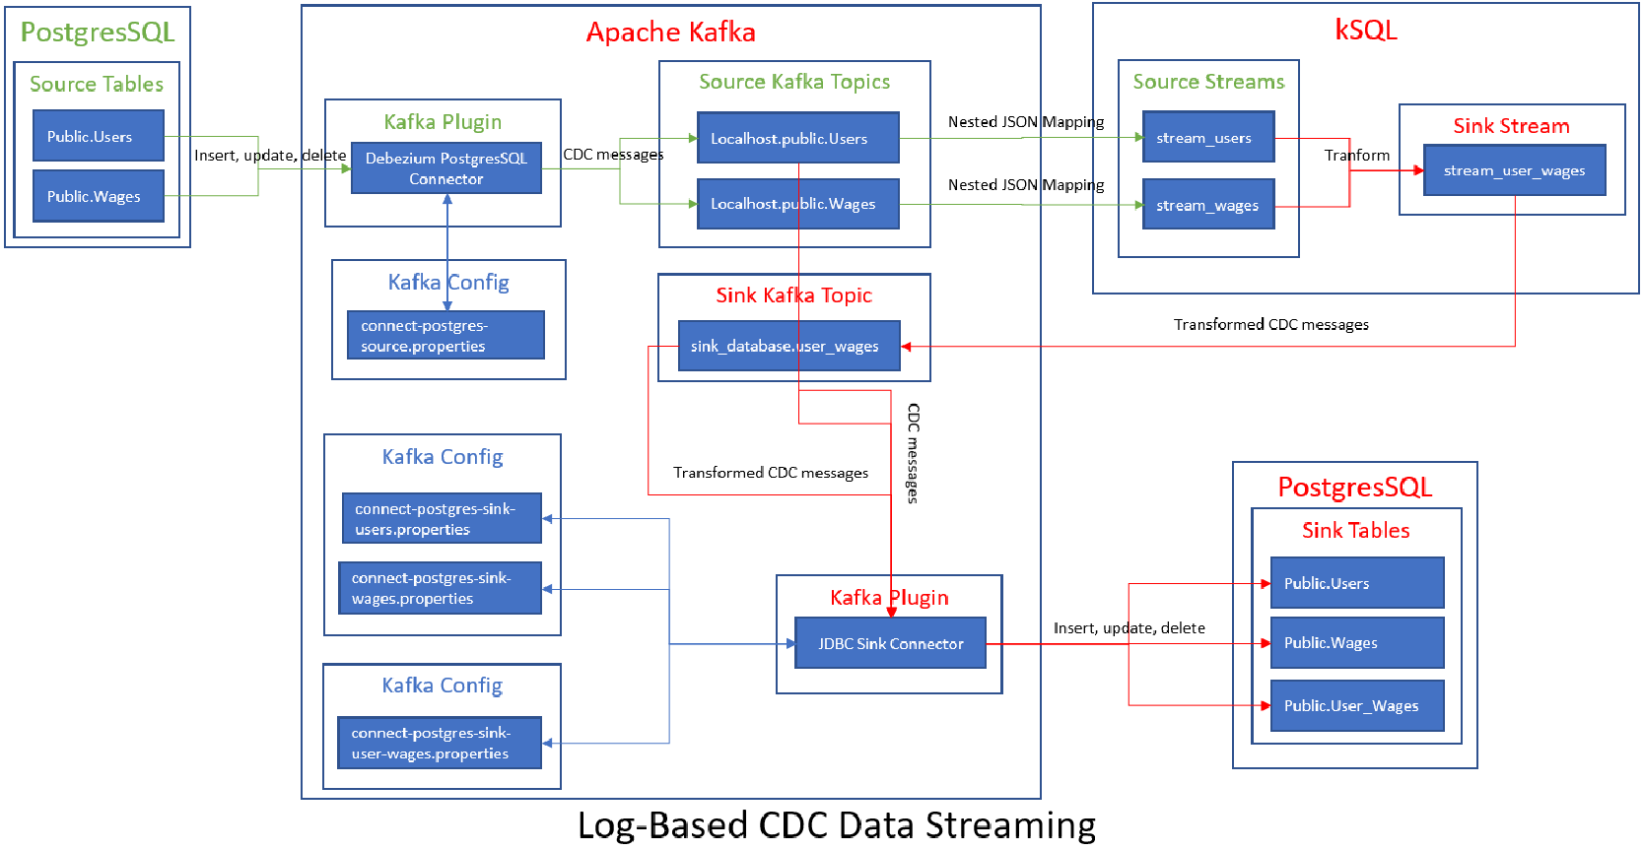
Architecture for both Context 1 and Context 2

Slide 8
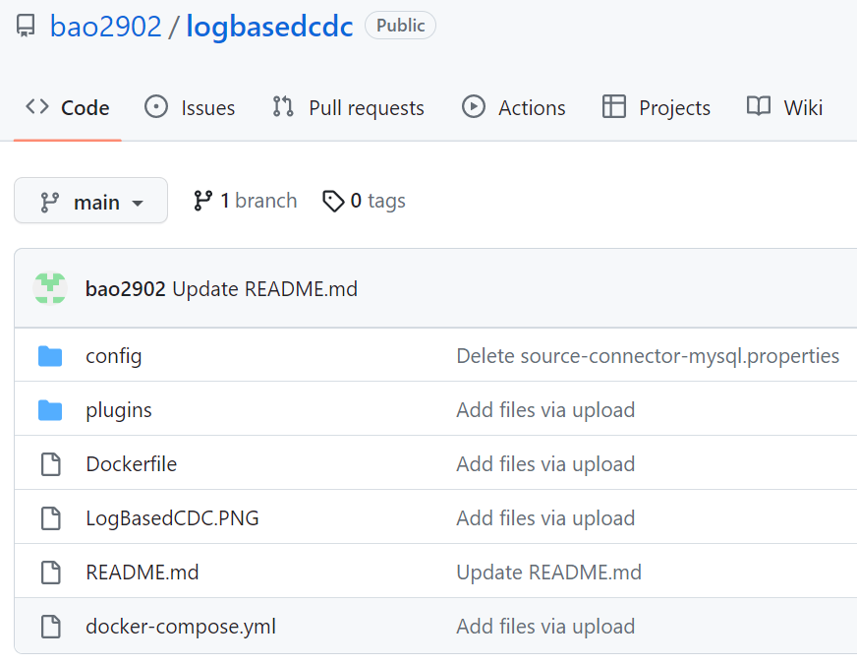
Git: https://github.com/bao2902/logbasedcdc

Slide 9
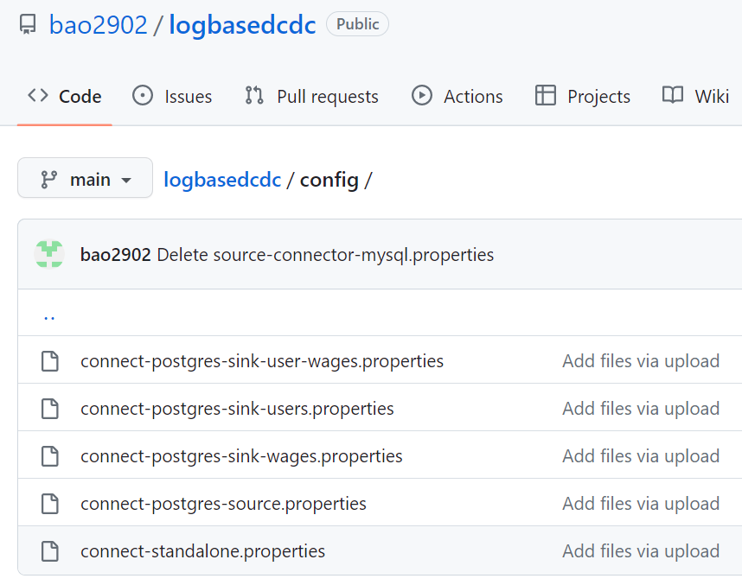
Git: https://github.com/bao2902/logbasedcdc

Slide 10
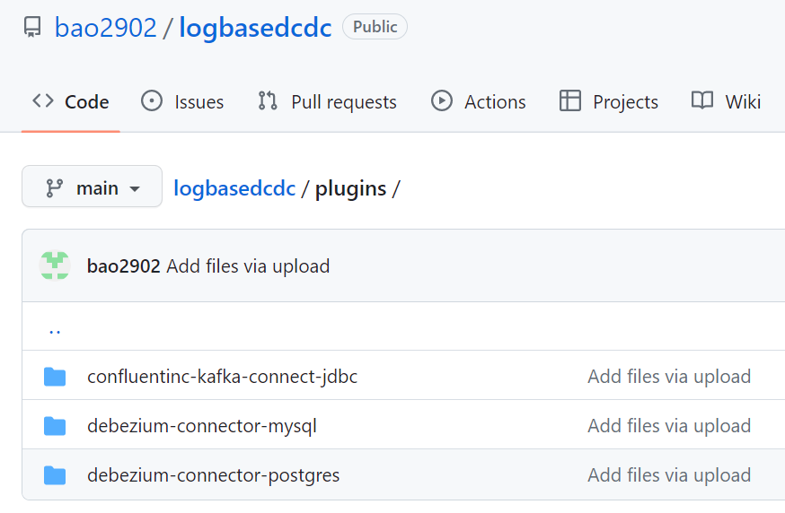
Git: https://github.com/bao2902/logbasedcdc

Slide 11
Concepts: Docker
Docker is an open platform for developing, shipping, and running applications. Docker enables you to separate your applications from your infrastructure so you can deliver software quickly.
A container is a runnable instance of an image. You can create, start, stop, move, or delete a container using the Docker API or CLI. You can connect a container to one or more networks, attach storage to it, or even create a new image based on its current state.
Compose is a tool for defining and running multi-container Docker applications. With Compose, you use a YAML file to configure your application’s services. Then, with a single command, you create and start all the services from your configuration.
References:
https://docs.docker.com/get-started/overview/
https://docs.docker.com/compose/

Slide 12
Concepts: Apache Kafka
Apache Kafka is an open-source distributed event streaming platform used by thousands of companies for high-performance data pipelines, streaming analytics, data integration, and mission-critical applications.
An event records the fact that "something happened" in the world or in your business. It is also called record or message in the documentation.
Producers are those client applications that publish (write) events to Kafka.
Consumers are those that subscribe to (read and process) these events.
Events are organized and durably stored in topics.
References:
https://kafka.apache.org/
https://kafka.apache.org/intro

Slide 13
Concepts: Debezium
Debezium
Debezium is an open-source tool for CDC that is based on Apache Kafka. It can capture row-level changes using transactional logs. The order of events recorded by Debezium is the same as how changes were made to the database. These events become topics published to Apache Kafka.
Debezium connector for PostgreSQL
The Debezium PostgreSQL connector captures row-level changes in the schemas of a PostgreSQL database.
References:
https://www.arcion.io/blog/cdc-tools
https://debezium.io/documentation/reference/stable/connectors/postgresql.html

Slide 14
Debezium CDC Insert Message Example
rowtime: 2023/04/28 02:51:17.887 Z, key: {"schema":{"type":"struct","fields":[{"type":"int32","optional":false,"field":"user_id"}],"optional":false,"name":"localhost.public.users.Key"},"payload":{"user_id":1}}, value: {"schema":{"type":"struct","fields":[{"type":"struct","fields":[{"type":"int32","optional":false,"field":"user_id"},{"type":"string","optional":true,"field":"first_name"},{"type":"string","optional":true,"field":"last_name"}],"optional":true,"name":"localhost.public.users.Value","field":"before"},{"type":"struct","fields":[{"type":"int32","optional":false,"field":"user_id"},{"type":"string","optional":true,"field":"first_name"},{"type":"string","optional":true,"field":"last_name"}],"optional":true,"name":"localhost.public.users.Value","field":"after"},{"type":"struct","fields":[{"type":"string","optional":false,"field":"version"},{"type":"string","optional":false,"field":"connector"},{"type":"string","optional":false,"field":"name"},{"type":"int64","optional":false,"field":"ts_ms"},{"type":"string","optional":true,"name":"io.debezium.data.Enum","version":1,"parameters":{"allowed":"true,last,false"},"default":"false","field":"snapshot"},{"type":"string","optional":false,"field":"db"},{"type":"string","optional":false,"field":"schema"},{"type":"string","optional":false,"field":"table"},{"type":"int64","optional":true,"field":"txId"},{"type":"int64","optional":true,"field":"lsn"},{"type":"int64","optional":true,"field":"xmin"}],"optional":false,"name":"io.debezium.connector.postgresql.Source","field":"source"},{"type":"string","optional":false,"field":"op"},{"type":"int64","optional":true,"field":"ts_ms"}],"optional":false,"name":"localhost.public.users.Envelope"},"payload":{"before":null,"after":{"user_id":1,"first_name":"first 1","last_name":"last 1"},"source":{"version":"0.10.0.Final","connector":"postgresql","name":"localhost","ts_ms":1682650277672,"snapshot":"false","db":"postgres","schema":"public","table":"users","txId":944,"lsn":23763632,"xmin":null},"op":"c","ts_ms":1682650277716}}, partition: 0

Slide 15
Debezium CDC Update Message Example
rowtime: 2023/04/28 02:51:43.387 Z, key: {"schema":{"type":"struct","fields":[{"type":"int32","optional":false,"field":"user_id"}],"optional":false,"name":"localhost.public.users.Key"},"payload":{"user_id":1}}, value: {"schema":{"type":"struct","fields":[{"type":"struct","fields":[{"type":"int32","optional":false,"field":"user_id"},{"type":"string","optional":true,"field":"first_name"},{"type":"string","optional":true,"field":"last_name"}],"optional":true,"name":"localhost.public.users.Value","field":"before"},{"type":"struct","fields":[{"type":"int32","optional":false,"field":"user_id"},{"type":"string","optional":true,"field":"first_name"},{"type":"string","optional":true,"field":"last_name"}],"optional":true,"name":"localhost.public.users.Value","field":"after"},{"type":"struct","fields":[{"type":"string","optional":false,"field":"version"},{"type":"string","optional":false,"field":"connector"},{"type":"string","optional":false,"field":"name"},{"type":"int64","optional":false,"field":"ts_ms"},{"type":"string","optional":true,"name":"io.debezium.data.Enum","version":1,"parameters":{"allowed":"true,last,false"},"default":"false","field":"snapshot"},{"type":"string","optional":false,"field":"db"},{"type":"string","optional":false,"field":"schema"},{"type":"string","optional":false,"field":"table"},{"type":"int64","optional":true,"field":"txId"},{"type":"int64","optional":true,"field":"lsn"},{"type":"int64","optional":true,"field":"xmin"}],"optional":false,"name":"io.debezium.connector.postgresql.Source","field":"source"},{"type":"string","optional":false,"field":"op"},{"type":"int64","optional":true,"field":"ts_ms"}],"optional":false,"name":"localhost.public.users.Envelope"},"payload":{"before":null,"after":{"user_id":1,"first_name":"first 1 updated","last_name":"last 1"},"source":{"version":"0.10.0.Final","connector":"postgresql","name":"localhost","ts_ms":1682650302911,"snapshot":"false","db":"postgres","schema":"public","table":"users","txId":945,"lsn":23764856,"xmin":null},"op":"u","ts_ms":1682650302918}}, partition: 0

Slide 16
Debezium CDC Delete Message Example
rowtime: 2023/04/28 02:52:01.387 Z, key: {"schema":{"type":"struct","fields":[{"type":"int32","optional":false,"field":"user_id"}],"optional":false,"name":"localhost.public.users.Key"},"payload":{"user_id":1}}, value: {"schema":{"type":"struct","fields":[{"type":"struct","fields":[{"type":"int32","optional":false,"field":"user_id"},{"type":"string","optional":true,"field":"first_name"},{"type":"string","optional":true,"field":"last_name"}],"optional":true,"name":"localhost.public.users.Value","field":"before"},{"type":"struct","fields":[{"type":"int32","optional":false,"field":"user_id"},{"type":"string","optional":true,"field":"first_name"},{"type":"string","optional":true,"field":"last_name"}],"optional":true,"name":"localhost.public.users.Value","field":"after"},{"type":"struct","fields":[{"type":"string","optional":false,"field":"version"},{"type":"string","optional":false,"field":"connector"},{"type":"string","optional":false,"field":"name"},{"type":"int64","optional":false,"field":"ts_ms"},{"type":"string","optional":true,"name":"io.debezium.data.Enum","version":1,"parameters":{"allowed":"true,last,false"},"default":"false","field":"snapshot"},{"type":"string","optional":false,"field":"db"},{"type":"string","optional":false,"field":"schema"},{"type":"string","optional":false,"field":"table"},{"type":"int64","optional":true,"field":"txId"},{"type":"int64","optional":true,"field":"lsn"},{"type":"int64","optional":true,"field":"xmin"}],"optional":false,"name":"io.debezium.connector.postgresql.Source","field":"source"},{"type":"string","optional":false,"field":"op"},{"type":"int64","optional":true,"field":"ts_ms"}],"optional":false,"name":"localhost.public.users.Envelope"},"payload":{"before":{"user_id":1,"first_name":null,"last_name":null},"after":null,"source":{"version":"0.10.0.Final","connector":"postgresql","name":"localhost","ts_ms":1682650321295,"snapshot":"false","db":"postgres","schema":"public","table":"users","txId":946,"lsn":23765080,"xmin":null},"op":"d","ts_ms":1682650321302}}, partition: 0
rowtime: 2023/04/28 02:52:01.388 Z, key: {"schema":{"type":"struct","fields":[{"type":"int32","optional":false,"field":"user_id"}],"optional":false,"name":"localhost.public.users.Key"},"payload":{"user_id":1}}, value: <null>, partition: 0

Slide 17
Concepts: KSQL
KSQL is an open source streaming SQL engine for Apache Kafka. It provides a simple and completely interactive SQL interface for stream processing on Kafka; no need to write code in a programming language such as Java or Python. KSQL is open-source (Apache 2.0 licensed), distributed, scalable, reliable, and real-time.
A stream is a partitioned, immutable, append-only collection that represents a series of historical facts.
A pull query is a form of query issued by a client that retrieves a result as of "now", like a query against a traditional RDBMS.
A push query is a form of query issued by a client that subscribes to a result as it changes in real-time.
References:
https://stackshare.io/ksql
https://docs.ksqldb.io/en/latest/concepts/streams/
https://docs.ksqldb.io/en/latest/concepts/queries/

Slide 18
Pros and Cons: Apache Kafka
Pros | Cons
Low Latency High Throughput Fault tolerance Durability Reduces the need for multiple integrations Easily accessible Distributed System Real-Time handling Batch approach Scalability | Do not have complete set of monitoring tools Message tweaking issues Do not support wildcard topic selection Reduces Performance Clumsy Behaviour Lack some message paradigms
References:
https://www.javatpoint.com/apache-kafka-advantages-and-disadvantages

Slide 19
Pros and Cons: Debezium
Pros | Cons
Open source software that is free. Maintains the order of the events. Fast and scalable. Supports database monitoring of common databases such as MySQL, MongoDB, PostgreSQL, SQLServer, etc. | Extensive engineering effort and technical know-how required. No guaranteed transactional integrity (and zero data loss). Some Debezium connectors have scalability issues Does not handle schema evolution gracefully. Limited data type support for some connectors. Does not scale well with data volume. Hidden costs in engineering effort and maintenance. Data pipelines can have long-term scalability issues.
References:
https://www.arcion.io/blog/cdc-tools

