Slide 1


Infrastructure as Code with
Terraform
9/2023

Slide 2
What we have done in last meeting
CRUD operations (create, read, update, delete) overview
Example about an AWS Simple Cloud Storage (S3): Plan, Create, No-op, Update, Delete.
Resource Drift
Terraform life circle

Slide 3
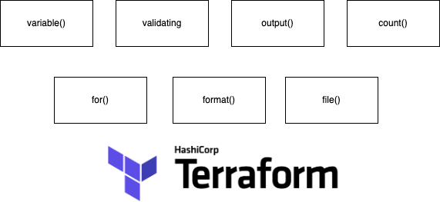
For this week, we will continue with functional programing in Terraform

Slide 4
Agenda
Variables in Terraform
Functions in Terraform
Demo: Creating Mad Libs story from template files in Terraform
Introduce template/2, element/2 functions.
Introduce count, for expressions
Introduce random_shuffle, local_file resources

Slide 5
variable()

Slide 6
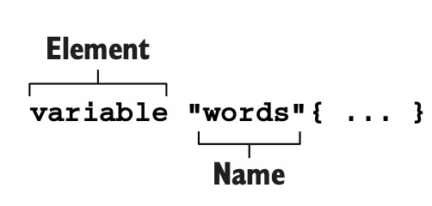
Input variables (or Terraform variables, or just variables) are user-supplied values that parametrize
Terraform modules without altering the source code.
Variables are declared with a variable block. The first label indicates the object Element type, which is variable, and the second is the variable’s name.
Notes:
Variables in Terraform are used to store and manage dynamic values in the configuration files. They make the infrastructure code flexible and reusable.
Variables can hold various types of data such as strings, numbers, lists, and maps. They allow customization and parameterization of the configuration, enabling the creation of multiple instances with different values.

Slide 7
Variable blocks accept four input arguments:
default—A preselected option to use when no alternative is available.
Leaving this argument blank means a variable is mandatory and must be explicitly set.
description—A string value providing helpful documentation to the user.
type—A type constraint to set for the variable. Types can be either primitive
(e.g. string, integer, bool) or complex (e.g. list, set, map, object, tuple).
validation—A nested block that can enforce custom validation rules.
Example:
variable "instance_type" {
type = string
description = "Instance type of the EC2"
validation {
condition = contains(["t2.micro", "t3.small"], var.instance_type)
error_message = "Value not allow."
}
}

Slide 8
Variable values can be accessed within a given module by using the expression var.<VARIABLE_NAME>.
Example:
variable "instance_count1" {
type = number
default = 1
}
variable "instance_count2" {
type = number
default = 2
}
resource "aws_instance" "web" {
ami = "ami-053b0d53c279acc90"
instance_type = "t3.micro"
count = sum([var.instance_count1, var.instance_count2])
tags = {
Name = ”Bao"
}
}

Slide 9
Terraform functions

Slide 10
Terraform functions are built-in, reusable code blocks that perform specific tasks
within Terraform configurations.
The general syntax for function calls is a function name followed
by comma-separated arguments in parentheses:
<function_name>(arg 1, arg 2).
The Terraform language does not support user-defined functions,
and so only the functions built-in to the language are available for use.
Example:
max(5, 12, 9)
12
List of build-in functions in Terraform: https://developer.hashicorp.com/terraform/language/functions
Notes:
Functions allow you to perform various operations, such as converting expressions to different data types, calculating lengths, and building complex variables.
These functions are split into multiple categories:

Slide 11
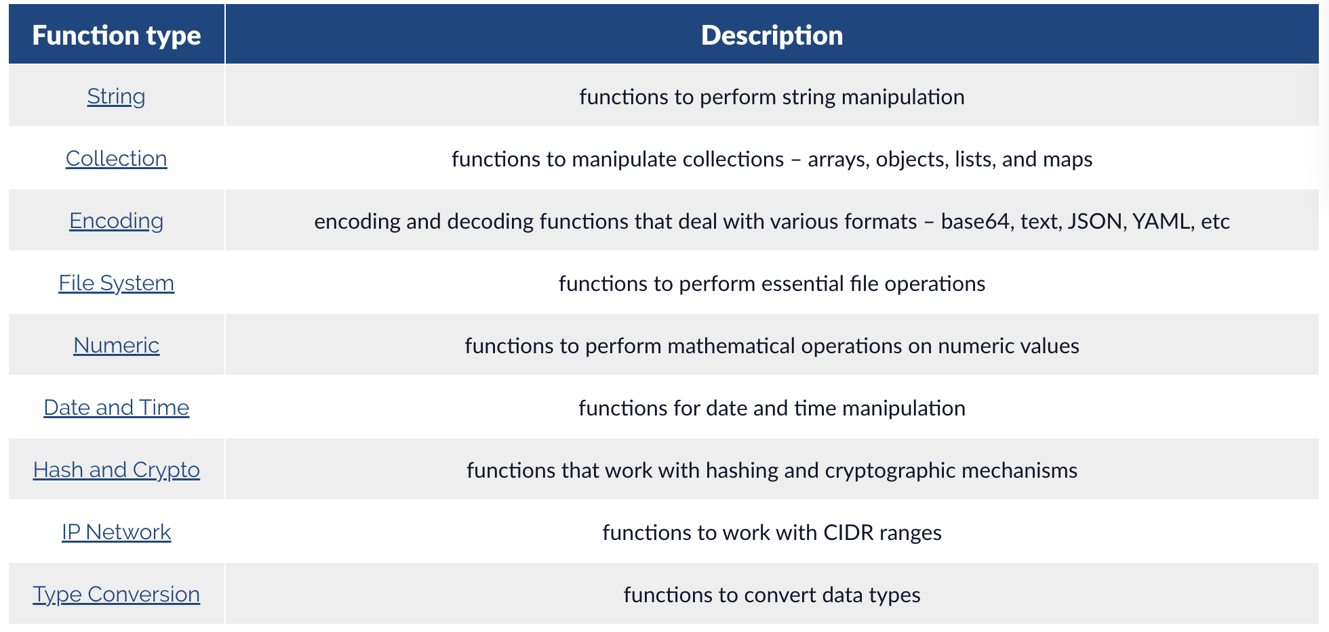
List of category of terraform Built-in Functions

Slide 12
Demo:
Generating Mad Libs paragraphs from template files.

Slide 13
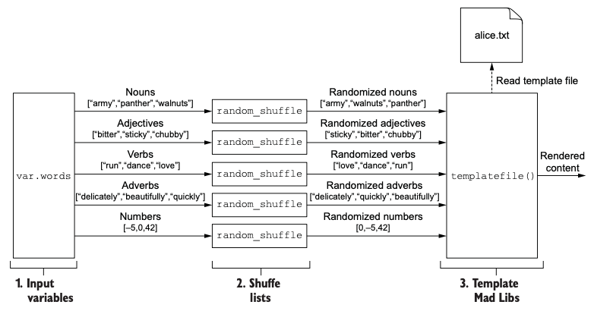
Mad Libs is a word game where one person asks another for words to fill in the blanks of a story template.
Example input: To make a pizza, you need to take a lump of <noun> and make a thin, round, <adjective> <noun>.
Example output:
To make a pizza, you need to take a lump of roses and make a thin, round, colorful ring.
Architecture diagram for what we’re about to do
Notes:
To begin, let's create a single Mad Libs story. To achieve this, we'll require a collection of randomized words to choose from and a template file. The final story will be displayed in the command line interface (CLI).resulting in a humorous or creative narrative.

Slide 14
Resources, blocks and fucntions we will use in the demo:
random_shuffle: Generates a random permutation of a list of strings given as an argument.
https://registry.terraform.io/providers/hashicorp/random/latest/docs/resources/shuffle
local_file: Generates a local file with the given content.
https://registry.terraform.io/providers/hashicorp/local/latest/docs/resources/file
templatefile(): This function reads the file located at the specified path and transforms its content into a template using a provided set of template variables.
https://developer.hashicorp.com/terraform/language/functions/templatefile
fileset(): This function lists the names of regular files based on a specified path and pattern.
https://developer.hashicorp.com/terraform/language/functions/fileset
element(): Retrieves a single element from a list.
https://developer.hashicorp.com/terraform/language/functions/element
locals{}: print output to local file
variable{}: declare new variable
output{}: print output to CLI
Notes:
When you change a list or tuple into a set, any duplicate values are removed, and the original order of elements is no longer preserved.
Converting a set back to a list or tuple will result in the elements being in a random order. If the elements in the set were strings, they will be arranged in lexicographical order. However, sets with elements of other types do not assure any specific order of elements.
count is what is known as a ‘meta-argument’ defined by the Terraform language. Meta-arguments help achieve certain requirements within the resource block.
For example, instead of defining three virtual machines all with their own separate resource blocks, you could define one and add the count = 3 ‘meta-argument’ into the resource block.

Slide 15
Create a new project workspace for your Terraform configuration, and make a new file called main.tf
terraform {
required_version = ">= 0.15"
}
variable "words" {
description = "A word pool to use for Mad Libs"
type = object({
nouns = list(string),
adjectives = list(string),
verbs = list(string),
adverbs = list(string),
numbers = list(number),
})
}
object({<ATTR NAME> = <TYPE>, ... })
Notes:
https://developer.hashicorp.com/terraform/language/functions/templatefile

Slide 16
Normally, variable values are defined within a different file, which is any file ending in either .tfvars or .tfvars.json
Create a new file in the workspace called terraform.tfvars, and add the following code:
words = {
nouns = ["army", "panther", "walnuts", "sandwich", "Zeus", "banana",
"cat", "jellyfish", "jigsaw", "violin", "milk", "sun"]
adjectives = ["bitter", "sticky", "thundering",
"abundant", "chubby", "grumpy"]
verbs = ["run", "dance", "love", "respect", "kicked", "baked"]
adverbs = ["delicately", "beautifully", "quickly",
"truthfully", "wearily"]
numbers = [42, 27, 101, 73, -5, 0]
}
Notes:
A variables definition file uses the same syntax as Terraform configuration code but consists exclusively of variable assignments.

Slide 17
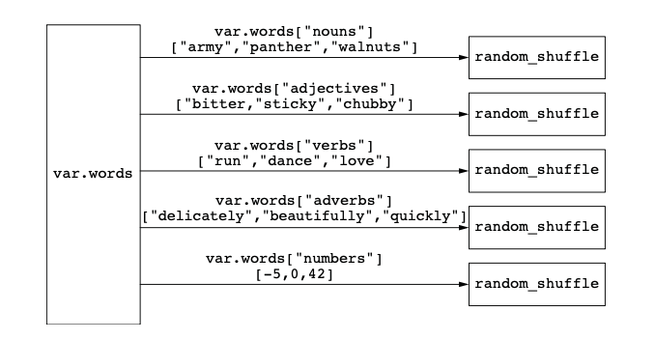
Now that we have words in our word pool, the next step is to shuffle them.
There a no function called shuffle() in Terraform.
There is a Resource name random_shuffle https://registry.terraform.io/providers/hashicorp/random/latest/docs/resources/shuffle
Since we have five lists, we need five random_shuffles. This is illustrated in the below figure:
Notes:
If we don’t shuffle the lists, the order will be fixed, which means exactly the same Mad Libs para- graph would be generated on each execution.

Slide 18
Next, we update the main.tf as below:
… resource "random_shuffle" "random_nouns" {
input = var.words["nouns"]
}
resource "random_shuffle" "random_adjectives" {
input = var.words["adjectives"]
}
resource "random_shuffle" "random_verbs" {
input = var.words["verbs"]
}
resource "random_shuffle" "random_adverbs" {
input = var.words["adverbs"]
}
resource "random_shuffle" "random_numbers" {
input = var.words["numbers"]
}
terraform {
required_version = ">= 0.15"
} variable "words" {
description = "A word pool to use for Mad Libs"
type = object({
nouns = list(string),
adjectives = list(string),
verbs = list(string),
adverbs = list(string),
numbers = list(number),
})} …

Slide 19
Creating a template file: alice.txt
ALICE'S UPSIDE-DOWN WORLD
Lewis Carroll's classic, "Alice's Adventures in Wonderland", as well
as its ${adjectives[0]} sequel, "Through the Looking ${nouns[0]}",
have enchanted both the young and old ${nouns[1]}s for the last
${numbers[0]} years, Alice's ${adjectives[1]} adventures begin
when she ${verbs[0]}s down a/an ${adjectives[2]} hole and lands
in a strange and topsy-turvy ${nouns[2]}. There she discovers she
can become a tall ${nouns[3]} or a small ${nouns[4]} simply by
nibbling on alternate sides of a magic ${nouns[5]}. In her travels
through Wonderland, Alice ${verbs[1]}s such remarkable
characters as the White ${nouns[6]}, the ${adjectives[3]} Hatter,
the Cheshire ${nouns[7]}, and even the Queen of ${nouns[8]}s.
Unfortunately, Alice's adventures come to a/an ${adjectives[4]}
end when Alice awakens from her ${nouns[8]}.
Notes:
We now have the variables pool and the configution file. What we need now is a template file.
Template syntax is the same as for interpolation values in the main Terraform language, which is anything enclosed in ${ ... } markers.
We’ll use the randomized list of words to replace placeholder values in a template file, rendering content for a new Mad Libs story.

Slide 20
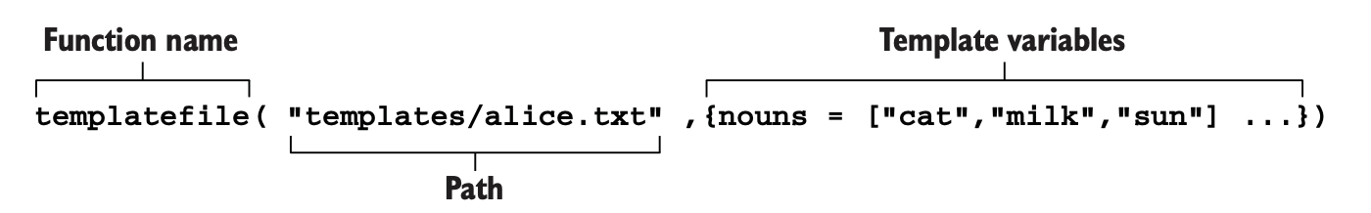
We will use the built-in templatefile()function inside the main.tf. templatefile()functions reads the file at the given path and renders its content as a
template using a supplied set of template variables.
templatefile(path, vars)
The "vars" argument must be an object.
Within the template file, each of the keys in the map is available as a variable for interpolation
https://developer.hashicorp.com/terraform/language/functions/templatefile
Notes:
We now have the variables pool and the configution file. What we need now is a template file.
Template syntax is the same as for interpolation values in the main Terraform language, which is anything enclosed in ${ ... } markers.
We’ll use the randomized list of words to replace placeholder values in a template file, rendering content for a new Mad Libs story.

Slide 21
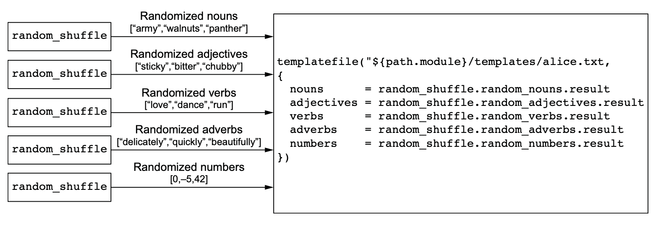
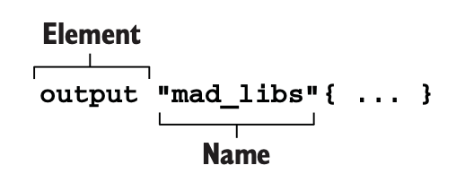
We’ll construct the map of template variables by aggregating together the lists of shuffled words
Now, we need to print the output for template/2 function. Terraform supports Output element to do that.
<Check the main.tf>
Notes:
We will build the map of template variables by combining the lists of shuffled words.
path.module is a reference to the filesystem path of the containing module.

Slide 22
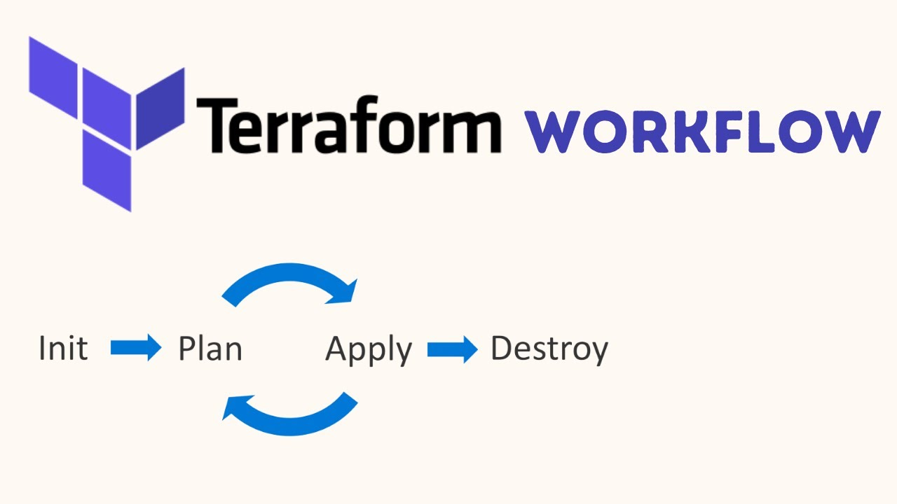
Let’s check our result by running init & apply commands

Slide 23
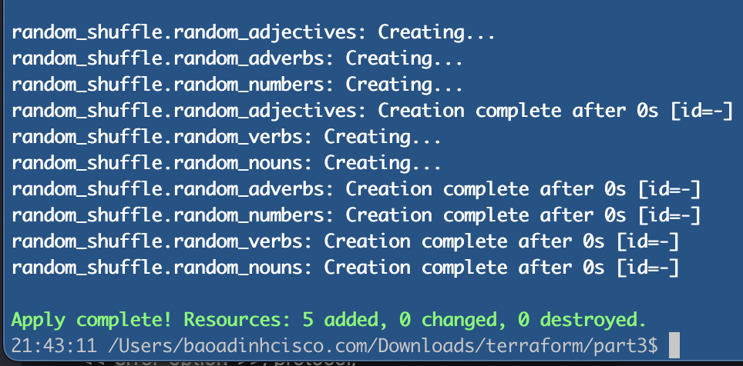
$ terraform init && terraform apply -auto-approve
(without output block)

Slide 24
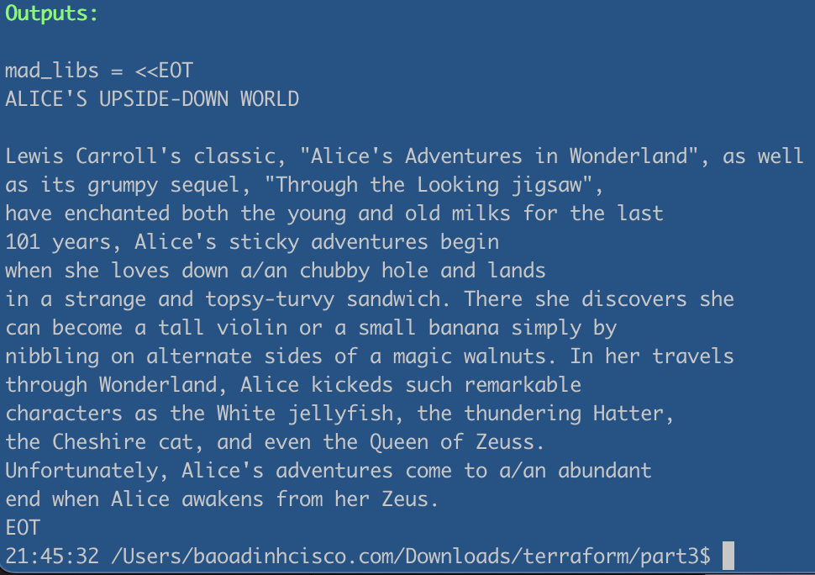
Uncomment the output block anf run apply again, we get the below result:

Slide 25
Let's increase the complexity of the Mad Libs by generating more than one Mad Lib at a time.

Slide 26
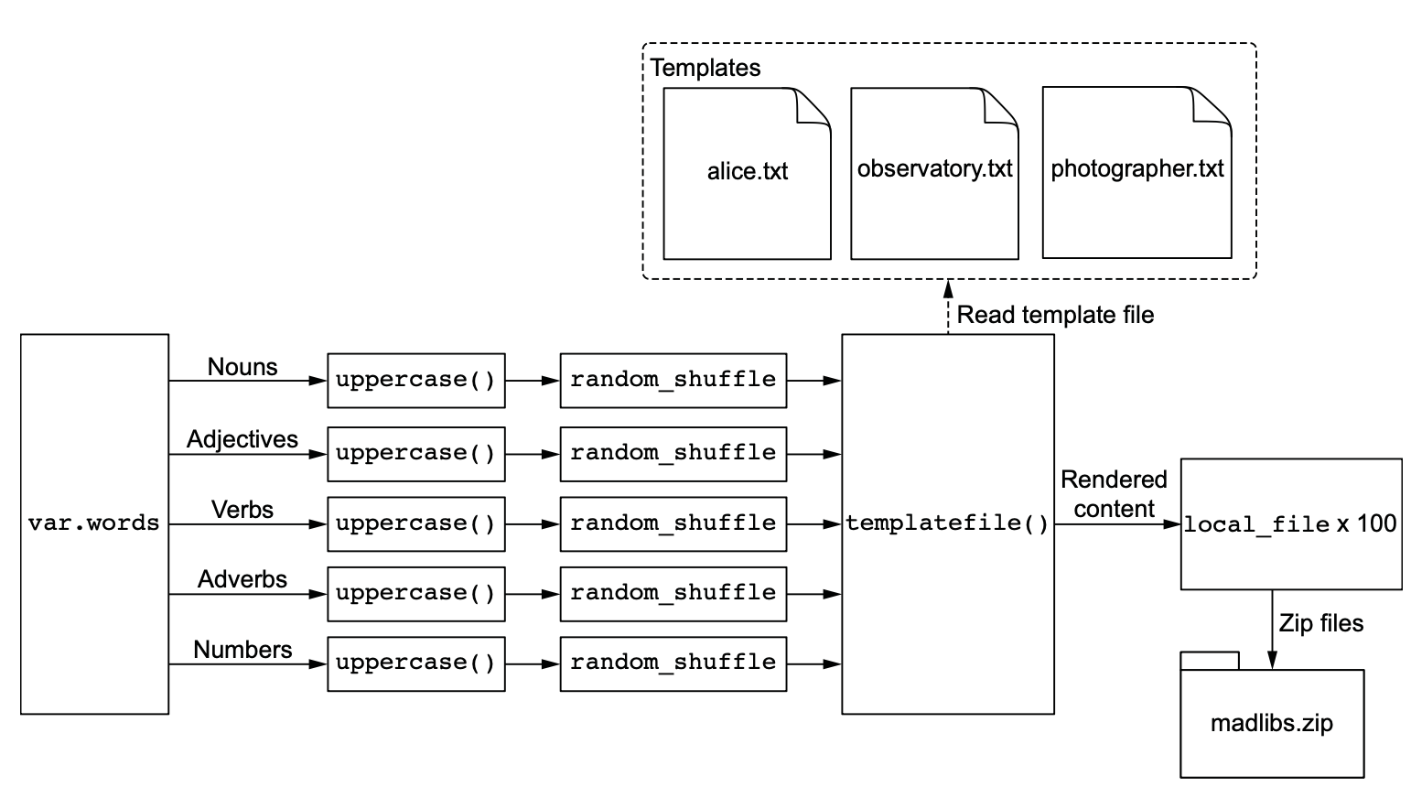

Here is the list of design changes:
- Create 100 Mad Libs paragraphs. - Use three template files (alice.txt, observatory.txt, and photographer.txt)
- Capitalize each word before shuffling.
- Save the Mad Libs paragraphs as text files.

Slide 27
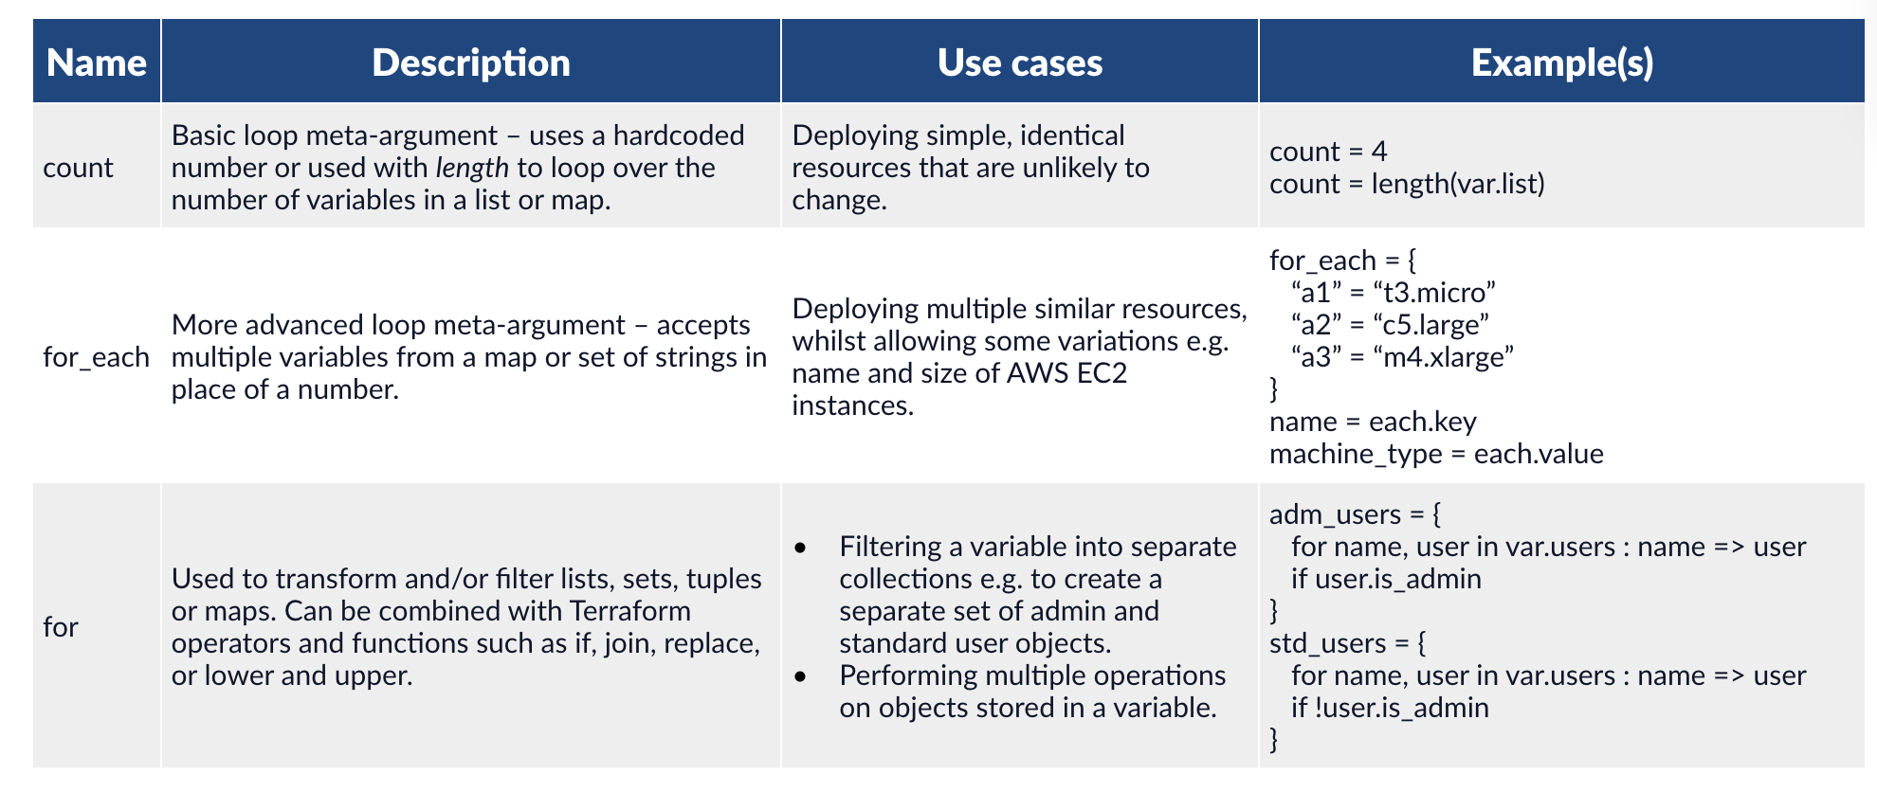
Before processing to the next step, I would like to show the summary of the three main looping
constructs found within the HashiCorp Configuration Language (HCL) used by Terraform.
Notes:
https://developer.hashicorp.com/terraform/language/meta-arguments/count
https://developer.hashicorp.com/terraform/language/meta-arguments/for_each
If the resources you are provisioning are identical or nearly identical, then count is a safe bet.
However, if elements of the resources change between the different instances, then for_each is
the way to go.
count is a meta-argument defined by the Terraform language. It can be used with modules and with every resource type.

Slide 28
When to use for_each instead of count
If the resources you are provisioning are identical or nearly identical, then count is a safe bet.
However, if elements of the resources change between the different instances, then for_each is
the way to go.
https://developer.hashicorp.com/terraform/language/meta-arguments/for_each
https://developer.hashicorp.com/terraform/language/meta-arguments/count

Slide 29
First, creating 2 new template files: observatory.txt and photographer.txt
THE OBSERVATORY
Out class when on a field trip to a ${adjectives[0]} observatory. It
was located on top of a ${nouns[0]}, and it looked like a giant
${nouns[1]} with a slit down its ${nouns[2]}. We went inside and
looked through a ${nouns[3]} and were able to see ${nouns[4]}s in
the sky that were millions of ${nouns[5]}s away. The men and
women who ${verbs[0]} in the observatory are called
${nouns[6]}s, and they are always watching for comets, eclipses,
and shooting ${nouns[7]}s. An eclipse occurs when a ${nouns[8]}
comes between the earth and the ${nouns[9]} and everything
gets ${adjectives[1]}. Next week, we place to ${verbs[1]} the
Museum of Modern ${nouns[10]}.

Slide 30
HOW TO BE A PHOTOGRAPHER
Many ${adjectives[0]} photographers make big money
photographing ${nouns[0]}s and beautiful ${nouns[1]}s. They sell
the prints to ${adjectives[1]} magazines or to agencies who use
them in ${nouns[2]} advertisements. To be a photographer, you
have to have a ${nouns[3]} camera. You also need an
${adjectives[2]} meter and filters and a special close-up
${nouns[4]}. Then you either hire professional ${nouns[1]}s or go
out and snap candid pictures of ordinary ${nouns[5]}s. But if you
want to have a career, you must study very ${adverbs[0]} for at
least ${numbers[0]} years.

Slide 31
Now we uppercase all string in var.words, it does make it easier to see templated words.
To do that we use a for expression.
https://developer.hashicorp.com/terraform/language/expressions/for
Example syntax of a for expression in Terraform:
uppercase_words = {for k, v in var.words : k => [for s in v : upper(s)]}
Explain: - Looping through each key-value pair in var.words and outputting a new map can be done
with the following expression:
{for k,v in var.words : k => v }
- The next expression uppercases each word in a list and outputs to a new list:
[for s in v : upper(s)]
Notes:
The brackets around a for expression determine the output type.
we used {}, then the result would be an object.
for s in ["cat","milk","sun"] : upper(s)

Slide 32
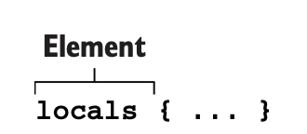
In Terraform, the result of an expression is assigned to a locals value.
Locals values assign a name to an expression, allowing it to be used multiple times without repetition.
Our main.tf now will be updated as the next slide

Slide 33
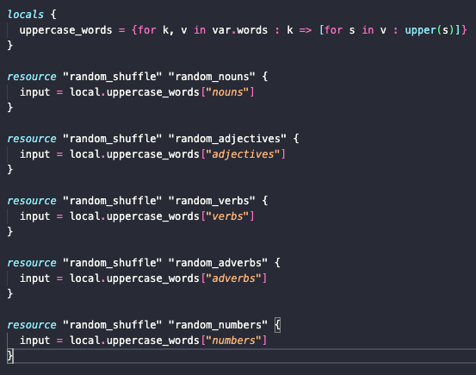

Slide 34
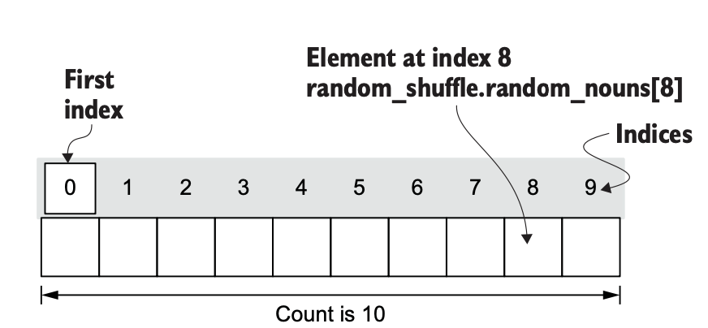
Next mission is to create 100 Mad Libs stories. To do that, we use Count
Let’s update our code to support producing an arbitrary number of Mad Libs stories.
First, add a new variable named var.num_files
Notes:
Count creates a list of resources that can be referenced using bracket notation.
Let’s update our code to support producing an arbitrary number of Mad Libs stories. First, add a new variable named var.num_files having type number and a default value of 100. Next, reference this variable to dynamically set the count meta argu- ment on each of the shuffle_resources. Your code will look like the next listing.

Slide 35
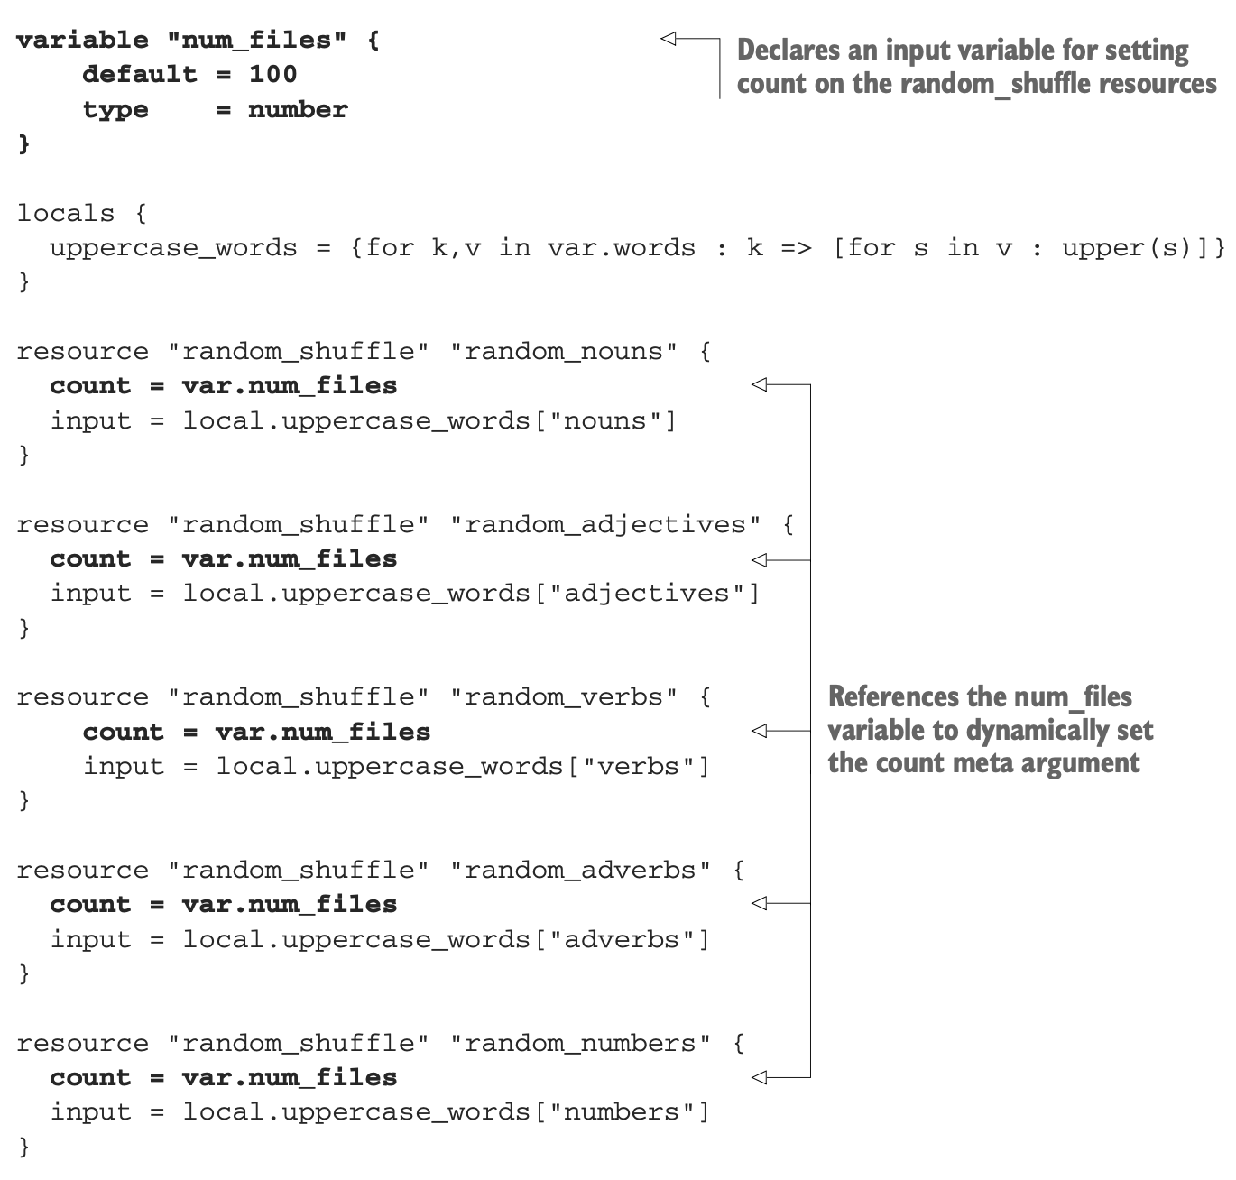

Slide 36
Instead of outputting to the CLI, we’ll save the results to disk with a local_file resource.
Because we have 100 stories, it’s very hard for us to read the output on CLI. Then, we will have 100 stories files.
First, we read all the template text files into a list. This is possible with the built-in fileset()function:
locals {
templates = tolist(fileset(path.module, "*.txt"))
}
Example output: > fileset(path.module, "files/*.txt") [ "files/hello.txt", "files/world.txt" ]
After compiling the list of template files, we can input the outcome into the local_file resource.

Slide 37
resource "local_file" "mad_libs" {
count = var.num_files
filename = ”main/madlibs-${count.index}.txt"
content = templatefile(element(local.templates, count.index),
{
nouns = random_shuffle.random_nouns[count.index].result
adjectives = random_shuffle.random_adjectives[count.index].result
verbs = random_shuffle.random_verbs[count.index].result
adverbs = random_shuffle.random_adverbs[count.index].result
numbers = random_shuffle.random_numbers[count.index].result
}
)}
Note:
For element/2 function: If the index you're given is bigger than how long the list is,
we kind of start over by dividing the index by the length of the list and using the remainder as the new index.
> element(["a", "b", "c"], 4)
b
Notes:
https://developer.hashicorp.com/terraform/language/functions/element
I'd like to highlight two important concepts: element() and count.index. The element() element retrieves a single element from a list.
on the main.tf file, the count.index variable is used. This represents the index number of the current count loop. The count index starts at 0 and increments by 1 for each resource. You include the count index variable in strings using interpolation. If you don’t want to start the count at 0 you can start at another value by incrementing the value, e.g. to Increment the count by three:
count.index + 3
https://developer.hashicorp.com/terraform/language/meta-arguments/count#count-index

Slide 38
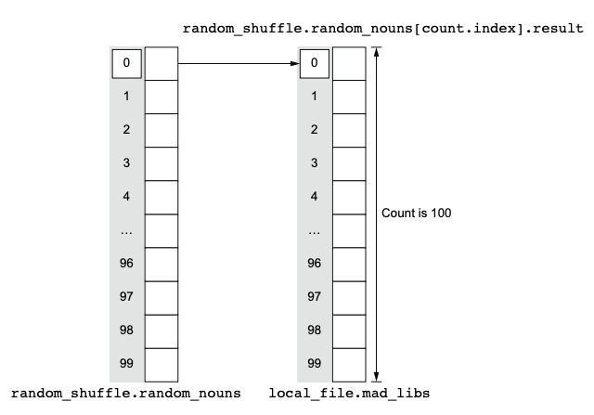
The count.index expression references the current index of a resource.
We use it to parameterize filenames and ensure that templatefile()
receives template variables from corresponding random_shuffle resources.

Slide 39
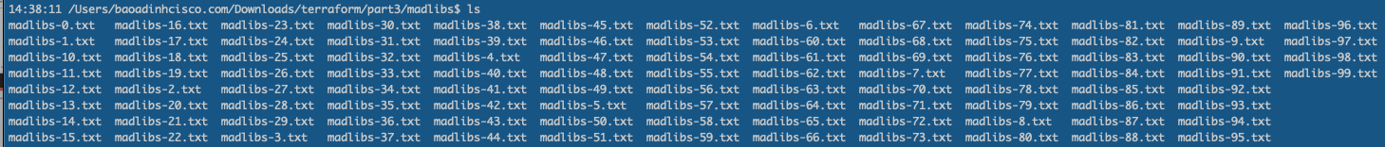
Everything is ready now, let’s run init and apply to get our stories.
<Check tree command to see the different after applying>
Finally, don’t forget to clean up by using terraform destroy ☺
Notes:
Because the output is quite big so I don’t put it here.

Slide 40

Summary
The focus of this chapter was on functions, expressions, and templates.
We started by comparing input variables, local values, and output values to the arguments, temporary symbols, and return values of a function. We then saw how we can template files using templatefile().
Next, we saw how to scale up to an arbitrary number of Mad Libs stories by using for expressions and count.
for expressions allow you to create higher-order functions with lambda-like syntax.
This is especially useful for transforming complex data before configuring resource attributes.
Input variables parameterize Terraform configurations.
Local values save the results of an expression.
Output values pass data around, either back to the user or to other modules.
The count meta argument can dynamically provision multiple instances of a resource. To access an instance of a resource created with count, use bracket notation [].

Slide 41
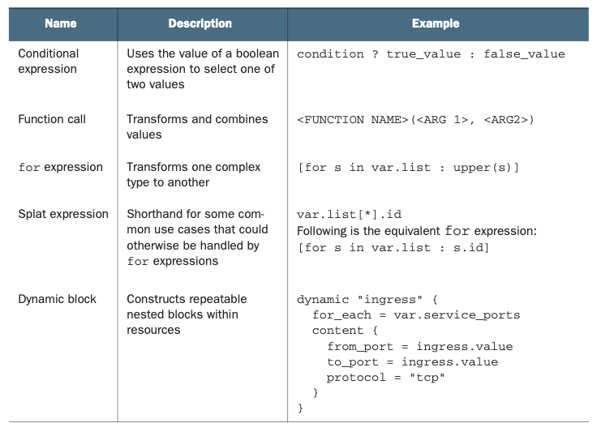
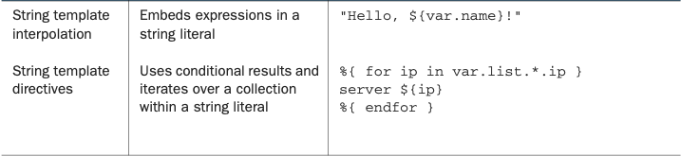
Expression reference

Slide 42


Slide 43
Chapter 4
Deploying a multi-tiered web application in AWS with Terraform
Setting project variables in variables definition files
Organizing code with nested modules
Using modules from the Terraform Registry
Passing data between modules using input variables and output values

Slide 44

Q&A
Notes:
https://someguys.blog/posts/2017-04-26-recovering-terraform-state/
https://medium.com/version-1/recovering-from-a-deleted-terraform-state-file-5e030c88aae0

