Slide 1


Infrastructure as Code with
Terraform
9/2023

Slide 2
What we have done in last meeting
Variables in Terraform
Functions in Terraform
Demo: Creating Mad Libs story from template files in Terraform
Introduce template/2, element/2 functions.
Introduce count, for expressions
Introduce random_shuffle, local_file resources

Slide 3
What we will have in the 4th part:
Host a static website with S3 – 1st meeting
Create AWS Virtual Private Cloud with Terraform Module – 2nd meeting
Deploying a Multi-Tier Web Application – 3rd

Slide 4
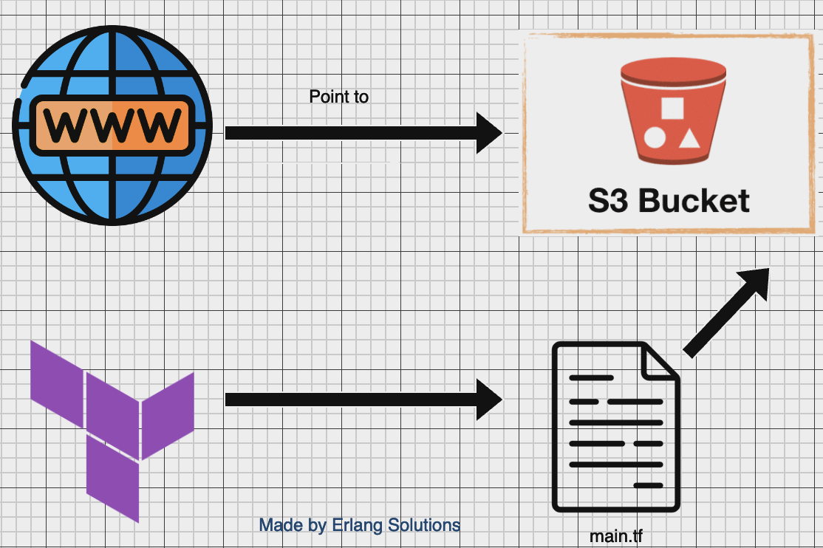
Hosting a Static Website on AWS S3 using Terraform
Part1

Slide 5
Steps to host static website on S3 using Terraform:
Create content for our static website
Setting up Terraform and AWS resources: policy, website configuration, provider, …
Setting the output for our website’s domain in terminal
Lastly, access the hosted static website.

Slide 6
Define content of the website

Slide 7
Let's start with the resources that you want to host. For this demo, we will create an index.html and style.css inside a directory called content
<!DOCTYPE html> <html lang="en"> <head> <meta charset="UTF-8">
<title></title>
<link rel="stylesheet" href="style.css">
</head>
<body>
Hello!
</body>
</html>
body { color: green; }
Notes:
Create a directory called content, where we will put all the files that our static website consists of. The first of those files will be index.html
As you can see, this is a very limited example: it just displays a "Hello!" message. It also links a stylesheet, so let's create a file called style.css
This stylesheet changes the color of the font to green, but it also serves another purpose: to prove that multiple files can be uploaded automatically by Terraform and linked between each other.

Slide 8
A typical website consists of multiple static files (in this demo two), and those files can be added
or removed frequently.
Taking that into account, this template will automatically upload to S3 everything from the content directory. However, by default AWS will set the content type of each file in S3 to binary/octet-stream. To fix this, let's define content types for different resources (HTML, CSS, JavaScript). Create a file called locals.tf. It will used later, to set the content type in S3 based on each file’s extension. locals {
content_types = {
".html" : "text/html",
".css" : "text/css",
".js" : "text/javascript"
}
}
Notes:
octet-stream is a binary file, you will need an application to properly read and open it - you won’t be able to see it in the body of an email, website.
If you attempt to download a file with a missing extension or an unknown format, your system will recognize it as an octet-stream file. Any type of file or program can appear on an octet-stream.
It’s mean, if octet-stream is present, the result in web browsers trying to download the files, instead of displaying them as a website.

Slide 9
Configuring Terraform and AWS resources

Slide 10
Create a file name config.tf:
terraform {
required_version = ">= 1.2"}
provider "aws" {
region = "eu-west-2"
}
Terraform setting: https://developer.hashicorp.com/terraform/language/settings
Provider AWS: https://registry.terraform.io/providers/hashicorp/aws/latest/docs
Notes:
My Terraform version is 1.5.7.

Slide 11
Let's now proceed with actual AWS resources, which will be configured in a file called main.tf.
The first resource is an S3 bucket:
resource "aws_s3_bucket" "bucket" {
bucket = ”bao-test-website"
}
This is the only place where we need to define the name of the bucket.
All other AWS resources will refer to it by using aws_s3_bucket.bucket.id
Reference link: https://registry.terraform.io/providers/hashicorp/aws/latest/docs/resources/s3_bucket

Slide 12
The next thing to configure is a bucket policy.
resource "aws_s3_bucket_policy" "bucket_policy" {
bucket = aws_s3_bucket.bucket.id
policy = jsonencode(
{
"Version" : "2012-10-17",
"Statement" : [
{
"Sid" : "PublicReadGetObject",
"Effect" : "Allow",
"Principal" : "*",
"Action" : "s3:GetObject",
"Resource" : "arn:aws:s3:::${aws_s3_bucket.bucket.id}/*"
}
]
}
)}
Reference resources: https://developer.hashicorp.com/terraform/tutorials/applications/cloudflare-static-website https://docs.aws.amazon.com/AmazonS3/latest/userguide/example-bucket-policies.html https://registry.terraform.io/providers/hashicorp/aws/latest/docs/resources/s3_bucket_policy https://docs.aws.amazon.com/IAM/latest/UserGuide/reference-arns.html
Notes:
Without this policy, S3 files will not be publicly available.
In this step, we will create an S3 bucket policy that allows anyone to retrieve objects from the bucket.
We’re using the aws_s3_bucket_policy resource to create the policy for our static website
The policy here specifies a single statement that allows anyone (* principal) to retrieve objects (s3:GetObject action) from the bucket. The Resource attribute specifies the ARN of the static website bucket and uses interpolation to reference the bucket's ID. Amazon Resource Names (ARNs) uniquely identify AWS resources. https://docs.aws.amazon.com/IAM/latest/UserGuide/reference-arns.html

Slide 13
Each file from the content directory will be uploaded as an S3 object (We have 2 files)
resource "aws_s3_object" "file" {
for_each = fileset(path.module, "content/**/*.{html,css,js}")
bucket = aws_s3_bucket.bucket.id
key = replace(each.value, "/^content//", "")
source = each.value
content_type = lookup(local.content_types, regex("\\.[^.]+$", each.value), null)
etag = filemd5(each.value)
}
for_each instruction to loop over all the files in the content directory, creating one aws_s3_object per file.
replace(each.value, "/^content//", "") to remove the prefix from each file's path.
That way S3 will reflect the actual content of our local directory.
To extract the extension from each file, regex("\\.[^.]+$", each.value) is used.
Reference: https://registry.terraform.io/providers/hashicorp/aws/latest/docs/data-sources/s3_object
Notes:
The S3 object data source allows access to the metadata and content of an object stored inside S3 bucket.
To set the content_type value correctly, our template uses the mapping defined earlier in locals.tf.
For each: Only .html, .css, and .js extensions are taken into account, because only they have a content type mapping defined in locals.tf. You can expand the list of content types by e.g. images, if you want to include them in your website. Replace: Uploading the files with their original paths would result in a content directory being created in our S3 bucket.

Slide 14
To actually host the files as a website, let's create a website configuration resource:
resource "aws_s3_bucket_website_configuration" "hosting" {
bucket = aws_s3_bucket.bucket.id
index_document {
suffix = "index.html"
}
}
This configuration is sufficient to host your website publicly.
Reference links: https://registry.terraform.io/providers/hashicorp/aws/latest/docs/resources/s3_bucket_website_configuration
Notes:
This policy allows anyone to view your static website.

Slide 15
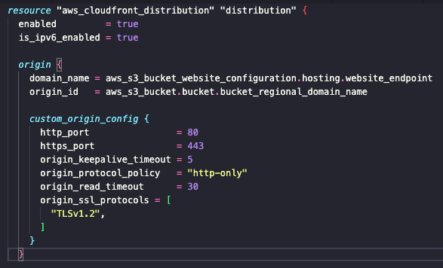
S3 is only capable of hosting files via HTTP.
To enable HTTPS, one more resource is necessary, so let's configure a CloudFront distribution:
This configuration will redirect all HTTP traffic to HTTPS, and will work for most HTTP request methods.
Reference resources: https://docs.aws.amazon.com/AmazonCloudFront/latest/DeveloperGuide/Introduction.html#HowCloudFrontWorksOverview
https://registry.terraform.io/providers/hashicorp/aws/latest/docs/resources/cloudfront_distribution
Notes:
Amazon CloudFront is a web service that speeds up distribution of your static and dynamic web content, such as .html, .css, .js, and image files, to your users.
I'd like to point out that, instead of defining a new cache policy, this template uses one of the managed policies: CachingOptimized, with the ID of 658327ea-f89d-4fab-a63d-7e88639e58f6. This is just one of the policies provided by AWS, you can use a different one if it is better for your needs.

Slide 16
Setting up the output for website domain in terminal

Slide 17
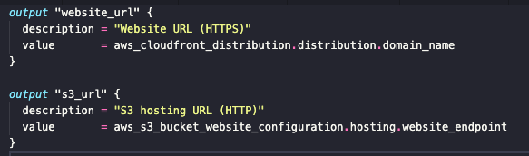
Terraform is ready now, but to find out where our website is hosted,
we still need to open the AWS console and investigate your newly created resources.
To show the address of your website in the terminal, let's create a file called outputs.tf
It will give you access to two values: the HTTPS domain created by CloudFront,
and the HTTP address that is provided by S3.
Reference links: https://developer.hashicorp.com/terraform/language/values/outputs

Slide 18
Time to Init and Apply everything ☺

Slide 19
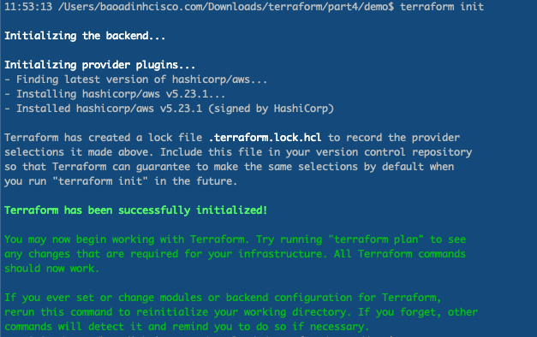

Slide 20
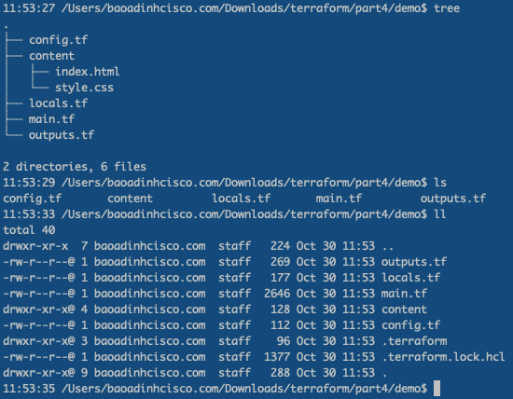

Slide 21
We may get the below error when running terrafoprm apply
It is because the security for S3 has changed There are some ways to resolve the Error:
https://docs.aws.amazon.com/AmazonS3/latest/userguide/troubleshoot-403-errors.html
I would like to share 2 common ways:
Configure the "aws_s3_bucket_public_access_block”
Unset Block public setting on AWS console.

Slide 22
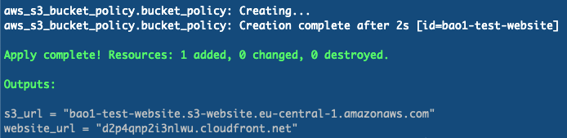
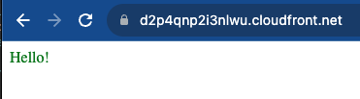
After running terraform apply successful
Click on the output links to access out website.

Slide 23

Clean up

Slide 24
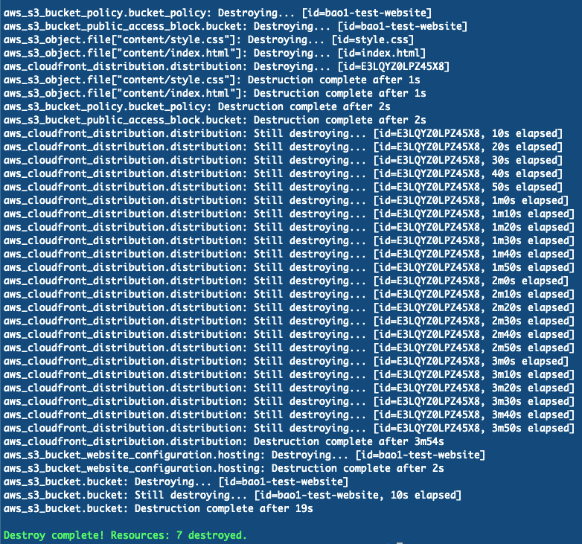
Because AWS resources usually cost money, we might want to remove them after we’re done
with testing. To do that, use the terraform destroy command and confirm with "yes"

Slide 25


Slide 26
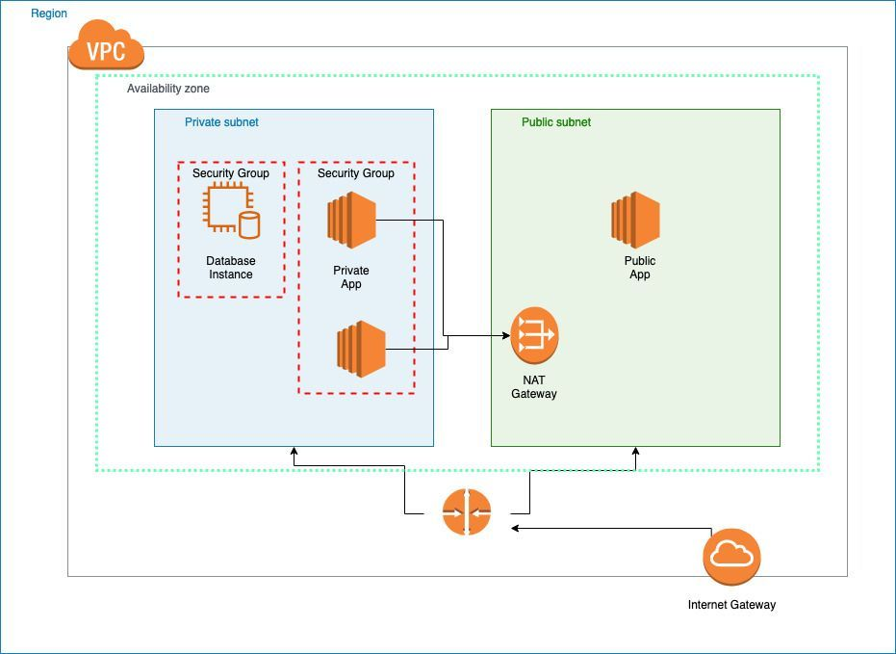
What’s next on part 2?
Create AWS Virtual Private Cloud with Terraform Module

Slide 27

Q&A
Notes:
https://someguys.blog/posts/2017-04-26-recovering-terraform-state/
https://medium.com/version-1/recovering-from-a-deleted-terraform-state-file-5e030c88aae0

