Slide 1
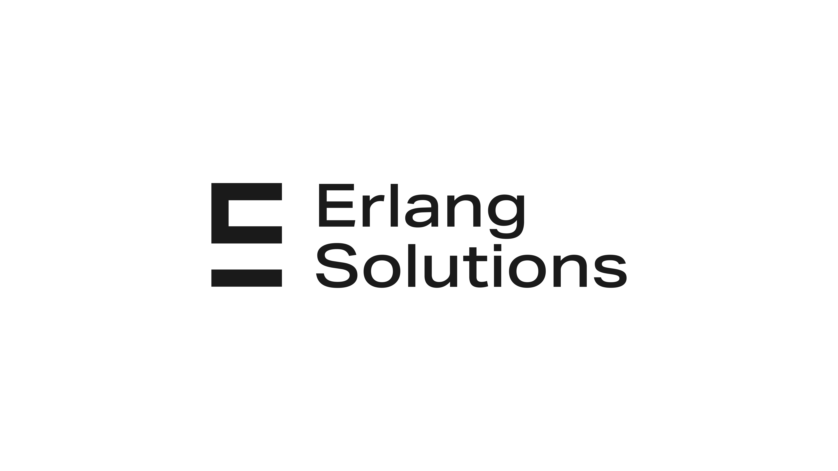
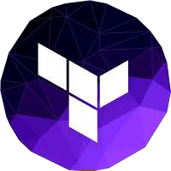
Infrastructure as Code with
Terraform
9/2023

Slide 2

What is Infrastructure as Code (IaC)
What is Terraform? Why use Terraform?
How does Terraform work?
Terraform VS similar technologies
Getting started with Terraform - Demo
Q&A
What’s next?

Slide 3

Let’s talk about: Infrastructure as Code (IaC)
Notes:
In the past, software delivery would follow this sort of pattern: - A System Administrator would setup up a physical server and install the operating system, patch the machine and install all the necessary software to run your application - Then a Database Administrator basically do the same - And you repeat the operation for the test and production environment - The developer would deliver the code by copying it to the test machine, Once the new code had gone through the entire test procedure on the test machine, you can deploy it in production right ?. Do you thnk this worked 100% of the time ?

Slide 4
- Infrastructure as code (IaC) is the process of managing and provisioning infrastructure through machine readable definition files. - We use IaC to automate processes that used to be done manually. - CM tools favor mutable infrastructure, whereas Terraform and other provisioning tools favor immutable infrastructure
Notes:
Infrastructure refers primarily to cloud-based infrastructure, although anything that could be controlled through an application programming interface (API) technically qualifies as infrastructure. Infrastructure as code is the process of managing and provisioning infrastructure through machine- readable definition files. We use IaC to automate processes that used to be done manually.
Provisioning is the process of creating and setting up IT infrastructure, and includes the steps required to manage user and system access to various resources. Provisioning is an early stage in the deployment of servers, applications, network components, storage, edge devices, and more.
Provisioning is not the same thing as configuration management, but they are both steps in the deployment process. Once a system has been provisioned, the next step is to configure the system and maintain it consistently over time.
Configuration management is a process for maintaining computer systems, servers, applications, network devices, and other IT components in a desired state. It’s a way to help ensure that a system performs as expected, even after many changes are made over timetions, network components, storage, edge devices, and more. Configuration management (CM) tools like Ansible, Puppet, SaltStack, and Chef
Infrastructure as Code (IaC) is the managing and provisioning of infrastructure through code instead of through manual processes.
With IaC, configuration files are created that contain your infrastructure specifications, which makes it easier to edit and distribute configurations. It also ensures that you provision the same environment every time.
Terraform is an infrastructure provisioning tool, not a CM tool. Provisioning tools deploy and manage infrastructure, whereas CM tools like Ansible, Puppet, SaltStack, and Chef deploy software onto existing servers. Some CM tools can also perform a degree of infrastructure provisioning, but not as well as Terraform, because this isn’t the task they were originally designed to do.
2. CM tools favor mutable infrastructure, whereas Terraform and other provisioning tools favor immutable infrastructure.
Mutable infrastructure means you perform software updates on existing servers. Immutable infrastructure, by contrast, doesn’t care about existing servers—it treats infrastructure as a disposable commodity. The difference between the two paradigms can be summarized as a reusable versus disposable mentality.

Slide 5
Key Benefits of IaC
- Provisioning tool—Deploys infrastructure, not just applications.
- Easy to use—For all of us non-geniuses.
- Cloud-agnostic—Deploy to any cloud using the same tool.
- Free and open source—Who doesn’t like free?
- Declarative—Say what you want, not how to do it.
- Expressive and extendable—You aren’t limited by the language.
Notes:
Terraform is an infrastructure provisioning tool, not a CM tool. Provisioning tools deploy and manage infrastructure, whereas CM tools like Ansible, Puppet, SaltStack, and Chef deploy software onto existing servers.
The basics of Terraform are quick and easy to learn, even for non-programmers.
A declarative approach defines the desired state of the system, including what resources you need and any properties they should have, and an IaC tool will configure it for you.
A declarative approach also keeps a list of the current state of your system objects, which makes taking down the infrastructure simpler to manage.
An imperative approach instead defines the specific commands needed to achieve the desired configuration, and those commands then need to be executed in the correct order.
Cloud-agnostic means being able to seamlessly run on any cloud platform using the same set of tools and workflows. Terraform is cloud-agnostic because you can deploy infrastructure to AWS just as easily as you could to GCP, Azure, or even a private data- center
With conditionals, for expressions, directives, template files, dynamic blocks, variables, and many built-in functions, it’s easy to write code to do exactly what you want.

Slide 6
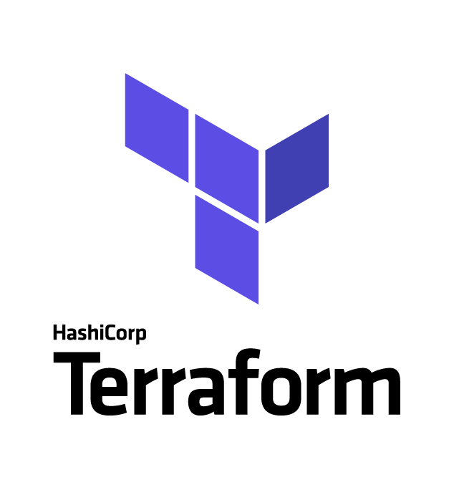
What’s Terraform?
Notes:
In the past, software delivery would follow this sort of pattern: - A System Administrator would setup up a physical server and install the operating system, patch the machine and install all the necessary software to run your application - Then a Database Administrator basically do the same - And you repeat the operation for the test and production environment - The developer would deliver the code by copying it to the test machine, Once the new code had gone through the entire test procedure on the test machine, you can deploy it in production right ?. Do you thnk this worked 100% of the time ?

Slide 7
Terraform is an IaC tool The provisioning of cloud resources, for instance, is one of the main use cases of Terraform. It’s a cloud-agnostic, open-source provisioning tool written in the Go language and created by HashiCorp.
Notes:
Terraform is a deployment technology for anyone who wants to provision and manage their infrastructure as code (IaC). Terraform is used to create, manage, and update infrastructure resources such as virtual networks, VMs, security rules, containers, domains and more. Almost any infrastructure type can be represented as a resource in Terraform.
Terraform supports more than just cloud providers. In total, terraform supports natively 130 different providers (as of Sep.2023).
HashiCorp Terraform now supports more than 3,000 integrations with more than 250 partners, including Amazon Web Services (AWS), Microsoft Azure, Google Cloud, Confluent, Datadog, MongoDB, Palo Alto Networks, ServiceNow, and Zscaler.
Terraform allows you to describe your complete infrastructure in the form of code. Even if your servers come from different providers such as AWS or Azure, Terraform helps you build and manage these resources in parallel across providers.

Slide 8

Why use Terraform?

Slide 9
- open source - Terraform can manage infrastructure on multiple cloud platforms - This simplifies management and orchestration for large-scale, multi-cloud infrastructures. - The human-readable configuration language helps you write infrastructure code quickly. - Terraform's state allows you to track resource changes throughout your deployments.

Slide 10
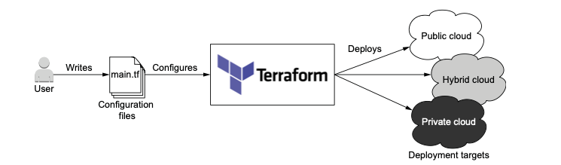
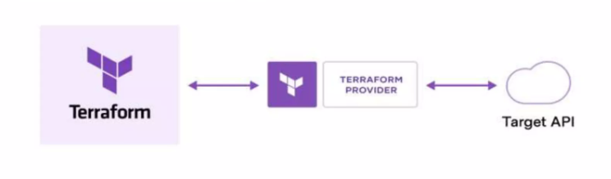
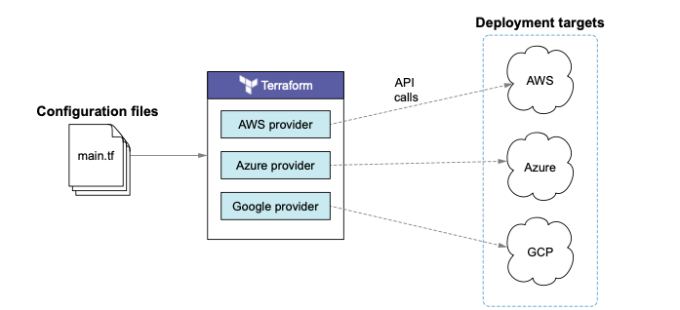
How does Terraform work?
Terraform creates and manages resources on cloud platforms and other services through their application programming interfaces (APIs).
Providers enable Terraform to work with virtually any platform or service with an accessible API
Notes:
Terraform creates and manages resources on cloud platforms and other services through their application programming interfaces (APIs). Providers enable Terraform to work with virtually any platform or service with an accessible API.
HashiCorp and the Terraform community have already written thousands of providers to manage many different types of resources and services. You can find all publicly available providers on the Terraform Registry, including Amazon Web Services (AWS), Azure, Google Cloud Platform (GCP), Kubernetes, Helm, GitHub, Splunk, DataDog, and many more. (https://registry.terraform.io/)

Slide 11
How does Terraform work?
Write: You define resources, which may be across multiple cloud providers and services. For example, you might create a configuration to deploy an application on virtual machine in a Virtual Private Cloud (VPC) network with security groups and a load balancer.
Plan: Terraform creates an execution plan describing the infrastructure it will create, update, or destroy based on the existing infrastructure and your configuration
Apply: On approval, Terraform performs the proposed operations in the correct order, respecting any resource dependencies. For Exam
Notes:
The core Terraform workflow consists of three stages:
Write: You define resources, which may be across multiple cloud providers and services. For example, you might create a configuration to deploy an application on virtual machines in a Virtual Private Cloud (VPC) network with security groups and a load balancer.
Plan: Terraform creates an execution plan describing the infrastructure it will create, update, or destroy based on the existing infrastructure and your configuration.
Apply: On approval, Terraform performs the proposed operations in the correct order, respecting any resource dependencies. For example, if you update the properties of a VPC and change the number of virtual machines in that VPC, Terraform will recreate the VPC before scaling the virtual machines.

Slide 12
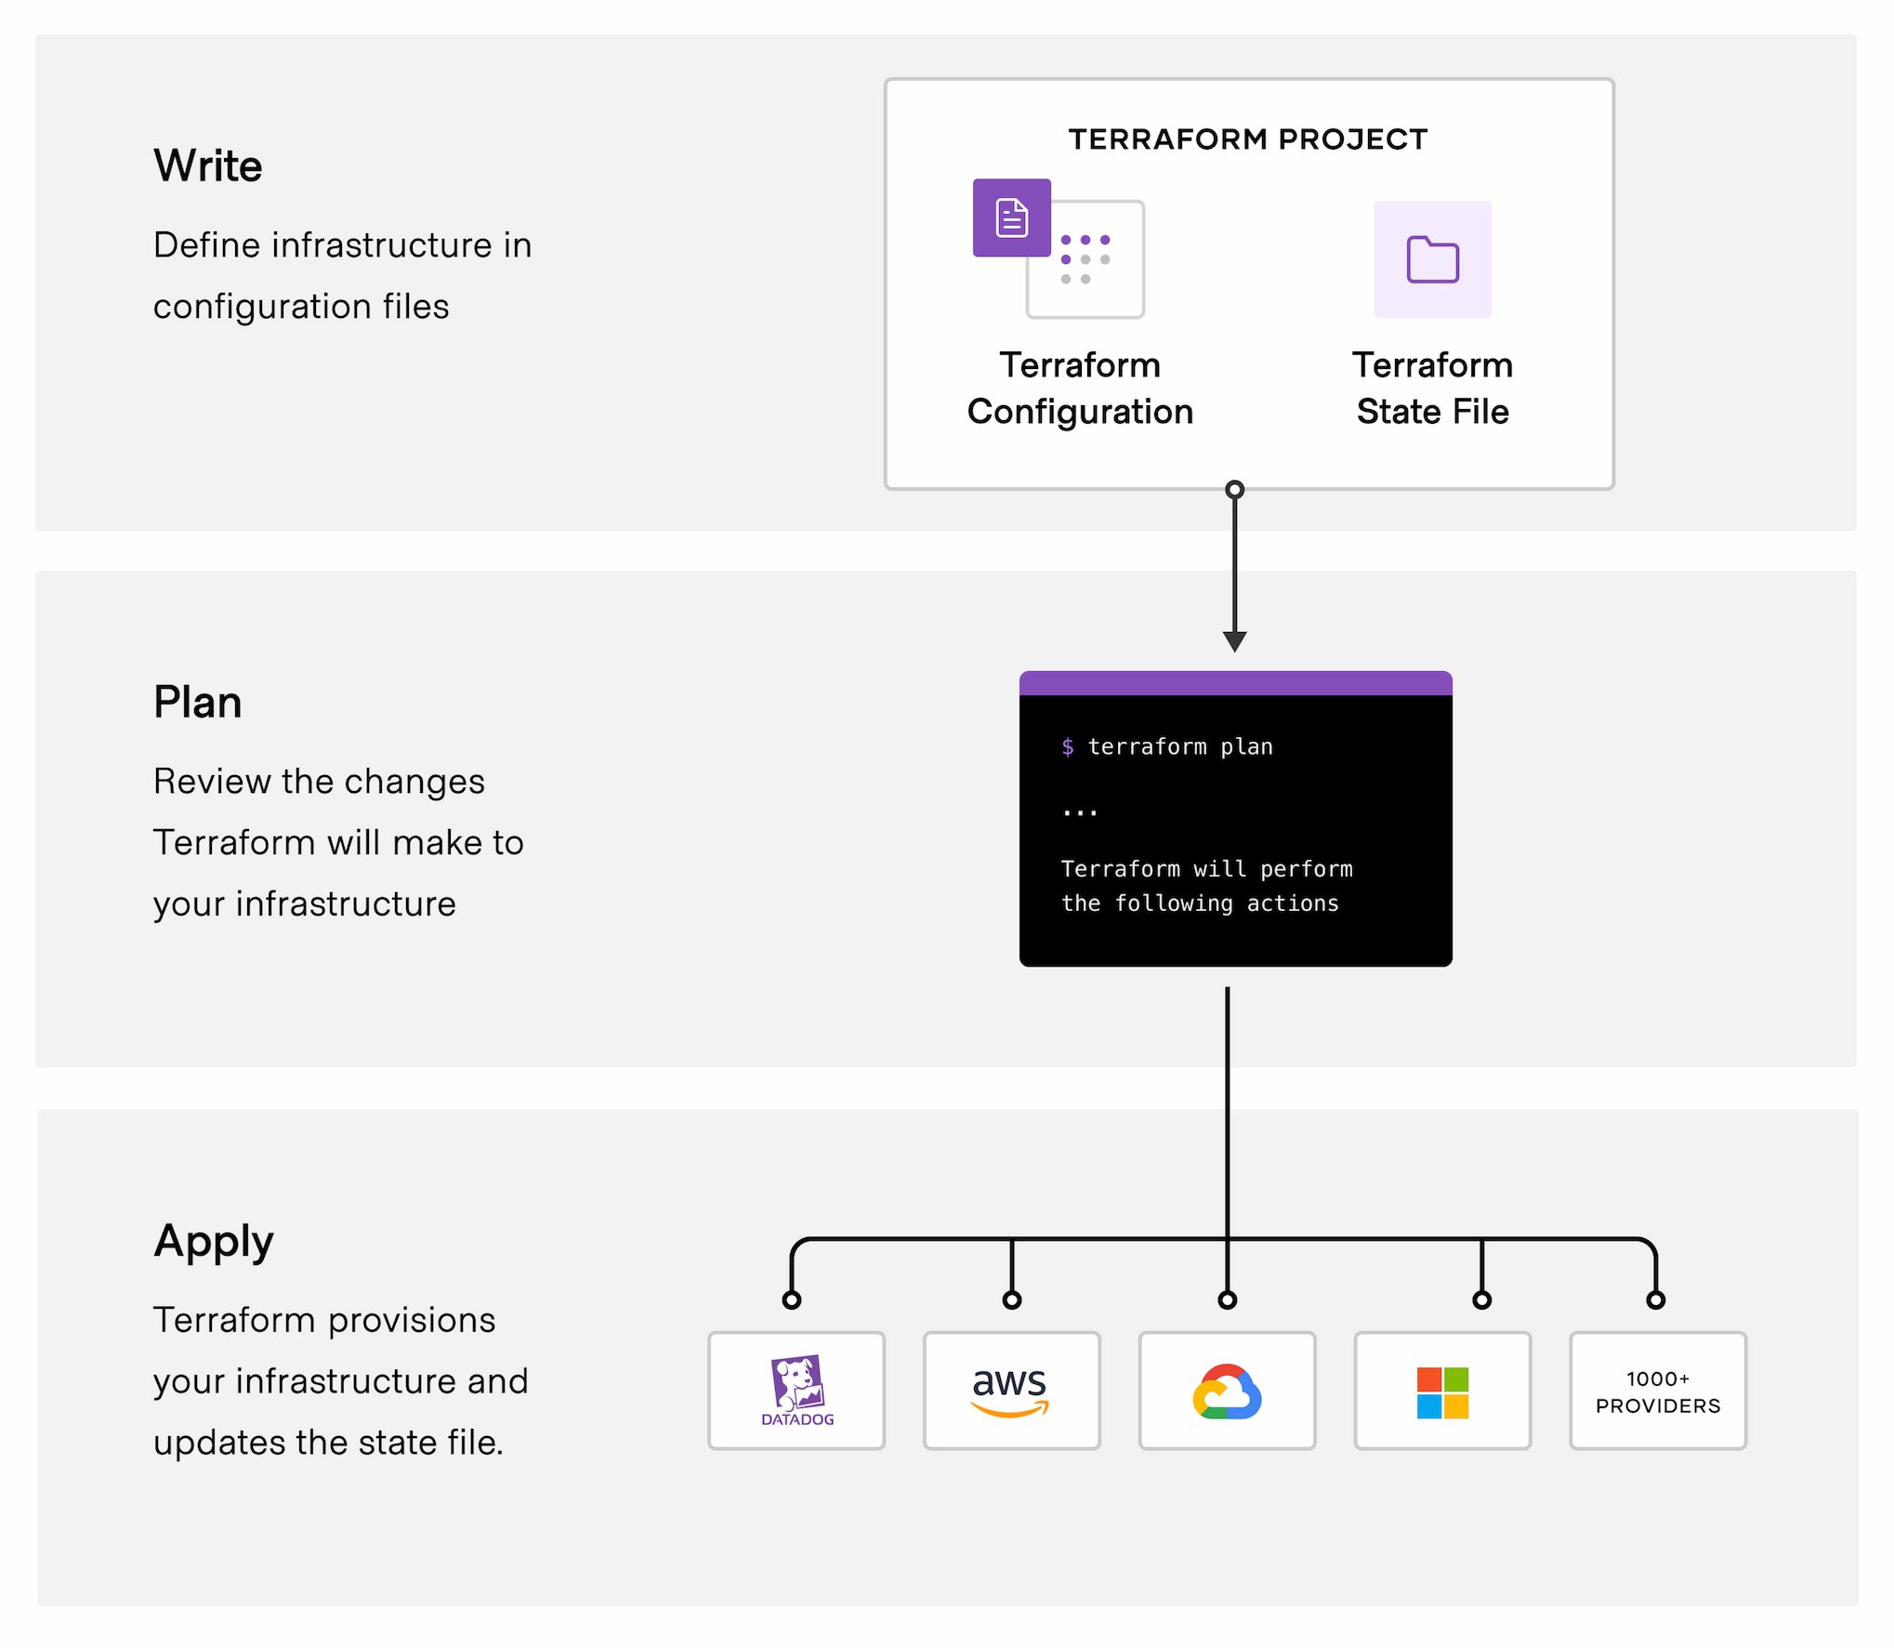
Terraform Workflow
Notes:
The core Terraform workflow consists of three stages:
Write: You define resources, which may be across multiple cloud providers and services. For example, you might create a configuration to deploy an application on virtual machines in a Virtual Private Cloud (VPC) network with security groups and a load balancer.
Plan: Terraform creates an execution plan describing the infrastructure it will create, update, or destroy based on the existing infrastructure and your configuration.
Apply: On approval, Terraform performs the proposed operations in the correct order, respecting any resource dependencies. For example, if you update the properties of a VPC and change the number of virtual machines in that VPC, Terraform will recreate the VPC before scaling the virtual machines.

Slide 13
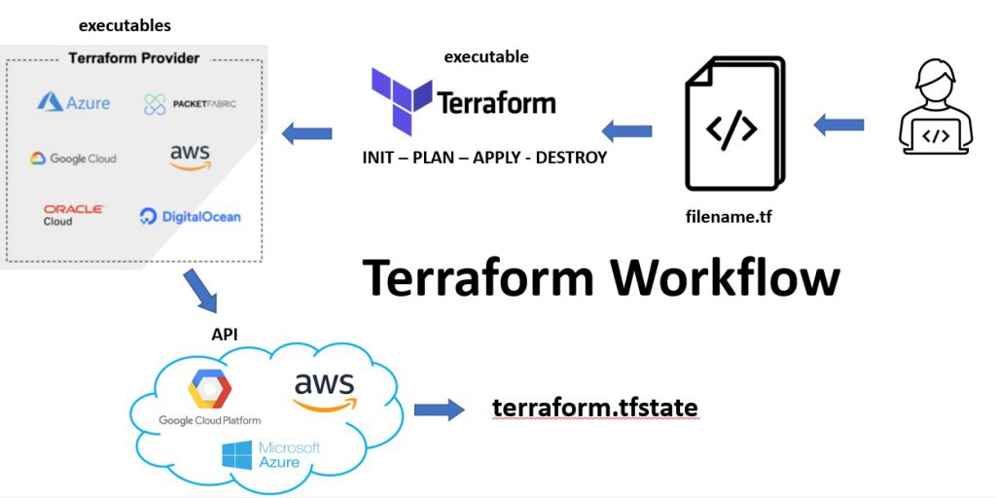
Terraform Workflow

Slide 14
Terraform vs Competitors?
10

Slide 15
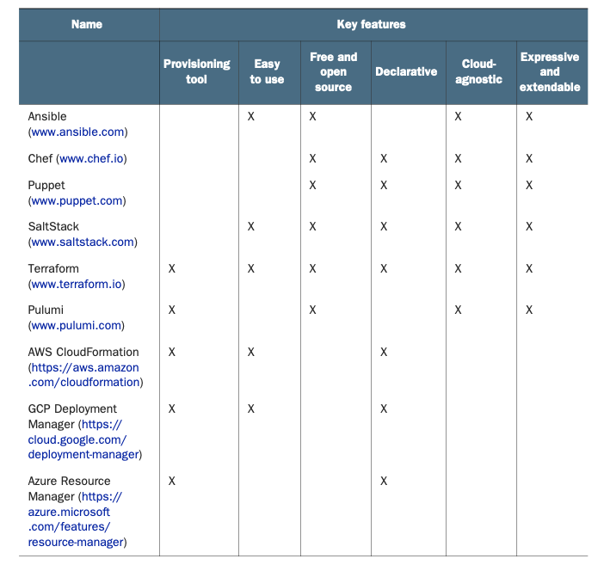
Notes:
There are alternatives on IaC market, each with its own advantages and drawbacks when stacked up against Terraform. Here are a few of the other major IaC tools on the market and how they compare with Terraform.
Terraform vs. Ansible
Ansible is an IaC tool designed for automating system configuration and management. The main difference is that Ansible is not a provisioning tool and follows a procedural approach, meaning the user needs to manually specify the steps of provisioning. This provides DevOps users with more control, but also requires more work. Ansible is best for provisioning servers with the proper software and updates already configured, while Terraform can set up and orchestrate infrastructure from scratch. Finally, Terraform allows for complete lifecycle management, while Ansible does not.
Terraform vs. Pulumi
Pulumi is a popular open-source IaC tool that can be used to design, deploy and manage cloud infrastructure resources. As opposed to Terraform, Pulumi doesn’t use a domain-specific software language, allowing users to deploy in GO, .NET, JavaScript, and others. And while Terraform follows strict coding guidelines, Pulumi does not, making it a bit more flexible in certain scenarios. However, Pulumi’s community is substantially smaller than Terraform’s, meaning there is less documentation available. While there are some flexibility benefits to Pulumi, Terraform is generally superior the larger the scope of deployment.
AWS CloudFormation was the original inspiration behind Terraform, and GCP Deployment Manager and Azure Resource Manager are cousins. These technologies, while decent, are neither cloud-agnostic nor open source. They only work for a particular cloud vendor and tend to be more verbose and less flexible than Terraform.
Ansible, Chef, Puppet, and SaltStack are configuration management (CM) tools, as opposed to infrastructure provisioning tools. They solve a slightly different kind of problem than Terraform does, although there is some overlap.

Slide 16

Demo

Slide 17

Hello World!

Slide 18
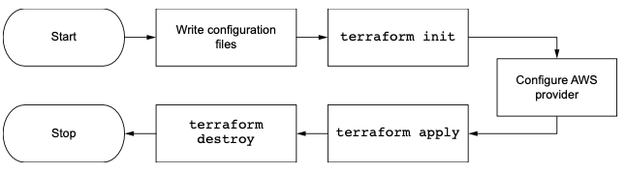
1. Install
https://learn.hashicorp.com/terraform/getting-started/install.html
2. Using Terraform to deploy EC2 instances to AWS
1 Write Terraform configuration files.
2 Configure the AWS provider.
3 Initialize Terraform with terraform init.
4 Deploy the EC2 instance with terraform apply.
5 Clean up with terraform destroy.
Notes:
When Terraform runs, it will read all files in the working directory that have a .tf extension and concatenate them together.

Slide 19
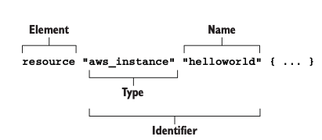
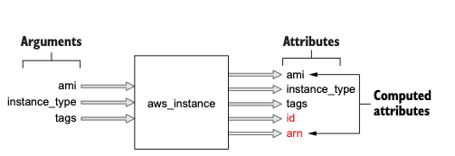
1. Prepare main.tf file
resource "aws_instance” "helloworld" {
ami = "ami-09dd2e08d601bff67"
instance_type = "t2.micro"
tags = { Name = "HelloWorld" }}
Each resource has inputs and outputs. Inputs are called arguments,
and outputs are called attributes. Arguments are passed through
the resource and are also available as resource attributes.
There are also computed attributes that are only available after the resource has been created.
Computed attributes contain calculated information about the managed resource.
Notes:
Terraform resources are the most important elements in Terraform, as they provision infrastructure such as VMs, load balancers, NAT gateways, and so forth. Resources are declared as HCL objects with type resource and exactly two labels. The first label specifies the type of resource you want to create, and the second is the resource name.
The name has no special significance and is only used to reference the resource within a given module scope.
Together, the type and name make up the resource identifier, which is unique for each resource.
When Terraform runs, it will read all files in the working directory that have a .tf extension and concatenate them together.

Slide 20

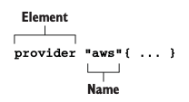
2. Configuring AWS provider
provider "aws" {
region = "us-west-2"}
resource "aws_instance” "helloworld" {
ami = "ami-09dd2e08d601bff67"
instance_type = "t2.micro"
tags = { Name = "HelloWorld" }}
Unlike resources, providers have only one label: Name. This is the official name of the provider as published in the Terraform Registry (e.g. “aws” for AWS, “google” for GCP, and “azurerm” for Azure)
Notes:
NOTE You will need to obtain AWS credentials before you can provision infrastructure.
$ export AWS_ACCESS_KEY_ID=?
$ export AWS_SECRET_ACCESS_KEY=?

Slide 21
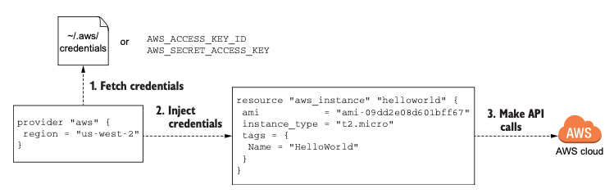
2. Configuring AWS provider (Cont.)
Providers don’t have outputs—only inputs. You configure a provider by passing inputs, or configuration arguments, to the provider block. Configuration arguments are things like the service endpoint URL, region, and provider version and any credentials needed to authenticate against the API.
Notes:
NOTE You will need to obtain AWS credentials before you can provision infrastructure.
$ export AWS_ACCESS_KEY_ID=?
$ export AWS_SECRET_ACCESS_KEY=?

Slide 22
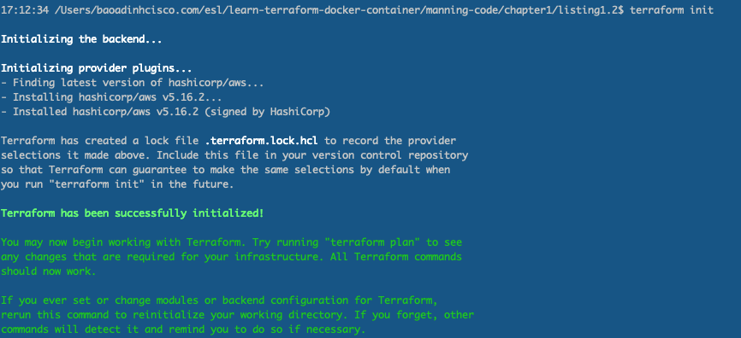
2. Initializing
Notes:
NOTE You will need to obtain AWS credentials before you can provision infrastructure.
$ export AWS_ACCESS_KEY_ID=?
$ export AWS_SECRET_ACCESS_KEY=?

Slide 23
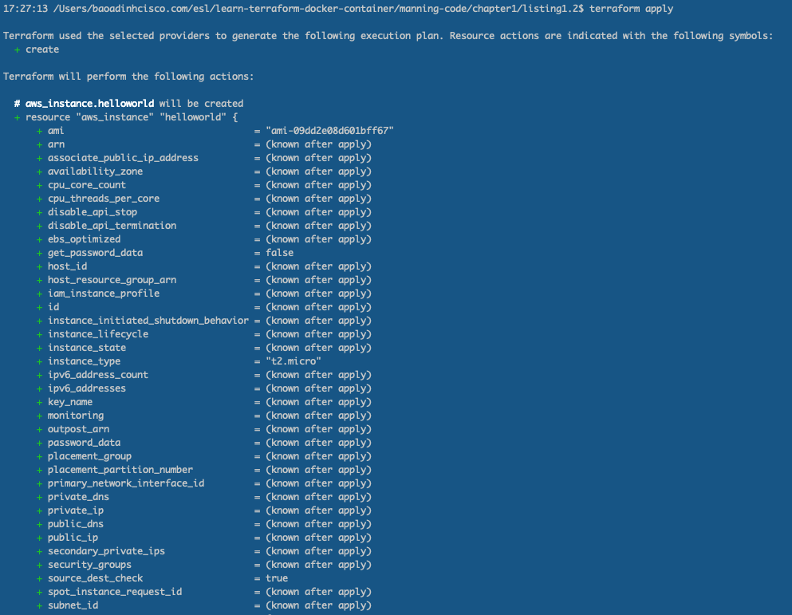
2. Deploying the EC2 instance

Slide 24
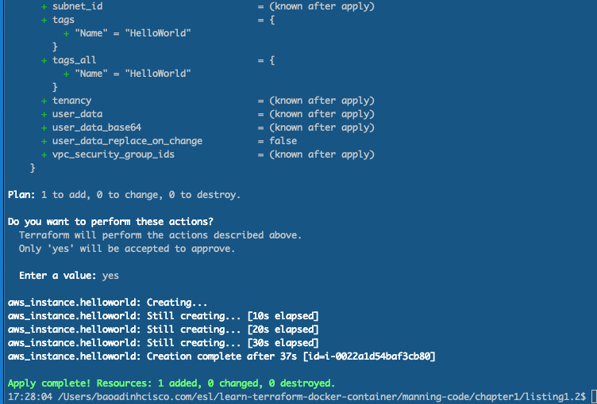

Slide 25
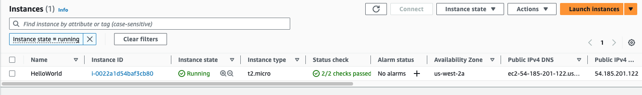
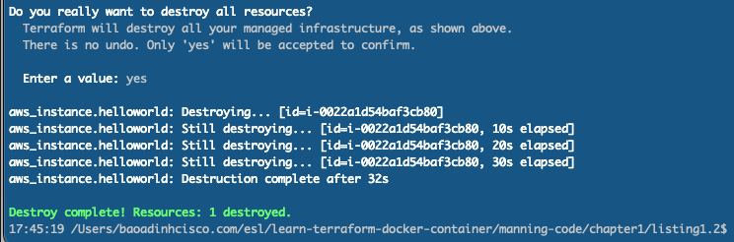
Verify that your resource was created by locating it in the AWS console for EC2
3. Destroy the E2C instance

Slide 26


Slide 27
Chapter 2 is a deep dive into Terraform: resource lifecycle and state management.
Examine how Terraform generates and applies execution plans to perform CRUD operations on managed resources and see how state plays a role in the process.

Slide 28

Q&A
Notes:
Is Terraform a DevOps tool?
Yes. Terraform is an extremely useful tool for DevOps teams for provisioning, managing, and orchestrating single or multi-cloud deployments.
What is Terraform in AWS?
Terraform is Infrastructure-as-Code (IaC) as it relates to AWS. Terraform accesses AWS resources via a provider, allowing users to then manage AWS via Terraform code.
What language does Terraform use?
Terraform is originally coded in the GO language, but works with all operating systems. Hashicorp Configuration Language (HCL) may also be used during setup.
Does Terraform work with Kubernetes?
Yes. Terraform can automate the provisioning of Kubernetes on cloud platforms. Terraform is not an alternative to Kubernetes, and in fact, they work very well together.
Closing Thoughts
Deploying, managing, and orchestrating multi-cloud environments can be a huge challenge for DevOps teams. But coordinating between different service providers and technologies like AWS and Azure Virtual Networks can be much easier and less time-consuming with Terraform infrastructure-as-code. Terraform is platform-agnostic and works with just about any cloud or data service provider. An experienced cybersecurity partner like Varonis can help you implement Terraform within your own ecosystem so you can then let the code do the heavy lifting, instead of your DevOps team.

