Slide 1


Infrastructure as Code with
Terraform
11/2023

Slide 2
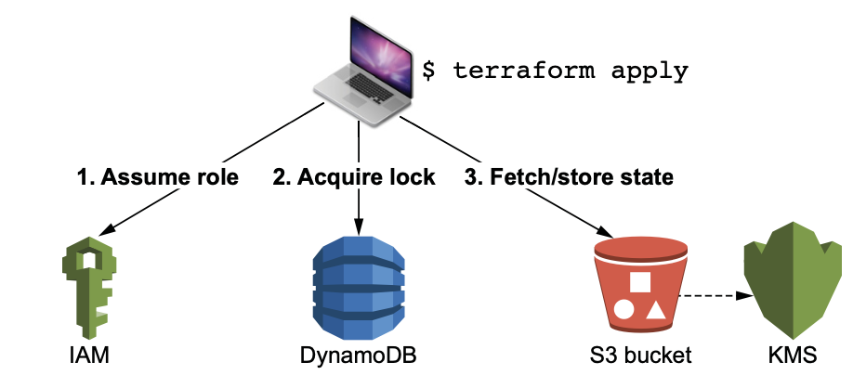
What we have done last meeting
Backend types in Terraform: Local Backend, Standard Backend, Remote Backend
Configuration of Terraform Backend
Demo: Developing Terraform Backend Module

Slide 3
Today we will talk about
Building CI / CD in Terraform

Slide 4
CI/CD
CI/CD stands for continuous integration (CI) / continuous deployment (CD).
It refers to the DevOps practice of enforcing automation in every step of software delivery.

Slide 5
Terrafrom Backend
A backend in Terraform determines how state is loaded and how CLI operations like
terraform plan and terraform apply behave.
Terraform will have 3 Backend types as follow: - Local Backend.
- Standard Backend.
- Remote Backend (Enhanced Backend).

Slide 6
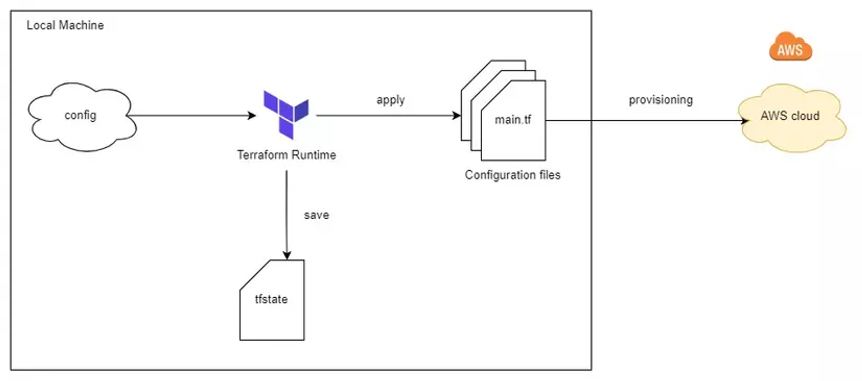
Local Backend
This is the default Backend
State files are stored locally on the machine where Terraform commands are executed.
It is suitable for development and testing but not recommended for production scenarios where state needs to be shared across a team.

Slide 7
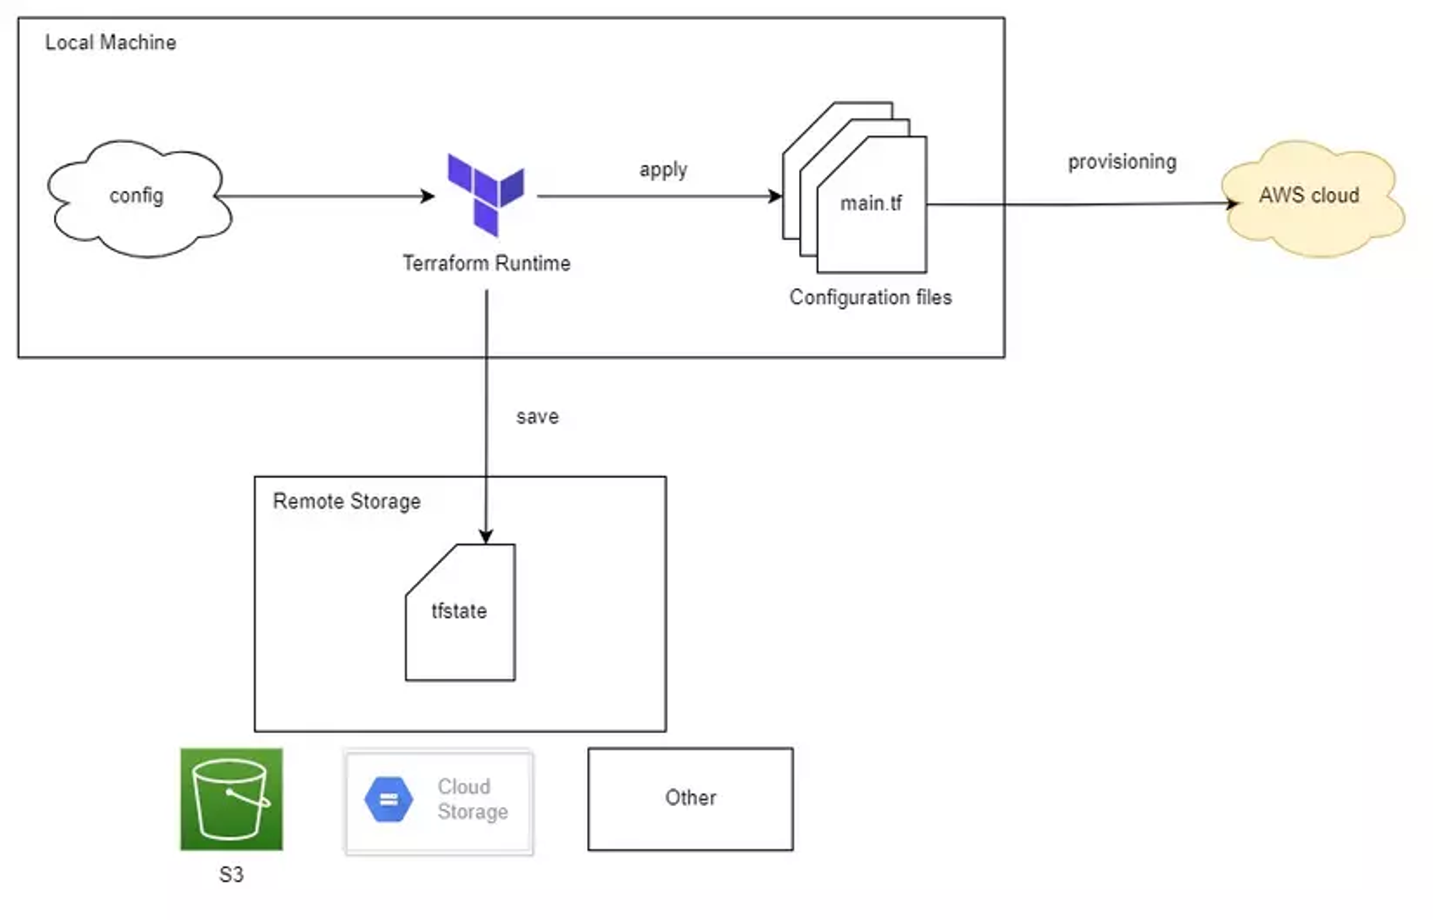
Standard Backend
Terraform Runtime is still executed on the local machine, but after it finishes running, the result will be stored in the Remote State. (AWS S3, GCP Cloud Storage, ...)

Slide 8
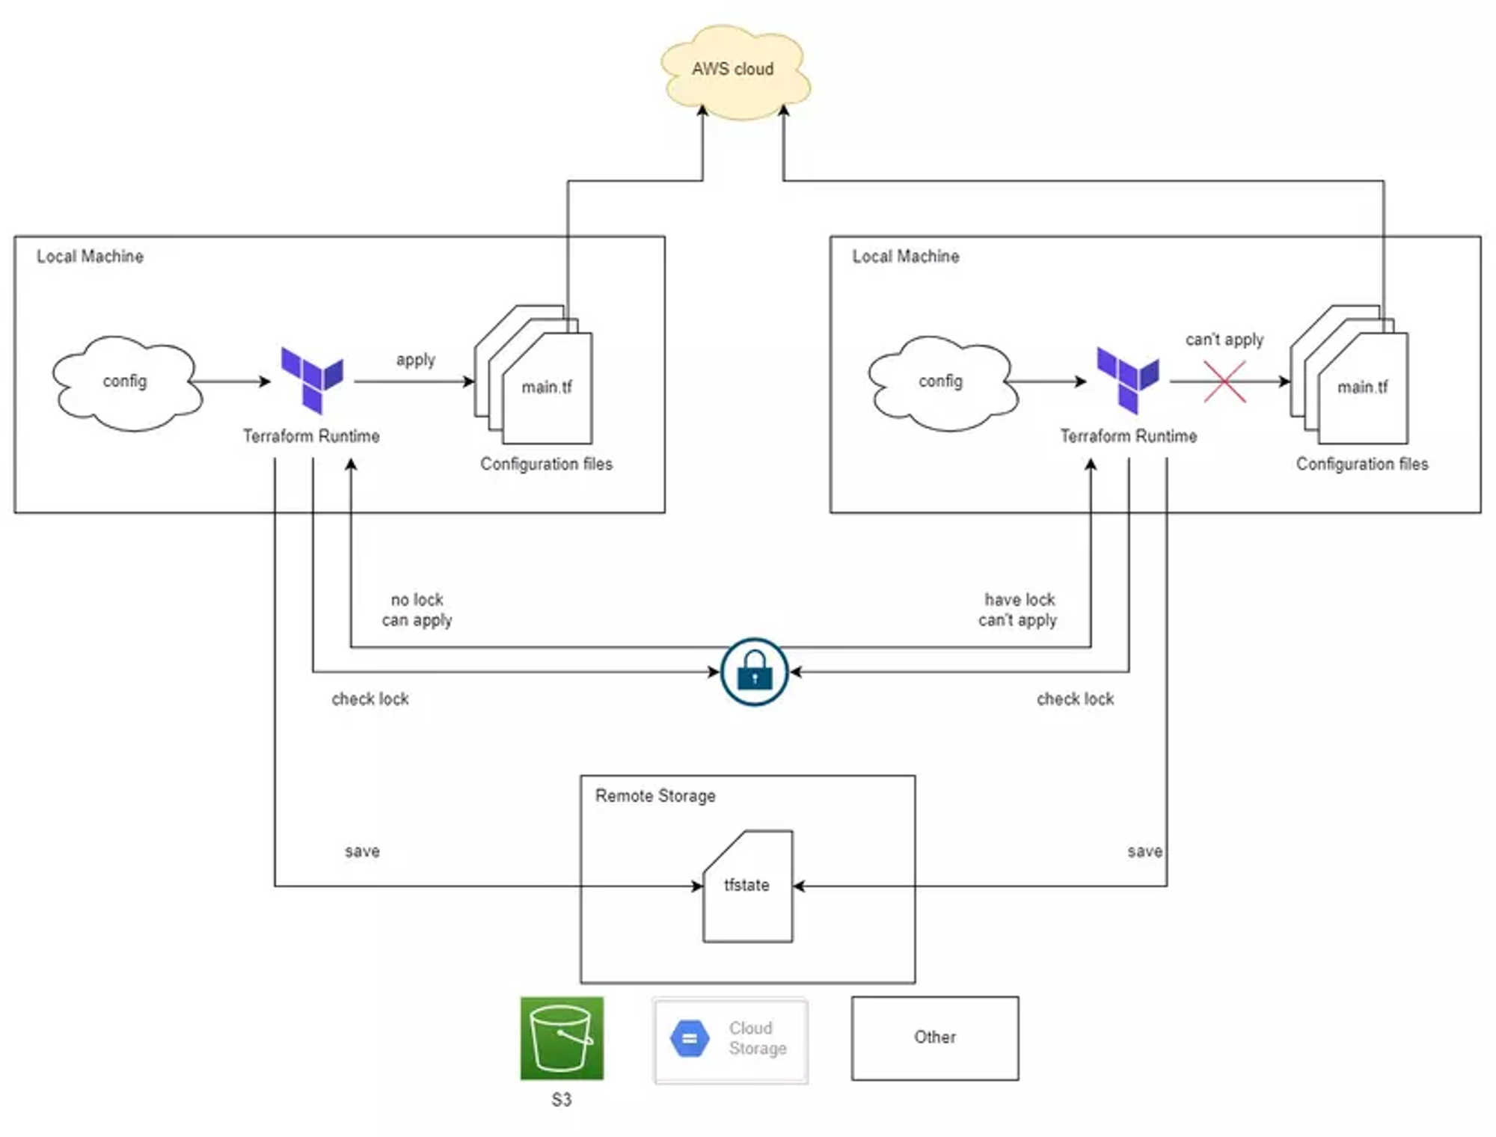
Standard Backend
Supports a feature called Lock Remote State.
Security is not good.
Notes:
When a user runs the terraform apply command, Terraform will lock our State file, at the same time if another user runs the Terraform command, Terraform checks that our State file is locked, it will refuse. terraform apply command of the second user => thereby solving the problem of multiple people running the terraform apply command at the same time.
In addition, when we use the Standard Backend, we can increase the security higher than the local backend a bit because the infrastructure configurations related to the Database such as Password will be stored in Remote State, not everyone can Go to Remote State to view.
When setting up Terraform for AWS, we usually store our secret key on our computer. To make things easier, many people create a special AWS account with full access rights and save its secret key on their computer. However, storing this key directly on a local machine is not secure.

Slide 9
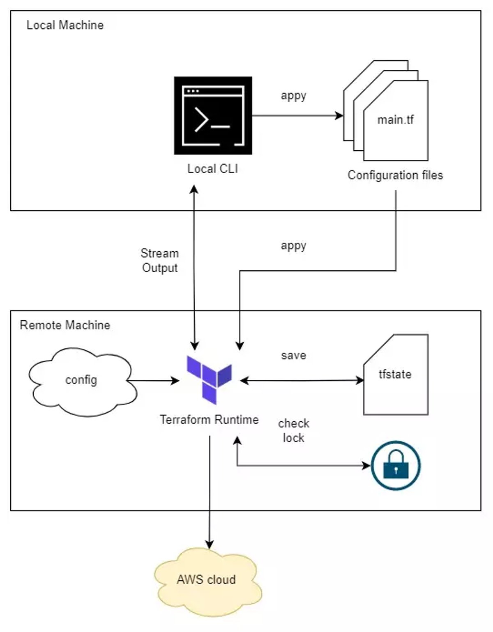
Remote Backend
Store the state file in a remote location, such as a cloud object storage service or a database.
The Terraform CLI on local machine is only responsible for Streaming the results printed from the Remote.
Provide several benefits, such as enabling collaboration between team members, versioning state files, and providing a history of changes.

Slide 10
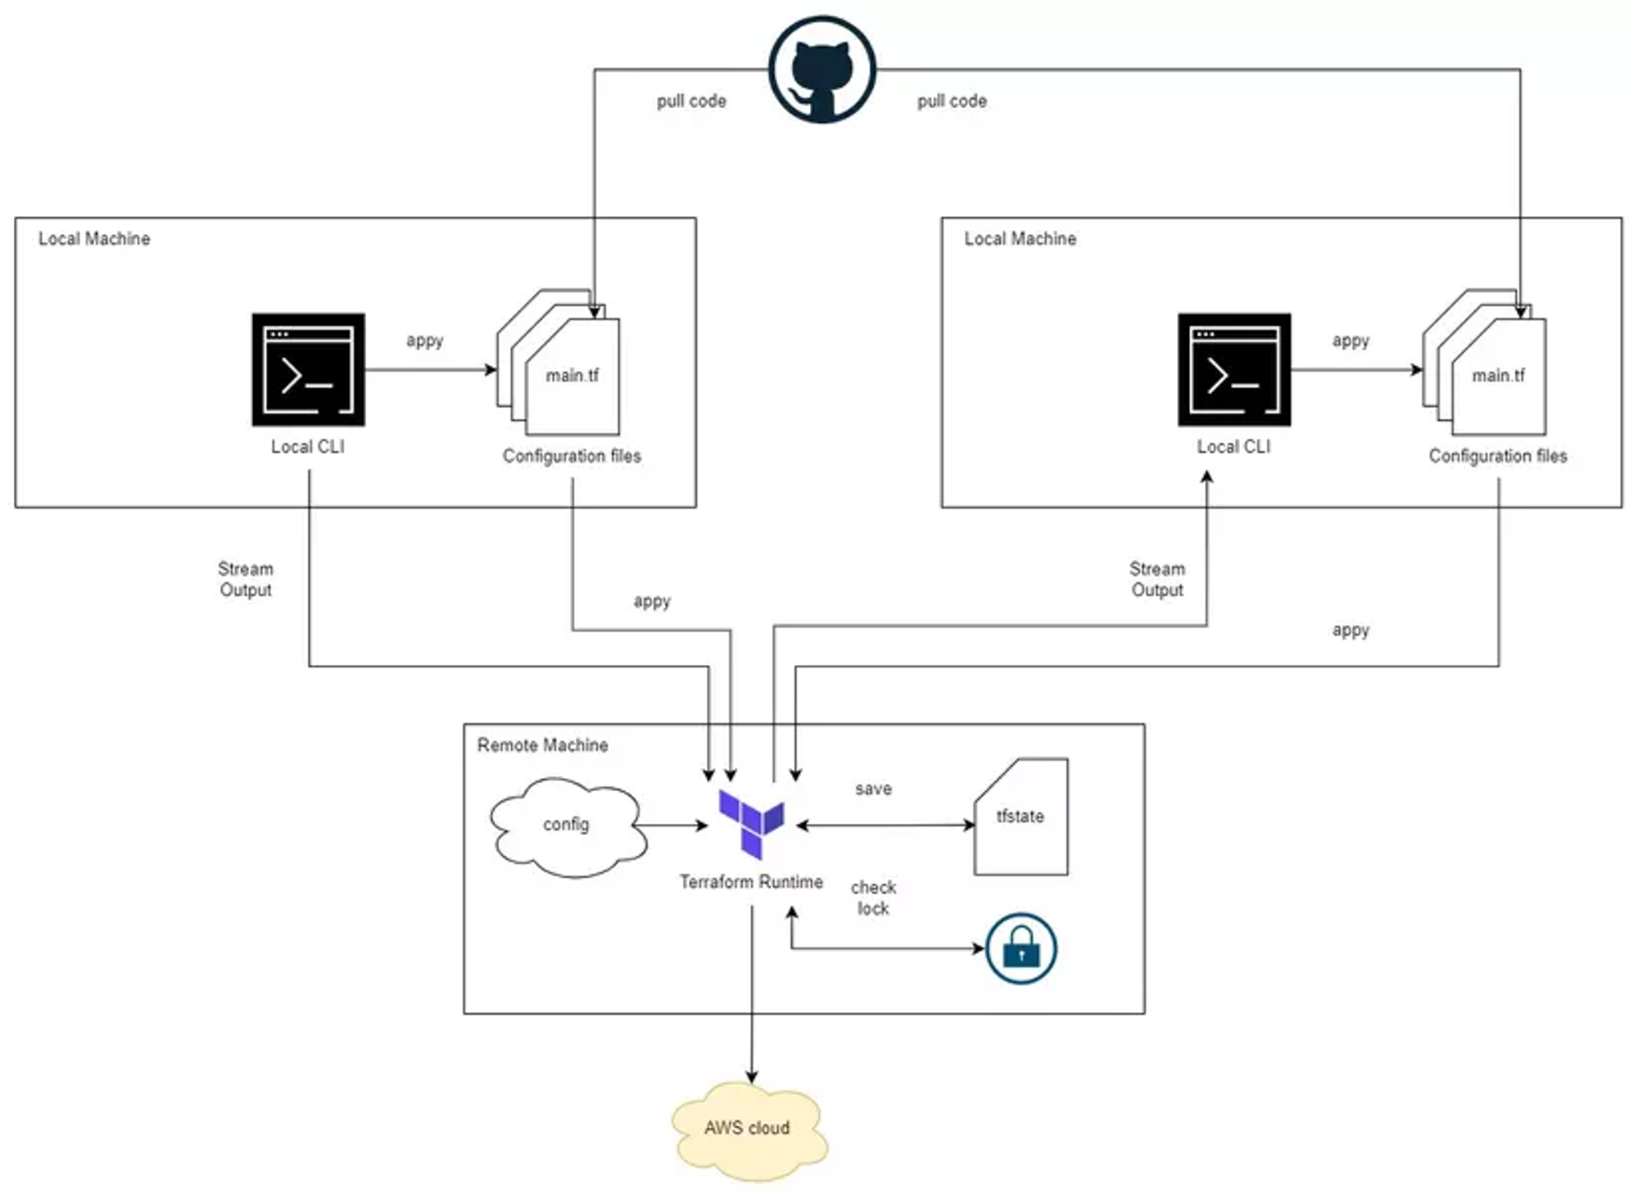
Remote Backend also has a State file locking feature to prevent multiple people run “apply” at the same time.

Slide 11
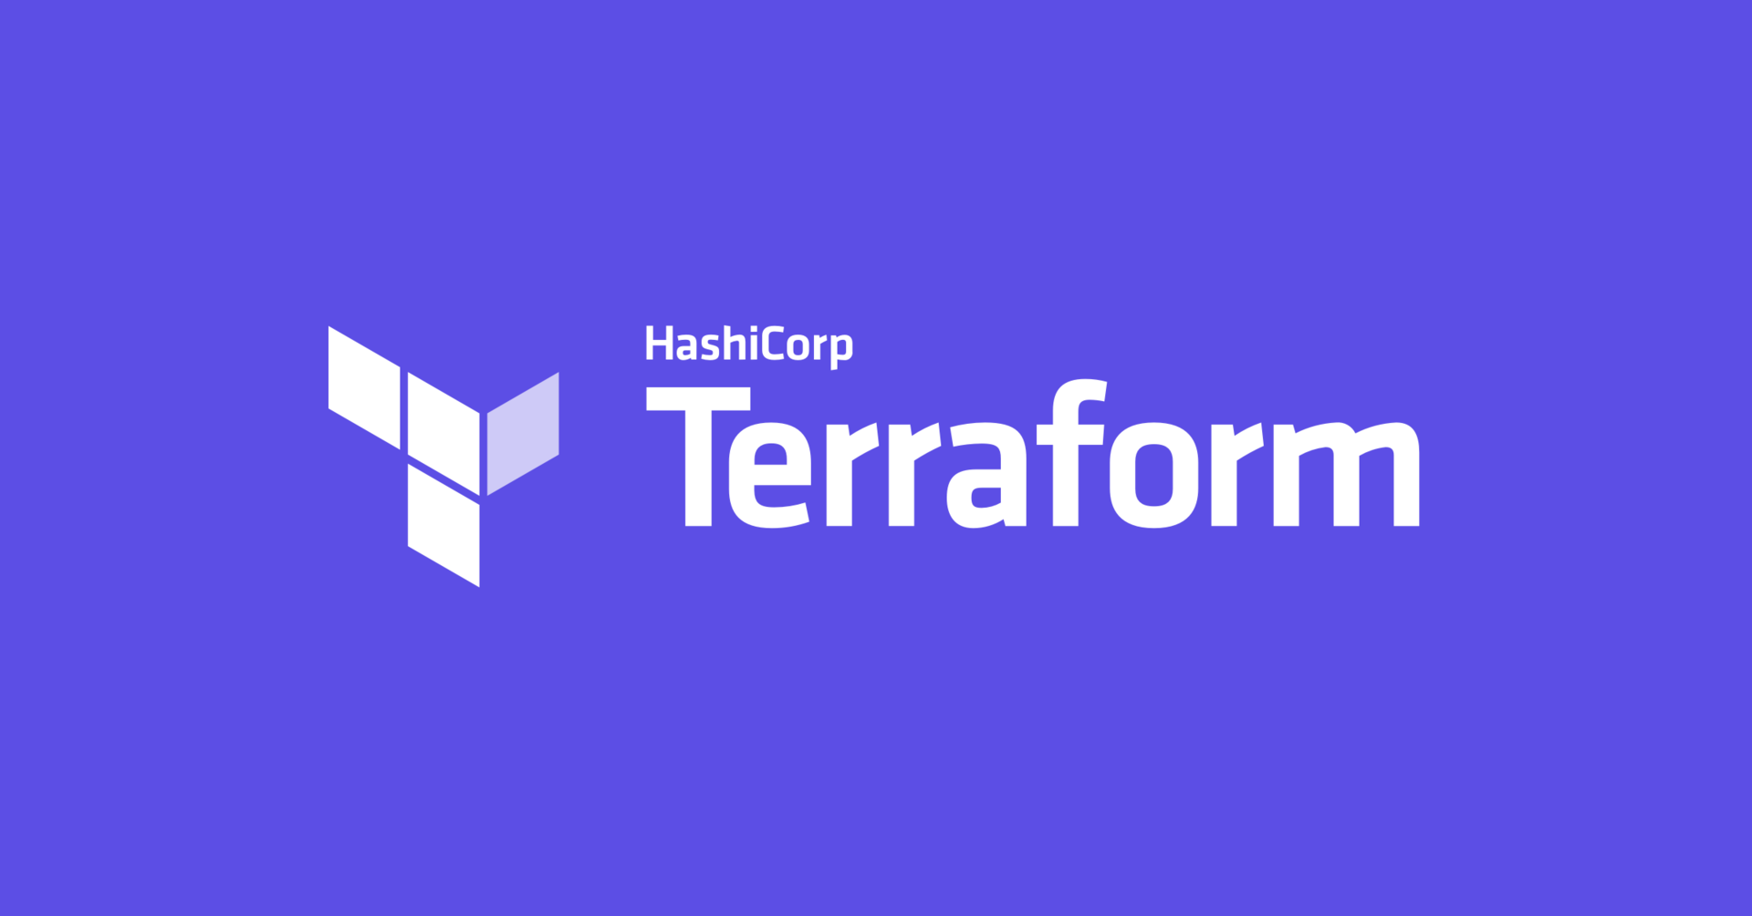
Configuring of Terraform Backend

Slide 12
Configuring a Local Backend
Normally, we don’t need to do anything to configure a local Backend.
However, if you want to use a local backend explicitly, you can add the following block
to your Terraform configuration file:
terraform { backend "local" {} }
Example:
terraform { backend "local"
{ path = ”./dev/terraform.tfstate" } }
Notes:
In this example, we’re using the local backend type, which stores the Terraform state file on the local filesystem. We're also specifying the path where we want to store the state file, which in this case is the file terraform.tfstate.
The main advantage of using a local backend is that it’s simple and doesn’t require any additional configuration. However, it’s not recommended for production environments since it can lead to inconsistencies if the state file is lost or corrupted.

Slide 13
Configuring a Standard Backend
Include the backend block in the Terraform configuration.
Specify the bucket name created in Step 1.
Specify the key attribute, which helps us create the state file with the same name as the provided value.
Specify the database table created in Step 2. (AWS doc)
terraform {
backend "s3" {
bucket = "rabbit-bucket"
key = "team/rabbitmq"
region = "us-west-2"
encrypt = true
dynamodb_table = ”example-db-name"
}
required_version = ">= 0.15"
required_providers {
null = {
source = "hashicorp/null"
version = "~> 3.0"
}
}
}

Slide 14
Configuring a Remote Backend
add a nested backend block within the top-level terraform block.
The block label of the backend block "remote” indicate that we are using remote backend
terraform {
backend "remote" {
hostname = "app.terraform.io"
organization = ”esl"
workspaces { name = ”rabbit" }
}
}
Notes:
We will use the Remote Backend when working with a team and using the Remote Backend we can gather all the configuration in one place.
In addition to choosing Backend for Terraform, in practice we often have to build CI/CD for a Terraform Project. To do CI/CD for Terraform is quite time-consuming, so to save time we can use the existing platform that called, Terraform Cloud.

Slide 15

DEMO
Developing an S3 backend module

Slide 16
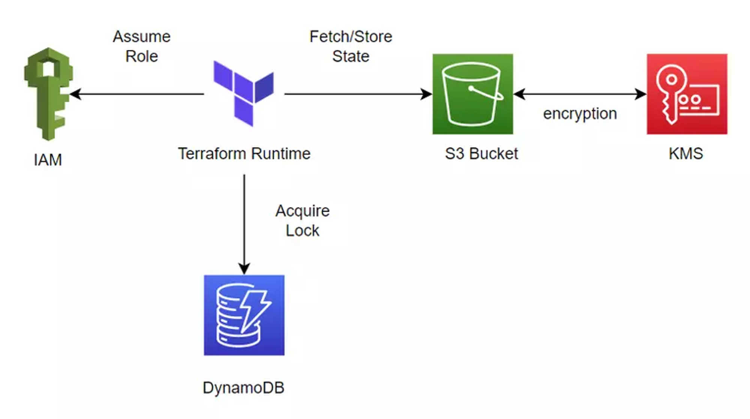
Architecture
IAM (Identity and Access Management): ensure that other AWS accounts can only assume a specific role
within this account. This allows them to perform deployments using the S3 backend, limiting their access to
only what is necessary for the task.
DynamoDB: For state locking.
S3 bucket – KMS (Key Management Service): For state storage and encryption at rest.

Slide 17
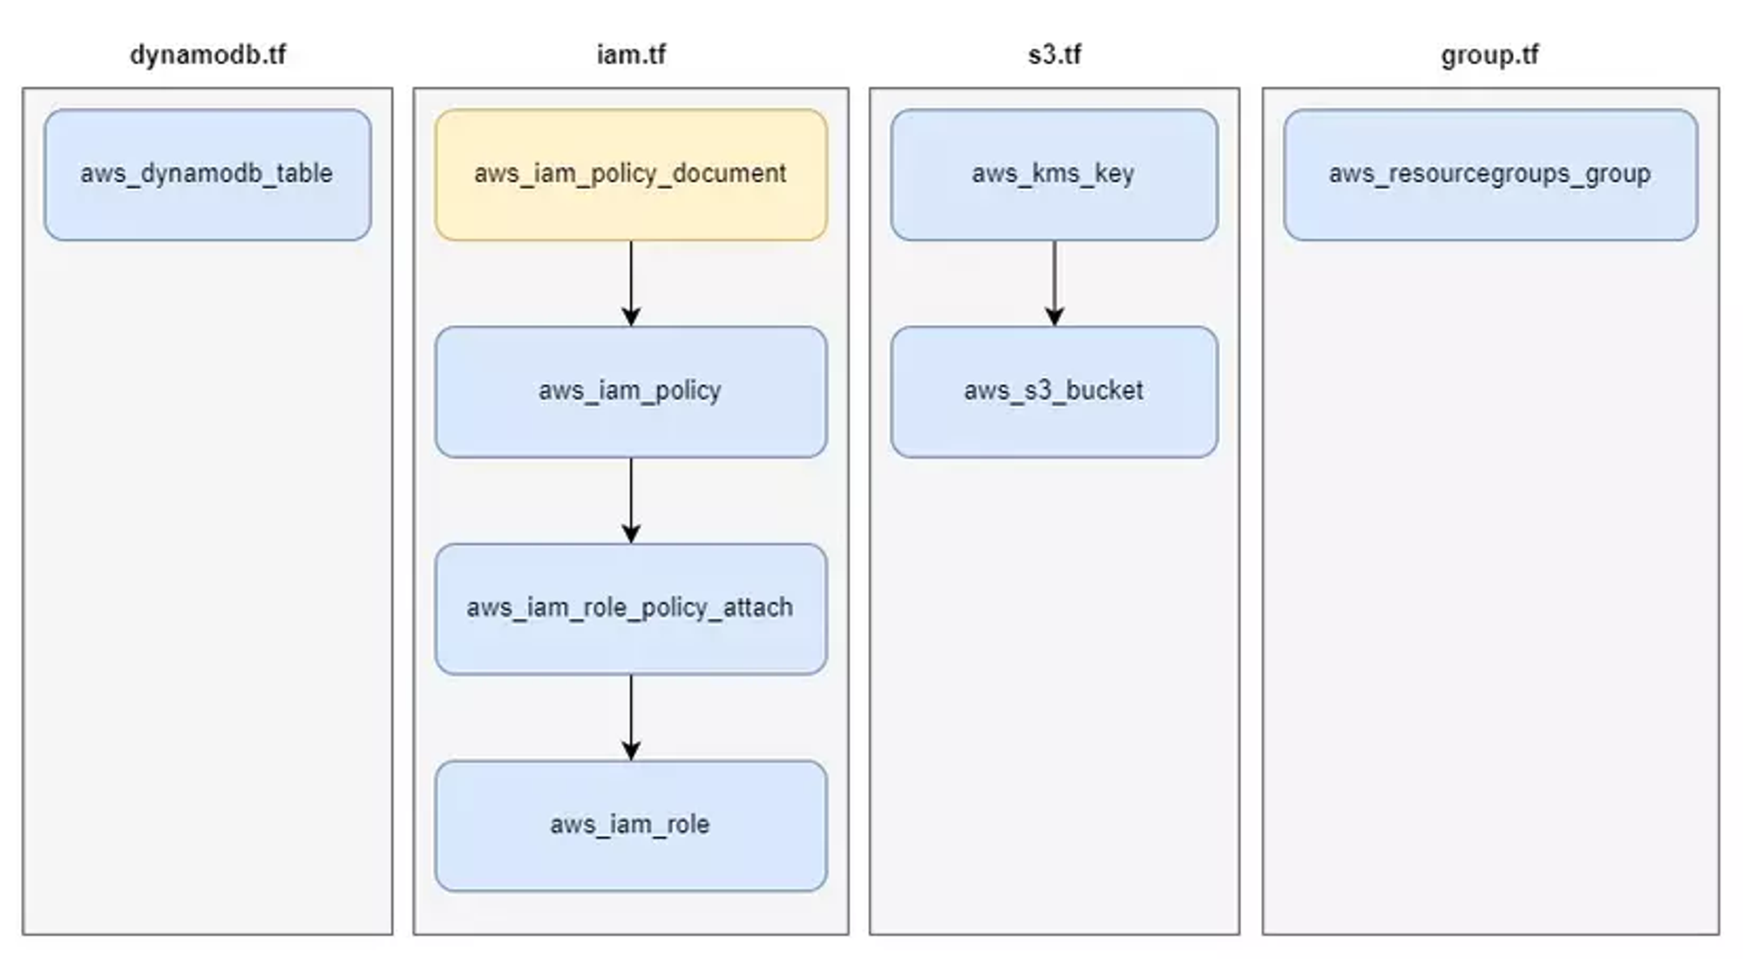
Deployment
Notes:
Now we will proceed to create S3 Backend, the resources that we will use to create S3 Backend are as shown below.

Slide 18
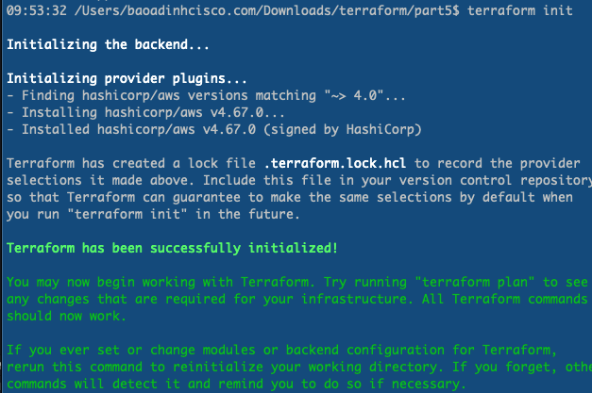
Create 3 files:
main.tf
variables.tf
versions.tf
Initializing the backend by running init

Slide 19
Create the DynamoDB Table for state locking.
Create a file name dynamodb.tf
resource "aws_dynamodb_table" "dynamodb_table" {
name = "${var.project}-s3-backend"
hash_key = "LockID"
billing_mode = "PAY_PER_REQUEST"
attribute {
name = "LockID"
type = "S"
}
tags = local.tags
}
Makes the database serverless
instead of provisioned
Notes:
This table will have a field called LockID with data type String. This is the required configuration that Terraform specifies for the Table used to store Lock State.

Slide 20
Define IAM resource
Create file name iam.tf
data "aws_caller_identity" "current" {}
locals {
principal_arns = var.principal_arns != null ? var.principal_arns : [data.aws_caller_identity.current.arn]
}
data "aws_iam_policy_document" "policy_doc" {
statement {
actions = ["s3:ListBucket"]
resources = [aws_s3_bucket.s3_bucket.arn]
}
statement {
actions = ["s3:GetObject", "s3:PutObject", "s3:DeleteObject"]
resources = ["${aws_s3_bucket.s3_bucket.arn}/*"]
}
statement {
actions = ["dynamodb:GetItem", "dynamodb:PutItem", "dynamodb:DeleteItem"]
resources = [aws_dynamodb_table.dynamodb_table.arn]
}
}
…
Data source aws_caller_identity
is used to get information about the
AWS Account we are running.
Comparison expressions in the
locals{} block:
If no principal ARNs are specified,
uses the current account
aws_iam_policy_document
resource is used to define Policies.
The Policy Document will define
the necessary permissions so we can
perform actions on DynamoDB, S3, KSM.
Next, we will attach this Policy Document
to Policy and Role.

Slide 21
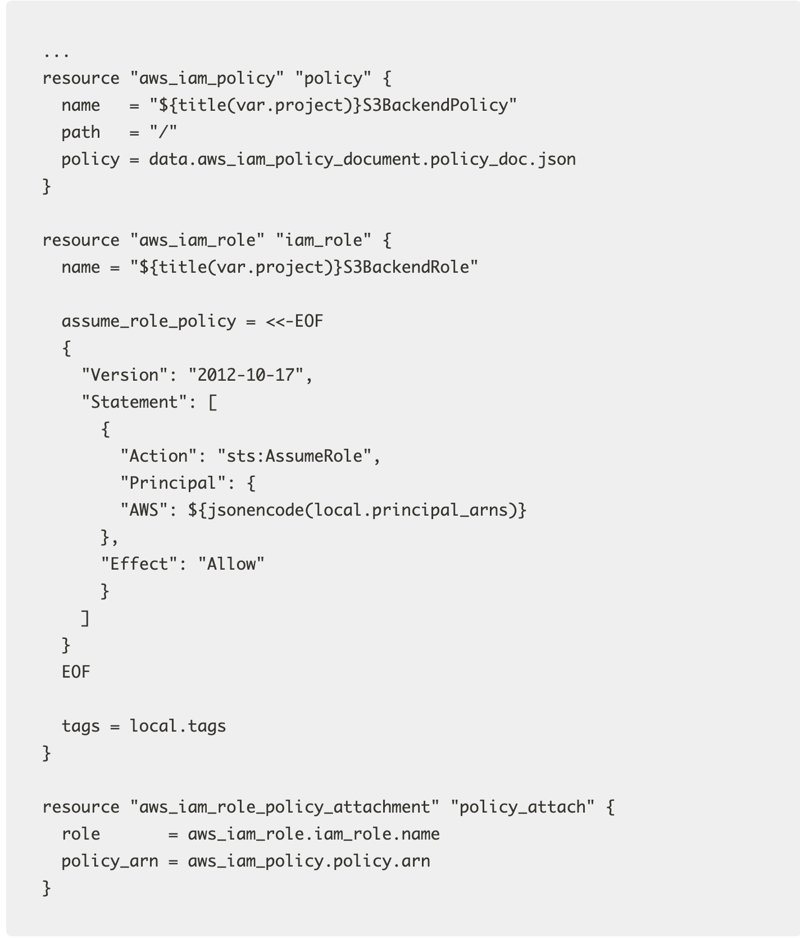

Slide 22
resource "aws_s3_bucket" "s3_bucket" {
bucket = "${var.project}-s3-backend"
force_destroy = false
tags = local.tags
}
resource "aws_s3_bucket_acl" "s3_bucket" {
bucket = aws_s3_bucket.s3_bucket.id
acl = "private"
}
resource "aws_s3_bucket_versioning" "s3_bucket" {
bucket = aws_s3_bucket.s3_bucket.id
versioning_configuration {
status = "Enabled"
}
}
resource "aws_kms_key" "kms_key" {
tags = local.tags
}
resource "aws_s3_bucket_server_side_encryption_configuration" "s3_bucket" {
bucket = aws_s3_bucket.s3_bucket.id
rule {
apply_server_side_encryption_by_default {
sse_algorithm = "aws:kms"
kms_master_key_id = aws_kms_key.kms_key.arn
}
}
}
Create s3.tf file for state storage

Slide 23
Create group.tf file to group resources for easy management.
resource "aws_resourcegroups_group" "resourcegroups_group" {
name = "${var.project}-s3-backend"
resource_query {
query = <<-JSON
{
"ResourceTypeFilters": [
"AWS::AllSupported"
],
"TagFilters": [
{
"Key": "project",
"Values": ["${var.project}"]
}
]
}
JSON
}
}

Slide 24
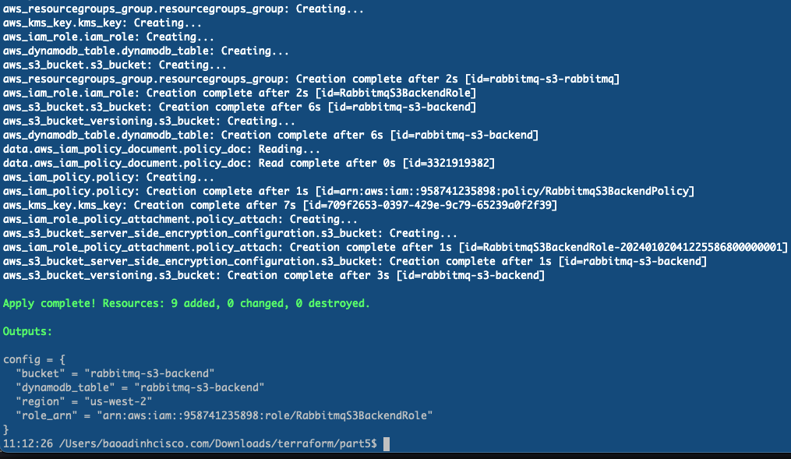
Run terraform apply
Notes:
Save the s3backend_config output value, as we’ll need it in the next step

Slide 25
Everyone gets an S3 backend
Create a new Terraform project with a test.tf file
Configure the backend using the output from the previous slide (see the next listing).
terraform {
backend "s3" {
bucket = "rabbitmq-s3-backend"
key = ”rabbit/bao"
region = "us-west-2"
encrypt = true
role_arn = "arn:aws:iam::958741235898:role/RabbitmqS3BackendRole"
dynamodb_table = "rabbitmq-s3-backend"
}
required_version = ">= 0.15"
required_providers {
null = {
source = "hashicorp/null"
version = "~> 3.0"
}
}
}
Notes:
Imagine we're setting up an S3 storage for a group named Team Rabbit. Once it's ready, we'll check if everything works by starting it up.
Now we’re ready for the interesting part, Initializing against the S3 backend and verifying that it works.
We have to create a unique key for the project, which is basically just a prefix to the object stored in S3. This can be anything, so let’s call it rabbit/bao

Slide 26
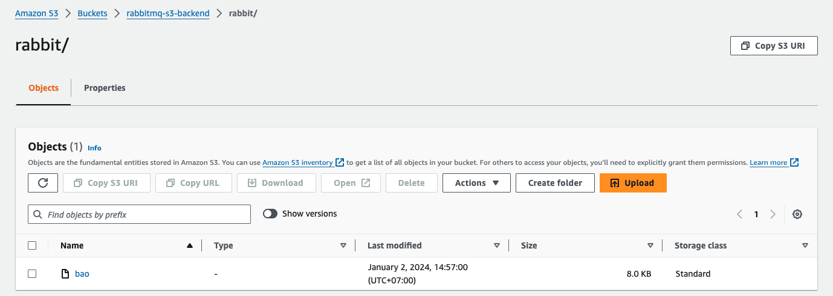
Run terraform init then run terraform apply.
After it finishes running you will see that terraform.tfstate will no longer be located locally.
We will need to go to the S3 Bucket to view our State file
Terraform state file

Slide 27
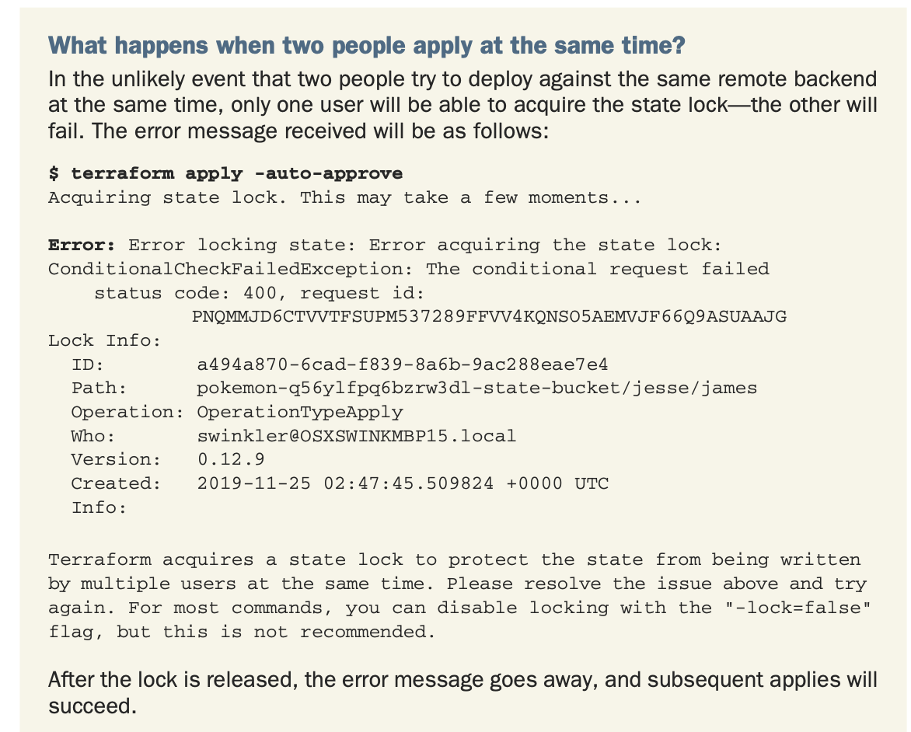

Slide 28

Clean up

Slide 29
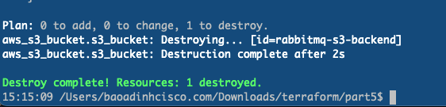
Because AWS resources usually cost money, we might want to remove them after we’re done
with testing. To do that, use the terraform destroy command and confirm with "yes"
Notes:
As we can see, using Terraform to create VPC is quite simple. But every time we want to create another VPC, do we have to copy this code somewhere else? The answer is no! To solve the problem of coding, Terraform provides us with a feature called Module, which helps us organize code into Modules and can be reused many times.

Slide 30

Summary
Local Backend is suitable when we do projects alone, Standard and Remote Backend are suitable when we work in groups.
When we work with a team, we can use S3 Backend for the project, both to centralize the State file and to resolve conflicts when many people run Terraform at the same time.

Slide 31
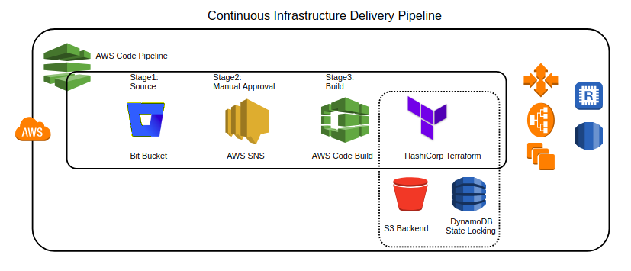
Upcoming topic: CI/CD pipelines as code

Slide 32

Q&A
Notes:
https://someguys.blog/posts/2017-04-26-recovering-terraform-state/
https://medium.com/version-1/recovering-from-a-deleted-terraform-state-file-5e030c88aae0

Slide 33

THE END

