Slide 1
Shoe shop manangement software
Thành viên nhóm:
16110016 - Lâm Phước Bảo
16110034 - LÊ THIỆN DUY
16110133 - Hứa Văn Lâm
16110191 - Nguyễn Thiên Quốc

Slide 2
i. specification

Slide 3


Manage bills of shop
Manage the products of shop
Reduce written pagers and documents
Manage staffs in the shop
1. iNtro
Goal:

Slide 4
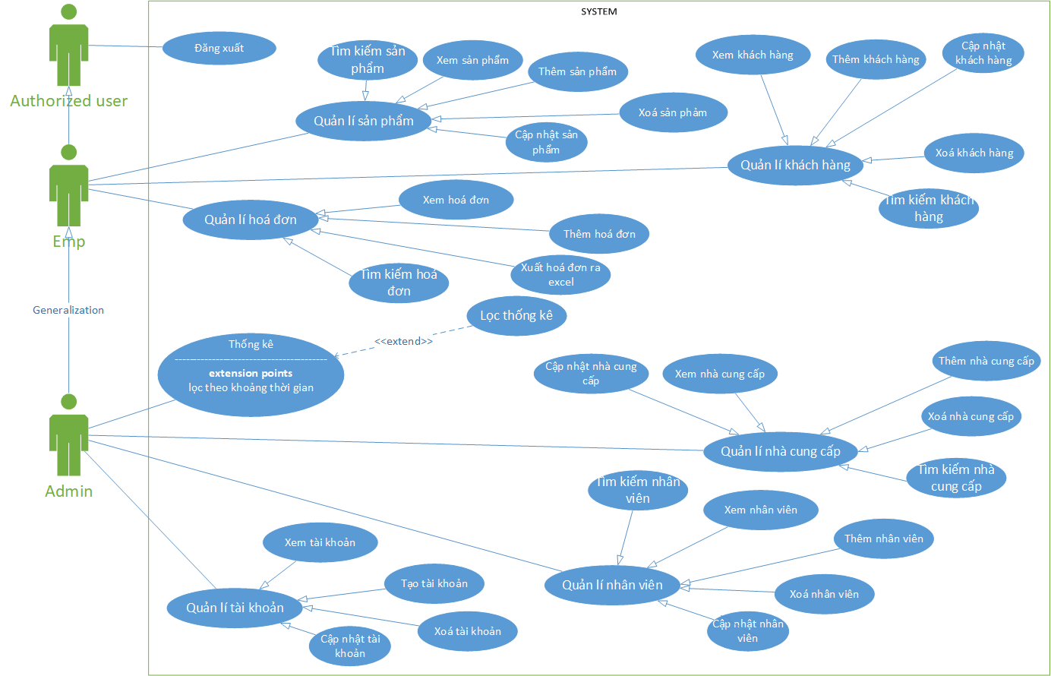

Slide 5
ii. development

Slide 6
1. design

Slide 7
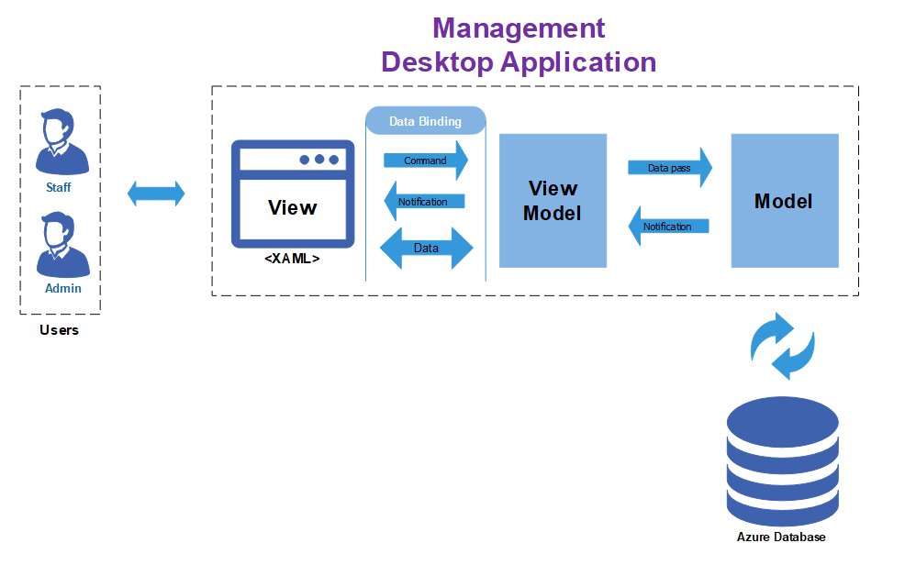
Architecture Diagram

Slide 8
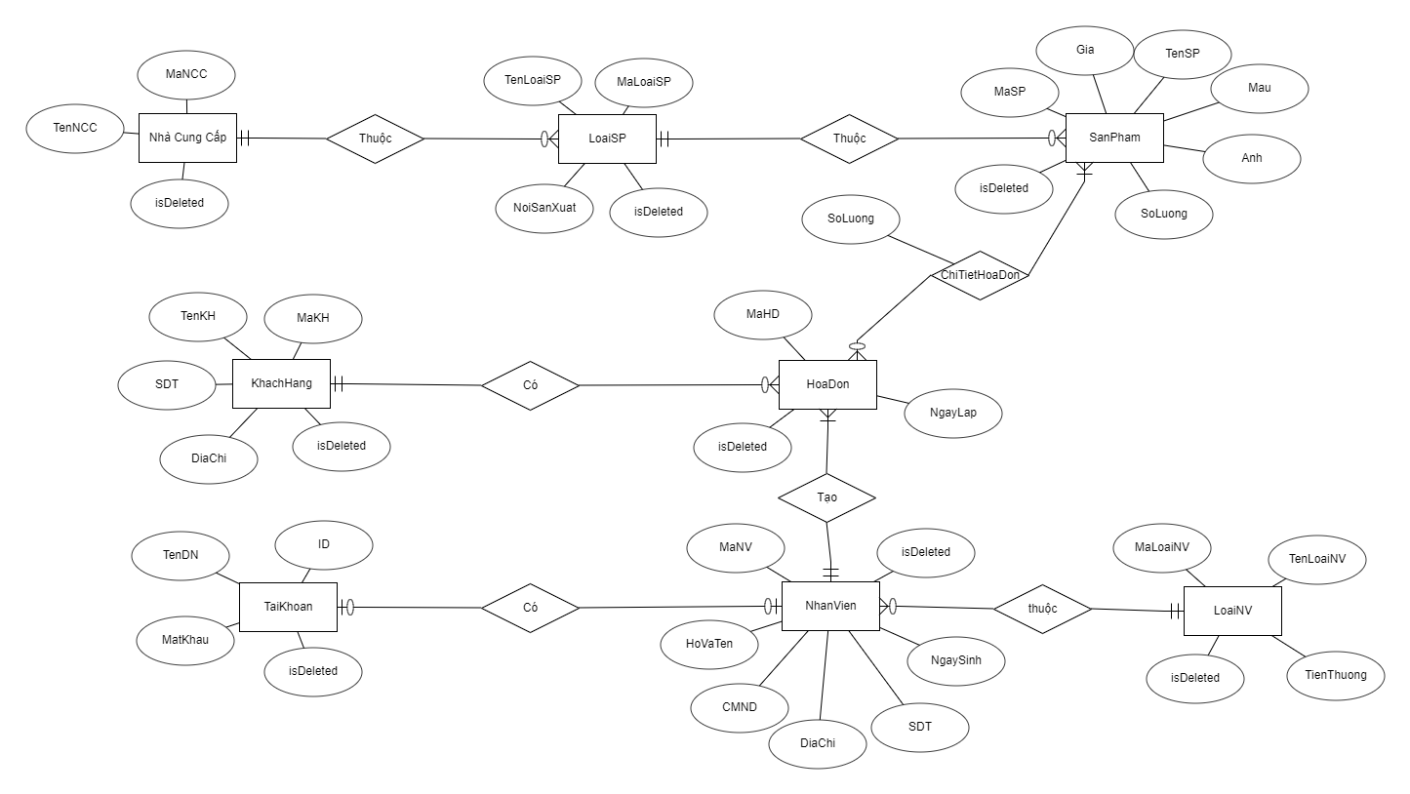
Entity
Relationship
Diagram

Slide 9
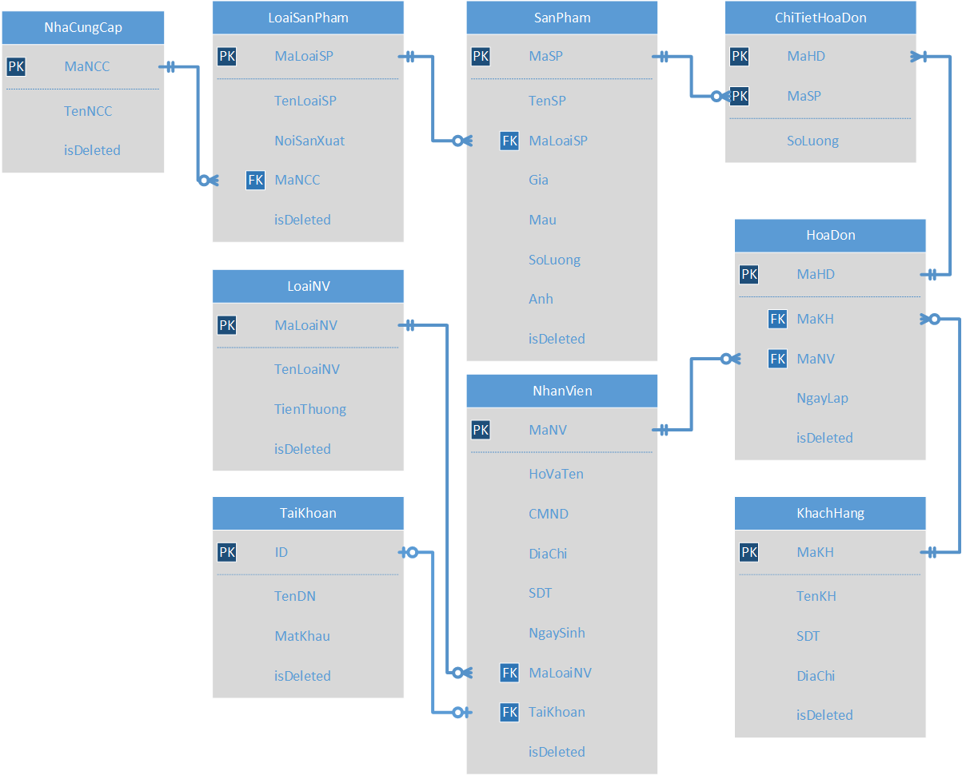
Logical Diagram

Slide 10
CLASS diagram

Slide 11
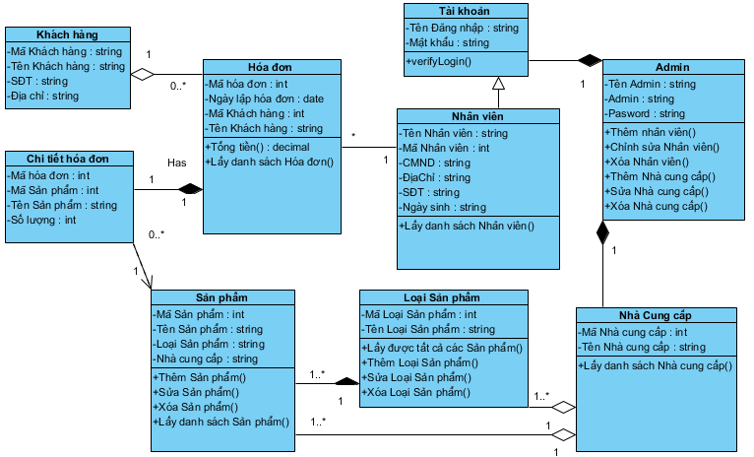

Slide 12
Sequence diagram

Slide 13
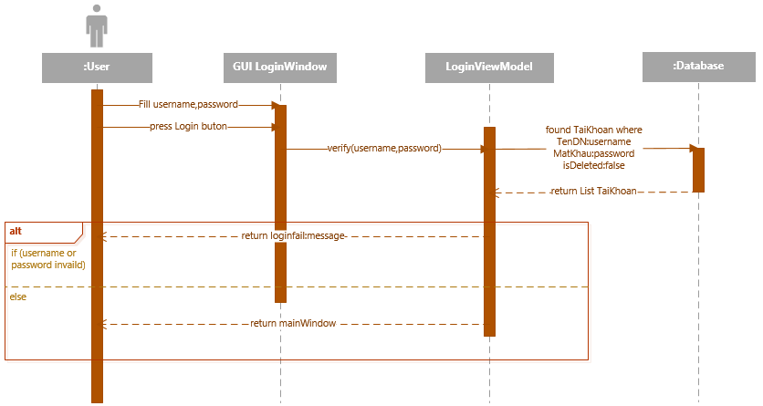

Slide 14
2. implement

Slide 15
Platform: App will run on Windows 10 Anniversary Update with .Net Framework 4.7.2.
IDE: Visual Studio version Community with .Net Framework 4.7.2.
DBMS: SQL Server Database in Cloud Azure
Teamwork: Team members use Github as source control and cooperate in project by Git flow devided into branches: feature, dev, release, master, and hotfix branch

Slide 16
iii. validaton

Slide 17
user authorization Test Case
Test Scenario ID |  | Authorize-1 |  |  | Test Case ID |  | Authorize -1A
Test Case Description |  | Authorize – Positive test case |  |  | Test Priority |  | High
Pre-Requisite |  | Account with Admin role |  |  | Post-Requisite |  | NA
Test Execution Steps:
S.No | Action |  | Inputs | Expected Output |  | Actual Output |  | Test window |  | Test Result | Test Comments
1 | Run Application |  |  | Login form show up |  | Login form show up |  | Window 10 version 1809 |  | Pass
2 | Input admin's account and click "Login" button |  | User id: Admin Password: 123 | Main form show up, Login form disappear |  | Main form show up, Login form disappear |  | Window 10 version 1809 |  | Pass
3 | Click on "Employee Management" button |  |  | Employee Management form show up |  | Employee Management form show up |  | Window 10 version 1809 |  | Pass

Slide 18
user authorization Test Case
Test Scenario ID |  | Authorize-1 |  |  | Test Case ID |  | Authorize -1B
Test Case Description |  | Authorize – Negative test case |  |  | Test Priority |  | High
Pre-Requisite |  | Account with Employee role |  |  | Post-Requisite |  | NA
Test Execution Steps:
S.No | Action |  | Inputs | Expected Output |  | Actual Output |  | Test window |  | Test Result | Test Comments
1 | Run Application |  |  | Login form show up |  | Login form show up |  | Window 10 version 1809 |  | Pass
2 | Input employee's account and click "Login" button |  | User id: thungan Password: 123 | Main form show up, Login form disappear |  | Main form show up, Login form disappear |  | Window 10 version 1809 |  | Pass
3 | Click on "Employee Management" button |  |  | Employee Management form don't show up |  | Employee Management form didn't show up |  | Window 10 version 1809 |  | Pass

Slide 19
DEMO

